Slide 1

Texas Department of State Health Services
Local Health Department Contract Overview
Epidemiology & Laboratory Capacity Workshop
Eric Garza, MPH
Emerging & Acute Infectious Disease Branch
www.dshs.state.tx.us/idcu/

Slide 2
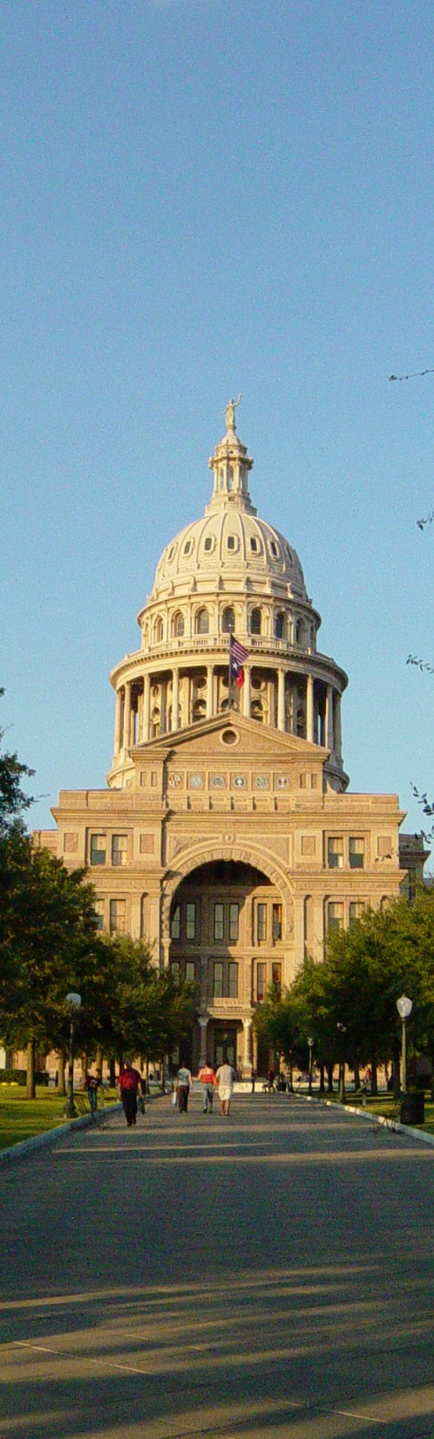
Exceptional Items
83rd Texas Legislative Session
  Disease Outbreaks and Disaster Response
    Foodborne epidemiologists positions in 17 local health departments
    Transitioned into general epidemiologist positions
84th Legislative Session
  Ebola
    Epidemiologists positions for 28 local health departments

Slide 3
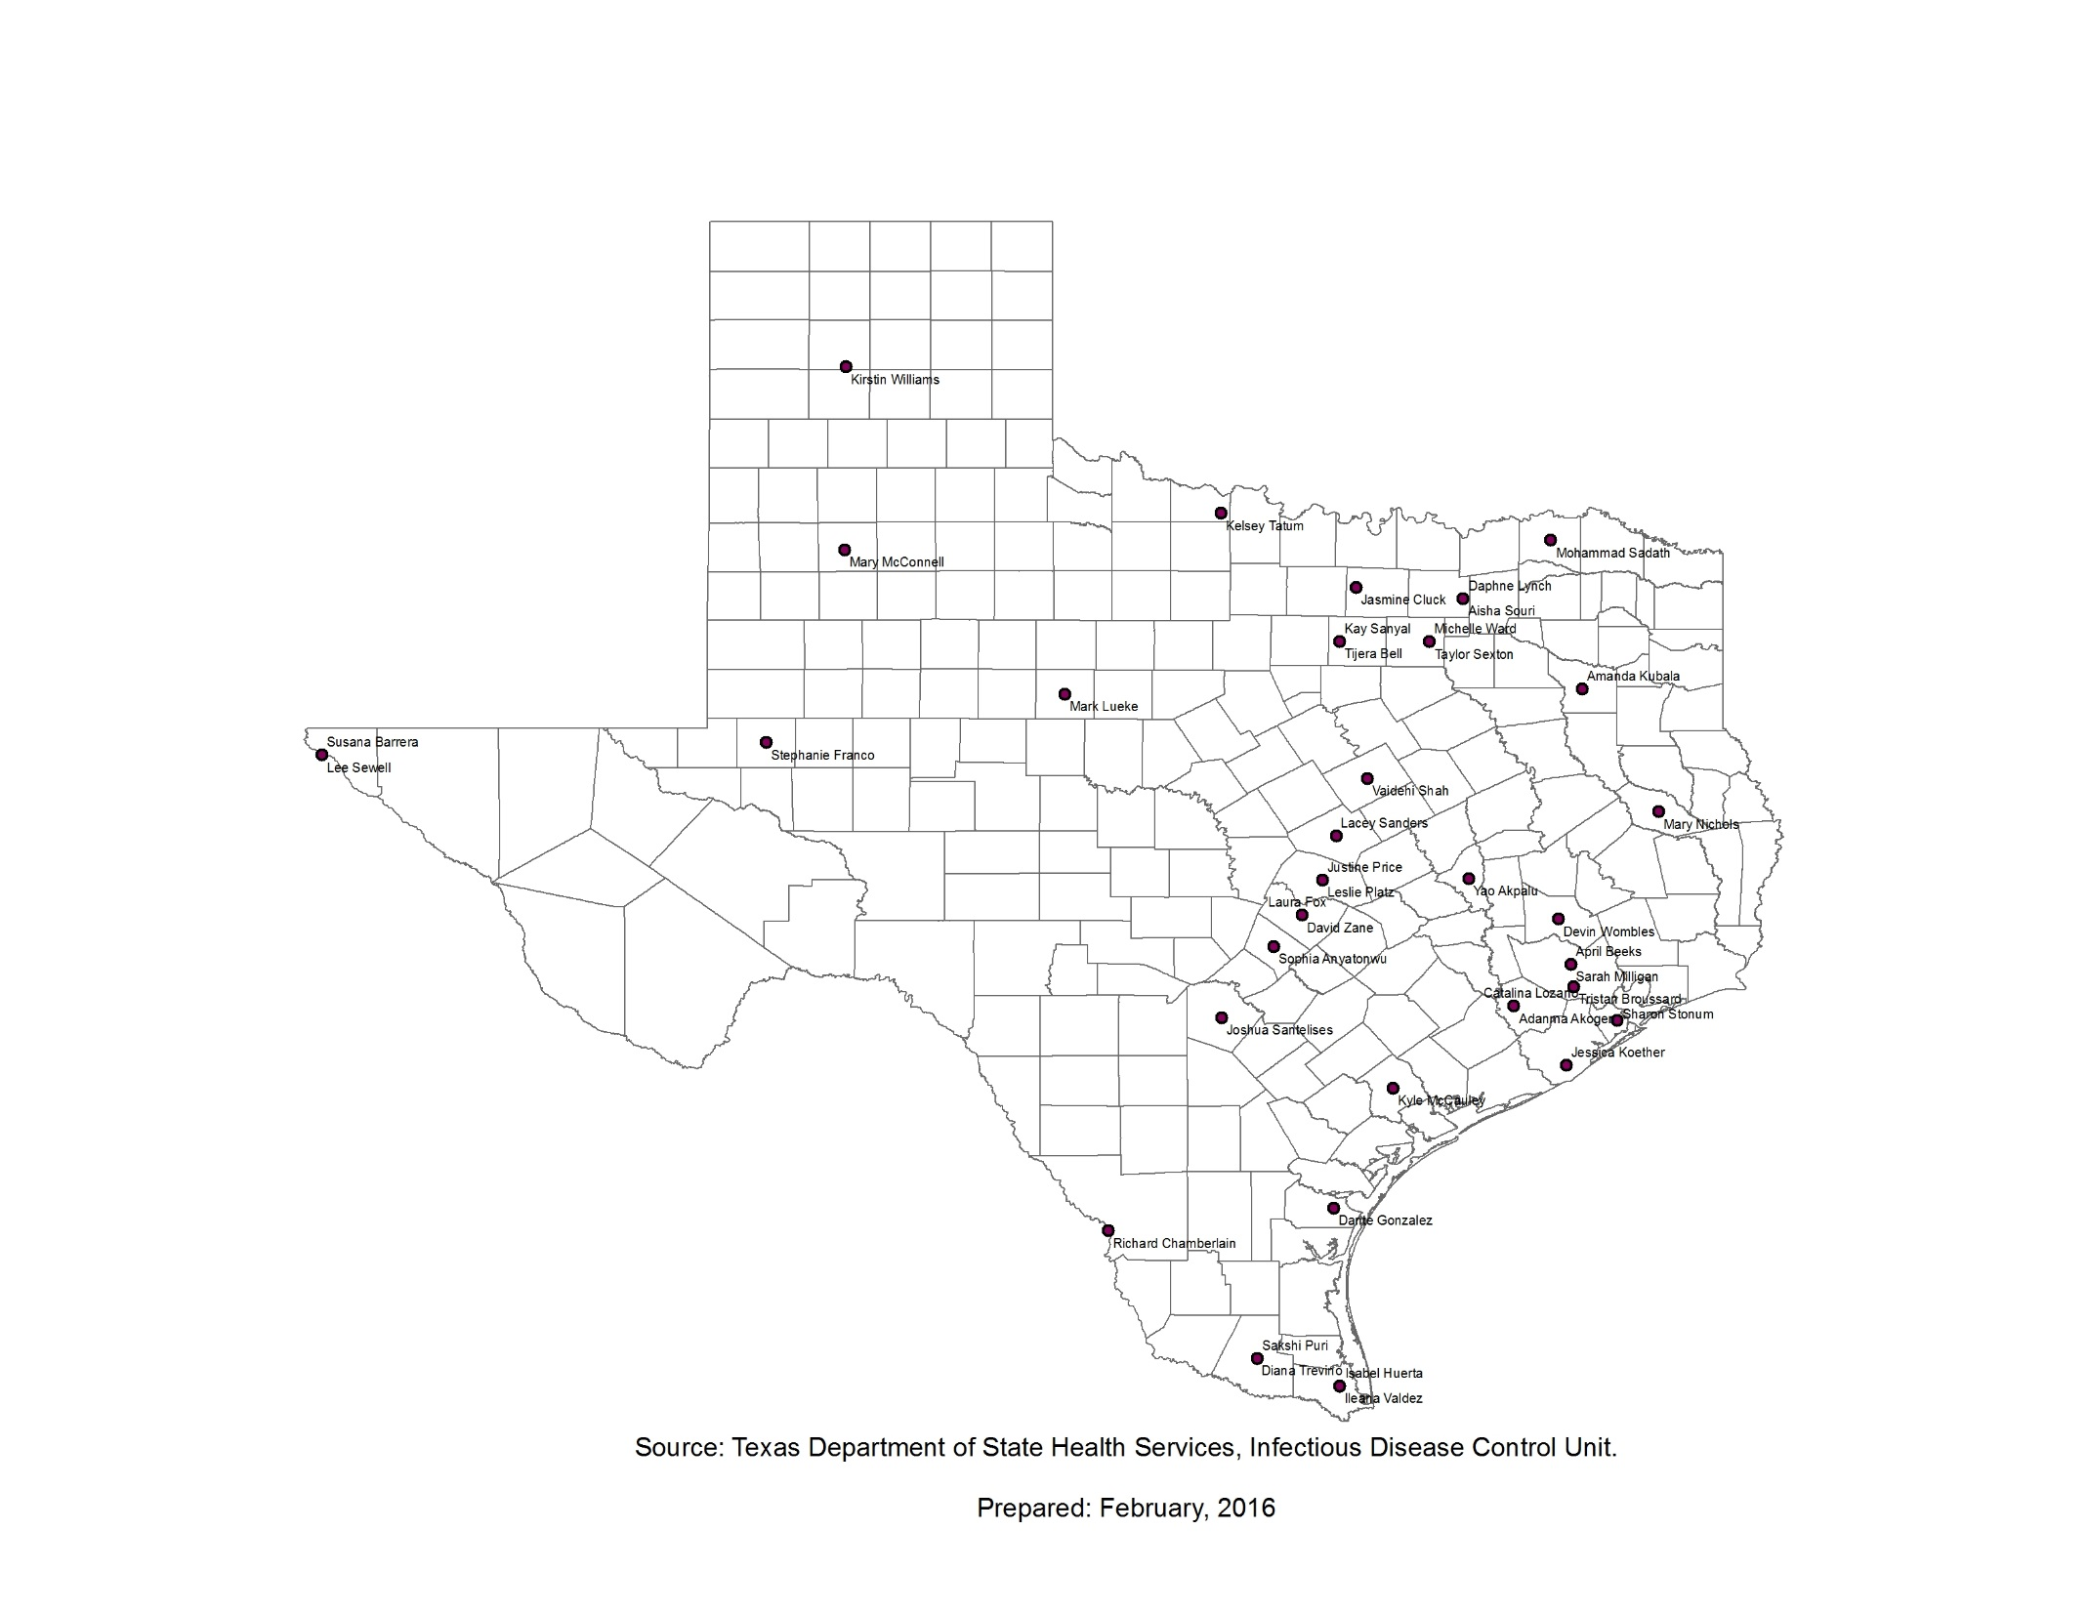
Local Health Departments

Slide 4
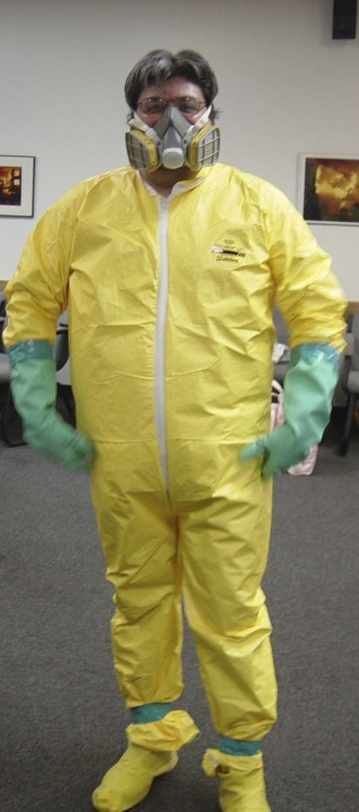
Eric Garza, MPH
Epidemiologist, dshs eric.garza@dshs.state.tx.us
512-776-6825
Thank you!

