Slide 1
Everything you might have known about laboratory testing but forgot
Lesley Brannan, MPH Invasive/Respiratory
Rachel Wiseman, MPH Vaccine Preventable
Venessa Cantu, MPH Foodborne
ELC Epidemiology Workshop 2014

Slide 2
How to Submit Specimens to the Lab
Do you have a DSHS lab account?
Find your office’s lab submitter number OR get a submitter number
Is your HD’s contact information current?
Do you have current versions of all of the submitter forms?
G-2A, G-2B, G-2V, G-27A, G-???
http://www.dshs.state.tx.us/lab/mrs_forms.shtm#Microbiological (Note: these are SAMPLE forms only and cannot be used for submission)
Email Labinfo@dshs.state.tx.us or contact Lab Reporting at 512-776-7578

Slide 3
Ordering Supplies
Foodborne and pertussis supplies
Order using G-6A form: http://www.dshs.state.tx.us/lab/mrs_forms.shtm#Microbiological
Questions? Contact Lab Container Preparation Group at (512) 776-7661
MMR and influenza-type supplies must be ordered through EAID
MMR
Contact Rachel Wiseman
Influenza/respiratory outbreaks (non-VPD)
Contact flutexas@dshs.state.tx.us
Have a sufficient number of supplies on hand in case of outbreaks!!!

Slide 4
Filling out the Forms
Each specimen needs a form
Form should be completely filled out
Information on form should match information on specimen (e.g. name, DOB)
Form(s) should be included in shipment with specimen(s)

Slide 5
CDC Submissions
CDC prefers specimens to be sent from state labs.
If testing at CDC is indicated, coordinate submitting specimens through DSHS Central Office/Laboratory, unless given different instructions.

Slide 6
Packaging/Shipping
Packaging
Triple-contained
Use appropriate labeling for boxes
Most specimens are “Biological substance category B”
For Category A agents, check with lab directly
Use enough ice packs/dry ice to maintain temperature (if applicable)
Include submission forms in shipment
Shipping
Send overnight mail
Use FedEx or courier of choice
Don’t ship on Friday or the day before a state holiday
Use physical address (1100 W 49th, lab services) for FedEx, couriers
Notes:
Isolates (pure cultures) or specimens from patients suspected of having an exotic, newly emerging or extremely rare pathogen may be classified as Category A agents.

Slide 7
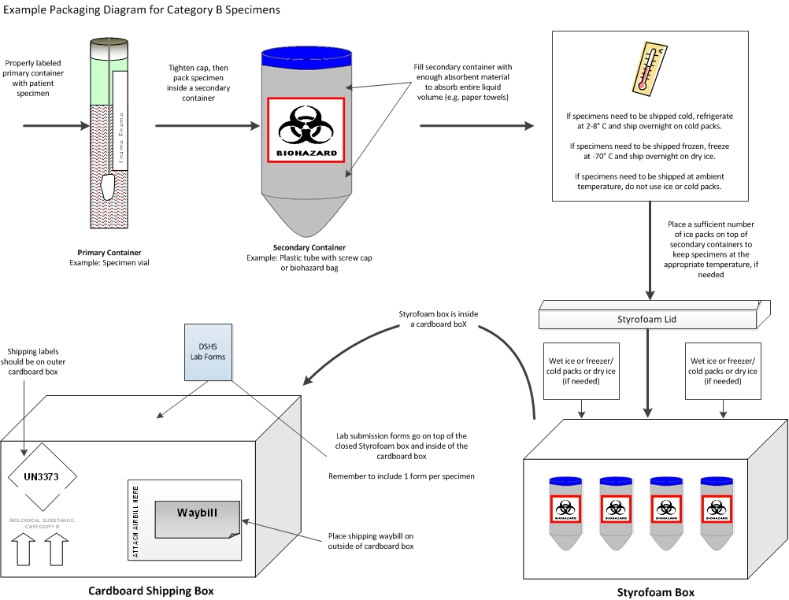

Slide 8
Common Reasons for Rejection
Specimen not received within appropriate timeframe after collection
No form or form incorrect
Information on specimen doesn’t match information on form
No information on specimen container
Submitted at wrong temperature
Expired media/supplies
Submitted on wrong media
Specimen tube leaking or broken
When in doubt, contact Central Office or the lab!

Slide 9
Accessing Results—LabWare
Get access to LabWare: https://results-web.dshs.state.tx.us:8443/index.jsp
Click on EPI registration (very bottom right)
Fill out PHLIMS confidentiality form AND
Fill out the EPI account registration
Most DSHS results are in LabWare
CDC results will need to be reported separately (usually via fax)
Many results will show up in NBS

Slide 10
Viral Respiratory Outbreaks (non-VPD)
Invasive/Respiratory Infectious Diseases

Slide 11
When to Collect Specimens
Collect outbreak specimens on:
Outbreaks/clusters in facilities (nursing homes, schools, jails, etc.)
Unknown etiology or etiology suspected but not confirmed
Flu outbreaks without subtyping results or only rapid test results
Pathogens under consideration
Bacterial – should be tested by private or hospital labs (or sometimes CDC)
Viral – common viral respiratory pathogen testing available at DSHS Austin
Notes:
Why collect specimens?
Characterize outbreak/Determine etiology
Prevention/control measures (e.g., need for vaccination or prophylaxis)
Identify repeated problems in facilities

Slide 12
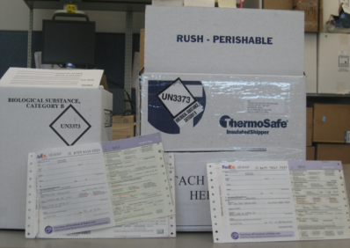
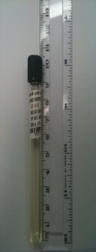
Specimen Collection Supplies
Have sufficient supplies on hand!
Supplies available:
Viral transport medium (VTM) for viruses
DSHS-prepared or commercially-prepared
Nasopharyngeal (NP) swabs
Secondary containers for packaging specimens
Labeled boxes and cold packs for shipping
FedEx waybills for prepaid shipping
Note: Dry ice & dry ice labels are not provided by DSHS
Supplies will arrive within 1-2 business days of request (if urgent)

Slide 13
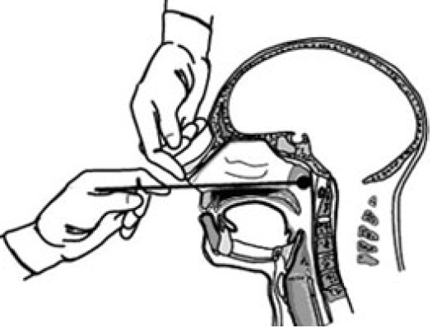
Specimen Collection
Specimen types:
NP swab required for viral respiratory PCR panel testing
Other specimen types (e.g., throat swab) will only get influenza PCR testing
Collect specimens within 4-5 days of onset
Try to submit 5-10 specimens per outbreak
Specimen submission rules:
If refrigerated and shipped on cold packs, lab must receive specimens within 72 hours of collection
If frozen and shipped on dry ice, no time restrictions from collection to submission

Slide 14
Lab Submission Form
Submission form: G-2V
In addition to submission form tips mentioned earlier in this presentation, do the following:
Virology (Section 4):
Check “Influenza surveillance {Influenza real-time RT-PCR}”, AND
Write “Outbreak investigation” in white space
Payor source (section 6):
Check “IDEAS” to avoid bill for submitter
√
Outbreak investigation

Slide 15
Testing
Who does it?
Flu PCR test: DSHS Austin, Laboratory Response Network (LRN) labs, private labs
Respiratory viral panel PCR test: DSHS Austin, private labs
Flu PCR test (public health labs)
Flu A H1, H3, 2009 H1; Flu B
Turnaround time: 2-5 days
Individual specimen results reported to submitter
Respiratory viral panel PCR test (DSHS Austin)
Rhinovirus, respiratory syncytial virus, human metapneumovirus, influenza, parainfluenza 1-3, adenovirus
Turnaround time: 1-4 weeks*
Results reported in aggregate to DSHS Austin EAIDB (public health use only)
Note: Prior epidemiology approval/notification required for testing

Slide 16
Other Testing
Suspect enterovirus - DSHS can culture
Mycoplasma – CDC tests
Bacterial testing, including Strep – usually performed at private labs or hospitals
Legionella
Urine antigen test for patient specimens at private labs (most common)
DSHS tests patient clinical specimens and pure cultures
DSHS tests environmental isolates only if patient isolate(s) available for comparison
Legionella water testing available from ELITE certified labs
Pathology specimens – tested by CDC Pathology Lab upon request
Unknown etiology/severe
If death, CDC Pathology Lab can test
If outbreak, options may be available after consultation with CDC URDO (Unexplained Respiratory Disease Outbreaks) Group
Notes:
General “fishing expedition” by viral culture – not available from DSHS

Slide 17
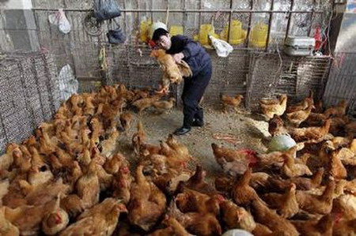
Novel Influenza & Novel Coronavirus
Invasive/Respiratory Infectious Diseases

Slide 18
When to Collect Specimens
Collect specimens from patients who meet criteria for a “Patient Under Investigation” (novel coronavirus) or a “Case Under Investigation” (novel flu)
Usually involves:
Specific symptoms or diagnoses
Specific exposure (one or more of the following may be required):
Travel, within 10-14 days of onset, to a specified area where the novel pathogen has been detected, OR
Epi-linked to a confirmed case, OR
Unprotected laboratory exposure (novel flu), OR
Recent contact with swine or other animal populations (H3N2v), OR
Part of a severe illness cluster of unknown etiology (novel coronavirus)
See CDC’s website for most up-to-date case criteria:
Novel influenza
H5N1: http://www.cdc.gov/flu/avianflu/h5n1/case-definitions.htm (Revised Jan 2014)
H7N9: http://www.cdc.gov/flu/avianflu/h7n9/case-definitions.htm (Rev Jan 2014)
H3N2v: http://www.cdc.gov/flu/swineflu/case-definitions.htm
Novel coronavirus: http://www.cdc.gov/coronavirus/mers/case-def.html

Slide 19
Specimen Collection Supplies
For novel viruses, specimen collection should begin ASAP!
Hospitals/providers should be encouraged to use their own collection supplies, if available
Regions/locals should keep supplies on hand in case of need
If requested, supplies will arrive within 1-2 business days of request from DSHS Austin
Supplies available – same as for influenza surveillance and viral (non-VPD) respiratory outbreaks
Media, NP swabs, secondary containers, labeled boxes and cold packs, prepaid FedEx waybills

Slide 20
Specimen Collection
Specimen types:
Novel flu
Upper respiratory specimens preferred
Lower respiratory specimens may be requested
Novel coronavirus
Lower respiratory specimens most important for virus detection/recovery
Also requested: NP and OP swabs, sera (acute and convalescent), stool
Collect specimens as close to onset as possible
See CDC guidance for full recommendations:
Novel flu: http://www.cdc.gov/flu/avianflu/h7n9/specimen-collection.htm (H5N1, H7N9)
Novel coronavirus: http://www.cdc.gov/coronavirus/mers/guidelines-clinical-specimens.html

Slide 21
Lab Submission Form
Submission Form: G-2V
In addition to submission form tips mentioned earlier in this presentation, do the following:
Novel Influenza
Virology (Section 4):
Check “Influenza surveillance {Influenza real-time RT-PCR}”, AND
Write “Suspect novel flu” in white space, AND
Note travel history and animal contact, if any
Novel Coronavirus
Virology (Section 4):
Check “Other:” and write in “MERS Coronavirus” on the adjacent line
General information for novel virus testing
Payor source (Section 6): Check “IDEAS” to avoid bill for submitter
Note: Prior epidemiology approval/notification required for testing

Slide 22
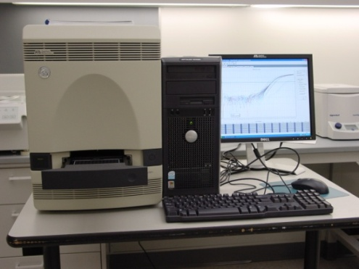
Testing
Who does it?
Novel flu: DSHS Austin, LRN labs, (private labs)
Novel coronavirus: DSHS Austin only
Novel Flu Testing
DSHS Austin and LRN labs can test for:
H5N1, H7N9, H3N2v
Other novel flu subtypes (unsubtypeable result)
Novel Coronavirus Testing
In Texas, testing only performed at DSHS Austin lab
General information for novel virus testing
Prior epidemiology notification and approval required for testing
Turnaround time: generally within 24 hours of receipt
Individual specimen results reported to submitter as “presumptive positive”
Presumptive positive results sent to CDC for confirmation

Slide 23
Meningococcal disease, invasive
Invasive/Respiratory Infectious Diseases

Slide 24
Specimen Submission Highlights
Submission of Neisseria meningitidis isolates from normally sterile sites or purpuric lesions required by law
Texas Administrative Code (Title 25, Part 1, Chapter 97, Subchapter A, Rule §97.5)
DSHS lab serogroups all N. meningitidis isolates
Currently licensed US vaccines only cover serogroups A, C, Y, & W-135
Outbreaks of serogroup B recently on college campuses
DSHS lab performs PFGE analysis on all N. meningitidis isolates to identify disease clusters

Slide 25
IRID Team Contacts
Lesley Brannan – Team Leader, Epidemiologist
Outbreaks, coronavirus, influenza, all diseases
(Vacant position) – Influenza Surveillance Coordinator, Epidemiologist
Influenza, RSV
Michael Fischer – CJD Surveillance Coordinator, Epidemiologist
Creutzfeldt-Jakob disease, amebic meningitis, coronavirus
Irina Cody – Public Health and Prevention Specialist
Meningococcal disease, legionellosis
Amy Littman – Public Health and Prevention Specialist
Streptococcal diseases (GAS, GBS, Strep pneumo)
Robert Russin – ILINet Coordinator, Public Health and Prevention Specialist
Influenza

Slide 26
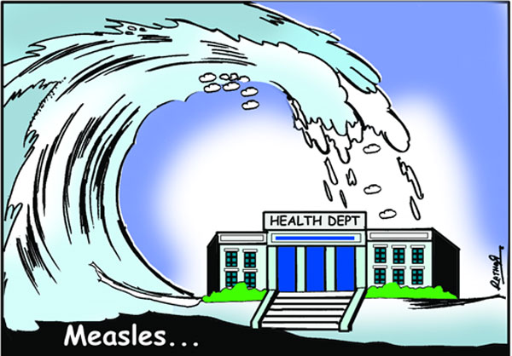
Measles, mumps, rubella testing
Vaccine Preventable Diseases

Slide 27
Measles, Mumps, Rubella Overview
Measles, mumps, rubella require lab testing to meet case definition
Testing for these is very similar
Preferred testing is PCR
Done off-site at MN DOH for measles, rubella
Mumps done at DSHS
Measles PCR is not available at commercial labs
Preferred site is throat for measles, rubella; cheek swab for mumps
Serology (IgM and IgG) is also useful
Done at DSHS
Can be tested at Minnesota or CDC, if indicated
Widely available commercially

Slide 28
MMR: Supplies You Need
G-2A for serology
G-2V for virology (includes PCR)
Viral transport media (e.g. Remel)
Pharyngeal (throat) swabs
Synthetic with plastic/aluminum handle
Serum separator tubes or gold top tubes
Centrifuge
Cold packs or dry ice
Shipping materials

Slide 29
MMR: Getting Supplies
You can purchase them
Any viral transport media will do
You should be able to use PHEP funds
You can request them from DSHS
You can pre-order them in small quantities
If needed urgently, we can get them to you overnight (excluding weekends)
If requesting from DSHS, contact Rachel Wiseman first

Slide 30
MMR: Collection Time Frames
Viral swabs should be collected within 10 days of symptom onset.
The sooner, the better
Serology for IgM should be collected as soon as possible after symptom onset.
Small risk of false negative IgM if drawn before day 5 after onset, but don’t wait.
IgM can be collected up to 30 days after onset.
Paired IgG samples should be collected shortly after onset and 2 weeks after onset.

Slide 31
MMR: Shipping Time Frames
PCR specimens should arrive within 48 hours of collection
If longer than 48 hours, must be frozen (-70)
Serology specimens should arrive within 48 hours of collection.
If longer than 48 hours, must be frozen (-20)
If over 48 hours and not frozen, testing at CDC is a possibility
Do not ship frozen in serum separator tubes

Slide 32
MMR: Important Serology Information
Mumps IgM can be falsely negative or positive.
Do not use a negative IgM as a rule out in vaccinated individuals.
Rubella IgM is frequently falsely positive.
It is highly cross-reactive to measles, rheumatoid factor, Epstein-Barr, & pregnancy.
Measles IgM can be falsely positive.
Send to DSHS lab for confirmatory testing.

Slide 33
MMR: Filling Out the G-2A
Check IgM and IgG.
Make sure you pick correctly between rubella and rubeola.
Choose Wisely

Slide 34
MMR: Filling out the G-2V
MUMPS
Measles PCR OR
Rubella PCR
MEASLES OR RUBELLA
DSHS virology lab prefers not to do culture testing; don’t mark culture. (PCR is faster)

Slide 35
MMR: If Requesting a Lab to Forward a Specimen
Ensure they have a G-2A or G-2V.
Fill out the G-2A or G-2V for them.
Make sure they understand the temperature the specimen needs to be at.
Most of the time the answer is FROZEN.
Get the tracking number for their shipment.
Tell Central Office a specimen is coming.
OR Central Office can do all this for you.

Slide 36
MMR: Paying for Testing
Immunity testing is NOT covered by DSHS.
All other MMR testing will be paid for by DSHS.
Mark the Immunizations box in the payor section of the G-2 form(s).
Do not check other boxes in this section.
DSHS will not correct any billing problems if the form was not completed correctly.

Slide 37
Varicella
Vaccine Preventable Diseases

Slide 38
When to Test for Varicella
Outbreaks
Distinguish between wild-type and vaccine strain disease
Breakthrough disease
May not look like varicella
Often misdiagnosed
Unfortunately, this can be hard to test

Slide 39
Varicella Testing
Varicella serology is no longer performed at DSHS.
IgM not recommended for diagnosis.
Varicella PCR testing is available.
DSHS sends specimens to MN DOH or CDC.
Providers can send directly to CDC.
Biopsies or CSF can be sent for PCR to CDC.
Severe cases/deaths
Should be shipped frozen
Notes:
DSHS lab can do varicella PCR as part of smallpox rule outs.
Our lab can do culture, the specimen shipping requirements are almost impossible to meet.

Slide 40
Supplies for Varicella PCR
Synthetic swabs
Transport tubes, NO media
Needles
Glass slides
G-2V form
Shipping materials
Instructions:
http://www.cdc.gov/chickenpox/lab-testing/collecting-specimens.html

Slide 41
Collecting Vesicular Specimens
Unroof the vesicle (use a sterile needle or slide).
Put scab in sealed container for testing.
Rub synthetic swab in lesion—vigorously!
Get vesicular fluid.
Get skin cells from base of lesion.
Don’t make the patient bleed.
Place swab in EMPTY transport tubes.
Use a different swab for each lesion or scab.
One swab or scab per tube.

Slide 42
Collecting Maculopapular Specimens
Rake edge of slide over lesion.
Make sure skin cells scrape off and onto slide.
Rub synthetic swab on scraped lesion.
Use same swab to collect skin cells from slide.
Use a different swab for each lesion.
Place swab in EMPTY transport tubes.
One swab per tube.

Slide 43
VZV Submission Forms
Use the G-2V.
Check “lesion” and write in the site (e.g. left arm) in Section 3, Specimen Source.
In Section 4, check “other” and write in VZV PCR.
Mark Immunizations as payor source in Section 6.
(If testing for smallpox, use the G-27A)

Slide 44
VZV Collection and Shipping
Best to collect within 5 days of rash onset.
Collect from at least 2 lesions.
Vesicles and scabs are preferred.
A good “rub” is better than no test.
Ship at room temperature.
Can use regular mail.
Can ship whenever after collection (but don’t wait too long).

Slide 45
pertussis
Vaccine Preventable Diseases

Slide 46
Pertussis Testing
DSHS lab can do culture.
It requires special media for collection/transport that the submitter has to obtain.
It cannot be done on what is submitted for pertussis PCR.
Pertussis PCR is widely available.
Testing at DSHS lab should be paid for by the submitter.
DSHS only pays for outbreak specimens in certain circumstances. You must get permission first.

Slide 47
Pertussis Testing Supplies
G-2B form
NP swab
Synthetic with plastic/aluminum handle
Transport tube, NO media
Cold packs
Shipping materials
http://www.cdc.gov/pertussis/clinical/downloads/diagnosis-pcr-bestpractices.pdf

Slide 48
Other vpds
Vaccine Preventable Diseases

Slide 49
H. influenzae
Labs can forward cultures/isolates to DSHS for ID and/or serotyping
Please request for all cases under five
Raw specimens can also be sent for culture, ID and serotyping
Sterile site specimens only
Use G2B
Results will be in NBS, regardless of type

Slide 50
Hepatitis A, B
Serology available at DSHS
Serology widely available commercially
Apart from special studies, commercial labs should be used
We will contact you to request specimens
DSHS lab can be used for perinatal hepatitis B testing
Check Immunizations in payor box on G2A

Slide 51
Tetanus
No testing recommended

Slide 52
Polio
CDC does testing for polio
Specimen types include
CSF 2-5mL
Stool 2-4 g on VTM
NP swab in VTM
Tissue in VTM
Blood (antibody testing)
Coordinate testing through DSHS lab
Use G2V to submit viral specimens

Slide 53
Diphtheria Isolation and/or ID
Use cotton or polyester swab
Suspects: swab below the membrane
Portion of membrane can be tested but does not yield C. diphtheriae well
Contacts: throat or NP swab
Ship on Amie’s or Stuarts or transfer to Loeffler’s slant
Use the G2B
Ship at 2-25 degrees within 48 hours

Slide 54
Always Notify VPD Team About Incoming Specimens
Some reagents have to be set out ahead of time
Rare tests=lab staffing/resource issues
We can advocate with the lab on your behalf
We can fix your form
They are going to call me about any specimens they receive with issues.
Does not apply to pertussis, HIB or perinatal hepatitis testing

Slide 55
VPD Team Contacts
Rachel Wiseman– Team Leader, Epidemiologist
Eric Garza– Program Specialist
Brandy Tidwell– Public Health and Prevention Specialist
Kayla Boykins– Public Health and Prevention Specialist

Slide 56
GI Outbreak- unknown pathogen
Foodborne

Slide 57
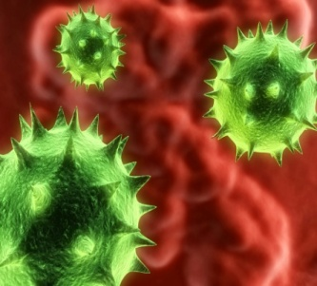
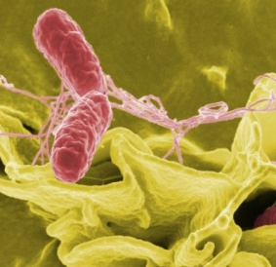
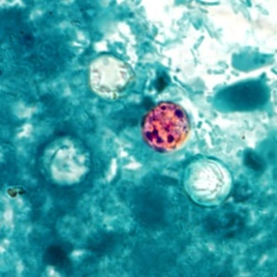
GI Outbreak - Unknown Pathogen
Available Testing at DSHS laboratory
Viral
Real time RT-PCR: Norovirus
Bacterial
Enteric pathogen isolation and ID
Shiga-toxin producing E. coli
EHEC, shiga-like toxin assay
Real time RT-PCR: STEC
Parasitic
Ova and Parasite detection and ID
Notes:
Unknown pathogen, often suspect norovirus

Slide 58
Specimen Types: GI Outbreak - Unknown Pathogen
Raw stool
Norovirus PCR testing
STEC PCR testing
Also acceptable for bacterial testing if received in lab <= 24 hrs from time of collection
If raw stool >= 24hrs
Transport media required for bacterial testing
E.g. Cary-blair
Use O & P collection vials for parasitic testing
10% formalin & Z-PVA
Notes:
Plain raw stool is best for viral testing, but most specimens should also be subdivided into Cary-Blair transport media. This will greatly enhance the possibility of bacterial recovery should the viral tests be negative. Generally, lab runs Noro PCR first and if negative sends it to Bacti.

Slide 59
Specimen Collection: Supply List
Stool Collection Kits
Collection cup or container (urine cups)
Plastic specimen bag (Biohazard)
Cary-Blair transport media
Gloves
Mask
Absorbent pads (you work on these to facilitate clean-up)
G-2B forms
Notes:
??? -FBI KITS ???
Suggest 5 kits on hand- maybe more for regions and larger LHDs OR
Keep some Cary-Blair transport media on hand for bacterial culture AND
O& P collection kits recommended for most parasitic tests but can probably order as needed (which won’t be often)

Slide 60
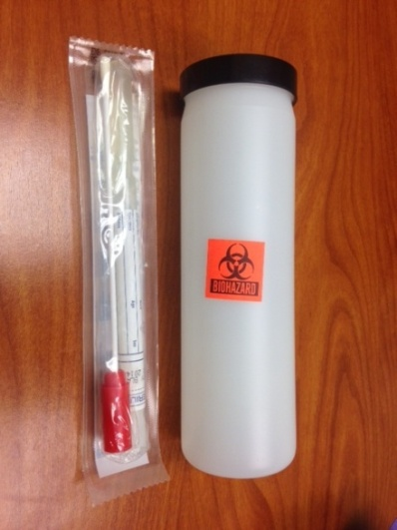
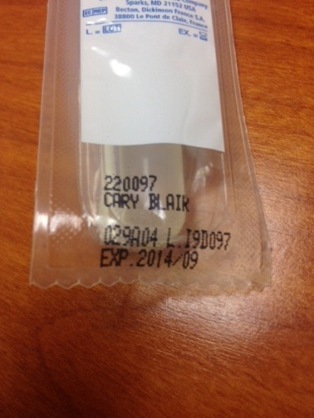
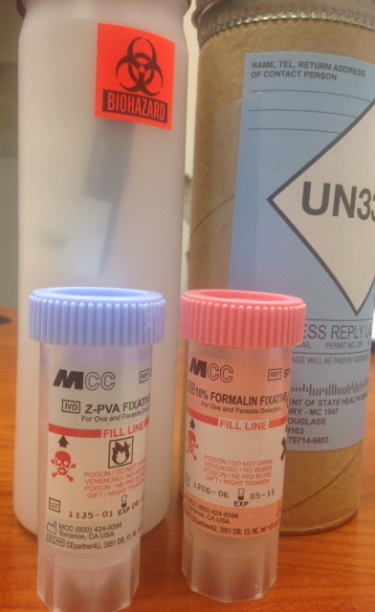
Available Supplies from DSHS
Foodborne
Feces, Bacteriology kit
Cary-Blair transport media
Secondary Container
Feces, O& P Kit*
10% Formalin & Z-PVA vials
Secondary and Outer Container
Cary-blair and O & P kits do have expiration dates
Supply requests are received and filled by the Container Preparation Group at the DSHS lab
*Available on as needed basis

Slide 61
Specimen collection: The Process
Collect raw stool from patient
Collection cup
Plastic specimen bag (biohazard)
Aliquoting specimen into Cary-Blair:
Stick a swab into the stool and transfer a small amount to the Cary- Blair
Wear gloves and a mask and work in an area that can be sanitized when you are done
Keep in mind that this stuff is potentially infectious
Notes:
If all goes according to plan, the patient will have given you a container containing a raw stool specimen in a biohazard bag
Noro testing requires 100 ul but actual sample needs to be more b/c often dries up
Aliquoting specimen:
-Just stick a swab into the stool and transfer a small amount to the Cary- Blair;
-Wear gloves and a mask and work in an area that can be sanitized when you are done;
-keep in mind that this stuff is potentially infectious!

Slide 62
Shipping Considerations
Norovirus testing (only raw stool accepted)
Transport temperature: 2-8ºC (ice pack)
Transport time: as soon as possible
Notes:
Transport time: as soon as possible because DNA may degrade over time

Slide 63
Shipping Considerations
Enteric pathogen isolation
Specimen type | Transport time to lab from time of collection | Transport temperature
Isolate | As soon as possible to ensure viability | Ambient or 2-8ºC (ice pack)
Raw stool [not preferred specimen] | ≤24 hours | 2-8ºC (ice pack)
Stool in transport solution/medium [preferred specimen] | ≤24 hours | Room Temp or 2-8ºC (ice pack)
Stool in transport solution/medium [preferred specimen] | >24 hours but ≤3 days | 2-8ºC (ice pack)
Stool in transport solution/medium [preferred specimen] | >3 days | Freeze immediately at ≤-70ºC. Ship on dry ice.

Slide 64
Shipping Considerations
Parasitic testing
Raw stool should be transferred within a few hours to 10% Formalin & Z-PVA vials
Can be shipped at Room Temp or 2-8ºC (ice pack)
Do Not Freeze

Slide 65
Lab Submission Form
Submitter form: G-2B
In addition to submission form tips mentioned earlier in this presentation, do the following:
Select appropriate test(s):
Molecular Studies (Section 6):
Check “PCR” and “Norovirus”
Bacteriology (Section 4)
Check “Culture, stool” under Clinical Specimen
Parasitology (Section 7)
Check “Fecal ova and parasite examination”
AND
Check “Outbreak association” and write in name of outbreak, (bottom of Section 2)
Payor source (Section 6):
Check “IDEAS” to avoid bill for submitter

Slide 66
Additional testing
Foodborne

Slide 67
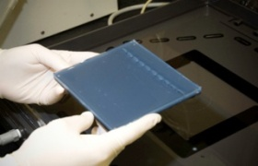
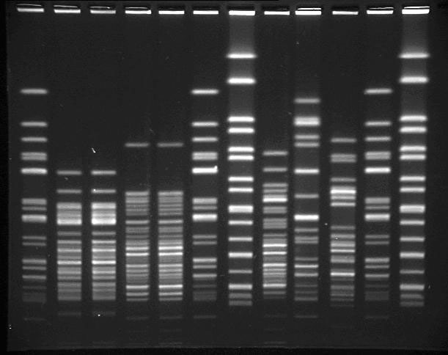
Additional Testing at DSHS
GI outbreak - known pathogen
Confirmation and molecular subtyping
PFGE available for:
Salmonella
Shigella
Shiga toxin-producing E. coli (STEC)*
Campylobacter
Listeria*
Vibrio* (V. cholerae non-O1 and
V. parahaemolyticus)
* Isolate submission required per TAC
Notes:
If known pathogen in an outbreak, Can request hospital/clinic labs to forward specimens to DSHS for confirmation and molecular subtyping.
Molecular subtyping can be useful…

Slide 68
Required Isolates
Diseases requiring submission of cultures*:
Botulism-adult and infant (Clostridium botulinum)
E.coli 0157:H7, isolates or specimens from cases where Shiga-toxin activity is demonstrated
Listeria monocytogenes
Vibrio species
Salmonella isolates not required but strongly encouraged!!!
*Texas Administrative Code (Title 25, Part 1, Chapter 97, Subchapter A, Rule §97.5)
Notes:
Not sure where to place
Why required?
Botulism b/c only state lab can confirm
DSHS Austin only
Botulism
DSHS laboratory is only laboratory in the state that can confirm botulism cases.
STEC, Listeria, and Vibrio- for confirmation, and subtyping, e.g. PFGE- outbreak detection, PulseNET
Note: Salmonella isolates

Slide 69
EHEC, shiga-like toxin assay: Time Considerations
Specimen type | Transport time to lab from time of collection | Transport temperature
Isolate | As soon as possible to ensure viability, however may lose toxin producing ability over time or with multiple transfers. | Ambient or 2-8ºC (ice pack)
Stool or broth | ≤7 days | 2-8ºC (ice pack)
Stool or broth | ≥7 days | Freeze immediately at ≤-70ºC. Ship on dry ice.

Slide 70
Botulism
DSHS Austin laboratory is only laboratory in the state that can confirm botulism cases
Key point:
Please have physician consult with an EAIDB foodborne epidemiologist prior to sample collection and/or submission.
After hours, please call (888) 963-7111

Slide 71
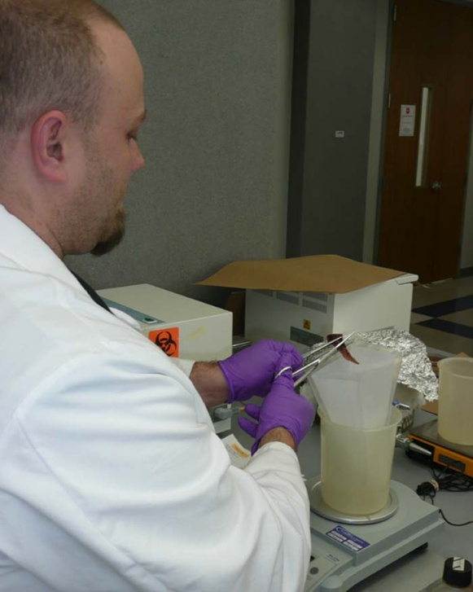
Food
Testing performed by Consumer Microbiology Team at DSHS lab
General policy
Test only food samples implicated in a suspected outbreak (not associated with single cases)
In outbreaks, will not test food unless a pathogen has been identified in a clinical specimen
Food samples must be collected by a registered sanitarian
Contact an EAIDB foodborne epidemiologist to discuss further

Slide 72
Food: Available Tests*
Aerobic Plate Count
Bacillus cereus Enumeration
Campylobacter spp.
Cronobacter sakazakii
Clostridium perfringens Enumeration
Coliform Count
Escherichia coli O157:H7
Escherichia coli count
non-O157 STEC in Meat Products (O26; O45; O103; O111; O121; and O145)
Listeria monocytogenes
Salmonella spp.
Shigella spp.
Staphylococcus aureus enterotoxin
Staphylococcus aureus Enumeration
Vibrio cholerae, Vibrio parahaemolyticus, Vibrio vulnificus
Yeast & Mold Count
Yersinia enterocolitica
*food is tested only upon prior approval
Notes:
Food is tested only upon request from DSHS, local city county health departments, and hospitals. All food testing is done by standard methods following the Bacteriological Analytical Manual, FDA, 8th Edition.
Methods:
Bax system
Traditional Culture Methods (BAM)
mini-VIDAS
E. coli O157:H7 testing
“Big 6” non-O157 testing (O26, O45, O103, O111, O121, O145). But we can
For E. coli O157:H7 there are not limitations. We can test anything only test raw ground beef for this test

Slide 73
Food: Specimen Collection & Handling
Food items should be refrigerated and maintained at 0º to 4º Celsius, until arrival at the laboratory.
Whenever possible, submit samples to the laboratory in the original, unopened containers.
If the original container is too large, transfer representative portions to sterile containers using aseptic technique.
Dry or canned foods that are not perishable should be collected and shipped at ambient temperature. Frozen foods should be shipped frozen.
Do not freeze refrigerated foods.
Collect at least 100 grams of each sample unit. (100 grams = 3.53 ounces or 0.22 pounds)
http://www.dshs.state.tx.us/lab/mic-cm_collect.shtm
Notes:
Food items should be refrigerated and maintained at 0º to 4º Celsius, until arrival at the laboratory. Whenever possible, submit samples to the laboratory in the original, unopened containers. If the original container is too large, transfer representative portions to sterile containers using asceptic technique. Dry or canned foods that are not perishable should be collected and shipped at ambient temperature. Frozen foods should be shipped frozen. Do not freeze refrigerated foods. Collect at least 100 grams of each sample unit. (100 grams = 3.53 ounces or 0.22 pounds)

Slide 74
Environmental Swabs
Testing performed by Consumer Microbiology Team at DSHS lab
General policy
Test environmental swabs only from facilities implicated in a suspected outbreak (not associated with single cases)
In outbreaks, will not test environmental swabs unless a pathogen has been identified in a clinical specimen
Environmental swabs must be collected by a registered sanitarian
Contact an EAIDB foodborne epidemiologist to discuss further
Notes:
Quik-Swabs (3M) or Spongesicles (Various providers)
If Environmental Swabs are to be collected, we would need a head’s up on how many and they would have be collected by a registered sanitarian.
As far as the Consumer Microbiology Lab, we can only test Salmonella for the following matrices:
Food
Environmental Swabs
That is standard practice that all samples collected should be by registered sanitarian. I understand this could be from opened packages from a case patient and that would be acceptable for investigational purposes. But we need a clear chain of custody from the home to the lab.

Slide 75
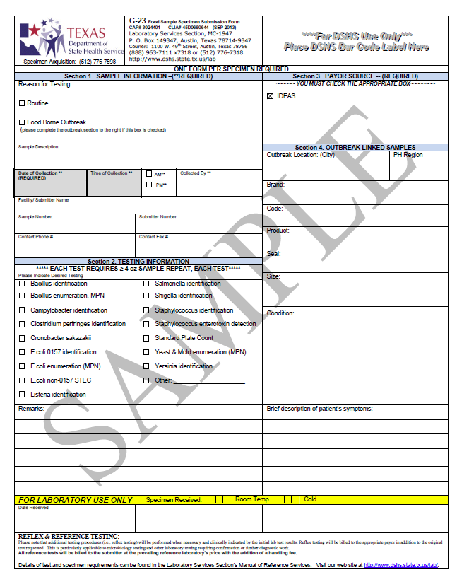
Complete the G-23 form for each food sample or environmental swab submitted

Slide 76
Foodborne Team Contacts
Venessa Cantu– Team Leader, Epidemiologist
Inger Vilcins– Epidemiologist
(vacant)– Epidemiologist
(vacant)– Epidemiologist
Greg Leos– Public Health and Prevention Specialist
Wendy Albers-Public Health and Prevention Specialist

Slide 77
Questions?

