Slide 1
Chikungunya
David Florin, MS, PhD
Laura E. Robinson, DVM, MS
Zoonosis Control Branch
Department of State Health Services

Slide 2
Chikungunya
AKA “CHIK”
First described during a 1952 outbreak in southern Tanzania, Africa
Spread throughout Africa and Asia through human travel
From 2006–2013 in US, average of 28 people per year with positive tests for recent chikungunya virus infection (range 5–65 per year). All travelers visiting or returning to the United States from affected areas, mostly in Asia

Slide 3
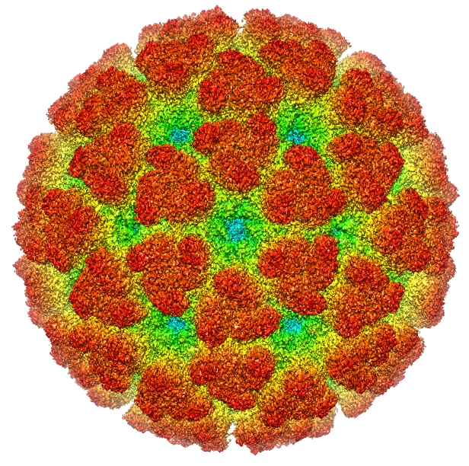
Chikungunya Virus
AKA “CHIKV”
Togaviridae
Alphavirus
Positive sense single stranded RNA
~11.8 kb
Variation structured into 3 main clusters: West African, Asian, and the East Central South African cluster
Bio-safety Level III required
In host, replication occurs in fibroblasts, skeletal muscle progenitor cells, and myofibers
Image source: "Emd-5577" by A2-33 - Own work. Licensed under CC BY-SA 3.0 via Wikimedia Commons - http://commons.wikimedia.org/wiki/File:Emd-5577.jpg#mediaviewer/File:Emd-5577.jpg

Slide 4
Chikungunya
Typically, acute onset of fever and severe polyarthralgias; the disease that “bends up”
After 1 year, at least 20% of patients have severe recurrent joint pains
Supportive treatment; no vaccine available
Extremely low rate of asymptomatic infections compared to dengue and West Nile virus
Incubation in human is typically 3 – 7 days (range 2 – 12 days)
The risk of a person transmitting the virus to a biting mosquito is highest when the patient is viremic during the first 7 days of illness

Slide 5
CHIKV in Africa
From: MM Thiboutot, S Kannan, OU Kawalekar, et al. (2013): Life cycle of Chikungunya virus in Africa showing the interconnection between the sylvatic cycle on the left and the urban cycle on the right. Figure_1.tif. PLOS Neglected Tropical Diseases. 10.1371/journal.pntd.0000623.g001.

Slide 6
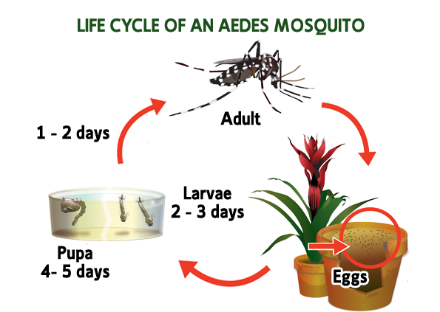
Taken from: http://4.bp.blogspot.com/-hZRbsZXgy8o/UdvAMW3aJ9I/AAAAAAAAJE4/UX0WwN0-0_w/s1600/Dengue+Life+Cycle+and+Facts+copy.png
Cavity breeders; use artificial, water-holding containers for oviposition
Synathropophilic: close association with humans

Slide 7
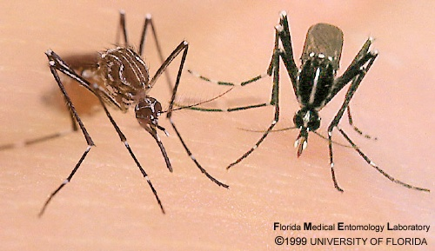
Yellow fever mosquito Aedes aegypti
Asian tiger mosquito Aedes albopictus
Photo from: http://fmel.ifas.ufl.edu/research/exotic.shtml
Subgenus Stegomyia
Both are invasive species that are firmly established in the Americas
Optimal activity usually 2 hours after sunrise and several hours before sunset, but can be active (and taking blood meals) anytime during the daylight hours
Flight range of both species is limited to ~200 meters from emergence
Ae. aegypti females take blood meals from humans exclusively; Ae. albopictus may have broader host range
Disease vector potential: multiple blood meals/gonotrophic cycle

Slide 9
Notes:
Mark Johnsen Ph.D., RS
Environmental Health Specialist
Medical Entomologist
Brazos County Health Department
201 N. Texas Ave
Bryan, Texas 77803
979-361-5757
mjohnsen@brazoscountytx.gov
Slides last updated 2010. Data gathered from multisources: literature (post WWII to present), trap data (eggs reared out to adults), and other sources such as DSHS Arbovirus Lab. New update expected in MAR 2015.

Slide 11
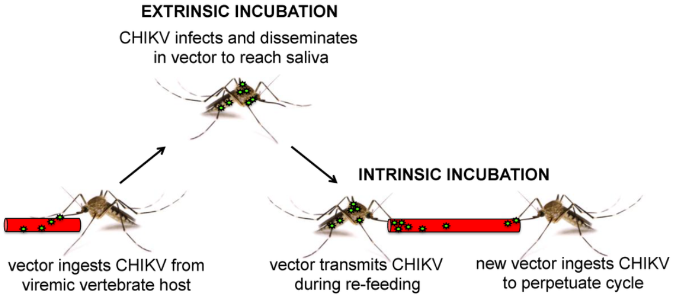

CHIKV: Extrinsic and Intrinsic Incubation
~5 – 7 days**
~2 to 12 days with a median incubation period of 3 days* for symptoms to appear; viremic for first ~7 days after onset of illness
From: Coffey et al. (2014) Viruses, 6(11), 4628-4663; doi:10.3390/v6114628
* Rudolph et al. (2014) Review Article: Incubation Periods of Mosquito-Borne Viral Infections: A Systematic Review. Am J. Trop. Med. Hyg 90(5): 882 – 891
** Dupont-Rouzeyrol et al. (2012) Chikungunya Virus and the Mosquito Vector Aedes aegypti in New Caledonia (South Pacific Region). 12(12): 1036 – 1041
** Vega-Rua et al. (2014) High Level of Vector Competence…, Journal of Virology. 88(11): 6294 – 6306

Slide 12
Chikungunya
From: Weaver, S. 2014. Arrival of Chikungunya Virus in the New World: Prospects for Spread and Impact on Public Health. PLOS Neglected Tropical Diseases. 8 (6).

Slide 13
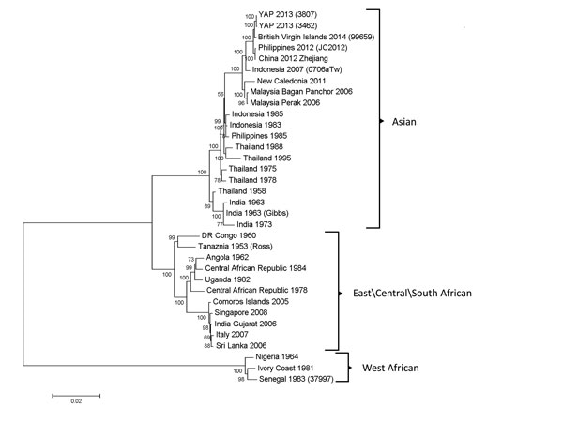
Phylogenetic tree derived by neighbor-joining methods (1,000 bootstrap replications) using complete genome sequences of chikungunya viruses obtained from GenBankScale bar represents the number of nucleotide substitutions per site
From: Lanciotti RS, Valadere AM. Transcontinental movement of Asian genotype chikungunya virus. EID. 2014 Aug. http://dx.doi.org/10.3201/eid2008.140268
Notes:
“The two CHIKVs isolated in Yap in 2013 are most closely related to the CHIKV from BVI, differing by only 16 – 19 nt.”

Slide 14
Previously in the Americas?
Carey, D. (1971) Chikungunya and Dengue: A Case of Mistaken Identity. J Hist Med. 26: 243 – 262
  The Americas may have experienced chikungunya pandemics in the past (1828 and 1850) that were erroneously attributed to dengue
  “It is proposed, on the basis of the recorded accounts of acute illnesses characterized by fever, joint pains, rash, and persistent arthralgia, that all of these epidemics were associated with chikungunya or a closely related virus.”
Halstead, SB. (2015) Reappearance of Chikungunya, Formerly Called Dengue, in the Americas. EID. 21(4): 557-61.
  “In 1823, classical chikungunya, a viral exanthem in humans, occurred on Zanzibar, and in 1827, it arrived in the Caribbean and spread to North and South America.”

Slide 15
Chikungunya in Texas
2007: 2 human cases in North Texas – infected in India, became ill in Texas
2009: 1 human case in North Texas – infected in India, became ill in Texas
2010: 1 human case in Central Texas – infected in Indonesia, became ill in Texas

Slide 16
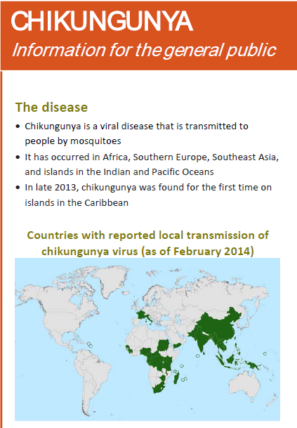
The Americas - 2013
December 2013: locally-acquired cases of chikungunya were reported from St. Martin, French territory in the Caribbean.
December 13, 2013 CDC Health Advisory: Notice to Public Health Officials and Clinicians: Recognizing, Managing, and Reporting Chikungunya Virus Infections in Travelers Returning from the Caribbean
February 2014: CDC Factsheet for the General Public published

Slide 17
Texas - 2014
DSHS News Release, July 7, 2014: Texas Confirms State’s First Chikungunya Case
DSHS Zoonosis Control, July 9, 2014: Distribution to Churches and Other Faith-Based Organizations Concerning Mosquito-Borne Disease Risk During Travel
DSHS Zoonosis Control, July 14, 2014: Guidance Document on Environmental and Educational Response to Suspect Chikungunya Cases
CDC guidance for State Health Departments distributed July 22, 2014: “If risk of viremia, assess and mitigate risk of local transmission
  a. Recommend the case-patient stay in air conditioned or screened accommodations during the first week of illness and reduce mosquito breeding sites in and around the patient’s home
  c. Consult with local health department, vector control agencies…to assess whether Aedes aegypti or Ae. albopictus mosquitoes are likely present and active in the local area, and determine if vector control and mosquito trapping/testing should be considered in the area”

Slide 18


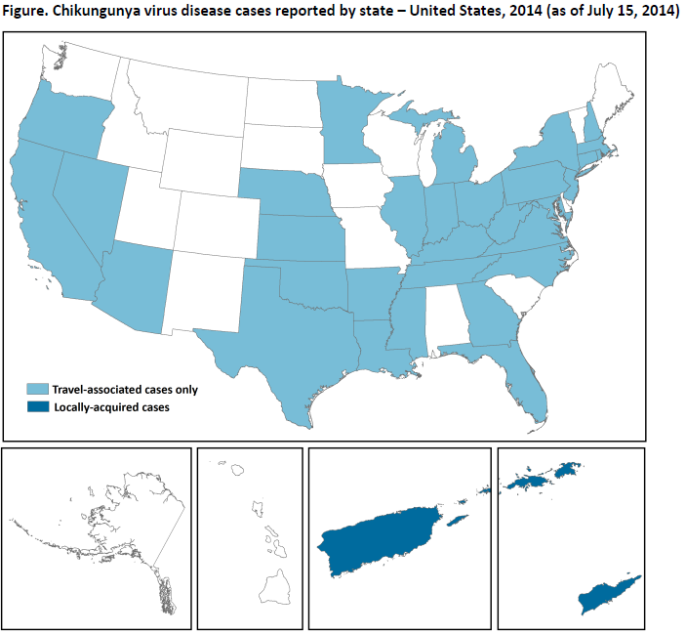
Travel Associated
US Total – 234 cases
Florida – 73 cases
Texas – 4 cases
Locally Acquired
Puerto Rico – 121 cases
US Virgin Is. – 2 cases

Slide 19
Friday, August 29, 2014
9:50 am: DSHS Zoonosis Control Branch (ZCB) notified by San Antonio Metropolitan Health District (SA Metro) and the Centers for Disease Control and Prevention (CDC) of a chikungunya case in Bexar County with possible local transmission
- Detailed email from medical provider in San Antonio included information about travel-associated case and possible secondary case
- ZCB notified Health Service Region 9/10 Zoonosis Control office and El Paso Department of Public Health

Slide 20
Texas – August-September 2014
Patient zero and spouse traveled in Puerto Rico for 5 days and were bitten by mosquitoes there 3 days prior to symptom onset.
Patient zero
Aug. 6: Onset of subjective fever (100.3 Tmax during admission), diffuse maculopapular rash, and disabling polyarthalgias
Aug. 8: Admitted to hospital in Bexar County
Aug. 9: Clinical diagnosis of chikungunya; samples drawn and submitted for PCR and serology (dengue testing subsequently negative).
Aug. 13: recheck at clinic. Spouse had minor complaints of diffuse arthralgias; samples collected and sent for PCR and serology. Two family members from El Paso were visiting at this time and accompanied the patient to the clinic visit. They did not accompany the patient to Puerto Rico and had not traveled overseas. All, including Patient zero, corroborated being bitten by mosquitoes inside the patient's home. They were counseled to present for care if they developed any symptoms of fever plus headache, arthralgias, rash, etc. Patient zero’s chikungunya positive PCR results reported to physician that day by laboratory.

Slide 21
Texas – August-September 2014
Suspected local transmission case:
August 18(?): The patient’s family members returned to El Paso County
Aug. 26: One family member seen by physician in El Paso after waking up with disabling diffuse arthralgias and fever. The physician presumptively diagnosed chikungunya but did not submit specimens for testing. This person had no travel history outside of the US per current information.
Aug. 28: ZCB notified by San Antonio Metro Health Department of Patient zero’s chikungunya positive PCR results
Aug. 29: ZCB notified by SA Metro and CDC of possible local transmission; ZCB notified HSR 10 ZC and El Paso DPH

Slide 22

Suspected Locally-Acquired Chikungunya Case
Yvonne Vasquez, MPH
El Paso Department of Public Health

Slide 23
Timeline
San Antonio Case
Illness Onset
PCR Confirmed
Travel-Associated CHIKV
Viremic
EP Family Visit
San Antonio
8/6
8/12
8/13
El Paso Case
Blood Sample Collected and Submitted to Austin for CHIKV testing
Test Results Negative for CHIKV
Suspected Case Reported
2nd Spray by Vector Control
Traveled to
San Antonio, TX
Returned to
El Paso, TX
Illness
Onset
Visited PCP
Vector Control Measures
San Antonio
El Paso
8/12
8/16
8/24
8/26
8/29
8/30
9/2
9/24
Labor Day Weekend

Slide 24
Public Health Response
Public Health – Patient Education
  During the first 7 days of illness:
    avoid mosquito exposure
    stay in air conditioned or screened accommodations
    reduce mosquito breeding sites in and around their home
    minimize outdoor exposure, but when required utilize long sleeved shirts and pants and mosquito repellents
Environmental – Vector Control
  Adulticide applications using truck-mounted equipment during late evening in the 1st application and early morning in 2nd application
  Biological larvicide operations at nearby reservoir and ponding area
  Mosquito light trap used for surveillance located near property
    Aedes aegypti normally collected

Slide 25
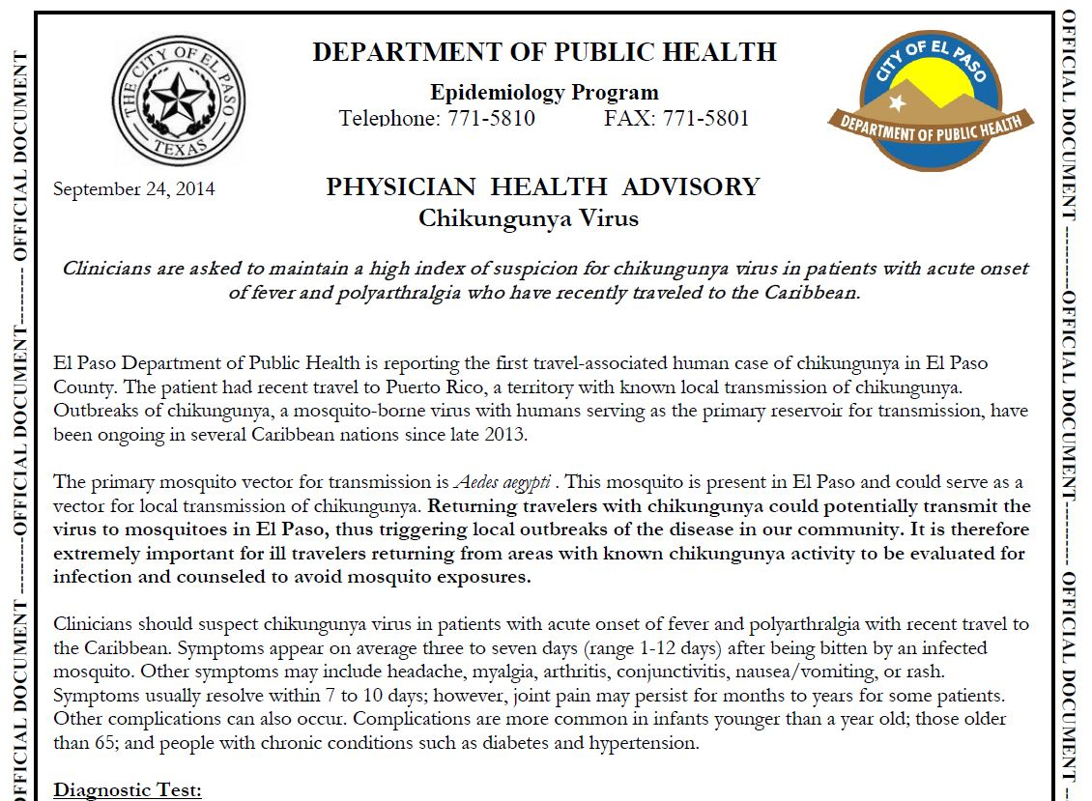

Slide 26
Prevention of Chikungunya
Educate Travelers
People traveling to areas with local transmission of CHIKV should take precautions to reduce mosquito exposure.
Educational materials and guidance should be provided to groups such as church- or faith-based organizations which plan to travel to at risk areas.
Educate Providers
Recommended diagnostic testing methods based on the patient’s length of illness and travel history
Important to counsel patients to avoid exposure to mosquitoes during the first 7 days after onset of illness.

Slide 27
Prevention of Chikungunya
Reduce mosquito exposure
Wear long-sleeved shirts and pants when outside
Use an insect repellent that has DEET, picaridin, IR3535, oil of lemon eucalyptus, para-methane-diol, or other effective repellent
Repair or replace screens on windows and doors
Reduce mosquito populations
Eliminate containers and objects that hold water and could serve as breeding sites for Aedes species mosquitoes
Implement integrated mosquito management, including surveillance for vector species

Slide 28
Mosquito Surveillance
Important to understand distribution and abundance of Ae. aegypti and Ae. albopictus in Texas
  What is the distribution and abundance of each species?
  Identification of breeding sites for control measures
  Delineation of risk zones
Although CHIKV will be detected by cell culture methods used in the DSHS arbovirus testing program, it is not useful (or cost-effective) for prevention purposes

Slide 29
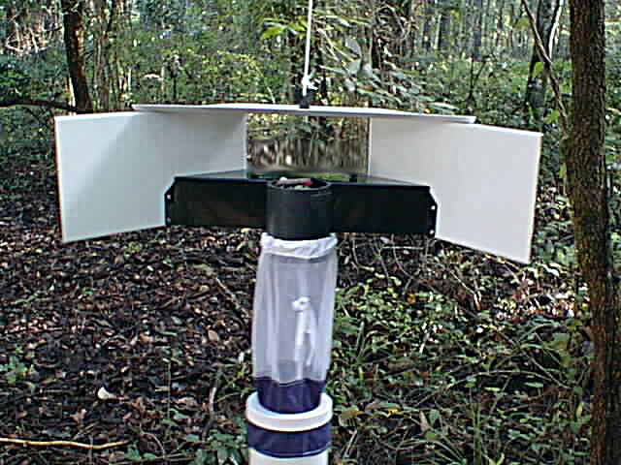
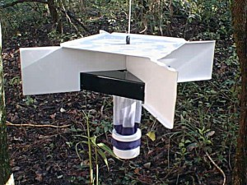
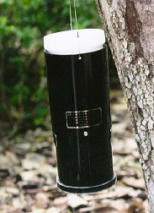

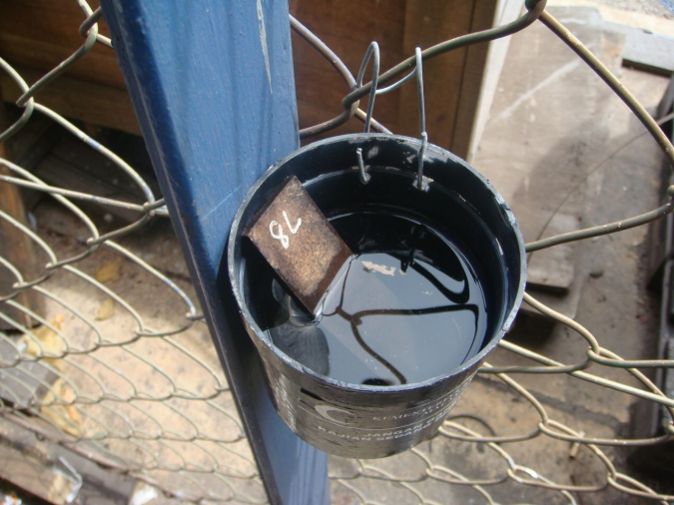
Surveillance for Stegomyia
3 above photos from: http://johnwhock.com/products/other-entomological-traps/
http://al02.blogspot.com/2008/10/kemaman-port-kuantan.html
http://www.bg-sentinel.com/downloads/BG-Sentinel_Manual.pdf
http://www.amazon.com/Mosquito-Magnet-MM4100-Patriot-Trap/dp/B002RMBDIM

Slide 30
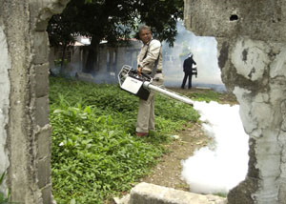
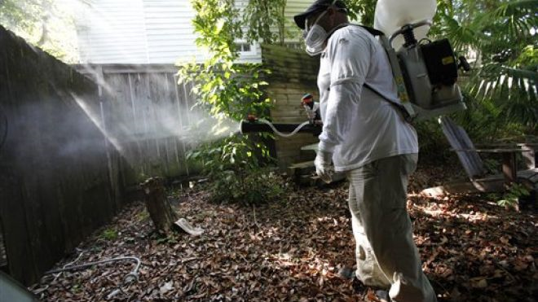
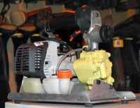
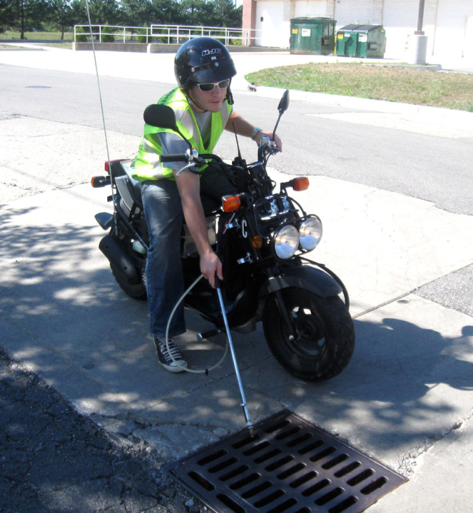
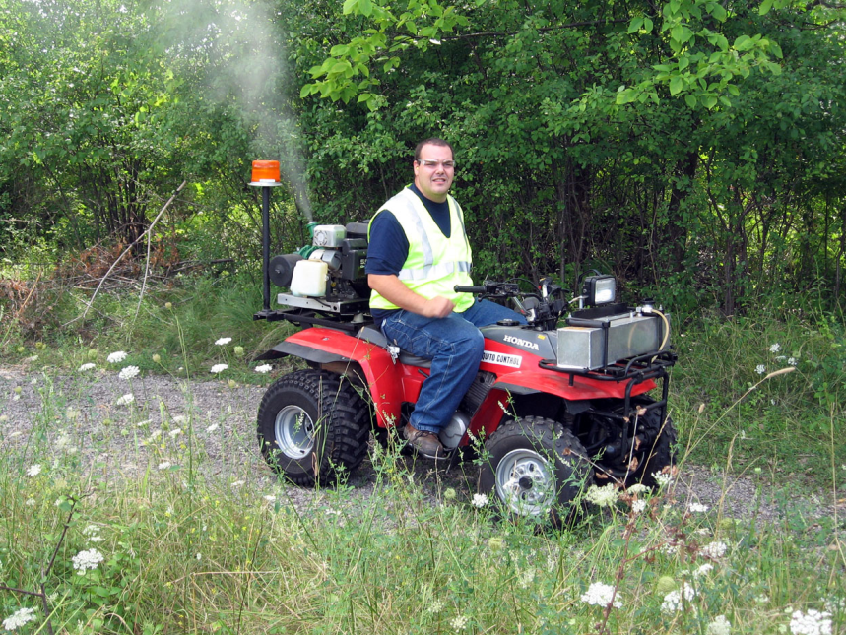
Photo: http://www.panama-guide.com/article.php/20110801171832343
Photo: http://latino.foxnews.com/latino/health/2012/12/06/latest-weapon-against-dengue-genetically-engineered-mosquitos/
Photos: http://www.scmac.org/equipment.htm

Slide 31
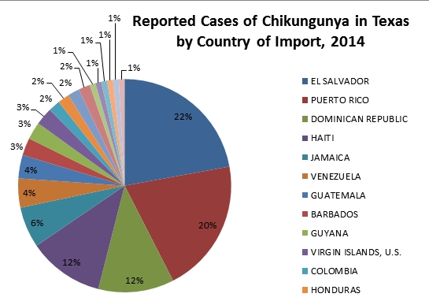
Chikungunya in Texas: 2014
114 cases: 43 confirmed and 71 probable
Of the 43 confirmed cases, 30 were PCR positive
11.4% (13) were hospitalized

Slide 32
Chikungunya in the US: 2014
www.cdc.gov/chikungunya/geo/united-states-2014.html
“As of February 10, 2015, a total of 2,492 chikungunya virus disease cases were reported to ArboNET from U.S. states for 2014. Eleven locally-transmitted cases were reported from Florida. All other cases occurred in travelers returning from affected areas.”
“A total of 4,513 chikungunya virus disease cases were reported to ArboNET from U.S. territories for 2014. Of these, 4,467 were locally-transmitted cases reported from Puerto Rico and the U.S. Virgin Islands. The remaining 46 cases occurred in travelers returning from other affected areas.”

Slide 33
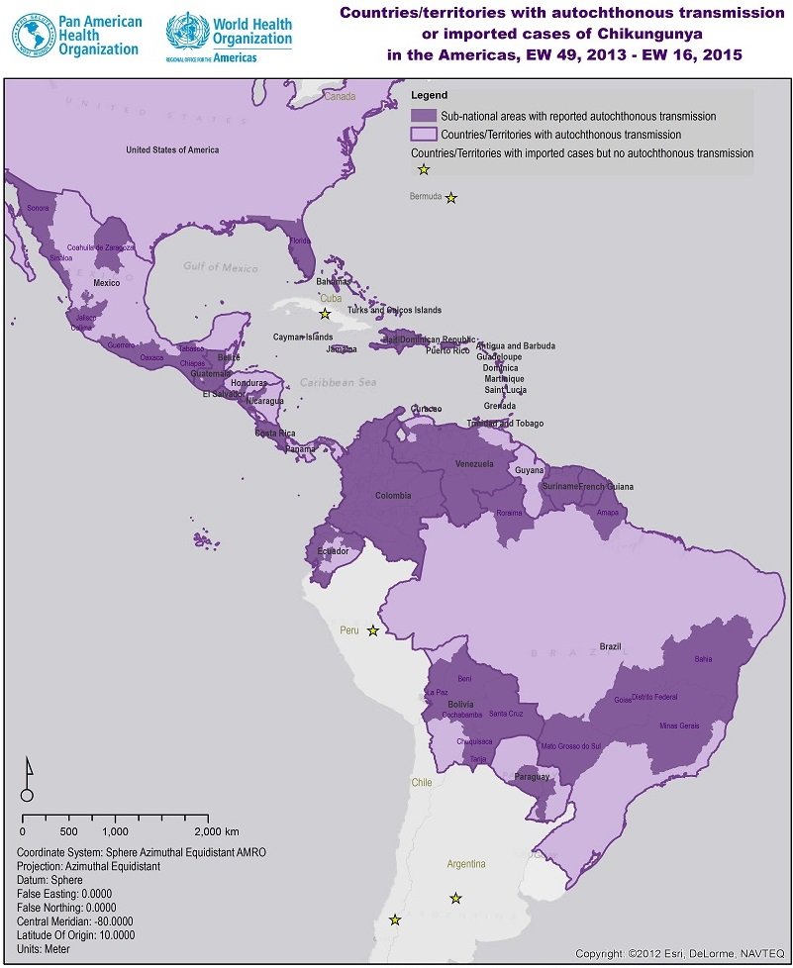
www.PAHO.org/chikungunya
From December 2013 through April 24, 2015 (Epi Week 16), more than 1.3 million suspected and confirmed cases have been reported from 50 countries and territories in the Americas.

Slide 34
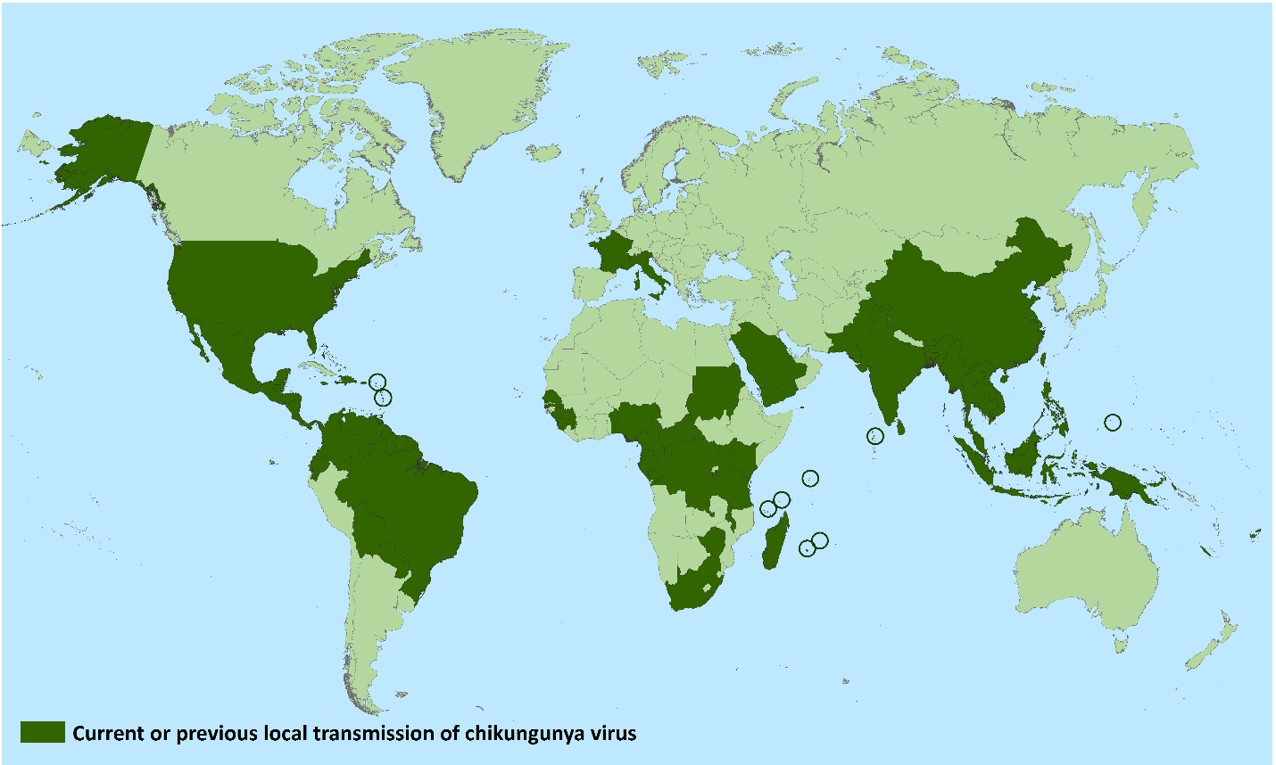
Chikungunya
World-wide distribution as of March 10, 2015
Source: http://www.cdc.gov/chikungunya/geo/united-states.html

Slide 35

Zoonosis Control Branch
www.TexasZoonosis.org
Yvonne Vasquez, MPH
El Paso Department of Public Health
(915) 212-6519
yvonne.vasquez@elpasotexas.gov

