Slide 1
Revised Monthly Correctional TB Report Forms
Continuing Quality Improvement (CQI) Group
Tuberculosis and Hansen’s Disease Unit

Slide 2
Objectives
Provide common terminology
Review the revised Monthly Correctional TB Report
Review the new Report of TB Conditions form
Link useful resources for monthly reports
Notes:
The objectives for this presentation are to:
Provide common terminology
Review the revised monthly correctional TB report and the instructions
Review the new Report of TB Conditions form and the instructions
Link Useful Resources for Monthly Reports

Slide 3
Common Terminology
Prior Positive
Written documented history of a previous positive TST written in millimeters or an IGRA
TB Disease
Active TB disease is diagnosed by medical history, physical evaluation, chest xray, and other laboratory tests (i.e., isolation of M. tuberculosis complex from a clinical specimen).
Suspected with TB Disease
Positive Reactor
An induration of 10 or more millimeters; or
An induration of 5 or more millimeter for:
People who are infected with human immunodeficiency virus (HIV); or
TB Infection
Determined by a positive result from an FDA-approved InterferonGamma Release Assay (IGRA) test such as T-Spot TB or QuantiFERON - TB GOLD In-Tube Test or a tuberculin skin test, and a normal chest radiograph with no presenting symptoms of TB disease. A clinician’s diagnosis must always be obtained to determine TB infection.
Recent contacts to TB Cases; or
People with chest x-ray findings suggestive of previous TB disease; or
People with organ transplants; or
Other immunocompromised persons receiving the equivalent of 15 mg/d or greater of
prednisone for one month or more
Conversion for a Chapter 89-Designated Facility
A change from a documented negative TST or IGRA to a positive TST or IGRA during the time of residence in the facility
Clinical suspicion of active TB is based on signs and symptoms and/or abnormalities on chest x-ray AND the clinician intends for the client to be placed in isolation OR placed on 4-drug therapy. If TB is suspected, a complete evaluation must be performed while waiting for final laboratory results.
Notes:
We will now review common terminology used on the monthly correctional TB reports and the positive reactors/suspects/cases form.
Prior positive is defined as an individual who has a written documented history of a previous positive TST (in mm) or and IGRA
TB Infection is determined by a positive result from an FDA-approved Interferon Gamma Release Assay (IGRA) test such as T-Spot TB or QuantiFERON - TB GOLD In-Tube Test or a tuberculin skin test, and a normal chest radiograph with no presenting symptoms of TB disease. A clinician’s diagnosis must always be obtained to determine TB infection.
TB Disease: Active TB disease is diagnosed by medical history, physical evaluation, chest x ray, and other laboratory tests (i.e., isolation of M. tuberculosis complex from a clinical specimen).
Suspected TB: Clinical suspicion of active TB is based on signs and symptoms and/or abnormalities on chest x-ray AND the clinician intends for the client to be placed in isolation OR placed on 4-drug therapy. If TB is suspected, a complete evaluation must be performed while waiting for final laboratory results.
Positive reactor: An individual with a positive IGRA or TST with induration of 10 mm or more is considered positive for all people in a correctional facility except the following: HIV-infected people, recent contacts to TB disease, people with fibrotic changes on CXR consistent with prior tuberculosis, organ transplant recipients, and other immunosuppressed people (those on TNF alpha inhibitors, or people taking a prolonged course of oral or intravenous corticosteroids such as prednisone). For these inmates, an induration of 5 mm or more is considered positive.
A conversion for a Chapter 89-Designated facility is defined as a change from a documented negative TST or IGRA to a positive TST or IGRA during the time of residence in the facility

Slide 4
Revised Monthly Correctional TB Report (12-11462)
Revised January 2023
Notes:
We will now review the revised monthly correctional TB report and the instructions

Slide 5
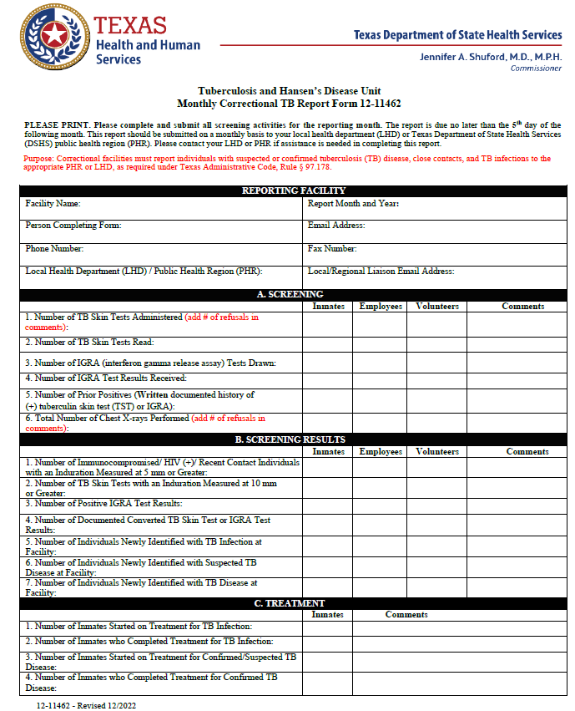
Sections of the Monthly Correctional TB Report (12-11462)
Reporting Facility
Section A. Screening
Section B. Screening Results
Section C. Treatment
Section D. Released to Community
Section E. Transfers
Section F. Comments
Notes:
The monthly correctional TB report has seven main sections that requests information on the reporting facility, screening of inmates, employees, and volunteers, screening results for inmates, employees, treatment of inmates, inmates who are released to the community, and inmates who are transferred out. Additionally, there is a section for comments that you can utilize to note any additional information.

Slide 6
Changes in the Monthly Correctional TB Report (12-11462)
MOVED
Number of Immunocompromised/ HIV (+)/ Recent Contact Individuals with an Induration Measured at 5mm or Greater row to B1
Number of TB Skin Tests with an Induration Measured at 10 mm or Greater row to B2
Number of Individuals with TB Infection Transferred In row to E1
Number of Individuals with Suspected TB Disease Transferred In row to E2
Number of Individuals with TB Disease Transferred In row to E3
REMOVED
Number of Chest X-rays Performed on Prior Positives row
Number of Chest X-rays Performed on Positive Reactors row
Number of Chest X-rays Performed on Individuals who Refused a TST or IGRA row
Total Number of Annual or Initial Screenings row
Number of Abnormal Chest X-rays row
Number of Symptomatic Individuals row
Number of Individuals who are Prior Positives Transferred In row
ADDED
“Add # of refusals in comments” to Number of TB Skin Tests Administered
“Add # of refusals in comments” to Total Number of Chest X-rays Performed
“Newly Identified” to Number of Individuals with TB Infection Diagnosed at Facility row
“Newly Identified” to Number of Individuals with Suspected TB Disease Diagnosed at Facility row
“Newly Identified” to Number of Individuals with TB Disease Diagnosed at Facility row
“Confirmed/Suspected” to Number of Inmates Started on Treatment for TB Disease row
“Confirmed” to Number of Inmates who Completed Treatment for TB Disease row
“Confirmed” to Number of Inmates with TB Disease Released to the Community row
More rows in the Comments section
“Self-reported prior positives need to have a TST placed if documentation is not present” to Reminders
“Include the Report of TB Conditions when submitting the Monthly Correctional TB Report to your PHR or LHD. If there are no TB infections, suspected, and confirmed disease to report, please write “NONE”.” to Reminders
Notes:
Listed above are all the changes made from the previous form.

Slide 7
Reporting Facility
Provide the legal name of the correctional facility (as stated on the screening plan) reporting TB screening activities. Please do not abbreviate.
Provide the month and year when TB screening activities occurred.
Provide the name of the person responsible for completing the monthly report and/or the person who can be contacted to clarify information submitted on this report. Include titles such as RN or LVN.
Provide the email address of the person completing the form from the facility.
Notes:
When listing the facility name, please provide the legal name of the correctional facility (as stated on the screening plan) reporting TB screening activities. Please do not abbreviate. For example, if on the screening plan, the facility name is listed as Texas County Sheriff’s Office, the monthly correctional TB report should also state Texas County Sheriff’s Office and not Texas County Jail.
Please provide the month and year when TB screening activities occurred. The report will be the information from the previous month.
Provide the name of the person responsible for completing the monthly report and/or the person who can be contacted to clarify information submitted on this report. Include titles such as RN or LVN.
Please provide the email address of the person completing the form.

Slide 8
Reporting Facility (cont.)
Provide the person completing the form’s phone number. Please include the area code and, if applicable, an extension.
Provide the person completing the form's fax number. Please include the area code.
Provide the facility's LHD or PHR that receives the Monthly Correctional TB Report.
Provide the LHD or PHR's correctional liaison’s email.
Notes:
Please provide the phone number of the person completing the form. If it is a main number, please provide the extension.
Please provide the fax number of the person completing the form including the area code.
Please provide the local health department or public health region name that you submit the reports to.
Please provide the email address of the correctional liaison at your public health regional or local health department.

Slide 9
Section A. Screening
Provide the total number of inmates, employees and volunteers who received a TB skin test during the reporting month. Please do not leave any fields blank, indicate 0 if applicable. If inmates refuse the TB skin test, please write “(#) inmates refused skin test” in the Comments section of A1.
Provide the total number of TB skin tests read for inmates, employees, and volunteers during the reporting month. TB skin tests must be read within 48-72 hours of placement. Please read TB skin tests even if they were not placed at the facility such as inmates who were transferred in. Please do not leave any fields blank, indicate 0 if applicable.
Provide the total number of inmates, employees, and volunteers who had an IGRA test drawn during the reporting month. Please do not draw IGRAs as confirmatory testing in the presence of a positive TST. Please do not leave any fields blank, indicate 0 if applicable. There are two types of IGRA tests approved by the U.S. Food and Drug Administration. They are QuantiFERON-TB Gold Plus (QFT®-Plus) /TSPOT®.TB.Test.
Notes:
A1. Number of TB Skin Tests Administered: Provide the total number of inmates, employees and volunteers who received a TB skin test during the reporting month. Please do not leave any fields blank, indicate 0 if applicable. If inmates refuse the TB skin test, please write “(#) inmates refused skin test” in the Comments section of A1.
A2. Number of TB Skin Tests Read: Provide the total number of TB skin tests read for inmates, employees, and volunteers during the reporting month. TB skin tests must be read within 48-72 hours of placement. Please read TB skin tests even if they were not placed at the facility such as inmates who were transferred in. Please do not leave any fields blank, indicate 0 if applicable.
A3. Number of IGRA (Interferon Gamma Release Assay) Tests Drawn: Provide the total number of inmates, employees, and volunteers who had an IGRA test drawn during the reporting month. Please do not draw IGRAs as confirmatory testing in the presence of a positive TST. Please do not leave any fields blank, indicate 0 if applicable. There are two types of IGRA tests approved by the U.S. Food and Drug Administration. They are QuantiFERON-TB Gold Plus (QFT®-Plus)/TSPOT®.TB.Test.

Slide 10
Section A. Screening (cont.)
Provide the total number of IGRA tests
analyzed by a laboratory and for which documented results were received for inmates, employees, and volunteers. Please do not draw IGRAs as confirmatory testing in the presence of a positive TST. Please do not leave any fields blank, indicate 0 if applicable.
Provide the total number of people with a written documented history of a positive skin test or IGRA result. Please do not leave any fields blank, indicate 0 if applicable. Self-reported prior positives should not be reported as prior positives on the 12-11462 form. If documentation of a prior positive is not present/the prior positive is self-reported, then a TST should be placed, and if positive, the information should be captured appropriately on the 12-11461 and 12-11462 forms.
Provide the total number of CXRs performed in the reporting month. Include in your count any individual exhibiting signs and symptoms of TB disease that did not receive a TST or IGRA but received a CXR. Include radiology done outside of the facility. Do not include CXRs done in lieu of a TST or IGRA. Please do not leave any fields blank, indicate 0 if applicable. If inmates refuse a CXR, please write “(#) inmates refused skin test” in the Comments section of A6.
Notes:
A4. Number of IGRA Test Results Received: Provide the total number of IGRA tests analyzed by a laboratory and for which documented results were received for inmates, employees, and volunteers. Please do not draw IGRAs as confirmatory testing in the presence of a positive TST. Please do not leave any fields blank, indicate 0 if applicable.
A5. Number of Prior Positives (written documented history of (+) tuberculin skin test TST or IGRA): Provide the total number of people with a written documented history of a positive skin test or IGRA result. Please do not leave any fields blank, indicate 0 if applicable. Self-reported prior positives should not be reported as prior positives on the 12-11462 form. If documentation of a prior positive is not present/the prior positive is self-reported, then a TST should be placed, and if positive, the information should be captured appropriately on the 12-11461 and 12-11462 forms.
List the name of the prior positive if they have been identified with TB infection and/or diagnosed with suspected or confirmed TB disease on the 12-11461 form (Report of TB Conditions).
A6. Total Number Chest X-rays Performed: Provide the total number of CXRs performed in the reporting month. Include in your count any individual exhibiting signs and symptoms of TB disease that did not receive a TST or IGRA but received a CXR. Include radiology done outside of the facility. Do not include CXRs done in lieu of a TST or IGRA. Please do not leave any fields blank, indicate 0 if applicable. If inmates refuse a CXR, please write “(#) inmates refused skin test” in the Comments section of A6.
List the name of the individual(s) with an abnormal CXR if they have been identified with TB infection and/or diagnosed with suspected or confirmed TB disease on the 12-11461 form (Report of TB Conditions).
NOTE: Individuals with symptoms suggestive of TB should receive a CXR, regardless of an IGRA or TST result. A CXR shall always be done within 72 hours of a positive TB skin test reading. A CXR and sputum smear and culture shall always be done within 72 hours of identification of symptoms of TB.

Slide 11
Section B. Screening Results
Provide total number of skin tests that were positive during the reporting month for immunocompromised/HIV (+)/recent contacts, or individuals with pre-existing conditions (an induration of 5mm or greater). Please do not leave any fields blank, indicate 0 if applicable. List the name of the positive reactors if they have been identified with TB infection and/or diagnosed with suspected or confirmed TB disease on the 12- 11461 form (Report of TB Conditions).
Provide the total number of TB skin tests where the indurations have a millimeter (mm) reading of 10 or above during the reporting month. Indurations measuring 10 mm or greater is considered positive. Individuals who are immunocompromised/HIV (+)/recent contacts, or individuals with pre-existing conditions with an induration of 5mm or more should not be included in this count. Please do not leave any fields blank, indicate 0 if applicable.
Provide the total number of inmates, employees, and volunteers that converted from a documented negative baseline IGRA or skin test result to a positive IGRA or skin test result. Please do not leave any fields blank, indicate 0 if applicable.
For inmates, employees, and volunteers who had an IGRA test drawn and resulted, provide the total number of inmates, employees, and volunteers who had a positive laboratory test result. Please do not count confirmatory test results. Please do not leave any fields blank, indicate 0 if applicable.
Notes:
B1. Number of Immunocompromised/ HIV (+)/ Recent Contact Individuals with an Induration Measured at 5 mm or Greater: Provide total number of skin tests that were positive during the reporting month for immunocompromised/HIV (+)/recent contacts, or individuals with pre-existing conditions (an induration of 5 mm or greater). Please do not leave any fields blank, indicate 0 if applicable. List the name of the positive reactors if they have been identified with TB infection and/or diagnosed with suspected or confirmed TB disease on the 12- 11461 form (Report of TB Conditions).
B2. Number of TB Skin Tests with an Induration Measured at 10 mm or Greater: : Provide the total number of TB skin tests where the indurations have a millimeter (mm) reading of 10 or above during the reporting month. Indurations measuring 10 mm or greater is considered positive. Individuals who are immunocompromised/HIV (+)/recent contacts, or individuals with pre-existing conditions with an induration of 5mm or more should not be included in this count. Please do not leave any fields blank, indicate 0 if applicable.
List the name of the positive reactors if they have been identified with TB infection and/or diagnosed with suspected or confirmed TB disease on the 12-11461 form (Report of TB Conditions).
B3. Number of Positive IGRA Tests Results: For inmates, employees, and volunteers who had an IGRA test drawn and resulted, provide the total number of inmates, employees, and volunteers who had a positive laboratory test result. Please do not count confirmatory test results. Please do not leave any fields blank, indicate 0 if applicable.
List the name of the positive reactors if they have been identified with TB infection and/or diagnosed with suspected or confirmed TB disease on the 12-11461 form (Report of TB Conditions).
B4. Number of Documented Converted TB Skin Test or IGRA Test Results: Provide the total number of inmates, employees, and volunteers that converted from a documented negative baseline IGRA or skin test result to a positive IGRA or skin test result. Please do not leave any fields blank, indicate 0 if applicable.
List the name of the positive reactor conversion if they have been identified with TB infection and/or diagnosed with suspected or confirmed TB disease on the 12-11461 form (Report of TB Conditions).
Converter: a change from a documented negative TST or IGRA to a positive TST or IGRA during the time of residence in the facility.

Slide 12
Section B. Screening Results (cont.)
Provide the total number of inmates and employees with newly identified TB infection (meets case definition) during the reporting month. Please do not leave any fields blank, indicate 0 if applicable.
Provide the total number of newly identified inmates, employees, and volunteers who had an abnormal CXRs, signs and symptoms of TB, sputum collected for TB, or were started on four anti-TB medications during the reporting month. Please do not leave any fields blank, indicate 0 if applicable. Inmates with symptoms of TB or CXR results suggestive of TB should be placed in an isolation room with negative air pressure.
Provide the total number of inmates and employees newly identified with active TB disease during the reporting month. Please do not leave any fields blank, indicate 0 if applicable. Diagnosis should be confirmed by a positive culture for M. Tuberculosis or by a physician.
Notes:
B5. Number of Individuals Newly Identified with TB Infection at Facility: Provide the total number of inmates and employees with newly identified TB infection (meets case definition) during the reporting month. Please do not leave any fields blank, indicate 0 if applicable.
List the name of the individuals with newly identified TB infection on the 12-11461 form (Report of TB Conditions).
TB Infection: TB infection is determined by a positive result from an FDA-approved Interferon Gamma Release Assay (IGRA) test such as T-Spot TB or QuantiFERON - TB GOLD In-Tube Test or a tuberculin skin test, and a normal chest radiograph with no presenting symptoms of TB disease. A clinician’s diagnosis must always be obtained to determine TB infection.
B6. Number of Individuals Newly Identified with Suspected TB Disease at Facility: Provide the total number of newly identified inmates, employees, and volunteers who had an abnormal CXRs, signs and symptoms of TB, sputum collected for TB, or were started on four anti-TB medications during the reporting month. Please do not leave any fields blank, indicate 0 if applicable. Inmates with symptoms of TB or CXR results suggestive of TB should be placed in an isolation room with negative air pressure.
List the name of the individuals newly identified with suspected of TB disease on the 12-11461 form (Report of TB Conditions) and attach a copy of their TB-400 to the monthly report.
B7. Number of Individuals Newly Identified with TB Disease at Facility: Provide the total number of inmates and employees newly identified with active TB disease during the reporting month. Please do not leave any fields blank, indicate 0 if applicable. Diagnosis should be confirmed by a positive culture for M. Tuberculosis or by a physician.
List the name of the individual with TB disease on the 12-11461 form (Report of TB Conditions) and attach a copy of their TB-400 to the monthly report.

Slide 13
Section C. Treatment
Provide the total number of inmates who completed treatment for TB infection while at the facility during the reporting month. Include those that were transferred in on treatment for TB Infection. Please do not leave any fields blank, indicate 0 if applicable.
Provide the total number of inmates who were started on drug therapy for TB infection while at the facility during the reporting month. Please do not leave any fields blank, indicate 0 if applicable.
Provide the total number of inmates who were given their 1st dose of treatment for active or suspected TB disease while at the facility during the reporting month. Please do not include transfers who have already started treatment. Please do not leave any fields blank, indicate 0 if applicable.
Provide the total number of inmates confirmed with active TB disease that completed treatment for TB while at the facility during the reporting month. Include those that were transferred in on treatment for TB. Do not leave fields blank, indicate 0 if applicable.
Notes:
C1. Number of Inmates Started on Treatment for TB Infection: Provide the total number of inmates who were started on drug therapy for TB infection while at the facility during the reporting month. Please do not leave any fields blank, indicate 0 if applicable.
List the name of individuals started on treatment on the 12-11461 form (Report of TB Conditions) and attach a copy of their TB-400 to the monthly report.
C2. Number of Inmates who Completed Treatment for TB Infection: Provide the total number of inmates who completed treatment for TB infection while at the facility during the reporting month. Include those that were transferred in on treatment for TB Infection. Please do not leave any fields blank, indicate 0 if applicable.
C3. Number of Inmates Started on Treatment for Confirmed/Suspected TB Disease: Provide the total number of inmates who were given their first dose of treatment for active or suspected TB disease while at the facility during the reporting month. Please do not include transfers who have already started treatment. Please do not leave any fields blank, indicate 0 if applicable.
List the name of individuals started on treatment on the 12-11461 form (Report of TB Conditions) and attach a copy of their TB-400 to the monthly report.
C4. Number of Inmates who Completed Treatment for Confirmed TB Disease: Provide the total number of inmates confirmed with active TB disease that completed treatment for TB while at the facility during the reporting month. Include those that were transferred in on treatment for TB. Do not leave fields blank, indicate 0 if applicable.

Slide 14
Section D. Released to Community
Provide the total number of inmates with recorded evidence of TB infection that were released to the community. This includes inmates who were sent home and will receive follow up care by the local health department or the Department of State Health Services regional office. Please notify the local health department or the DSHS regional office of the inmates’ release. Please do not leave any fields blank, indicate 0 if applicable.
Provide the total number of inmates suspected of TB disease released to the community. This includes inmates who were sent home and will receive follow up care by the local health department or the Department of State Health Services regional office. Please notify the local health department or the DSHS regional office of the inmates’ release. Please do not leave any fields blank, indicate 0 if applicable.
Provide the total number of inmates with confirmed TB disease released to the community. This includes inmates who were sent home and will receive follow up care by the local health department or the Department of State Health Services regional office Please notify the local health department or the DSHS regional office of the inmates’ release. Please do not leave any fields blank, indicate 0 if applicable.
Notes:
D1. Number of Inmates with TB Infection Released to the Community: Provide the total number of inmates with recorded evidence of TB infection that were released to the community. This includes inmates who were sent home and will receive follow up care by the local health department or the Department of State Health Services regional office. Please notify the local health department or the DSHS regional office of the inmates’ release. Please do not leave any fields blank, indicate 0 if applicable.
List the name of the individuals with TB infection released to the community during the reporting month on the 12-11461 form (Report of TB Conditions).
D2. Number of Inmates with Suspected TB Disease Released to the Community: Provide the total number of inmates suspected of TB disease released to the community. This includes inmates who were sent home and will receive follow up care by the local health department or the Department of State Health Services regional office. Please notify the local health department or the DSHS regional office of the inmates’ release. Please do not leave any fields blank, indicate 0 if applicable.
List the name of the inmates suspected of TB disease on the 12-11461 form (Report of TB Conditions) and attach a copy of their TB400 to the monthly report.
D3. Number of Inmates with TB Disease Released to the Community: Provide the total number of inmates with confirmed TB disease released to the community. This includes inmates who were sent home and will receive follow up care by the local health department or the Department of State Health Services regional office Please notify the local health department or the DSHS regional office of the inmates’ release. Please do not leave any fields blank, indicate 0 if applicable.
List the name of the inmates with confirmed TB disease on the 12-11461 form (Report of TB Conditions) and attach a copy of their TB400 to the monthly report.

Slide 15
Section E. Transfers
Provide the total number of inmates with TB infection who were transferred into the facility during the reporting month. Please do not leave any fields blank, indicate 0 if applicable.
Provide the total number of inmates diagnosed with confirmed active TB disease transferred into the facility during the reporting month. Please do not leave any fields blank, indicate 0 if applicable. Diagnosis should be confirmed by a positive culture for M. Tuberculosis or by a physician.
Provide the total number of inmates with a record of an abnormal CXR indicative of TB, signs and symptoms of TB, sputum collection for TB, initiation of four anti-TB medications transferred into the facility during the reporting month. Please do not leave any fields blank, indicate 0 if applicable. Inmates with symptoms of TB or CXR results suggestive of TB should be placed in an isolation room with negative air pressure.
Notes:
E1. Number of Inmates with TB Infection Transferred In: Provide the total number of inmates with TB infection who were transferred into the facility during the reporting month. Please do not leave any fields blank, indicate 0 if applicable.
List the name of the individuals with TB infection on the 12-11461 form (Report of TB Conditions).
E2. Number of Inmates with Suspected TB Disease Transferred In: Provide the total number of inmates with a record of an abnormal CXR indicative of TB, signs and symptoms of TB, sputum collection for TB, initiation of four anti-TB medications transferred into the facility during the reporting month. Please do not leave any fields blank, indicate 0 if applicable. Inmates with symptoms of TB or CXR results suggestive of TB should be placed in an isolation room with negative air pressure.
List the name of the individuals suspected of TB disease on the 12-11461 form (Report of TB Conditions) and attach a copy of their TB-400 to the monthly report.
E3. Number of Inmates with TB Disease Transferred In: Provide the total number of inmates diagnosed with confirmed active TB disease transferred into the facility during the reporting month. Please do not leave any fields blank, indicate 0 if applicable. Diagnosis should be confirmed by a positive culture for M. Tuberculosis or by a physician.
List the name of the individuals with confirmed TB disease on the 12-11461 form (Report of TB Conditions) and attach a copy of their TB-400 to the monthly report.

Slide 16
Section E. Transfers (cont.)
Provide the total number of inmates with recorded evidence of TB infection who were transferred to another facility during the reporting month. Please notify the local health department or DSHS regional office of the transfer. Please do not leave any fields blank, indicate 0 if applicable.
Provide the total number of inmates diagnosed with confirmed TB disease who were transferred to another correctional facility during the reporting month. Please notify the local health department or DSHS regional office of the transfer. Please do not leave any fields blank, indicate 0 if applicable.
Provide the total number of inmates suspected of TB disease who were transferred to another facility during the reporting month. Please notify the local health department or DSHS regional office of the transfer. Please do not leave any fields blank, indicate 0 if applicable.
Notes:
E4. Number of Inmates with TB Infection Transferred Out: Provide the total number of inmates with recorded evidence of TB infection who were transferred to another facility during the reporting month. Please notify the local health department or DSHS regional office of the transfer. Please do not leave any fields blank, indicate 0 if applicable.
List the name of the individuals with TB infection transferred out during the reporting month on the 12-11461 form (Report of TB Conditions).
E5. Number of Inmates with Suspected TB Disease Transferred Out: Provide the total number of inmates suspected of TB disease who were transferred to another facility during the reporting month. Please notify the local health department or DSHS regional office of the transfer. Please do not leave any fields blank, indicate 0 if applicable.
List the name of the individuals suspected of TB disease on the 12-11461 form (Report of TB Conditions) and attach a copy of their TB400 to the monthly report.
E6. Number of Inmates with TB Disease Transferred Out: Provide the total number of inmates diagnosed with confirmed TB disease who were transferred to another correctional facility during the reporting month. Please notify the local health department or DSHS regional office of the transfer. Please do not leave any fields blank, indicate 0 if applicable.
List the name of the individuals with confirmed TB disease on the 12- 11461 form (Report of TB Conditions) and attach a copy of their TB400 to the monthly report.

Slide 17
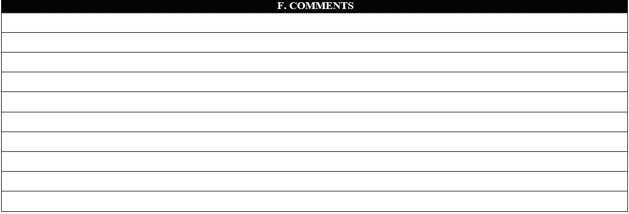
F. Comments
Include any additional information or possible discrepancies in the comment section. If there is a comment in a previous section that is too large to place in that section’s comment cells, please place the comment in this section.
Notes:
Include any additional information or possible discrepancies in the comment section. If there is a comment in a previous section that is too large to place in that section’s comment cells, please place the comment in this section.

Slide 18
Reminders
Notes:
Here are the reminders at the end of the form.

Slide 19
NEW! Report of TB Conditions (12-11461)
Revised: January 2023
Notes:
We will now review the new report of TB conditions and the instructions. Previously known as the positive reactors/suspects/cases form.

Slide 20
Changes in the Report of TB Conditions (12-11461)
RENAMED the form from Positive Reactors/Suspects/Cases Form to Report of TB Conditions
CHANGED
Purpose to “document all individuals with a notifiable Tuberculosis condition reported to health departments”
Date Placed column to Date Placed or Drawn
Result MM column to Result MM and IGRA
CXR Normal/Abnormal column to CXR Result
Rx Start Date column to Treatment Start Date
Released to Community or Transferred to Released, Transferred, Both, None
REMOVED
Numbering
Initial or Annual Screening column
Inmate Number column
Positive Reactor Y or N column
Immuno/HIV/Recent Contact column
Documented Prior Positive column
Date LHD/PHR was notified of Suspect/Case/TB Infection column
Comments column
ADDED
Results of prior positives to footnotes
If Y, include dates placed/drawn of last negative test to footnotes
Format: A-Abnormal; N-Normal
C- Case; S- Suspect; I- TB Infection to footnotes
Format: Transferred In; Transferred Out; Released; Both (released and transferred in); None to footnotes
Provide the dates of transfers or release to footnotes
Notes:
Here is what has changed from the previous form.

Slide 21
Who Should be Included on the Report of TB Conditions Form?
Individuals with TB infection diagnosed at facility, transferred in, transferred out that has not been previously reported, or released that has not been previously reported
Suspected or confirmed TB disease, diagnosed at facility, transferred in, transferred out that has not been previously reported, or released that has not been previously reported
Inmates started on treatment for TB infection or TB disease

Slide 22
Report of TB Conditions (Form 12-11461)
Provide the legal name of the correctional facility reporting TB screening activities. Please do not abbreviate.
Provide the name of the person responsible for completing the monthly report and/or the person who can be contacted to clarify information submitted on this report. Include titles such as RN or LVN.
Provide the month and year of the reporting period.
Notes:
Name of Facility: Provide the legal name of the correctional facility reporting TB screening activities. Please do not abbreviate.
Person Completing Form: Provide the name of the person responsible for completing the monthly report and/or the person who can be contacted to clarify information submitted on this report. Include titles such as RN or LVN.
Reporting Month and Year: Provide the month and year of the reporting period.

Slide 23
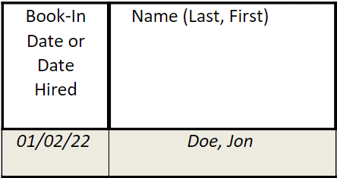
Report of TB Conditions (Form 12-11461)
Provide the individual's full name. (Format: Last, First)
For all inmates, provide the book-in date (intake date) of the TB infection, suspected case, or confirmed case being reported. For employees and volunteers, include the date they were hired. (Format: MM/DD/YY)
Notes:
Book-In Date or Date Hired: For all inmates, provide the book-in date (intake date) of the TB infection, suspected case, or confirmed case being reported. For employees and volunteers, include the date they were hired. (Format: mm/dd/yy)
Name: Provide the individual's full name. (Format: Last, First)

Slide 24
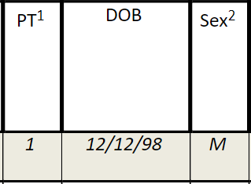
Report of TB Conditions (Form 12-11461)
Provide individual's date of birth.
(Format: MM/DD/YY)
Provide the individual's given sex; male, female, or unknown/other.
(Format: M for male, F for female, O for unknown/other)
Provide the individual’s patient type.
Select 1 if the individual is an inmate.
Select 2 if the individual is an employee.
Select 3 if the individual is a volunteer.
Notes:
Patient Type (PT): Provide the individual’s patient type. (Format: 1 if the individual is an inmate, 2 if the individual is an employee, and 3 if the individual is a volunteer)
Date of Birth (DOB): Provide individual's date of birth. (Format: mm/dd/yy)
Sex: Provide the individual's given sex; male, female, or unknown/other. (Format: M for male, F for female, O for unknown/other)

Slide 25
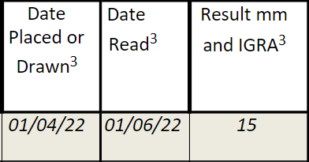
Report of TB Conditions (Form 12-11461)
Provide the date the individual’s TST or IGRA was read. Include the written documentation of prior positive dates. Please do not leave this field blank.
NOTE: For inmates with a written documented history of a being a prior positive, write the documented date the TST was read (Format: MM/DD/YY).
Provide the results of the individual’s TST or IGRA. If reporting a TST result, provide the mm of induration. If reporting an IGRA test result, please indicate negative, positive, or indeterminate. Please do not leave this column blank.
NOTE: For inmates with a written documented history of being a prior positive, write the baseline result.
Provide the date the individual was administered their TB test or the date the IGRA was drawn. (Format: MM/DD/YY). TSTs or IGRAs should be for the reporting month unless the following conditions apply: a) individual is a prior positive, or b) individual received a diagnostic evaluation the month following the positive TST or IGRA. Please do not leave this field blank.
NOTE: For inmates with a written documented history of a being a prior positive, write the documented date the TST was applied. This serves as the baseline for individuals who were previously positive.
Notes:
Date Placed or Drawn: Provide the date the individual was administered their TB test or the date the IGRA was drawn. (Format: MM/DD/YY). TSTs or IGRAs should be for the reporting month unless the following conditions apply: a) individual is a prior positive, or b) individual received a diagnostic evaluation the month following the positive TST or IGRA. Please do not leave this field blank. NOTE: For inmates with a written documented history of a being a prior positive, write the documented date the TST was applied. This serves as the baseline for individuals who were previously positive.
Date Read: Provide the date the individual’s TST or IGRA was read. Include the written documentation of prior positive dates. Please do not leave this field blank. NOTE: For inmates with a written documented history of a being a prior positive, write the documented date the TST was read (Format: MM/DD/YY).
Results mm and IGRA: Provide the results of the individual’s TST or IGRA. If reporting a TST result, provide the mm of induration. If reporting an IGRA test result, please indicate negative, positive, or indeterminate. Please do not leave this column blank. NOTE: For inmates with a written documented history of being a prior positive, write the baseline result.

Slide 26
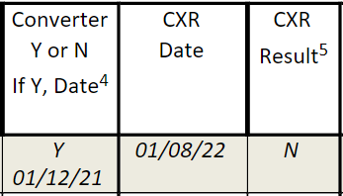
Report of TB Conditions (Form 12-11461)
Indicate if the inmate is a converter or not. (Format: Y for yes, N for no). If yes, please provide the date their last negative TST was placed or IGRA was drawn. (Format: MM/DD/YY)
Provide the recorded interpretation of the chest radiograph.
(Format: Abnormal (A), Normal (N) )
Provide the date when the CXR was done for inmates, employees, and volunteers.
(Format: MM/DD/YY).
NOTE: This section only applies to CXRs for individuals identified as TB infections, suspected disease, or active disease. Do not include CXRs that were performed in lieu of a TST or IGRA (ex: testing refusals). However, all CXRs performed in the reporting month should be included on the 12-11462 (Monthly Correctional TB Report).
Notes:
Converter Y or N; If Y, Date: Indicate if the inmate is a converter or not. (Format: Y for yes, N for no). If yes, please provide the date their last negative TST was placed or IGRA was drawn.
Converter: a change from a documented negative TST or IGRA to a positive TST or IGRA during the time of residence in the facility.
Chest X-Ray (CXR) Date: Provide the date when the CXR was done for inmates, employees, and volunteers. (Format: MM/DD/YY) NOTE: This section only applies to CXRs for individuals identified as TB infections, suspected disease, or active disease. Do not include CXRs that were performed in lieu of a TST or IGRA (ex: testing refusals). However, all CXRs performed in the reporting month should be included on the 12-11462 (Monthly Correctional TB Report).
CXR Result: Provide the recorded interpretation of the chest radiograph. (Format: Abnormal (A), Normal (N)

Slide 27
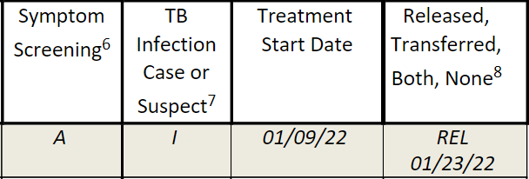
Report of TB Conditions (Form 12-11461)
Provide whether the individual is a case (C), a suspect (S), or TB infection (I). NOTE: If the individual meets the case definition and has physician diagnosis, report this as TB infection.
Provide whether the individual was symptomatic (S) or asymptomatic (A). If symptom screening was not performed, they should be marked Not Completed (NC).
Indicate if the individual was released to the
community, transferred into the facility, if they were transferred out to another facility or both (Inmate was transferred in and released). Please also include the date they were released or transferred. (Format: MM/DD/YY) (Format: TI-Transferred In; TO-Transferred Out; REL-Released; B-Both (released and transferred in); N-None)
Include the date when the individual was given their first dose of treatment for TB infection or active/suspected TB disease while at the facility during the reporting month. Please do not include transfers who have already started treatment. (Format: MM/DD/YY)
Notes:
Symptom Screening: Provide whether the individual was symptomatic (S) or asymptomatic (A). If symptom screening was not performed, they should be marked Not Completed (NC).
TB Infection, Case, or Suspect: Provide whether the individual is a case (C), a suspect (S), or TB infection (I). NOTE: If the individual meets the case definition for TB infection and has physician diagnosis, report this as TB infection.
Treatment Start Date: Include the date when the individual was given their first dose of treatment for TB infection or active/suspected TB disease while at the facility during the reporting month. Please do not include transfers who have already started treatment. (Format: MM/DD/YY)
Released, Transferred, Both, None: Indicate if the individual was released to the community, transferred into the facility, if they were transferred out to another facility or both (Inmate was transferred in and released). Please also include the date they were released or transferred. (Format: MM/DD/YY) (Format: TI-Transferred In; TO-Transferred Out; REL-Released; B-Both (released and transferred in); N-None)

Slide 28
Resources
Notes:
We will now review the revised monthly correctional TB report and the instructions

Slide 29
Resources
Epi Case Criteria for TB (texas.gov)
TB Forms
Fact Sheets (PDF)
Correctional TB Reporting FAQ (PDF)
Algorithms for Incarcerated Individuals and Employees/Volunteers
Monthly Correctional TB Form (PDF) and Instructions (PDF)
Report of TB Conditions Form (PDF and Excel) and Instructions
Notes:
Here are the useful resources to use when filling out the monthly correctional TB reports. There is a link to the Epi case criteria for TB with useful definitions. As well, linked is where you can find the following TB forms:

Slide 30
High Level Summary
TB infection and TB disease (known/suspected) are notifiable conditions and are required to be reported in a timely manner.
The monthly correctional TB report and the Report of TB Conditions form must be submitted to the local or regional health department by the 5th day of the month.
Screening should be a holistic process.
Reports should be accurate and complete.
Reach out to your correctional liaison for questions regarding reporting and completion.
Your correctional liaison may reach out for clarification and/or revisions prior to submission to the TB Unit for review.
Notes:
TB infection and TB disease (known/suspected) are notifiable conditions and are required to be reported in a timely manner.
The monthly correctional TB report and the Report of TB Conditions form must be submitted to the local or regional health department by the 5th day of the month.
Screening should be a holistic process.
Reports should be accurate and complete.
Reach out to your correctional liaison for questions regarding reporting and completion.
Your correctional liaison may reach out for clarification and/or revisions prior to submission to the TB Unit for review.

