Slide 1
Session 3: Infection Prevention and Control
Notes:
Welcome to Session 3 of today’s conference, in which we will cover a significant number of topics under Infection Prevention and Control, and Outbreaks

Slide 2
This session has three sections
Prevention, including Clinical Bundles and Checklists
Control, including precautions, environmental cleaning and disinfection
Dealing with an Outbreak, in Acute and Long Term Care Settings
Notes:
Prevention, Control, and Outbreaks are all part of the same discussion, but we are first going to discuss preventing incidence of cases, then we are going to talk about transmission and how information might be used for controlling infection (minimizing cases), and finally, literature about outbreaks in acute care and long term care settings

Slide 3
The primary objectives of Session 3 are as follows:
Describe the Campaign to Reduce Antimicrobial Resistance In Healthcare Settings
Understand the literature on transmission control
Describe isolation and other transmission precautions
Describe cleaning and disinfection procedures and policies
Notes:
The primary objectives of this session:

Slide 4



Section A: C. difficile and MDROs: Prevention
In this section, we are going to discuss
Surveillance and prevention strategies
Bundles and checklists
4

Slide 5
Surveillance and Risk Assessment
Surveillance is a keystone of Infection Prevention
  You don’t know what your problems are if you aren’t looking for them
Once you know what you have, you can define your risk and plan your actions accordingly
From CDC’s 2012 CRE Toolkit:
  “Inpatient facilities should have an awareness of whether or not Carbapenem-resistant Enterobacteriaceae (CRE -- at least E. coli and Klebsiella spp.) have ever been cultured from patients admitted to their facility and, if so, whether these positive cultures were collected within 48 hours of admission.”
    CDC: 2012 CRE Toolkit - Guidance for Control of Carbapenem-resistant Enterobacteriaceae (CRE)

Slide 6
Surveillance
If CRE have been present, determine
  Is there evidence of intra-facility transmission?
  Which wards/units are most affected?
If facilities don’t have this information
  Consider evaluation to quantify incidence
    Review archived lab results to determine number and/or proportion of Enterobacteriaceae that are CRE over a specified time period
    Collect patient level information to help with epidemiology of disease

Slide 7
Prevention Strategies
Preventing infections reduces the burden of MDROs/C. diff
Prevention of antimicrobial resistance depends on appropriate clinical practices in ALL routine patient care
  Management of vascular and urinary catheters
  Prevention of lower respiratory tract infections in ventilated patients
  Accurate infectious etiology diagnosis
  Judicious antimicrobial selection and utilization
Siegel JD, Rhinehart E, Jackson M, Chiarello L. Management of Multidrug-Resistant Organisms In Healthcare Settings. The Healthcare Infection Control Practices Advisory Committee. http://www.cdc.gov/hicpac/pdf/MDRO/MDROGuideline 2006.pdf. Accessed June 20, 2014
7
Notes:
Prevention has many components, most of which we should be familiar with

Slide 8
Prevention Strategies – CDC efforts
The Campaign to Reduce Antimicrobial Resistance in Healthcare Settings is a multifaceted, evidence-based approach with four parallel strategies
  Infection Prevention
  Accurate and prompt diagnosis and treatment
  Prudent use of antimicrobials
  Prevention of transmission
Campaign materials are available for acute care hospital, surgical settings, dialysis units, LTCFs, and pediatric care units
www.cdc.gov/drugresistance/healthcare/default.htm
8
Notes:
The CDC started the Campaign to Reduce Antimicrobial Resistance in Healthcare Settings Program, which has four parallel strategies (read each). Materials and tools can be found on the CDC web page.

Slide 9
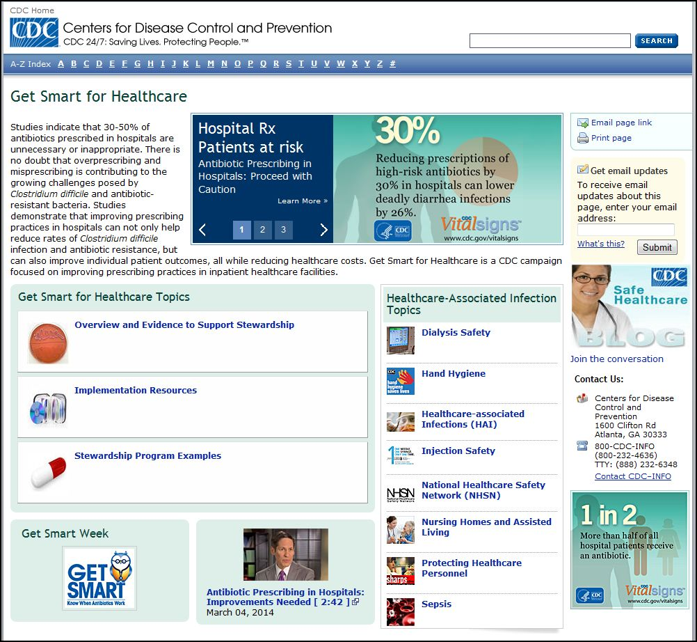
Prevention Strategies – CDC efforts
A good deal of information on antimicrobial stewardship and implementation resources can be found on the website.
9
Notes:
A good deal of information on antimicrobial stewardship and Implementation resources can be found on the website. We’ll talk more about antimicrobial stewardship later today.

Slide 10

Hand Hygiene
Without hand hygiene, most other measures to reduce the transmission of bacteria and viruses are likely to fail
Very difficult to guarantee
Compliance still not close to 100%
Is a common theme in all bundles and tool-kits related to prevention of infections
Many strategies for increasing hand hygiene compliance exist and all facilities should persist in working to increase compliance
10
Notes:
With all the focus on specific organisms or infections, the simple act of good hand hygiene is still a difficult thing to achieve with 100% certainty every time it is required. We could spend the day on just strategies to increase compliance with hand hygiene, but we will have to leave that to you to pursue.

Slide 11
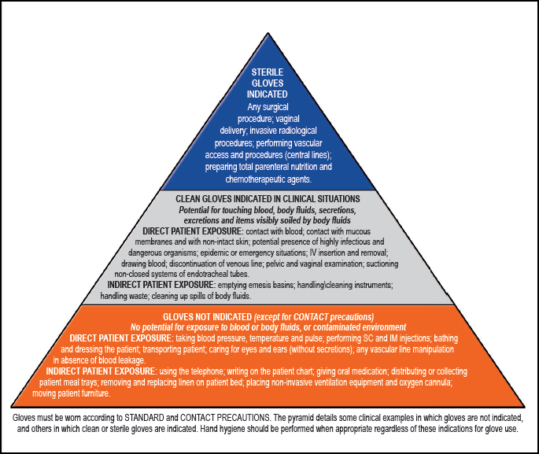
World Health Organization’s Glove Use Pyramid
The WHO provides good criteria for glove use. We’ll take a closer look at when gloves are not indicated.
http://www.who.int/gpsc/tools/Infsheet6.pdf?ua=1
Notes:
Observation has shown that over-use of gloves can add to transmission. Just think about how many times you have seen someone wearing gloves touching all kinds of things before moving to the patient or the patient’s environment. We must discourage the unnecessary use of gloves as much as encouraging the necessary use. [Review bottom of pyramid and discuss]

Slide 12

Gloves NOT Indicated
The over-use of gloves can add to transmission. Just think about how many times you have seen someone wearing gloves touching all kinds of things before moving to the patient or the patient’s environment.
We must discourage the unnecessary use of gloves as much as encouraging the necessary use.
Siegel JD, Rhinehart E, Jackson M, Chiarello L. Management of Multidrug-Resistant Organisms In Healthcare Settings. The Healthcare Infection Control Practices Advisory Committee. http://www.cdc.gov/hicpac/pdf/MDRO/MDROGuideline 2006.pdf. Accessed June 20, 2014
12

Slide 13
Gloves NOT Indicated – WHO Guidelines
Gloves Not Indicated (except for contact precautions)
No exposure to blood or body fluids, or contaminated environment
DIRECT PATIENT EXPOSURE: blood pressure, temperature and pulse, IM or SC injections, bathing, dressing, transporting, caring for eyes and ears (without secretions), vascular line manipulation (without the presence of blood)
INDIRECT PATIENT EXPOSURE: using telephone, writing on patient chart, giving oral medication, delivering or collecting meal trays, changing patient bed, moving furniture, placing non-invasive ventilation equipment and oxygen cannula
Siegel JD, Rhinehart E, Jackson M, Chiarello L. Management of Multidrug-Resistant Organisms In Healthcare Settings. The Healthcare Infection Control Practices Advisory Committee. http://www.cdc.gov/hicpac/pdf/MDRO/MDROGuideline 2006.pdf. Accessed June 20, 2014
13

Slide 14
Bundles and Checklists
To reduce rates of device-associated healthcare infections, a number of bundled evidence-based clinical practices have been identified
  No studies have specifically demonstrated a subsequent reduction in MDRO infection and colonization rates, but there is an assumption that decreasing device-associated infections will in turn decrease antibiotic use and decrease opportunities for emergence and transmission of resistant organisms
Siegel JD, Rhinehart E, Jackson M, Chiarello L. Management of Multidrug-Resistant Organisms In Healthcare Settings. The Healthcare Infection Control Practices Advisory Committee. http://www.cdc.gov/hicpac/pdf/MDRO/MDROGuideline 2006.pdf. Accessed June 20, 2014
14
Notes:
MDROs and C. difficile are bacteria, just like Staph aureus, Pseudomonas, etc. Utilizing bundles and checklists is an example of horizontal infection prevention. Best practice when it comes to invasive devices and procedures in the healthcare setting has the effect of preventing infections with whatever pathogens might be in the area – including CRE, and C. difficile. [Speaker, highlight content of slide]

Slide 15

Bundles and Checklists
Clinical care bundles and checklists to prevent HAIs have existed for many years
These include, but are not limited to, bundles for prevention of
  CAUTI
  CLABSI
  SSI
  VAP/VAE
We will focus mainly on CAUTI and CLABSI in today’s presentation
15
Notes:
[Speaker, highlight content of slide]
CAUTI: Catheter-Associated Urinary Tract Infection
CLABSI: Central Line-Associated Bloodstream Infection
SSI: Surgical Site Infections
VAP/VAE: Ventilator-Associated Pneumonia / Ventilator-Associated Event

Slide 16
Catheter Associated Urinary Tract Infection (CAUTI)
CAUTI is a common type of healthcare-associated infection
  It represents > 15% of HAIs reported to CDC’s National Healthcare Safety Network
  There are an estimated > 560,000 nosocomial UTIs annually
Increased morbidity & mortality
  There are an estimated 13,000 attributable deaths annually
  CAUTI is the leading cause of secondary blood stream infection with ~10% mortality
CAUTI is associated with
  Excess length of stay – 2 to 4 days
  Increased cost -- $0.4 to 0.5 billion per year nationally
  Unnecessary antimicrobial use
16
Notes:
Let’s talk about CAUTI first. CAUTIs are quite common in healthcare settings, both in acute and long term care. [Read statistics]

Slide 17
CAUTI
Unfortunately, we do not monitor indwelling catheters as well as we should.
Catheters are
  Often placed for inappropriate indications
  Physicians are frequently unaware that catheter is still in place and should be discontinued
In a recent survey of U.S. hospitals:
  > 50% did not monitor which patients were catheterized
  75% did not monitor duration and/or discontinuation
17
Notes:
Unfortunately, we do not monitor indwelling catheters as well as we should – catheters ought to be discontinued as soon as clinically appropriate, but resistance from nursing staff, patients, and family members, and lack of prioritization among physicians still exists.

Slide 18
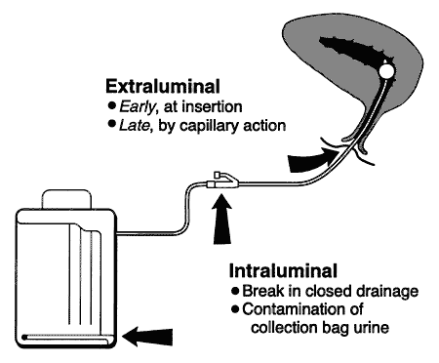
CAUTI
Source of microorganisms may be endogenous (meatal, rectal, or vaginal colonization) or exogenous, usually via contaminated hands of healthcare personnel during catheter insertion or manipulation of the collecting system
Figure from: Maki DG, Tambyah PA. Emerge Infect Dis 2001;7:1-6
18
Notes:
Sources of infection can be meatal, rectal, or vaginal and endogenous in nature, or they can be from contaminated hands and, thus, exogenous

Slide 19
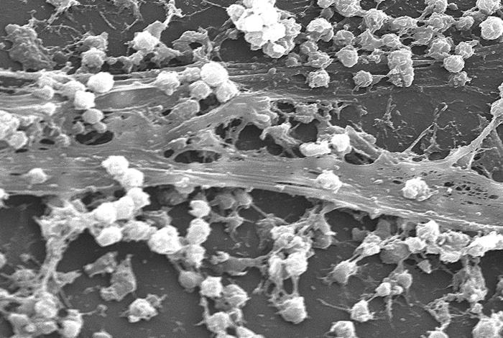
CAUTI
Bacteria within biofilms can be resistant to antimicrobials and host defenses
Some novel strategies in CAUTI prevention have targeted biofilms
Scanning electron micrograph of S. aureus bacteria on the luminal surface of an indwelling catheter with an interwoven complex matrix of extracellular polymeric substances known as a biofilm
19
Notes:
This figure shows a scanning electron micrograph of S aureus on the luminal surface of an indwelling catheter with biofilm. Bacteria within biofilms can be resistant to antimicrobials and host defenses and have, thus, become targets for prevention strategies.

Slide 20
Core Prevention Strategies for CAUTI
Insert catheters only for appropriate indications
Leave catheters in place only as long as needed
Ensure that only properly trained persons insert and maintain catheters
Insert catheters using aseptic technique and sterile equipment (acute care setting)
Following aseptic insertion, maintain a closed drainage system
Maintain unobstructed urine flow
Hand hygiene and Standard (or appropriate isolation) Precautions
Source: http://www.cdc.gov/hicpac/cauti/001_cauti.html
20
Notes:
Standard prevention strategies in CAUTI include [Speaker, highlight content of slide]

Slide 21
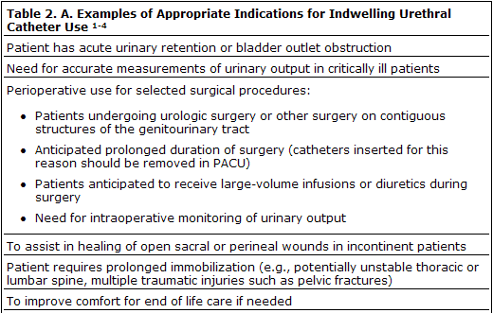
Core Prevention Strategies for CAUTI
Insert catheters only for appropriate indications (HICPAC guidelines)
Source: http://www.cdc.gov/hicpac/cauti/001_cauti.html
21
Notes:
This table shows the HICPAC guideline’s appropriate indications for continuing catheter use. [speaker, highlight content of slide]

Slide 22
Central Line Associated Blood Stream Infections (CLABSI)
It is estimated that 41,000 CLABSIs occur in U.S. hospitalized patients each year
Most bloodstream infections are associated with the presence of a central line or umbilical catheter (in neonates) at the time of or before the onset of the infection
Common devices associated with blood stream infections (not all are central lines):
  Central venous catheters (CVCs)
  Arterial catheters
  Peripherally inserted central catheters (PICCs)
  Dialysis catheters and ports
  Peritoneal dialysis catheters
  Epidural catheters
  External fixator pins
Richards M, Edwards J, Culver D, Gaynes R. Nosocomial infections in medical intensive care units in the United States. National Nosocomial Infections Surveillance System. Critical Care Medicine. 1999;27:853-854
22
Notes:
Now let’s talk a bit about CLABSIs. Central Line Associated Blood Stream Infections occur in at least 40,000 patients every year in the United States. Most bloodstream infections are associated with common devices such as [read list]

Slide 23
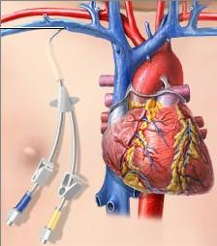
CLABSI
A central line is
  An intravascular catheter that terminates at or close to the heart or in one of the great vessels which is used for infusion, withdrawal of blood, or hemodynamic monitoring
Examples of Great Vessels include:
  Aorta
  Pulmonary artery
  Superior vena cava
  Inferior vena cava
  Brachiocephalic veins
  Internal jugular veins
  Subclavian veins
  External iliac veins
  Common iliac veins
  Femoral veins
  In neonates, the umbilical artery/vein
23
Notes:
[Speaker, highlight content of slide]

Slide 24
CLABSI – NHSN Definition
A central line-associated bloodstream infection (CLABSI) is a laboratory-confirmed primary bloodstream infection (LCBI) where:
Central line (CL) or umbilical catheter (UC) was in place for >2 calendar days when all elements of the LCBI criterion were first present together, with day of device placement being Day 1
AND
A CL or UC was in place on the date of event or the day before
If a CL or UC was in place for >2 calendar days and then removed, the LCBI criteria must be fully met on the day of device discontinuation or the next day. If the patient is admitted or transferred into a facility with a central line in place (e.g., tunneled or implanted central line), day of first access is considered Day 1.
24
Notes:
CLABSIs are identified when [speaker, highlight content of slide]
LCBI – laboratory-confirmed primary bloodstream infection
CL – central line
UC – umbilical catheter

Slide 25
Central Venous Line Insertion Bundle
It is important to follow proper insertion practices
  Perform hand hygiene before insertion
  Adhere to aseptic technique
  Use maximal sterile barrier precautions (i.e., mask, cap, gown, sterile gloves, and sterile full­body drape)
  Perform skin antisepsis with >0.5% chlorhexidine with alcohol
  Choose the best site to minimize infections and mechanical complications
    Avoid femoral site in adult patients
  Cover the site with sterile gauze or sterile, transparent, semipermeable dressings
Based on 2011 CDC guideline for prevention of intravascular catheter-associated bloodstream infections:
http://www.cdc.gov/hicpac/pdf/guidelines/bsi-guidelines-2011.pdf
25

Slide 26
Prevention of CLABSI
What we can do to prevent CLABSIs?
Site checks every shift
  Visual inspection of the CVC insertion site, CVC dressing, and the CVC itself at the start of each shift can help prevent future complications
What to look for:
Is the dressing clean, dry, intact, & dated?
Is the dressing due to be changed?
How does the skin integrity under & around the dressing look?
Is the catheter in the same position as documented at time of insertion?
Are all ports of the CVC in working order? Do they flush easily and draw briskly?
26
Notes:
Many initiatives have sought to reduce incidence of CLABSIs over the last several years. Clinical approaches to prevention include: [Speaker, highlight content of slide]

Slide 27

Prevention of CLABSI
What can we do to prevent CLABSIs?
Good shift-to-shift communication is important
  Your site check observations
  Dressing, tubing, or cap changes you may have performed
  Any patient complaints, questions, or concerns
  Any tests or procedures
  Any interventions you may have performed, such as a line de-clot
27
Notes:
Shift to shift communication may also contribute to a reduction in CLABSIs. Some examples of points of discussion during shift change include: [read list]

Slide 28
CLABSI is not the only bloodstream infection
CLABSI prevention checklist based on CDC guidelines
  Following recommended practices for all vascular access devices
  Comply with hand hygiene requirements
  Scrub the access port or hub immediately prior to each use with an appropriate antiseptic (e.g., chlorhexidine, povidone iodine, an iodophor, or 70% alcohol)
  Access catheters only with sterile devices
  Replace dressings that are wet, soiled, or dislodged
There doesn’t have to be a central line, however, to require this type of care. Peripheral lines are even more pervasive invasive devices!
28
Notes:
These recommendations are from the CLABSI prevention checklist based on CDC guidelines, but it doesn’t have to be a central line to require this kind of care!!!

Slide 29
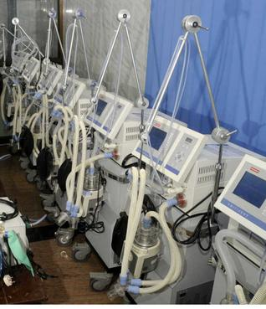
Ventilator Bundle
Pneumonia is a serious complication in the ICU, and MDROs may be the pathogens.
Ventilator bundle
  Elevation of the head of the bed
  Daily “sedation vacations" and assessment of readiness to extubate
  Peptic ulcer disease prophylaxis
  Deep venous thrombosis prophylaxis
  Daily oral care with chlorhexidine
Notes:
Since pneumonia is a serious complication in the ICU, and MDROs may be the pathogen, we would be remiss not to mention the ventilator bundle. However, per the CDC Epicenter project “Wake up and Breathe”, Spontaneous Awakening Trial (SAT) with Spontaneous Breathing Trial (SBT) are the only measures that significantly improve ICU morbidity and mortality. Girard, Lancet 2008;371:126

Slide 30
Section B: Controlling MDROs
In this section, we are going to discuss
Literature on transmission control
Isolation precautions
Cleaning and disinfection
  Environmental cleaning
    EPA approved disinfectants
    Advances in environmental cleaning
    Assessing cleaning & disinfectant quality
Case studies and examples
Notes:
Now let’s discuss Controlling the Spread of MDROs. We are going to present information on the following topics in this section [read slide]

Slide 31

Controlling MDROs
Movie Quiz:
31
Notes:
But first, time for a quiz: What movie is this scene from? [Answer: Caddyshack!]

Slide 32
Controlling MDROs
Researchers reviewed the literature and published several papers from 2006 to 2007, including guidelines for prevention and control of MDROs.
  Nearly all studies that have reported successful MDRO control employed a median of 7 to 8 different interventions concurrently or sequentially
  The variations in definitions, outcomes measured, study design, and periods of follow up make it difficult for us to clearly understand the best comprehensive approach for controlling MDROs
Siegel JD, Rhinehart E, Jackson M, Chiarello L. Management of Multidrug-Resistant Organisms In Healthcare Settings. The Healthcare Infection Control Practices Advisory Committee. http://www.cdc.gov/hicpac/pdf/MDRO/MDROGuideline 2006.pdf. Accessed June 20, 2014
32
Notes:
[Speaker, highlight content of slide] Siegel et al. reviewed the literature and published several papers from 2006 to 2007, including guidelines for prevention and control of MDROs. They noted that nearly all studies have employed roughly 7 to 8 different interventions either concurrently or sequentially in order to achieve success. This means that there is no one ‘magic bullet’ for control. It is difficult for us to standardize approaches as studies differ greatly in the way they define and measure outcomes.

Slide 33
Intervention to Reduce Transmission of Resistant Bacteria in Intensive Care (Huskins et al., 2011)
Huskins sought to evaluate the effects of surveillance for MRSA and VRE colonization and of expanded use of barrier precautions in the ICU
The group of patients receiving the intervention underwent the following:
  Swabs for MRSA and VRE surveillance cultures
  Contact precautions were assigned and maintained throughout the stay if patients had been infected or colonized with MRSA or VRE during the previous year or swab results were positive
  All other patients received universal gloving from the time of admission until discharge, or until results returned negative
  When swab results were negative, these patients received standard precautions
Patients in the control group continued on with current policies that were considered “usual care”
Huskins et al. NEJM 2011;364:1407-1418
33
Notes:
Study details will be provided in speaker notes throughout presentation in order for speakers to become familiar with studies and more thoroughly prepare for the presentation.
Huskins et al. developed an intervention whereby they sought to evaluate the effects of surveillance for MRSA and VRE colonization and of expanded use of barrier precautions in the ICU.
Intervention Group:
-Within 2 days of ICU admission, weekly thereafter, & within 2 days before or after ICU discharge, the following were obtained:
Nasal swabs for MRSA surveillance cultures
Stool or perianal swabs for VRE surveillance cultures
-Assignment of patients to contact precautions were made at the time of admission if a patient was infected or colonized with MRSA or VRE during the previous year and at any time during ICU stay if clinical or surveillance cultures positive for MRSA or VRE
-Contact precautions, once initiated, were maintained throughout ICU stay
-All other patients received universal gloving from the time of admission until discharge, or until results returned negative. When results were negative, these patients received standard precautions
The control group basically continued on with the policies they had in place and were considered “usual care.”

Slide 34
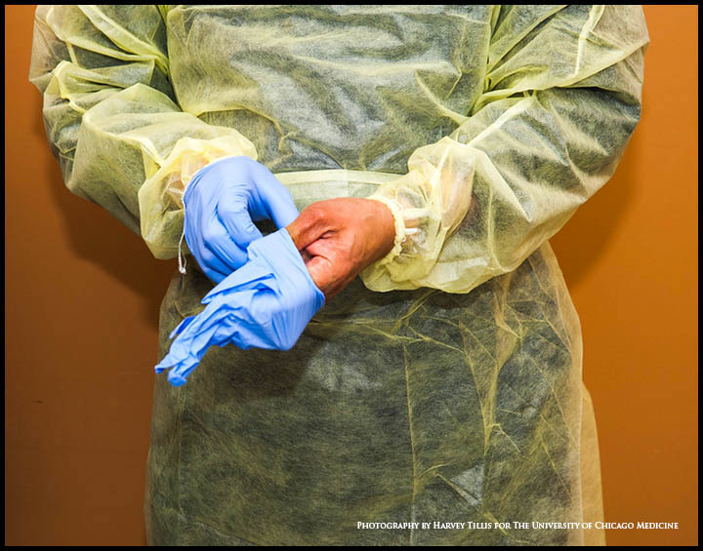
Intervention to Reduce Transmission of Resistant Bacteria in Intensive Care (Huskins et al., 2011)
Let’s review the levels of precautions in this study
Contact Precautions
  Hand hygiene, gloves, and gowns for all contacts
Universal Gloving
  Hand hygiene and gloves for all contacts
  Gown only for sterile contacts
Standard Precautions
  Hand hygiene for all contacts
  Gloves for sterile, contaminated, or blood/body fluid contacts
  Gown only for sterile contacts
34
Huskins et al. NEJM 2011;364:1407-1418
Notes:
Patients are assigned to three groups: contact precautions, universal gloving, and standard precautions
With contact precautions, hand hygiene, gloves, and gowns are required with all contacts.
Sterile contacts involved performing a sterile procedure
Contaminated contacts involved potential contact with secretions, excretions, mucous membranes, non-intact skin, or items or surfaces that are likely to be contaminated with body secretions or excretions
Blood or body-fluid contacts involved potential contact with blood or body fluids capable of transmitting bloodborne viruses
Invasive-device contacts involved opening or accessing an invasive device that entered a sterile body site directly
Other patient contact involved contacts not included in the previously described categories
Environment-only contacts involved touching items or surfaces in the patient’s immediate environment only

Slide 35
Intervention to Reduce Transmission of Resistant Bacteria in Intensive Care (Huskins et al.)
Results
Colonized/infected patients were assigned to precautions more often in intervention ICUs
Intervention ICU providers used clean gloves, gowns, and hand hygiene less frequently than required, but more frequently than providers in control ICUs
  Gloves: 82% (intervention) vs. 72% (control)
  Gowns: 77% vs. 59%
  Hand hygiene: 69% vs. 59%
There was no significant difference between intervention and control groups in MRSA/VRE infection or colonization
Huskins et al. NEJM 2011;364:1407-1418
35
Notes:
There were some interesting results from this study. Not surprisingly, more patients were assigned to barrier precautions in the intervention group than in the control group.
However, for contacts with patients assigned to contact precautions, providers in intervention ICUs used clean gloves and a gown and performed hand hygiene after contact less frequently than required,
but more frequently than did providers in control ICUs. Clean gloves were used for a median of 82% of contacts in intervention ICUs, as compared with 72% in control ICUs.
Gowns, for 77% of contacts in intervention ICUs vs. 59% in control ICUs.
Hand hygiene after contact, for 69% of contacts in intervention ICUs, as compared with 59% in control ICUs.
For contacts with patients assigned to universal gloving in intervention ICUs, providers used clean gloves and performed hand hygiene after contact less frequently than required and less frequently than for contacts with patients assigned to contact precautions. Clean gloves were used for a median of 72% of contacts and hygiene after contact for 62% of contacts.
The mean ICU-level incidence of events of colonization or infection with MRSA or VRE per 1000 patient-days at risk did not differ significantly between the intervention and control ICUs.

Slide 36
Intervention to Reduce Transmission of Resistant Bacteria in Intensive Care (Huskins et al.)
The authors concluded:
  More must be done to improve compliance.
“The results of this trial indicate that merely improving the identification of colonized patients and expanding the use of barrier precautions, at least as achieved during this trial, are measures that are not likely to be broadly effective.”
Huskins et al. NEJM 2011;364:1407-1418
36
Notes:
[speaker, highlight content of slide] – The bottom line: just putting out a sign on the door does not guarantee compliance. We will talk later about an outbreak at the NIH hospital where they actually put “guards” or compliance monitors outside the doors of the rooms to ensure compliance.

Slide 37
Controlling MDROs
There is no standard list of control measures for MDRO transmission
A combination of interventions may be necessary
  Hand hygiene
  Use of Contact Precautions until patients are culture-negative for a target MDRO
  Active surveillance cultures (ASC)
  Education
  Enhanced environmental cleaning
  Improvement in communication about patients with MDROs within and between healthcare facilities
Siegel JD, Rhinehart E, Jackson M, Chiarello L. Management of Multidrug-Resistant Organisms In Healthcare Settings. The Healthcare Infection Control Practices Advisory Committee. http://www.cdc.gov/hicpac/pdf/MDRO/MDROGuideline 2006.pdf. Accessed June 20, 2014
37
Notes:
As mentioned previously, there is no standard list of control measures for all MDRO transmission. Depending on the organism and the environment, a combination of any of the following may be needed. In all cases, improvement in communication between and within healthcare facilities is greatly needed in most communities. We’ll talk more about this last item later today.

Slide 38
Contamination in Acute Care

Slide 39
C. difficile Contamination
C. Diff contamination is an issue in both acute and long-term care. Important facts include:
Widespread environmental contamination is difficult to eradicate using conventional methods
One study showed that 29% of hospital rooms housing asymptomatic patients have contamination ¹
As many as 60% of CDI patients with resolution of diarrhea still have skin contamination ²
Almost 40% of CDI patients with resolution may continue to shed spores in their stool ²
1 McFarland LV et al. N Engl J Med 1989; 320:204-210
2 Sethi A et al. Infect Control Hosp Epidemiol 2010; 31:21-27
39
Notes:
Now let’s move on to C. difficile. Contamination is an issue in acute care as well as long term care. Here are some important facts about contamination [speaker, highlight content of slide]

Slide 40
Contamination in Long Term Care
Let’s review studies looking at bacterial contamination in long term care settings

Slide 41
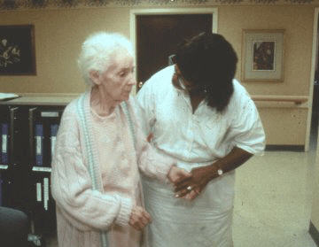
Anatomic sites of patient colonization and environmental contamination with Klebsiella pneumoniae carbapenemase-producing Enterobacteriaceae at long-term acute care hospitals (Thurlow et al., 2013)
6 long-term acute care hospitals in Chicago were involved in this study
The researchers found that:
  Environmental contamination was rare
41
Thurlow CJ et al. ICHE 2013;34(1):56-61
Notes:
A study by Thurlow et al. looked at KPC-producing Enterobacteriaceae at long-term acute care hospitals. The researchers conducted a cross-sectional microbiologic and medical
record survey at 6 LTACHs in metropolitan Chicago over a 4-month period in 2011. Each LTACH was visited only once. Swab samples of anatomic sites and inanimate surfaces in patient rooms and common areas were cultured.
24 patients had at least 1 anatomic site that grew a KPC-positive isolate, and 23 (96%) patients had more than 1 positive anatomic site. The single most sensitive anatomic site was rectal Colonization of intact skin by KPC-producing Enterobacteriaceae was common. Of the 24 patients who were colonized at any anatomic site, 23 patients (96%) had KPC-producing Enterobacteriaceae detected at 1 or more skin sites.
A total of 371 environmental sites were cultured. Of these, 2 sites (bed rails and call button) were positive for KPC-producing Enterobacteriaceae.

Slide 42
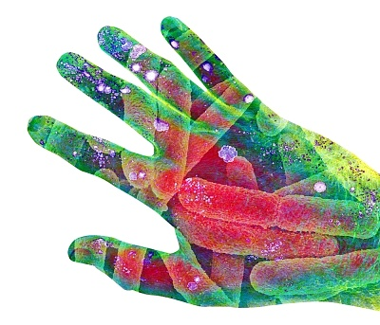
Asymptomatic Carriers are a Potential Source for Transmission of Epidemic and Nonepidemic Clostridium difficile Strains among Long-Term Care Facility Residents (Riggs et al., 2007)
Background
The authors of this study wanted to assess the impact of asymptomatic fecal carriage of C. diff on transmission
They evaluated the frequency of skin and environmental contamination
Riggs MM et al. Clinical Infectious Diseases 2007;45:992-998
42
Notes:
Asymptomatic fecal carriage of Clostridium difficile is common in patients staying in health care facilities, but the importance of asymptomatic carriers with regard to disease transmission is unclear.
The authors of this study prospectively examined the prevalence of asymptomatic carriage of epidemic North American pulsed-field gel electrophoresis type 1 and nonepidemic toxigenic C. difficile strains among long-term care patients in the context of an outbreak of C. difficile-associated disease and evaluated the frequency of skin and environmental contamination.

Slide 43
Asymptomatic Carriers are a Potential Source for Transmission of Epidemic and Nonepidemic Clostridium difficile Strains among Long-Term Care Facility Residents (Riggs et al., 2007)
Results
51% of asymptomatic patients were carriers of toxigenic C. difficile, and 37% of these carried epidemic strains
Compared to non-carriers, asymptomatic carriers had
  Significantly more skin contamination (19% vs. 61%)
  Significantly more environmental contamination (24% vs 59%)
Previous C. diff-associated disease and previous antibiotic use were significantly associated with asymptomatic carriage
Riggs MM et al. Clinical Infectious Diseases 2007;45:992-998
43
Notes:
51% (35/68) of asymptomatic patients were carriers of toxigenic C. difficile, and 37% (n=13) of these patients carried epidemic strains.
Compared with noncarriers, asymptomatic carriers had significantly higher percentages of skin (asymptomatic carrier – 61% vs. non-carrier 19%)
87% of isolates found in skin samples were identical to concurrent isolates found in stool samples.
Spores on the skin of asymptomatic patients were easily transferred to investigators' hands.
Compared with noncarriers, asymptomatic carriers had significantly more environmental contamination (asymptomatic carrier – 59% vs. non-carrier 24%)
58% of isolates found in environmental samples were identical to concurrent isolates found in stool samples.
Previous C. difficile-associated disease and previous antibiotic use were significantly associated with asymptomatic carriage, and the combination of these 2 variables was predictive of asymptomatic carriage.

Slide 44

Asymptomatic Carriers are a Potential Source for Transmission of Epidemic and Nonepidemic Clostridium difficile Strains among Long-Term Care Facility Residents (Riggs et al., 2007)
Researchers concluded that asymptomatic carriers of epidemic and non epidemic C. diff strains may contribute significantly to transmission in long term care facilities
Riggs MM et al. Clinical Infectious Diseases 2007;45:992-998
44

Slide 45
Effectiveness of Routine Daily Chlorhexidine Gluconate Bathing in Reducing Klebsiella pneumoniae Carbapenemase-Producing Enterobacteriaceae Skin Burden among Long-Term Acute Care Hospital Patients (Lin et al., 2014)
This study evaluated patients before and after their daily CHG baths to determine rates of skin colonization with KPC
Tested skin sites included
  Inguinal
  Upper back
  Antecubital
  Axilla
  Neck
Lin MY et al. ICHE 2014;35(4):440-442
45
Notes:
This study evaluated the effectiveness of daily chlorhexidine gluconate (CHG) bathing (as a component of a KPC control bundle) in decreasing skin carriage of Klebsiella pneumoniae carbapenemase–producing Enterobacteriaceae (KPC) among long-term acute care hospital patients. Patients were evaluated before and after their daily CHG bath to determine rates of skin colonization with KPC.
Swab samples from 5 intact skin sites at risk for KPC colonization were obtained. There were: inguinal, upper back, antecubital, axilla, and neck. Specimens for CHG concentration determination were tested using a semiquantitative colorimetric assay, and culture specimens were obtained from adjacent skin.
62 patients participated in this study; 43% were male. The median length of stay was 29 days, with a range of 5 to 589 days. The median age was 63 years. The majority of patients had a tracheostomy (73%) and gastrostomy (90%); 43% had diarrhea.
Although all study patients received routine CHG bathing before study enrollment, skin contamination with KPC was common. 56% (n=35) of patients had at least 1 skin site positive for KPC immediately before bathing, versus 32% (n=20) of patients after bathing (P = .01).

Slide 46
Effectiveness of Routine Daily Chlorhexidine Gluconate Bathing in Reducing Klebsiella pneumoniae Carbapenemase-Producing Enterobacteriaceae Skin Burden among Long-Term Acute Care Hospital Patients (Lin et al., 2014)
Results
56% of patients had at least one skin site positive for KPC immediately before bathing
32% of patients had at least one skin site positive for KPC after bathing
Session 3
46
Lin MY et al. ICHE 2014;35(4):440-442
Notes:
This study evaluated the effectiveness of daily chlorhexidine gluconate (CHG) bathing (as a component of a KPC control bundle) in decreasing skin carriage of Klebsiella pneumoniae carbapenemase–producing Enterobacteriaceae (KPC) among long-term acute care hospital patients. Patients were evaluated before and after their daily CHG bath to determine rates of skin colonization with KPC.
Swab samples from 5 intact skin sites at risk for KPC colonization were obtained. There were: inguinal, upper back, antecubital, axilla, and neck. Specimens for CHG concentration determination were tested using a semiquantitative colorimetric assay, and culture specimens were obtained from adjacent skin.
62 patients participated in this study; 43% were male. The median length of stay was 29 days, with a range of 5 to 589 days. The median age was 63 years. The majority of patients had a tracheostomy (73%) and gastrostomy (90%); 43% had diarrhea.
Although all study patients received routine CHG bathing before study enrollment, skin contamination with KPC was common. 56% (n=35) of patients had at least 1 skin site positive for KPC immediately before bathing, versus 32% (n=20) of patients after bathing (P = .01).
46

Slide 47
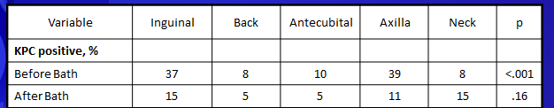
Effectiveness of Routine Daily Chlorhexidine Gluconate Bathing in Reducing Klebsiella pneumoniae Carbapenemase-Producing Enterobacteriaceae Skin Burden among Long-Term Acute Care Hospital Patients (Lin et al., 2014)
Results
Notable colonization rates occurred at axillary (39%) and inguinal (37%) sites before bathing
After bathing, colonization rates were 10% overall, representing a 51% decrease from rates before bathing.
Lin MY et al. ICHE 2014;35(4):440-442
47
Notes:
Colonization rates before bathing significantly differed across skin sites (P < .001), with 39% of axillary and 37% of inguinal sites colonized with KPC. Post-bath KPC colonization rates were 10% overall and homogeneous across skin sites, representing a 51% decrease from rates before bathing (P < .001). Notably, the neck colonization rate was before and after bathing was not statically significantly different (P = .40).
The median concentration of CHG on skin was higher overall among patients after bathing compared with before bathing (312.5 vs 78.1 μg/mL; P < .001), but differed across body sites (P < .001); inguinal and axillary skin sites had the highest median CHG values. The proportion of skin sites with CHG concentrations of at least 128 μg/mL was higher among patients after bathing than before bathing (74% vs 40%; P < .001), although skin site–specific differences were present for both before- and after-bathing groups (P < .001).

Slide 48
Multidrug resistant Acinetobacter baumannii infection, colonization, and transmission related to a long-term care facility providing subacute care (Mortensen et al., 2014)
The purpose of this study was to investigate A. baumannii infection, colonization, and transmission within and beyond a LTC facility
The California Department of Public Health had noticed clusters of patients being admitted to 2 local hospitals with MDR A. baumannii infections – patients were predominantly coming from 1 particular LTCF
Mortensen E et al. ICHE 2014;35(4):406-411
48
Notes:
This study published in April 2014 sought to investigate Acinetobacter baumannii infection, colonization, and transmission related to a long-term care facility.
During February 2010, the California Department of Public Health was notified of clusters of patients with multidrug-resistant Acinetobacter baumannii infections at 2 local hospitals; all patients appeared to be admitted predominantly from one particular long-term care facility providing both subacute (i.e., ventilatory support, intensive rehabilitation, complex wound care, and postsurgical recovery) and skilled nursing care. The LTCF implicated in this investigation had 77 subacute care and 82 skilled nursing beds. Residents in the subacute section are ventilator dependent or require suctioning, air mist, or supplemental oxygen through tracheostomies, whereas those residing in the skilled nursing section do not require ventilatory assistance. The objectives this investigation were to determine and describe the extent of A. baumannii infection and colonization associated with the facility, identify risk factors for colonization with A. baumannii at the facility, and determine the extent of spread within and beyond the facility.

Slide 49
Multidrug resistant Acinetobacter baumannii infection, colonization, and transmission related to a long-term care facility providing subacute care (Mortensen et al., 2014)
Results
20% of sputum specimens collected from facility residents were positive for A. baumannii
  86% of those were positive for multidrug resistant A. baumannii
Colonization was significantly associated with receiving antibiotics and ventilatory support
Additionally, 4% of A. baumannii positive hospitalized non-residents were eventually transferred to the LTCF, indicating a bidirectional flow (A. baumannii was coming into the facility as well as going out)
Session 3
49
Mortensen E et al. ICHE 2014;35(4):406-411
Notes:
Of 70 sputum specimens collected from the facility’s residents (55 from subacute care and 15 from skilled nursing beds), 20% (n=14) were positive for A. baumannii, and 86% (N=12) of those were MDR A. baumannii.
Colonization was significantly associated with receiving antibiotics and ventilatory support at the time of the survey.
PFGE (pulsed-field gel electrophoresis) analysis of 31 of 36 A. baumannii isolates from the facility revealed 4 groups of PFGE strains – all 4 strain groups were identified in facility residents.
Additionally, these researchers found that 5 (4%) of 133 A. baumannii–positive hospitalized patients who had not previously resided of the facility were eventually transferred there, which showed the bidirectional flow of such patients.
49

Slide 50
Multidrug resistant Acinetobacter baumannii infection, colonization, and transmission related to a long-term care facility providing subacute care (Mortensen et al., 2014)
The researchers recommended
  Hospitals that receive residents from high-risk LTCFs should consider screening patients on the basis of risk factors for colonization
    Should consider isolating colonized patients
  LTCFs receiving patients from hospitals with high rates of MDROs should consider screening patients
  “Regional collaborations must be developed among healthcare facilities across the continuum of care, supported by public health programs.”
Mortensen E et al. ICHE 2014;35(4):406-411
50
Notes:
In conclusion, MDR A. baumannii was prevalent in this LTCF that provided subacute care, with subsequent adverse impacts on residents and the hospitals to which they are often transferred.
These researchers recommended that hospitals that receive residents from high-risk LTCFs should consider screening patients on the basis of risk factors for colonization and consider isolating colonized patients. LTCFs that receive patients from hospitals with high rates of MDROs should also consider screening patients at admission.
Healthcare settings with the greatest potential for amplification of resistance, the subacute LTCFs and LTACHs, typically have the fewest resources for infection prevention and antimicrobial stewardship. To address this threat, Mortensen et al. stressed that regional collaborations should be developed among healthcare facilities across the continuum of care, supported by public health programs.

Slide 51
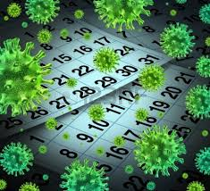
Section C. Dealing with an Outbreak
In this section, we are going to discuss:
Acute care interventions
Long term care interventions
51

Slide 52
Responding to Outbreaks in Acute Care

Slide 53

Challenges in the Management of Infections due to Carbapenem-Resistant Enterobacteriaceae (Drekonja et al., 2014)
In 2012 the Emerging Infection Network (EIN) conducted a survey of members in 22 states regarding experiences treating CRE infections
The conclusion: there are few antimicrobials to treat CRE and all have substantial limitations
53
Drekonja DM et al. Infection Control and Hospital Epidemiology 2014;35(4):437-439
Notes:
In July 2012, EIN members were invited to complete a report form describing their experiences with treating CRE infections.
54 members provided information regarding 85 source patients. Hospital settings represented by respondents included university (24), nonuniversity teaching (13), community (8), Veterans Administration/Department of Defense (5), and city/county (4) facilities.
Infections were reported from 22 states, with the most reports from California (20), Pennsylvania (19), and Ohio (8). An additional 213 respondents indicated that CRE infections were not encountered in their practice.
Reported pathogens included 68 Klebsiella species; 12 Enterobacter species; 12 Escherichia coli; 2 Citrobacter species; and 1 each of Proteus, Pseudomonas (though not an Enterobacteriaceae), Salmonella, and Serratia species. Antimicrobial resistance was prevalent.

Slide 54
Carbapenem-Resistant Enterobacteriaceae Rectal Screening during an Outbreak of New Delhi Metallo-Beta-Lactamase-Producing Klebsiella pneumoniae at an Acute Care Hospital (Pisney et al., 2014)
CRE infections have high mortality rates and are associated with high costs to treat and control following an outbreak
The goal of this study was to investigate an outbreak of New Delhi metallo-beta-lactamase producing CRE
CRE rectal SC was performed following a manual CDC-developed laboratory protocol
54
Pisney LM et al. Infection Control and Hospital Epidemiology 2014;35(4):434-436
Notes:
Carbapenem-resistant Enterobacteriaceae (CRE) are an emerging healthcare threat given the limited therapeutic options and high mortality associated with these organisms, with reports of attributable mortality up to 50% in patients with bacteremia. Because clinical cultures identify only a fraction of patients with CRE, the Centers for Disease Control and Prevention (CDC) recommends active surveillance to identify CRE-colonized patients in an institution once an infection with CRE has been documented.
Rectal surveillance cultures (SC) were performed as part of an investigation of an outbreak of NDM-producing CRE that occurred at a 437-bed tertiary care university teaching hospital in the Denver metropolitan area. Seven rounds of point prevalence screening were performed from August 27 to November 5, 2012, in units that housed affected patients. These units included the burn intensive care unit (ICU), the surgical ICU, the neurosurgical ICU, the cardiology unit, and the rehabilitation unit. One additional round of point prevalence screening was performed on the medical ICU, neurology, and transplant floors on November 12, 2012, given an overlap of patients in these units with the affected units. Beginning in December 2012, screening was broadened to include any patient who had been housed in affected units from May 27 to September 26, 2012, the time period during which transmission was known to have occurred. Patients identified for screening were flagged in the electronic record and, if readmitted, were placed under preemptive contact precautions until SC results were available. CRE rectal SC was performed following the CDC-developed laboratory protocol.
560 CRE screens from 440 patients were performed from August 27, 2012, to July 15, 2013. Fifteen patients without previous clinical isolates of CRE were found to have rectal carriage of Enterobacteriaceae that were nonsusceptible to ERT. Five of these 15 were positive for NDM by PCR testing.
Screening cultures grew 161 different gram-negative isolates, of which 135 (84%) were Enterobacteriaceae that were ERT susceptible. None of the patients found to be asymptomatically colonized with ERT-nonsusceptible organisms developed a clinical infection with CRE. Cultures took 72 hours to confirm no growth.
Conservatively, 90 hours and $4,904.55 of additional technologist time and costs were required to work up growth of Enterobacteriaceae that were ERT susceptible.

Slide 55
Carbapenem-Resistant Enterobacteriaceae Rectal Screening during an Outbreak of New Delhi Metallo-Beta-Lactamase-Producing Klebsiella pneumoniae at an Acute Care Hospital (Pisney et al., 2014)
Results
15 patients without previous clinical isolates of CRE were found to have rectal carriage of Enterobacteriaceae that were nonsusceptible to ERT
    Five were positive for NDM
  None of the patients found to be asymptomatically colonized with ERT nonsusceptible organisms developed a clinical infection with CRE
  90 hours and $4,904.55 additional technologist time and costs were required to work up growth of Enterobacteriaceae that were ERT susceptible
55
Pisney LM et al. Infection Control and Hospital Epidemiology 2014;35(4):434-436
Notes:
Carbapenem-resistant Enterobacteriaceae (CRE) are an emerging healthcare threat given the limited therapeutic options and high mortality associated with these organisms, with reports of attributable mortality up to 50% in patients with bacteremia. Because clinical cultures identify only a fraction of patients with CRE, the Centers for Disease Control and Prevention (CDC) recommends active surveillance to identify CRE-colonized patients in an institution once an infection with CRE has been documented.
Rectal surveillance cultures (SC) were performed as part of an investigation of an outbreak of NDM-producing CRE that occurred at a 437-bed tertiary care university teaching hospital in the Denver metropolitan area. Seven rounds of point prevalence screening were performed from August 27 to November 5, 2012, in units that housed affected patients. These units included the burn intensive care unit (ICU), the surgical ICU, the neurosurgical ICU, the cardiology unit, and the rehabilitation unit. One additional round of point prevalence screening was performed on the medical ICU, neurology, and transplant floors on November 12, 2012, given an overlap of patients in these units with the affected units. Beginning in December 2012, screening was broadened to include any patient who had been housed in affected units from May 27 to September 26, 2012, the time period during which transmission was known to have occurred. Patients identified for screening were flagged in the electronic record and, if readmitted, were placed under preemptive contact precautions until SC results were available. CRE rectal SC was performed following the CDC-developed laboratory protocol.
560 CRE screens from 440 patients were performed from August 27, 2012, to July 15, 2013. Fifteen patients without previous clinical isolates of CRE were found to have rectal carriage of Enterobacteriaceae that were nonsusceptible to ERT. Five of these 15 were positive for NDM by PCR testing.
Screening cultures grew 161 different gram-negative isolates, of which 135 (84%) were Enterobacteriaceae that were ERT susceptible. None of the patients found to be asymptomatically colonized with ERT-nonsusceptible organisms developed a clinical infection with CRE. Cultures took 72 hours to confirm no growth.
Conservatively, 90 hours and $4,904.55 of additional technologist time and costs were required to work up growth of Enterobacteriaceae that were ERT susceptible.

Slide 56
Carbapenem-Resistant Enterobacteriaceae Rectal Screening during an Outbreak of New Delhi Metallo-Beta-Lactamase-Producing Klebsiella pneumoniae at an Acute Care Hospital (Pisney et al., 2014)
The researchers concluded that
The manual method for CRE screening was useful for detecting patients with asymptomatic CRE carriage during an outbreak of NDM
  time-consuming and costly, largely because of the workup of ERT susceptible Enterobacteriaceae
Lack of specificity required additional testing
Further studies are needed to determine the most efficient and cost-effective method to screen for CRE
56
Pisney LM et al. Infection Control and Hospital Epidemiology 2014;35(4):434-436
Notes:
The authors said that in their experience, the manual method for CRE screening was useful for detecting patients with asymptomatic CRE carriage during an outbreak of NDM.
The clinical laboratory was required to rapidly implement a CRE screening procedure to support infection control efforts in response to the outbreak. The CDC-recommended procedure utilizes readily available supplies, and the protocol was validated in 5 days. This method was time-consuming and costly, in large part due to the workup of ERT-susceptible Enterobacteriaceae. The lack of specificity of this method required that cultures with growth of any Enterobacteriaceae require additional testing to confirm carbapenem resistance. To minimize disruptions in laboratory workflow, they chose to perform a standard gram-negative disk diffusion susceptibility panel first, and only ERT-nonsusceptible organisms underwent expanded disk diffusion testing. Personnel should be aware that confirmatory testing results in reporting delays for both positive and negative results; these authors suggested that confirmatory testing could be consolidated to expanded disk diffusion testing only to save time.
Given the high mortality and economic costs associated with treating CRE infections as well as the costs associated with control of a CRE outbreak, further studies are warranted to determine the most efficient and cost-effective method to screen for CRE.

Slide 57
Carbapenem-Resistant Klebsiella pneumoniae Producing New Delhi Metallo-Beta-Lactamase at an Acute Care Hospital, Colorado 2012 (Epson et al., 2014)
This study sought to investigate an outbreak of NDM CRE and determine interventions to interrupt transmission
Conclusion
The use of surveillance cultures to identify colonized patients led to interrupting transmission
57
Epson et al. Infection Control and Hospital Epidemiology 2014;35(4):390-397
Notes:
The objective of Epson et al. was to investigate an outbreak of New Delhi metallo-β-lactamase (NDM)–producing carbapenem-resistant Enterobacteriaceae (CRE) and determine interventions to interrupt transmission.
Two patients were initially identified with NDM-producing CRE during July–August 2012. CRKP were isolated from respiratory specimens.
A third case patient, admitted in May 2012, was identified through microbiology records review.
Screening cultures identified 5 additional case patients.
Patients had resided in 11 different units before identification. 4 units were identified as likely transmission sites (BICU, SICU, and cardiology and rehabilitation units).
NDM-producing CRE positivity in certain patients was not explained by direct epidemiologic overlap, which suggests that undetected colonized patients were involved in transmission.
Conclusions. A 4-month outbreak of NDM-producing CRE occurred at a single hospital, highlighting the risk for spread of these organisms. Timely SC, combined with targeted IC measures, were likely responsible for controlling transmission.

Slide 58
Carbapenem-Resistant Klebsiella pneumoniae Producing New Delhi Metallo-Beta-Lactamase at an Acute Care Hospital, Colorado 2012 (Epson et al., 2014)
Let’s look at the Infection Prevention Assessment that went along with this outbreak
Upon recognition of the outbreak in August
  Patients with NDM-producing CRE were maintained on contact precautions with a 1∶1 nursing ratio
  When additional case patients were identified through screening cultures, all case patients who remained in the hospital were cohorted on the same hospital unit and assigned dedicated nursing staff and medical equipment
  A visitor policy restricting young children and limiting visitors to 2 at a time was implemented.
  Hospital IC staff performed targeted education about CRE and the importance of hand hygiene and CP adherence among staff on units where case patients were residing.
58
Epson et al. Infection Control and Hospital Epidemiology 2014;35(4):390-397
Notes:
This slide details the infection prevention assessment that went along with this outbreak.

Slide 59
Carbapenem-Resistant Klebsiella pneumoniae Producing New Delhi Metallo-Beta-Lactamase at an Acute Care Hospital, Colorado 2012 (Epson et al., 2014)
There were lapses in hand hygiene and adherence to contact precautions among physicians, nurses, and visitors
Of all the opportunities for hand hygiene, 27% were missed by physicians, nurses, nursing assistants, and visitors
Lack of documentation of cleaning and disinfection of portable medical equipment between patients was noted
Infrequent cleaning of certain patient care access areas (e.g., radiology rooms and a rehabilitation gym) were also noted
Epson et al. Infection Control and Hospital Epidemiology 2014;35(4):390-397
59
Notes:
Observations identified lapses in hand hygiene and adherence to CP among physicians, nurses, and visitors in perioperative areas.
Of 102 opportunities for hand hygiene, 28 (27%) were missed by physicians, nurses, nursing assistants, and visitors
Lack of documentation of cleaning and disinfection of portable medical equipment between patients was noted
Infrequent cleaning of certain patient care access areas (e.g., radiology rooms and a rehabilitation gym) were also noted

Slide 60
Responding to Outbreaks in
Long Term Care

Slide 61
Successful Control of an Outbreak of Klebsiella pneumoniae Carbapenemase-Producing K. pneumoniae at a Long-Term Acute Care Hospital (Munoz-Price et al., 2010)
A 2008 outbreak of KPC-producing K. pneumoniae in the Greater Chicago area was traced to one LTACH
The objective of this study was to determine the effect of a bundle of infection control interventions on transmission
Bundled Intervention
  Daily chlorhexidine baths for all infected and colonized cases
  Environmental Cleaning
Infect Control Hosp Epidemiol 2010; 31:341-347
61
Notes:
[speaker, highlight content of slide]
OBJECTIVE:
To determine the effect of a bundle of infection control interventions on the horizontal transmission of Klebsiella pneumoniae carbapenemase (KPC)-producing K. pneumoniae during an outbreak.
DESIGN:
Quasi-experimental study. Setting. Long-term acute care hospital. Intervention. On July 23, 2008, a bundled intervention was implemented: daily 2% chlorhexidine gluconate baths for patients, enhanced environmental cleaning, surveillance cultures at admission, serial point prevalence surveillance (PPS), isolation precautions, and training of personnel. Baseline PPS was performed before the intervention was implemented. Any gram-negative rod isolate suspected of KPC production underwent a modified Hodge test and, if results were positive, confirmatory polymerase chain reaction testing. Clinical cases were defined to occur for patients whose samples yielded KPC-positive gram-negative rods in clinical cultures.
Two cleaning personnel were identified as the only staff in charge of cleaning the facility on a daily basis. They were both observed while cleaning 4 rooms (2 each), including 2 postdischarge “terminal” cleanings. Several surfaces were observed not to be cleaned at all, including bed rails, intravenous pumps and poles, respiratory tubing systems, oxygen valves (attached to the walls), and call buttons. It was later discovered that a previous directive by the administration had placed registered nurses in charge of cleaning surfaces deemed to be close to patients (eg, bed
rails and intravenous pumps and poles) in order to prevent accidental patient injury. Follow-up interviews with nurses revealed that nurses did not follow this rule. On the basis of our observations, we continued to direct that cleaning be performed with use of quaternary ammonium products according to existing institutional policy. However, buckets were eliminated from all cleaning carts to lessen the possible risk of environmental cross-contamination between patient rooms, and use of spray bottles was instituted. Furthermore, cleaning personnel were authorized and
expected to clean all surfaces, including bed rails and intravenous pumps and poles in close proximity to patients. Rooms of patients who were colonized with KPC-producing gram-negative rods were cleaned at the end of the day. The relevance of meticulous cleaning was emphasized on a one-on-one basis with both cleaning staff members during the initial visit and during 2 subsequent follow-up visits. Respiratory therapists were assigned nightly cleaning of all mechanical ventilator surfaces and wall-mounted oxygen valves. Nursing aides were instructed to disinfect, with use
of quaternary ammonium wipes (Sani Cloth HB; Nice-Pak Products), all objects shared among patients (eg, blood pressure machines and glucometers) after each use. Finally, because all bedside curtains (used for patient privacy) were found to be soiled, new curtains were installed on July 22, 2008.

Slide 62
Successful Control of an Outbreak of Klebsiella pneumoniae Carbapenemase-Producing K. pneumoniae at a Long-Term Acute Care Hospital (Munoz-Price et al., 2010)
Bundled Intervention also included:
  Surveillance cultures for all patients
  Contact Precautions for all high risk patients
    Negative cultures allowed high risk to be cohorted with other negative high risk, but they stayed in isolation
  Personnel education
  Environmental cultures
Infect Control Hosp Epidemiol 2010; 31:341-347
62
Notes:
[Speaker, highlight content of slide]
According to existing institutional policy, surveillance culture samples from the rectum, nares, wounds, central vascular catheter insertion sites, and gastrostomy tube sites were collected within 24 hours from all newly admitted patients; however, as part of the bundled intervention, all ertapenem- or imipenem-nonsusceptible gram-negative rods identified in surveillance cultures were also evaluated for KPC production as described above.
PPS. We performed baseline PPS before the bundled intervention and follow-up PPS on 5 occasions. On PPS days, surveillance rectal swab culture samples were obtained from ll patients in the institution (including patients who had been previously identified as carriers of KPC-producing strains) and evaluated for KPC-producing gram-negative rods.
Isolation and contact precautions. At admission, all patients considered to have high risk (ie, those patients on hemodialysis, with a tracheostomy, or with a history of colonization or infection with a multidrug-resistant organism, including a KPC-producing gram-negative rod) were placed
under contact precautions (ie, use of gown and gloves by healthcare workers). Each isolation room for patients under contact precautions was supplied with its own disposable stethoscope, blood pressure cuff, and thermometer. Isolation and contact precautions were in place for high-risk patients until the results of all admission surveillance cultures were available. If culture results were negative, high-risk patients were kept under contact precautions but cohorted in doubleoccupancy rooms with other KPC-negative patients, unless the occupancy rate permitted a move to single-bed rooms. KPC-positive patients were also cohorted in double-occupancy rooms, if necessary on the basis of the institution’s occupancy rate, and maintained under contact precautions. Patients considered not to be at high risk for colonization or infection with KPC-producing strains were not placed under contact precautions or isolation at admission, but they did participate in admission surveillance culture sampling.
Patients newly identified as carriers of KPC-producing strains during PPS, or at any time during their hospital stay, were placed under contact precautions in private rooms or were cohorted in double-occupancy rooms.
Personnel education. Physicians, staff nurses, nursing aides, respiratory therapists, and hemodialysis nurses all received training on the relevance of KPC-producing gram-negative rods and their routes of transmission. Educational pamphlets were placed in high-traffic areas of the institution, including nursing stations, bathrooms, and staff lounges. Because several patients who were positive for KPC-producing strains required either mechanical ventilation or hemodialysis, special emphasis was placed on training respiratory therapists and hemodialysis nurses. In coordination with managers, we made sure that hemodialysis nurses’ personal objects (eg, cell phones, pagers, clipboards, pens, food, books, and supply boxes) were not present during in-room dialysis, and the use of contact precautions was enforced during all dialysis treatments at the institution regardless of patient colonization status. Hemodialysis nurses were also trained to perform surface disinfection of their machines after every dialysis treatment at the institution.
Environmental cultures. Environmental cultures of 3 patient rooms, 2 of which were occupied by patients who were colonized or infected with a KPC-producing strain, were performed 1 week after implementation of the bundled intervention, which, as previously described, included coaching of leaning personnel. Surfaces cultured included bed rails, mechanical ventilators, tubing systems, intravenous medication pumps and poles, hemodialysis machines, and bedside tables. Specimens were obtained before the scheduled daily cleaning.
62

Slide 63
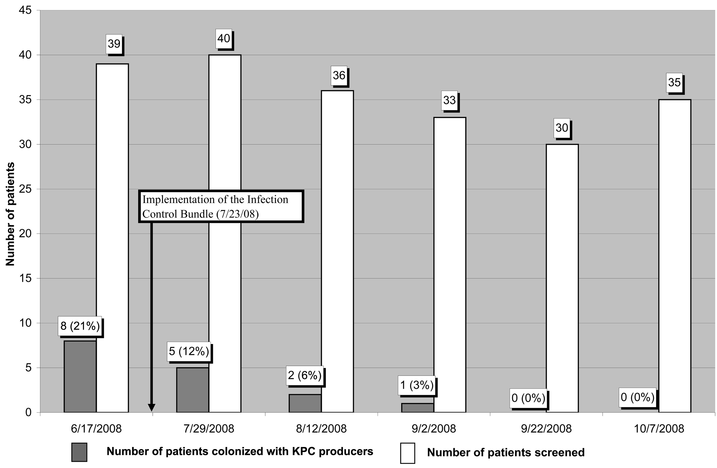
After bundle implementation, prevalence of colonization decreased to 12%, then to 6%, 3%, and 0%.
The bundled intervention successfully prevented bacteria spread, despite ongoing admissions of patients colonized with KPC producers.
Successful Control of an Outbreak of Klebsiella pneumoniae Carbapenemase–Producing K. pneumoniae at a Long‐Term Acute Care Hospital • L. Silvia Munoz‐Price, MD, et al, Infection Control and Hospital Epidemiology, Vol. 31, No. 4 (April 2010), pp. 341-347
Notes:
Results of point prevalence surveillance that was performed before and after the implementation of the bundle. On selected dates, rectal swab culture samples were obtained from all patients at the institution to determine carriage of Klebsiella pneumoniae carbapenemase (KPC)–producing gram‐negative rods.
RESULTS:
Baseline PPS performed on June 17, 2008, showed a prevalence of colonization with KPC-producing isolates of 21% (8 of 39 patients screened). After implementation of the intervention, monthly PPS was performed 5 times, which showed prevalences of colonization with KPC-producing isolates of 12%, 6%, 3%, 0%, and 0% (P < .001). From January 1, 2008, until the intervention, 8 KPC-positive clinical cases--suspected to be due to horizontal transmission--were detected. From implementation of the intervention through December 31, 2008, only 2 KPC-positive clinical cases, both in August 2008, were detected. From January 1 through December 31, 2008, 8 patients were detected as carriers of KPC-producing isolates at admission to the institution, 4 patients before and 4 patients after the intervention.
CONCLUSION:
A bundled intervention was successful in preventing horizontal spread of KPC-producing gram-negative rods in a long-term acute care hospital, despite ongoing admission of patients colonized with KPC producers.

Slide 64
Cleaning and Disinfecting

Slide 65
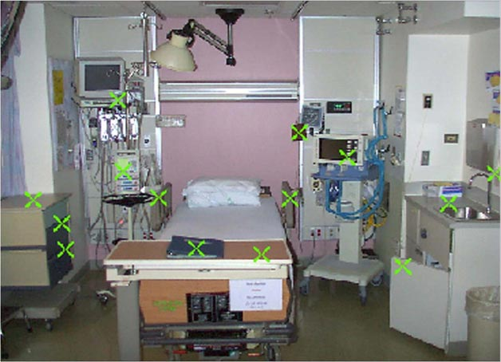
The Inanimate Environment Can Facilitate Transmission
X represents VRE culture positive sites
~ Contaminated surfaces increase cross-transmission ~
Abstract: The Risk of Hand and Glove Contamination after Contact with a VRE (+) Patient Environment. Hayden M, ICAAC, 2001, Chicago, IL.

Slide 66
Environmental Cleaning Standards
CDC. Regulatory Framework for Disinfectants and Sterilants. MMWR 2003; 52(RR17);62-64. http://www.cdc.gov/mmwr/preview/mmwrhtml/rr5217a2.htm. Accessed July 4, 2014
CDC, FDA, and EPA classify disinfectants differently
CDC and FDA use same basic terminology and classification scheme
  to categorize medical devices
    critical, semi-critical, and noncritical
  to define antimicrobial potency for processing surfaces
    sterilization, and high-, intermediate- and low-level disinfection
EPA registers environmental surface disinfectants based on the manufacturer's microbiological activity claims when registering its disinfectant.
  Doesn’t use the terms intermediate- and low-level disinfectants as used in CDC guidelines
66
Notes:
[speaker, highlight content of slide]
66

Slide 67
Disinfectants
CDC designates any EPA-registered hospital disinfectant
  without a tuberculocidal claim as a low-level disinfectant
  with a tuberculocidal claim as an intermediate-level disinfectant
CDC. Regulatory Framework for Disinfectants and Sterilants. MMWR 2003; 52(RR17);62-64. http://www.cdc.gov/mmwr/preview/mmwrhtml/rr5217a2.htm. Accessed July 4, 2014
67
Notes:
[Speaker, highlight content of slide]

Slide 68
Disinfectants
EPA registration of disinfectants
  To be labeled as an EPA hospital disinfectant, the product must pass Association of Official Analytical Chemists (AOAC) effectiveness tests against three target organisms:
    Salmonella choleraesuis for effectiveness against gram-negative bacteria;
    Staphylococcus aureus for effectiveness against gram-positive bacteria; and
    Pseudomonas aeruginosa for effectiveness against a primarily nosocomial pathogen
  Substantiated label claims of effectiveness of a disinfectant against specific microorganisms other than the test microorganisms are permitted, but not required
    provided that the test microorganisms are likely to be present in or on the recommended use areas and surfaces
CDC. Regulatory Framework for Disinfectants and Sterilants. MMWR 2003; 52(RR17);62-64. http://www.cdc.gov/mmwr/preview/mmwrhtml/rr5217a2.htm. Accessed July 4, 2014
Session 3
68
Notes:
[Speaker, highlight content of slide]
68

Slide 69
Disinfectants
EPA registration of disinfectants
  Potency against Mycobacterium tuberculosis recognized as a substantial benchmark
  However, the tuberculocidal claim is used only as a benchmark to measure germicidal potency
    Tuberculosis is not transmitted via environmental surfaces but by the airborne route
      Thus, use of products on environmental surfaces plays no role in preventing the spread of tuberculosis
CDC. Regulatory Framework for Disinfectants and Sterilants. MMWR 2003; 52(RR17);62-64. http://www.cdc.gov/mmwr/preview/mmwrhtml/rr5217a2.htm. Accessed July 4, 2014
69
Notes:
[speaker, highlight content of slide]

Slide 70
Disinfectants
EPA registration of disinfectants
    Because mycobacteria have among the highest intrinsic levels of resistance among the vegetative bacteria, viruses, and fungi, any germicide with a tuberculocidal claim on the label is considered capable of inactivating a broad spectrum of pathogens, including such less-resistant organisms as blood-borne pathogens (e.g., HBV, HCV, and HIV)
      It is this broad-spectrum capability, rather than the product's specific potency against mycobacteria, that is the basis for protocols and regulations dictating use of tuberculocidal chemicals for surface disinfection
CDC. Regulatory Framework for Disinfectants and Sterilants. MMWR 2003; 52(RR17);62-64. http://www.cdc.gov/mmwr/preview/mmwrhtml/rr5217a2.htm. Accessed July 4, 2014
Session 3
70
Notes:
[speaker, highlight content of slide]
70

Slide 71
Disinfectants and Sterilizers
Antimicrobial products registered by the EPA for healthcare use are effective against the most common emerging pathogens. Lists are updated and can be found on www.epa.gov
List A: EPA’s Registered Antimicrobial Products as Sterilizers (PDF) (5 pp, 127k, About PDF)
List B: EPA Registered Tuberculocide Products Effective Against Mycobacterium tuberculosis (PDF) (12 pp, 218k, About PDF)
List C: EPA’s Registered Antimicrobial Products Effective Against Human HIV-1 Virus (PDF) (66 pp, 483k, About PDF)
List D: EPA’s Registered Antimicrobial Products Effective Against Human HIV-1 and Hepatitis B Virus (PDF) (30 pp, 128k, About PDF)
List E: EPA’s Registered Antimicrobial Products Effective Against Mycobacterium tuberculosis Human HIV-1 and Hepatitis B Virus (PDF) (8 pp, 53k, About PDF)
List F: EPA’s Registered Antimicrobial Products Effective Against Hepatitis C Virus (PDF) (22 pp, 94k, About PDF)
List G: EPA’s Registered Antimicrobial Products Effective Against Norovirus (PDF) (7 pp, 51k, About PDF)
List H: EPA’s Registered Antimicrobial Products Effective Against Methicillin Resistant Staphylococcus aureus (MRSA) and Vancomycin Resistant Enterococcus faecalis or faecium (VRE) (PDF) (40 pp, 566k, About PDF)
List J: EPA’s Registered Antimicrobial Products for Medical Waste Treatment (PDF) (5 pp, 70k, About PDF)
List K: EPA’s Registered Antimicrobial Products Effective Against Clostridium difficile Spores (PDF) (2 pp, 56k, About PDF)
71

Slide 72
Hospital Policies and Procedures
Studies have shown that admitting a patient into a room previously occupied by a patient with environmentally-associated pathogens increases the risk of acquisition to the new patient
  Presumably due to residual contamination
  While there are some studies that indicate improved cleaning/disinfecting does NOT reduce transmission risk, there are many more studies that indicate contaminated surfaces to contribute to transmission, and many have conducted comparative effectiveness studies on various agents and procedures
Most hospitals employ a manual process of disinfecting and sterilizing
  However studies also show that continual staff education and training is needed as decontamination efforts are frequently inadequate
72
Notes:
[speaker, highlight content of slide]

Slide 73

Reduction of Clostridium difficile and vancomycin-resistant Enterococcus contamination of environmental surfaces after an intervention to improve cleaning methods (Eckstein et al., 2007)
This study at the Cleveland Veteran Affairs Medical Center sought to assess and improve decontamination efforts after a C. diff outbreak
Eckstein BC et al. BMC Infectious Diseases 2007;7:61
73
Notes:
Beginning in 2002, this institution has experienced a significant outbreak of C. difficile-associated disease (CDAD). Despite control measures including contact precautions for patients with documented and confirmed CDAD and environmental disinfection of CDAD patients' rooms with 10% bleach, they continued to experience high rates of infection (~15 CDAD cases/1,000 patient discharges). So in this study the researchers wanted to address the adequacy of cleaning practices in rooms of patients with Clostridium difficile-associated diarrhea (CDAD) and vancomycin-resistant Enterococcus (VRE) colonization or infection and examine whether an intervention would result in improved decontamination of surfaces.
The Cleveland Veterans Affairs Medical Center is a 368-bed acute care medical facility. Patients with CDAD are placed in contact precautions until diarrhea has resolved. Housekeeping staff use 10% bleach solution (Sunstorm) for terminal disinfection of CDAD patients' rooms. Terminal disinfection is performed using a clean cloth or mop soaked in 10% bleach, and it is stressed that frequently touched objects such as bed rails, bedside tables, and call buttons need to be disinfected.
Patients with VRE colonization or infection were included as a comparison group because they are currently managed with standard precautions and routine terminal cleaning is performed. According to the housekeeping
staff, routine terminal disinfection included bed rails and bedside tables, but telephones, call buttons, and door handles were not cleaned unless they were obviously soiled. The disinfectant used for routine decontamination
of patient rooms was Super HDQ Neutral, which is a quaternary ammonium compound.

Slide 74
Reduction of Clostridium difficile and vancomycin-resistant Enterococcus contamination of environmental surfaces after an intervention to improve cleaning methods (Eckstein et al., 2007)
CDAD Results
100% of CDAD patient rooms had one or more positive culture of the surfaces surveyed before housekeeping cleaning
78% had positive culture after housekeeping cleaning
VRE Results
94% of VRE patient rooms had one or more positive culture of the surfaces surveyed before housekeeping cleaning
71% had positive culture after housekeeping cleaning
Housekeeping cleaning was effective in disinfecting bedrails but not in other surfaces
Eckstein BC et al. BMC Infectious Diseases 2007;7:61
74
Notes:
A prospective 6-week before-after study was performed. Baseline cultures of environmental surfaces were obtained within 3 days of patient discharge from the room for patients with CDAD and VRE colonization or infection, before and after housekeeping cleaning. Surfaces were re-cultured a third time after disinfection with 10% bleach performed by the research staff. Six sites were cultured in each room, including the bedrail, telephone, call button, door knob, toilet seat, and bedside table.
After completion of the initial assessment of adequacy of housekeeping cleaning, the research team presented their findings to the housekeeping staff. Education was provided regarding the importance of environmental cleaning as a means to reduce transmission of pathogens. The importance of cleaning and disinfecting frequently touched surfaces was emphasized. In addition, the housekeeping staff was encouraged to provide input regarding measures that might improve their ability to perform adequate terminal cleaning.
To assess the effect of the intervention, additional cultures were obtained before and after the housekeeping staff performed terminal cleaning of rooms of several patients with CDAD or VRE colonization or infection during a 10-week period after the intervention. Prior to the intervention, they studied 17 patients with VRE colonization and 9 patients with CDAD.
Of the 17 rooms of patients with VRE colonization or infection on at least one of the surfaces surveyed, 16 (94%) had one or more positive environmental cultures before cleaning versus 12 (71%) after housekeeping cleaning (p = 0.125), whereas none had positive cultures after bleach disinfection by the research staff (p < 0.001). Housekeeping staff were effective in disinfecting bedrails (p=0.002) but not substantially so for other surfaces.
Of the 9 rooms of patients with CDAD, 100% had one or more positive cultures prior to cleaning versus 7 (78%) after housekeeping cleaning (p = 0.50), whereas only 1 (11%) had a single positive culture from a toilet after research bleach disinfection (p =0.031).

Slide 75
Reduction of Clostridium difficile and vancomycin-resistant Enterococcus contamination of environmental surfaces after an intervention to improve cleaning methods (Eckstein et al., 2007)
Other Results
Cleaning staff opted to use spray bottles with 10% bleach solution and were allowed more time to clean a room and notification that a room needed to be cleaned sooner
In the 10 weeks following the intervention
  90% of rooms with CDAD patients were positive before cleaning, while 20% were positive after cleaning
  80% of rooms with VRE patients had >1 positive environmental culture before cleaning, and 0% had positive cultures after cleaning
The research team noted that monthly meetings between Infection Control and housekeeping are needed to maintain awareness and adequate cleaning
Eckstein BC et al. BMC Infectious Diseases 2007;7:61
75
Notes:
After the intervention, the housekeeping staff agreed to apply 10% bleach solution to disinfect frequently touched surfaces toilet seats, door handles in rooms of CDAD patients using a spray bottle. The surfaces were then allowed to air-dry. In addition, without prompting from the research team, the housekeeping staff elected to incorporate this method of bleach disinfection of commonly touched objects into their terminal cleaning practices for all patient rooms in our facility. The hospital administration agreed to allow the housekeeping staff additional time for terminal cleaning (30 minutes/room) and the nursing staff was asked to provide more rapid notification of when rooms were ready for cleaning.
To assess the effect of the intervention, environmental cultures were performed before and after housekeeping cleaning in rooms of 10 patients with VRE colonization or infection and 10 patients with CDAD after the intervention. Eight (80%) rooms of patients with VRE colonization or infection had one or more positive environmental cultures before cleaning versus 0 (0%) after housekeeping cleaning (p < 0.001). Nine (90%) of rooms of patients with CDAD had one or more positive cultures prior to cleaning versus 2 (20%) after housekeeping cleaning (p < 0.01).
The Infection Control Department meets monthly with the housekeeping staff to provide feedback regarding culture results and to maintain awareness of the importance of environmental cleaning.

Slide 76
Hospital Cleaning Protocols
UTMB provides online documentation of their environmental cleaning and disinfecting policies and procedures (revised 11.5.13)
In their policy, they provide step-by-step instruction for environmental and equipment decontamination, including procedures for cleaning rooms
  Medical/surgical nursing unit rooms
  ICUs
  Patient rooms and procedure rooms after performance of high risk aerosolization procedures
  Negative Pressure Zones in the ED
Forms must be checked by personnel and approved and signed by the supervisor
http://www.utmb.edu/policies_and_procedures/Non-IHOP/Healthcare_Epidemiology/03.12%20-Environmental%20and%20Equipment%20Cleaning%20and%20Disinfection%20in%20Rooms%20with%20Patients%20with%20an%20Emerging%20Infectious%20Disease%20%28EID%29.pdf
76
Notes:
The UTMB policy provides instructions for cleaning:
Medical/surgical nursing unit rooms
ICUs
Patient rooms and procedure rooms (e.g., bronchoscopy suite) after performance of high risk aerosolization procedures
Negative pressure zones in the ED

Slide 77
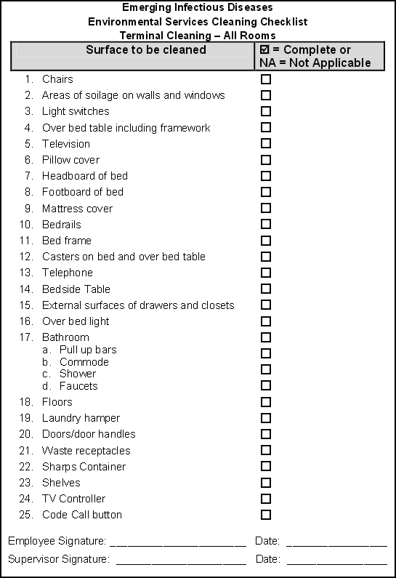
UTMB Sample Checklist
Example of a cleaning checklist
http://www.utmb.edu/policies_and_procedures/Non-IHOP/Healthcare_Epidemiology/03.12%20-Environmental%20and%20Equipment%20Cleaning%20and%20Disinfection%20in%20Rooms%20with%20Patients%20with%20an%20Emerging%20Infectious%20Disease%20%28EID%29.pdf
77
Notes:
Here is an example of a cleaning checklist

Slide 78
Advances in Environmental Cleaning: Robotics
As discussed, routine terminal cleaning with cloths, wipes and mops may be inadequate and frequently requires on-going staff education
Increasingly supplemental methods of cleaning are being instituted in hospitals
  Ultraviolet environmental disinfection
  Hydrogen Peroxide Vapor disinfection
78

Slide 79
Advances in Environmental Cleaning:
Ultraviolet Light
A patented pulse xenon UV disinfection system is a pesticidal device used for the advanced environmental cleaning of healthcare facilities
Pulsed-Xenon UV Lamp
  Using a Xenon bulb, a powerful, non-mercury form of UV light, combined with a pulse technology that generates high intensity pulses, which makes Xenex the most powerful form of UV-C
Uses reflectors and movement to focus UV light towards "high touch" surfaces
http://www.xenex.com/xenex-robot. Accessed July 6, 2014
79
Notes:
[read slide]

Slide 80
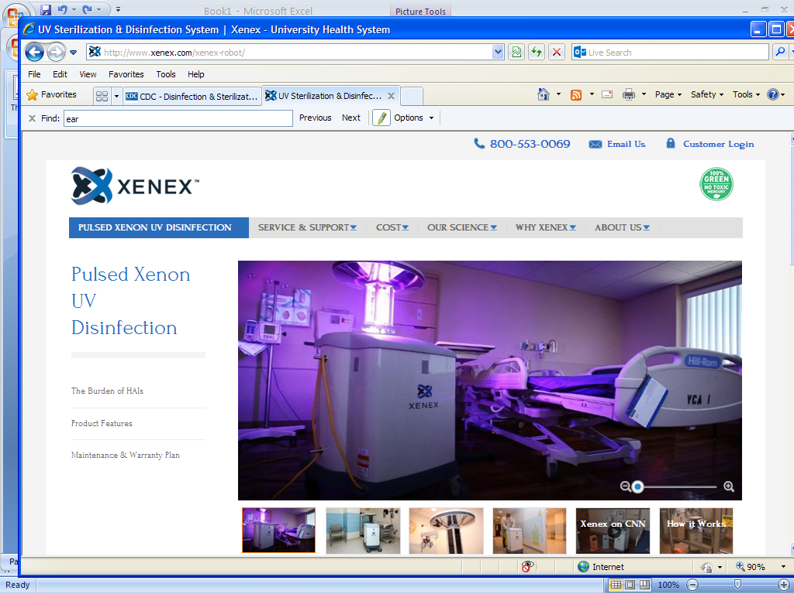
Advances in Environmental Cleaning:
Ultraviolet Light
Does the device give off radiation?
All light is technically “radiation.” What is emitted by the device is just like light – when it is “on” you see it and when it is “off” you don’t. If it is “off” you can immediately enter the room.
80

Slide 81
Implementation and impact of ultraviolet environmental disinfection in an acute care setting (Hass et al., 2014)
This study assessed effectiveness of UVD in an academic medical center to reduce hospital acquired MDROs and C. diff
A period before UVD use was compared to a period after UVD was implemented
Results
UVD added 51 minutes per discharge (31 minutes arrival including set up)
  Not used 24% of the time at discharge in rooms of patients with contact precautions – missed opportunity
The rate of MDRO + C. diff was significantly lower with UVD than without
Haas JP et al. AJIC 2014;42:586-590
81
Notes:
This slide presents a study of the implementation of ultraviolet environmental disinfection (UVD) following discharge cleaning of contact precautions rooms and other high-risk areas at Westchester Medical Center, a 643-bed tertiary care academic medical center near NYC. The period before UVD was 30 months (January 2009-June 2011), and the UVD period was 22 months (July 2011-April 2013).
Bleach-based (sodium hypochlorite 0.55%) disinfectants are used daily and at discharge for all rooms occupied by adults. Pediatric rooms are disinfected daily using a quaternary ammonium compound; a sodium hypochlorite 0.55% disinfectant is used daily for contact precautions rooms and for all discharge cleaning. Patients with MDROs or CD receive care in a private room, are placed in a semiprivate room with the other bed blocked from occupancy, or are cohorted with another patient who harbors the same organism.
UVD added an average of 51 minutes per discharge. This included approximately 31 minutes for arrival including setup of machine and setup of blackout curtains in areas that had open bays or glass windows and walls.
During the time period UVD was in use, there was a significant decrease in overall hospital-acquired MDRO plus CD in spite of missing 24% of opportunities to disinfect contact precautions rooms.

Slide 82
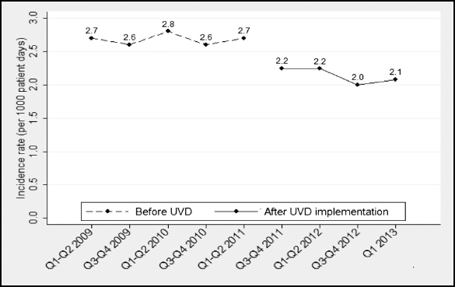
Implementation and impact of ultraviolet environmental disinfection in an acute care setting (Haas et al.)
Incidence of hospital-acquired multiple drug resistant organisms plus Clostridium difficile from January 2009 until April 2013
UVD implementation
Haas JP et al. AJIC 2014;42:586-590
82

Slide 83
Advances in Environmental Cleaning:
Hydrogen Peroxide Vapor
The H2O2 system is a robotic vapor-dispersing device for decontamination
  It consists of automated devices that disperse an EPA registered sterilant (i.e., a bleaching agent of hydrogen peroxide) into the air and onto surfaces, and then convert the sterilant to a harmless state (i.e., converting the sterilant to water and oxygen)
Researchers at Johns Hopkins assessed the device, in comparison with traditional hand-cleaning and mopping with bleaching agents
Johns Hopkins reported in 2012 that the two devices cost more than $40,000
www.bioquellus.com. Accessed July 4, 2014
83

Slide 84
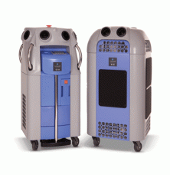
Advances in Environmental Cleaning:
Hydrogen Peroxide Vapor
The hydrogen peroxide vapor (HPV) bio-decontamination system can be used to bio-decontaminate rooms, laboratories and hospital wards/units
www.bioquellus.com. Accessed July 4, 2014
84

Slide 85
An Evaluation of Environmental Decontamination with Hydrogen Peroxide Vapor for Reducing the risk of Patient Acquisition of Multidrug-Resistant Organisms (Passaretti et al., 2013)
This study assessed decontamination efficacy of standard techniques vs the hydrogen peroxide vapor (HPV) system at Johns Hopkins Hospital
Passaretti CL et al. Clin Infectious Diseases 2013;56(1):27-35
85
Notes:
This study evaluated the environmental and clinical impact of hydrogen peroxide vapor (HPV) room disinfection. This was a 30-month prospective cohort intervention study on 6 high-risk units at Johns Hopkins Hospital, a 994-bed tertiary referral center. Following a 12-month preintervention phase, HPV was implemented on 3 units to decontaminate the rooms of patients known to be infected or colonized with epidemiologically important MDROs, following their discharge. Monthly environmental samples for MDROs were collected on all study units for 3 preintervention and 6 intervention months. The risk of MDRO acquisition in patients admitted to rooms decontaminated using HPV was compared with rooms disinfected using standard methods.
HPV decontamination was performed after routine cleaning and disinfection when possible in 2 single-occupancy intensive care units and a high-risk 30-bed surgical unit during the intervention phase. Standard cleaning and disinfection processes continued on the other 3 “standard cleaning” units (16-bed medical, 18-bed cardiothoracic surgery, and 20-bed surgical oncology ICUs) throughout all study periods. No other cleaning interventions occurred during the study.
In standard cleaning, floors and surfaces were cleaned/disinfected daily and after discharge using a quaternary ammonium compound (QAC). QAC was applied using WetTask wipes for surfaces, where the cleaner/disinfectant is poured into the WetTask bucket to impregnate disposable wipes, and a mop and bucket for floors. A hydrogen peroxide–containing liquid cleaner/disinfectant (Oxivir) was used to clean the rooms of patients with C. difficile.

Slide 86
An Evaluation of Environmental Decontamination with Hydrogen Peroxide Vapor for Reducing the Risk of Patient Acquisition of Multidrug-Resistant Organisms (Passaretti et al., 2013)
Results
Patients admitted to rooms disinfected using HPV were 64% less likely to acquire an MDRA and 80% less likely to acquire VRE
Risk of acquiring C. diff, MRSA, and MDR gram-negative rods was reduced, but not significantly
Proportion of rooms environmentally contaminated with MDROs was reduced significantly on the HPV units, but not on non-HPV units
Conclusion
HPV decontamination reduced environmental contamination and the risk of acquiring MDROs compared with standard cleaning protocols
Passaretti CL et al. Clin Infectious Diseases 2013;56(1):27-35
86
Notes:
Overall, 6350 room occupations by 5378 patients were at risk of nosocomial MDRO acquisition and were included in the study.
The prior room occupant was known to be infected or colonized with an MDRO in 22% of 6350 admissions.
Patients admitted to rooms decontaminated using HPV were 64% less likely to acquire any MDRO (P < .001) and 80% less likely to acquire VRE (P < .001).
The risk of acquiring Clostridium difficile, methicillin-resistant Staphylococcus aureus, and multidrug-resistant gram-negative rods individually was reduced, but not significantly.
The proportion of rooms environmentally contaminated with MDROs was reduced significantly on the HPV units, but not on non-HPV units.
HPV decontamination reduced environmental contamination and the risk of acquiring MDROs compared with standard cleaning protocols.

Slide 87
Isolation of Acinetobacter baumannii complex and methicillin-resistant Staphylococcus aureus from hospital rooms following terminal cleaning and disinfection: Can we do better? (Manian et al., 2011)
This study examined the frequency of isolation of A. baumannii complex (ABC) and MRSA from room surfaces after routine cleaning vs HPV treatment
Methods
Routine cleaning
  Wiping of visibly soiled surfaces with a QAC, followed by 10% bleach
  30-60 minutes
  Meticulous cleaning was stressed
HPV cleaning
  Routine cleaning + HPV
  3-4 hours
Manian FA et al. ICHE 2011;32(7):667-672
87
Notes:
The objective of this study was to examine the frequency of isolation of Acinetobacter baumannii complex (ABC) and methicillin-resistant Staphylococcus aureus (MRSA) from surfaces of rooms newly vacated by patients with multidrug-resistant (MDR) ABC following various rounds of routine terminal cleaning and disinfection (C/D) with bleach or 1 round of C/D followed by hydrogen peroxide vapor (HPV) treatment. (St. John’s in St. Louis)
Routine terminal C/D of rooms newly vacated by MDRABC-positive patients included wiping of visibly soiled surfaces with a quaternary ammonium compound followed by disinfection with 10% bleach. Briefly, a dedicated cart with buckets was set up outside of the room, with separate buckets used for disinfection of the floor. Multiple wiping cotton cloths were used to avoid double dipping of clean cloths into the buckets containing bleach. Soiled curtains were replaced. Total C/D time commonly ranged between 30 and 60 minutes per room. The importance of meticulous C/D was stressed to the environmental service staff upon hire, daily during infection control ward rounds, and through weekly meetings of the infection control with the environmental service staff. While occupied by MDRABC-positive patients, such hospital rooms also underwent daily C/D with bleach (twice daily in the burn unit). Persistently ABC-positive rooms underwent 4 rounds of C/D.
Hydrogen Peroxide Vapor (HPV) Treatment – HPV (Bioquell) rooms underwent 1 round of C/D with bleach followed by HPV treatment. The entire process usually took 3–4 hours/room.

Slide 88
Isolation of Acinetobacter baumannii complex and methicillin-resistant Staphylococcus aureus from hospital rooms following terminal cleaning and disinfection: Can we do better? (Manian et al., 2011)
Results
After 4 rounds of routine C/D, 26.6% of rooms had >1 culture-positive site for A. baumannii complex (ABC) and MRSA
After 1 round of routine C/D + HPV treatment, 4.5% of rooms were culture-positive for ABC,MRSA, or both
“Routine terminal C/D of hospital rooms vacated by MDRABC-positive patients may be associated with a significant number of ABC- or MRSA-positive room surfaces even when up to 4 rounds of C/D are performed. The addition of HPV treatment to 1 round of C/D appears effective in reducing the number of persistently contaminated room sites in this setting.”
Manian FA et al. ICHE 2011;32(7):667-672
88
Notes:
Following 4 rounds of C/D, 83 (26.6%) rooms had 1 or more culture-positive sites; 102 (1.8%) sites in 51 (16.4%) rooms grew ABC, and 108 (1.9%) sites in 44 (14.1%) rooms grew MRSA. The addition of HPV treatment to 1 round of C/D resulted in a significant drop in ABC- and MRSA-positive room . Following 1 round of C/D and HPV treatment, 6 (4.5%) rooms were culture-positive for ABC, MRSA, or both.

Slide 89
Questions and Discussion

