Slide 1
Session 1: Introduction to MDROs

Slide 2

Introduction to MDROs
In this session, we will discuss the following:
What is an MDRO?
  We will introduce MRSA and VRE in this session and focus on ESBLs and CRE in later sessions
Where do they come from?
How do they spread?
What are risk factors?
Where in the body do they infect?
How are they treated?
How do we control MDROs?
Why are they a significant public health concern?
Notes:
In this session, we are going to give a basic overview of multi-drug resistant organisms, using MRSA and VRE as examples that you are probably very familiar with. The concepts of MDROs are similar, just the details are different for different organisms.

Slide 3
Introduction to MDROs
Primary Objectives of this Session
Define a multi-drug resistant organism
Describe ways to prevent spread
Identify reasons for public health concern
3
Notes:
In this session, we are going to achieve the following objectives.
3

Slide 4
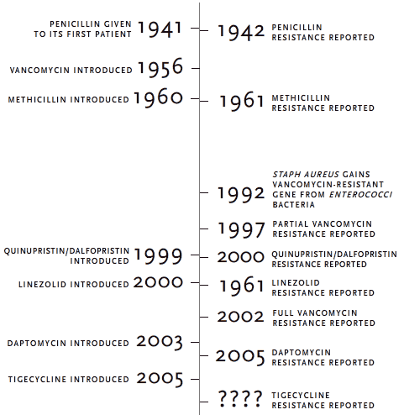
Once upon a time, a scientist named Fleming discovered the miracle of antibiotics…..
2001
http://www.pbs.org/wgbh/nova/sciencenow/0303/04-arms-nf.html
Notes:
This timeline illustrates just how adaptive bacteria are. Medical scientists have been predicting a return to a “pre-antibiotic” era, and with fewer antibiotics being developed, it is easy to see why. This is why public health specialists at the CDC and TxDSHS are working so hard to get ahead of the newer MDROs.

Slide 5
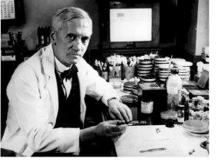
Antimicrobial Stewardship
“…. the microbes are educated to resist penicillin and a host of penicillin-fast organisms is bred out… In such cases the thoughtless person playing with penicillin is morally responsible for the death of the man who finally succumbs to infection with the penicillin-resistant organism. I hope this evil can be averted.”
- Sir Alexander Fleming, June 1945
Lynfield, The Continued Assault of Antibiotic-Resistance; IDSA Congressional briefing. Accessed 7.27.14 at http://www.idsociety.org/WHDbriefing/

Slide 6
What are MDROs?
Multi-drug resistant organisms are bacteria that have developed resistance to one or more classes of antibiotics
  These antibiotics can no longer be used effectively to control or kill the bacteria
  MDROs are predominantly bacteria, but can also include viruses, fungi, or parasites
  The names of some MDROs identify resistance to only one drug agent, but they are frequently resistant to multiple drugs
    MRSA (Methicillin-resistant Staphylococcus aureus)
    VRE (Vancomycin-resistant Enterococci)
Source: http://www.ct.gov/dph/cwp. Accessed June 20, 2014
6
Notes:
MDRO covers a lot of organisms, but mostly bacteria
HIV and influenza are viruses that are MDR
Malaria can be resistant to antiparasitic drugs
Candida yeasts can be resistant to antifungals
While the names of MDROs can sound like they are resistant to only one drug agent, they are frequently resistant to multiple drugs. Examples include MRSA and VRE

Slide 7
The most challenging MDROs in Healthcare
Methicillin-resistant Staphylococcus aureus (MRSA)
Vancomycin-resistant enterococcus (VRE)
Extended-spectrum beta-lactamase-producing bacteria (ESBLs)
Carbapenem-resistant enterobacteriaceae (CRE)
Multi-drug resistant Acinetobacter baumanii (MDR-A)
In this first session, we will briefly review MRSA and VRE
7
Notes:
Currently, we have some particular MDROs that challenge us in healthcare. These are MRSA, VRE, ESBLs, CRE and MDR-A. We will discuss ESBLs and CREs in more detail later, but we will touch upon MRSA and VRE here
7

Slide 8
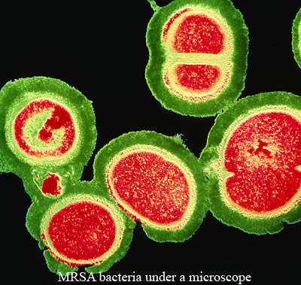
MDROs are Not a New Problem –
The Case of MRSA
Staphylococcus aureus developed resistance to penicillin in the late 1940s and throughout the 1950s
Methicillin was introduced to counter this resistance problem
In 1961 the first strains of MRSA were identified in Britain
  1968 – the first US human case of MRSA
MRSA is resistant to all beta-lactams
  Penicillin, amoxicillin, methicillin, etc.
In 2002, the first strains of S. aureus resistant to vancomycin emerged
  These strains are still rare currently
Source: http://www.ct.gov/dph/cwp. Accessed June 20, 2014
8
Notes:
It should be noted that these are NOT new problems. MRSA has been around for many decades.

Slide 9
What is MRSA?
MRSA is a type of staph bacteria that is resistant to certain antibiotics called beta-lactams (e.g., penicillins, carbapenems)
Recognizing the signs and receiving treatment in early stages reduces the chances of the infection becoming severe
More severe and potentially life-threatening MRSA infections occur in the hospital setting
  Bloodstream infections
  Surgical site infections
  Pneumonia
According to the CDC, these more serious infections have been declining in hospitals for several years
9
Notes:
Although MRSA is still a major patient threat, a CDC study published in the Journal of the American Medical Association Internal Medicine showed that invasive (life-threatening) MRSA infections in healthcare settings are declining. Invasive MRSA infections that began in hospitals declined 54% between 2005 and 2011, with 30,800 fewer severe MRSA infections. In addition, the study showed 9,000 fewer deaths in hospital patients in 2011 versus 2005. This study (or report) complements data from the National Healthcare Safety Network (NHSN)that found rates of MRSA bloodstream infections occurring in hospitalized patients fell nearly 50% from 1997 to 2007.
9

Slide 10
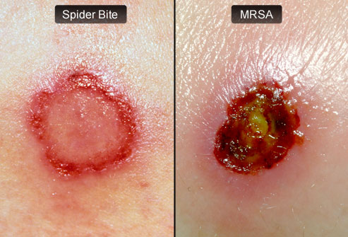
Clinical Manifestations of MRSA
Most MRSA infections are skin infections that appear as pustules or boils which are often red, swollen, painful, or have pus or other drainage
They can look like spider bites
They commonly occur at sites of visible skin trauma, such as cuts and abrasions, and areas covered by hair, such as the back of the neck, groin, or beard
Source: http://www.webmd.com/skin-problems-and-treatments/ss/slideshow-closer-look-at-mrsa. Accessed July 3, 2014
10
Notes:
Most MRSA start off as skin infections and can be mistaken for a spider bite. They are often red, swollen, painful and have drainage/pus. They can occur at skin trauma sites or areas covered by hair such as the groin or a beard or armpit
10

Slide 11
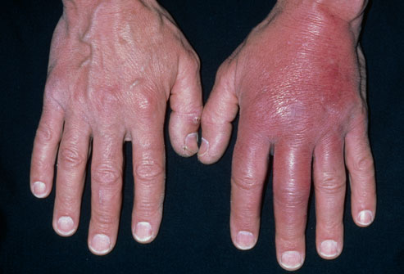
Clinical Manifestations of MRSA
MRSA skin infections can lead to:
  Abscesses
  Cellulitis
Source: http://www.mayoclinic.org/diseasesconditions/cellulitis/basics/causes/con-20023471 Accessed July 6, 2014
11
Notes:
MRSA can cause a minor infection site to become an abscess -- a painful lump under the skin that’s filled with pus. Treatment may require surgical drainage and antibiotics.
MRSA can also lead to cellulitis, an infection of the deeper layers of skin and the tissues beneath them. Cellulitis can spread quickly over a few hours. The skin looks pink or red, like a sunburn, and may be warm, tender, and swollen.
11

Slide 12
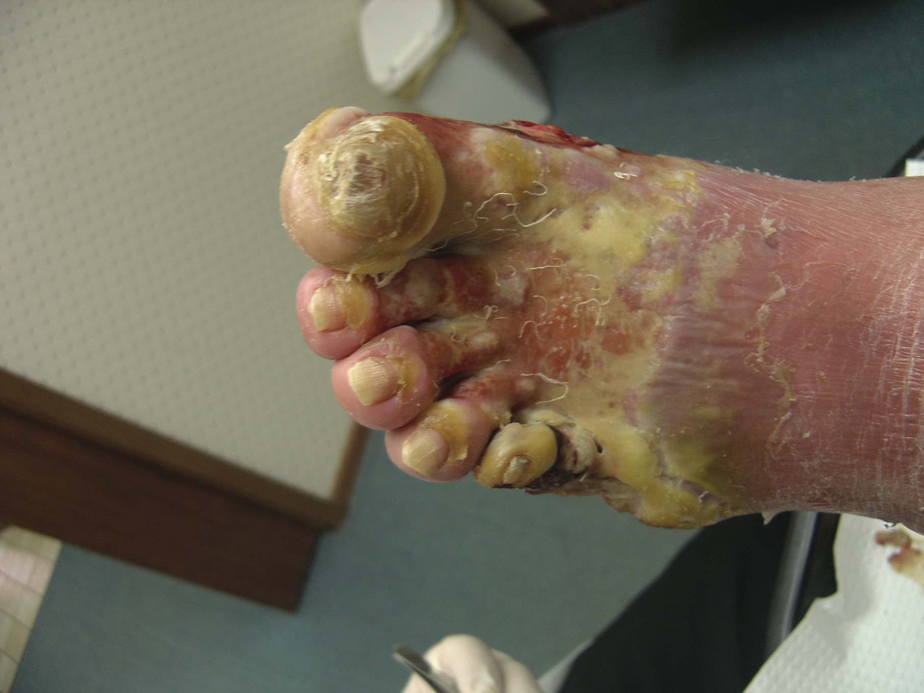
What is Vancomycin-Resistant Enterococci (VRE)?
Enterococci are bacteria that are normally present in the human intestine (gut flora), the female genital tract and the environment, but they can also cause infection
Vancomycin is an antibiotic that is used to treat some drug-resistant infections caused by enterococci
Enterococci that have become resistant = VRE
Source: http://trialx.com/curetalk/wp-content/blogs.dir/7/files/2011/05/diseases/Vre_Infection-1.jpg. Accessed July 3, 2014
12
Notes:
Now, enterococci are usually present in the human body, and don’t always cause infection. Those bacteria that have become resistant to vancomycin and other drugs are called VRE
12

Slide 13
Where does VRE cause infections and how it is transmitted?
VRE can live in humans without causing disease (colonization) and can be found in feces
Sometimes it causes infections of the urinary tract, the bloodstream, in wounds, and is often associated with catheters or surgical procedures
VRE is passed from person to person by contaminated hands
It can live on a surface for up to 58 days
It is NOT spread in the air by coughing or sneezing
13
Notes:
VRE is passed most often by contaminated hands – it is not airborne. It can also live on a surface for about two months
13

Slide 14
What are risk factors for VRE infection?
Previous treatment with vancomycin
Long-term exposure to antibiotics
Extended periods of hospitalization
Weakened immune systems
Surgical procedures
  Abdominal and chest surgery
Indwelling medical devices
  Urinary catheters
  Central intravenous catheters
Source: http://infectionpreventionresource.com/files%5CVRE%20Fact%20Sheet%205.19.Rev1.pdf
Accessed July 6, 2014
14
Notes:
Risk factors associated with VRE infection include previous treatment with vancomycin or other antibiotics for long periods of time, extended periods of hospitalization, weakened immune systems such as patients in intensive care units, or in cancer or transplant wards, surgical procedures such as abdominal or chest surgery and indwelling medical devices such as urinary catheters or central intravenous (IV) catheters.
14

Slide 15

Are all MDROs spread in the same way?
Most MDROs are transmitted from patient to patient via hands of healthcare workers
Also spread via objects such as medication cart handles, bed rails, bedside tables, IV poles
Direct contact (e.g., touching an oozing sore)
Source: http://www.ct.gov/dph/cwp. Accessed June 20, 2014
15
Notes:
Other surfaces besides hands can transmit VRE. Examples include hospital carts, bed rails, and tables. It almost goes without saying that touching an oozing sore will contaminate the hand

Slide 16
What are risk factors for MDROs?
The risk of infection increases among elderly and immune-suppressed patients, and also patients with:
  An existing severe illness
  An underlying disease or condition (e.g., diabetes, CKD)
  Previous prolonged use of antibiotics
  Invasive procedures/medical devices (e.g., dialysis, catheters)
  Repeated contact with the healthcare system (e.g., multiple hospital admissions)
  An extended hospitalization
  Previous colonization with a MDRO
Source: http://www.ct.gov/dph/cwp. Accessed June 20, 2014
16
Notes:
There are certain risk factors for MDRO but they are beginning to occur in patients of all ages and health status. Patients whose health is deteriorating, who have used antibiotics for extended periods, have invasive devices, or have previously had MDRO (colonization or infection) are at risk

Slide 17
What kinds of infections can MDROs cause?
Just about any part of the body, including
  Bloodstream
  Lungs
  Urinary tract
  Wounds
  Surgical sites
How are they treated?
These are hard to treat because they do not respond to many common antibiotics
  We’ll discuss particular antibiotics later in this presentation
Source: http://www.ct.gov/dph/cwp. Accessed June 20, 2014
Notes:
MDROs really can show up anywhere, and are increasingly difficult to treat. We’ll talk more about antibiotic therapy and antimicrobial stewardship later today

Slide 18
Public Health and Clinical Significance of MDROs
~10% of hospitalizations are complicated by healthcare-associated infections (HAIs)
As many as 75% of HAIs are caused by organisms that are first-line antimicrobial therapy resistant
These resistant infections result in about $20 billion in annual healthcare costs
We will present the significance of specific organisms in a coming session.
Cosgrove SE. Clin Infect Dis 2006;42(sppl2):S82-S89.
Roberts RR, et al. Clin Infect Dis 2009;49(3):1175-1184.
Notes:
“First line antimicrobial therapy resistant” means that the antibiotic that has “always worked before” no longer works. MDROs are a potential threat for everyone. They cause significant healthcare costs.

Slide 19
Public Health and Clinical Significance of MDROs
Multi-drug resistance among gram negative bacteria represents a unique and immediate threat
  Significant increases in prevalence: ¹⁻⁴
Extended-spectrum beta lactamase (ESBL) producing Enterobacteriaceae
    Carbapenem-resistant Enterobacteriaceae
    MDR strains of Pseudomonas aeruginosa and Acinetobacter baumannii
  Significantly worse outcomes, mortality rates up to 4 times higher than infections caused by susceptible strains ⁵⁻⁷
  Potential for widespread and rapid transmission ⁸
1. Hidron AI, et al. Infect Control Hosp Epidemiol 2008;29(11):996-1011.
2. Rhomberg PR, Jones RN. Diagnost Microbiol Infect Dis 2009;65(4):414-426.
3. Lautenbach E, et al. Infect Control Hosp Epidemiol 2009;30(12):1186-1192.
4. Lautenbach E, et al. Infect Control Hosp Epidemiol 2010;31(1):47-53.
5. Schwaber MJ, et al. Antimicrob Agents Chemother 2008;52(3):1028-1033.
6. Patel G, et al. Infect Control Hosp Epidemiol 2008;29(12):1099-1106.
7. Ben-David D, et al. Clin Microbiol Infect 2012;18(1):54-60.
8. Lautenbach E, Perencevich EN. ICHE 2014;35(4): 333-335.
Notes:
They also lead to death and are easily spread

Slide 20
Public Health: Antibiotic Resistance and Our Food
As part of a drug-resistance surveillance pilot study in Canada, researchers sampled squid purchased from a seafood section of a food store in January 2014
  They identified Pseudomonas fluorescens resistant to all beta-lactam drugs tested, including ertapenem
They concluded that there is an urgent need for expanded resistance surveillance for carbapenemase-producing organisms and their resistance plasmids in food products
Rubin JE et al. Emerging Infectious Diseases July 2014;20:1264-1265. www.cdc.gov/eid. Accessed June 25, 2014
20
Notes:
MDROs are frequently found on our food. In a recent case study, surveillance researchers in Canada sampled seafood in a local supermarket. While the squid they sampled did not indicate country of origin, it appeared that the squid originated in South Korea. The researchers found pseudomonas fluorescens on the squid, and it was resistant to all beta-lactam antibiotics tested. The study concluded that expanded surveillance efforts in food was required.

Slide 21

MDROs: Public Health
In a recent study conducted at a university hospital in Switzerland, researchers found
86% of 35 hospital kitchen raw chicken samples were positive for extended-spectrum beta-lactamase (ESBL)-producing Enterobacteriaceae (ESBL-PE), predominately E. coli
100% of 30 supermarket samples were positive for ESBL-PE
No prepared hospital food demonstrated ESBL PE
Stewardson AJ et al. ICHE 2014;35:375-383
21
Notes:
Similarly, a study in Switzerland took 35 hospital kitchen food samples and 30 local supermarket food samples, and found that 86% of raw chicken in the hospitals was positive for ESBLs, as were 100% of supermarket samples. The researchers noted that cooked chicken did not pose a threat. However, this study highlights the potential health hazards associated with our food sources. By the way, is this a Swiss chicken or a French chicken?

Slide 22

MDROs: Public Health
TV Show Quiz:
22
Notes:
Okay – Here is a popular TV show with two of the show’s physicians possibly enjoying some hospital prepared chicken and salad. Who can tell me the name of the show? (scrubs)

Slide 23

How can we control the spread of MDROs?
Only use antibiotics when they are needed and as directed
Washing hands with soap and water (or alcohol hand rub) for at least 20 seconds
Wear disposable gloves and possibly gowns when applicable
Family members should be instructed to wash their hands upon entering a patient’s room and before leaving the room
Source: http://www.ct.gov/dph/cwp. Accessed June 20, 2014
Notes:
Universally, MDRO has less chance of spreading with antimicrobial stewardship, appropriate hand hygiene, contact precautions, and family and patient education. We will talk more about each of these later today as well

Slide 24
Questions?
Notes:
Before we move into Session 2, are there any questions?

