Slide 1

Program Income Training 101
Ann Duncan, DSHS FMU Director
April Marek, DSHS FMU HIV Branch Manager
Courtlin Burke, HIV Branch Financial Analyst Team Lead
Savannah Hedge, HIV Branch Financial Analyst
William Tucker, HIV Branch Financial Analyst

Slide 2
Overview
HIV Prevention Services Grant
What is program income?
What are the requirements for program income?
How is program income used?
How should program income be documented?

Slide 3
HIV Prevention Services Grant

Slide 4
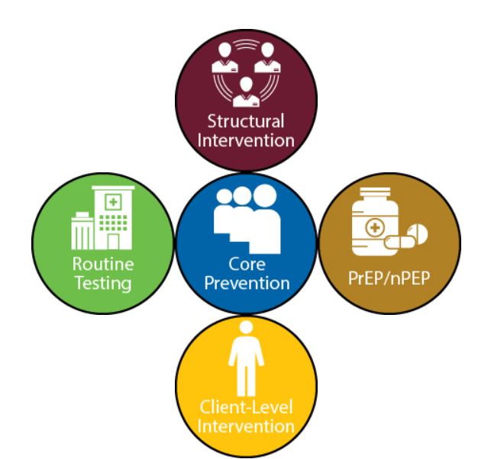
HIV Prevention Services Grant
Purpose the HIV Prevention Grant
Length of Grant

Slide 5
There are funding opportunities in 5 key areas:
Routine HIV screening in health care settings
Core HIV prevention programs
PrEP and nPEP programs
Client-Level Interventions (CLI)
Structural Interventions

Slide 6
Introduction to Program Income

Slide 7
What is Program income?
Program income means gross income earned by the non-Federal entity that is directly generated by a supported activity or earned as a result of the Federal award during the period of performance except as provided in 45 CFR §75.307(f). Program income includes but is not limited to:
  Income from fees for services performed
  The use or rental of real or personal property acquired under Federal awards
  The sale of commodities or items fabricated under a Federal award
  License fees and royalties on patents and copyrights
​

Slide 8

Program Income Specific Criteria
  Federal Criteria:
    2 CFR 200
    45 CFR 75
  State Criteria:
    UGMS. 40
    UGMS. Subpart A. (5) “Program Income”
    UGMS. 21. I.
    UGMS. 25
    UGMS. 41. (b)
    DSHS contract
​

Slide 9
    Flow of the Funds
Starting from the top of the hierarchy
U.S. Department of Health & Human Services (HHS)
Centers for Disease Control and Prevention
Texas Department of State Health Services (DSHS)
Grantees (sub-recipients)

Slide 10


340B: How does it work
A drug manufacturer enters into a Pharmaceutical Pricing Agreement with the Health Resources and Services Administration (HRSA)
A covered entity registers to participate in the 340B program with HRSA’s Office of Pharmacy Affairs at https://340bopais.hrsa.gov/
The covered entity purchases drugs at the 340B price from a distributor, which receives drugs from the manufacturer
The covered entity enters into a contract with a third party, usually a retail pharmacy
The distributor ships the covered entity’s drugs to the contract pharmacy
The patient receives the 340B drug at the contract pharmacy

Slide 11
340B Program Income
All 340B generated revenue IS program income.
Covered entities are able to generate savings on each drug by purchasing these drugs at a discounted 340B rate and yet receive normal payments from insurers. Covered entities are able to provide drugs to low-income patients at free or significantly reduced costs and also use savings to provide other health care services under the scope of work for the contract in which made them eligible to receive 340B certification.
    Insurance Reimbursement
  - 340B Drug Pricing from Manufacturer
340B Generated Program Income
​

Slide 12
Program Income Example
Organization C receives a Prevention grant receiving all 5 funding opportunities in their scope of work :
    The total cost of providing routine HIV services in January 2020 was $100. The total cost of providing core HIV services in January 2020 was $110. Expenses total $210 for the month of January 2020.
    Each client visit to the clinic to receive services costs $10. While Medicaid and Medicare normally pay these costs, some insurances require a copay of $10.
    If 25 clients had to pay a co-pay of $10 in January 2020; the total amount of program income generated is 25 X $10 = $250.
    $250 is the amount reported to DSHS as PI generated, however, the full amount goes back into the program in which it was generated.
    Most grantees spend the program income on their expenses; $210, and any additional is to further the program in which it was generated.
      $250 (PI) - $210 (expenses) = $40 (PI to put back into the program)
    ** The program income does not have to go back to the funding source in the scope of work (this example core and routine) in which it was earned. The $40 could go to CLI. **

Slide 13
Program Income Requirements

Slide 14
1
2
3
4
Program income must comply with grant conditions, State and Federal regulations (CDC, 2020).
Program income must be spent during the contract term it is earned and not allowed to be carried over to next term, except with approved spending plan (45 CFR 75).
All program income must be disbursed before requesting additional grant payments (UGMS and 45 CFR §75.307).
Program income must be used for the purposes of the Federal award. ​(45 CFR §75.307)

Slide 15
Allowable Uses of Program Income
Direct costs, such as:
  personnel
  fringe benefits
  staff travel
  contractual services
Allowable administrative costs include usual and recognized overhead
  including indirect rates for all organizations
Per the grant contract, program specific outreach is allowable
(DSHS contract Allowable and Prohibited uses of funds)

Slide 16
Funding Restrictions
Funds:
may only be used for reasonable program purposes (CDC, 2020; 45 CFR 75.404).
may not be used for research (CDC, 2020).
may not be used to purchase furniture or equipment, except if approved and clearly identified in the proposed spending budget (CDC, 2020; 45 CFR 75.307(d)).
may not be used to purchase or exchange needles or syringes for drug injection (CDC, 2020; UGMS, 2016) .
may not be used to purchase capital expenditures or buildings (45 CFR 75.439 (b)(1)).
CDC (2018). Additional Requirements can be found at: https://www.cdc.gov/grants/additional-requirements/index.html
CDC. (2020). Funding Restrictions and Limitations. https://www.cdc.gov/grants/documents/General-Terms-and-Conditions-Non-Research-Awards.pdf
CDC. (2020). Integrated HIV Programs for Health Departments to Support Ending the HIV Epidemic in the United States https://www.cdc.gov/hiv/pdf/funding/announcements/ps20-2010/CDC-RFA-PS20-2010.pdf

Slide 17
Unallowable Costs for HIV Prevention Grant
Grant funds may not be used to:
Purchase PrEP or nPEP medication (funds may be used to pay for clinical staff time and medical testing)
Fund staff salaries not directly related or necessary to the implementation of the program
Advertise an organization nor for fundraising
Entertainment costs
(DSHS contract section Allowable and Prohibited uses of funds)

Slide 18
Prevention Grant Specific Examples
  Health education material for HIV patients
  HIV program service outreach
  Contractor work
  Contract staff working on the HIV prevention program

Slide 19
Use of Program Income

Slide 20
Additive Method
45 CFR §75.307(e)(2) ​
Program income is added to funds committed to the program and used to further program objectives
Calculation:
Earned Program Income + Federal award + Other Funding
= Funds for eligible program objectives.

Slide 21
Example
Organization A received a $100,000 grant​ in 2020
During September 2020, Organization A generated $1,000 in program income.​
Under the additive method, the total allowed project costs is now $101,000 ​
  the original $100,000 in addition to the generated $1,000​

Slide 22
Documenting Program Income
How to document Program Income?

Slide 23
Documentation of Program Income
Program income should have a separate cost center established in the grantee’s General Ledger.
Program income should be able to be identified by the grant in which it was generated
Multiple funding streams where grantee is unable to fully identify the grant = appropriate allocation methodology and allocation work to be shown when monitored
Retain invoices and payments for billing
Readily available for third party reviewers
** This is currently a requirement and will continue to be so in future renewals. **

Slide 24
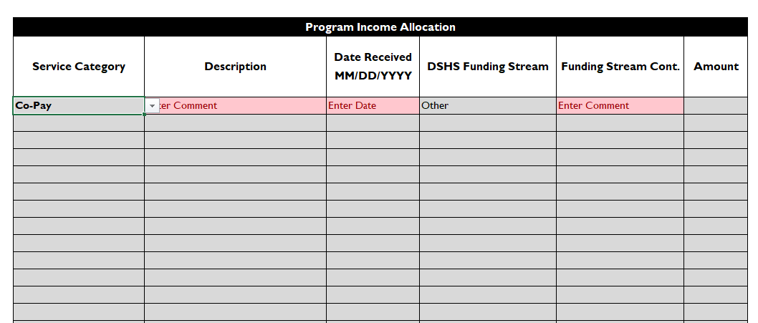
Program Income Monitoring Tool

Slide 25
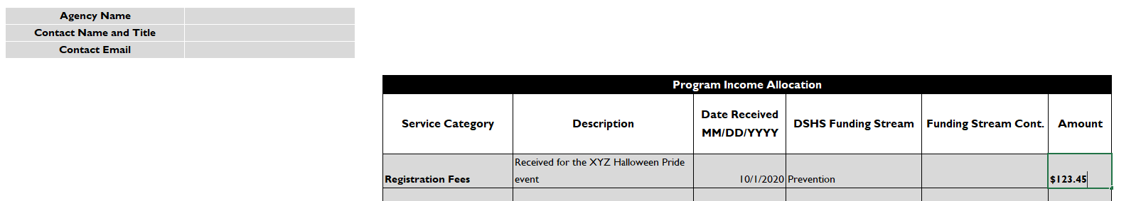
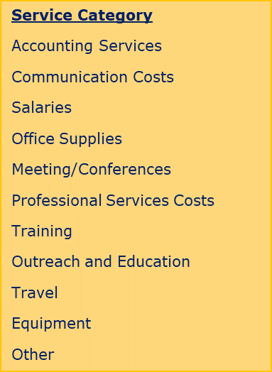
Program Income Monitoring Tool Cont.

Slide 26
Additional Resources
45 CFR Part 75. (2020). Uniform Administrative Requirements, Cost Principles, and Audit Requirements for HHS Awards. Retrieved from https://www.ecfr.gov/cgi-bin/text-idx?node=pt45.1.75
CDC. (2018). Award Terms and Conditions, Federal Regulations and Policies. Retrieved from https://www.cdc.gov/grants/federal-regulations-policies/index.html
Centers for Disease Control and Prevention. (2020). PS20-2010 Notice of Funding Opportunity. Retrieved from https://www.cdc.gov/hiv/pdf/funding/announcements/ps20-2010/CDC-RFA-PS20-2010.pdf
DSHS. (2020). Technical Assistance & Resources. Retrieved from https://www.dshs.state.tx.us/fiscal-monitoring/tech/
HHS. (2020). Grants Policy and Regulations. Retrieved from https://www.hhs.gov/grants/grants/grants-policies-regulations/index.html

Slide 27
Q&A
Email FMU at: fmu@dshs.texas.gov
https://www.dshs.state.tx.us/fiscal-monitoring/about/

