Slide 2
Patterns in New HIV Diagnoses and HIV Prevalence, Texas 2021
HIV/STD/HCV Epidemiology and Surveillance Unit
Source: DSHS surveillance data, August 2022

Slide 3
Overview

Slide 4
Big Picture
Prevalence increases each year because more people living with HIV are living longer lives.
Based on patterns in HIV morbidity in Texas, the priority populations are:
White men who have sex with men (MSM)
Black MSM
Hispanic MSM
Black women whose mode of HIV transmission was sex with a male
People who are Transgender

Slide 5
Acronyms
HIV = Human Immunodeficiency Virus
PLWH = People Living With HIV
EMA = Eligible Metropolitan Area
TGA = Transitional Grant Area
MSM = Men Who Have Sex With Men
IDU = Injection Drug Use
ICE = Immigration and Customs Enforcement
TDCJ = Texas Department of Criminal Justice

Slide 6
New HIV Diagnoses, Persons Living with HIV, and Deaths in Texas (1981-2021)
Notes:
This chart shows the number of people diagnosed each year since 1981 (red line), the number of total people living with HIV in Texas each year since 1981 (green line) and the annual number of deaths among people with HIV (purple line). You will see a marked drop off in the mid-1990s after the approval of antiretroviral medications. People are living longer and healthier lives with HIV, which means that the green line keeps climbing year over year. The number of new diagnoses of HIV has remained relatively stable since the mid-2000s, meaning that there is more do in the prevention (and treatment as prevention) realm.
Since the number of new diagnoses are higher than the number of deaths, this results in increases in the number of Texans living with HIV.

Slide 7
New Diagnoses

Slide 8
New HIV Diagnoses
Rates of new HIV diagnoses have slightly decreased from 16.8/100,000 in 2012 to 14.8/100,000 in 2021.
In 2021, rates of new HIV diagnoses are highest among males (24.6/100,000), Blacks (41.7/100,000), and those between 25 and 29 years of age (44.3/100,000).
Between 2012 and 2021, the proportion of new HIV diagnoses increased for Hispanic MSM, from 39.2% to 42.8% and among Black MSM, from 26.1% to 28.6%.
Within the last ten years, among those newly diagnosed with HIV, the proportion of those with a late diagnoses (3 months between HIV diagnosis and AIDS) has declined from 27.8% in 2012 to 21.4% in 2021.

Slide 9
New HIV Diagnoses and Rates by Year of Diagnosis, 2012-2021
Notes:
The decrease in cases and rate in 2020 should be interpreted with caution, due to decreased testing during Covid pandemic
Excluding 2020, the number of persons newly diagnosed with over the past decade has remained with fairly stable

Slide 10
New HIV Diagnosis Rates by Sex at Birth and Year of Diagnosis, 2012-2021
Year
Notes:
The rate of new HIV diagnosis for males is nearly 5 times higher for males compared to females.

Slide 11
New HIV Diagnosis Rates by Race/Ethnicity and Year of Diagnosis, 2012-2021
Year
Notes:
Racial disparities in the rate of new HIV diagnoses persist despite the noteworthy decline in the rate of new HIV diagnoses among Black Texans.

Slide 12
New HIV Diagnosis Rates Among Ages 15-39, 2012-2021
Notes:
The majority of persons newly diagnosed with HIV are between the ages of 15-34. Those 20-29 have the highest rates of new diagnosis.

Slide 13
New HIV Diagnosis Rates by Age at Diagnosis, 2021
Notes:
The higher rates of new HIV diagnosis are among those aged under 40, with 25-29 year olds having the highest rates.

Slide 14
New HIV Diagnoses by Mode of Transmission*, 2012-2021
Notes:
Over 72% of new HIV diagnoses were among MSM. This explains the large rate of HIV diagnosis disparity between Males and Females displayed in slide 10.

Slide 15
New HIV Diagnoses by Mode of Transmission and Sex at Birth, 2021
Notes:
The primary mode of transmission for Males and Females is sexual contact, with MSM representing 87.16% of new diagnoses among males and sex with males representing 79.56% of new diagnoses among females.

Slide 16
New HIV Diagnoses by Priority Group, 2012 vs. 2021
N=4,377
N=4,377
Notes:
The proportion of Hispanic and Black MSM increased between 2012 and 2021.

Slide 17
New HIV Diagnoses by Mode of Transmission and EMA/TGA*, 2021
Area
Notes:
The majority of new HIV diagnoses by mode of transmission is MSM across all EMA/TGAs for 2018.

Slide 18
Late Diagnoses

Slide 19
Late Diagnoses* as Percentage of Total HIV Diagnoses, 2012-2021
* Stage 3 (AIDS) diagnosis within 3 months of HIV diagnosis
Notes:
The percent of late diagnoses steadily from 2012 to 2019, with a slight uptick in 2020 and 2021.

Slide 20
Late Diagnoses* as Percentage of Total HIV Diagnoses by EMA/TGA**, 2021
Area
Notes:
The U.S.-Mexico border region, East Texas, and “All other Texas” have the highest percentage of persons diagnosed late in the course of their infection

Slide 21
People Living with HIV in Texas

Slide 22
HIV Prevalence, 2021
102,800 Texans living with HIV at the end of 2021.
348.1 per 100,000 Texans
1 in every 288 people in Texas is living with HIV
Over half (63%) of people living with HIV (PLWH) acquired the virus through male-male sexual contact.
By 2021, over half of PLWH were 45 years of age or older.
Between 2012 and 2021, the total number of PLWH increased by 28% and proportion of PLWH within priority populations increased by 5.5%.
A majority of people living with HIV live in urban areas of Texas. The counties with the largest numbers of PLWH were Harris and Dallas, followed by Bexar, Tarrant, and Travis counties.

Slide 23
Sex at Birth of PLWH, 2021
Notes:
Men make up a larger proportion of people living with HIV

Slide 24
Race/Ethnicity of PLWH, 2021
Notes:
There are more Black Texans living with HIV than any other race/ethnicity.

Slide 25
Age Distribution of PLWH, 2021
Notes:
Due to antiretroviral therapy people are living longer with HIV. The majority of people living with HIV are over 45 years of age.

Slide 26
PLWH by Mode of Transmission*, 2021
* Mode of transmission is imputed for individual patients when risk information is missing
** Adult Other includes received clotting factor, transfusion/transplant, other and unknown
Notes:
MSM comprised the majority of PLWH.
*Note due to rounding of weighted estimates the total may be off by 1 case

Slide 27
HIV Prevalence by Priority Group, 2012 vs. 2021

Slide 28
Regional Data

Slide 29
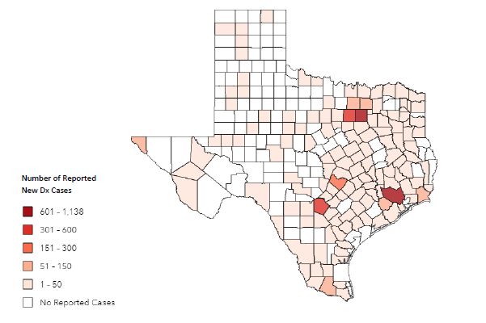
Number of New HIV Diagnoses by Texas County, 2021
Total New HIV Diagnoses: 4,264
Data source: DSHS Surveillance Data, March 2023 Map Source: ArcGIS Enterprise
Notes:
Total new HIV diagnoses number excludes ICE Facilities, FED Prisons, and TDCJ. Total including the previous listed facilities is 4,377.

Slide 30
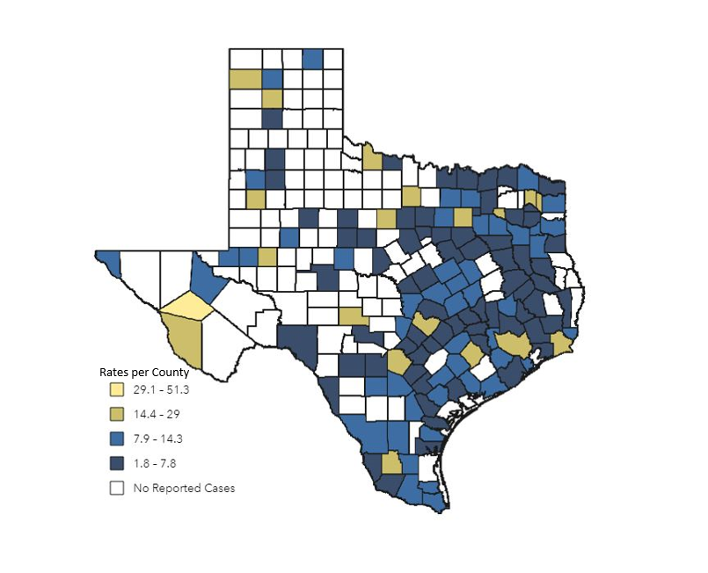
Rate of New HIV Diagnoses by Texas County per 100,000, 2021
Data source: DSHS Surveillance Data, March 2023 Map Source: ArcGIS Enterprise

Slide 31
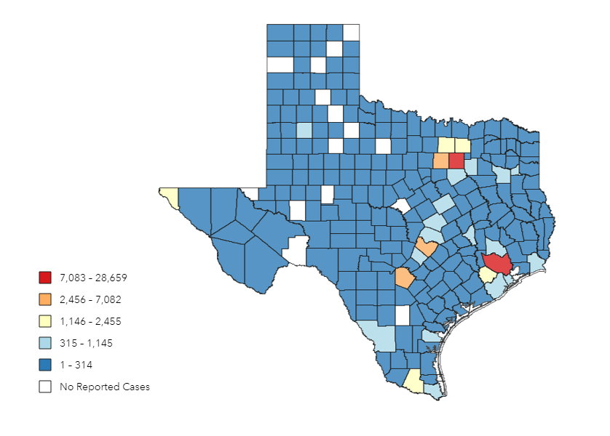
Number of People Living With HIV (PLWH) by Texas County, 2021
Total Number of PLWH: 98,854
Number of Cases
Data source: DSHS Surveillance Data, March 2023 Map Source: ArcGIS Enterprise
Notes:
Total PLWH number excludes ICE Facilities, FED Prisons, and TDCJ. Total including the previous listed facilities is 102,800.

Slide 32
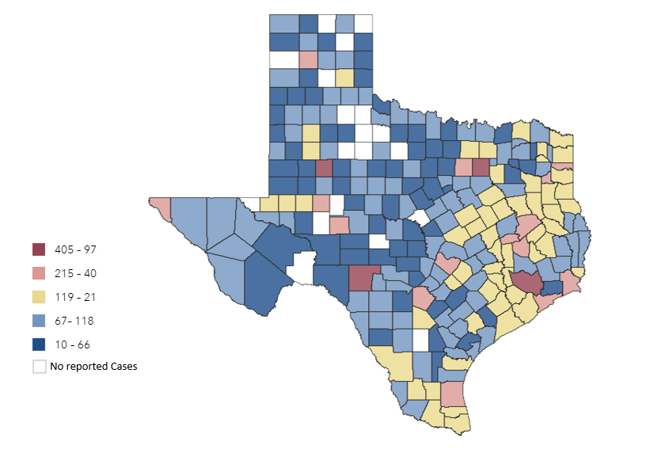
HIV Prevalence Rate by Texas County per 100,000, 2021
Rates per 100,000
Data source: DSHS Surveillance Data, March 2023 Map Source: ArcGIS Enterprise
Notes:
Rates of PLWH are highest in the counties in the eastern half of Texas, including the most populous counties.

Slide 33
Texas HIV Treatment Cascade, 2021

Slide 34
Thank you!

