Slide 1
Basic System Training
Texas EMS/Trauma Registry

Slide 2
Agenda
Logging In & Main Dashboard
Navigation Toolbar
Entering New Records
Searching for Records
Roster Import
Recently Accessed Records

Slide 3
Logging In & Main Dashboard

Slide 4
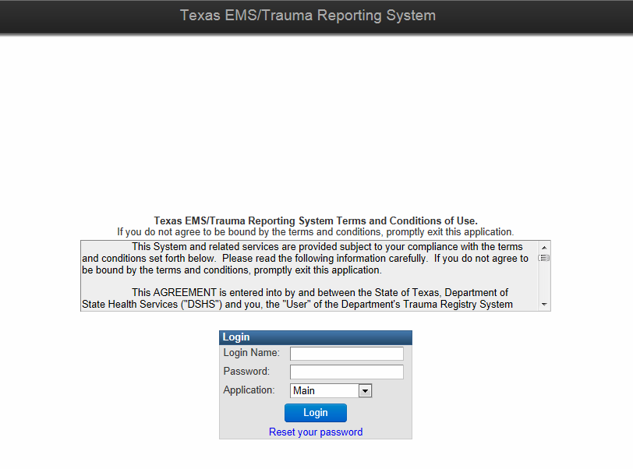
This is the Login page.
Enter the Login Name and Password that was provided to you in a secure email.
Notes:
The Main user interface. There is also an Administration user interface, which the local administrators/account managers will use for account management. This functionality will not be available on September 17th so local admins will not be able to log into the Administrative user interface until a later date. We will conduct a local administrator training session at that time.

Slide 5
Passwords
The first time you log in to the Trauma Registry, you will be required to change your password.
Password criteria:
8-14 characters in length
One number
One symbol (e.g. *,&,#, $, etc.)
One uppercase letter
After successfully changing your password, you must go through all training slides.
If you are an administrator/account manager, you will have a second set of training slides to view.

Slide 6
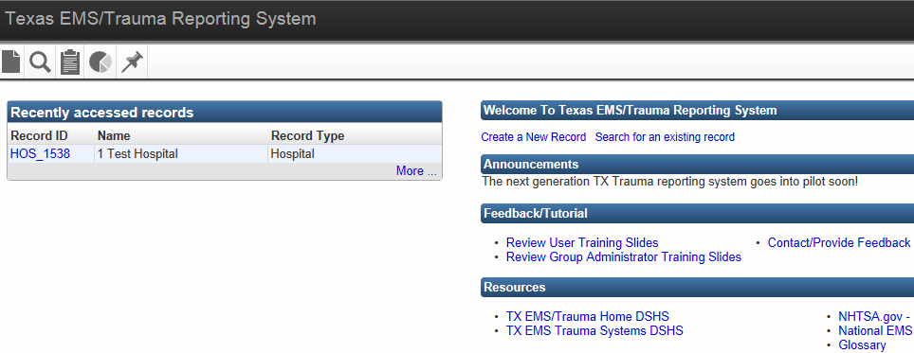
Main Dashboard
Recently accessed records displays the last 5 records that have been opened or created.
To see additional records, select “More.”
The Dashboard is the main page of the new system.
Notes:
Dashboard may also be referred to as the “splash” page. Main page of the new system.
Recently accessed records – displays the last 5 events the user has opened or created. The user may see other events by selecting “More…”

Slide 7
Main Dashboard
Home button
Takes you back to the Main Dashboard.
Help button
Takes you to the online Maven User Guide.
Search
Allows you to search by Record ID
Username drop down
Edit profile
Administration – switch screens between Main and Admin for administrators
Logout
Notes:
Help button – need to discuss with Michelle. At the moment this button leads to a login page at Consilience. Not sure our users are supposed to have this feature.

Slide 8
Main Dashboard
For web data entry, select Create a New Record to enter a new record.
To search for a record or entity, select Search for an existing record.
Notes:
Dashboard may also be referred to as the “splash” page. Main page of the new system.
Recently accessed records – displays the last 5 events the user has opened or created. The user may see other events by selecting “More…”

Slide 9
Edit User (Profile)
Notes:
Account Managers/Administrators do not have or see this icon on their toolbar.

Slide 10
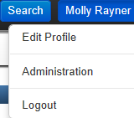
Edit User
To update your user information, click on your name in the top right corner of the screen.
Select Edit Profile from the drop down menu.

Slide 11
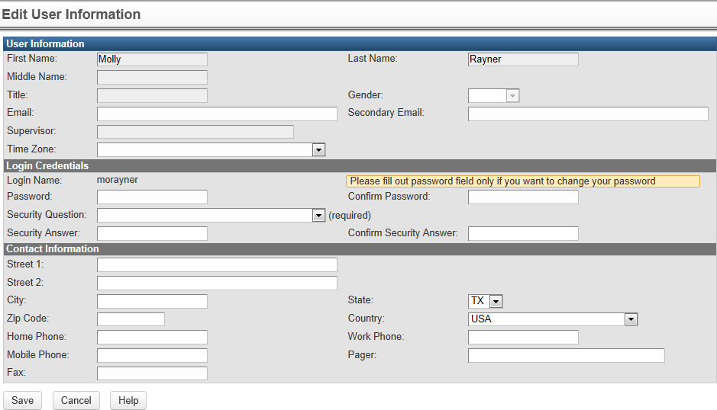
Edit User
The Edit User Information screen consists of three sections.
1. User Information
2. Login Credentials
3. Contact Information
Notes:
Quick view of the entire screen. Each of the three sections will be described in the following slides.

Slide 12
Edit User
1. User Information
Only two fields are editable on this screen:
Email
Secondary Email
Contact your Administrator/Contract Manager or DSHS to update all other fields.
You must enter an email address in the system in order to reset your own password.
Notes:
Quick view of the entire screen. Each of the three sections will be described in the following slides.

Slide 13
Edit User
2. Login Credentials
The Login Credentials screen is where you can change your password and set up a Security Question.
You must set a Security Question in order to reset your password.

Slide 14
Edit User
3. Contact Information
The Contact Information fields are intended to collect contact information for the individual user, not the entity.
It is important to include at least one phone number.

Slide 15
Navigation

Slide 16
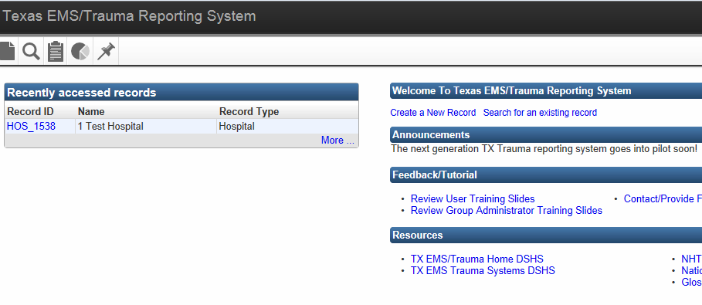
Navigation Toolbar
The navigation toolbar is located in the top left corner of the main Dashboard.
The toolbar contains buttons/icons that perform the majority of the functions in Maven.
Notes:
The toolbar contains buttons/icons that perform the majority of the functions in Maven. The buttons displayed on the toolbar vary depending on a user’s role (i.e. local administrations/account managers will NOT see the “little man” icon and may have some additional buttons).

Slide 17
Navigation Buttons
Search Event
Recently Accessed Records
Reports
Import Roster
Create Event
Notes:
Create Event – Used to create a new event.
Search Event – Used to search for an existing event based on various search criteria. Users may only search for events reported by their entity.
Import Roster (upload data file) - Allows a user to import an electronic data file and create multiple events automatically.
Reports – Used to view, print, and export reports from data entered in Maven. Reports functionality will not be available on September 17th.
User Information – Used to view or update information about the current user and to change the user’s password.
Recently Accessed Records – Used to provide access to the last 20 events the user has opened or created (through web data entry).
Reports is gray because although the button will be there and be active, reports will not be available to users on September 17th .

Slide 18
Entering New Records (Web Data Entry)
Create Event

Slide 19
Create a New Record
There are two ways to begin entering a record.
Select Create a New Record
Select the Create Event
navigation button.

Slide 20
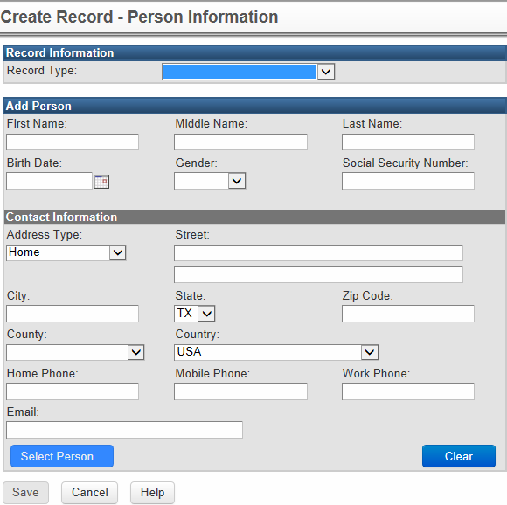
Create a New Record
Record Type
Use the drop down menu to choose which type of record you want to submit.
All Record Types
Record Types are based on the type of entity that you belong to. (i.e., EMS can only see Patient Record – EMS)

Slide 21
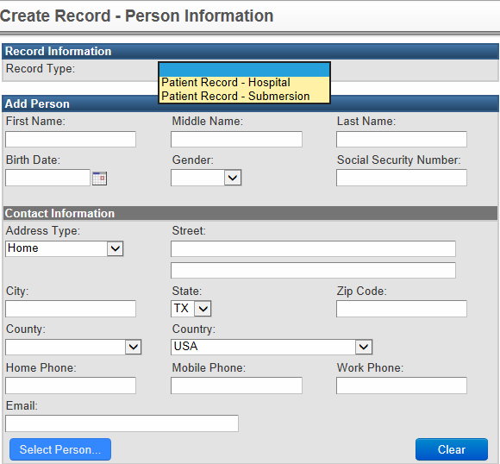
Create a New Record
In this example, the user belongs to a hospital.
Please note, hospitals are the only entity that have two choices for Record Type.

Slide 22
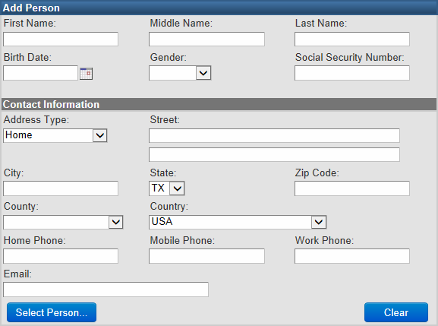
Create a New Record
The best way to avoid creating duplicate persons in your database is to use the Select Person button before manually entering person information.
This will allow you to select an existing person from your database.
Notes:
If the person was entered by another entity, his/her information will not be available using the “Select Person” feature. This is only available for those people who have already been reported by the entity. This should prevent them from entering the same person twice. If the person’s information, such as address, has changed, this can be updated after the event is created. Maven will keep a history of any addresses listed for the same person.

Slide 23
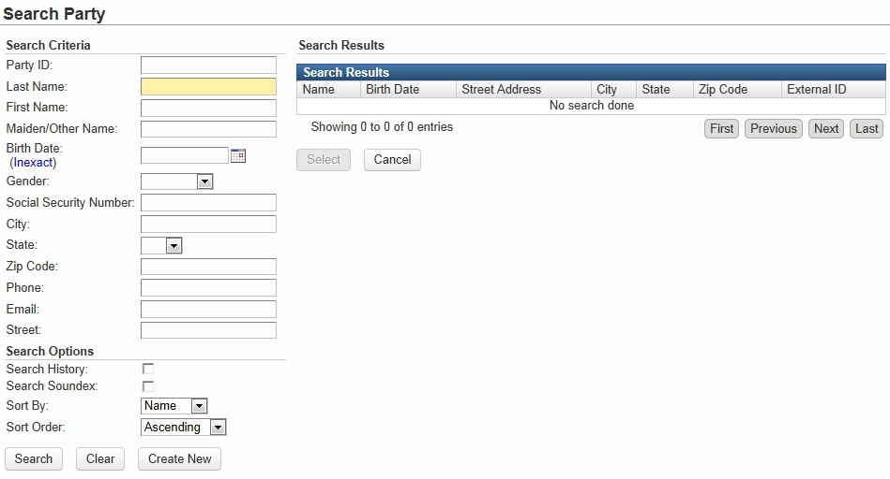
Create a New Record - Select Person
The following fields may be used to search for a person:
Party ID
Last/First Name
Birth Date
Gender
Phone
Address
Notes:
The Party ID is a registry-generated ID number, not a number like medical record number or patient care report number.

Slide 24
Create a New Record - Select Person
By selecting Inexact, you can search for a Birth Date range.
Allows the user to broaden the search to include historical information
When selected, historical demographic and/or address information is also compared against the search criteria.
Example: Old address
Allows the user to broaden the search beyond literal spelling of the search criteria.
Example: “Tom” will search on “Thom” and “John” will search on “Jack.”
Notes:
These three features can help the user find the right person if there is inaccurate or out-of-date information.
Birth date inexact link – changes from one date field to two date fields to search in a range instead of by specific date
Search history – the system tracks all demographic information kept in a patient’s record, even after it is updated, and this feature will search historical as well as current information
Some additional examples of names returned when the first name “John” is searched for using the Search Soundex feature (not a complete list):
Johnny
Juan
Johnnie
Jon
Jonathan
Johnathan
Jimmy

Slide 25
Create a New Record - Select Person
An entity may only search for people reported by that specific entity.
Patients reported by other entities will not display in the Search Results.
Notes:
An example of the search results. The only information provided is Name, Birth Date, and Address. External ID is for the system and is not relevant to the end user.

Slide 26
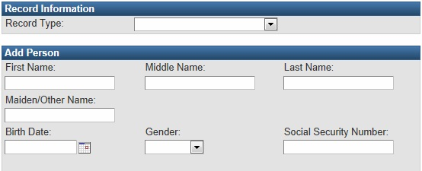
Create a New Record
First Name and Last Name are required to create a new record.
If you do not have the person’s name, use “Unknown” for First/Last Name.
Notes:
“Unknown” should be the only value entered for last or first name if the person’s name is unknown. Do not enter a name such as “John/Jane Doe,” etc.

Slide 27
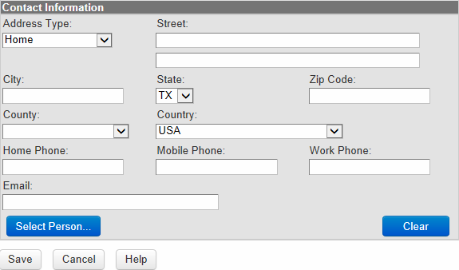
Create a New Record
Enter all available Contact Information.
Any unknown information should be left blank.
Select Save to continue.

Slide 28
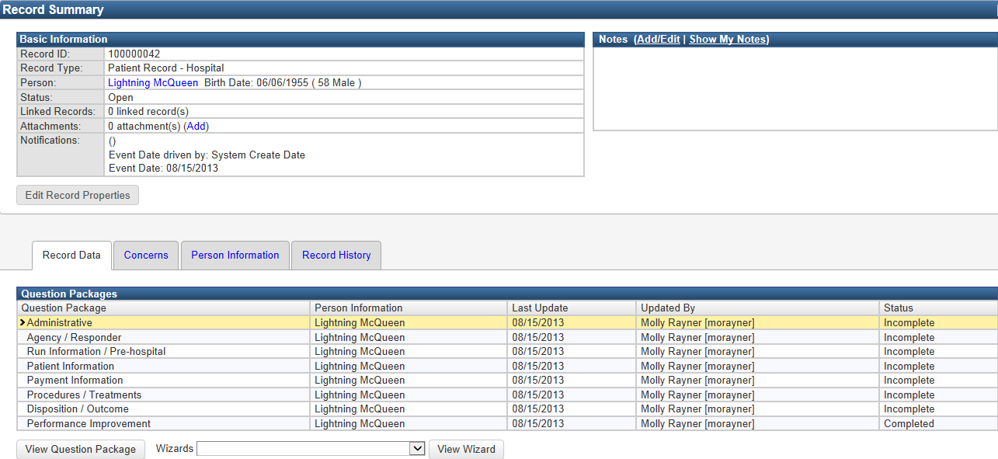
Record Summary
The Record Summary screen is an overview of Patient Record information.
There are four main sections to this screen.
1. Basic Information
2. Notes
3. Question Packages
4. Wizard
Notes:
Quick view of the entire screen. Areas of interest will be highlighted and enlarged in the following slides.

Slide 29
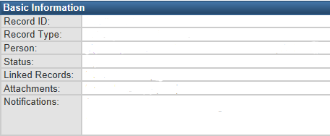
Record Summary
1. Basic Information
Unique ID assigned by the system
Type of event
Name of Person involved in event, birthdate, age
Current status of the event
Record linking will be done by DSHS
Files can be attached (i.e. EMS run sheet, report)
Contains custom information (i.e. hospital name, event date)
Notes:
Entities will not be able to link records or view linked records. However, this line will still display on the record dashboard. Users will not be able to see the linking DSHS does for aggregate data purposes.
Previous text from Notifications section – not sure what this is saying:
Notifications – any the event are displayed here, examples:
Incident date (when entered)
Age at incident (when both birth date and incident date entered)

Slide 30
Record Summary
2. Notes
The notes section is where you can enter any additional comments or information regarding the patient record.

Slide 31
Record Summary
3. Question Packages
Question Packages are groups of questions that share a common theme.
Do not enter your data using the Question Packages.
DSHS is only asking you to answer the questions located in the Wizard (shown on the next slide).
The Status will show Incomplete for some Question Packages after completing the Wizard – this is OK.

Slide 32
Record Summary
4. Wizard
The Wizard contains all currently Required questions.
Select the Wizard that displays in the drop down menu.
Select View Wizard to continue.

Slide 33
Record Summary
Wizard Selections
Wizards have been created for Hospital, EMS, and Submersion data entry.
EMS Legacy (NEMSIS Flow) Data Elements
Hospital Future National Data Standard Elements
Hospital Legacy (NTDB Flow) Data Elements
Submersion Required Data Elements
The “legacy” wizards contain the same fields that were collected in the previous trauma registry.
Notes:
When a wizard “follows the order of the NTDB or NEMSIS data dictionary,” it follows the order of the applicable data dictionary’s table of contents. Entities will not have to enter any additional required data elements than what was collected in the TRACIT system.

Slide 34
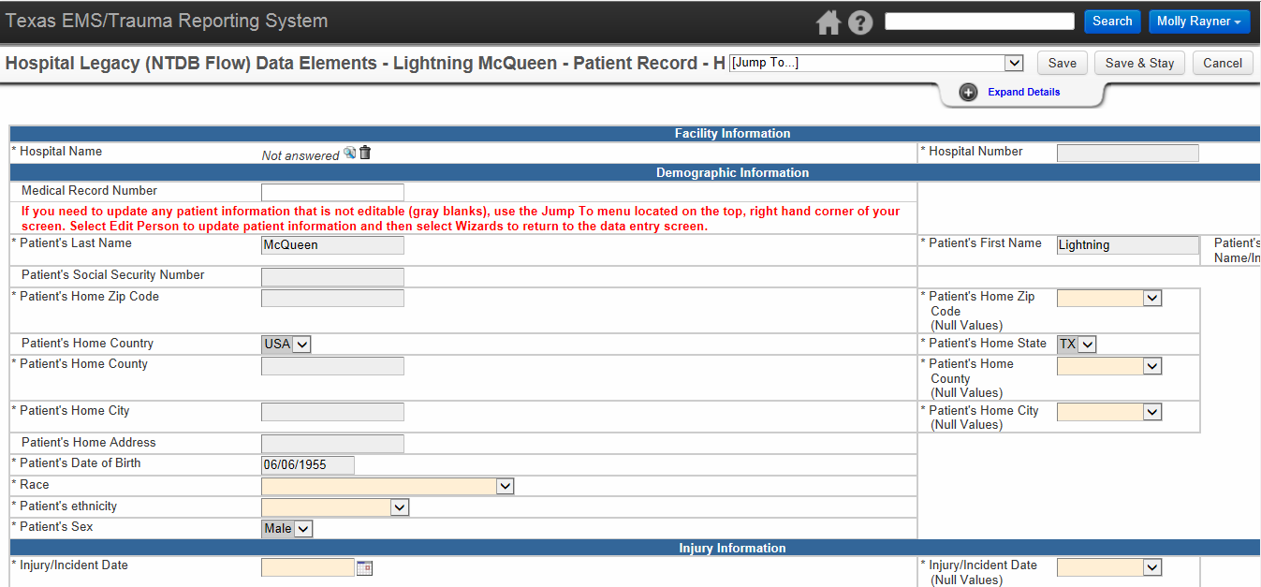
Data Entry Screen
The Wizard contains all currently required questions.
The data entry screen is broken into sections that align with the Question Packages.

Slide 35
Data Entry Screen - Header
The left side of the Header provides information about the current record including:
Question Package you are currently in (in this case you are in the Wizard)
Patient Name
Record Type

Slide 36
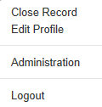
Data Entry Screen - Header
The right side of the Header provides a number of functions.
The Home, Help, and Search functions are the same as the main dashboard.
Close Record – same as Unload Record.
Edit Profile – edit details of your user account.
Administration – this only displays for Contract Managers/Administrators.
Logout – used to log out of the system

Slide 37
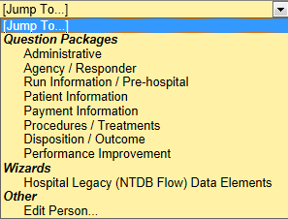
Data Entry Screen - Header
Save – save the record
Save & Stay – save the record and stay on this page
Cancel – go back
The Jump To menu is a way to quickly jump from one Question Package to another.

Slide 38
Data Entry Screen - Header
Select Expand Details to view the Status bar.
The Status bar shows whether or not you have answered all of the required questions.
If your Status says Completed, then you have entered all required information for this record.

Slide 39
Data Entry Screen - Entity Search
Facility Name – this required question is often missed.
It is important that to complete this field so the record links to your facility.
To search for your facility, select the magnifying glass.
Searching and selecting your facility auto-populates your Hospital Number (DSHS ID).
Notes:
This step must be completed to associate the record with the entity, even though that information may also be tied to the user. The search results will only return facility names for those entities the user is tied to and will auto-populate the DSHS Registry ID number, which makes selecting the entity simple.

Slide 40
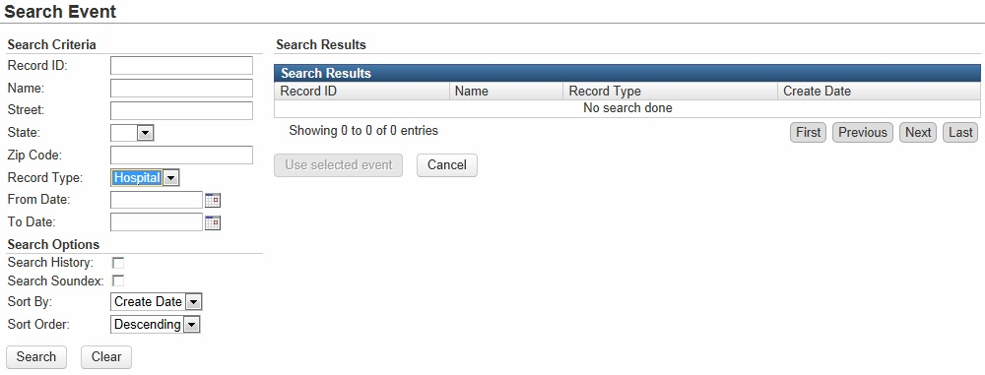
Data Entry Screen - Entity Search
The Record Type will default to your facility type.
Select Search to continue.

Slide 41
Data Entry Screen - Entity Search
Select your hospital by clicking it once.
The facility will be highlighted when selected.
Press ‘Use selected event’ to continue.
Alternatively, you can double-click on your facility to select it.

Slide 42
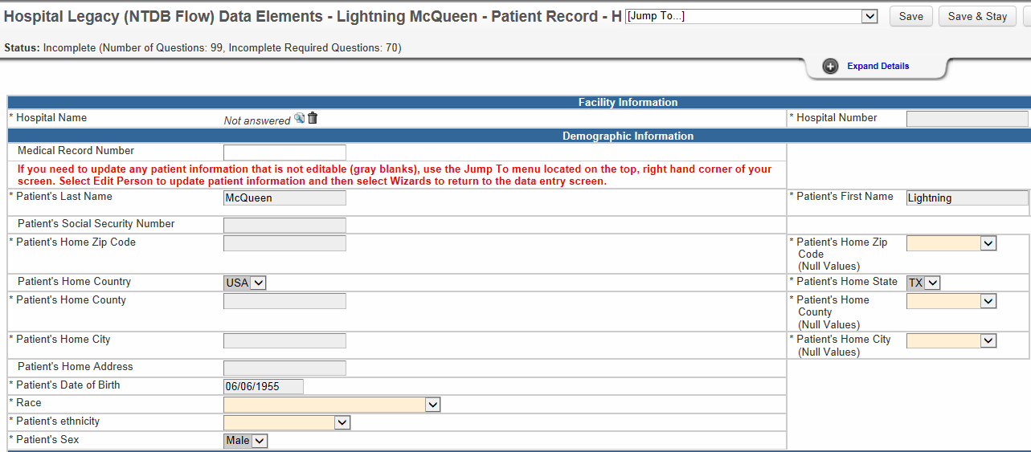
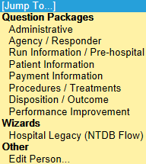
Data Entry Screen – Edit Person
If you need to update patient information that is not editable (gray blanks), use the Jump To menu located on the top, right hand corner of your screen.
Select Edit Person.
Notes:
This is the only way to edit the person’s demographic information in gray boxes. This information can’t be changed in the record itself. This allows the system to track all historical information for a single patient, including historical address and/or demographic information.

Slide 43
Searching for Records
Search Event

Slide 44
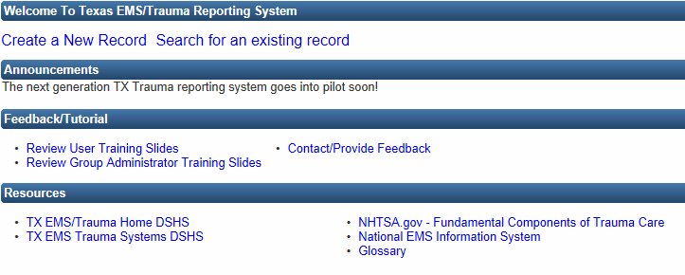
Search Event
To search for a specific record, select Search for an existing record located on the Main Dashboard.

Slide 45
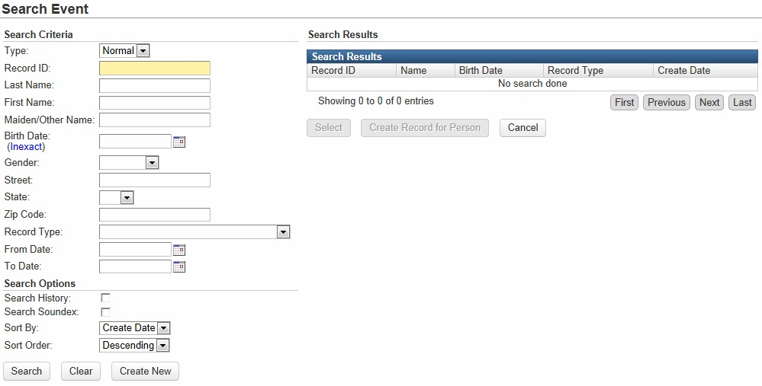
Search Event
The following fields may be used to search for a record:
Record ID
Last/First Name
Birth Date
Gender
State
Record Type
Patient Record – Hospital
Patient Record – EMS
Patient Record – Submersion
Notes:
Record Type may only be relevant for those users who report for both hospital and EMS entities and wish to limit the search by record type. “Patient Record – Submersion” will display for both hospital and EMS users if their entity has been given permission to report submersions.

Slide 46
Search Event
By selecting Inexact, you can search for a Birth Date range.
Allows the user to broaden the search to include historical information
When selected, historical demographic and/or address information is also compared against the search criteria.
Example: Old address
Allows the user to broaden the search beyond literal spelling of the search criteria.
Example: “Tom” will search on “Thom” and “John” will search on “Jack.”
Notes:
These three features can help the user find the right person if there is inaccurate or out-of-date information.
Birth date inexact link – changes from one date field to two date fields to search in a range instead of by specific date
Search history – the system tracks all demographic information kept in a patient’s record, even after it is updated, and this feature will search historical as well as current information
Some additional examples of names returned when the first name “John” is searched for using the Search Soundex feature (not a complete list):
Johnny
Juan
Johnnie
Jon
Jonathan
Johnathan
Jimmy

Slide 47
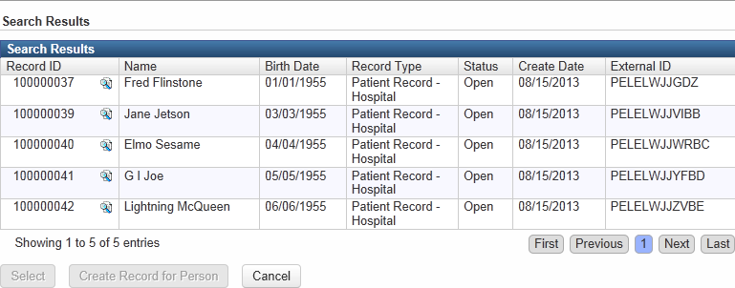
Search Event
An entity may only search for records reported by that specific entity
Records reported by other entities will not display in the Search Results

Slide 48
Roster Import (Upload Data File)
Import Roster

Slide 49
Roster Import
Entities will continue to use the same data extract file previously used to upload data to the “current” EMS/Trauma Registry (aka TRACIT or TXETRA).
DSHS will work with software vendors on the new data set before any entities are asked to upload the new file format.
New data set will include national elements from NTDB and NEMSIS.
NTDB – National Trauma Data Bank (hospitals)
NEMSIS – National EMS Information System (EMS)
Notes:
Submersion data fields also can’t be reported through electronic data import until software vendors are able to update their programs.

Slide 50
Roster Import – Hospital File
The following fields must be populated in every record:
Trauma registry number
EMS/Trauma Registry ID number
Last name and first name*
*If the person’s name is unknown, use “Unknown” for first and/or last names
Sex
Date of birth
County – of residence
Transfer status – from another facility
Transferring hospital number – transferring hospital’s DSHS EMS/Trauma Registry ID number, if person was transferred in.
Hospital disposition
Patient discharged to facility number – accepting facility’s DSHS EMS/Trauma Registry ID number, if hospital disposition indicates person was discharged to another facility.
ED/Hospital arrival date
Any records without these fields will be rejected
Notes:
A field is considered “populated” even if the answer is a null value (“not applicable” or “unknown”). There must be something in the field, it just can’t be blank.

Slide 51
Roster Import – EMS File
The following fields must be populated in every record:
EMS/Trauma Registry ID number
PSAP call date
Last name and first name*
*If the person’s name is unknown, use “Unknown” for first and/or last names
Sex
Date of birth
Incident county
Destination type
Destination code –receiving hospital’s DSHS EMS/Trauma Registry ID number, if destination type indicates patient was taken to a hospital
Patient care report number
Any records without these fields will be rejected
Notes:
A field is considered “populated” even if the answer is a null value (“not applicable” or “unknown”). There must be something in the field, it just can’t be blank.

Slide 52
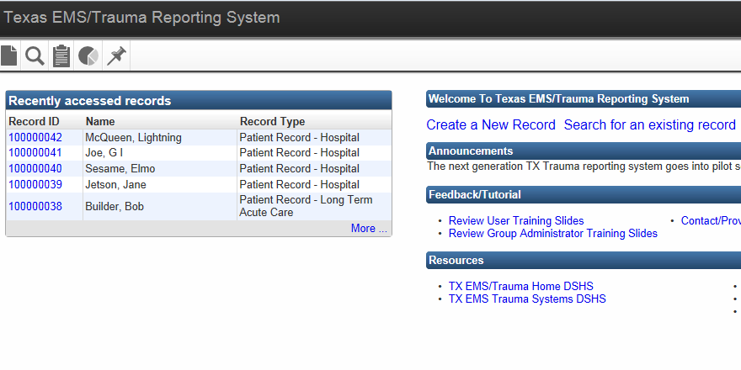
Roster Import
Select the Import Roster button/icon located in the Navigation Toolbar on the Main Dashboard.

Slide 53
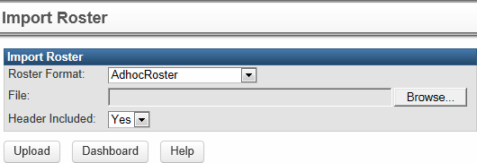
Roster Import
Roster Format – indicate what type of file you are uploading:
EMSRosterImport
HospitalRosterImport

Slide 54
Roster Import
File – attach your import file here using the Browse button.
Header Included
Indicate if your import file contains or does not contain headers (e.g. column headers in Excel).
If the first record in the file is “real data,” change Header Included to “No” or the first record will not be imported.
After you have attached the import file, select the Upload button.
Notes:
Leaving Header Included to “Yes” tells the system the first row in the file is not a record. Leaving this field on “Yes” tells the system to ignore the first row in the data file.

Slide 55
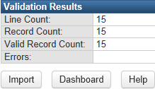
Roster Import
After selecting Upload, the Validation box will appear with the following information:
Line count – total number of lines in the file, including the header row.
Record count – total number of records listed in the file.
Valid record count – total number of valid records in file.
Errors – if there are any errors in the import process, they will be noted in this field (e.g. unaccepted file format.)
When you are ready to Import the file, select the Import button.
Notes:
After selecting the Upload button, the Validation Results box appears directly below the previous screenshot. The screen can help ensure there aren’t any major problems with the data file before actually importing the data into the registry.
Record Count and Valid Record Count are listed as “0” because the Header Included option on the previous screen was not selected correctly. There was only one record (line) in this file but it was not a header, however the field was left to the setting of “Yes” which told the system to ignore the first row in the file. The file must be reattached, the Header Included field set to the proper selection, and select the Upload button again.
The data file will not be imported into the system until the user selects “Import.”

Slide 56
Roster Import
Review the Recent Queued Roster Imports to check the status of your data upload.
The Status will be listed as “Unprocessed” until the entire file has been processed.
Select Refresh to check the status of the import.
If the file uploaded correctly, the status will change from “Unprocessed” to “Successful.”
Select Download Results to review the log regarding the specific file and any errors that may have occurred*
*See import error results on next slide. The file contained errors for demonstration purposes.

Slide 57
Roster Import – Results Log
Only the person who uploads the file can see the Results Log.
There are five sections of the Results Log.
Each section is a line listing of all successfully processed records.
Section 1: Import Errors
Section 2: Import Message
Section 3: Detail Log
Section 4: Full Log – (for DSHS use only)
Section 5: Summary

Slide 58
Roster Import – Results Log
Section 1: Import Error
Import Error – catastrophic mistake or incorrect format of data and record rejected.
Catastrophic mistake – invalid data choice
Date 09/09/9999 – should choose a Null Value instead
Entity reporting number – 1111111` should be 1111111
Spaces
Format
Must be ASCII tab delimited
Hospitals – 9 fields (mandatory)
EMS – 8 fields (mandatory)
Section 2: Import Message
Import Message [Warning] – a mistake to be corrected, but record not rejected.

Slide 59
Roster Import – Results Log
Section 3: Detail Log
Detail Log – List of accepted records with patient names and corroborating entity and record numbers.
Row 1 modified existing event 333333333 and modified existing person SUZANNE L SUMMER.
Section 4: Full Log – (for DSHS use only)

Slide 60
Roster Import – Results Log
Section 5: Summary
Summary – Overall statistics about the data file submission.
~*~*~*~*~*~* Import Summary *~*~*~*~*~*~
[INFO ] [] 2012/07/26 08:57:44 Rows in feed : 1
[INFO ] [] 2012/07/26 08:57:44 Records in feed : 1
[INFO ] [] 2012/07/26 08:57:44 Records processed successfully : 1
[INFO ] [] 2012/07/26 08:57:44 Records with errors : 0
[INFO ] [] 2012/07/26 08:57:44 Records skipped : 0
[INFO ] [] 2012/07/26 08:57:44 New Cases Created : 1
[INFO ] [] 2012/07/26 08:57:44 New Parties Created : 1
[INFO ] [] 2012/07/26 08:57:44 Deduplicated and Updated Parties : 0
[INFO ] [] 2012/07/26 08:57:44 Deduplicated and Updated Cases : 0
[INFO ] [] 2012/07/26 08:57:44 Deduplicated and Not Updated Parties : 0
[INFO ] [] 2012/07/26 08:57:44 Deduplicated and Not Updated Cases : 0
[INFO ] [] 2012/07/26 08:57:44 Import finished successfully after 0 seconds.

Slide 61
Roster Import – Results Log
Exception: Record 1111111_3333333
(Import Errors & Import Messages)
The Results Log lists the records using a specific numbering system.
Understanding this numbering system will help you identify the record with the issue.
This number is 6 or 7 digits followed by an underscore symbol followed by another number.
The number listed before the underscore symbol is your Entity ID number.
The number listed after the underscore symbol is the unique sequential ID your entity issues to each record.

Slide 62
Roster Import – Results Log
Maven Created Record ID (Detailed Messages)
Row 1 modified existing event 444444444 and modified existing person DIANE L SUMMER
When submitting a data file, Maven creates a unique sequential ID = Record ID
You can search for your records to view the data by using the Record ID or by Patient Name (see slides 43-47).
Records are viewable for 730 days or 2 years.

Slide 63
Recently Accessed Records
Recently Accessed Records

Slide 64
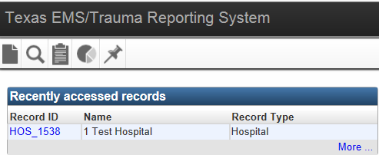
Recently Accessed Records
There are two options to go to the Recently Accessed Records screen.
Selecting the icon
Selecting More…

Slide 65
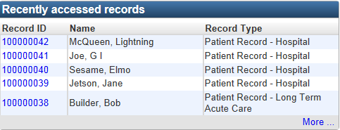
Recently Accessed Records
The Recently Accessed Records on the Dashboard displays the last 5 records that were accessed.
To see more records, either select the icon or select More.

Slide 66
Recently Accessed Records
The Recent Events screen displays the last 20 accessed records.
By selecting the star, you can bookmark specific cases.
To remove a bookmark, select the star again.
Bookmarked cases do not count toward the 20 recent events displayed in the list.
Cases will remain in the Recent Events list until they are removed by the user.

