Slide 1
COVID-19 Trends
Jennifer A. Shuford, MD, MPH
Texas Department of State Health Services
October 13, 2021

Slide 2
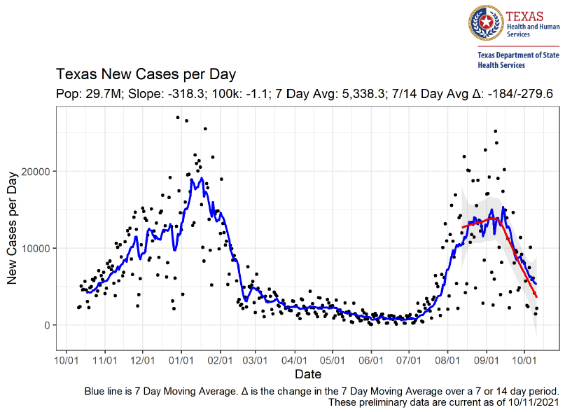

Slide 3
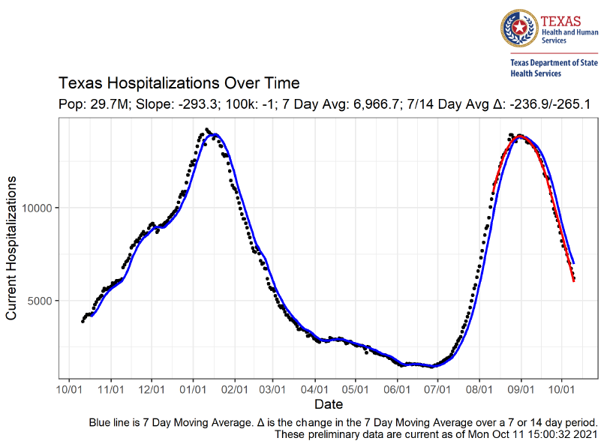

Slide 5
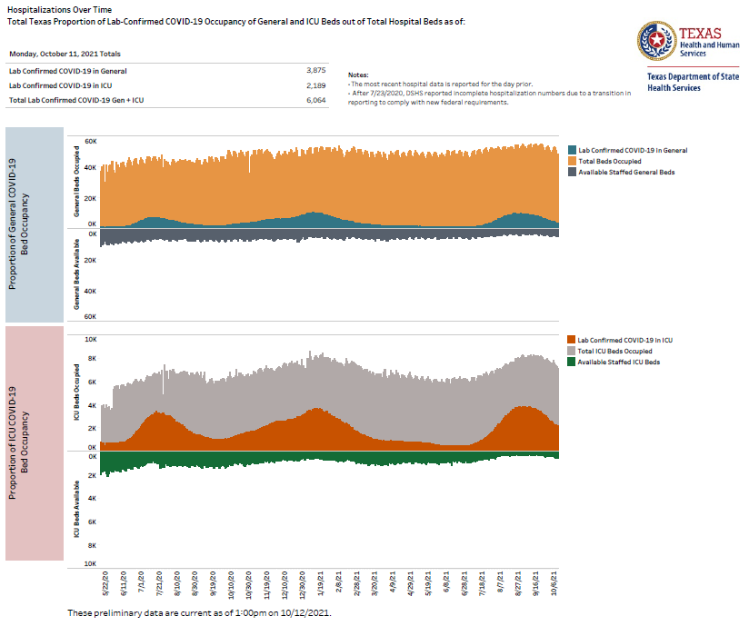

Slide 6
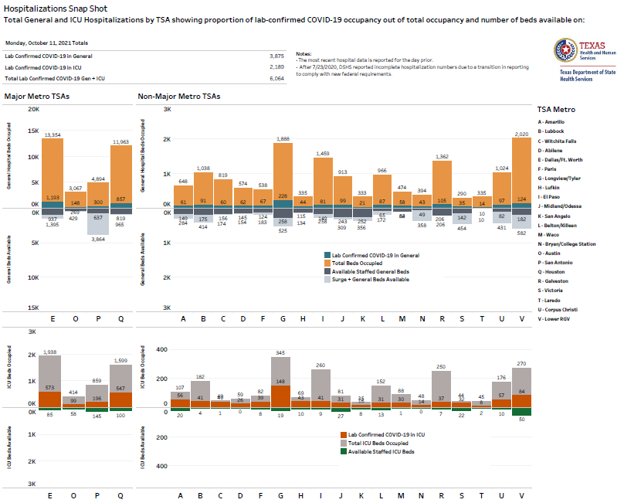

Slide 7
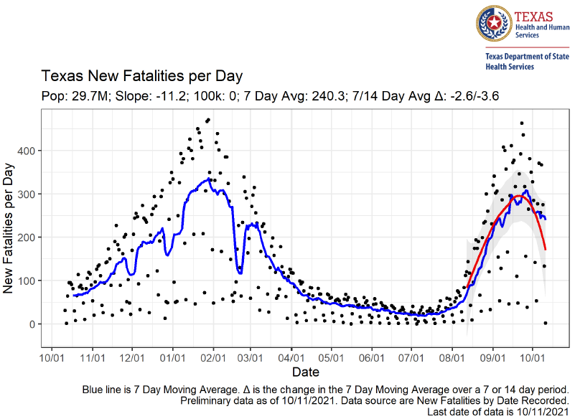

Slide 8
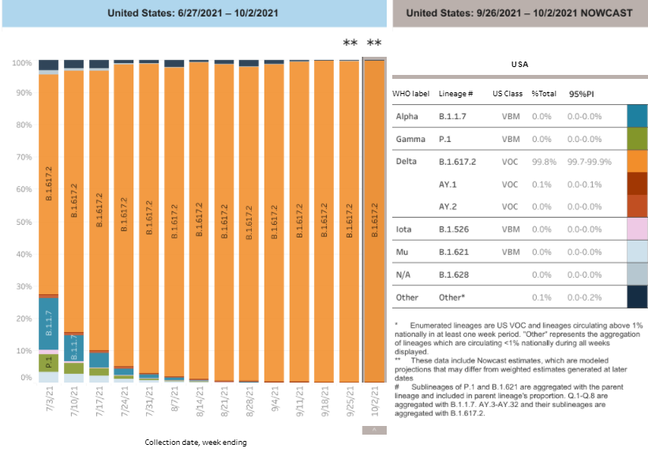
CDC- National Data, 6/27/2021 – 10/2/2021
Available at: https://covid.cdc.gov/covid-data-tracker/#variant-proportions. Accessed 10/13/2021.

Slide 9
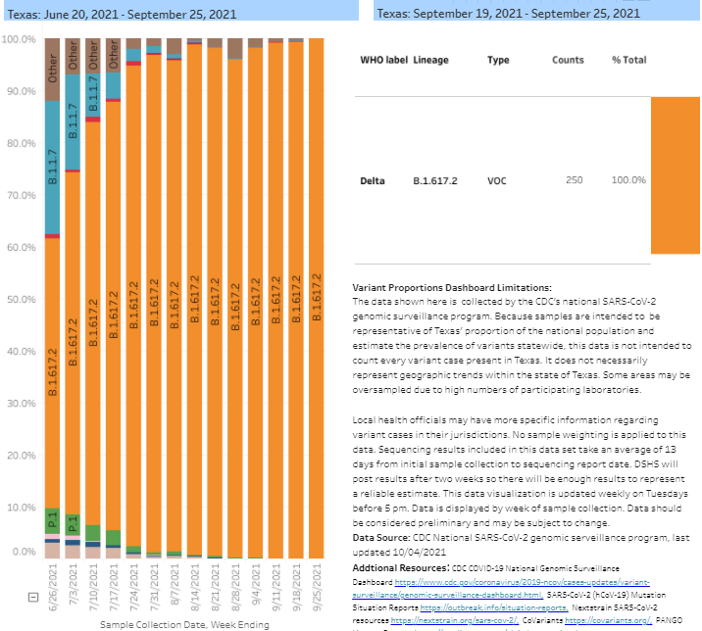
CDC- Texas Data, 6/19/2021 – 9/25/2021
Available at: https://dshs.texas.gov/coronavirus/variants-data.aspx. Accessed 10/13/2021.

Slide 10
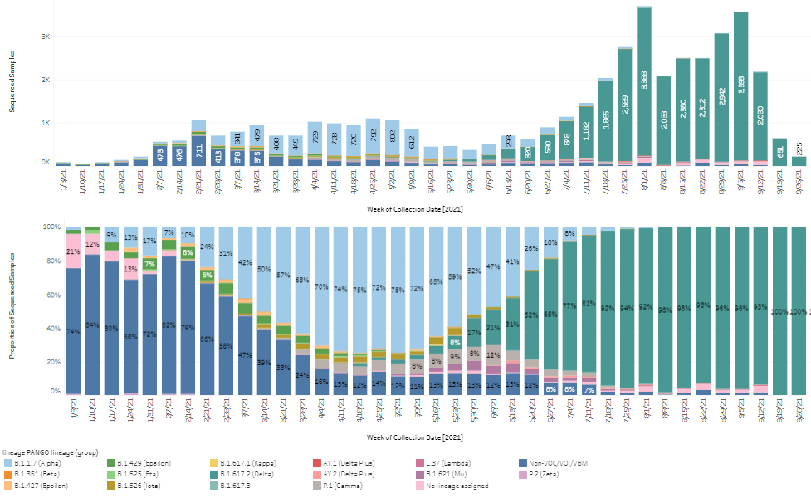
CDC- Texas Data, 12/28/2021 – 9/26/2021*
*Preliminary data. Subject to change.

Slide 11
DSHS and COVID-19 Therapeutics
Therapeutics that may be available soon
Molnupiravir
Long-acting monoclonal antibodies
Others?
Questions about ordering: therapeutics@dshs.texas.gov

Slide 12
Thank you!
Jennifer A. Shuford, MD, MPH
Jennifer.Shuford@dshs.texas.gov

