Slide 1
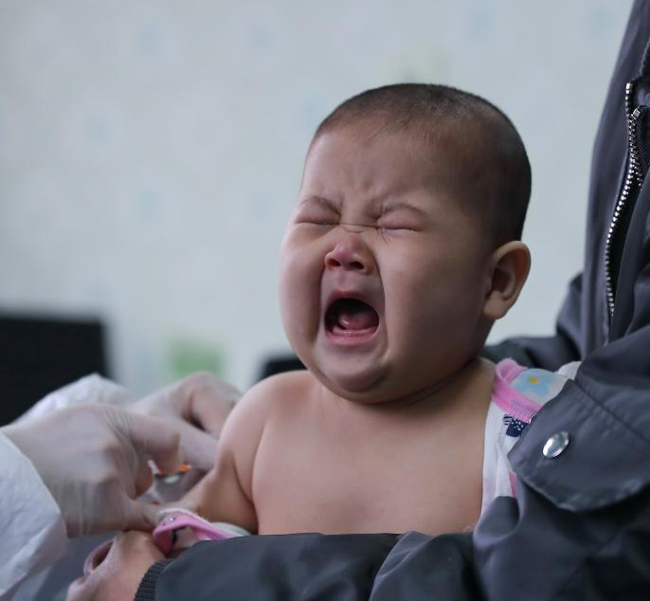

Slide 2
PHFPC COVID-19 Vaccine Debriefing
The information presented today is based on CDC’s recent guidance and MAY change.
Saroj Rai, PhD, MPH
Senior Scientific Advisor| Office of Chief State Epidemiologist
May 25, 2022

Slide 3
COVID-19 Vaccination
The information presented today is based on CDC’s recent guidance and MAY change.
May 25, 2022

Slide 4
COVID-19 Vaccine Updates

Slide 5
Terminology for COVID-19 Vaccine Use
Primary series:
For most people, a 2-dose series of an mRNA COVID-19 vaccine (Pfizer-BioNTech and Moderna) or a single dose of Janssen COVID-19 Vaccine.
For people who are moderately or severely immunocompromised, a 3-dose series of an mRNA COVID-19 vaccine or a single dose of Janssen COVID-19 Vaccine.
Additional dose: A subsequent dose of vaccine administered to people who were less likely to mount a protective immune response after initial vaccination. People who are moderately or severely immunocompromised and who received Janssen COVID-19 Vaccine for their primary series should receive an additional dose.
Booster dose: A subsequent dose of vaccine administered to enhance or restore protection which might have waned over time after primary series vaccination.
Homologous booster dose: The same vaccine product used for the booster dose was administered for the primary series.
Heterologous booster dose (mix-and-match booster): The vaccine product used for the booster dose differs from the product administered for the primary series.
Up to date: People ages 5 years and older are up to date with their COVID-19 vaccines when they have received all doses in the primary series and all booster doses recommended for them, when eligible.
People >50 yrs and people who are moderately or severely immunocompromised should get a second booster dose to be up to date.
People ages 18 - 49 yrs who received a Janssen COVID-19 vaccine for both their primary and booster dose may get a second booster dose of either Pfizer or Moderna COVID-19 vaccine, but the second booster dose is not required to be considered up to date.
CDC Interim Clinical Considerations

Slide 6
COVID-19 Vaccines Approved or Authorized in the United States
May 23, 2022
Dose 1
 | Age Indication | Vaccine Vial Cap Color | Dilution Required | Primary Series |  | Booster Dose ^{b}
 |  |  |  | Dose | Injection Volume | Dose | Injection Volume
Pfizer | 5 – 11 years | Orange | Yes | 10 mcg | 0.2 mLª | 10 mcg | 0.2 mLª
Pfizer | > 12 years | Gray | No | 30 mcg | 0.3 mL | 30 mcg | 0.3 mL
Moderna | > 18 years | Red^{d} | No | 100 mcg | 0.5 mL | 50 mcg | 0.25 mL
Moderna | > 18 years | Blue^{d} | No | NA | NA | 50 mcg | 0.5 mL
J&J’s Janssen^{c} | > 18 years | Blue | No | 5×10¹⁰ viral particles | 0.5 mL | 5×10¹⁰ viral particles | 0.5 mL
a: Dose based on age at the time of the vaccination
b: Booster doses may be mix and match for individuals >18 yrs, mRNA vaccines are preferred : Booster dose may be mix-and-match vaccine
c: mRNA COVID-19 vaccines are preferred over the J&J COVID-19 vaccine
d: Either Moderna COVID-19 Vaccine supplied in a vial with a red cap (0.25 mL injection volume) or Moderna COVID-19 Vaccine supplied in a vial with a blue cap (0.5 mL injection volume)
can be used to administer a 50-mcg booster dose.
CDC Interim Clinical Considerations

Slide 7
May 23, 2022 | COVID-19 Vaccination Schedule for People Who are NOT Moderately or Severely Immunocompromised |  | Booster Dose
 | Number of Doses in Primary Series | Number of Booster Doses+ | Interval between 1st Dose and 2nd Dose* | Interval between 2nd Dose and Booster Dose^{b}
Pfizer (5-11 years) (orange cap) | 2 | 1 | 3 weeks | > 5 months
Pfizer (>12 years) (gray cap) | 2 | 1 | 3-8 weeks | > 5 months
Moderna (>18 years) (blue cap) | 2 | 1 | 4-8 weeks | > 5 months
J&J’s Janssen (>18 years)^{c} | 1 | 1 | NA | > 2 months (between dose 1 and booster dose)
Dose 1
February 22, 2022
+Number of booster doses for people who are NOT moderately or severely immunocompromised are as follows:
All people >5 years: Should receive 1 booster dose of an age-appropriate COVID-19 vaccine; an mRNA vaccine is preferred.
People ages 18-49 years: Those who received Janssen COVID-19 Vaccine as both their primary series dose and booster dose may receive a second booster dose using an mRNA COVID-19 vaccine at least 4 months after the Janssen booster dose.
People >50 years: Should receive a second booster dose using an mRNA COVID-19 vaccine at least 4 months after the first booster
*An 8-week interval may be optimal for some people ages 5 years and older, especially for males ages 12–39 years. A shorter interval (3 weeks for Pfizer; 4 weeks for Moderna) between the first and second doses remains the recommended interval for people who are moderately or severely immunocompromised; adults ages 65 years and older; and in situations in which there is increased concern about COVID-19 community levels or an individual’s higher risk of severe disease.
CDC Interim Clinical Considerations

Slide 8
May 23, 2022 | COVID-19 Vaccination Schedule for People Who Are Moderately or Severely Immunocompromised |  | Booster Dose
 | Number of Doses in Primary Series | Number of Booster Doses | Interval between 1st Dose and 2nd Dose | Interval between 2nd dose and 3rd Dose | Interval between 3rd Dose and 1st Booster doseª
Pfizer (5-11 years) (orange cap) | 3 | 1 | 3 weeks | > 4 weeks | > 3 months
Pfizer (>12 years) (purple → gray cap) | 3 | 2 | 3 weeks | > 4 weeks | > 3 months
Moderna (>18 years) | 3 | 2 | 4 weeks | > 4 weeks | > 3 months
J&J’s Janssen (>18 years)^{b*} | 1 Dose Janssen, followed by 1 Dose of mRNA vaccine | 2 | 4 weeks | > 2 months | NA
March 29, 2022
*mRNA COVID-19 vaccines are preferred over J&J COVID-19 vaccine.
Number of booster doses for people who are moderately or severely immunocompromised:
All people ages 5 years and older: Should receive 1 booster dose of an age-appropriate COVID-19 vaccine; an mRNA COVID-19 vaccine is preferred.
People ages 12 years and older: Should receive a second booster dose using an age-appropriate mRNA COVID-19 vaccine at least 4 months after the first booster dose.
.
CDC Interim Clinical Considerations

Slide 9
COVID-19 Vaccine Pediatric
Moderna: 6 months – 5 years
Pfizer: 6 months – 4 years

Slide 10
COVID-19 Vaccines for Pediatric
6 months – 4/5 years
Both Moderna and Pfizer are in the going through the regulatory process with the FDA for their respective COVID-19 vaccine in 6 months – 4/5 years of age
  Moderna COVID-19 vaccine (6 months – 5 years)
  Pfizer COVID-19 vaccine (6 months – 4 years)
Both manufacturers have a different vaccine products than their current vaccine products in-use
  Moderna COVID-19 vaccine blue cap vial
    0.25 mL/25 mcg per dose
    2-dose primary series, @28 days apart
  Pfizer COVID-19 vaccine maroon cap vial
    0.2 mL after dilution (3 mcg per dose )
    3-dose primary series, @dose intervals?

Slide 11
Path to COVID-19 Vaccine Authorization for Pediatric (6 mos - 5 yrs)
FDA Advisory
VRBPAC Meeting
CDC (ACIP) Recommendations
CDC Director’s Sign-Off
Begin Vaccination
FDA Authorization
Three tentative VRPABC meeting dates:
June 15, 2022
Date Unknown
Date Unknown
Date Unknown
Date Unknown
FDA: Food and Drug Administration
VRBPAC: Vaccine and Related Biological Products Committee
ACIP: Advisory Committee on Immunization Practices

Slide 12
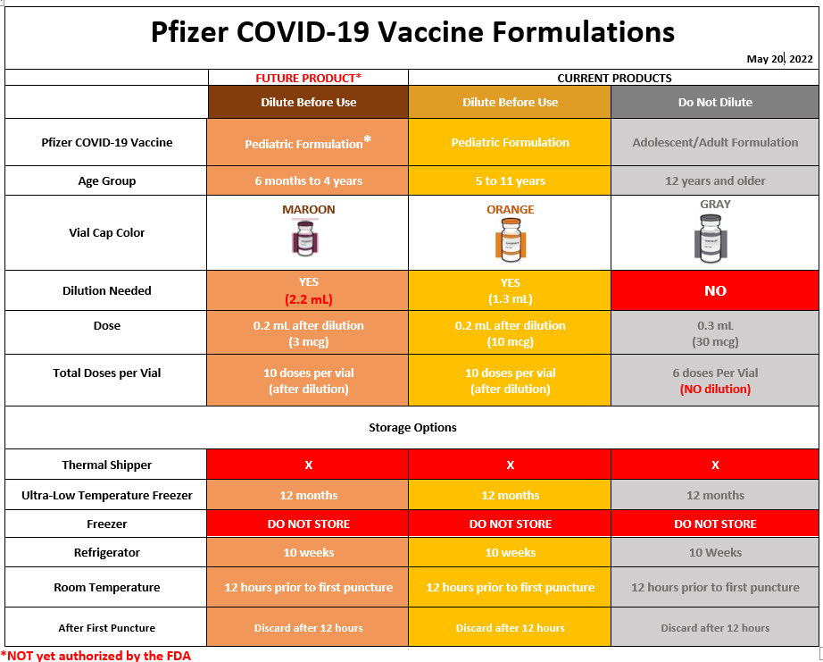

Slide 13
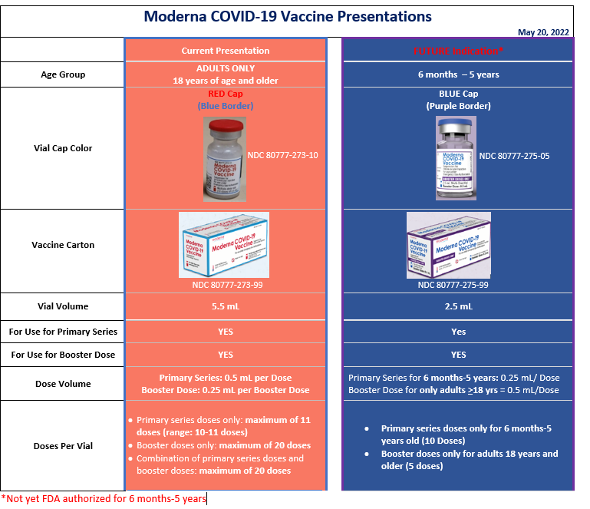

Slide 14
COVID-19 Vaccination
Texas Overall Summary

Slide 15
 | Population Estimates | People Fully Vaccinated | People with a First booster dose | People with a Second booster dose
Total Texas Pop | 28,995,881 | 17,672,479 | 6,872,761 | 689,425
Population ≥5 yrs | 26,967,586 | 17,671,131 | 6,872,711 | 689,424
Population ≥12 yrs | 24,068,624 | 16,929,481 | 6,867,585 | 689,234
Population ≥18 yrs | 21,596,071 | 15,456,839 | 6,609,007 | 688,014
Population ≥65 yrs | 3,734,229 | 3,194,801 | 2,087,913 | 442,115
17M
People Fully Vaccinate
6M
People with a First booster dose*
679K
People with a second booster dose**
People Vaccinated includes first doses of Moderna and Pfizer and single doses of Janssen. Fully Vaccinated includes second doses of Moderna and Pfizer and single doses of Janssen.
*First Additional Doses is the first dose after primary series completion if dose administered is after 8/13/21.
** Second Additional Doses is the second additional dose given after primary series completion if dose administered is after 8/13/21.
Data as of 5/23/2022

Slide 16
Vaccination coverage by age group
People Vaccinated | 0% | 37% | 75% | 76% | 72% | 78% | 85% | 90% | 99% | 92%
Fully Vaccinated | 0% | 26% | 59% | 61% | 58% | 65% | 73% | 79% | 88% | 82%
Data as of 5/23/2022

Slide 17
COVID-19 Vaccine
First Booster Dose

Slide 18
Data as of 5/23/2022

Slide 19
Fully Vaccinated Individuals Eligible for Booster – All Vaccines
Age Group | 2019 Texas Population | Total Eligible Individuals as of May Remaining Due for Booster* | Eligible Individuals Received at least One Additional/Booster Dose
Age 5-11 yrs | 2,898,962 | 360,793 | 5,126
Age 12-17 yrs | 2,472,553 | 1,090,543 | 258,578
Age 18-64 yrs | 17,861,842 | 7,327,519 | 4,521,094
Age >65 yrs | 3,734,229 | 1,041,239 | 2,087,913
*Eligible population includes December 2020 to January 2021 for 2-dose vaccines and December 2020 to March 2022 for J&J vaccine. Individuals who received an additional dose after
8/13/21 are not included in the projection. As of 1/10/22, 2-dose vaccines are projected at 5 months and 2 months for J&J vaccine per ACIP recommendations.
Data as of 5/23/2022

Slide 20
COVID-19 Vaccine
Second Booster Dose

Slide 21
Individuals >50 yrs Eligible for 2nd Booster By Month (All Vaccines)
8,710,162
TX >50 yrs total pop
7,132,530
(82%)
People >50 yrs fully vaccinated¹
3,371,582
(39% total pop)
People >50 yrs received first booster dose² and eligible for a Second booster by Sept 22
Individuals>50 yrs Eligible for 2nd Booster By Month (All Vaccines) ³ | Total
22-May | 3,004,020
22-Jun | 125,730
22-Jul | 80,464
22-Aug | 107,119
22-Sep | 54,249
1. Fully Vaccinated includes second doses of Moderna and Pfizer and single doses of Janssen.
First Booster doses includes all additional/booster doses administered on or after 8/13/21.
Second booster dose projected for 4 months post first booster dose by month.
Data as of 5/23/2022

Slide 22
Data as of 5/23/2022

Slide 23
First doses 7-day Rolling Average includes 1st doses of Moderna, Pfizer, and single doses of Janssen.
Second Doses 7-day Rolling Average includes 2nd doses of Moderna and Pfizer.
First Additional/Booster Doses is the first dose after primary series completion if dose administered is after 8/13/21.
Second Additional/Booster Doses is the second additional/booster dose given after primary series completion if dose administered is after 8/13/21.
Data as of 5/23/2022

Slide 24
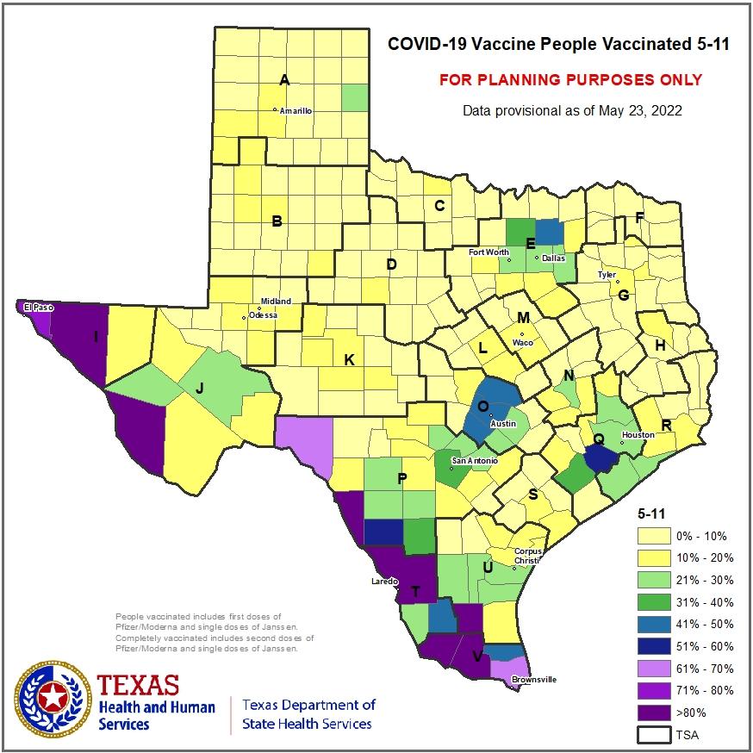
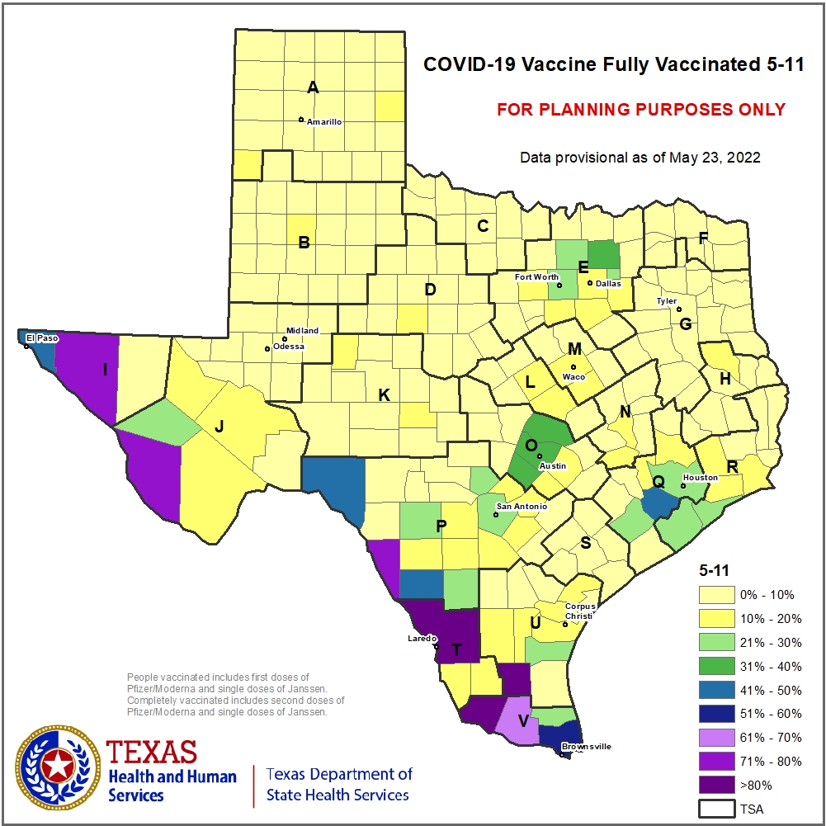
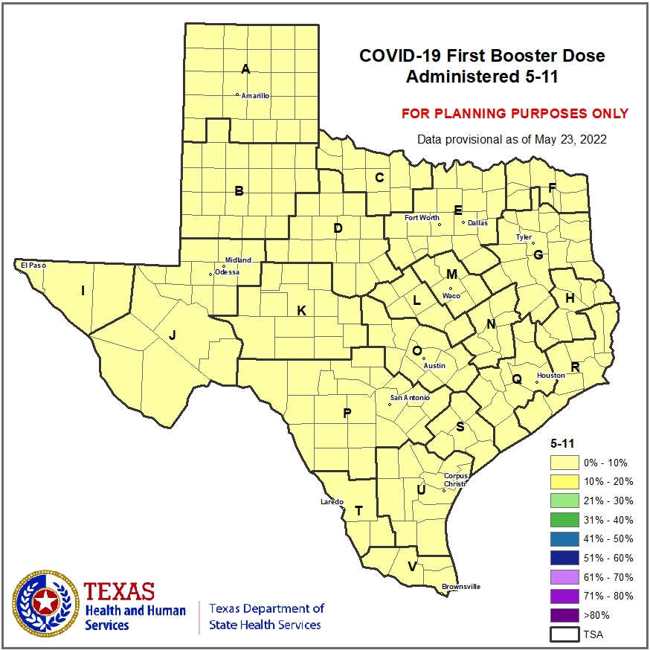

Slide 25
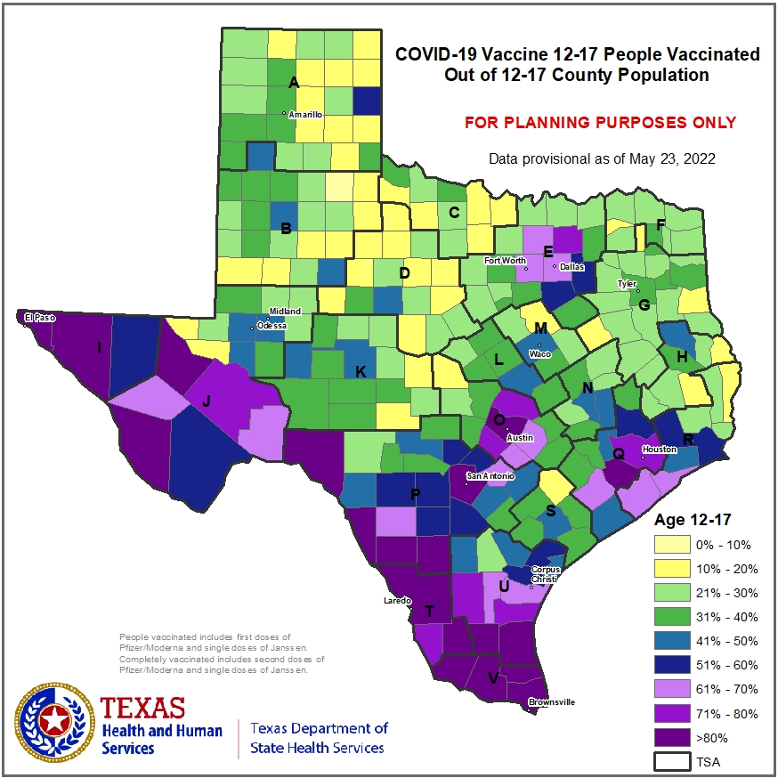
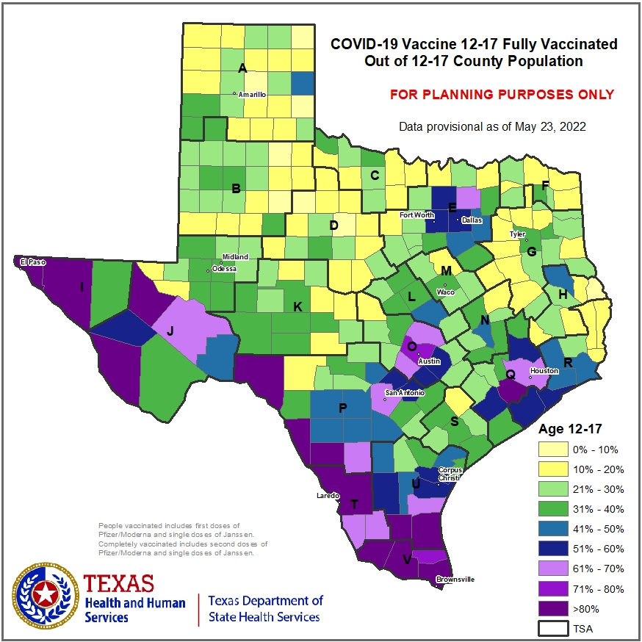
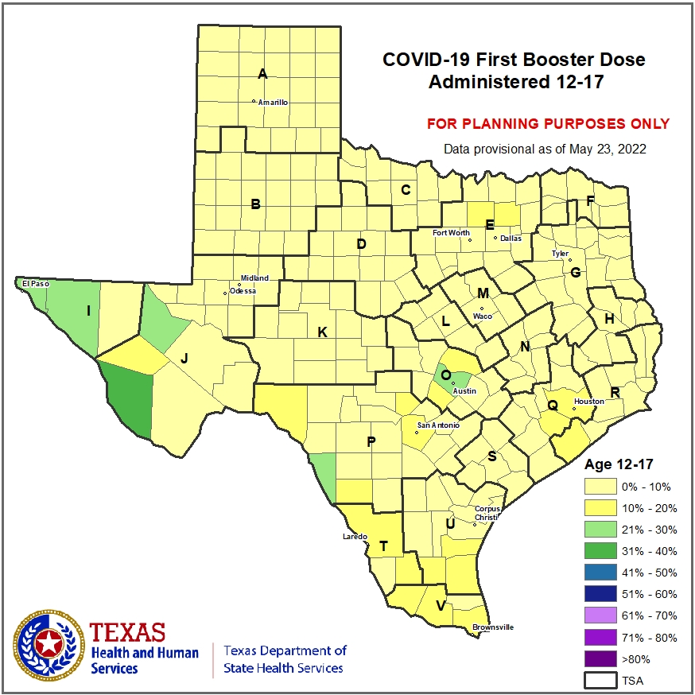

Slide 26
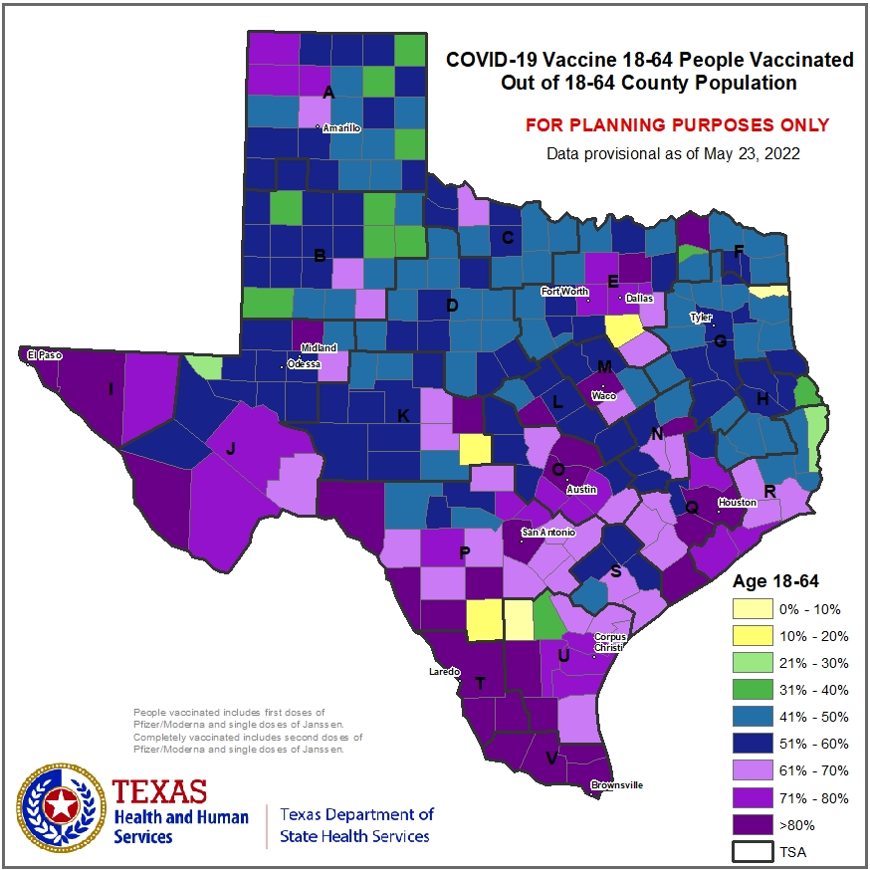
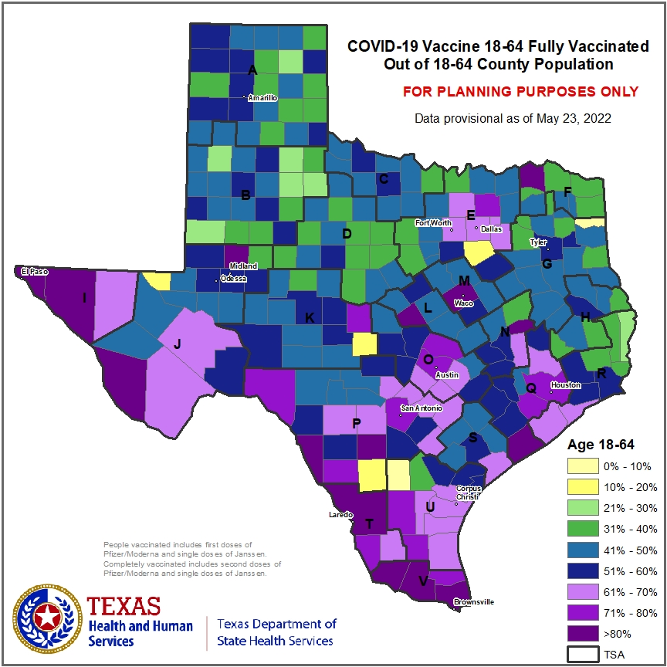
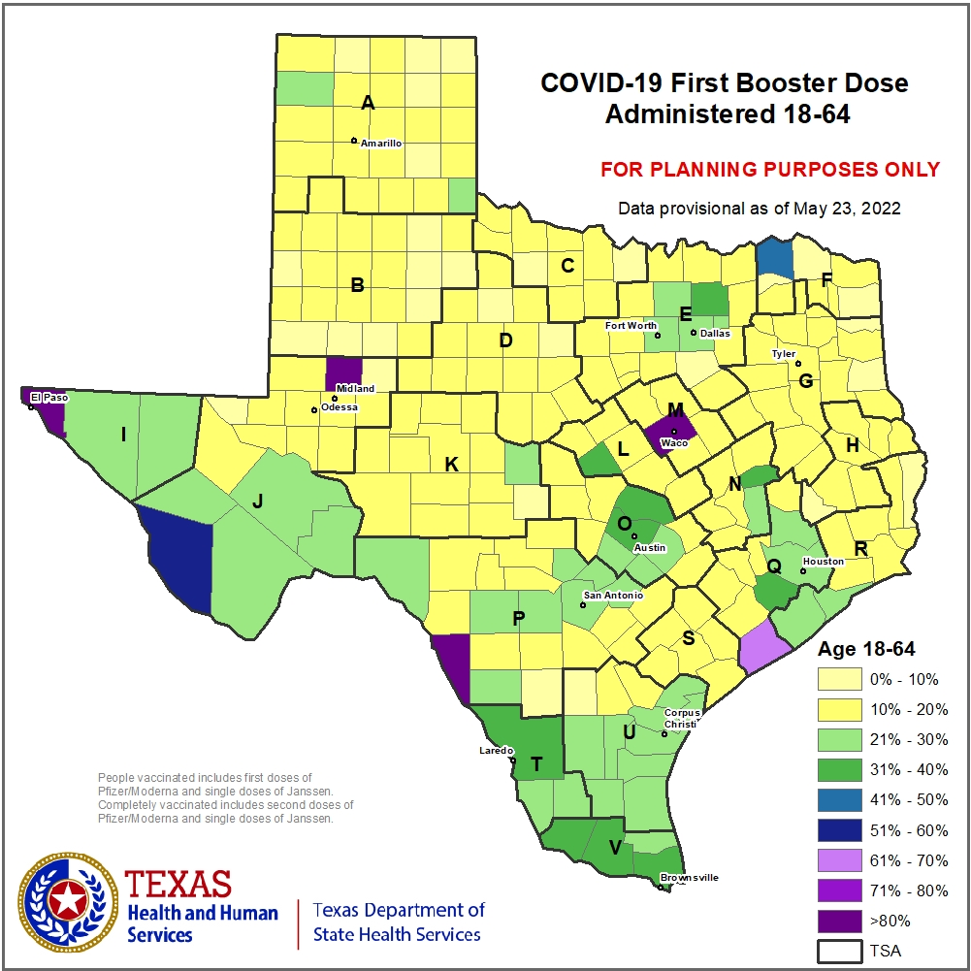

Slide 27
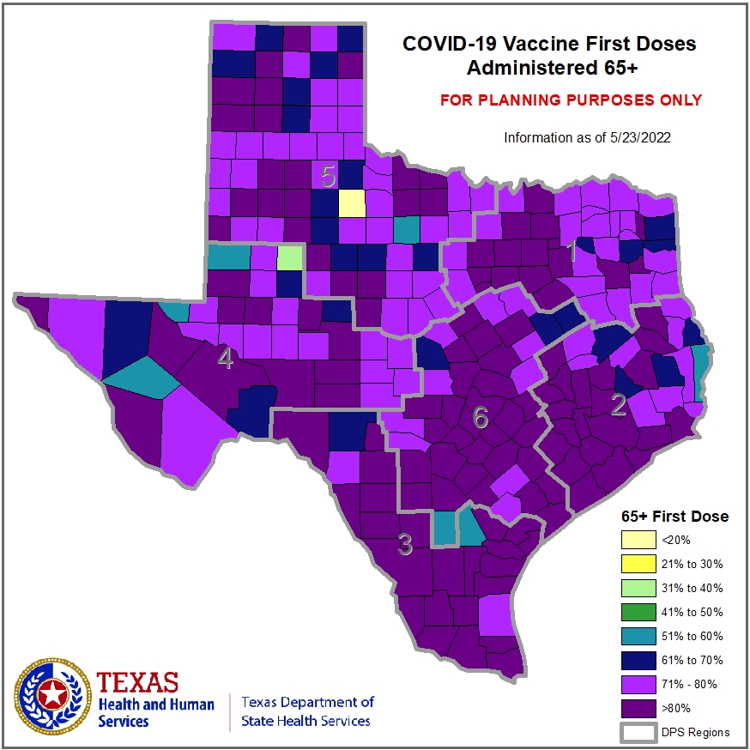
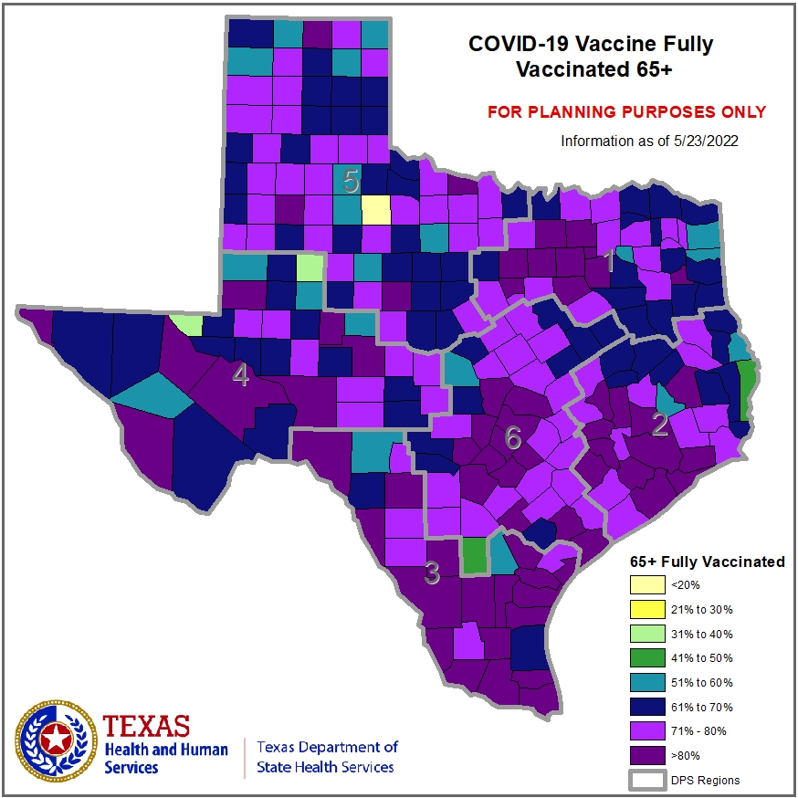
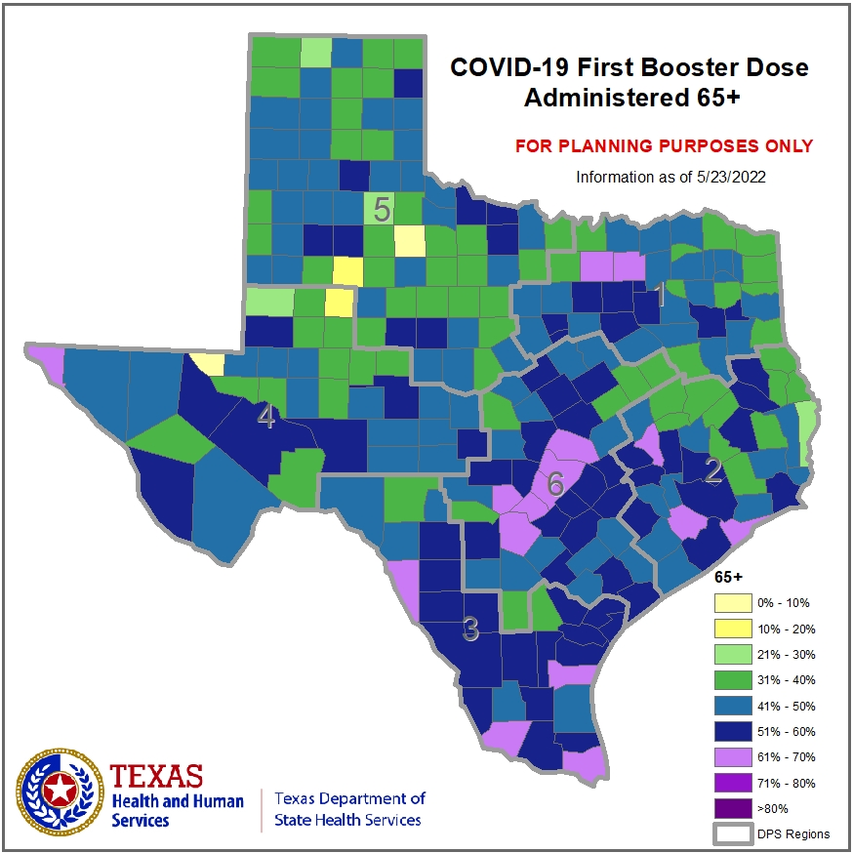

Slide 28
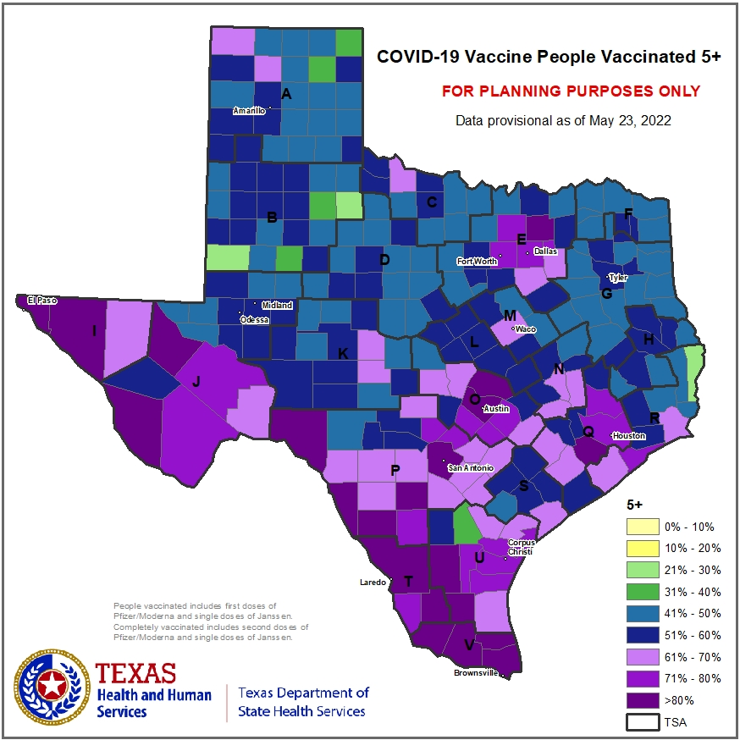
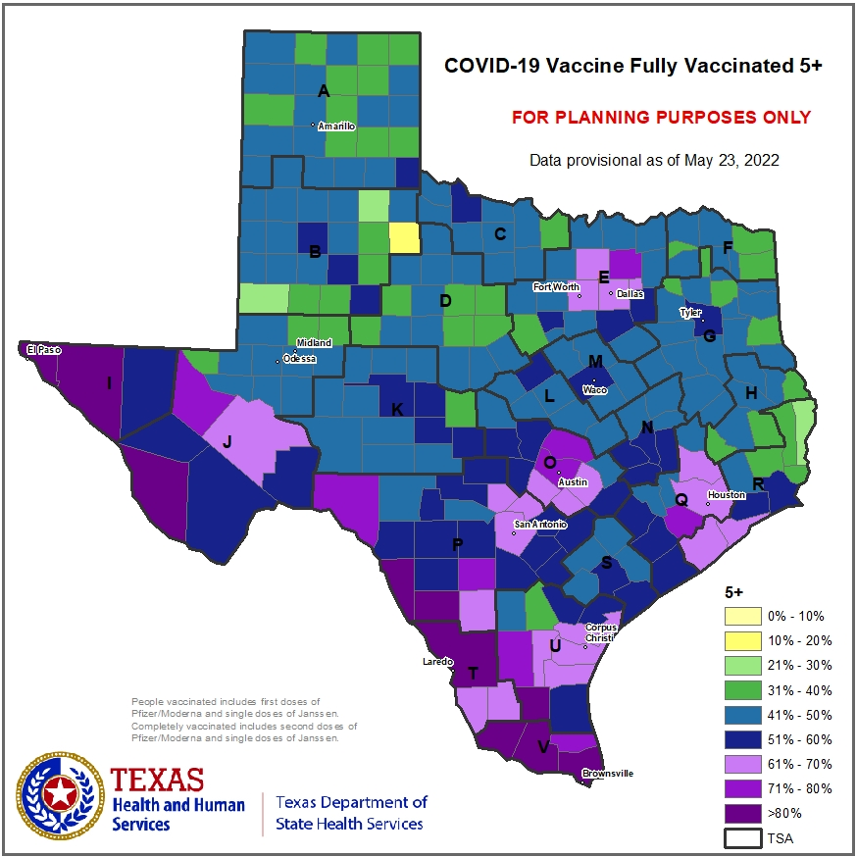
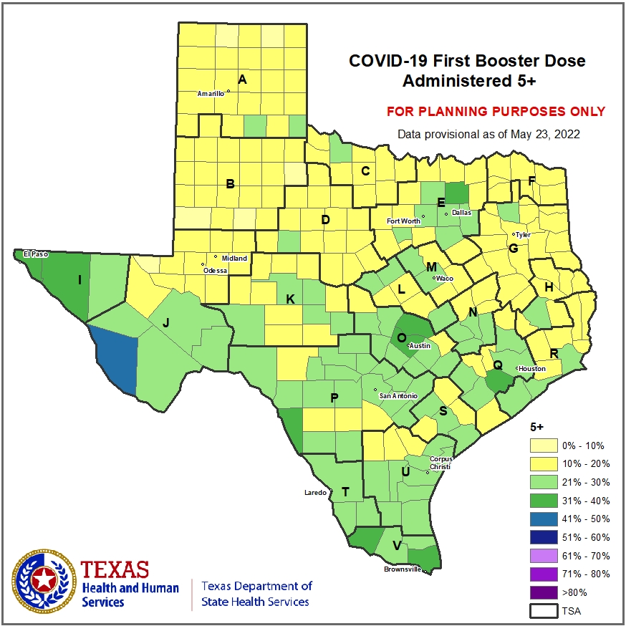

Slide 29
DISCLAIMER
The information presented today is based on CDC’s recent guidance and MAY change.
May 25, 2022

