Slide 2
CDC Funding
DSHS will administer $45.2M in CDC funds to engage targeted communities disproportionately impacted by COVID-19 and build sustainable relationships in those targeted communities leading to improved health among vulnerable populations.
  $6.3M: Epidemiology and Laboratory Capacity (ELC) funds [6/1/21 – 7/31/23]
  $38.9M: National Initiative to Address COVID-19 Health Disparities Among Populations at High-Risk and Underserved, Including Racial and Ethnic Minority Populations and Rural Communities (CDC-RFA-OT21-2103) [6/1/21 – 5/31/23]

Slide 3
Grant Goals / Impact Statements
Infrastructure: Describe existing human infrastructure or proposed human infrastructure
Community Engagement: Identify communities most impacted by COVID-19
COVID-19 Vaccinations: Implement steps to maximize COVID-19 vaccination rates in impacted communities
Partnership Directory: Document engaged community partners & build sustainable cross sectoral partnerships

Slide 4
Grant Goals / Impact Statements
Health Disparity Improvement Initiative: Design interventions aimed at addressing an identified community need
Information Sharing & Learning: Describe efforts to learn & share information on addressing COVID-19 health disparities among vulnerable populations

Slide 5
Implementation Mechanisms
Community engagement
  Establishing rapport & developing relationships
  Spending time in the community & building trust
  Listening to community needs
    Town halls, listening sessions, interviews, focus groups
  Staying engaged with community when funding dissipates
Building sustainable relationships
  Engaging community partners
    Hospitals, clinics, FQHCs, community-based organizations, faith-based organizations, social service agencies
  Cross sectoral partnerships
    Public health – healthcare – social services

Slide 6
54 LHDs Eligible for
DSHS COVID-19 Health Disparity Funding
$19,550,000 was available for 54 local health departments (LHDs) to support community engagement in targeted communities disproportionately impacted by COVID-19 and to build sustainable relationships in those targeted communities.
46 LHDs requested $16,977,708 (87%) of the available $19,550,000.

Slide 7
7 LHDs Receiving Separate CDC Funding
The following 7 LHDs are not eligible to receive COVID-19 Health Disparity Funding from DSHS because they will receive direct funding from CDC:
• Austin Public Health
• City of El Paso Department of Public Health
• Dallas County Health and Human Services
• Harris County Public Health
• Houston Health Department
• San Antonio Metropolitan Health District
• Tarrant County Public Health

Slide 8
8 DSHS PHRs Eligible for
DSHS COVID-19 Health Disparity Funding
$3,325,000 will be available for 7 DSHS administrative Public Health Regions (PHRs) to support community engagement in targeted communities, without an LHD, disproportionately impacted by COVID-19 and the building of sustainable relationships in those targeted communities.
Each of the 7 DSHS PHRs eligible to receive up to $475,000.

Slide 9
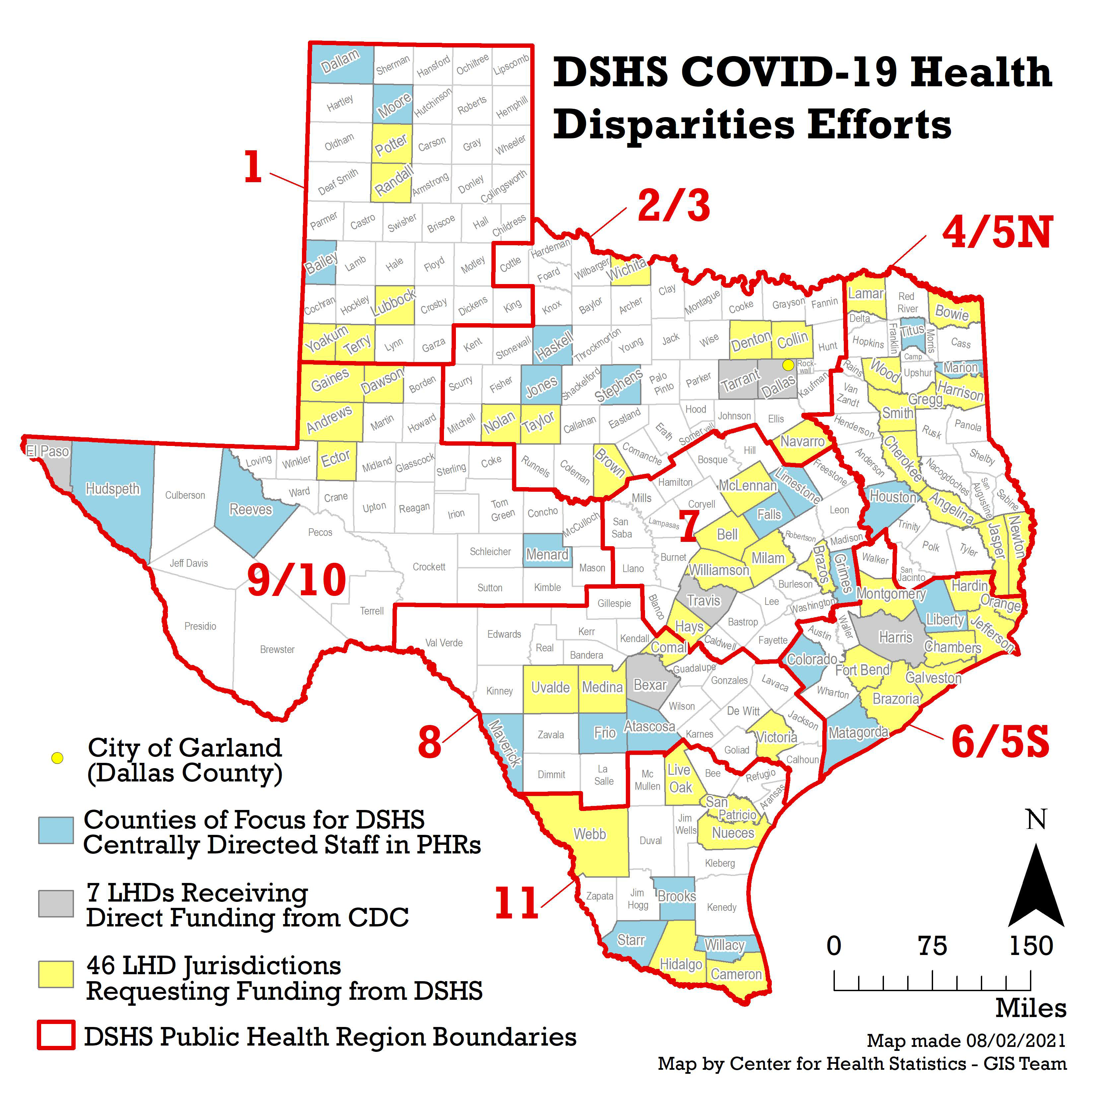

Slide 10
Texas Public Health Fellowship
What is the Texas Public Health Fellowship?
  A paid training program for up to 16 fellows with the goal to expand diversity in the public health workforce & to address health disparities among underserved and higher risk populations
Who’s Eligible?
  Recent graduates from community and technical colleges, non-four-year academic institutions, historically black colleges and universities, or graduates from public health programs with diverse backgrounds and experiences
  54 eligible local health departments
How will this work?
  DSHS will match host sites with Fellows who will work on public health, COVID response, and/or health disparity initiatives
  Fellows will be matched based on geography, subject matter interest, and relevant skills
  DSHS and host sites will provide a mentorship component to all Fellows to supplement their experience

Slide 11

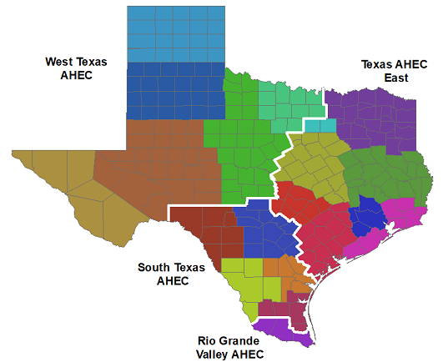

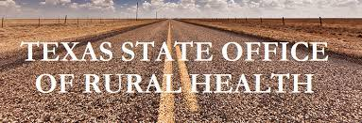
Additional State Partners
Texas A&M AgriLife Extension – Hire 8 AgriLife Health Disparity Specialists; existing expertise, community partners, and infrastructure across TX
Area Health Education Centers (AHECs) - Investment in the public health workforce (e.g., community health workers)
Texas Parks and Wildlife Department - Hire Community Health and Nature Liaison to improve access to nature and outdoor programs for vulnerable populations across LHDs and PHRs
State Office of Rural Health - Pilot Community Paramedicine Program to improve primary care services to rural communities

