Slide 1


Slide 2
PHFPC COVID-19 Vaccine Debriefing
The information presented today is based on CDC’s recent guidance and MAY change.
Saroj Rai, PhD, MPH
Senior Scientific Advisor| Office of Chief State Epidemiologist
February 9, 2022

Slide 3
DISCLAIMER
The information presented today is based on CDC’s recent guidance and MAY change.
February 9, 2022

Slide 4
COVID-19 Vaccine Updates

Slide 5
CDC Updated COVID-19 Vaccination Status Language
The following is attributed to CDC:
CDC has updated its webpage to align with standard language CDC uses about other vaccinations, CDC will now use the phrase “up to date” when talking about COVID-19 vaccination.
CDC recommends that individuals stay “up to date” by receiving any additional doses they are eligible for, according to CDC’s recommendations, to ensure they have optimal protection against COVID-19.
The technical definition of “fully vaccinated” – two doses of an mRNA vaccine or one dose of the J&J vaccine – has not changed.
Individuals are considered fully vaccinated once they have received their primary series. This change is reflected on CDC webpages.
The following link will reflect this change: When You’ve Been Fully Vaccinated | CDC

Slide 6
Moderna COVID-19 Vaccine
On January 31, 2022, the FDA announced the second approval of a COVID-19 vaccine. The vaccine has been known as the Moderna COVID-19 Vaccine, and will now be marketed as Spikevax, for the prevention of COVID-19 in individuals 18 years of age and older.
Spikevax has the same formulation as the EUA Moderna COVID-19 Vaccine and is administered as a primary series of two doses, one month apart.
Spikevax can be used interchangeably with the EUA Moderna COVID-19 Vaccine to provide the COVID-19 vaccination series.
Moderna COVID-19 Vaccine is available under EUA as a two-dose primary series for individuals 18 years of age and older, as a third primary series dose for individuals 18 years of age and older who have been determined to have certain kinds of immunocompromise, and as a single booster dose for individuals 18 years of age and older at least five months after completing a primary series of the vaccine.
The Moderna COVID-19 Vaccine is also authorized for use as a heterologous (or “mix and match”) single booster dose for individuals 18 years of age and older following completion of primary vaccination with a different available COVID-19 vaccine.
The prescribing information for Spikevax can be found here: Package Insert - SPIKEVAX (fda.gov)
Spikevax and Moderna COVID-19 Vaccine | FDA

Slide 7
Novavax COVID-19 Vaccine
On January 31, 2022, Novavax announced submission of a request to the U.S. FDA for emergency use authorization of their COVID-19 vaccine for individuals 18 years and older*
  Two dose series vaccine regimen given 21 days apart. Intramuscularly.
  The vaccine can be stored under refrigerated temperatures.
  Each vial contains 10 doses. Each dose is 0.5 mL (5 mcg antigen and 50 mcg Matrix M adjuvant).
  A US Phase 3 study showed 100% protection against moderate and severe disease and 90.4% overall efficacy, evaluated at least 7 days after the second dose.
  The two-dose regimen of the vaccine has shown cross-reactive immune- responses against Omicron and other variants.
  The vaccine is now authorized by the WHO and in multiple countries including Australia, UK, New Zealand, and European Commission countries.
*Novavax Submits Request to the U.S. FDA for Emergency Use Authorization of COVID-19 Vaccine - Jan 31, 2022

Slide 8
Path to COVID-19 Vaccine Authorization for Pediatric (6 months – 4 years)
Application Filing
FDA Advisory Panel Meeting
FDA Authorization
CDC (ACIP) Recommen-
dations
CDC Director’s Sign-Off*
Begin Vaccination
February 1, 2022, Pfizer submitted clinical safety and efficacy data to the FDA and requested expansion of the EUA for 6 months to 4 years of age.
February 15, 2022, FDA advisory committee, VRBPAC scheduled to meet to review the filing.
Date Unknown
Date Unknown
Date Unknown
Date Unknown
FDA: Food and Drug Administration
EUA: Emergency Use Authorization
VRBPAC: Vaccine and Related Biological Products Committee ACIP: Advisory Committee on Immunization Practices
*Administration can only begin once ACIP has issued the clinical recommendations which has been signed by the CDC Director.

Slide 9
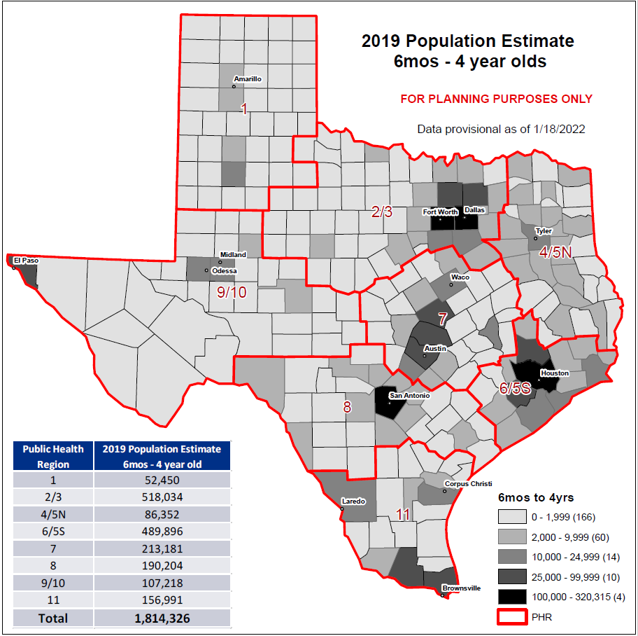

Slide 10
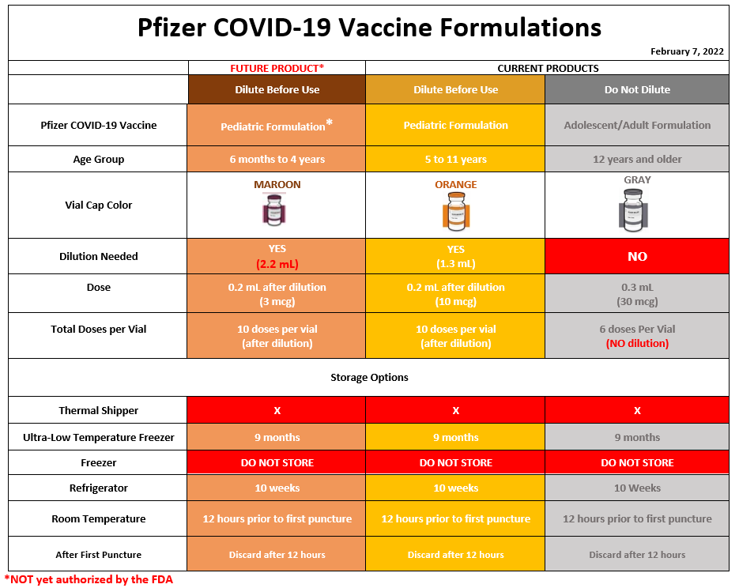

Slide 11
Pfizer COVID-19 Vaccine (6 months – 4 years)
Ordering & Shipment
DSHS sent a communication to begin pre-ordering the vaccine in the Vaccine Allocation and Ordering System (VAOS).
The initial orders must be placed in VAOS by Monday, February 14th, 2022, 5pm CST.
  Additional ordering dates/times will be communicated as they become available.
  A full pack size order is 100 doses (10 vials).
  If providers would like to place a smaller order than minimum pack size, the order should be made in increments of 10 doses (1 vial).
Vaccine allocations will be made based on doses available to Texas. Please note all doses requested may not be filled during the initial ordering.

Slide 12
Pfizer COVID-19 Vaccine (6 months – 4 years)
Ordering & Shipment
Shipment of Pfizer COVID-19 vaccine for children ages 6 months–4 years is planned to begin once FDA issues the EUA. However, vaccine administration can only begin following the final recommendations by the Centers for Disease Control and Prevention’s Advisory Committee on Immunization Practices (ACIP).
Providers must accept delivery shipments and must be able to receive orders on Monday, February 21, 2022, which is a President’s Day holiday.
Pediatric ancillary kits, containing necessary needles, syringes, diluent, alcohol swabs, limited PPE, and shot cards, will be automatically added to a vaccine order and will ship at the same time as the vaccine.
If you have questions on pre-ordering, please email COVID19VacShipments@dshs.texas.gov.

Slide 13
COVID-19 Vaccine
Texas Overall Summary

Slide 14
 | Population Estimates | People Vaccinated | Fully Vaccinated | Up-to-Date
Texas Total | 28,995,881 | 20,105,553 | 17,008,844 | 8,636,052
 |  | 69% | 59% | 30%
5-11 years | 2,898,962 | 816,575 | 527,687 | 527,383
 |  | 28% | 18% | 18%
5 years and older | 26,967,586 | 20,100,649 | 17,007,535 | 8,635,788
 |  | 75% | 63% | 32%
12 years and older | 24,068,624 | 19,284,074 | 16,479,848 | 8,108,405
 |  | 80% | 68% | 34%
18 years and older | 21,596,071 | 17,560,524 | 15,094,962 | 7,595,436
 |  | 81% | 70% | 35%
65 years and older | 3,734,229 | 3,527,780 | 3,133,913 | 2,087,710
 |  | 94% | 84% | 56%
People Vaccinated includes first doses of Moderna and Pfizer and single doses of Janssen.
Fully Vaccinated includes second doses of Moderna and Pfizer and single doses of Janssen.
Up-to-Date includes people with an additional/booster dose and people who are fully vaccinated but not yet eligible for an additional/booster
Data as of 2/7/2022

Slide 15
Data as of 2/7/2022

Slide 16
Fully Vaccinated Individuals Eligible for Booster – All Vaccines
Age Group | 2019 Texas Population | Total Eligible Individuals as of January Remaining Due for Booster* | Eligible Individuals Received an Additional/Booster Dose
Age 12-17 yrs | 2,472,553 | 1,001,155 | 174,384
Age 18-64 yrs | 17,861,842 | 7,020,390 | 3,936,243
Age > 65 yrs | 3,734,229 | 1,097,175 | 1,895,229
Eligible population includes December 2020 to August 2021 for 2-dose vaccines and December 2020 to November 2021 for J&J vaccine. Individuals who received an additional dose after
8/13/21 are not included in the projection. As of 1/10/22, 2-dose vaccines are projected at 5 months and 2 months for J&J vaccine per ACIP recommendations.
Data as of 2/7/2022

Slide 17
People (>65 yrs) Boosters Details for Selected Counties
Client County | 2019 Population Estimate ( > 65 yrs) | Total Eligible People ( > 65 yrs) as of January Remaining Due for Booster | Eligible Individuals ( > 65 yrs) Received a Booster
Bexar | 247,843 | 62,245 | 137,981 (69%)
Collin | 116,575 | 34,815 | 65,046 (65%)
Dallas | 292,117 | 80,598 | 148,094 (65%)
Denton | 93,499 | 27,989 | 53,680 (66%)
El Paso | 105,175 | 36,797 | 58,405 (61%)
Harris | 514,167 | 154,699 | 264,618 (63%)
Tarrant | 244,511 | 68,666 | 130,242 (65%)
Travis | 129,553 | 31,861 | 77,462 (71%)
Williamson | 73,202 | 20,124 | 44,572 (69%)
Data as of 1/10/22
Data as of 2/7/2022

Slide 18
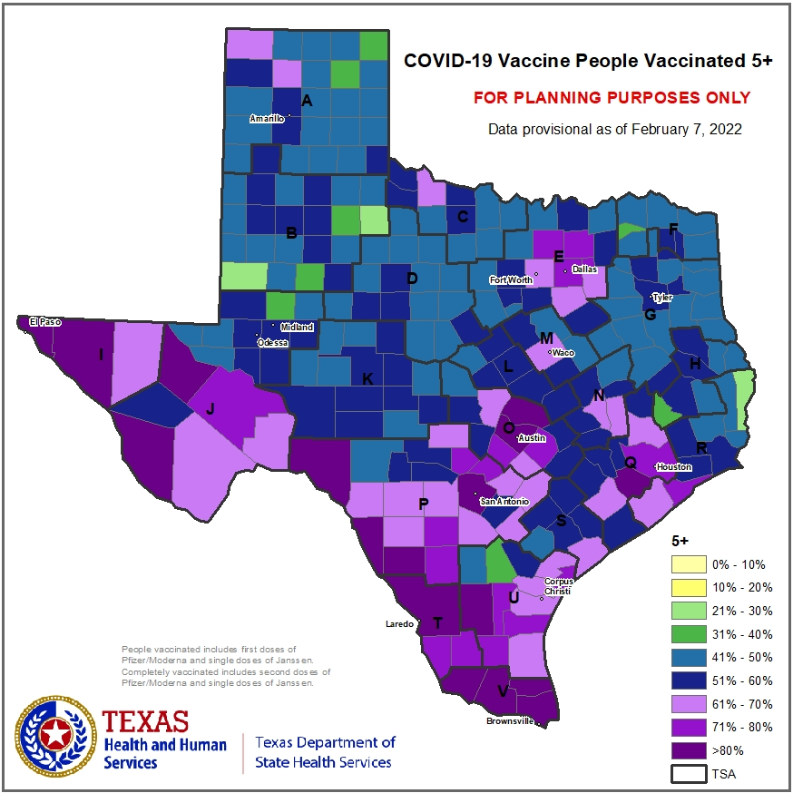
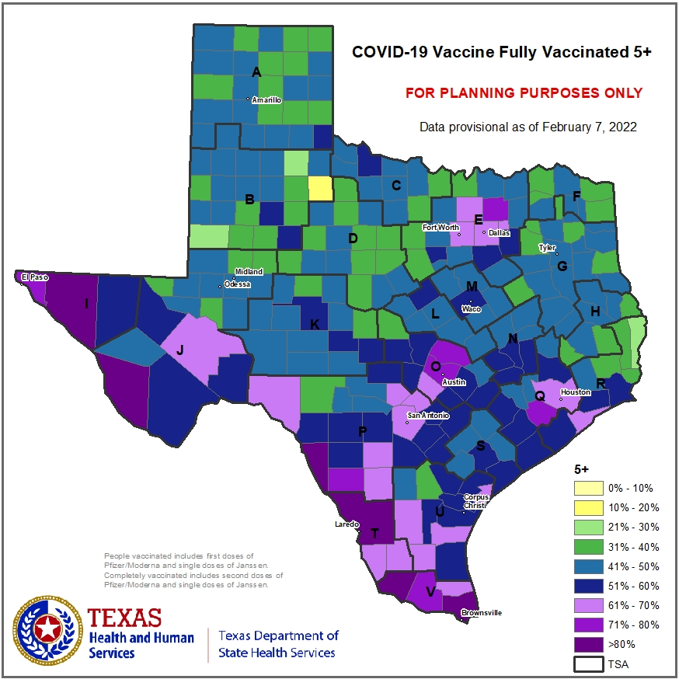
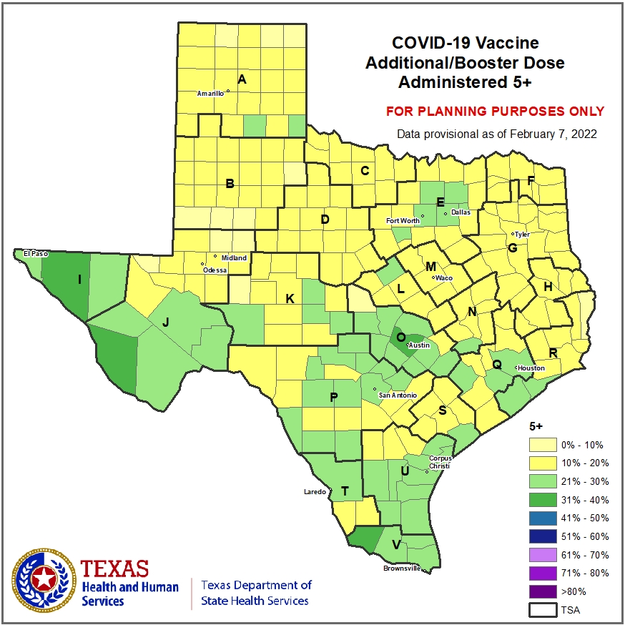

Slide 19
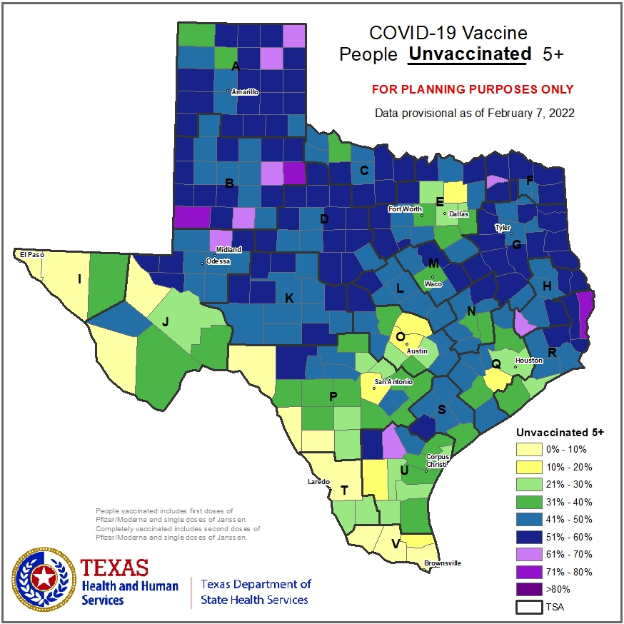

Slide 20
COVID-19 Vaccine
Looking Forward

Slide 21
COVID-19 Vaccine
Focus Areas
Continued emphasis on vaccinating the unvaccinated ages 5 years and older
Emphasis on boosters for eligible population
Planning and implementation for pediatric (6 months - 4 years) vaccination launch

Slide 22
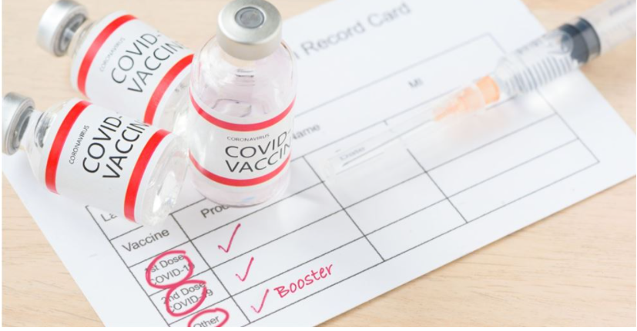
Vaccinate
&
BOOST

Slide 23
DISCLAIMER
The information presented today is based on CDC’s recent guidance and MAY change.
February 9, 2022

