Slide 1


Slide 2
COVID-19 Vaccine Distribution Plan
December 9, 2020
Imelda Garcia, MPH
Associate Commissioner | Laboratory & Infectious Disease Services Division

Slide 3
DISCLAIMER
The information presented today is based on CDC’s recent guidance and MAY change.
December 9, 2020

Slide 4
Discussion Topics
COVID-19 Vaccine Update
COVID-19 Vaccine Distribution Plan
Expert Vaccine Allocation Panel
Pharmacy Partnership for Long-Term Care

Slide 5
Vaccine Updates

Slide 6
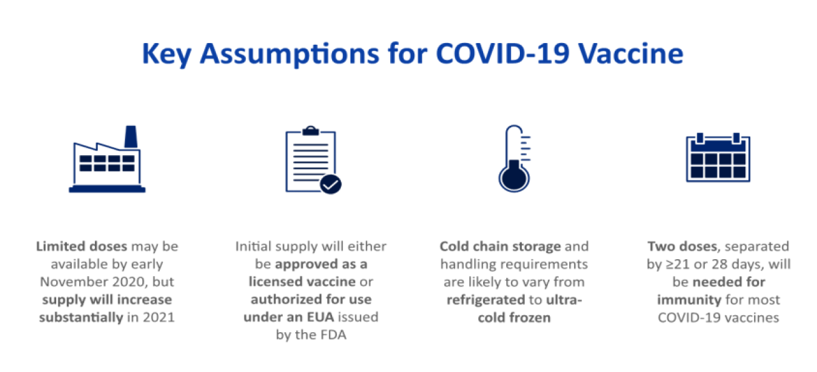
Evolving Landscape for COVID-19 Vaccine
available in December 2020, but

Slide 7
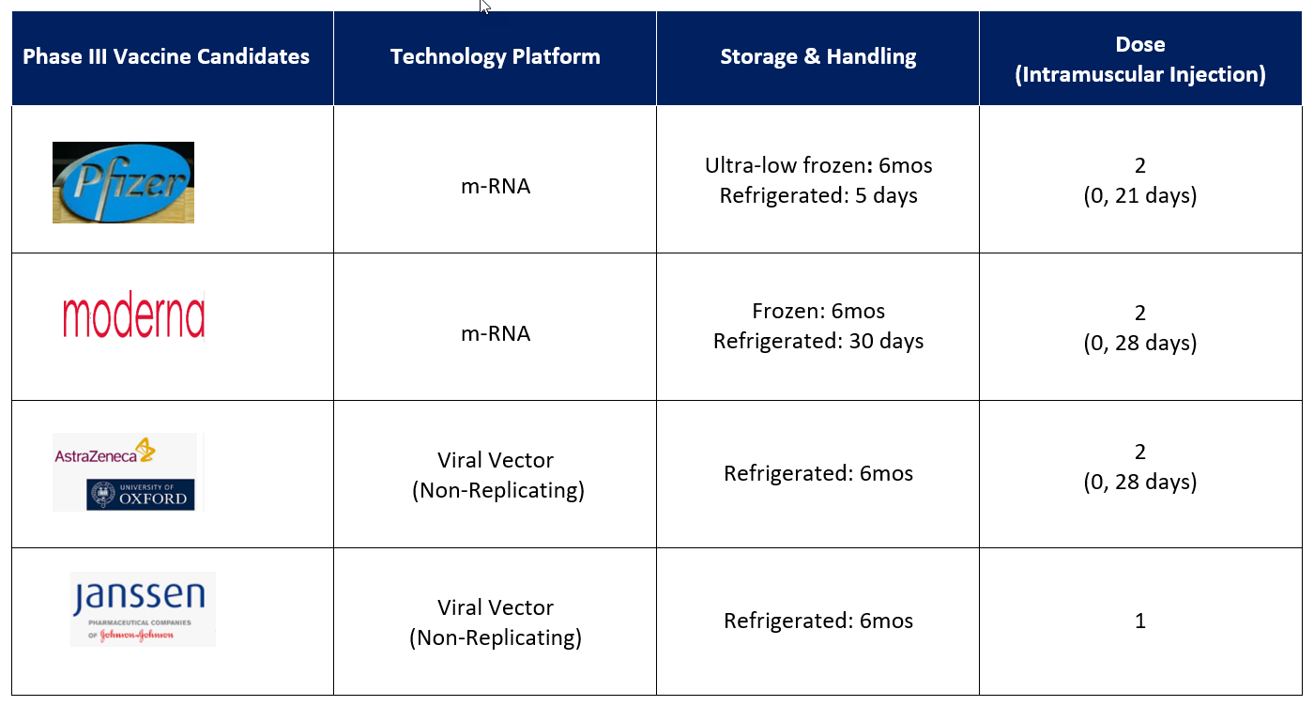
COVID-19 Vaccine Updates

Slide 8
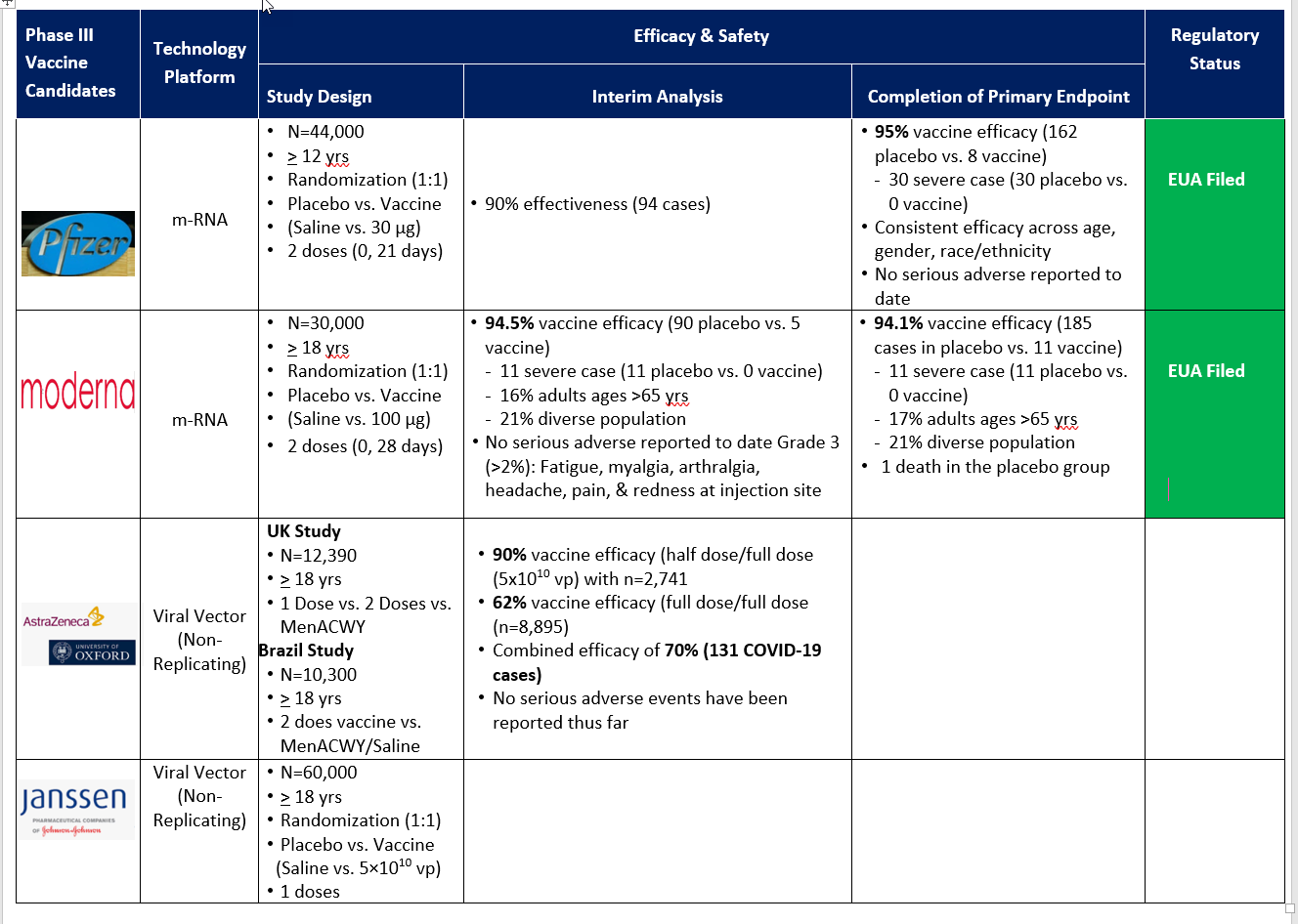

Slide 9
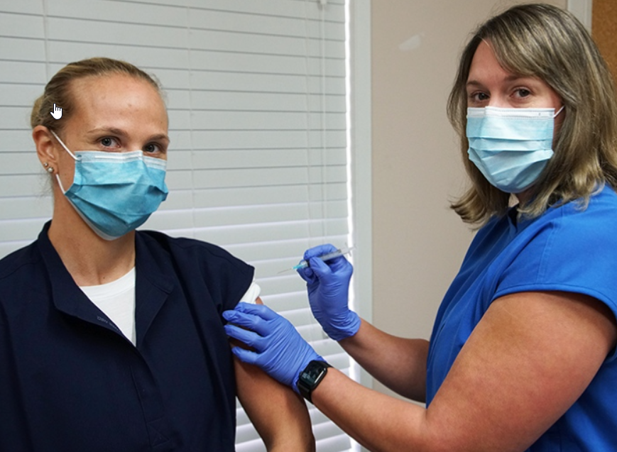
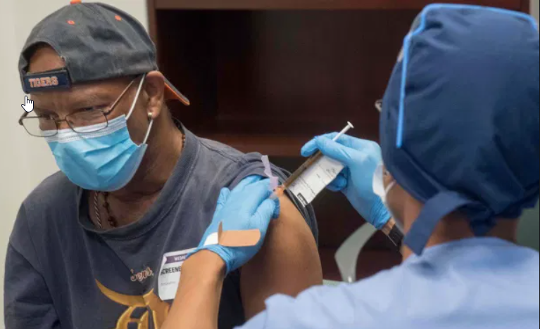
PFIZER
  Dec. 10
  Dec. 11-14
  Dec. 11-14
  Dec. 14 -18
Begin Vaccination
VRBPAC Open Session Meeting
FDA Reviews all the Data
CDC ACIP Calls an Immediate Meeting
  EUA
  Recommendations
BLA (Biologics Licensure Application)
EUA (Emergency Use Authorization)
EA (Expanded Access)

Slide 10
MODERNA
  Dec. 17
  Dec. 18-21
  Dec. 18-21
  Dec. 21-23
Vaccination
VRBPAC Open Session Meeting
FDA Reviews all the Data
CDC ACIP Calls an Immediate Meeting
  EUA
  Recommendations
BLA (Biologics Licensure Application)
EUA (Emergency Use Authorization)
EA (Expanded Access)

Slide 11
COVID-19 Vaccine Distribution Plan Update

Slide 12
Phased Approach to Vaccination
(Specific dates are subject to change)
Phase 0 (October 2020 - November 2020)
  Provider recruitment and registration into ImmTrac2 and new web-based portal.
Phase 1 (December 2020 – January 2021): Limited supply of COVID-19 vaccine doses available.
  Vaccines will be direct-shipped to registered providers serving healthcare workers and other select populations based upon the DSHS Commissioner’s approval in accordance with CDC/ACIP recommendations.
  Occupational healthcare settings will be the primary administrators of vaccines.
  Some large chains enrolled directly by CDC to serve some targeted populations (long-term care facilities).
  Continue ongoing provider recruitment and registration to ensure access to vaccination.

Slide 13
Phased Approach to Vaccination
(Specific dates are subject to change)
Phase 2 (February 2021-July 2021): Increased number of vaccine doses available.
  Emphasis on ensuring access to vaccine for members of Phase 1 critical populations who were not yet vaccinated as well as for the additional populations; expand provider network.
  Texas will use specialized vaccine teams, as needed, to vaccinate identified critical groups lacking access to the vaccine (e.g., rural communities).
Phase 3 (July 2021 -October 2021): Sufficient supply of vaccine doses for entire population.
  DSHS will focus on ensuring equitable vaccination access across the entire population. Monitor vaccine uptake and coverage; reassess strategy to increase uptake in populations or communities with low coverage.
  May consider extending the use of vaccine teams depending on the uptake and coverage received thus far, especially to ensure second doses are administered from the end of Phase 2.
Phase 4 (October 2021 and forward): Sufficient supply of vaccine with a decreased need due to most of the population being vaccinated already.
  May include boosters or annual vaccines, if required.
  Vaccine availability open throughout private providers. Population able to visit provider of choice.

Slide 14
CDC Critical Populations for COVID-19
Groups and individuals may fall into multiple categories.
Prioritization recommendations among and within groups are in development.
Category | Includes:
Essential workers | Healthcare personnel (i.e. EMS, hospital staff, vaccinators, pharmacy and long-term care staff) Other essential workers (i.e. first responders, education, others with critical roles who cannot easily socially distance)
People at increased risk for severe COVID-19 illness | People 65 years of age and older LTCF residents (i.e., nursing home, assisted living, others) People with underlying medical conditions that are risk factors for severe COVID-19 illness
People at increased risk of acquiring or transmitting COVID-19 | People from racial and ethnic minority groups People from tribal communities People who are incarcerated/detained in correctional facilities People experiencing homelessness/living in shelters People attending colleges/universities People living in other congregate settings
People with limited access to routine vaccination services | People living in rural communities People with disabilities People who are under- or un-insured

Slide 15
Expert Vaccine Allocation Panel
(EVAP)

Slide 16
Expert Vaccination Allocation Panel (EVAP)
Texas has convened a team of appointed external and internal subject-matter experts (SME) into the COVID-19 Expert Vaccine Allocation Panel (EVAP) to develop vaccine allocation strategies as recommendations to the Texas Commissioner of Health.
The recommendations from the EVAP will be sent to the Texas Commissioner of Health for final approval.
EVAP voting members https://www.dshs.texas.gov/coronavirus/immunize/evap.aspx
The panel will develop and apply guiding principles in their recommendations.

Slide 17
Texas Guiding Principles
Protecting health care workers who fill a critical role in caring for and preserving the lives of COVID-19 patients and maintaining the health care infrastructure for all who need it.
Protecting front-line workers who are at greater risk of contracting COVID-19 due to the nature of their work providing critical services and preserving the economy.
Protecting vulnerable populations who are at greater risk of severe disease and death if they contract COVID-19.
Mitigating heath inequities due to factors such as demographics, poverty, insurance status and geography.
Data-driven allocations using the best available scientific evidence and epidemiology at the time, allowing for flexibility for local conditions.
Geographic diversity through a balanced approach that considers access in urban and rural communities and in affected ZIP codes.
Transparency through sharing allocations with the public and seeking public feedback.
https://gov.texas.gov/news/post/governor-abbott-dshs-announce-covid-19-vaccine-distribution-plan

Slide 18
COVID-19 Critical Population Update
Phase 1A Healthcare Workers Definition – First Tier
Hospital staff working directly with patients who are positive or at high risk for COVID-19. Includes:
  Physicians, nurses, respiratory therapists and other support staff (custodial staff, etc.)
  Additional clinical staff providing supporting laboratory, pharmacy, diagnostic and/or rehabilitation services
2. Long-term care staff working directly with vulnerable residents. Includes:
a. Direct care providers at nursing homes, assisted living facilities, and state supported living centers
b. Physicians, nurses, personal care assistants, custodial, food service staff
EMS providers who engage in 9-1-1 emergency services like pre-hospital care and transport
Home health care workers, including hospice care, who directly interface with vulnerable and high-risk patients
Residents of long-term care facilities

Slide 19
COVID-19 Critical Population Update
Phase 1A Healthcare Workers Definition – Second Tier
Staff in outpatient care offices who interact with symptomatic patients. Includes:
  Physicians, nurses, respiratory therapists and other support staff (custodial staff, etc.).
  Clinical staff providing diagnostic, laboratory, and/or rehabilitation services
  Non 9-1-1 transportation for routine care
Direct care staff in freestanding emergency medical care facilities and urgent care clinics.
Community pharmacy staff who may provide direct services to clients, including vaccination or testing for individuals who may have COVID.
Public health and emergency response staff directly involved in administration of COVID testing and vaccinations.
Last responders who provide mortuary or death services to decedents with COVID-19. Includes:
  Embalmers and funeral home workers who have direct contact with decedents
  Medical examiners and other medical certifiers who have direct contact with decedents.
School nurses who provide health care to students and teachers.

Slide 20
Pharmacy Partnership for Long-term Care (LTC) Program

Slide 21
CDC Pharmacy Partnership for Long-term Care (LTC) Program
Facilitate safe vaccination of this critical patient population, while reducing the burden on LTC facilities (LTCF) and health departments.
Provide end-to-end management of the COVID-19 vaccination process
  cold chain management
  on-site vaccinations
  fulfillment of reporting requirements at no cost to facilities.
LTCF staff who have not received COVID-19 vaccine can also be vaccinated.
Notes:
This program is being implemented in close coordination with jurisdictions, LTCFs, federal partners, such as the Centers for Medicare and Medicaid Services (CMS), and professional organizations, including the American Health Care Association (AHCA) and Leading Age, with members representing both nursing homes and assisted living facilities.

Slide 22
Engaging Pharmacies During Phase 1
CDC has partnered with national chains (CVS, Walgreens) to provide vaccination services to long-term care facility residents.
CDC will provide direct allocation to pharmacy partners during Phase 1, only to support vaccination efforts in long-term care facilities
DSHS has been working with other pharmacy partners to provide vaccination services to facilities not covered by the federal program.

Slide 23
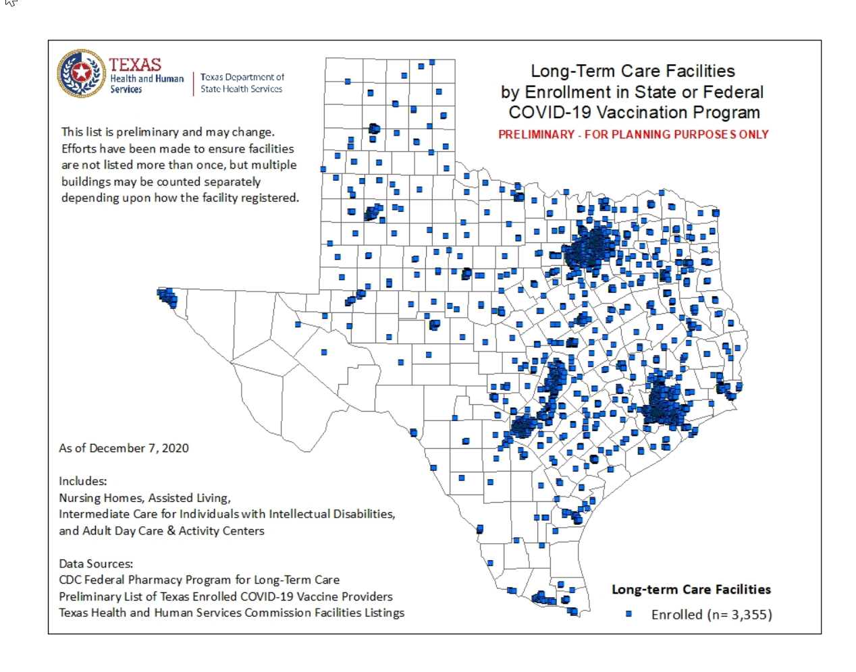

Slide 24
Pharmacy Partnerships in Phase 2
CDC is partnering with pharmacies nationwide to increase access to vaccine.
Partners who enroll in this program will receive a direct allocation of COVID-19 vaccine when supply is sufficient and vaccine is recommended for use beyond the initial critical populations.
Pharmacy partners include national chains, large regional chains, and networks of independent pharmacies and regional chains.
Pharmacies can also enroll directly through Texas as COVID-19 vaccine providers, if not in the federal program.

Slide 25
Current Federal Pharmacy Partners in Texas
Amerisource Bergen Corp.
Albertsons Companies, Inc.
Cardinal Health Retail Pharmacies*
Costco Wholesale
CPSEN – Community Pharmacies Advanced Services Network*
CVS Pharmacy
Gerimed
Health Mart*
H-E-B, LP
The Kroger Co.
Topco – Associated Food Stores Pharmacies & Brookshire Brothers
Walgreens Co.
Walmart & Sam’s East, Inc
*Includes independently owned pharmacies operating under various names

Slide 26
Texas COVID-19 Vaccination Efforts
Provider gap areas in the state
Hosting vaccination events
Local coordination and partnership

Slide 27
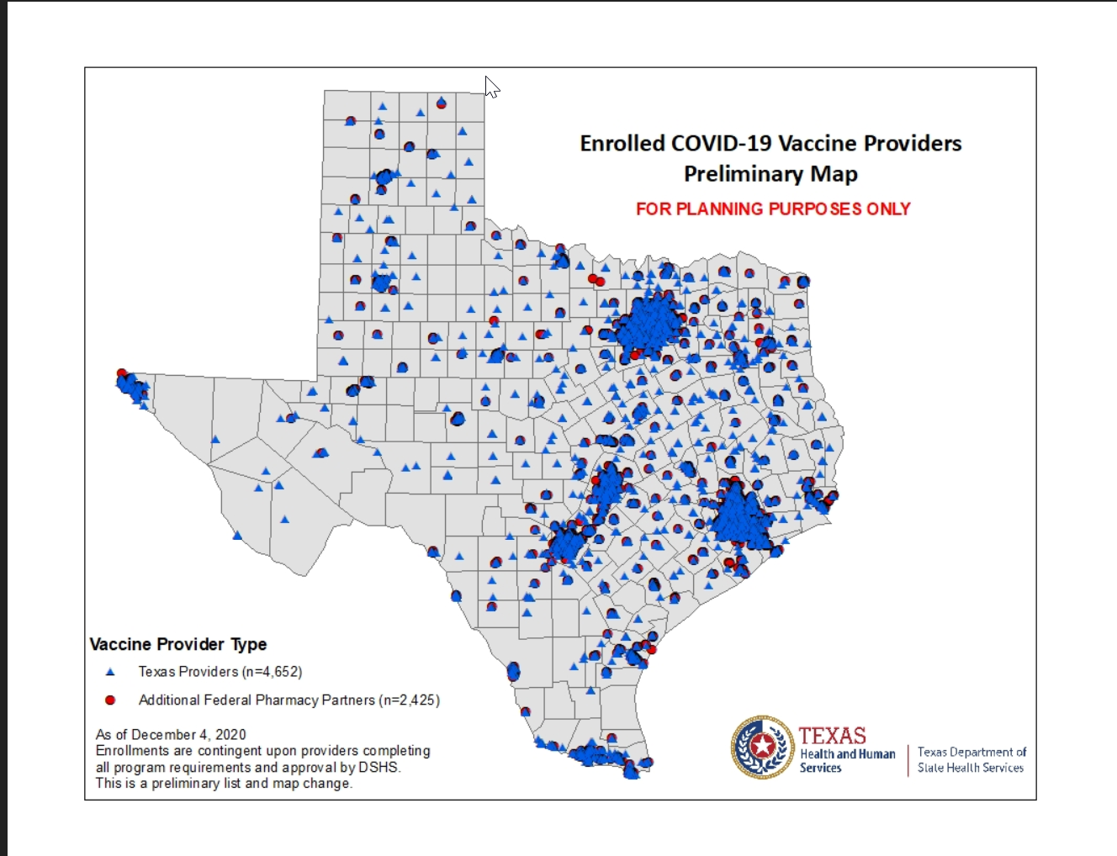
Notes:
Federal Pharmacy Partners include CVs, Walgreens, HEB, Brookshire, Walmart, some pharmacies form the national independent pharmacies organizations.

Slide 28
REMINDER
The information presented today is based on CDC’s recent guidance and MAY change.
December 9, 2020

Slide 29
More Information
  Website for Providers:
  www.dshs.texas.gov/coronavirus/immunize/provider-information.aspx
  DSHS COVID-19 Vaccine Provider hotline:
  (877) 835-7750, 8 a.m. to 5 p.m., Monday through Friday or
  Email: COVID19VacEnroll@dshs.texas.gov
  Website to enroll as a COVID-19 provider:
  EnrollTexasIZ.dshs.texas.gov
  General Questions:
  Email: COVIDvaccineQs@dshs.texas.gov

