Slide 1


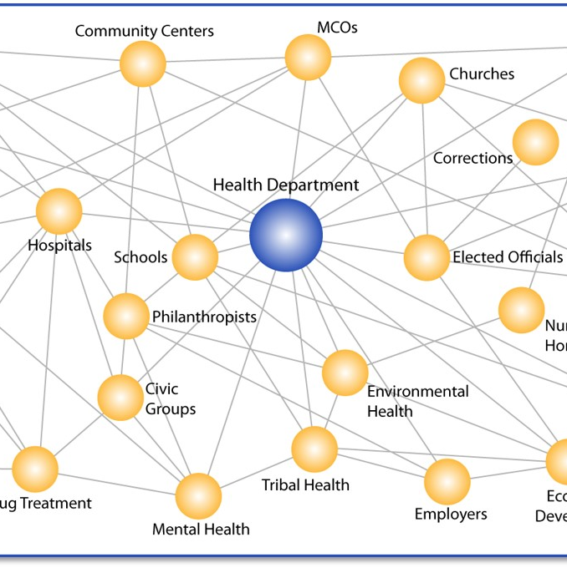

Cooperative Agreement for Emergency Response:
Public Health Crisis Response
CDC-RFA-TP18-1802

Slide 2
AGENDA
        Grant Overview
        Grant Administration
        Open Discussion

Slide 3
Part I
Grant Overview

Slide 4
Expand Public Health Departments with Additional Staff to Support COVID-19
Dedicated Funding to Hire School Nurses
Development of Public Health Leaders
Creation of Public Heath AmeriCorps (federal)
Expand CDC Epidemic Intelligence Service (EIS)
Create a new program to expand, train and modernize future public health workforce through a new grant program
MAJOR GOALS

Slide 5
GRANT TERMS & CONDITION SPECIFICS
Amount
Nationally - $7.4B/$2B to STLT
Texas (State) - $157M
Texas (City of Houston) - $16M
Distribution
25% School Nurse ($39M)
75% Remaining
  40% to LHD/Community ($47M)
  60% open ($71M)
Grant Period
Two year period: Jul 2021 – Jun 2023
(In notice: “Efforts are underway, subject to availability of funds to develop solutions that allow for a more sustained workforce. Details will be provided when available.)
Terms & Conditions
(General related to any grant associated with COVID from Feds)
Comply with existing and/or future directives and guidance from HHS Secretary
Provide individual COVID-19 patient care regardless of external constraints
Assist USG in implementation and enforcement of federal orders related to Q & I
Comply with COVID-19 test reporting
Provide CDC data or access to data collected through use of these funds
Distribute and administer vaccine as per fed guidelines
Concurrence among state health official, preparedness, lab and epi programs

Slide 6
Establish, expand, train, and sustain the STLT public health workforce to support jurisdictional COVID-19 prevention, preparedness, response, and recovery initiatives, including school-based health programs.
CDC expects public health agencies to use available funding to:
  Recruit, hire, and train personnel to address projected jurisdictional COVID-19 response needs over the performance period, including hiring personnel
  Use CDC’s Social Vulnerability Index data and tools to inform jurisdiction COVID-19 planning, response, and hiring strategies.
  Hire personnel for roles that may range from senior leadership positions to early career or entry-level positions
Types of Personnel Allowed:
  Permanent full-time and part-time staff (which may include converting part-time positions to full-time positions during the performance period)
  Temporary or term-limited staff
  Fellows
  Interns
  Contractors or contracted employees
Funding Focus

Slide 7
Professional or clinical staff, including public health physicians and nurses (other than school-based staff); mental or behavioral health specialists to support workforce and community resilience; social service specialists; vaccinators; or laboratory scientists or technicians;
Disease investigation staff, including epidemiologists; case investigators; contact tracers; or disease intervention specialists;
School nurses and school-based health services personnel, including hiring school-based nurses, converting current nurses from part-time to full-time work, increasing hours, increasing nursing salaries or otherwise supporting retention efforts;
Program staff, including program managers; communications and policy staff; logisticians; planning and exercise specialists; program evaluators; pandemic preparedness and response coordinators to support the current pandemic response and identify lessons learned to help prepare for possible future disease outbreaks; health equity officers or teams; data managers, including informaticians, data scientists, or data entry personnel; translation services; trainers or health educators; or other community health workers;
Administrative staff, including human resources personnel; fiscal or grant managers; clerical staff; staff to track and report on hiring under this cooperative agreement; or others needed to ensure rapid hiring and procurement of goods and services and other administrative services associated with successfully managing multiple federal funding streams for the COVID-19 response; and
Any other positions as may be required to prevent, prepare for, and respond to COVID–19
Equipment, supplies and administrative services to support public health workforce expansion
Allowable Costs
The costs, including wages and benefits, related to recruiting, hiring, and training of individuals to serve as:

Slide 8
Forming partnerships with academic institutions, creating student internship or fellowship opportunities, and building graduation-to-workforce pipelines and establishing partnerships with schools of public health, technical and administrative schools, and social services and social science programs;
Using funds to conduct a workforce analysis to determine whether health departments were organized to maximum benefit for the COVID-19 response and how they may want to be reconstituted to prepare for future emergencies.
Training and education for new and existing staff on topics such as incident management training; health equity issues and working with underserved populations; cultural competency; disease investigations; informatics or data management; or other needs identified by the jurisdiction.
Developing, training, and equipping response-ready “strike force” teams capable of deploying rapidly to meet emergent needs, including through the Emergency Management Assistance Compact.
Ensuring a focus on diversity, health equity, and inclusion by delineating goals for hiring and training a diverse work force across all levels who are representative of, and have language competence for, the local communities they serve. CDC’s Social Vulnerability Index should be used to inform jurisdictional activities, strategies, and hiring.
Ensuring the systematic collection of information about the activities, characteristics, and outcomes of programs, including COVID-19 pandemic response efforts, to inform current program decisions, improve program effectiveness, and make decisions about future program development.
Addressing community recovery and resilience needs to respond effectively to the COVID-19 pandemic and other biologic threats including vaccine-related education.
Allowable Activities

Slide 9
Progress toward meeting hiring goals including types of staff hired and the general roles they hold. Recipients must report these data for all staff, including those hired by subrecipients.
Recipients should develop approximate goals and metrics regarding diversity of staff hired and equity and inclusion activities, and report on their progress against those measures.
Measures
and
Metrics

Slide 10
Focus
PH Workforce
Establish
Expand
Train
Sustain
Overview
PH Infrastructure
PH Workforce
Workforce Expertise
PH Americorps
Modernize
Funding
$157M Total
$39M School
$47M Local
$71M
2-years
Allowable
Staff & Support
PH positions
Admin Support
Partnerships
Equipment
Future
New Grant to sustain
$3B
CDC will work with public health community
Metrics
Staff and Equity
#staff hired
Diversity
SVI
Summary

Slide 11
Part II
Grant Implementation

Slide 12
Strategic Guidelines
SVI
Underfunded (Inability to perform essential public health functions as per Texas Health and Safety Code Chapter 121)
Diversity/Social Determinants of Health/One Health
Survey Responses
Ability to spend

Slide 13

Essential Public Health Services:
  monitor the health status of individuals in the community to identify community health problems;
  diagnose and investigate community health problems and community health hazards;
  inform, educate, and empower the community with respect to health issues;
  mobilize community partnerships in identifying and solving community health problems;
  develop policies and plans that support individual and community efforts to improve health;
  enforce laws and rules that protect the public health and ensure safety in accordance with those laws and rules;
  link individuals who have a need for community and personal health services to appropriate community and private providers;
  ensure a competent workforce for the provision of essential public health services;
  research new insights and innovative solutions to community health problems; and
  evaluate the effectiveness, accessibility, and quality of personal and population-based health services in a community.
Texas Health and Safety Code Chapter 121

Slide 14
SVI Locations
Angelina
Bee
Caldwell
Calhoun
Cameron
Cherokee
El Paso
Hale
Hidalgo
Jim Wells
Kleberg
Navarro
Potter
San Patricio
Terry
Uvalde
Webb
Zapata
Social vulnerability refers to the potential negative effects on communities caused by external stresses on human health. Such stresses include natural or human-caused disasters, or disease outbreaks. Reducing social vulnerability can decrease both human suffering and economic loss.
Percentile of .075 or higher; the county is more vulnerable than 75% of all counties against which it is ranked. This includes only counties with an existing LHE.

Slide 15
Survey

Slide 16
PH Workforce Crisis Co-Ag
Period of Performance - July 1, 2021 - June 30, 2023 (2 yrs)
Task / Activities | Start Date | End Date | Duration (working days)
Local Health Entities (LHE) Call - 2:00 - 3:00 pm | 8-Jun-21 | 8-Jun-21 | 0
LHEs & DSHS Programs - Declaration of Intent to Apply (DIA) submitted | 8-Jun-21 | 11-Jun-21 | 3
"Save the date" email invite to Stakeholders re: Kick-off meeting | 18-Jun-21 | 18-Jun-21 | 0
Kick-off meeting for Stakeholders | 22-Jun-21 | 22-Jun-21 | 0
Project and budget templates and Allocations sent out to LHE & DSHS Programs for completion - CHEPRS will host webinar to walk through the templates (as needed) | 23-Jun-21 | 12-Jul-21 | 13
DSHS SME's complete technical reviews, to include obtaining clarifications from LHEs as needed | 13-Jul-21 | 20-Jul-21 | 6
Quarterly Progress Reports (Q1) | 3-Jan-22 | 7-Jan-22 | 5
Timeline

Slide 17
DISCUSSION

