Slide 1

Current, Emerging and Re-emerging Issues in Occupational Safety and Health
Ketki Patel, MD, PhD, MPH
Manager, Environmental Surveillance and Toxicology Branch, Texas Department of State Health Surveillances
Notes:
Hello everyone and thank you for joining us this afternoon to celebrate 50 years of NIOSH’s contributions to science and efforts to prevent and protect the health of workers. In this segment of the today’s webinar, I will focus on some of the current (pesticide/chemicals), emerging (COVID-19 pandemic) and re-emerging (silicosis) occupational safety and health issues in the modern-day U.S. and the world. The presentation will highlight key challenges and opportunities from a state-based surveillance and prevention standpoint.

Slide 2
Disclaimer
The findings and conclusions in this presentation are those of the author(s) and do not necessarily represent the official position of the National Institute for Occupational Safety and Health, Centers for Disease Control and Prevention

Slide 3
Current Issues in Occupational Safety and Health Surveillance
Pesticide-related injury and illness

Slide 4
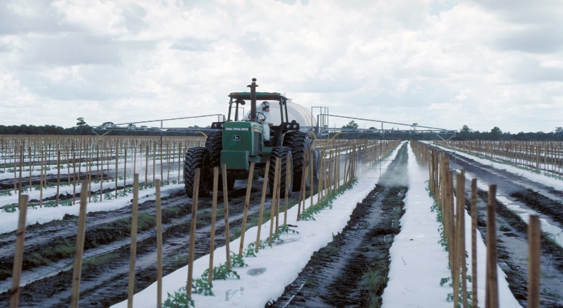
Pesticides
“A pesticide is any substance or mixture of substances intended for
  Preventing, destroying, repelling or mitigating any pest.
  Use as a plant regulator, defoliant, or desiccant.
  Use as a nitrogen stabilizer”
Image Source: https://secure.flickr.com/photos/usdagov/46790417815/in/album-72157706329251631/
Source: United States Environmental Protection Agency (EPA). https://www.epa.gov/ingredients-used-pesticide-products/basic-information-about-pesticide-ingredients
Notes:
EPA defines a pesticide as…. <say definition given on the slide>
Any pesticide product contains active ingredients and inert ingredients. Active ingredient are chemicals in the product that destroys, controls, repels, or prevents the pests. Based on the type of active ingredient and its action on the pests, they are categorized into different chemical and functional classes. A few examples of types of pesticides used in both industrial and household settings are Insecticides, Herbicides, Rodenticides, Fungicides, Disinfectants and antimicrobials, Swimming pool treatment chemicals, Plant growth regulators, Plant defoliants.
Currently, >17,000 pesticide products on the more the market

Slide 5
Need for continued surveillance and prevention
Limited occupational surveillance data on pesticide exposure and related illness available in most countries. Globally, 44% percent farmers are affected by pesticide poisoning each year.¹
The U.S. Bureau of Labor Statistics’ Current Population Survey estimated over 1.1 million workers employed in farming occupations in 2019.²
Several other occupations and industry groups have potential for exposure to pesticides such as veterinarians, animal handlers, landscapers, maintenance workers, cleaners and janitorial services, lawn/pest service providers, air crews, etc.
Source:
1. Boedeker, W., Watts, M., Clausing, P., & Marquez, E. (2020). The global distribution of acute unintentional pesticide poisoning: estimations based on a systematic review. BMC public health, 20(1), 1-19.
2. National Institute for Occupational Safety and Health. Centers for Disease Control and Prevention. Employed Labor Force (ELF) query system. https://wwwn.cdc.gov/Wisards/cps/cps_estimates_results.aspx
Notes:
Few developed nations such as the United States, Canada, United Kingdom, Australia, Finland, Sweden use multiple data systems to identify and monitor human exposures to pesticides and associated injuries and illnesses.

Slide 6
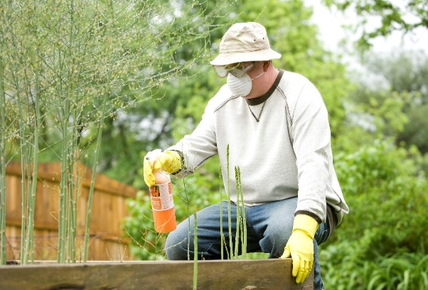
Occupational Pesticide Safety and Health in the U.S.
40 CFR, Part 170 Worker Protection Standard
“Reduce the risks of illness or injury resulting from workers' and handlers' occupational exposures to pesticides used in the production of agricultural plants on farms or in nurseries, greenhouses, and forests and also from the accidental exposure of workers and other persons to such pesticides. It requires workplace practices designed to reduce or eliminate exposure to pesticides and establishes procedures for responding to exposure-related emergencies.”
Image source: https://phil.cdc.gov/Details.aspx?pid=11492
Notes:
Under the Federal Insecticide, Fungicide, and Rodenticide Act (FIFRA), EPA’s pesticide program provides information and training to workers and health care providers on pesticide safety, as well as implements the worker protection standard.

Slide 7
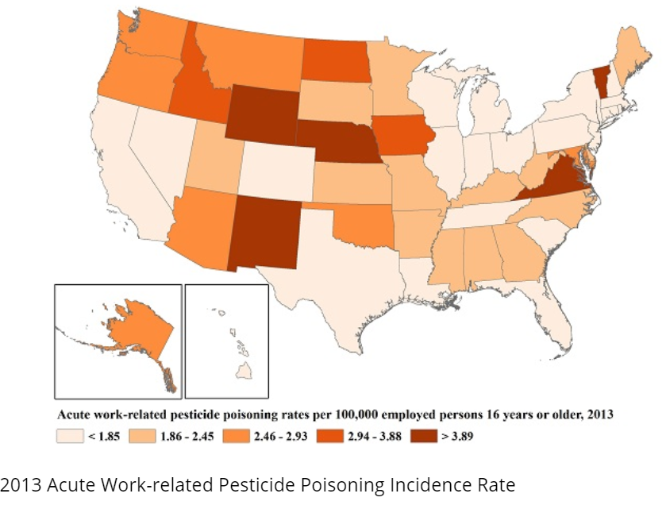
Occupational Pesticide Safety and Health in the U.S.
Surveillance efforts:
National Poison Data System
US EPA
NIOSH SENSOR-Pesticides Program
Image Source: https://www.cdc.gov/niosh/topics/pesticides/animatedmap.html
Notes:
The image on left, shows the acute work-related pesticide poisonings reported to poison centers in the U.S. in the year 2013. The National Poison Data System remains a key source of data on exposure and illness information for pesticide surveillance.
Under FIFRA and worker protection standard, EPA too, monitors exposures and health risks associated with pesticides through their incident reporting system.
NIOSH’s Sentinel Event Notification System for Occupational Risk (SENSOR) program provides funding and technical support to state HDs to conduct surveillance and prevention of acute occupational pesticide-related illness and injury. Currently, 13 states participate in NIOSH-SENSOR Pesticide Program and provide data on acute pesticide-related illness and injury.

Slide 8
State-based Pesticide-related Injury and Illness Surveillance
The NIOSH-SENSOR Pesticides’ model:
  Provides guidance and training to build state capacity
  Allows states to focus on their priority populations and areas for improvement in surveillance and prevention
  Provides more timely data for interventions
  Fosters local, state, and federal partnerships

Slide 9
State-based Pesticide-related Injury and Illness Surveillance
Challenges and work-in-progress:
  Underreporting
  Vulnerable and hard-to-reach worker populations
  Language and cultural barriers
  Knowledge and awareness on safe use, storage and disposal of pesticide products
  Resources
Notes:
In most states, pesticide exposures and related injury or illness are not reportable conditions. Not all pesticide exposure result in adverse health effects, for which a worker may seek medical care, or report to poison center for additional guidance on management or more information. Additional challenges of surveillance in vulnerable worker populations such as farmworkers, migrant and seasonal workers, non-English speaking populations

Slide 10
Emerging Issues in Occupational Safety and Health Surveillance
Coronavirus Disease 2019 (COVID-19) pandemic

Slide 11
Timeline of COVID-19 Pandemic
1/21/20
1st case of COVID-19
2/3/20
Declared public health emergency
3/11/20
WHO declared COVID-19 as a Pandemic
3/13/20
COVID-19 declared as a National Emergency
3/15/20
States & U.S. territories begin to issue statewide stay-at-home orders
12/11/202012/18/2020
FDA EUA* for two COVID-19 Vaccinesª
12/20/2020- present day Several variants of SARS-CoV-2 emerged; cases have been reported in many countries
2/27/2021
FDA EUA* for third vaccine^{b}
*EUA= Emergency Use Authorization.
ª EUA for Pfizer BioNTech and Moderna COVID-19 vaccines. ^{b} EUA for J&J COVID-19 vaccine
Notes:
In 2020, the first territorial stay-at-home order was issued by Puerto Rico (March 15), and the first state order by California (March 19). Most states began to rescind or allow expiration of stay-at-home orders beginning end of April (Alaska, 4/24/20) to early June 2020.
Pfizer vaccine EUA was 12/11/2020; Moderna vaccine EUA was 12/18/2020 and J&J EUA on 2/27/2021

Slide 12
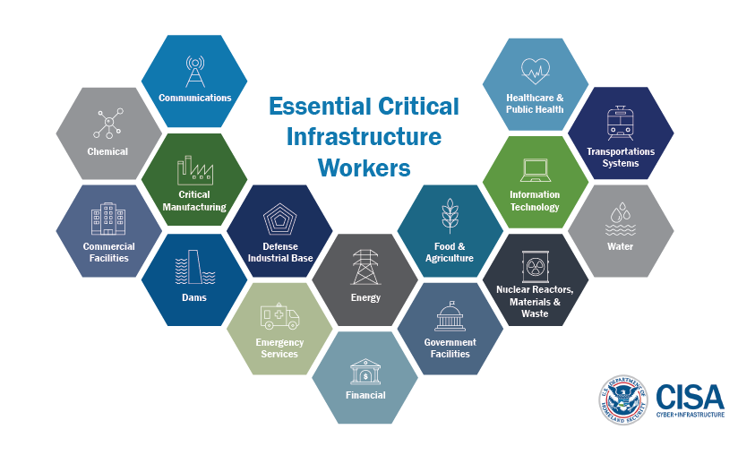
COVID-19 and Critical Infrastructure Workforce
“Cybersecurity and Infrastructure Security Agency (CISA) identifies 16 critical infrastructure sectors whose assets, systems, and networks, whether physical or virtual, are considered so vital to the United States that their incapacitation or destruction would have a debilitating effect on security, national economic security, national public health or safety, or any combination thereof”
Source: https://www.cisa.gov/identifying-critical-infrastructure-during-covid-19
Notes:
Cybersecurity and Infrastructure Security Agency identifies 16 critical infrastructure sectors whose assets, systems, and networks, whether physical or virtual, are considered so vital to the United States that their incapacitation or destruction would have a debilitating effect on security, national economic security, national public health or safety, or any combination thereof. Several critical infrastructure workplaces were still operational during the course of the pandemic.

Slide 13
COVID-19 and State-based Occupational Health Surveillance and Prevention
Case Investigation and Contact Tracing
  Technical Assistance
    Industry and occupation data collection and coding
    Collecting other details about work/job tasks
Workplace Outbreaks
  Facility assessments and epidemiologic investigations
  Education and outreach
  Capacity building
  Technical assistance & expert consultations to employers and businesses
Notes:
During March through July 2020, several states observed widespread community transmission and outbreaks in different workplaces such as health care facilities, long term care and nursing facilities, correctional facilities, farms, food processing plants including meat, poultry and sea food processing, warehouses, schools, universities, etc.
States have had a varying degree of response and efforts involving occupational safety and health in relation to COVID-19 pandemic, which primarily depended on the OH capacity within the state HDs including resources and scale of workplace outbreaks.

Slide 14
COVID-19 and State-based Occupational Health Surveillance and Prevention
Vaccination Efforts
  Workforce data
    By industry and occupation groups, high-risk for severe illness
    Capacity building
  Education and outreach
Other support & logistics
  Guidance for purchase, and correct use of appropriate personal protective equipment as well as disinfection and cleaning products*
  Additional surveillance for COVID-19 pandemic related exposures and issues (for example: pesticide and chemical exposures)
* Based on most update guidance from CDC/NIOSH, FDA Emergency Use Authorizations for PPE, and EPA N-List for Disinfectants.

Slide 15
Council of State and Territorial Epidemiologists (CSTE)
CSTE COVID-19 Outbreak Workgroup
  Outbreak definitions and interim guidance for further investigation:
    Non-residential, non-healthcare workplace settings
    Educational settings
    Healthcare settings (collaborative effort with CORHA* members)
      Acute care
      Long term care facilities
CSTE Occupational Health Subcommittee
  Additional guidance and tools:
    Epidemiological Classification of COVID-19 Work-relatedness and Documentation of Public-facing Occupations
    SARS-CoV-2 Occupational Exposure Risk Matrix or SOEM using O*NET
* CORHA: The Council for Outbreak Response: Healthcare-Associated Infections and Antimicrobial-Resistant Pathogens.
Notes:
CSTE workgroups comprising of state, CSTE and NIOSH representatives tirelessly worked from May through July 2020 to publish three outbreak definition and interim guidance for further investigation. Developing a definition and guidance for investigating non-health care workplace clusters of COVID-19 was highest priority at the time.
The CSTE OH Subcommittee convened two additional workgroups that focused on producing two evidence-based guidance and tools further detailing how to determine and classify work-relatedness for COVID-19 cases and close contacts, and occupational exposure risk based on a person’s occupation/job tasks.

Slide 16
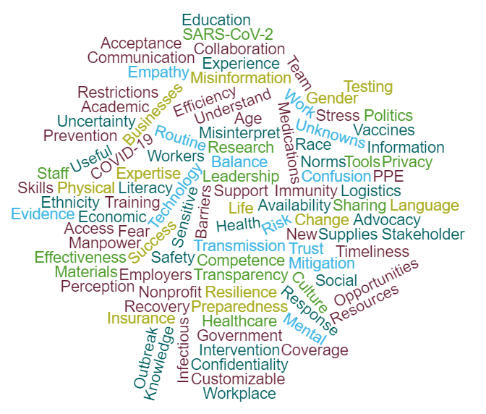
COVID-19 and Occupational Health Surveillance and Prevention
Improved visibility and awareness on Occupational Health
Strengthened and new partnerships, local and federal
New or enhanced tools, resources and skills
New evidence on infectious disease (COVID-19) outbreaks in workplaces
Better understanding about communities and businesses
Notes:
As the pandemic continues to evolve, so do the workplaces, work processes and the workforce, which demands continued need for integration of occupational health into mainstream public health alongside infectious disease and emergency preparedness and response. Some of the emerging issues related to COVID-19 pandemic also include mental health, stress and fatigue, preparedness of workplaces for public health emergencies and further alignment with the concept of total worker health.

Slide 17
Re-emerging Issues in Occupational Safety and Health Surveillance
Occupational Lung Disease - Silicosis
Notes:
While we have looked at examples of current and emerging issues, there are occupational health conditions that are re-emerging. One such re-emerging issue is an occupational lung disease – Silicosis.

Slide 18
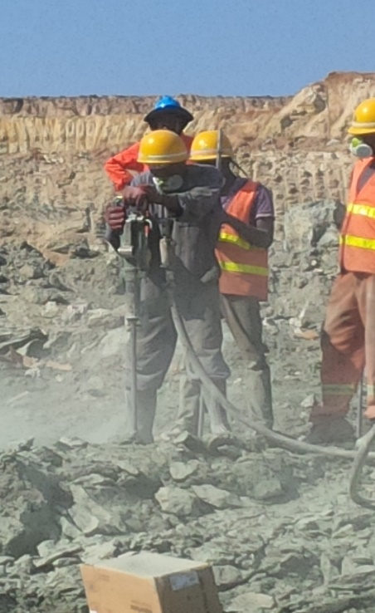
Silicosis
Results from inhalation of silicon dioxide or by exposure to respirable crystalline silica
Occupational Exposures to Silica:
Mining
Sandblasting
Quarrying
Rock Drilling
Manufacturing
Agricultural Industries
Stone Masonry
Glass Manufacturing
Construction
Image source: https://phil.cdc.gov/Details.aspx?pid=22795
Notes:
Silicosis is the oldest known occupational lung disease, caused by exposure to respirable crystalline silica that leads to inflammation and then scarring of the lung tissue. Crystalline silica is a component of rocks and sand.
An estimated 2.3 million U. S. workers are potentially exposed to respirable crystalline silica. Occupational exposures to silica occur across a broad range of industries, including mining, manufacturing, construction, maritime work, and agricultural industries. Exposure to silica can occur as part of common workplace operations involving the dissociation (crushing) of stone and rock products and in operations that use sand, such as glass manufacturing, foundries, and sand blasting.
Let’s take a took at history. An incident that triggered rules, regulations and occupational safety and health efforts for silicosis in the U.S.

Slide 19
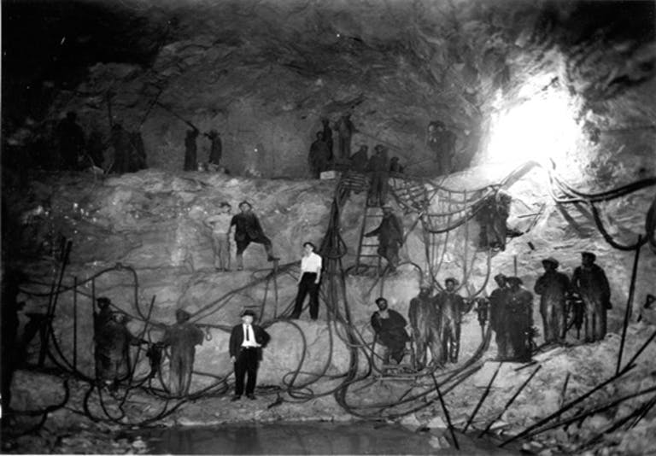
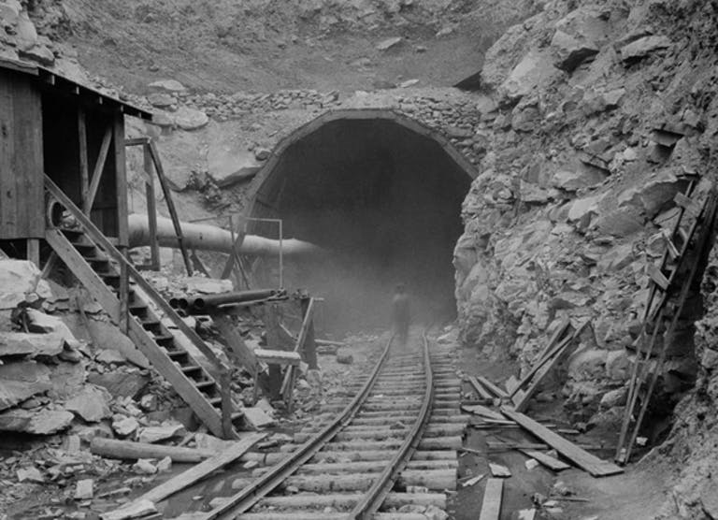
Hawk’s Nest Tunnel Tragedy (1930-31)
Image Source: https://img.ehstoday.com/files/base/ebm/ehstoday/image/2019/03/ehstoday_4244_hawks_nest_workers.png?w=768
Image Source: https://img.ehstoday.com/files/base/ebm/ehstoday/image/2019/03/ehstoday_4248_miner_0.png?w=768
Notes:
The event that introduced the nation to the dangers of silica dust was the Hawk’s Nest Tunnel Tragedy in 1930s, in Hawk’s Nest, West Virginia. To the right, we have an image showing workers and company staff onsite, wearing little to protection from dust. Although wet drilling methods were used, the primary method used to cut the tunnel through the mountain was drilling and blasting. Of the estimated 2,500 workers who worked in the tunnel, 764 died from acute silicosis and an additional 1,500 ultimately developed the disease. The incident garnered attention of national media, U.S. Congress, and the public, and in response by the end of 1937, a total of 46 states had passed laws relevant to workers with silicosis and many of them incorporated workers compensation for silicosis (Sources: 1. Cherniack, M. (1986). Hawk's nest incident: America's worst industrial disaster. 2. Stalnaker, C. K. (2006). Hawk's nest tunnel. Professional Safety, 51(10), 27.)

Slide 20
Post-war Economy and Silicosis
Several cases of silicosis were identified among workers in shipyards, offshore oil rigs and oil refineries in Louisiana, Texas, and Mississippi in 1970-80s.^{1,2}
U.S. Occupational Safety and Health Administration (OSHA):
  Established a Special Emphasis Program for Silicosis in 1996, which was later expanded to a National Emphasis Program in 2008, cancelled in 2017, and re-implemented in 2020³
Rosner, D., Markowitz, G., Kroll-Smith, S., Brown, P., & Gunter, V. J. (2000). Illness and the Environment.
Rosner, D., Markowitz, G., & Markowitz, G. E. (2006). Deadly dust: Silicosis and the on-going struggle to protect workers' health. University of Michigan Press.
OSHA. National Emphasis Program – Respirable Crystalline Silica https://www.osha.gov/sites/default/files/enforcement/directives/CPL_03-00-023.pdf
Notes:
By the 1950’s, silicosis was a forgotten disease by the media and the public. The booming economy in the postwar era had hundreds of thousands of workers who were engaged in occupations/job tasks involving dangerous dust exposures with little regard to the potentially resulting disease. These included individuals employed in maritime, mining and oil and gas extraction industries.
In the early 1980s, the OSHA placed special emphasis on the prevention of silicosis in foundry personnel, and in 1996 implemented a Special Emphasis Program (SEP) to step up enforcement of the crystalline silica permissible exposure limits (PELs). In 2016, OSHA issued two new standards for RCS – one for general industry and maritime (29 CFR § 1910.1053) and one for construction (29 CFR § 1926.1153). The 2016 standards established a new action level of 25 µg/m3 , and a new PEL of 50 µg/m3 , both calculated as 8-hour TWAs. The standards also required employers to take other steps to protect workers from silica hazards, and therefore, agency cancelled the 2008 Silica NEP in 2017. However, reports published by CDC /NIOSH demonstrated that hazardous silica exposures are continuing to occur in industry, e.g., during hydraulic fracturing of gas and oil wells and among workers who fabricate and install engineered stone countertops, and OSHA’s sampling data continued to show a high rate of noncompliance (i.e., employee overexposures). Hence, NEP was reimplemented in 2020 targeting industries expected to have the highest exposures to respirable crystalline silica

Slide 21
Occupational Lung Disease Surveillance and Prevention
NIOSH’s Work-related Lung Disease Surveillance System (eWoRLD)
NIOSH’s National Occupational Mortality Surveillance (NOMS) program
State-based Surveillance
  California, Connecticut, Massachusetts, Michigan, New Jersey, New Mexico, New York, Oregon, Texas, Washington, Wisconsin
Notes:
The Work-Related Lung Disease Surveillance System (eWoRLD) provides morbidity, mortality, and workplace exposures data on selected work-related respiratory diseases. Data are available by geographic region, industry and occupation, and demographic groups. Diseases include pneumoconioses, asthma, chronic obstructive pulmonary disease, hypersensitivity pneumonitis, respiratory tuberculosis, pneumonia and influenza, and certain cancers.
NIOSH’s National Occupational Mortality Surveillance (NOMS) program is a federal-state partnership that monitors changes in cause of death by usual occupation or industry in the United States.
Currently, there are 11 U.S. states that conduct some form of state-based Occupational Respiratory Disease Surveillance.

Slide 22
Silicosis Associated with Artificial (Engineered) Stone
In recent years, state-based occupational health surveillance programs have identified several cases silicosis and silicosis-related deaths among workers in engineered stone countertop manufacturing and fabrication in the U.S. ¹
Researchers have found similar cases of silicosis in engineered stone workers globally, often with rapid progression of disease. ³⁻⁵
Rose C, Heinzerling A, Patel K, et al. Severe Silicosis in Engineered Stone Fabrication Workers — California, Colorado, Texas, and Washington, 2017–2019. MMWR Morb Mortal Wkly Rep 2019;68:813–818. DOI: http://dx.doi.org/10.15585/mmwr.mm6838a1
Hoy, R. F., Glass, D. C., Dimitriadis, C., Hansen, J., Hore-Lacy, F., & Sim, M. R. (2021). Identification of early-stage silicosis through health screening of stone benchtop industry workers in Victoria, Australia. Occupational and environmental medicine, 78(4), 296-302.
León-Jiménez, A., Hidalgo-Molina, A., Conde-Sánchez, M. Á., Pérez-Alonso, A., Morales-Morales, J. M., García-Gámez, E. M., & Córdoba-Doña, J. A. (2020). Artificial stone silicosis: rapid progression following exposure cessation. Chest, 158(3), 1060-1068.
Leso, V., Fontana, L., Romano, R., Gervetti, P., & Iavicoli, I. (2019). Artificial stone associated silicosis: a systematic review. International journal of environmental research and public health, 16(4), 568.
Hoy, R. F., Baird, T., Hammerschlag, G., Hart, D., Johnson, A. R., King, P., ... & Yates, D. H. (2018). Artificial stone-associated silicosis: a rapidly emerging occupational lung disease. Occupational and environmental medicine, 75(1), 3-5.
Notes:
In recent years, cases of silicosis are rapidly emerging in high-income countries in relation to the replacement of natural stone with artificial stone, especially in the manufacturing and installation of kitchen and bathroom countertops. In the U.S., the first case of silicosis associated with engineered stone countertop fabrication was identified in Texas in 2014. From 2018-2020, the states of California, Colorado, Washington as well as Texas, identified additional cases of silicosis in engineered stone fabrication workers through passive and sentinel surveillance. Silicosis is a preventable, and therefore it is critical that appropriate public health actions are taken at state and national-level to reduce risk and prevent further excess exposures to silica dust.
Several other countries have identified similar clusters of silicosis in engineered stone manufacturing and fabrication industry workers, and have implemented targeted intervention strategies such as medical screenings, stringent regulations, and exposure prevention through engineering solutions and education and outreach for workers and employers/business.

Slide 23

Challenges in State-based Surveillance and Prevention
Diverse workforce, rapidly evolving work processes, work organization (non-standard work arrangements, contingent workers)
Underreporting/ under recording
Access to quality data
Limited exposure and health outcomes data
Hard-to-reach worker populations
Cultural and language barriers
Resources
Image source: http://edwinmoindi.blogspot.com/2014/08/the-falacy-that-is-public-education-are.html
Notes:
Under reporting or under recording by employer and employee due to :
Concerns for data confidentiality/privacy
Limited knowledge on reporting requirement, and what and how to report
Concerns for consequences of reporting an injury or illness

Slide 24
Road forward: Opportunities for surveillance, research and prevention
Strategic partnerships
Capacity building
Improving state and national-level surveillance for silicosis as well as other occupational respiratory diseases
Innovative methods for educational interventions:
  Use of digital and social media
  Targeted outreach to health care providers, employers and businesses, and worker populations
Notes:
Strategic partnerships: Interdisciplinary collaborations to enhance surveillance and prevention capacity–
State agencies/programs,
Academia
Non-profit groups, worker organizations, labor unions, industry/trade associations
Training the next generation of health care, public health and environmental/occupational health professionals. Strengthening informatics capacity in existing public health workforce.
Improved surveillance processes - Reporting, Data management, Data analytics, and Timely data sharing and dissemination. Designate work info as a demographic parameter, and include it in state health surveys and surveillance systems.

