Slide 1
Medication Education and Adherence
An Educational Reference for Community Health Workers
Last Updated March 2022

Slide 2
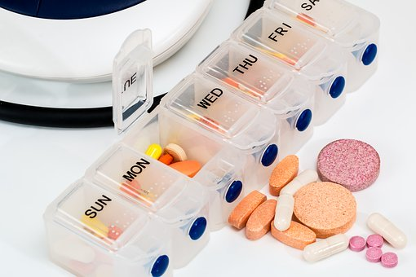
Taking Your Medication is Important
It is important to know why you take your medicines and how they work in your body.
Notes:
Page 1 – Introduction to Medication Management
The most common treatment for chronic illness is medication, so it is very important that you take your medication as prescribed.
It’s also important for you to understand the reason for the medications you take and how they work in your body.

Slide 3
Medication Management
Using Medicines Safely
Take medicines correctly so they work properly in your body.
If medication is not taken right, it may cause harm or even death.
Taking medicine, the right way, can help you feel better.
Notes:
Page 2 - Medication Management
In order for the medications to work properly in your body, you must be able to take your prescription or over-the-counter medications correctly.”
Not taking your medication the right way may cause harm to you or even death.
But taking your medication the right way can make you feel good and give you a better quality of life.

Slide 4
Medication Management (cont.)
Using Medicines Safely (continued)
Don't skip doses or take half doses to save money.
Take medication until it is finished or until your doctor says it is okay to stop.
Don't take medicines prescribed for another person.
Notes:
Page 2 - Medication Management
In order for the medications to work properly in your body, you must be able to take your prescription or over-the-counter medications correctly.”
Not taking your medication the right way may cause harm to you or even death.
But taking your medication the right way can make you feel good and give you a better quality of life.

Slide 5
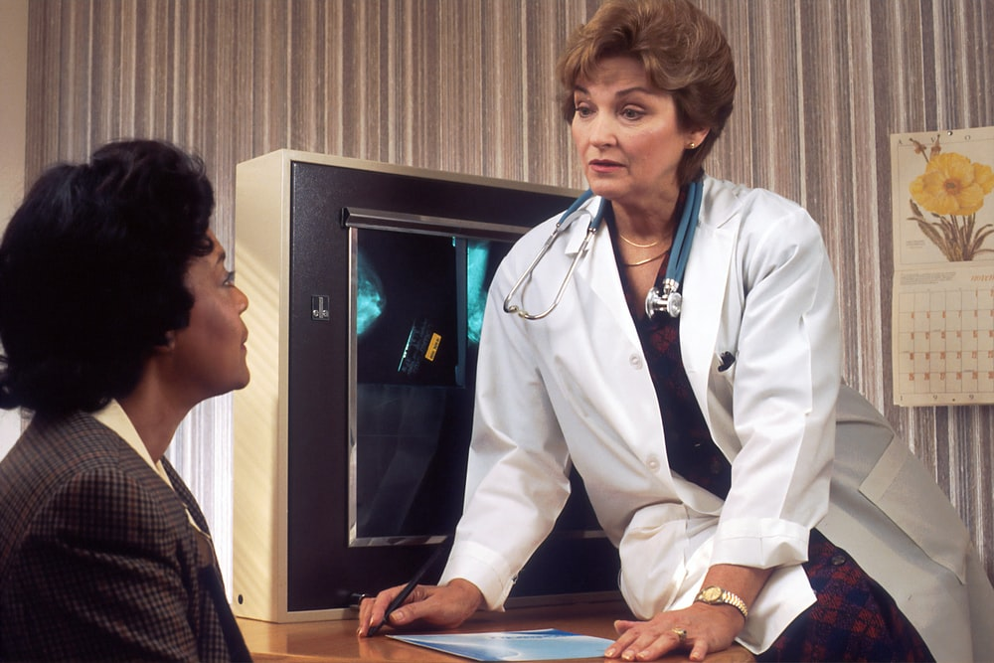
Your Medication Management Team
Medication Management Team
Primary Care Doctor
Pharmacist
Nurse
Community Health Worker
You
Notes:
Page 3 - Managing your chronic diseases takes a team-based approach. Your medical team is partnering with you to help you manage your chronic conditions.
Your medication management team consists of:
Primary Care Doctor: Your doctor oversees your medical care.
Nurse: Your nurse will be the person you speak to between your doctors appointments. He/she will act as a liaison between you and your doctor.
Pharmacist: Your pharmacist will dispense your medication at the pharmacy. The pharmacist also provides education on medications that are ordered for you.
Community Health Worker: The Community Health Worker helps you access the clinical and community services you need
You: You are the most important player on your team. All of your medical care is centered around you. That is why it is important for you to be able to manage your medications the right way
Photo source: https://unsplash.com/photos/TFJw-mTWw_U

Slide 6
Taking Your Medication
Notes:
Page 4 – The more you know about how to take your medications, the better they will work and the healthier you will stay. Here are some pointers to get the most from your medications:
Know the names of your medicines
Know what they do
Know how and when to take them for example, "Aspirin 325mg, take once daily"
Keep a current list of all of your medications, as well as the times you take them, the dose and the directions for taking them: "Aspirin 325mg, take once daily"
Image: https://unsplash.com/photos/b9CaYHNfmho

Slide 7
Know the Name of Your Medication
Name | Dose | Why do I take this medication? | When do I take this medication?
Metformin | 500 mg | Diabetes | Take one in morning, one in the evening
Furosemide | 80 mg | Blood Pressure | Once in the morning
Aspirin | 81 mg | Blood Thinner | Once daily
Notes:
Page 5 – Know the name of your medication.
Know the names of your medicines
Know what they do
Know how and when to take them
Know the times you take the time
Keep a list of all your medicines

Slide 8
Always Check Your Medications
When starting a medicine
Taking a medicine
Adding a medicine
Reviewing a medicine
Stopping a medicine
Notes:
Page 6 – Check to Your Medications
Be proactive when it comes to managing your medications.
Be sure to always check your medication. Check to be sure you have the right medication and you are taking the right medication.
Review with your doctor when to begin taking medication, how to take it, if new medicines are added, and when stop taking a medication.
Photo source: https://unsplash.com/photos/byGTytEGjBo

Slide 9
Ask Questions About Your Medication
Questions to ask your doctor
What is the name of this medicine and what is it for?
What are the risks and possible side-effects?
When should I take this medicine and how much to take?
Should I take this medicine with food or water?
Is a piece of bread enough to take a medicine?
Is sharing prescription medication illegal?
What will happen if I miss a dose?
What if I have side effects or an allergic reaction?
Does this medication interact with any other medicine?
What will happen if I stop taking the medicine?
Notes:
Page 7 – Ask questions about your medication.
If you don’t understand something about your medication, then ask questions about your medication.
These are some questions that you can ask your doctor or pharmacist.
What is the name of this medicine and what is it for?
What are the risks and possible side-effects?
When should I take this medicine and how much to take?
Should I take this medicine with food or water?
What will happen if I miss a dose?
What is I have side effects or an allergic reaction?
Does this medication interact with any other medication?
What will happen if I stop taking the medication?

Slide 10
Remembering to Take Your Medications
Make taking your medicine a habit to help you set a routine.
Ways to remember:
Set reminders on cell phone or alarm clock
Use a pill box with daily compartments
Use sticky notes
Notes:
Page 8 – Remembering Your Medications
Sometimes it can be hard to remember to take your medications. There are tricks that you can use to help you remember.
First, make taking your medicine a habit! Taking it everyday at the same time helps you to set a routine.
You can also try:
Placing your medication next to your tooth brush or something that you do everyday
Setting reminders on your cell phone or alarm clock
Asking a friend or family member to remind you to take your medicine
Using a pill box with daily compartments that you fill each week. This can prevent you from taking extra pills, especially if you have trouble remembering if you took them or not.
Placing sticky notes on the refrigerator, bedside table, or some other location where you spend a lot of time and can see it.
Image: https://unsplash.com/photos/2w_U2-Ah57E

Slide 11
Other Barriers to Taking Medication
Barriers can include:
Not able to open bottles
Unable to afford medicines
Fear of medicine side effects
Taking medicines at different times
Notes:
Page 9 – Other Barriers to Taking Medication
There may be many barriers to taking medications besides forgetting.
These include:
•Not being able to open the bottle
•Unable to afford medications
•Fear of side effects or not liking how medication makes you feel
•Many different types of medications that have to be taken at different times or instructions you don’t understand
•Unable to get to the pharmacy to get prescription filled or refilled

Slide 12
Overcoming Barriers to Taking Medication
Talk to your healthcare team
If you can’t afford your medicine, ask your doctor to prescribe a lower cost medication.
Ask for help on ways to remember to take your medicine.
Tell your doctor about if the medicine makes you feel bad.
If you take a lot of medicines, ask your doctor to simplify your medicine regimen.
If you can’t go to the pharmacy, ask the pharmacist about delivery or a 90-day supply.
Notes:
Page 10 – Overcoming Barriers to Taking Medication
If you have some of these barriers, there is no need to be ashamed. There are ways to overcome these barriers.
First, make sure to speak with your healthcare team about the issues that you are having.
Let your doctor know if you can’t afford your medicine. Talk with your doctor about co-pay discount cards, pharmacy discount lists for generic medicines, or changing to a lower cost medication."
Ask for help with tips to help you remember to take your medicine
Tell your doctor about any side effects or if the mediation makes you feel bad
If you are taking a lot of medications, ask your doctor to simplify your medicine regimen
If you can’t get to the pharmacy, call the pharmacist and ask about delivery or 90-day supplies

Slide 13
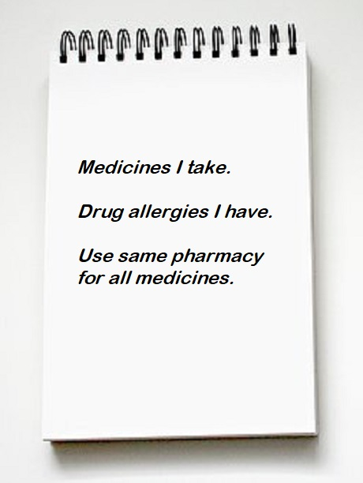
What else can you do?
Take a list of all of your medicines each time you visit a doctor.
Make sure the list includes any drug allergies.
Try to get all of you medications at the same pharmacy. This helps your doctor and pharmacist to better track your medication usage and refill history.
Notes:
Page 11 – What else can you do?
Make sure to take a list of all of your medications with you each time you visit a doctor.
Make sure the list includes any drug allergies.
Get all of your medications at the same pharmacy. This helps your doctor and pharmacist keep better track of how you are taking your medicines.

Slide 14
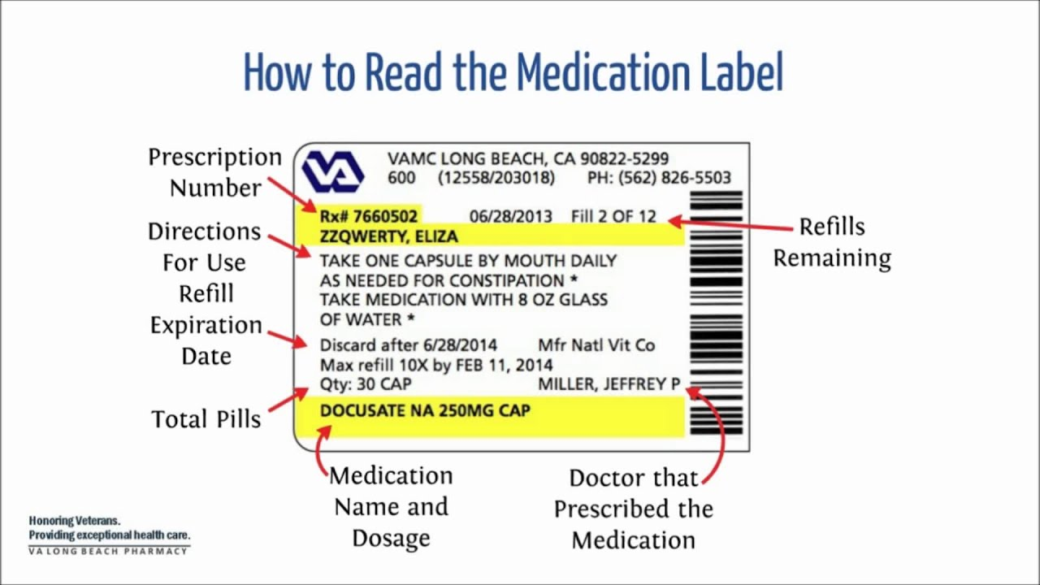
Reading a Prescription Label
Notes:
Page - 12
Now, let’s look at a prescription medication label. … (CHW: complete this activity with the patient)
CHW: Can you tell me who is this medication for?
(Eliza ZZQwerty)
How many tablets should be taken every day?
(one)
When should this medication be taken?
(daily, but does not specify a certain time to take it) (Encourage patient to ask doctor for specific time to take medication)
Are there any special instructions for how the medication should be taken?
(take with 8 oz glass of water)
Can this prescription be refilled? If so, how many refills are left?
(Yes, 10 more refills)
What is the doctors name?
(Miller, Jeffrey P)
What is the pharmacies name?
VAMC (VA Medical Center)
Why is the RX# important?
(The RX# is needed to call in refills)
(CHW: Be sure to point out refill and expiration date, generic versus trade name, and contact information of pharmacy)

Slide 15
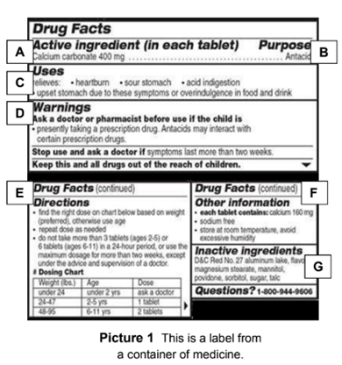
Reading an Over-the-Counter Drug Facts Label
Notes:
Page – 13
Now lets look at the Over-the-counter Drug Facts Label
What is this medication used for?
(Heartburn, sour stomach, acid indigestion, and upset stomach)
Are there any side effects associated with this medication?
(None stated)
Why are some reasons that someone might have to contact their doctor before or after taking this medication?
(If they are taking a prescription drug or taking antacids or if their symptoms last longer than 2 weeks).
What section of the label would you refer to in order to determine the correct dose to take?
(The dosing chart under directions).
(CHW: Be sure to point out other information on the drug facts label, like storing instructions, active/inactive ingredients, and warnings or precautions)

Slide 16
Assessment: Taking Your Medication
Do you ever forget to take your (_____) medicine?
Do you have problems remembering to take your medicine?
When you feel better, do you sometimes stop taking your (______) medicine?
Sometimes if you feel worse when you take your (name of health condition) medicine, do you stop taking it?
Notes:
Page -14 (Final Page)
(CHW: Ask the patient these questions)
1. Do you ever forget to take your (_____) medicine?
(If yes, ask the reasons why, then assist with problem-solving)
Placing your medication next to your tooth brush or something that you do everyday
Set reminders on your cell phone or alarm clock
Ask a friend or family member to remind you to take your medication.
Use a pill box with daily compartments that you fill each week. This will stop you from taking extra pills, especially if you have trouble remembering if you took them or not.
Place sticky notes on the refrigerator or bedside table or some other location where you spend a lot of time and can see it.
2. Do you have problem remembering to take your medicine?
(If yes, ask why and which medication, then using the ASK TELL ASK method, help the client to understand the importance of taking their medication)
3. When you feel better, do you sometimes stop taking your (______) medicine?
(If yes, ask why and which medication, then using the ASK TELL ASK method, help the client to understand the importance of taking their medication)
4. Sometimes if you feel worse when you take your (name of health condition) medicine, do you stop taking it?
(If yes, ask why and which medication, then using the ASK TELL ASK method, help the client to understand the importance of taking their medication)
Extra: Do you have trouble affording all of your mediation?
(If yes, work with client to help them navigate community resources and social service agencies or programs that can assist them with the cost of their medication. Be sure to also inform the medical team and tell the client to inform their doctor and pharmacist as well).

Slide 17
References
Apgar, T., & Nunlist, M. (2019, May 17). Are your patients taking their medications? Seven questions to help you find out. AAFP Home. Retrieved March 23, 2022, from https://www.aafp.org/journals/fpm/blogs/inpractice/entry/improving_medication_adherence.html
Center for Drug Evaluation and Research. (2017, September 27). The over-the-counter medicine label: Take A look. U.S. Food and Drug Administration. Retrieved March 23, 2022, from https://www.fda.gov/drugs/resources-you-drugs/over-counter-medicine-label-take-look
Centers for Disease Control and Prevention. (2014, June 13). Medication Safety Program. Centers for Disease Control and Prevention. Retrieved March 21, 2022, from https://www.cdc.gov/medicationsafety/index.html
Centers for Disease Control and Prevention. (2020, June 25). Promoting team-based care to improve high blood pressure control. Centers for Disease Control and Prevention. Retrieved March 22, 2022, from https://www.cdc.gov/dhdsp/pubs/guides/best-practices/team-based-care.htm
Chan, A. H., Cooper, V., Lycett, H., & Horne, R. (2020). Practical barriers to medication adherence: What do current self- or observer-reported instruments assess? Frontiers in Pharmacology, 11. https://doi.org/10.3389/fphar.2020.00572
FDA. (2020). How Do I Use Prescription Drug Labeling. U.S. Food and Drug Administration. Retrieved March 22, 2022, from https://www.fda.gov/about-fda/oncology-center-excellence/how-do-i-use-prescription-drug-labeling
Gleeson, J. R. (2018, April 19). 8 Easy Ways to Remember to Take Your Medication. Health & Wellness Topics, Health Tips & Disease Prevention. Retrieved March 23, 2022, from https://healthblog.uofmhealth.org/wellness-prevention/8-easy-ways-to-remember-to-take-your-medication
Mitchell, L. (2018, April 30). Medication questions you should be asking. University of Utah Health. Retrieved March 22, 2022, from https://healthcare.utah.edu/healthfeed/postings/2018/04/medication-questions.php
Neiman, A. B., Ruppar, T., Ho, M., Garber, L., Weidle, P. J., Hong, Y., George, M. G., & Thorpe, P. G. (2017). CDC Grand Rounds: Improving medication adherence for chronic disease management — innovations and opportunities. MMWR. Morbidity and Mortality Weekly Report, 66(45), 1248–1251. https://doi.org/10.15585/mmwr.mm6645a2

Slide 18
Final Slide with Agency Logo and OBPH Text Mark

