Slide 1



DSHS How to Use Social Media

Slide 2

Social Media Toolkit
This toolkit aims to assist MCH partners in sharing verified messaging to their audience.
It offers guidance on best practices, guidelines, and design resources for use on popular social media platforms such as Facebook, Instagram, X (Twitter), and LinkedIn.

Slide 3
General Elements
Introduction to Social Media
Social Media Platforms
Social Media Best Practices

Slide 4
Introduction
Social media platforms have become essential tools for communication, particularly for public health and healthcare organizations to connect with the community. They allow for real-time sharing of news, information, and content that are easily accessed.

Slide 5
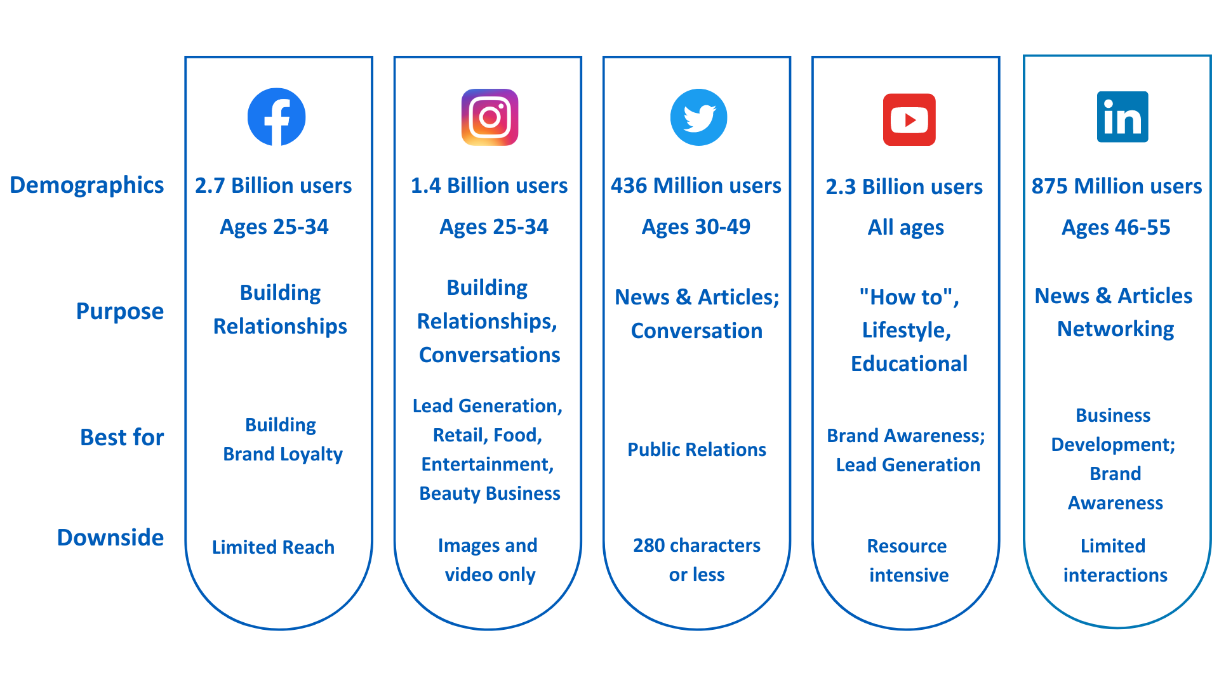

Social Media Platforms
Choosing the Right Platform
or
Notes:
https://aofund.org/resource/choosing-right-social-media-platform-your-business/

Slide 6


Facebook & Instagram
Best Practices
For posts, do:
Use high-resolution media. Avoid image pixelation.
Write attractive, concise, and short headlines.
Keep 80% of the image clear of text.
Create meaningful & informative captions.
Insert a call-to-action (CTA) to drive a response.
Notes:
Instagram Business. (n.d.). Instagram Post Tips. [Website]. Retrieved from https://business.instagram.com/instagram-post-tips on 4th February 2023.
For Media. (n.d.). Best Practices for Facebook and Instagram. [Blog post]. Retrieved from https://www.facebook.com/formedia/blog/best-practices-for-facebook-and-instagram on 4th February 2023.
Insert a call-to-action (CTA) to drive a response: announcement of classes, community health events, email newsletter signups, website visits, page likes, comments, etc.
https://business.instagram.com/instagram-post-tips
https://www.facebook.com/formedia/blog/best-practices-for-facebook-and-instagram

Slide 7
Facebook & Instagram cont.
Best Practices
For posts, do:
Use high-resolution media. Avoid image pixelation.
Write attractive, concise, and short headlines.
Keep 80% of the image clear of text.
Create meaningful & informative captions.
Insert a call-to-action (CTA) to drive a response
Notes:
CTAs can include announcement of classes, community health events, email newsletter signups, website visits, page likes, comments, etc.
Instagram Business. (n.d.). Instagram Post Tips. [Website]. Retrieved from https://business.instagram.com/instagram-post-tips on 4th February 2023.
For Media. (n.d.). Best Practices for Facebook and Instagram. [Blog post]. Retrieved from https://www.facebook.com/formedia/blog/best-practices-for-facebook-and-instagram on 4th February 2023.
https://business.instagram.com/instagram-post-tips
https://www.facebook.com/formedia/blog/best-practices-for-facebook-and-instagram

Slide 8
Facebook & Instagram cont. 2
Best Practices
For posts, do:
Use relevant hashtags
Direct posts to appropriate website
Cite statements and facts
Post 2-3 posts per week and 5 to 7 stories per week.
Create a monthly content calendar.
Notes:
Use relevant hashtags that align with the main topic to grow the post views.
Make sure that the post directs to a website that is reflective of the content that is being shared.
Always remember to properly cite statements and facts.
Instagram Business. (n.d.). Instagram Post Tips. [Website]. Retrieved from https://business.instagram.com/instagram-post-tips on 4th February 2023.
For Media. (n.d.). Best Practices for Facebook and Instagram. [Blog post]. Retrieved from https://www.facebook.com/formedia/blog/best-practices-for-facebook-and-instagram on 4th February 2023.
https://business.instagram.com/instagram-post-tips
https://www.facebook.com/formedia/blog/best-practices-for-facebook-and-instagram

Slide 9
Facebook & Instagram cont. 3
Best Practices
For posts, do:
Use relevant hashtags that align with the main topic to grow the post views.
Make sure that the post directs to a website that is reflective of the content that is being shared.
Always remember to properly cite statements and facts.
Post 2-3 posts per week and 5 to 7 stories per week.
Create a monthly content calendar.
Notes:
Instagram Business. (n.d.). Instagram Post Tips. [Website]. Retrieved from https://business.instagram.com/instagram-post-tips on 4th February 2023.
For Media. (n.d.). Best Practices for Facebook and Instagram. [Blog post]. Retrieved from https://www.facebook.com/formedia/blog/best-practices-for-facebook-and-instagram on 4th February 2023.
https://business.instagram.com/instagram-post-tips
https://www.facebook.com/formedia/blog/best-practices-for-facebook-and-instagram

Slide 10
X (Twitter)
or
Best Practices
X (or Twitter) is a real-time platform, meaning that the information and conversations on the site are constantly updating and happening in the present moment. It is also a good way to reach reporters and industry leaders.
For Posts, do:
Keep text short and sweet. X (Twitter) has a 280-character limit for tweets, so it's important to be concise and to the point.
Add visuals like, photos, GIFs and/or videos. Keep videos to 15 seconds or less. Tweets with images or videos tend to get more engagement than text-only tweets.
Notes:
https://business.twitter.com/en/basics/what-to-tweet.html

Slide 11
X (Twitter) cont.
or
Best Practices
X (Twitter) is a real-time platform, meaning that the information and conversations on the site are constantly updating and happening in the present moment. It is also a good way to reach reporters and industry leaders.
For Posts, do:
Keep text short and sweet. X (Twitter) has a 280-character limit for tweets, so it's important to be concise and to the point.
Add visuals like, photos, GIFs and/or videos. Keep videos to 15 seconds or less. Tweets with images or videos tend to get more engagement than text-only tweets.
Notes:
https://business.twitter.com/en/basics/what-to-tweet.html

Slide 12
X (Twitter) cont. 2
or
Best Practices
For Posts, do:
Avoid images with heavy text
Ask Questions.
Limit to 1-2 hashtags per tweet.
Check the meaning of hashtags before posting.
Plan your tweets.
Notes:
https://business.twitter.com/en/basics/what-to-tweet.html
Avoid images with heavy text
Ask Questions. Drive conversations with your community where possible.
Limit to 1-2 hashtags per tweet. Make sure they are timely and relevant.
Check the meaning of hashtags before posting to avoid misinterpretations.
Plan your tweets. Prioritize planning and preparation for your tweets by brainstorming ideas and perfecting them before releasing them for maximum impact.

Slide 13
X (Twitter) cont. 3
or
Best Practices
For Posts, do:
Tweet consistently at least 1-2 times a day to avoid overwhelming followers. The recommended frequency of tweets depends on goals and content.
Subscribe to Lists for relevant topics and groups
Create Lists of influential and important figures and accounts to actively engage with via replies, retweets, and likes.
Review X (Twitter) Policies and responsibilities to determine which platforms may be appropriate for their organization/agency and message.
Notes:
https://business.twitter.com/en/basics/what-to-tweet.html

Slide 14

LinkedIn
Best Practices
For posts, do:
Associate your content with ongoing conversations and communities by using 3-5 hashtags.
Respond to comments or interactions when possible.
Post at least twice a month.
Increase your community growth over time by posting 1-2 times a week, including weekends.

Slide 15
LinkedIn cont.
Best Practices
For posts, do:
Associate your content with ongoing conversations and communities by using 3-5 hashtags.
Respond to comments or interactions when possible.
Post at least twice a month.
Increase your community growth over time by posting 1-2 times a week, including weekends.

Slide 16
Social Media Platforms
Best Practices across platforms
Consistent and professional-looking content is more likely to catch the eye of followers, which can lead to increased engagement such as likes, comments, and shares.
Notes:
Follow….

Slide 17
Social Media Platforms cont.
Size recommendations
Following this size recommendation guarantees that all images and videos look consistent and professional on your Facebook account.
DSHS standard size and recommendation is using 1080 x1080 pixels posts across all platforms, none the less, each platform is also optimized for the sizes shown on the next slides.
Following these recommendations can also help prevent issues with cropping, blurring, or misalignment, which can detract from the overall quality of your content.
Square
1080 x 1080
Pixels
DSHS recommended
Notes:
Follow….

Slide 18
Social Media Platforms cont. 2
Size recommendations
Facebook
Posts and Timeline photos
Recommended size:
1200 x 630 pixels
Minimum size: 600 x 315
Stories
1080 x 1920 Pixels
Notes:
Follow….

Slide 19
Social Media Platforms cont. 3
Size recommendations
Instagram
Landscape
1080 x 566
pixels
Portrait
1080 x 1350
pixels
Square
1080 x 1080
pixels
Stories
1080 x 1920
pixels
Notes:
Follow….

Slide 20
Social Media Platforms cont. 4
Size recommendations
LinkedIn
Landscape
1200 x 627
Pixels
Portrait
1080 x 1850
Pixels
Square
1200 x 1200
Pixels
Notes:
Follow….

Slide 21
Social Media Platforms cont. 5
Size recommendations
or
X (Twitter)
By using the recommended sizes for images and videos on X (Twitter), you can achieve better results in terms of appearance and engagement.
Card Image
120 x 120
Pixels
(Minimum size)
In-stream photos
1600 x 900
Pixels
(Minimum size)
Video
1920 x 1200
Pixels
(Maximum size)
Notes:
Follow….

Slide 22
Thank you!

