Slide 1

Antiviral Resistant Influenza in Texas
2012
Carol M Davis, MSPH, CPH
Epidemiologist
Emerging and Acute Infectious Diseases
Texas Department of State Health Services
Image from the CDC image library

Slide 2
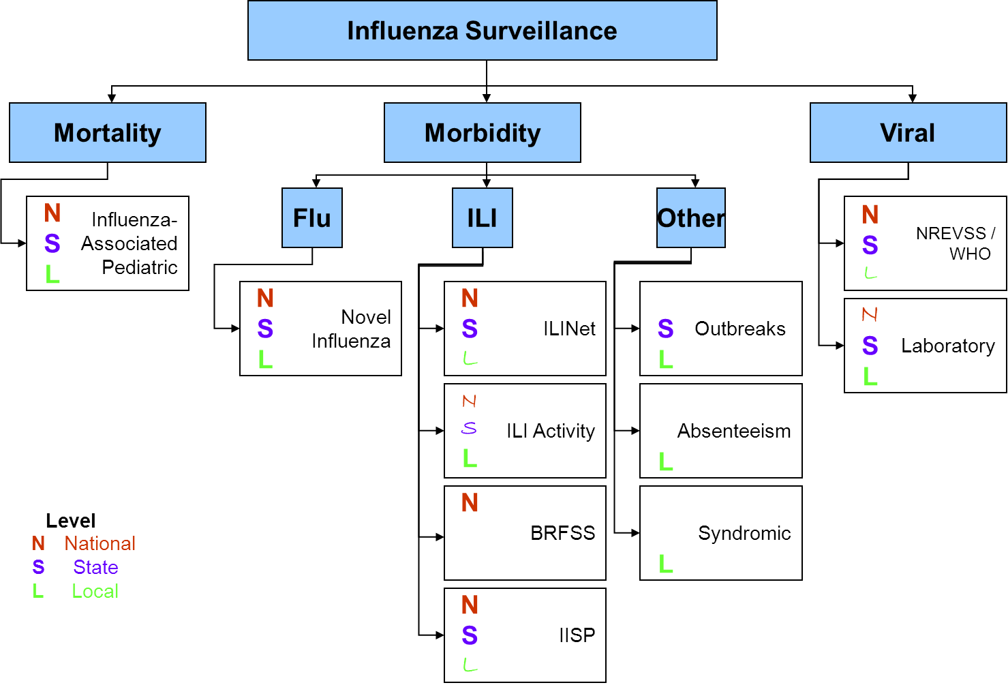
Texas Influenza Surveillance
Notes:
Will describe components of flu surveillance in Texas broadly

Slide 3
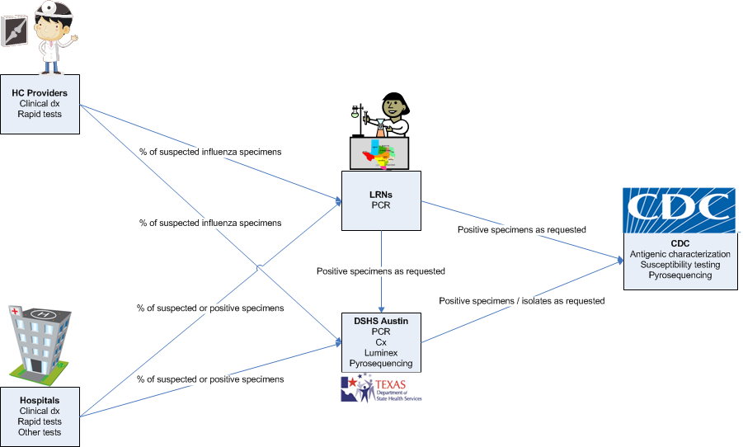
Laboratory (Viral) Surveillance
Notes:
Will describe how specimens are sent to our lab and the CDC

Slide 4
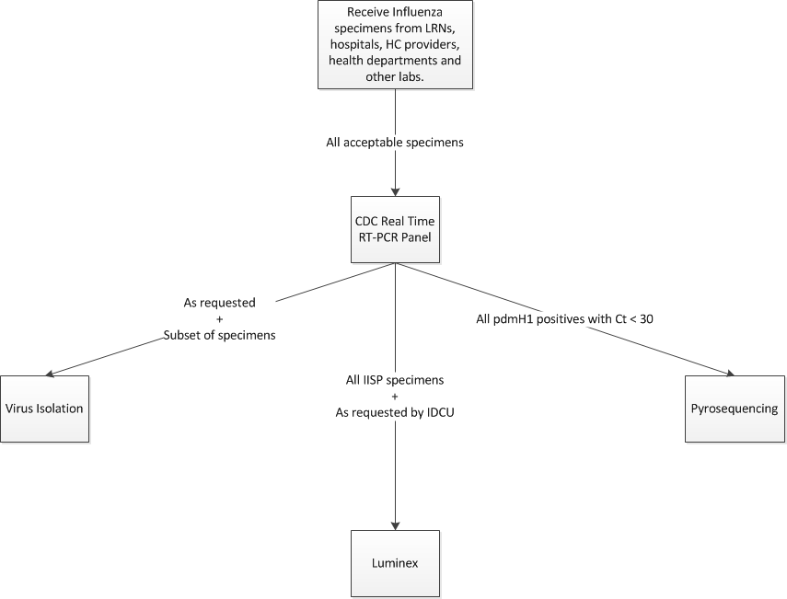
DSHS AVR Testing
Looks for the H275Y mutation
Notes:
Will describe Martha’s testing algorithm

Slide 5

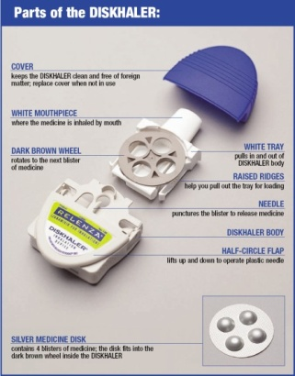
AV Background
Two classes
  Neuraminidase inhibitors
    Influenza A and B
    Brands:
      Oseltamivir (Tamiflu®)
        capsule or liquid; ages 1+
      Zanamivir (Relenza®)
        inhaled powder; ages 7+
  Adamantanes
    Influenza A only
      current H3N2 and pdmH1 viruses are resistant
    Brands:
      Amantadine
      Rimantadine
Notes:
Source: http://www.cdc.gov/flu/professionals/antivirals/antiviral-drug-resistance.htm
http://en.wikipedia.org/wiki/Oseltamivir
detenganlavacuna.wordpress.com

Slide 6
AV Background
Recommendations for use (2011-2012)
  Only oseltamivir or zanamivir recommended.
  Give
    ASAP for confirmed or suspected flu in people who
      are hospitalized,
      have severe, complicated or progressive disease, or
      are at high risk for complications:
        <2 or >65 years old
        pregnant or up to two weeks postpartum
        immunosuppressed
        chronic illness
        residents of nursing homes / LTC
    Within 48 hours of onset of symptoms for any previously healthy, symptomatic outpatient
Notes:
Source: http://www.cdc.gov/flu/professionals/antivirals/antiviral-drug-resistance.htm

Slide 7
AVR Background
AVR can develop during treatment of influenza
  More likely to occur in
    immunosuppressed patients with prolonged viral replication during AV treatment
    persons who developed illness while receiving AV chemoprophylaxis
Notes:
http://www.cdc.gov/flu/professionals/antivirals/antiviral-drug-resistance.htm

Slide 8
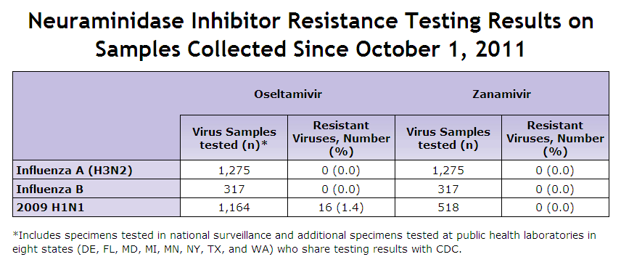
AVR in 2012
CDC tracks resistance
  High levels of resistance to adamantanes continues in H1 and H3 viruses
  No resistance to zanamivir this year
  Sporadic oseltamivir-resistant 2009 H1N1 virus infections have been identified, including with rare episodes of limited transmission, but the public health impact has been limited to date.
        1.4% in 2011-12, 0.9% in 2010-11 and 1.1% in 2009-2010
Table from the week 20 CDC Flu View Report: http://www.cdc.gov/flu/weekly/

Slide 9
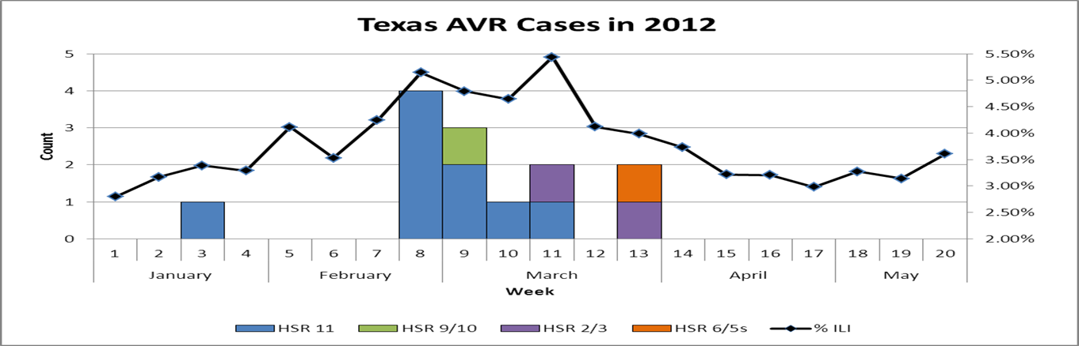
AVR in Texas - 2012
AVR in 2012
  13 AVR influenza cases identified in Texas
    All were resistant to oseltamivir
    All were 2009 H1N1
  Texas percentage higher than national percentage

Slide 10
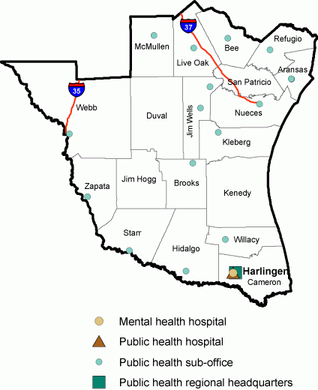
Investigation of AVR Cluster in Region 11
Herminia Alva, MPH, CPH
Regional Epidemiologist
Health Service Region 11
Texas Department of State Health Services

Slide 11
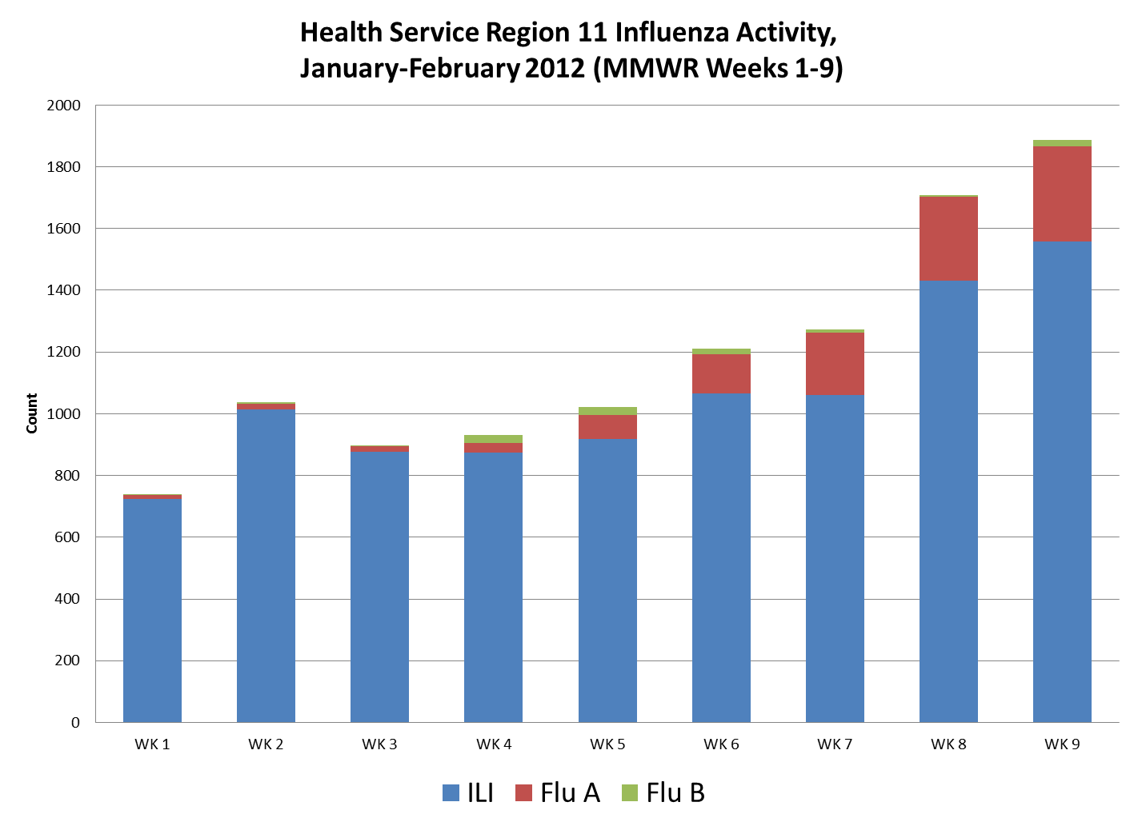
Influenza Activity in HSR-11
January – February 2012
  Mild flu season, H1N1 predominating in Region 11
  Hearing reports/rumors about H1N1 outbreaks in Mexico
Source: Texas Department of State Health Services – Health Service Region 11, February 2013, vh
Notes:
Mild Flu season, H1N1 predominating in HSR 11
January and February - hearing reports/rumors about H1N1 outbreaks in Mexico

Slide 12
Index case
Investigation of AVR Cluster
March 15, 2012
  preliminary positive oseltamivir-resistant 2009 H1N1 specimen sent to the CDC for confirmation
5 yo male
DOC 1/26/12
Resident of Webb County
Investigation by City of Laredo Health Department (CLHD)
  Onset 1-18-12 fever, cough, wheezing
  Re quired hospitalization
  Tamiflu started 1/27/12
    No AV exposure prior to test
  No flu vaccination
  No travel hx
  No ill contacts within 7d of onset
    Relative ill 2 wks prior
  Recovered
Notes:
1st AVR case in Texas

Slide 13
Another case
Investigation of AVR Cluster
March 30, 2012 - notified about 2nd oseltamivir-resistant 2009 H1N1 specimen
  Directly submitted to CDC by LRN
  10 mo male, DOC 2/25/12
  Duval Co. resident (later identified as Jim Wells resident)
Notified CLHD
  Requested investigation
  Asked to look for any commonalities with 1st case

Slide 14

While traveling to last year’s Epi Workshop….
Investigation of AVR Cluster
April 2, 2012
Next day – 3 more!
3rd – Jim Wells Co
  12yo female
  DOC 2/21/12
  Submitted directly to CDC by LRN
Central office added supplemental form
  Gatherings
  More extensive info on school/day care & close contacts
4th & 5th – Webb Co.
  11mo F & 4 mo M
  Both DOC 3/2/12
  6th – Hidalgo Co.
    5 yo F, DOC 3/12/12
Alerted CLHD and Hidalgo County Health and Human Services (HCHHS)

Slide 15
Summary of actions
April 4, 2012
DSHS Austin informs
  EAIDB management
  DSHS Press Officer
  Office of Border Health
Region 11 informs
  Regional management
  Working with LHDs to investigate cases
Office of Border Health
  Informs Mexican States bordering Region 11
    Shares minimal info per TX-TAM agreements
CDC requests conference call
Notes:
Per Texas-Tamaulipas agreements (through EWIDS) any unusual cases/outbreaks/clusters are reportable immediately (even if not binational). States of TAM and NL were told have 6 cases with only 1 investigation completed and no travel hx reported for that 1 case. Also, told this was not binational and that the information was being shared per TX-TAM agreements.

Slide 16
Investigation of AVR Cluster
AVR Confirmation
Case Summary
4/5/12 - notified CDC confirmed 3 AVR cases
Same day conf call held between Region 11, DSHS Austin, and CDC
  CDC very interested in cluster because not typically seen
    Early signal of trend in resistance patterns?
All pediatric pts
  3-4 mo to 12 yrs
  DOC range: 1/26 – 3/12/12
  Counties of residence: Duval, Jim Wells, Hidalgo, Webb
2nd investigation done
  3^{rd case} - Jim Wells Co.
    Onset 2/19
    Asthma
    father ill 5 days prior to patient’s onset
    traveled within state
    Both vaccinated
    No AV exposure prior to test

Slide 17
Public Health Response
Investigation of AVR Cluster
Region 11
EAIDB & DSHS lab
Enhanced surveillance
  LHDs encouraged flu submitters to send specimens to DSHS lab/LRN for case finding
  Local hospital sent all saved 2009 H1N1 specimens to CDC for testing
Review ILI data
Continue to work with LHDs on pending investigations to find commonalities
Increase testing
  Survey all LRNs
    Determine how many 2009 H1N1 specimens had not been tested for AVR
  Requested LRNs send all positive H1N1 specimens to CDC contract lab for pyrosequencing
    Identified 7th AVR case, Jim Wells Co.

Slide 18
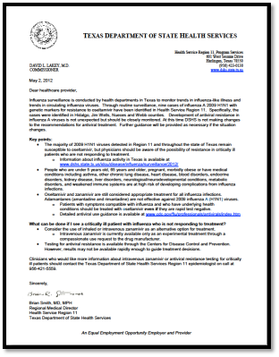
Two additional cases detected
8th - 7 month Hispanic male from Hidalgo County
9th - 28 yo non-Hispanic male from Nueces County
Investigation of AVR Cluster
Public Health Response
Letter to clinicians informing them of AVR cases – May 4, 2012
  No changes to current AV treatment recommendations
  Increase awareness of possibility of resistance in critically ill patients who are not responding to treatment
    Inhaled or IV zanamivir – available as experimental treatment
  Increase case finding
    No additional cases identified
    End of flu season, decreased flu activity
    Transmission low

Slide 19
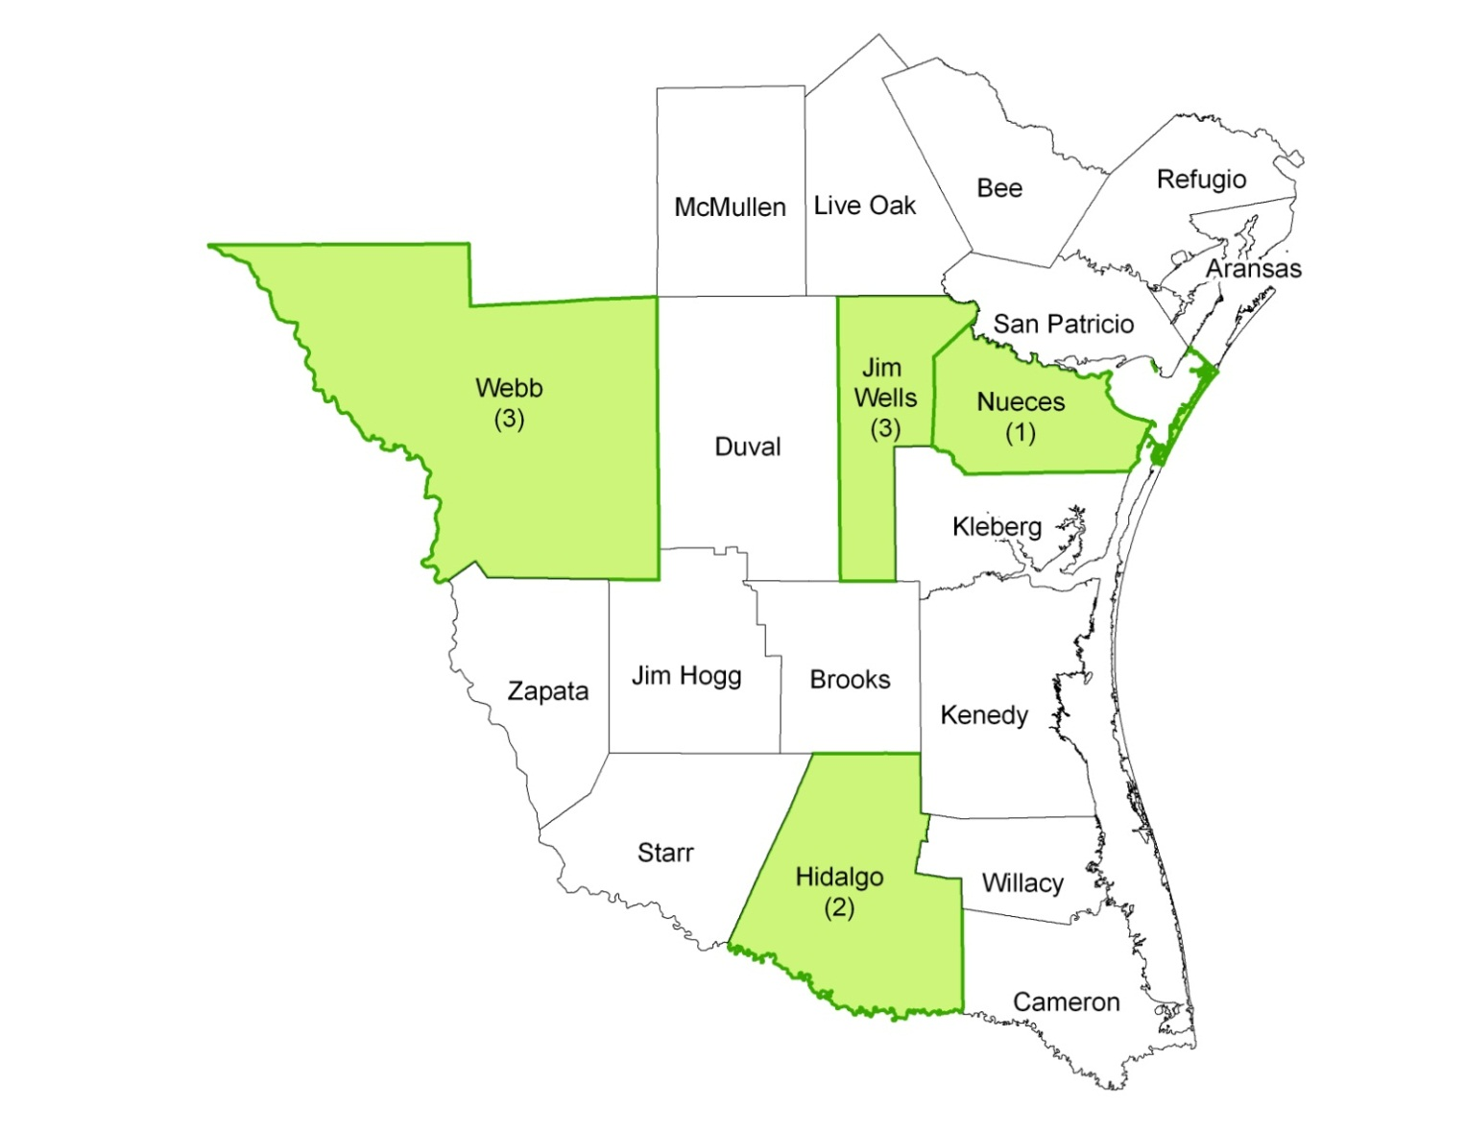
Geographic distribution of AVR cases
Investigation of AVR Cluster
  Case Summary
  Age range: 3 mo to 28 yrs
  56% male
  Onset: 1/18 - 3/17/12
  44% had no underlying health conditions
  89% not vaccinated in current season
    Of these, 22% vaccinated in 2009
  2 of 9 reported travel hx
    Coah, MX – 4d prior onset
    Within state, location unk
  78% were not on AV at the time of test
  No epidemiological link between cases
    Community-acquired transmission
Source: Texas Department of State Health Services, February 2013, ha/th

Slide 20
Does oseltamivir-resistant A(H1N1)pdm09 virus differ epidemiologically and clinically from oseltamivir-sensitive A(H1N1)pdm09 virus?
The Study Question
Proxy to viral fitness
“H1 viruses can accept mutations without effect to fitness.” – CDC influenza surveillance

Slide 21
The Study Question
Case-control study design
  Cases: Oseltamivir-resistant pdmH1 positive case-patients
  Controls: Oseltamivir-sensitive pdmH1 positive case-patients
Match by age
  Age is confounder for illness severity and underlying conditions
  Frequency sampling
  1 case : 4 controls
Currently in analysis phase

Slide 22
Conclusions
Demonstrates why we conduct surveillance.
  Per CDC “Additional sporadic cases of oseltamivir-resistant 2009 H1N1 virus infection can be expected, and ongoing surveillance for oseltamivir resistance among influenza viruses is essential for public health because oseltamivir is the most widely used antiviral medication.”
Where can I find information on AVR in Texas?
  Texas Flu Report - www.dshs.state.tx.us/idcu/disease/influenza/
Notes:
http://www.cdc.gov/flu/professionals/antivirals/antiviral-drug-resistance.htm

Slide 23
Acknowledgements
Lesley Brannan
  Influenza Surveillance Coordinator
Martha Thompson
  Viral Isolation Team Lead
Vivienne Heines
  Region 11 Influenza Coordinator
Melissa Davis
  Region 11 ERT Nurse
Tracy Haywood
  Health Geographer
CDC Influenza Surveillance
City of Laredo Health Department
Hidalgo County Health and Human Services
Corpus Christi-Nueces County Health District
Notes:
http://www.cdc.gov/flu/professionals/antivirals/antiviral-drug-resistance.htm

