Slide 1
Overview and Highlights-
2012 Preliminary Case Counts
Shelley Lucas, MPH
Infectious Disease Data and Prevention Group, Manager

Slide 2
Preliminary counts – 2012 disease data will not be finalized until June, 2013
Data obtained from NBS, ArboNet, and Houston and Harris County line lists
Counts include:
  - reported Texas notifiable conditions
  - confirmed and probable cases
  - NBS data has an approved notification
Incidence rates shown are per 100,000 population and are based on census or estimated/projected population data obtained from the DSHS Center for Health Statistics
Notes:
A few things to note regarding the data presented…

Slide 3
Overview
Notes:
So first an overview of the total preliminary counts.

Slide 4
Top Conditions Reported- by Count and Incidence Rate
count◊ IR*
Salmonellosis 4975 18.8
Varicella 2407 9.1
Campylobacteriosis 2358 8.9
Pertussis 2180 8.3
Shigellosis 1922 7.3
Streptococcus pneumoniae, invasive 1512 5.7
Aseptic (viral) meningitis 1137 4.3
West Nile Virus
Fever 1021 3.9
Neuroinvasive disease 851 3.2
Group B Streptococcus, invasive 1001 3.8
Total 19364
◊ Preliminary data
*Incidence rates are per 100K population and are based on projected population data obtained from the DSHS Center for Health Statistics
Notes:
These ten conditions represent 87% of all cases reported. The preliminary total count for all conditions is 22,244. Salmonellosis was the most reported condition by far, accounting for two times as many cases as varicella, the next most reported condition.

Slide 5
Conditions with the Fewest Reports
Anaplasma phagocytophilum |  |  |  |  | 1
Taeniasis
Trichinosis
Tickborne Encephalitis
Typhus Fever, epidemic louseborne
Botulism- infant(1)/wound(1) |  |  |  |  | 2
Cholera
Tetanus
Haemophilus influenzae, invasive |  |  |  |  | 3
LaCrosse Encephalitis
St. Louis Encephalitis
Ehrlichiosis, chaffeensis |  |  |  |  | 4
Hepatitis B Viral Infection, Perinatal
Leishmaniasis
Notes:
Here are conditions with the fewest reports, grouped according to counts per condition. As I’m sure you’re all aware, while these conditions may have few cases reported, the investigations are still time consuming.

Slide 6
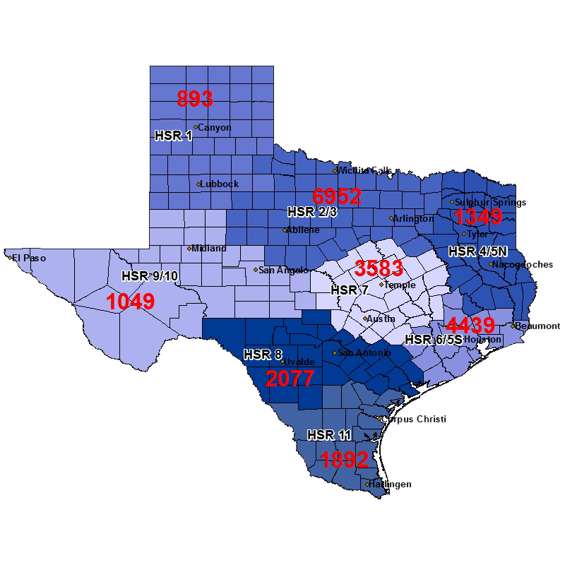
Counts by Region
Notes:
Here is a look at numbers of cases reported by public health region. The highest number of cases at 6952 were reported in PHR 2/3, followed by 4439 in PHR 6/5S. The fewest, 893, were reported in PHR 1.

Slide 7
Counts by Age Group
Years
Notes:
This slide shows the burden of disease by age group. Almost half of all reported cases were in the very young, 0-4 years of age, and those 60 years and older.

Slide 8
Condition-related Reported Deaths
Deaths shown for conditions with more than one reported fatality.
Notes:
There were 278 condition-related deaths reported in 2012. This slide shows those conditions for which more than one death was reported. West Nile-related deaths were highest, with 86 fatalities reported, followed by Strep pnemo invasive. Not included in the graph are deaths reported for Campylobacteriosis, cysticercosis, acute Hep B, Malaria, Typhoid fever, murine typhus, and yersiniosis, with one fatality each.

Slide 9
Reported Hospitalizations
All conditions shown had at least 100 reported hospitalizations.
Notes:
Here we’re looking at those conditions with at least 100 hospitalizations reported. WNV had the highest number of condition-related hospitalizations, followed closely by Salmonellosis and Strep pnemo, invasive.

Slide 10
Severity of Illness
All conditions shown had at least 100 reported hospitalizations.
Notes:
This slide shows severity of illness by the percentage of reported cases with a related hospitalization. 91% of reported Legionellosis cases were hospitalized with illness while only 10% of persons with reported pertussis required hospitalization. While WNV accounted for the highest total number of hospitalizations, only a little over half of those infected were hospitalized.

Slide 11
Highlights
Notes:
And next I want to highlight a few conditions that had interesting trends in 2012.

Slide 12
Campylobacteriosis- Counts and Incidence Rates by Year
*Preliminary count
Incidence rates are per 100K population and are based on census data or estimated/projected population data obtained from the DSHS Center for
Health Statistics
Notes:
After a decline in 2011 to under 2000 cases, reported Campylobacteriosis cases rose again to 2358 and 2012 had the highest incidence rate over the 10 year period.

Slide 13
Shigellosis- Counts and Incidence Rates by Year
*Preliminary count
Incidence rates are per 100K population and are based on census data or estimated/projected population data obtained from the DSHS Center for
Health Statistics
Notes:
Conversely, Shigellosis has been declining from a high of 4,665 cases reported in 2008 to less than 2000 cases reported in 2012. 2012 had the fewest number of cases (1,922) reported and the lowest incidence rate over the 10 year period.

Slide 14
Shiga toxin-producing Escherichia coli-
2012 Counts and Incidence Rates by Age Group
*Preliminary count
Incidence rates are per 100K population and are based on census data or estimated/projected population data obtained from the DSHS Center for
Health Statistics
Notes:
Approximately 500 STEC cases were reported in 2012. Although the largest number of reported cases occurred in the 1-4 years age range, the incidence of disease was highest in children under one year of age. Very young children and the elderly experience more severe illness and may be more likely to receive medical care, which drives reporting.

Slide 15
Meningococcal Invasive Disease-
Counts and Incidence Rates by Year
*Preliminary count
Incidence rates are per 100K population and are based on census data or estimated/projected population data obtained from the DSHS Center for Health Statistics
Notes:
Meningococcal invasive disease has steadily decreased from 2003 to 2011. After a low last year of 30 reported cases, there was a slight uptick in 2012 cases reported, however the incidence rate did not increase.

Slide 16
Legionellosis- Counts and Incidence Rates by Year
*Preliminary count
Incidence rates are per 100K population and are based on census data or estimated/projected population data obtained from the DSHS Center for Health Statistics
Notes:
Since the urine antigen test became widely utilized, the number of cases of Legionellosis in Texas has been increasing but we believe it is beginning to level out. On average, 118 cases were reported annually over the last 6 years. In 2012, approximately 150 cases were reported.

Slide 17
Acute Hepatitis A- Counts by Year and Age Group
*Preliminary count
Incidence rates are per 100K population and are based on census data or estimated/projected population data obtained from the DSHS Center for
Health Statistics
Notes:
Hepatitis A continued to decline in 2012 in most age groups due to vaccine availability and childhood immunization requirements. Since 2009, two doses of Hep A vaccine are required for kindergarten entry statewide.

Slide 18
Varicella- Counts by Year and Age Group
*Preliminary count
Incidence rates are per 100K population and are based on census data or estimated/projected population data obtained from the DSHS Center for
Health Statistics
Notes:
Varicella has been steadily decreasing in school aged children over the last six years. With the recommendation on two doses of vaccine, reported cases have dropped dramatically since 2007 and since 2010 appear to be leveling out.

Slide 19
West Nile Virus- 2012 Counts and Deaths by Age Group
Notes:
Lastly, there has been a higher than usual number of human West Nile virus cases in Texas in 2012. 851 cases of WNND and 1021 cases of WNF have been reported, with almost half (398 WNND/324 WNF) of infections occurring in persons 60 years and older. 72 of the 86 West Nile related fatalities reported have been in those 60 years and older as well.

Slide 20
2013 Reporting Changes
Notes:
And now I’d like to review changes to the Texas Administrative Code on infectious disease reporting implemented in 2013.

Slide 21
Changes in the Texas Administrative Code Regarding Notifiable Conditions
Added:
Removed (no longer reportable):
Amebic meningitis and encephalitis
Anaplasmosis
Novel influenza
Newly reportable:
  Chagas’ disease (human and animal)
  Babesiosis
  Polio virus infection, non-paralytic
Encephalitis (specify etiology)
Non-arboviral encephalitis
Hepatitis D, acute
Hepatitis, unspecified, acute
Meningitis (specify type)
  Fungal meningitis
  Aseptic/viral meningitis
  Bacterial meningitis caused by a non-reportable pathogen
Notes:
Please note that amebic meningitis and encephalitis have always been reportable but were added to the TAC by name when encephalitis and meningitis (specify type) were removed. Novel influenza is now specified in the TAC but previously fell under the requirement to report any outbreak or unusual group expression of a disease. The following are newly reportable conditions starting in 2013: Chagas… Removed and no longer reportable are…

Slide 22
Changes in the Texas Administrative Code Regarding Notifiable Conditions
Renamed:
Clarification:
E. coli, entero-hemorrhagic infection was renamed shiga-toxin producing E. coli infection
The following kinds of meningitis are still reportable-
Meningitis caused by any ameba
Meningitis caused by a reportable condition such as Neisseria meningitidis (meningococcal meningitis), Streptococcus pyogenes/ agalactiae/pneumoniae, varicella, etc.
Notes:
To clarify meningitis reporting, please note you should still report meningitis caused by any ameba as well as any caused by a reportable condition.

Slide 23
Questions?
If you have any questions or would like further information, I can be reached at:
Shelley Lucas
Shelley.Lucas@dshs.texas.gov
512-776-6335
Notes:
Thank you all for your time this morning and I hope you enjoy the rest of the conference.

