Slide 1
What was fishy about the sushi?
Lessons learned from a large-scale, multi-state, multi-agency foodborne illness investigation
Virginia L. Headley, PhD, WCCHD; Julie Borders, MSHP, DSHS; Venessa Cantu, MPH, DSHS
Epidemiology-Laboratory Capacity Workshop
February 26, 2013

Slide 2
Overview
Foodborne Illness
Salmonella Bareilly: Early Investigation
Local Health Department’s Role
Restaurant Cluster Investigation
FDA’s Role
Investigation Summary
Notes:
Foodborne Illness - Venessa
Salmonella Bareilly: Early Investigation - Venessa
Local Health Department’s Role - Virginia
Restaurant Cluster Investigation - Virginia
FDA’s Role - Julie
Investigation Summary - Virginia

Slide 3
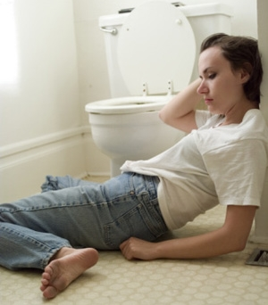

Foodborne Illness
~48 million Americans are victims of foodborne illness every year
128,000 are hospitalized, and 3,000 die of foodborne diseases.
Notes:
The CDC estimates that roughly 1 in 6 Americans or ~48 million Americans are victims of foodborne illness every year. Most of us just tough it out, figuring it was something we ate that did not agree with us.
Some of us go to the doctor. -- CDC estimates 128,000 are hospitalized, and 3,000 die of foodborne diseases.
Since 2005 in Texas, more than 7000 lab-confirmed cases have been hospitalized and more than 130 people have died.
Infants, young children, the elderly, and the immunocompromised are most likely to have the most serious outcomes.
Because of the overall burden of disease as well as the seriousness of consequences, public health involvement in the investigation and control of foodborne illness is needed.

Slide 4

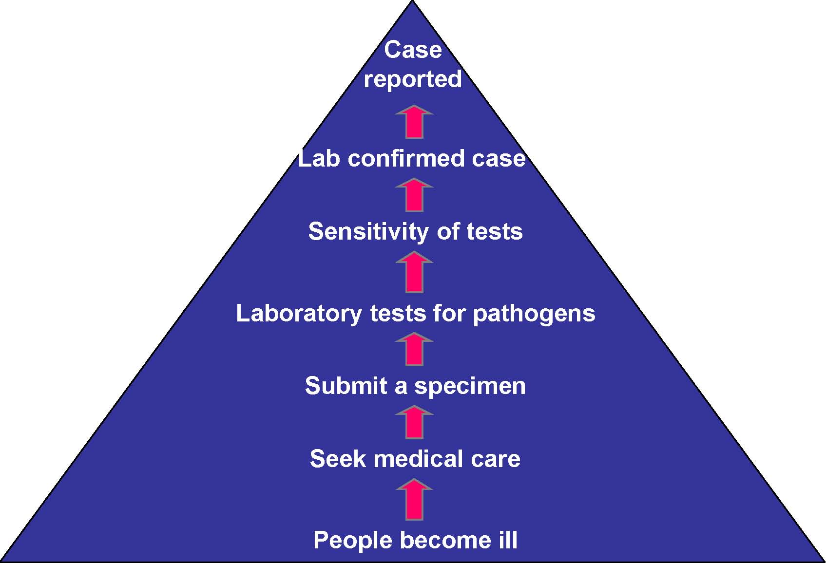
Surveillance Pyramid
Notes:
But how does public health find out about possible foodborne illnesses?
In 1999 CDC estimated that for every case of bloody diarrhea reported to CDC, 22 other people became ill; for every non-bloody diarrhea case reported to CDC, 38 other people became ill. A reported case, then, is only the tip of the iceberg.

Slide 5
Painter JA, Hoekstra RM, Ayers T, Tauxe RV, Braden CR, Angulo FJ, et al. Attribution of foodborne illnesses, hospitalizations, and deaths to food commodities by using outbreak data, United States, 1998–2008. Emerg Infect Dis [Internet]. 2013 Mar [accessed 02/07/13]
Notes:
In their most recent analysis of food commodities attributed to outbreaks, the CDC found most illnesses were attributed to plant commodities and most deaths to land animal commodities. They attributed 46% of illnesses to produce; the large number of norovirus illnesses in this time period was a major driver of this result. More deaths were attributed to poultry than to any other commodity. Though the different commodities vary greatly in relative contribution, this slide also demonstrates that virtually everything we consume has the potential to be the vehicle of a foodborne pathogen.

Slide 6
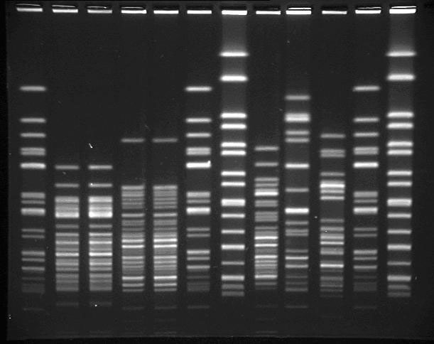
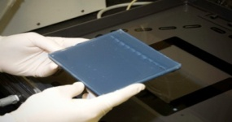
Is it a Cluster or Outbreak?
Report of more than the usual number of cases
Apparent common exposure
  Residence, work, school
  Event
Common genetic strain
  PFGE
Notes:
How do we identify a cluster or an outbreak?
Sometimes by a report of more than the usual # of cases.
Another way we identify a cluster is when there is a common exposure.
Cases have common place of residence, work, school (daycare outbreak)
Cases attended common event (classic church picnic scenario)
These outbreaks usually are local investigations, contained to a specific geographic location, easier to detect than outbreaks that occur over many counties and states.
That’s where PFGE comes into play. Molecular testing, such as PFGE allows us to identify clusters that were previously difficult to detect. PFGE and PulseNet can help us determine whether an outbreak is occurring, even if the affected persons are geographically far apart.
This is important because Food consumption and practices have changed in the past 20 years in the United States.
Described as a shift from the typical point source, or “church picnic” outbreak, to more widespread outbreaks that occur over many communities with only a few illnesses in each community.

Slide 7
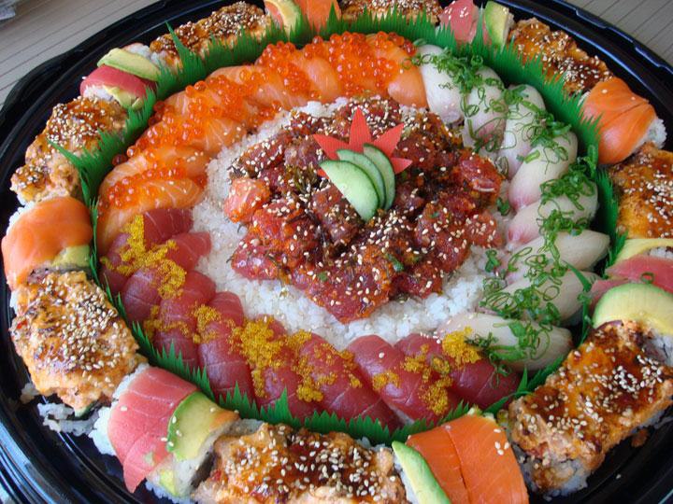
So, what was fishy about the sushi?
2012 Salmonella Bareilly Investigation
Notes:
The CDC has also shown that most bacterial pathogens are seeing reduced incidence in the U.S., but Salmonella is on the rise. Because the current trends in vehicles associated with foodborne illness include produce, raw foods in general, and imported foods, this plate is more than a plate of beautiful sushi – it’s a plate of opportunity….for foodborne illness!

Slide 8
March 2012
CDC to States (11)
NY to CDC (4)
Sunday | Monday | Tuesday | Wednesday | Thursday | Friday | Saturday
 |  |  |  | 1 | 2 | 3
4 | 5 | 6 | 7 | 8 | 9 | 10
11 | 12 | 13 | 14 | 15 | 16 | 17
18 | 19 | 20 | 21 | 22 | 23 | 24
25 | 26 | 27 | 28 | 29 | 30 | 31
Notes:
The investigation begins on March 1, 2012, when NY State notified the CDC Outbreak Response Team that they had a cluster of four isolates of a rare serotype of Salmonella- Salmonella Bareilly– all with the same unusual PFGE pattern.
On March 2, PulseNet reports 11 isolates in 7 states with a matching PFGE pattern, including 1 case in Texas from Williamson County. CDC begins coordinating the multi-state investigation and holds the first conference call on March 2nd.

Slide 9
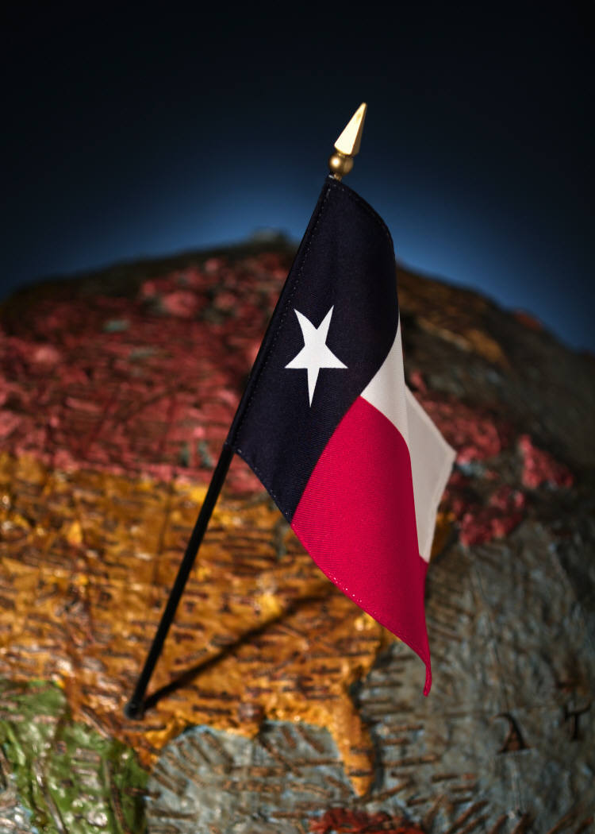
March 2?
What were they thinking?
  It’s Friday!
  It’s a State Holiday!
Notes:
Turns out March 2nd was Texas Independence Day and a state holiday…

Slide 10
March 2012
Sunday | Monday | Tuesday | Wednesday | Thursday | Friday | Saturday
 |  |  |  | 1 | 2 | 3
 |  |  |  | NY to CDC (4) | CDC to States (11)
4 | 5 | 6 | 7 | 8 | 9 | 10
11 | 12 | 13 | 14 | 15 | 16 | 17
18 | 19 | 20 | 21 | 22 | 23 | 24
25 | 26 | 27 | 28 | 29 | 30 | 31
 |  |  |  |  |  | Teleconference Dates (#cases)
DSHS to WCCHD
FDA joins investigation (18)
DSHS to ATCHHS
(26)
TX reports restaurant cluster (27)
Notes:
Delayed just a bit by the holiday weekend, DSHS contacts Williamson County & Cities Health District on Monday, March 5 to alert them to the single Texas case that matched the cluster pattern and requests the Hypothesis-generating questionnaire also be administered.
By Tuesday, the cluster had increased to 18 matching isolates.---Also on Tuesday, FDA reached out to CDC and stated that their Signals team has been monitoring this cluster and doing some background research on Salmonella Bareilly. FDA saw many seafood samples, mostly from countries such as India, Thailand, and Vietnam. Other isolates came from frog legs and various pepper spices. The CDC invited FDA to join on the next call to be held on Thursday, March 8.
On Wednesday, CDC informs DSHS that there are now 26 cases in 12 states, including a 2nd case in Texas from Austin/Travis -DSHS contacts Austin-Travis County Health and Human Services Department (HHSD) to notify them of the second case in their jurisdiction and requests the Hypothesis-generating questionnaire also be administered.
By the time of the conference call on Thursday, February 8th, 27 cases had been identified, from 12 states, including 2 cases in Texas. On the call, we hear that initial exposure information from 8 cases revealed that 7 reported eating seafood and 5 ate sushi in the week before becoming ill. Luckily before the call, DSHS receives initial case reports on both cases previously completed by Williamson County and Travis County and both cases reported eating at the same restaurant. Texas reports on the call first cluster of 2 unrelated ill persons who ate at the same Japanese restaurant which serves sushi.

Slide 11
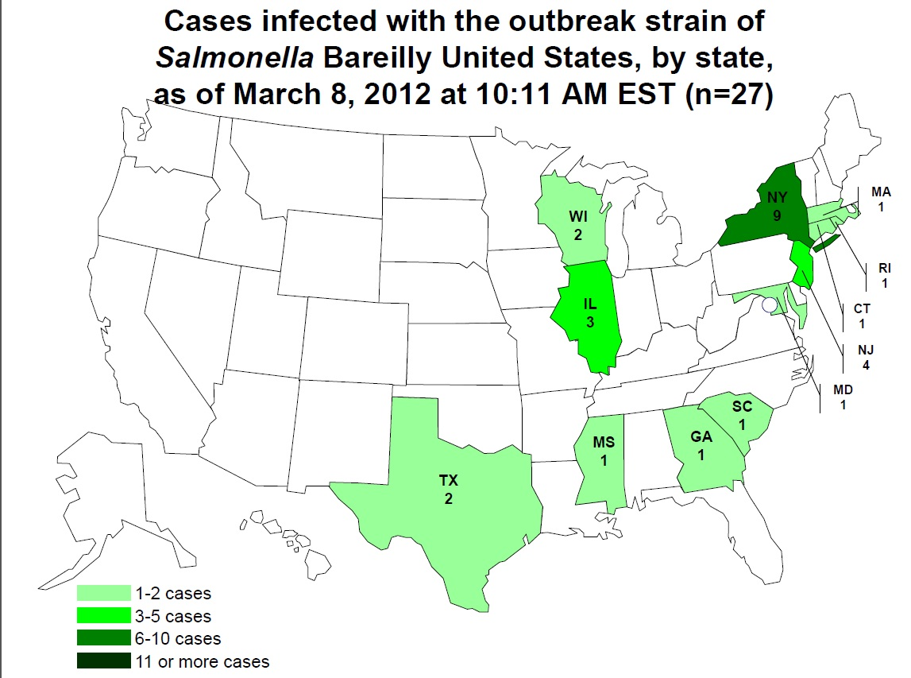
At the outset:
Notes:
By March 8, twelve states were involved in the investigation of the cluster, along with the CDC and FDA.
Map- distribution of cases, as of March 8th

Slide 12
March 2012
Sunday | Monday | Tuesday | Wednesday | Thursday | Friday | Saturday
 |  |  |  | 1 | 2 | 3
 |  |  |  | (4) | (11)
4 | 5 | 6 | 7 | 8 | 9 | 10
 | WCCHD joins investigation | FDA joins investigation (18) | ATCHHS joins investigation (26) | TX reports restaurant cluster (27)
11 | 12 | 13 | 14 | 15 | 16 | 17
 |  | (43) |  |  | (61)
18 | 19 | 20 | 21 | 22 | 23 | 24
 |  | (62) |  | (68)
25 | 26 | 27 | 28 | 29 | 30 | 31
 | (79) |  |  | (88)
 |  |  |  |  |  | Teleconference Dates ((#cases)
Notes:
As the calls continued, the cases mounted up. By the end of the month, there were 88 cases identified and 20 states involved, including 3 cases in TEXAS.

Slide 13
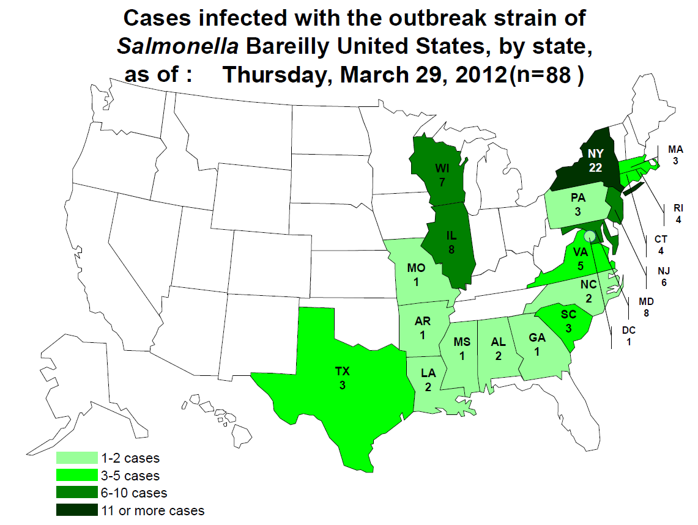
End of March:
Notes:
Map- distribution of cases, as of March 29th

Slide 14
Local Health Departments’ role in the investigation:
Initial case reports
Administer questionnaires
Contact restaurants to obtain
  menus
  invoices
    identify brand names
    Common distributors
  orders for comparison study
Maintain good will with businesses

Slide 15
The (Dreaded) Questionnaires:
Case report
Open ended food history
Hypothesis generating questionnaire(s)
Supplemental questionnaire(s)
Notes:
Questionnaires are an everyday part of disease investigations. After the fairly simple case report – most case interviews stop after the standard three-day open ended food history. But as anyone involved in a complex foodborne illness investigation can tell you, the initial fog brought on my an unknown vehicle makes for some mighty big hypothesis generating questionnaires. The initial questionnaire for this outbreak was 18 pages long. The second and third revisions were only 14 and 13 pages, respectively.

Slide 16
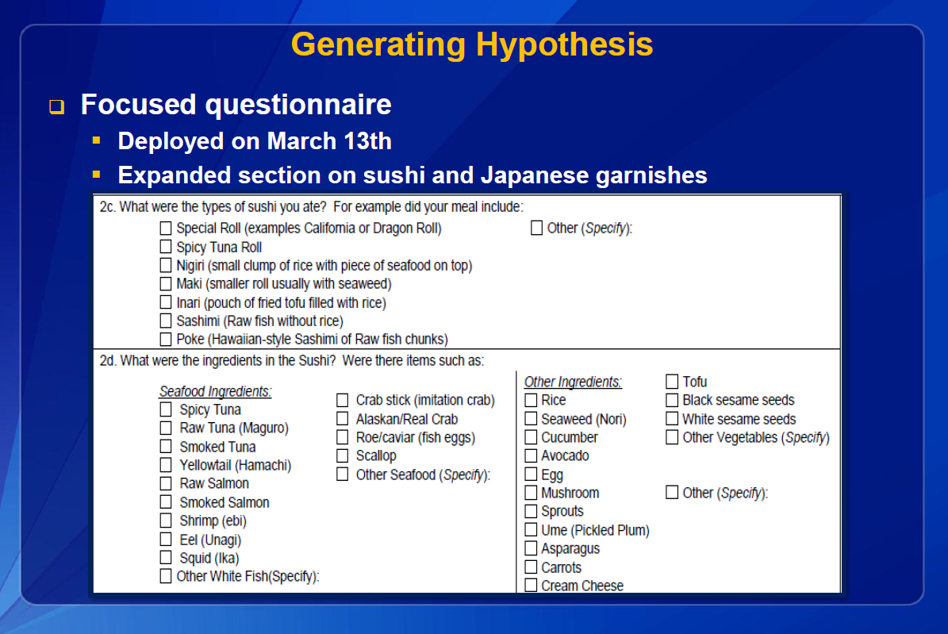
Notes:
By March 13th, we were on the third questionnaire for the cases. The focus was getting very narrow, looking for specific menu items and ingredients consumed. We felt so fortunate that our case had a good memory (aided by her frequent visits to this particular restaurant) and was engaged in the overall process. She felt as though she was part of the detective team, helping to solve the mystery. By the end, we probably had spent close to six hours on the phone with her, over multiple calls, after all the interviews were said and done. Thanks Case A!

Slide 17
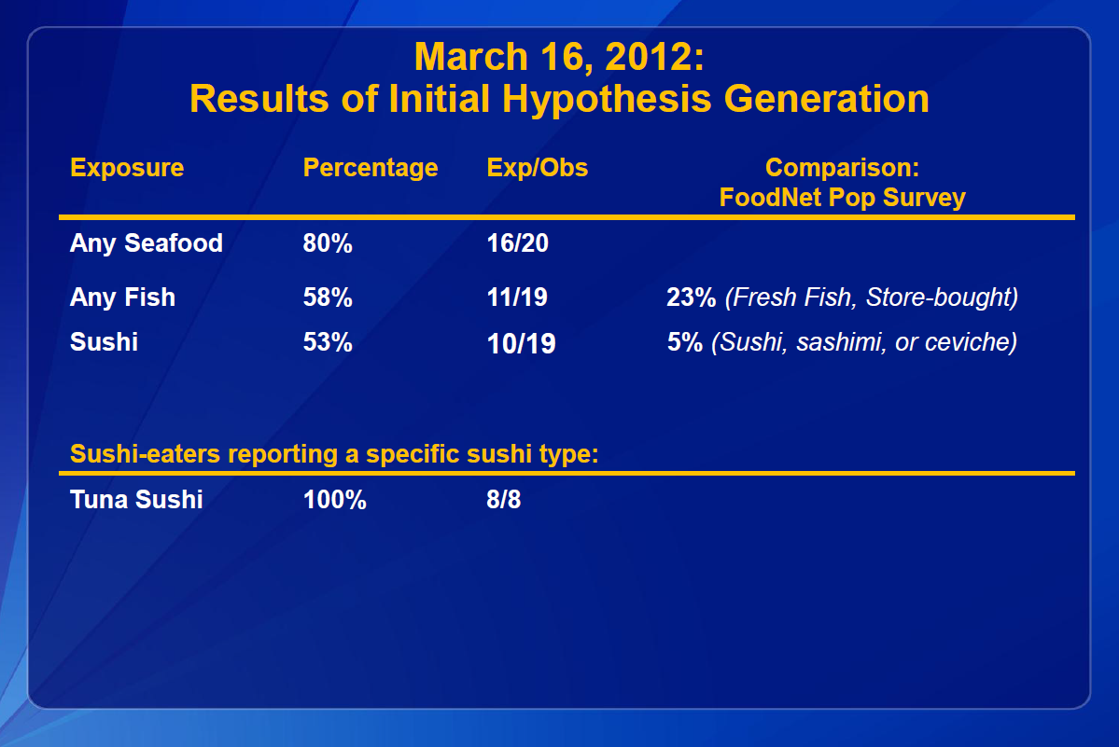

Slide 18
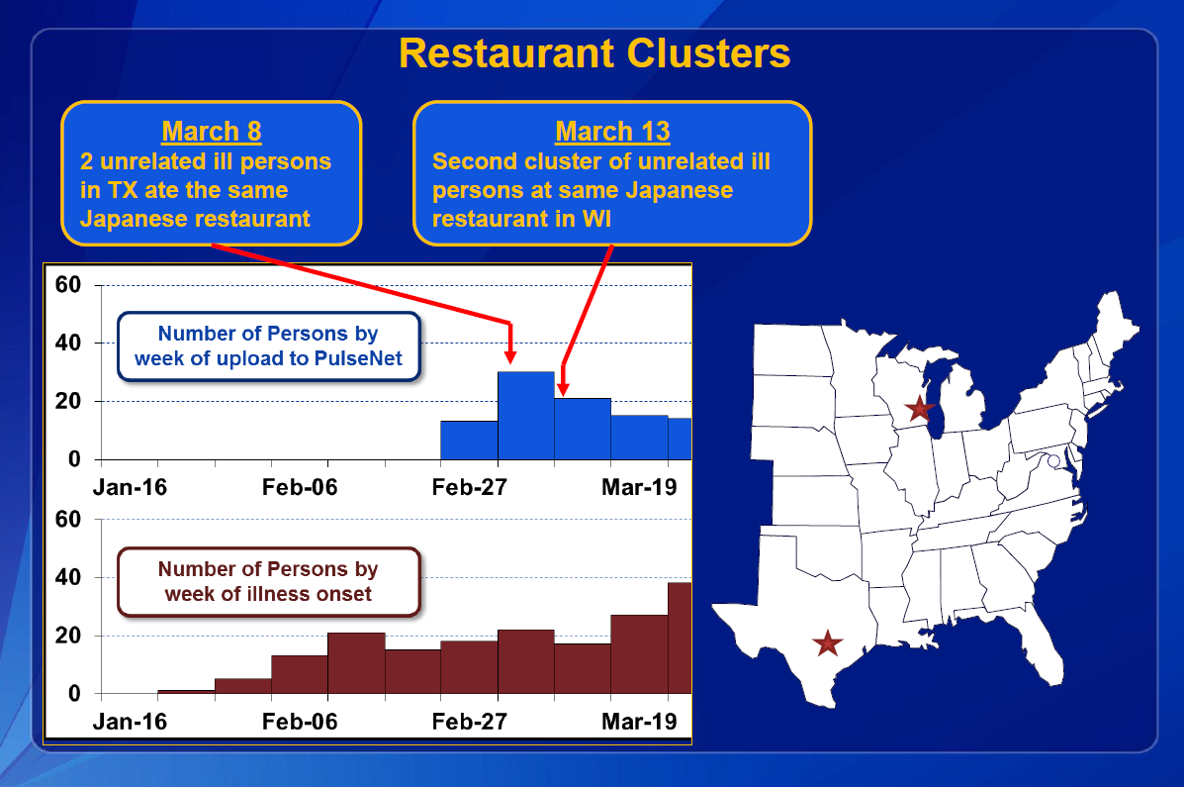

Slide 19
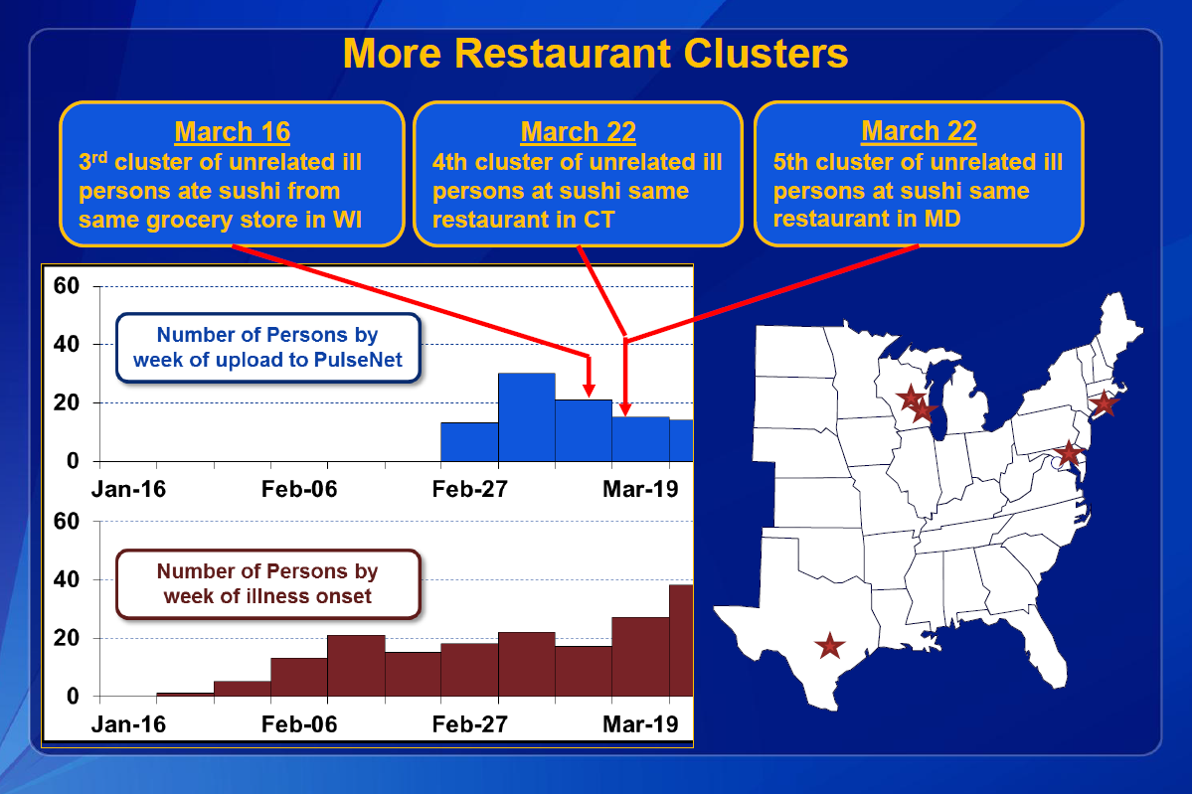

Slide 20
March 2012
Sunday | Monday | Tuesday | Wednesday | Thursday | Friday | Saturday
 |  |  |  | 1 | 2 | 3
 |  |  |  | (4) | (11)
4 | 5 | 6 | 7 | 8 | 9 | 10
 | WCCHD joins investigation | FDA joins investigation | ATCHHS joins investigation | TX reports restaurant cluster (27)
11 | 12 | 13 | 14 | 15 | 16 | 17
 |  | (43) |  |  | (61)
18 | 19 | 20 | 21 | 22 | 23 | 24
 |  | (62) |  | (68)
25 | 26 | 27 | 28 | 29 | 30 | 31
 | (79) |  |  | (88)
 |  |  |  |  |  | Teleconference Dates (#cases)
Restaurant A investigation
Samples collected
Notes:
WCCHD sanitarians and myself visited the restaurant in our jurisdiction associated with 2 cases. It was important for us to repeatedly emphasize that the restaurant itself was not under investigation as having caused the outbreak, given its national distribution. Maintaining a cooperative relationship can sometimes be challenging in these situations. We were able to obtain food samples on March 22, but these were all negative upon testing.

Slide 21
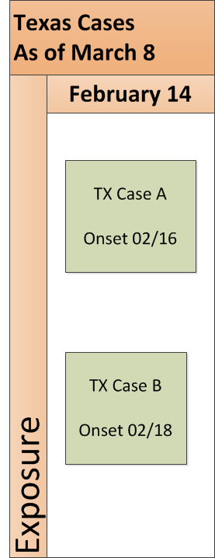
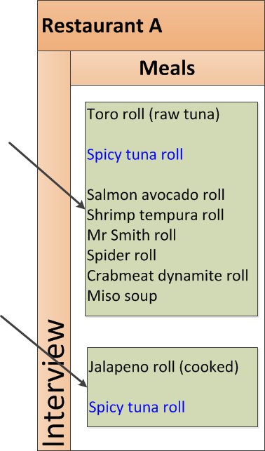
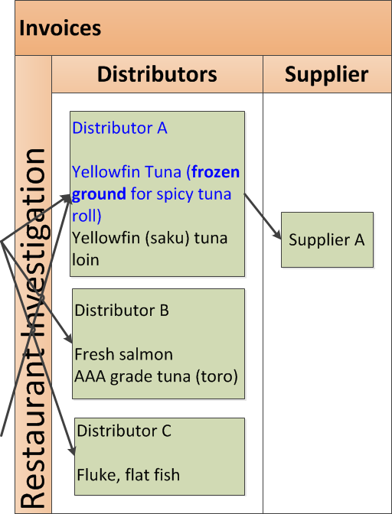
The Restaurant Investigation
Notes:
With the identification of the first restaurant cluster here, visits were paid to the establishment to collect invoices and gather information on the only shared menu item – the spicy tuna roll. Batches of spicy tuna were prepared daily, so we had the opportunity to watch a batch being made. As other restaurant clusters were investigated across the country, the finger continued to point to “spicy tuna” – but the recipes and ingredients differed from restaurant to restaurant, except for one, mostly universal ingredient, frozen ground tuna. One question loomed in all the epidemiologists’ minds – was the association “significant”? This was not a simple cohort of a single meal at a single event making a closed group of individuals sick. How could we define controls for a case study analysis?

Slide 22
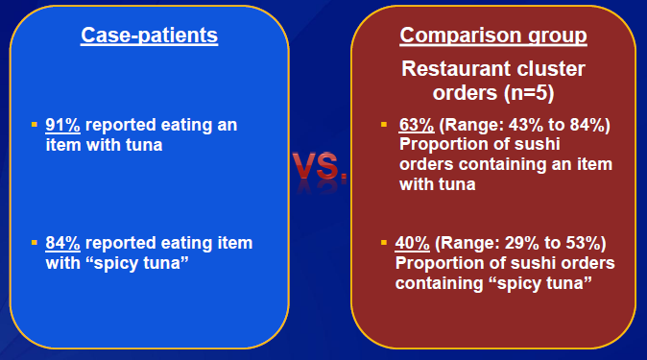
Sushi Order Comparison Results
Notes:
The solution was a comparison order study with the goal to compare the frequency of consumption of tuna and spicy tuna between cases and all sushi eaters.
Comparison group:
Orders from diners who ate at one of the restaurants associated with the outbreak
Orders placed at the same time of day (lunch or diner) and as close to the date when the ill person ate at the restaurant.
Five restaurants across the country agreed to participate in providing comparison group data, including one in Texas and carried out by the the City of Farmers Branch Health Department. The restaurant in Williamson County that was included in the cluster analysis and traceback was not included because we
Findings indicated that the spicy tuna rolls were indeed very popular, but fewer “control” patrons ate them as compared to the cases.

Slide 23
Salmonella Nchanga
April 12 teleconference:
  WI reports 7
  GA reports 1
  NY reports 4
Sushi related
  One case at a Bareilly-associated restaurant
  One was chef at Bareilly-associated restaurant
Notes:
And just when we thought things were interesting enough, a second extremely rare serotype appeared to be associated with the same cluster. In the April 12 teleconference, Wisconsin reported seven cases of Salmonella Nchanga infection with history of spicy tuna consumption. Georgia and New York reported cases as well. Prior to this appearance only nine isolates of Salmonella Nchanga had ever been seen by CDC in US cases.

Slide 24
FDA’s role in the investigation
Narrow down suspect vehicle
Traceback
Traceforward
Sampling
Work with firm to recall product
International inspection
Notes:
Finally, when a suspect food is identified, then our regulatory partners are called in to assist with trace backs to locate the source or sources from where the food came. If possible, samples of the food and the environment are taken. The food laboratory analyzes those samples. If the samples come back with a matching PFGE – we’ve hit the gold standard and confirmed the suspect vehicle.
FDA CORE
Coordinated Outbreak Response and Evaluation = “CORE” Team
Activated March 15
80% seafood exposure; 55% sushi exposure – got their attention!

Slide 25
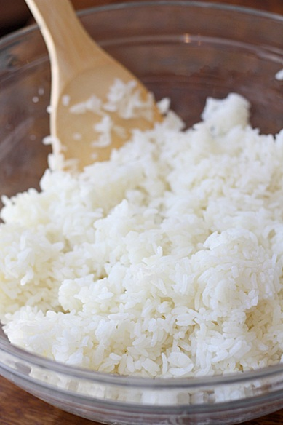
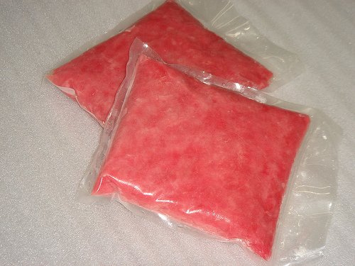
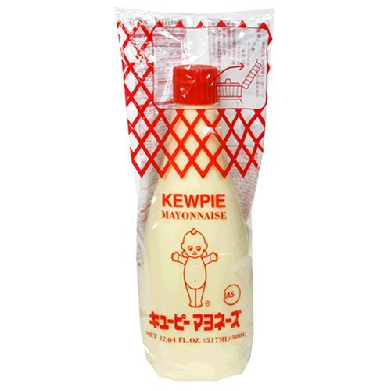
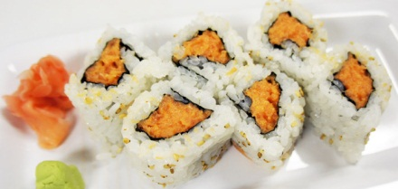
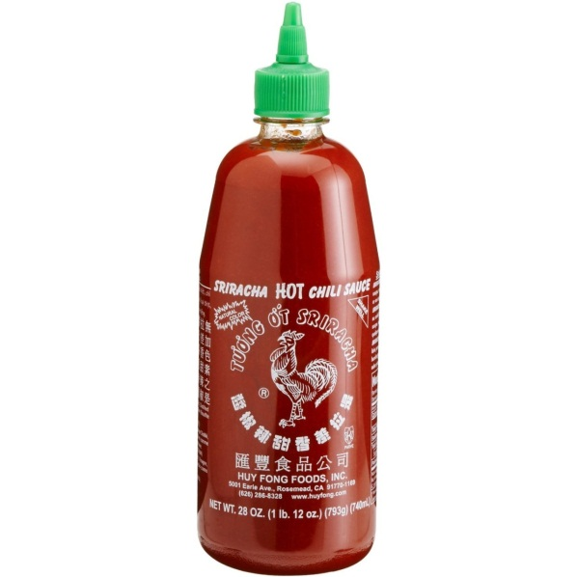
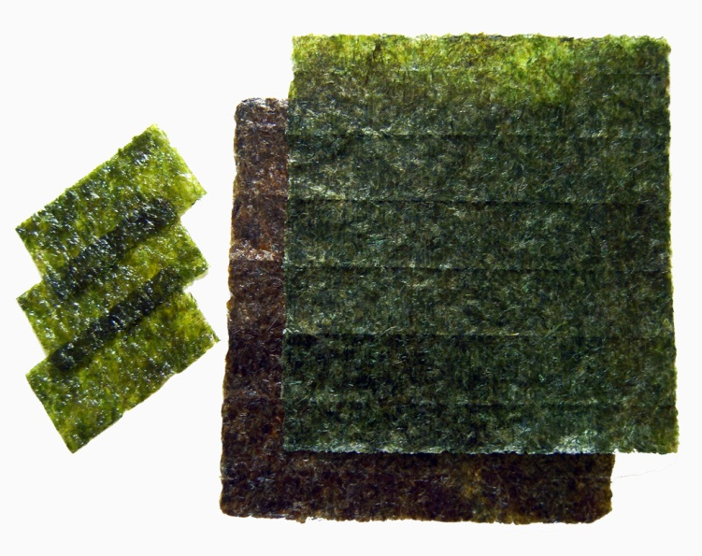
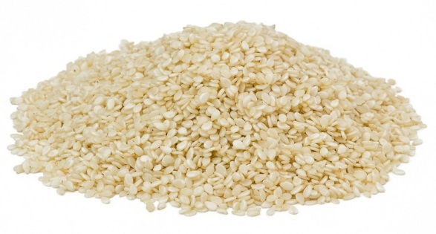
FDA Traceback Challenge
Convergence in recipes?
Notes:
With a multi-component suspect food item, the challenge is to identify common ingredients. For spicy tuna, these were:
- Mayonnaise
Sesame seeds
Tuna fresh and frozen
Hot sauce
Seaweed
Rice

Slide 26
FDA Traceback Targets
Narrowed commonalities to
  hot sauce
  tuna – fresh & frozen
Notes:
Once the common ingredients were identified, were there also potential single sources for ingredients? Two common ingredients were considered – the hot sauce, which seemed to be a single brand, and the fresh/frozen tuna. Both red peppers and raw fish had been involved in Salmonella outbreaks in the past.

Slide 27
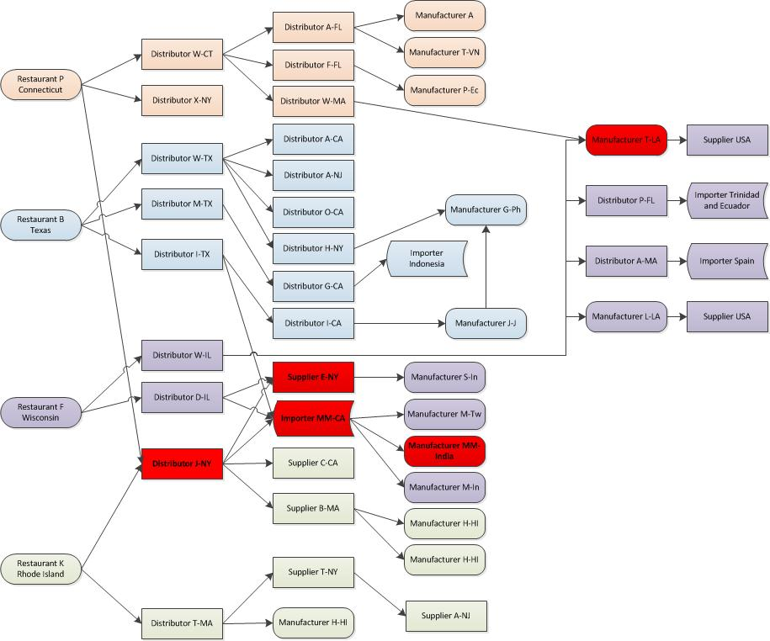
Notes:
Don’t worry – it’s not your eyes. This slide is not meant to be read, but rather to illustrate the complex web of distributors, suppliers, importers and manufacturers of fresh and/or frozen tuna that the FDA had to untangle to reach a target for traceback. They focused on four restaurant case clusters, one each from Connecticut, Texas, Wisconsin and Rhode Island. Using invoices and interviews, they mapped common sources. Slowly the picture emerged of a single suppler out of India.

Slide 28
Traceback Challenges
Cash & carry customers – little documentation
Invoice not clear if fresh or frozen tuna
Invoices not showing correct country of origin
Discrepancies in product descriptions
Lack of labeling

Slide 29
April –May 2012
FDA Memo Leak
Sunday | Monday | Tuesday | Wednesday | Thursday | Friday | Saturday
1 | 2 | 3 | 4 | 5 | 6 | 7
 | (93) |  | (100)
8 | 9 | 10 | 11 | 12 | 13 | 14
 |  |  | 50-state call (116) | (129) | Press Releases
15 | 16 | 17 | 18 | 19 | 20 | 21
22 | 23 | 24 | 25 | 26 | 27 | 28
 |  |  | (210)
29 | 30 | 1 | 2 | 3 | 4 | 5
 |  |  | (258)
 |  |  |  |  |  | Teleconference Dates (#cases)
RECALL
Notes:
News of the investigation first surfaced to the public late Tue 3 Apr 2012, when an internal memo was inadvertently sent to everyone at the FDA, according to FDA spokesman Curtis Allen. He said the memo speculated about a possible source of contamination, sushi, but at that time he said the FDA didn't know the origins of the outbreak. Traceback activities occurred throughout the first two weeks of April. By April 11, FDA and CDC convened a conference call to all 50 states to alert them to the investigation. By Friday the 13th, the implicated importer had been contacted by the FDA, had chosen to issue a voluntary recall of its implicated product, and official press releases were published by both FDA and CDC.

Slide 30
FDA Recall & Inspection
4/13/12 – Moon Marine USA voluntarily issues recall frozen raw yellow fin tuna product
4/13/12 to 4/14/12 - FDA issued two Import Alerts for fresh and frozen tuna from Moon Fishery India Pvt Ltd.
4/19/12 to 4/24/12 - FDA conducted a seafood Hazard Analysis and Critical Control Point inspection
Notes:
4/13/12 – Moon Marine USA voluntarily issues recall frozen raw yellowfin tuna product, labeled as Nakaochi Scrape AA or AAA from a single tuna processing facility in India. CDC and FDA warned public not to eat recalled product.
4/13/12 to 4/14/12 - FDA issued two Import Alerts for fresh and frozen tuna from Moon Fishery India Pvt Ltd

Slide 31
Nakaochi Scrape
http://www.youtube.com/watch?v=7nRxlMcZdOY

Slide 32
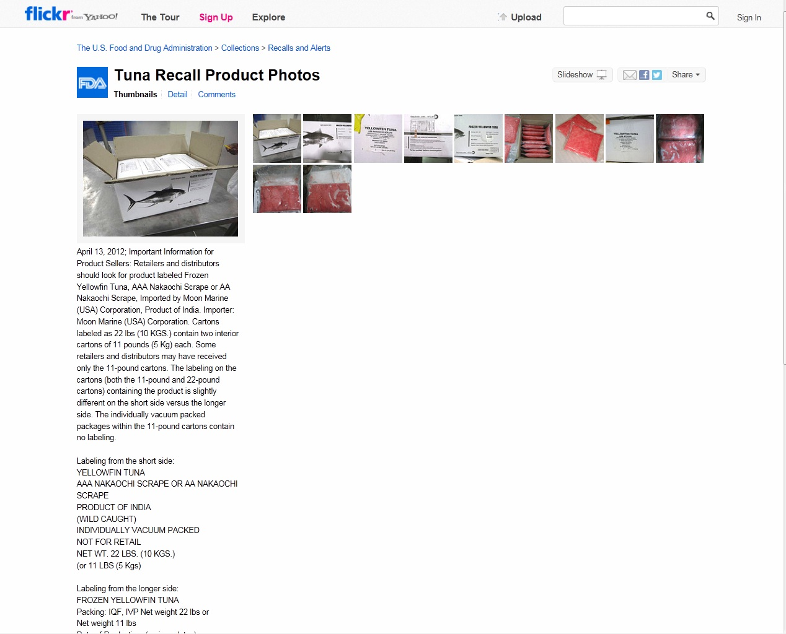
Who knew?
Notes:
That FDA has a Flickr photostream!

Slide 33
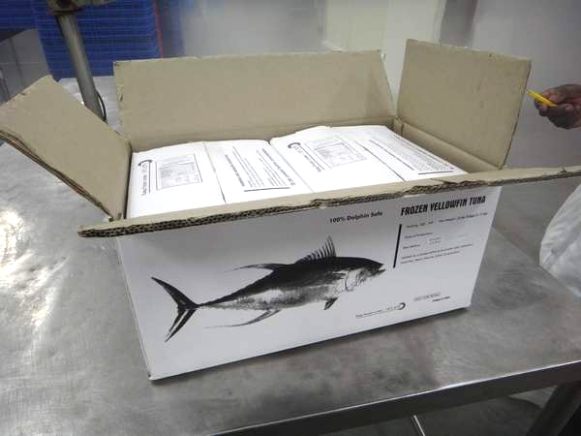
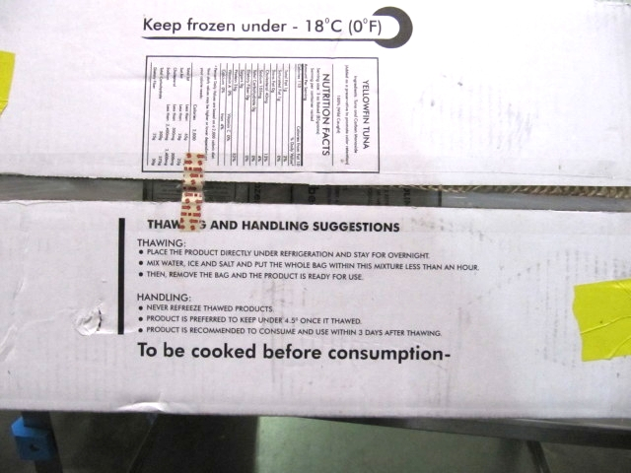
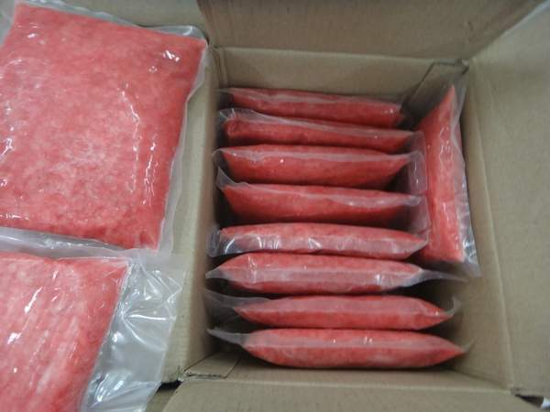
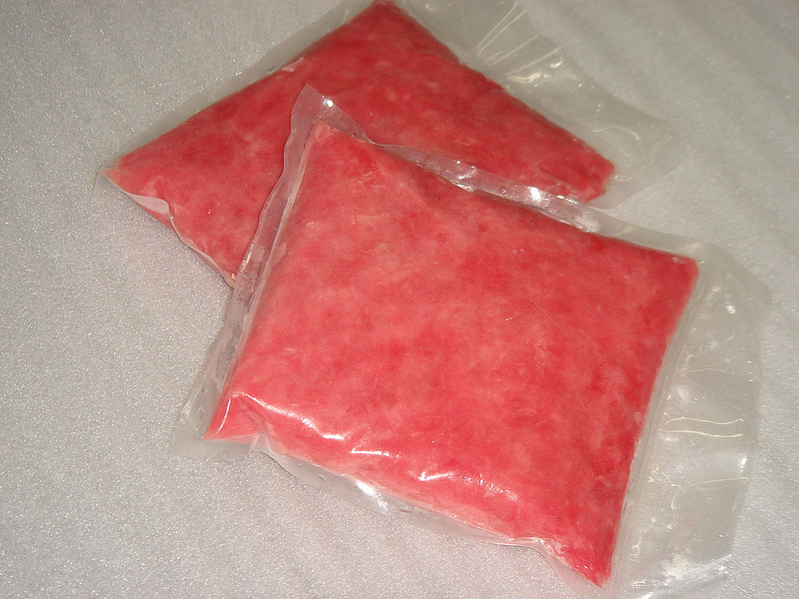
Notes:
FDA provided on the Flickr site photos of the outer box, with all required information to be found. Most interesting to me was the disclaimer about consumption! Upon opening, however, there were two smaller boxes containing the actual packages. The individual packages have no labeling at all.

Slide 34
Traceforward
4/19/12 to 4/24/12 - FDA identifies where Moon Fishery (India) had sent product
4/26/12 - Salmonella Bareilly and Salmonella Nchanga found in unopened packages of yellowfin tuna product imported from Moon Marine USA Corporation
5/10/12 - Moon Fishery (India) Pvt. Ltd. recalled its 22-pound boxes of “Tuna Strips”
Notes:
4/19/12 to 4/24/12 - FDA conducted a seafood Hazard Analysis and Critical Control Point inspection at Moon Fishery Pvt Ltd. in India.
4/26/12 - FDA announced finding the outbreak strains of Salmonella Bareilly and Salmonella Nchanga in unopened packages of yellowfin tuna product imported from Moon Marine USA Corporation.
Investigation loop now closed! But wait – there’s more – Bareilly and Nchanga found in a second product, so recall expanded 5/10/12 to include tuna strips as well as the nakaochi scrape.
In the meantime, though, people continue to become sick. On May 23rd Tarrant County identified two unrelated Tarrant County residents who went to the same Denton County restaurant on April 30th and May 5th. Because of the recall challenges, this restaurant had not identified at the time that they were in possession of the recalled product.

Slide 35
FDA Conclusions:
The source of this outbreak is nakaochi scrape tuna from Moon Fishery (India) Pvt. Ltd.
FDA inspectors identified several seafood HACCP deficiencies, including several significant sanitation observations of concern.
  Unpurified water used for ice
Notes:
Based on epidemiologic data, traceback and traceforward efforts, and laboratory results, the source of this outbreak is nakaochi scrape tuna from Moon Fishery (India) Pvt. Ltd.
FDA inspectors identified several seafood HACCP deficiencies, including several significant sanitation observations of concern.
- Unpurified water used for ice

Slide 36
Control Actions
Recall: Nakaochi scrape 4/13/12
  58,828 lbs = 30 tons! Unlabeled!
Recall: AA/AAA Tuna strips 5/9/12
Import “red list”
Cooperation of Indian government – pulled manufacturing license
Notes:
FDA “red list = detention of specified products without physical examination

Slide 37
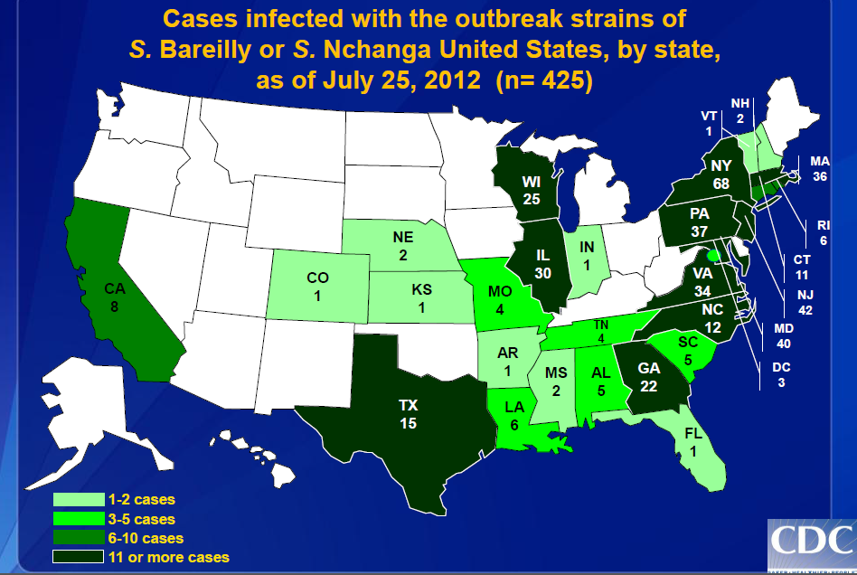
Notes:
CDC wrapped up the investigation on July 25, publishing these “final” statistics.
- 28 states and DC all had reported associated cases
- 410 Salmonella Bareilly infections
- 15 Salmonella Nchanga infections
- Median age = 30 years
(range: <1 to 86 years)
- 60% (254/423) female
- 17% (55/326) hospitalized
- No deaths reported

Slide 38
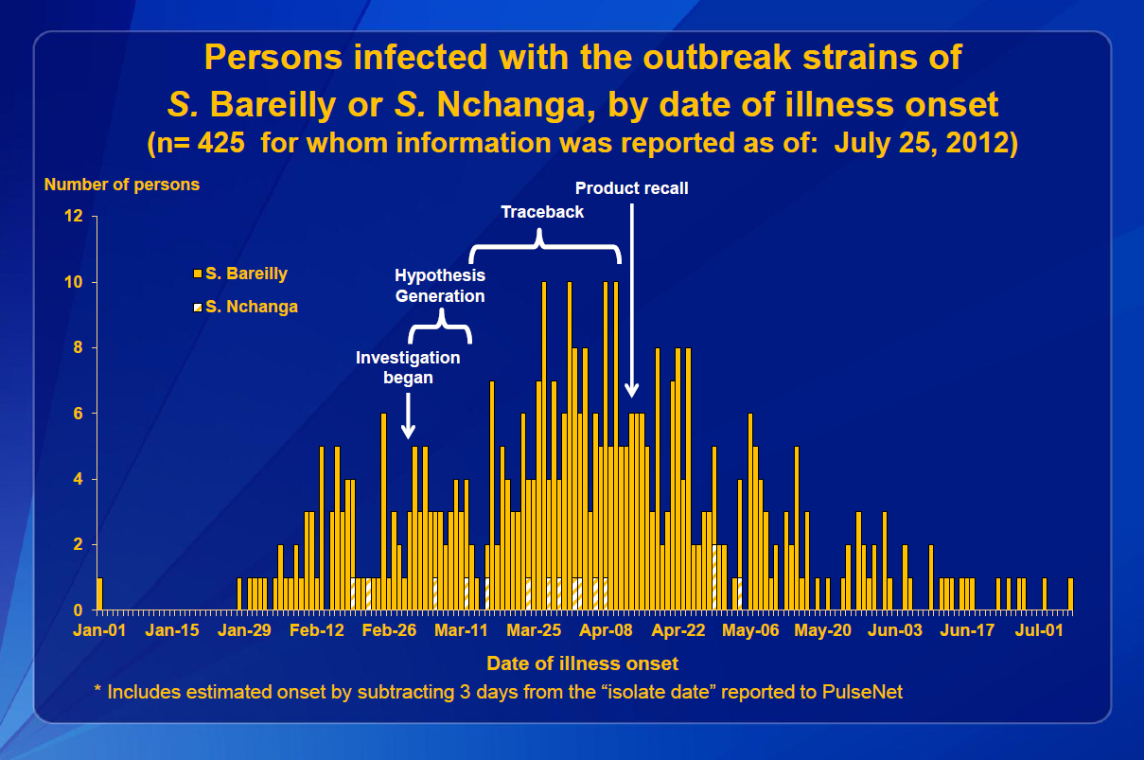
Notes:
410 cases of Bareilly and 15 cases of Nchanga are shown here in the wrap-up epi-curve. Given the convolutions of the distribution chain, as well as the problems with labeling of product, it is not surprising that it took some number of weeks for the recall to have an effect on incidence. Also, not noted on this slide, is the second recall on May 9 for the tuna strip product, which perhaps might explain some of the later cases.

Slide 39
Conclusions:
First multistate outbreak of Salmonella Bareilly and Salmonella Nchanga infections linked to raw scraped tuna product
First documented outbreak of Salmonella Nchanga infections in United States
Outbreak was an example of the difficulty in investigating an ingredient-driven outbreak
Collaborative efforts between state and local health departments, FDA, CDC, and laboratories enabled traceback to one producer

Slide 40
Acknowledgements:
CDC PulseNet and OutbreakNet, DSHS, Local and Texas Regional Health Departments (next slide)
U.S. Centers for Disease Control & Prevention
FDA District Offices
  Domestic and International
  FDA laboratories
FDA CORE Response Team 2

Slide 41
Acknowledgements:
Local and Texas Regional Health Departments
  Health Service Regions 2/3, and 7
  Austin-Travis Co. Health & Human Services
  Dallas Co. Health & Human Services
  Denton Co. Health Department
  City of Farmers Branch Health Department
  Fort Bend Co. Health Department
  Tarrant Co. Public Health Department
  Williamson Co. & Cities Health District

Slide 42
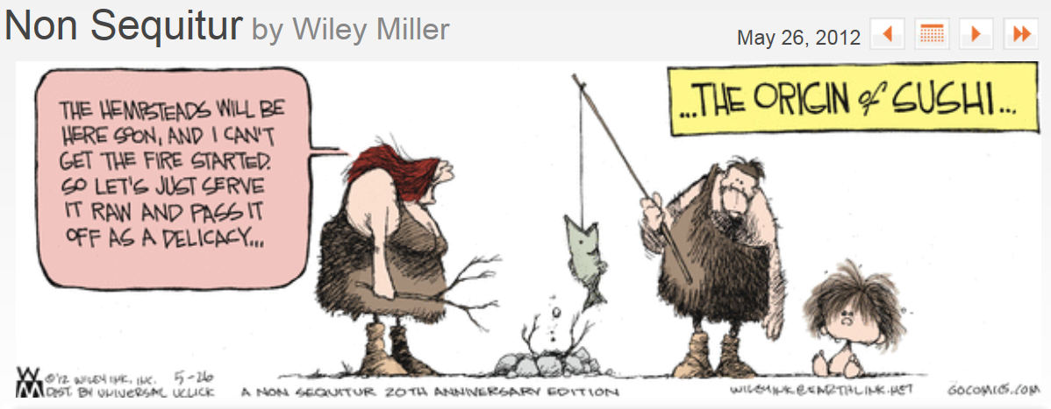
Notes:
Perhaps only a coincidence, but the fishiness of sushi did manage to cross-over into the funny papers by the end of May.

