Slide 1
Botulism in the Panhandle
Botulism Investigation:
City of Amarillo
Public Health and Environmental Health
In conjunction with DSHS and CDC
March 4, 2014

Slide 2
December 6th Friday:
BSA notified DPH of potential botulism case needing testing
Health Authority contacted; discussed case with medical community
DPH staff and APD visited apartment for initial investigation regarding potential source
CDC contacted; agreed that botulism was likely; botulism antitoxin transported to Amarillo by 9pm
Notes:
Details of notification. Lab tech… 10am, information sent to HA around noon, initial interview of first two identified cases and consent to search apartment noon-4:30, 5:00 apartment search.
Promptness of antitoxin arrival.

Slide 3
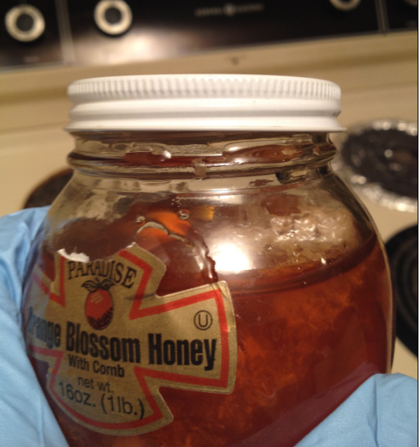
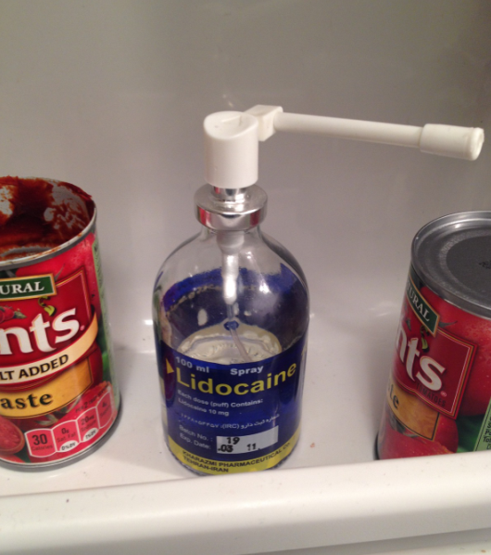
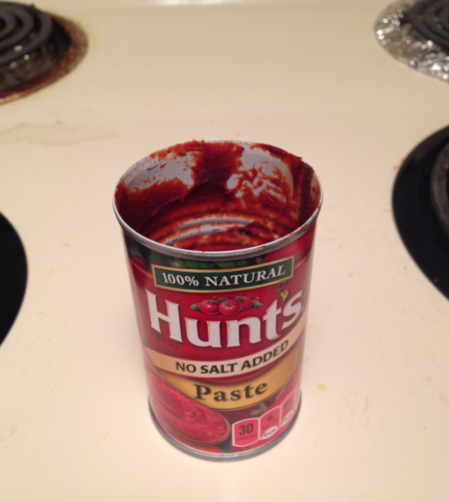
Notes:
I

Slide 4
December 7th, Saturday:
Botulism antitoxin administered to 2 patients
3rd case identified (GA)
Clinical samples sent to DSHS for testing at their request
CDC consulted in testing and patient diagnoses
DPH worked with CDC on 3rd case; CDC contacted FBI/Homeland Security
Notes:
CDC sent staff to interview 3rd case in GA. We appreciate this.
Sunday: Health authority: attending physician was discussing with residents who had cared for a patient at a different hospital with like symptoms. His onset was roughly one month prior to the other cases.
Monday: Interview with the fourth patient identified revealed that all four cases new each other. Relationship uncertain at the time.

Slide 5
December 8th, Sunday:
Health authority identifying potential cases
December 9th, Monday:
4th case identified
Confirmed that all 4 cases knew each other; two clusters of two
EH coordinated info to local FBI agent

Slide 6
December 10th, Tuesday:
CDC interviewed case in GA
DPH/EH coordinated conference call with CDC/DSHS;
CDC offered Epi-Aid team for assistance
Health Authority asked for health alert and press release for public
DPH had tentative common food history at a local restaurant
EH sent sanitarians to the apartment in question for re-investigation
EH visited possible common food source at local restaurant
Noted significant deficiencies relating to a suspect food

Slide 7
December 11th, Wednesday:
Local Emergency Management notified
Health Alert sent to physicians
Press release issued
Press conference
DSHS conference calls
CDC invited to respond locally
CDC interviewed patient in GA in person

Slide 8
December 12th, Thursday:
CDC arrives at 11 am
All avenues of investigation discussed including common food sources, patient relationships, intention/criminal activity, and other topics
10pm: Positive mass spectrometer test result for Botulism Toxin Type B in chili oil from local restaurant
This was a “new” test unapproved by FDA for sample confirmation
At this point, the mass spec test links 3 of 4 cases to local restaurant
Notes:
Reed and Sarah: EIS

Slide 9
December 13th, Friday:
CDC and EH re-inspect local restaurant
Identified process with positively-testing chili oil that could create anaerobic growth in food
Restaurant voluntarily closes after lunch
Patient interviews are continuing
DSHS and CDC push for press release for national case finding investigation regarding local restaurant based on mass spec test results while epidemiological investigation was not conclusive

Slide 10
DPH and EH drafted press release and insisted on DSHS and CDC confirmation of source
This was not given on Friday the 13th!
At 9pm, CDC contacted DPH and said that the mass spec test result on chili oil was in question and could not be “confirmed”
DPH and EH delayed press release implicating local restaurant
Both departments demanded a joint confirmation from CDC/DSHS on test status before release additional information implicating any source

Slide 11
December 14th, Saturday:
Patient samples continue be negative for botulism
CDC epi team continue to re-interview patient along with DPH and EH
Local restaurant communicates with EH and says they have hired a cleaning crew and will retrain on chili oil process
CDC notifies DPH that they will “rule out” the positive mass spec test on chili oil as confirmatory
No national case finding investigation to be performed
Patient interviews continuing; no new leads

Slide 12
December 15th, Sunday:
DPH/CDC re-interview hospitalized patients
Common food source found!!!
Torshi/Turshi/Tursu: pickled raw vegetables
Room temp. hot water bath
Fermented for 3 weeks
Sketchy common food history and location
Notes:
Dedication of EIS team was invaluable.
Cultural differences forced Reed to perform all interviews.

Slide 13
Continued negative results on environmental and clinical lab tests
Late Sunday, all 4 patients linked to potentially contaminated turshi batch
2 clusters admit to making/eating turshi
Continued interviews for each patient
Investigation attempting to identify container and food product for testing

Slide 14
December 16th, Monday:
Chart review and epi links for all food histories concluded
All patients admit to eating turshi
CDC epi team begins summaries and plans departure
Clinical and environmental samples continue to be negative
Discussion of local press release for botulism investigation update
DSHS and CDC call all four cases “clinically compatible for botulism” without lab confirmation, but with strong epidemiological evidence
FDA/CDC agree that turshi is the source

Slide 15
Take Home Message
Maintain positive relationship with community partners: Infection control, lab, providers.
Maintain positive relationship with other agencies: Environmental Health and Police.
Work with DSHS and CDC labs.
Communicate with all agencies: DSHS, CDC, Local.
Utilize CDC assistance through EPI Aid.
Trust your gut (and your epi).

Slide 16
QUESTIONS?

