Slide 1
Disaster and Outbreak Response Exceptional Item Funded by the 83rd Legislative Session
Marilyn Felkner and Sky Newsome
Emerging and Acute Infectious Disease Branch
Texas Department of State Health Services
March 4, 2014

Slide 2
Why These Positions Are Needed
In 2012, Texas epidemiologists (EAID, HSR, and LHD) investigated 406 Salmonella cases in 72 clusters that were part of CDC-coordinated multi-state outbreaks.

Slide 3
Why These Positions Are Needed
168 (41%) of questionnaires for these Salmonella cases were not returned.

Slide 4
Why These Positions Are Needed
HSRs and LHDs took an average of 7 days to return questionnaires.
CDC requests a 48 hour turn around time.

Slide 5
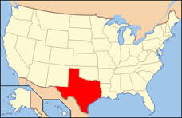
Why These Positions Are Needed
From October 2011 through Dec. 2012 there were 162 clusters (1,276 isolates) which did not meet the CDC criteria for a multi-state investigation.

Slide 6
Why These Positions Are Needed
Health departments did not have the staff resources to conduct follow up investigations on these Texas-only clusters.

Slide 7
Why These Positions Are Needed
This salmonellosis only.
It does not include
listeriosis
shigellosis
vibriosis
campylobacterosis
E. coli
parasitic infections

Slide 8
Where These Positions Are Needed
4 local health departments with populations > 1 million returned less than 60% of the foodborne interviews requested by CDC/EAID during 2012.

Slide 9
Where These Positions Are Needed
6 local health departments with populations > 100,000 returned less than 60% of the foodborne interviews requested by CDC/EAID during 2012

Slide 10
Where These Positions Are Needed
2 local health departments with populations > 1 million are currently returning approximately 70% of the foodborne interviews requested by CDC/EAID during 2012 but due to sheer numbers have a significant number of unreturned questionnaires.

Slide 11
Where These Positions Are Needed
Increased data collection in the LHDs generates increased information to be shared among the CDC, EAID, HSRs and LHDs.
Emerging and Acute Infectious Disease Branch staff are best positioned to triage information.

Slide 12
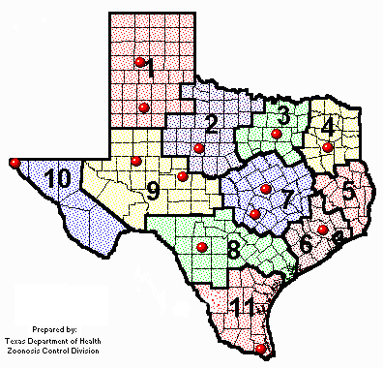
How These Positions Will Be Managed in the LHDs
Positions belong to LHDs who hire and supervise staff
Each LHD would have one position--Epidemiologist II, Epidemiologist I or Public Health and Prevention Specialist III

Slide 13
How These Positions Will Be Managed in the LHDs
Enhanced manpower expected to result in
Improved coordination of state and national investigations
More rapid turn around times for information requests
Increased likelihood of identifying vehicles of foodborne illness
Contracts written with deliverables defining these expectations

Slide 14
Role of EI Epidemiologist II in EAID
Responsible for
Training (July 7-10 in Austin)
Mentoring as needed
Notifying LHDs of cases in their jurisdictions that are part of clusters/outbreaks
Distributing applicable questionnaires
Tracking questionnaire completion

Slide 15
Role of Rapid Response Team Epidemiologist II (the epidemiologist formerly known as Julie Borders)
Responsible for
Entering cluster/outbreak data for multi-jurisdictional investigations
Analyzing cluster/outbreak data for multi-jurisdictional investigations

Slide 16
Where are we today?
12 of 16 LHDs responded affirmatively and are finalizing contracts
The Epidemiologist II job description has been submitted for administrative approval

