Slide 1
Investigation & Outbreak Tools
Carol M Davis, MSPH, CPH Rachel Wiseman, MPH
Invasive and Respiratory Vaccine-Preventable
Infectious Disease Team lead Disease Team lead
Emerging and Acute Infectious Disease Branch
Infectious Disease Control Unit

Slide 2
Types of Outbreak Tools
Books
Websites
Subject Matter Experts
More DSHS Tools
Other Tools

Slide 3





Books Every Epi and Disease
Investigator Should Own
Control of Communicable Diseases Manual
Red Book
Pink Book
Field Epidemiology
A Dictionary of Epidemiology

Slide 4
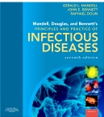
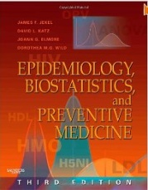
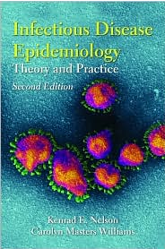

More Good Books
Mandell, Douglas, and Bennett’s Principles and Practices of Infectious Diseases
Epidemiology, Biostatistics and Preventive Medicine Review
Infectious Disease Epidemiology Theory and Practice
The Medical Detectives
Principles of Epidemiology in Public Health Practice
  http://www2a.cdc.gov/TCEOnline/registration/detailpage.asp?res_id=1394

Slide 5

Websites
DSHS
  www.dshs.state.tx.us/
  www.dshs.state.tx.us/idcu/
CDC
  www.CDC.gov
ACIP
  www.cdc.gov/vaccines/acip/index.html
Your favorite search engine…
Search

Slide 6
Random Outbreak Websites
Focus on Field Epidemiology
  http://cphp.sph.unc.edu/focus/issuelist.htm
Epidemiology in the Classroom
  http://www.cdc.gov/excite/classroom/outbreak/index.htm
IDREADY
  http://www.idready.org/slides/03outbreak-notes.pdf
  http://www.idready.org/temp/arizona/QuickRefGuide-handout.pdf
Young Epidemiologist Scholars Program
  http://www.collegeboard.com/prod_downloads/yes/disease_outbreak.pdf
North Carolina Public Health
  http://epi.publichealth.nc.gov/cd/lhds/manuals/cd/training/Module_1_1.6_ppt_OutbreakInvestigation.pdf

Slide 7
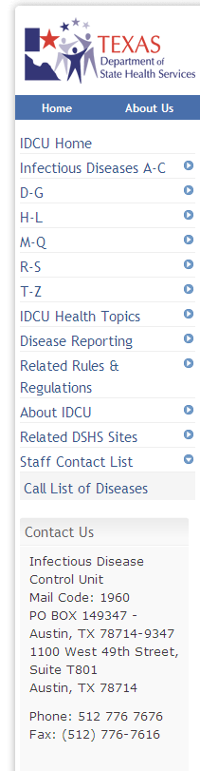
Subject Matter Experts
Who to call
  DSHS Regional Offices
  DSHS EAIDB
When to call
  Have questions about response, control or investigation
  Need approval for testing at the DSHS lab
  Need approval for prophylaxis or mass vaccination from DSHS
  Need help or advice
  It is an outbreak or otherwise immediately reportable condition
  Expect investigation to get media attention
  www.dshs.state.tx.us/idcu/

Slide 8
More DSHS Tools
Texas Administrative Code (TAC)
Notifiable Conditions List
Epi Case Criteria Guide
Investigation and Report Forms
VPD/IRID Investigation Guidelines
Influenza Surveillance Handbook
NBS Data Entry Guide

Slide 9
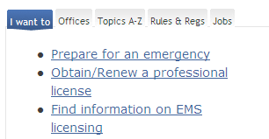
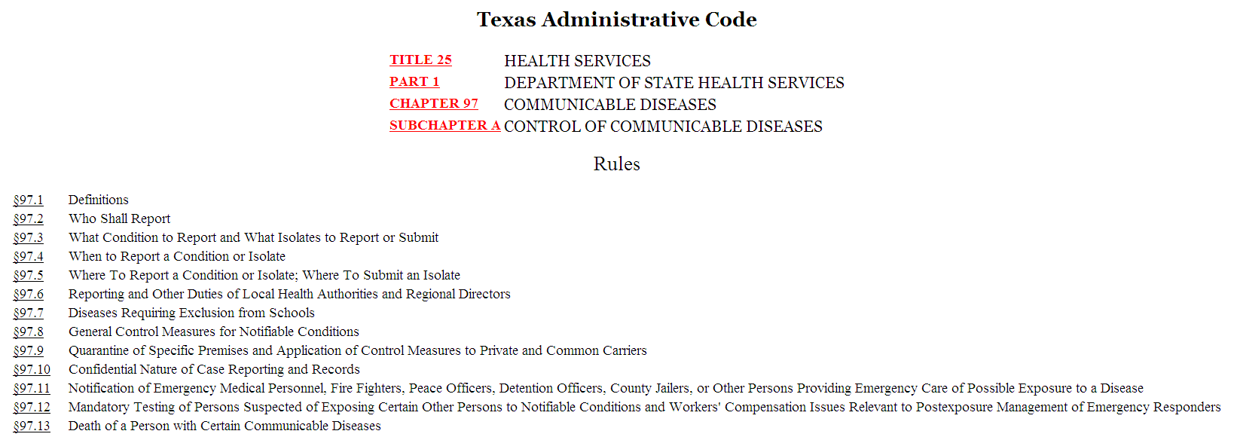
Texas Administrative Code (TAC)
  www.dshs.state.tx.us
2013 School Exclusion Changes
Fever
Diarrhea
Chickenpox
Conjunctivitis
Head lice
Mumps
Ringworm
Changes to notifiable conditions
Changes to school exclusions

Slide 10
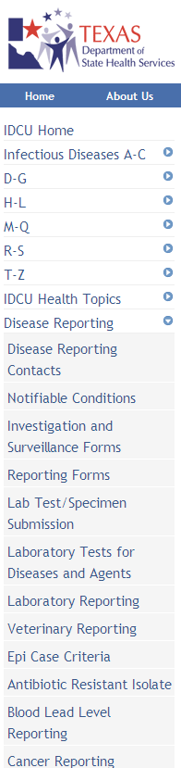
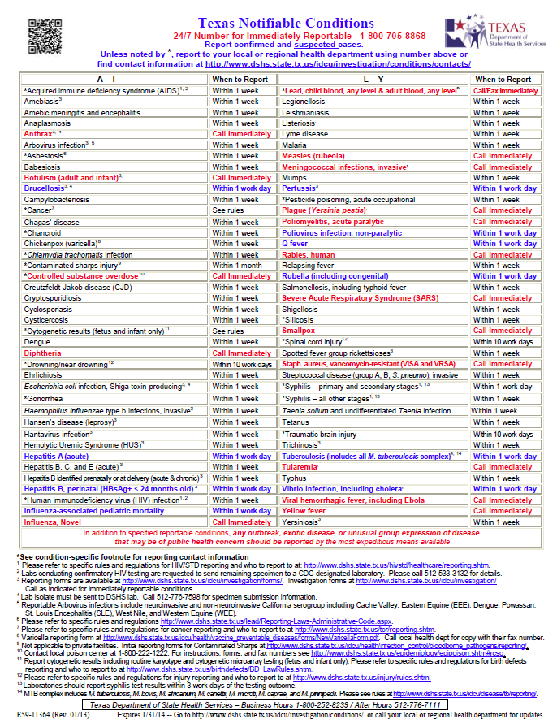
Notifiable Conditions List
Changes in 2013
Additions
  Amebic meningitis and encephalitis
  Anaplasmosis
  Babesiosis
  Chagas disease
  Novel influenza
  Polio, non-paralytic infection
Removals
  Encephalitis (specify)
  Meningitis (specify)
  Hep D
  Unspecified viral hepatitis
  www.dshs.state.tx.us/idcu/
Notes:
Isolates of Neisseria meningitidis are still required to be submitted to the DSHS laboratory for characterization and typing.
Notes for health departments:
If someone calls to report a case of bacterial meningitis, make sure you ask what bacteria was found or is suspected before telling them it is no longer reportable. Someone with symptoms of meningitis AND with gram – dipplococci or with a petechial rash/purpura fulminans would be considered a probable meningococcal (Neisseria meningitidis) case which warrants full investigation and response even without lab confirmation. Someone with meningitis caused by group A strep (Streptococcus pyogenes) would still be reportable as a confirmed invasive Group A Strep case.

Slide 11
Epi Case Criteria Guide
Several updates to reflect changes in reportable diseases
Major case definition changes:
  Measles
  SARS
Other changes of note:
  Sterile site update
  Influenza-associated pediatric mortality
  Cyclosporiasis
  Campylobacteriosis
  Amebiasis
  Cryptosporidiosis
  www.dshs.state.tx.us/idcu/
Notes:
Major changes:
Campylobacteriosis: added a Suspect case definition
A case with campylobacter spp. detected, in a clinical specimen, by use of culture independent laboratory methods (e.g., EIA)
Cyclosporiasis: added a Probable case definition
A clinically compatible case that is epidemiologically linked to a confirmed case
Amebiasis: adding a Suspect case definition
(***have not finalized wording but will do so tomorrow and get back to you***)
Minor changes:
Cryptosporidiosis: changes to wording of Probable case definition.

Slide 12
Investigation Forms
Chickenpox report form (Jun 2012)
Hib (Oct 2012)
Legionella (Oct 2011)
Meningococcal (Oct 2011)
Mumps (Feb 2013)
Ped Flu (Summer 2012)
Pertussis (Mar 2012)
Rash Fever Illness (Nov 2012)
Streptococcal (Jul 2012)
Tetanus (Nov 2012)
  www.dshs.state.tx.us/idcu/
Notes:
Refer to Appendix B of the IRID/VPD guidelines

Slide 13
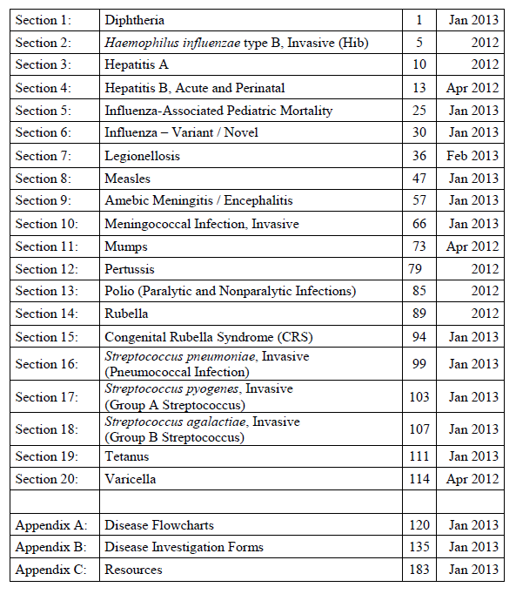
VPD and IRID Investigation Guide
Sections Include:
  Basic Epidemiology
  Definitions
  Case Investigation
  Managing Special Situations
  Reporting and Data Entry Requirements
  Laboratory Procedures
Feedback wanted!
http://www.dshs.state.tx.us/idcu/health/vaccine_preventable_diseases/resources/
Notes:
Refer to the IRID/VPD guidelines

Slide 14
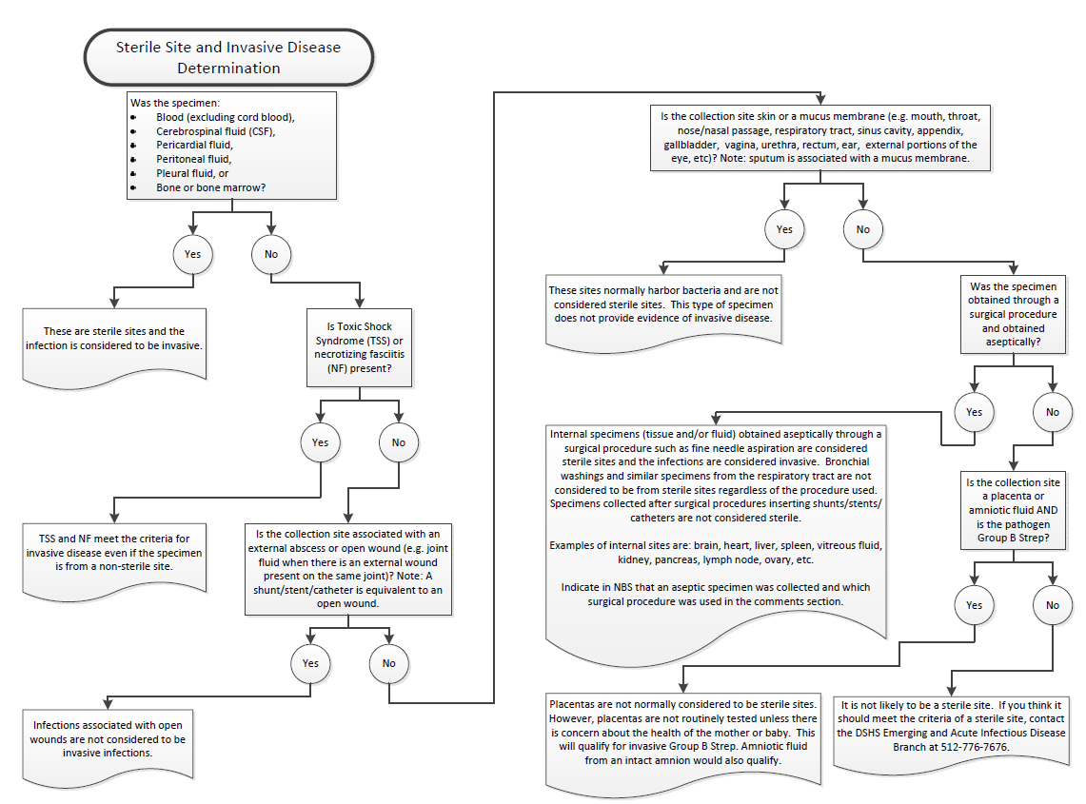
Sterile Sites for Invasive Disease
Found in the VPD / IRID Guide
Notes:
Refer to Appendix A of the IRID/VPD guidelines

Slide 15
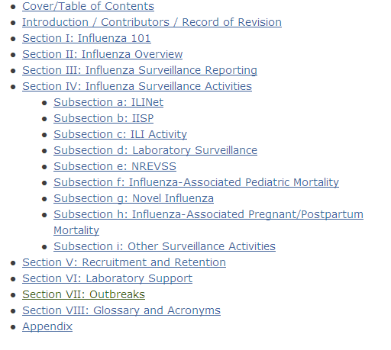
Texas Influenza Surveillance Handbook
Outbreak Section:
  Why investigate
  Outline of a response
  Basic info to collect
  Case definitions
  Line lists
  Epi Curves
  Case Confirmation
  Resources
http://www.dshs.state.tx.us/idcu/disease/influenza/Texas-Influenza-Surveillance-Handbook/

Slide 16

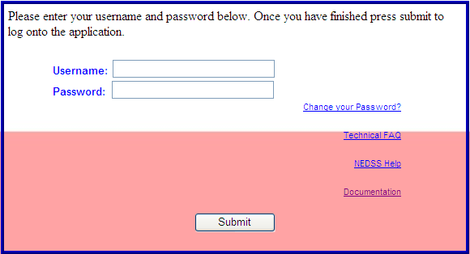
NBS Data Entry Guide
Currently being revised to reflect changes in notifiable conditions
Name changes
  Granulomatous Amebic Encephalitis to Amebic Meningitis, Other
  Primary amebic meningoencephalitis to Amebic meningoencephalitis, Primary (PAM)
  Group A Streptococcus, invasive to Streptococcus, invasive Group A
  Group B Streptococcus, invasive to Streptococcus, invasive Group B
  Novel Influenza A Virus Infections to Influenza A, novel / variant
  S. aureus, coag-pos, vancomycin-resistant (VRSA) to Vancomycin-resistant Staphylococcus aureus (VRSA) [VISA too]
  Escherichia coli, Shiga toxin-producing (STEC) to Shiga toxin-producing Escherichia coli (STEC)
Don’t forget to update your reports to include the new names
  https://txnedss.dshs.state.tx.us:8009/login/login.asp
UserResources
Notes:
Refer to Appendix B of the IRID/VPD guidelines

Slide 17
Additional Tools
What tools do you currently use?
What tools do you need?

Slide 18
Feedback
If you have any suggestions for improving the VPD/IRID guidelines, please send your comments or ideas to
Rachel.Wiseman@dshs.state.tx.us
Carol.Davis@dshs.state.tx.us

