Slide 1
Creutzfeldt-Jakob Disease and other Prion Diseases
Michael Fischer, MD, MPH & TM
Epidemiologist – Creutzfeldt-Jakob Disease
Emerging and Acute Infectious Disease Branch
Texas Department of State Health Services

Slide 2
Outline:
Discuss terminology and abbreviations
The prion, prion theory, and transmissible spongiform encephalopathies
History of transmissible spongiform encephalopathies
Bovine spongiform encephalopathy and variant Creutzfeldt-Jakob Disease (United States focus)
Discuss the Journal of Emerging Infectious Diseases: Iatrogenic Creutzfeldt-Jakob Disease, Final Assessment
The State of Texas and CJD, case counts, local and regional health departments, vital statistics, and NPDPSC
Areas where regional and local health departments can play an important role
Steps to keep in mind for investigation of iatrogenic CJD due to surgical instrument contamination
Resources on CJD that are nice to keep on hand

Slide 3
Abbreviations
TSE – Transmissible Spongiform Encephalopathy (prion disease)
CJD – Creutzfeldt-Jakob Disease
sCJD – sporadic CJD (1/million per year) (85%ofCJD)
fCJD – familial CJD (10-15%)
iCJD – iatrogenic CJD (<1%)
sFI – sporadic Fatal Insomnia
FFI – Familial Fatal Insomnia
vCJD – variant Creutzfeldt-Jakob Disease
BSE – Bovine Spongiform Encephalopathy (“mad cow” disease)
CWD – Chronic Wasting Disease

Slide 4
Prion and Prion Theory
Prion:
A “proteinaceous infectious particle” resistant to procedures that modify nucleic acid”
Prion theory:
Prions propagate by transmitting a misfolded protein state.
It induces existing, properly folded proteins to convert into the disease-associated, prion form; the prion acts as a template to guide the miss-folding of more proteins into prion form.
The newly formed prions can then go on to convert more proteins themselves; this triggers a chain reaction that produces large amounts of the prion form.

Slide 5
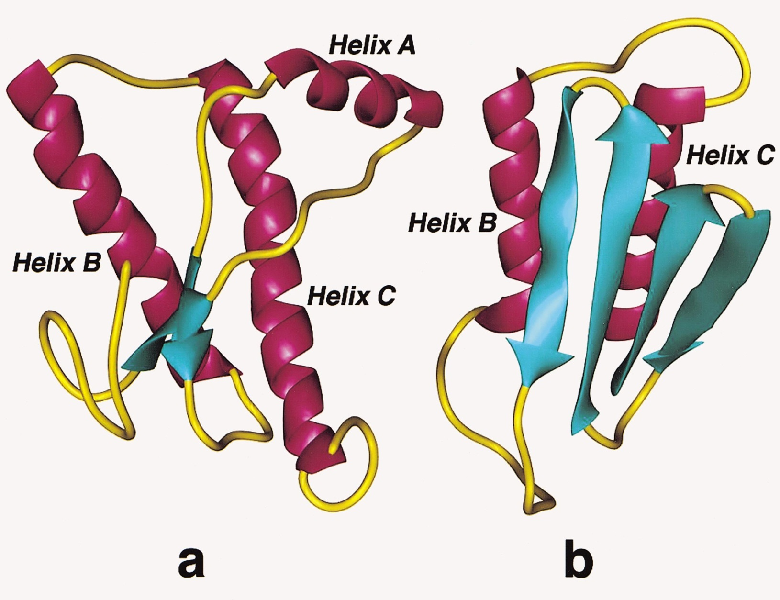
PrPc and PrPsc

Slide 6
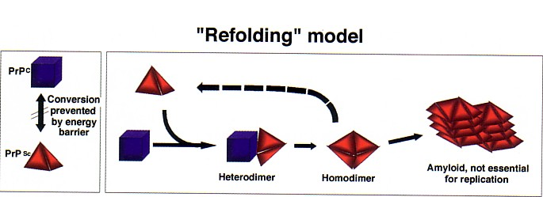

PrPc – PrPsc “Conversion”

Slide 7
Characteristics Transmissible Spongiform Encephalopathies (TSEs):
Neurodegenerative diseases
Rapidly progressive, always fatal
Long incubation periods
Brain, spinal cord, and adjacent tissues are considered infectious
Absence of Immune response
Neuropathology – amyloid plaques, no inflammatory reactions, and reactive gliosis; neuronal loss & spongiform changes
Affect humans and animals
Notes:
Prion diseases are also referred to as transmissible spongiform encephalopathies (TSEs). They occur in humans and animals, primarily affecting the central nervous system. They can be sporadic (spontaneous), familial (genetic/inherited), or acquired (transmitted by infection). The hallmark of these diseases is the presence of microscopic vacuolization of the brain tissue, called spongiform degeneration (meaning that the tissue deteriorates, developing a spongy texture), and an abnormal protein, called scrapie prion protein (PrP^{Sc}), prion, or abnormal prion protein. The PrP^{Sc}, unlike other known infectious diseases, is believed to result from a change in the conformation or shape of a normal protein called cellular prion protein (PrP^{C}), which is present in large amounts in the brain as well as in other tissues. Since the abnormal prion protein cannot be broken down through the body's normal process, it aggregates mostly in the brain causing degeneration and disease. The abnormal prion protein is often infectious and, under certain conditions, can transmit the disease. Currently, there are no cures for prion diseases. The average worldwide occurrence of prion diseases is approximately one case per million people per year. (for details, see Caughey B. British Medical Bulletin 2003; 66: 109)
Once symptoms begin to appear, the disease is progressive, symptoms get worse, never better.
Glial scar formation (gliosis) is a reactive cellular process involving astrogliosis that occurs after injury to the Central Nervous System.
The differential in diagnosis can be difficult to say the least, Next I have a slide with some of the more common disesases that are being investigated along with CJD. There is a lot to rule out before coming to a suspicion or diagnosis of CJD.

Slide 8
Some of the common diseases that will be in a differential diagnosis and need to be ruled out before a diagnosis of CJD is made
Alzheimer and vascular dementia
Herpes encephalitis
Multiple sclerosis
Hashimoto encephalitis
Alzheimer's disease (AD)
Dementia with Lewy bodies (DLB)
Vascular dementia (VD)
Chronic inflammatory disorders – Hashimoto’s thyroiditis leading to Hashimoto encephalitis,
Infectious or granulomatous processes (eg, neurosyphilis, CNS fungal disease, sarcoid, HIV-1-related diseases, Lyme disease), tumors, and vasculitis
Toxins (especially inorganic mercury)
A primary central nervous system vasculitis with little or no laboratory evidence of systemic inflammation
Hashimoto thyroiditis
Paraneoplastic syndromes (eg, cerebellar degeneration or limbic encephalitis)
"Mixed" degenerative processes (eg, Lewy body dementia, frontotemporal dementia,Parkinson disease with dementia
Amyotrophic lateral sclerosis with dementia

Slide 9
A Quick History Lesson:
1730s: A written record on Scrapie in English sheep, the disease is seen all throughout Europe.
1920s: CJD first described
1950’s: Symptoms similar to Scrapie were found in a tribe of natives that practiced ritualistic cannibalism of their dead in Papua New Guinea . The tribe named the disease “ Kuru”
1960s: Scientists experimentally transmit Kuru and CJD to chimpanzees, leading the conclusion that is transmissible!
1970’s: Iatrogenic CJD cases identified – corneal transplants, silver electrodes
1982: Stanley Prusiner coins the term “prion “ (Proteinaceous infectious Particle) Highly purified PrP-res is shown to be infectious.
1985: Iatrogenic CJD associated with human growth hormones
1987: Dura mater grafts implicated as cause of iatrogenic CJD
1997: Stanley Prusiner won the Nobel Prize in Physiology and Medicine
2000: ”Mad Cow” Disease outbreak- 180,000 cattle has been estimated to be infected.
2005: vCJD is linked to exposure to BSE from British beef causing 155 deaths in the U.K.
Notes:
In the 1950s, a district medical officer working in the highlands of New Guinea observed a fatal disease among the people of the Fore (FOR-ay) tribe. The Fore people called this sickness kuru, which means "trembling in fear." After initially becoming unable to walk, victims of kuru lost the ability to swallow or chew. Drastic weight loss would inevitably lead to death. Today we know that kuru is one of several diseases in humans and animals caused by prion (PREE-on) proteins Women & children – prepared body and meat; ate brain and organ tissue while men ate the muscle.

Slide 10
Bovine Spongiform Encephalopathy (BSE) in the United States:
There have been four cases of BSE in cattle identified in the United States.
The first case of BSE was identified in Washington State (2002) and the cow was found to have been imported from Canada.
In 2004 BSE was identified in a Texas-born cow representing the first native case in the United States.
A second native case was reported in Alabama during 2006.
A third native case was reported in California this past year (2012);
  A dairy cow, not intended for slaughter,
  Neuropathology analysis was performed
  Case was confirmed as a sporadic case of BSE

Slide 11
vCJD World-Wide
From October 1996 to March 2011 (WHO website)
  175 cases of vCJD have been reported in the United Kingdom (3 are secondary cases of vCJD related to blood transfusion)
  25 in France
  5 in Spain
  4 in Ireland
  3 in the Netherlands
  3 in the United States of America (USA)
  2 each in Canada, Italy and Portugal
  1 each in Japan, Saudi Arabia and Taiwan.
The number of cases of vCJD in the United Kingdom peaked in 2000 with 28 deaths. It has since declined to about 2 diagnosed cases and 2 deaths per year in 2008.
Notes:
We are at the tail end as I will show you in a few slides. The U.S.had its last case in 2006. Interestingly all of the cases confirmed by autopsy or biopsy of the 175 cases reported in the U.K. also tested positive for a methionine / methionine at the 129 codon. This site is tested on all patients if consent for genetic testing is given. Other combinations are methionine / valine and valine / valine. All have been shown in lab to be susceptible to infection. So the question is…. will those individuals with methionine/valine or valine/valine become symptomatic at a much later age (incubation time 20 or 30 years versus 8-10)??

Slide 12
vCJD In the United States:
There have been three cases
  The first case-patient was born in the United Kingdom in the late 1970s and lived there until relocating to Florida in 1995. Onset of symptoms began in 2001 and the patient died in 2004.
  The second case–patient was born and raised in England before moving to Texas in 2001. Symptoms began in 2005 and were confirmed neuropathologically (by autopsy) in 2006 by experts in the United Kingdom. Both the first and second case-patients are believed to have been exposed to the BSE agent while residing in the United Kingdom during the defined period of risk (1980–1996).
  The third case–patient was born and raised in Saudi Arabia and resided in the United States since 2005. Variant CJD was neuropathologically confirmed by biopsy in 2006. Investigators believe that exposure most likely occurred from consumption of contaminated cattle while residing in Saudi Arabia as a child.

Slide 13
Journal of
Emerging Infectious Disease
Iatrogenic Creutzfeldt-Jakob disease, final assessment.
Brown P, Brandel J-P, Sato T, Nakamura Y, MacKenzie J, Will RG, et al. Iatrogenic Creutzfeldt-Jakob disease, final assessment. Emerg Infect Dis [serial on the Internet]. 2012 Jun [date cited]. http://dx.doi.org/10.3201/eid1806.120116

Slide 14
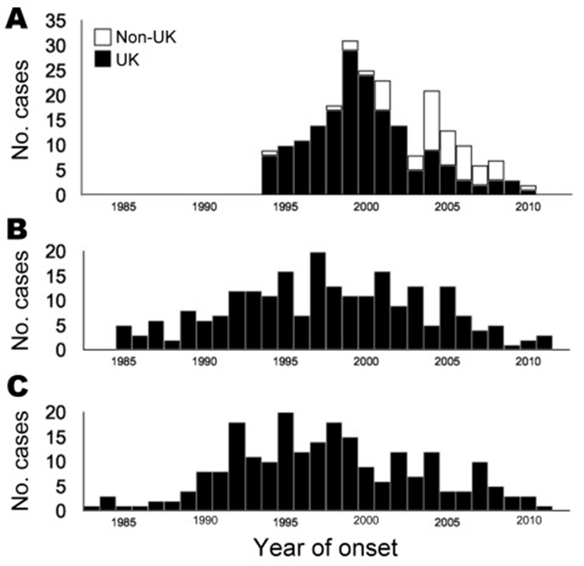
Annual incidence of variant Creutzfeldt-Jakob disease (vCJD) caused by (1982–2011)
Cases from outside the United Kingdom, which were delayed in parallel with the later appearance of bovine spongiform encephalopathy outside the United Kingdom
Annual incidence of variant Creutzfeldt-Jakob disease (vCJD) caused by ingestion of meat products contaminated with bovine spongiform encephalopathy agent
Cadaveric human growth hormone
Iatrogenic CJD caused by contaminated dura mater
Notes:
Arrows -(not a second wave resulting from codon 129 genotype differences).
Two patients are excluded: 1 presymptomatic patient from the United States who received human growth hormone and died of an intercurrent illness and 1 dura mater recipient from the United Kingdom with disease onset in 1978.

Slide 15
Incubation periods and clinical presentations of iatrogenic Creutzfeldt-Jakob disease, according to source of infection
Source of Infection | No. cases | Mean incubation period, y (range) | Clinical signs†
Dura mater graft | 228 | 12 (1.3–30) | Cerebellar, visual, dementia
Neurosurgical instruments | 4 | 1.4 (1–2.3) | Visual, dementia, cerebellar
Stereotactic EEG* needles | 2 | 1.3, 1.7 | Dementia, cerebellar
Corneal transplant | 2 | 1.5, 27 | Dementia, cerebellar
Growth hormone | 226 | 17 (5–42)‡ | Cerebellar
Gonadotropin | 4 | 13.5 (12–16) | Cerebellar
Packed red blood cells§ | 3 | 6.5, 7.8, 8.3 | Psychiatric, sensory, dementia, cerebellar
*EEG, electroencephalogram.
†In order of decreasing frequency.
‡Averages and ranges were 13 (5–24) y in France; 20 (7–39) y in the United Kingdom; and 22 (10–42) y in the United States.
§An additional asymptomatic but infected red-cell recipient died of an unrelated illness; another asymptomatic infected hemophilia patient who had been exposed to potentially contaminated factor VIII also died of an unrelated illness (neither is included in the table).
Notes:
Dura mater grafts and growth hormone cases are the major out breaks as you can see. Dura mater grafts are highly resistant to sodium hydroxide and can survive a stringent chemical treatment –this was used to prevent further incidents until other tissue grafts were found adequate and safe and finally synthetic grafts developed and now are used.
Human growth hormone derived from human cadaver pituitary glands has now been replaced with synthetic growth hormone produced by recombinant technology.

Slide 16
Possible, Probable and Confirmed Cases of CJD by Year

Slide 17
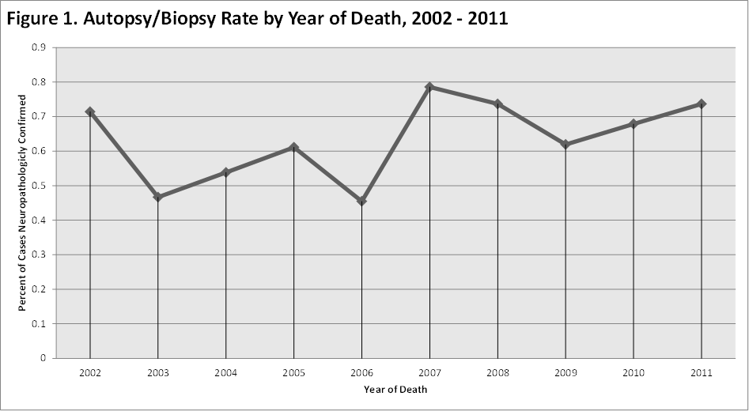
Percent of confirmed by biopsy/autopsy over all possible, probable, and confirmed cases by year - 2002 - 2011

Slide 18
Possible, Probable and Confirmed Cases of CJD by Year

Slide 19
Texas 2012
23 - possible, probable, confirmed cases
3 - cases were out of state residents (2 were confirmed
sCJD by autopsy the other remained probable)
11 - Confirmed cases
      9 - sCJD
      1 - VPSPR (variably protease sensitive prionopathy) a sporadic
            form (still counted as sCJD)
      1 - Familial case (identified in 2004)
9 - Probable sCJD cases
55% confirmed by neurohistochemical pathological analysis

Slide 20
Review of 2012 data (so far) shows:
Of the 11 confirmed cases
  1 case reported by a local health department
  1 case was known of since 2004 (genetic testing)
  1 reported by a family member
  2 initial notifications by autopsy report from the NPDPSC
  6 initial notifications via NPDPSC lab reports
Of the 9 probable cases
  2 were initiated by local health departments4
  3 initial notifications were by death certificates
  4 initial notifications via NPDPSC lab reports

Slide 21
Review of 2012 data (so far) shows:
Of the 6 cases classified “Not a Case”
  1 initiated by a regional health department
  4 initiated by a local health department
      Of which 1 was initiated via the vital statistics of the local health department
  1 initiated by a call from a physician

Slide 22
In summary …
Local and regional health departments work closer with the vital statistics office and can be of great help in identifying
  Cases that were missed in life,
  Cases that were confirmed by alternate means – hospital pathologist via biopsy or medical examiner…
  Cases misdiagnosed or improper diagnosis given

Slide 23
In summary …
Regional and local health departments are a significant source of catching probable and possible cases for CJD
With CJD, possible (suspect) cases are important

Slide 24
Quickly a few cases where local and regional health departments are involved in prion disease investigations
Public inquiry into a CJD case calling it “mad cow” disease
Inquiries into clustering of CJD cases
  2012 – inquiry of a cluster at a hospice
Recent neurologic procedures on a suspected CJD case – an investigation has to be done quickly, methodically, and accurately before risk assessment can be done.

Slide 25
Recommended Steps for Investigation of Possible Iatrogenic Creutzfeldt‐Jakob Disease Transmission via Contaminated Surgical Instruments
Request and Review medical records of case patient
Interview family
Request and Review surgical log
Request and Review pathology log
Request and Review hospitalization database
Request and Review of procedures for instrument handling in the operating room
Determine number of autoclave cycles and/or other sterilization cycles
Search vital statistics database
Natalie Keeler , DVM, Lawrence B. Schonberger , MD, Ermias D. Belay , MD, Lynne Sehulster , PhD, George Turabelidze , MD and James J. Sejvar , MD; Investigation of a Possible Iatrogenic Case of Creutzfeldt‐Jakob Disease After a Neurosurgical Procedure • Infection Control and Hospital Epidemiology , Vol. 27, No. 12 (December 2006), pp. 1352-1357
Notes:
Other information includes: serial numbers of the each instrument (id number), were the instruments part of a set and did they remain together as a set or potential mixing of instruments was allowed.
Number of sterilizations and the exact procedure of sterilization including autoclave temperatures and cycling times are important in determining current infectivity of the equipment and risk of infection to others. As normal sterilization processes do deactivate some of the prions each time the process if performed. Thus for each round performed there is an expected reduction in activated prion protein.
What was the tissue that was the initial exposure and was it the same for the 2nd ary exposures.
These are just some of the information needed, but will allow me to knowlegeably discuss with the medical officer at the CDC, more information is good information.

Slide 26
Thank-you, for your time
And remember, the initial reporting of a disease can be very time sensitive
  It can take months of clinical investigation before CJD come into the differential diagnosis of a patient
  And with a 6 month mean duration from onset of symptoms to death (4 month median) …
Time is essential
My number is 512- 776 – 6338
Michael Fischer MD, MPH-TM
Emerging and Acute Infectious Diseases Branch
Texas Department of State Health Services
Notes:
I am happy to assist in any investigation, if a local or regional wants to investigate a CJD case, I just ask that I am informed about the case as soon as it is known of, because of this time sensitivity of providing autopsy services to the family, they deserve the chance to get an accurate diagnosis. There is less than 72 hour window from death to sample collection. Less in the hot summer. There are only 2 places that perform autopsies for Texas at this time, one in Houston and the other in Albuquerque New Mexico. Coordination of events, getting family to sign appropriate documents and get them to the prion center, and for them to organize these events takes time and autopsies are Not done on weekends. The Friday scramble is not uncommon.

Slide 27




Resources
National Prion Disease Pathology Surveillance Center (NPDPSC)
  Free autopsy and transportation and will coordinate the events (can save family money, get them an accurate diagnosis, and take care of arranging the autopsy)
CJD Foundation
  Family/Patient support, Family conference, 7 day a week “hotline”
Centers for Disease Control and Prevention (CDC)
  Quarterly conference calls
World Health Organization (WHO)
Guidelines for diagnosis, infection control, and surveillance

