Slide 1
Exceptional Items (EI)
David G. Bastis, MPH
Group Manager
Emerging & Acute Infectious Disease Branch

Slide 3
Legislative Appropriations Requests (LARs)
Bridge between the development of the state agency's strategic plan and the General Appropriations Act (GAA)
Formal request for funding made by each state agency
Includes quantitative information such as project performance, projected cost, and methods of financing proposed for state services
Information provided is related to narrative language which is integral to preparation of the GAA. The administrator's statement highlights significant changes in policy, provisions of service and purpose of new fund requests
Notes:
Part of the State’s Budget process.

Slide 4
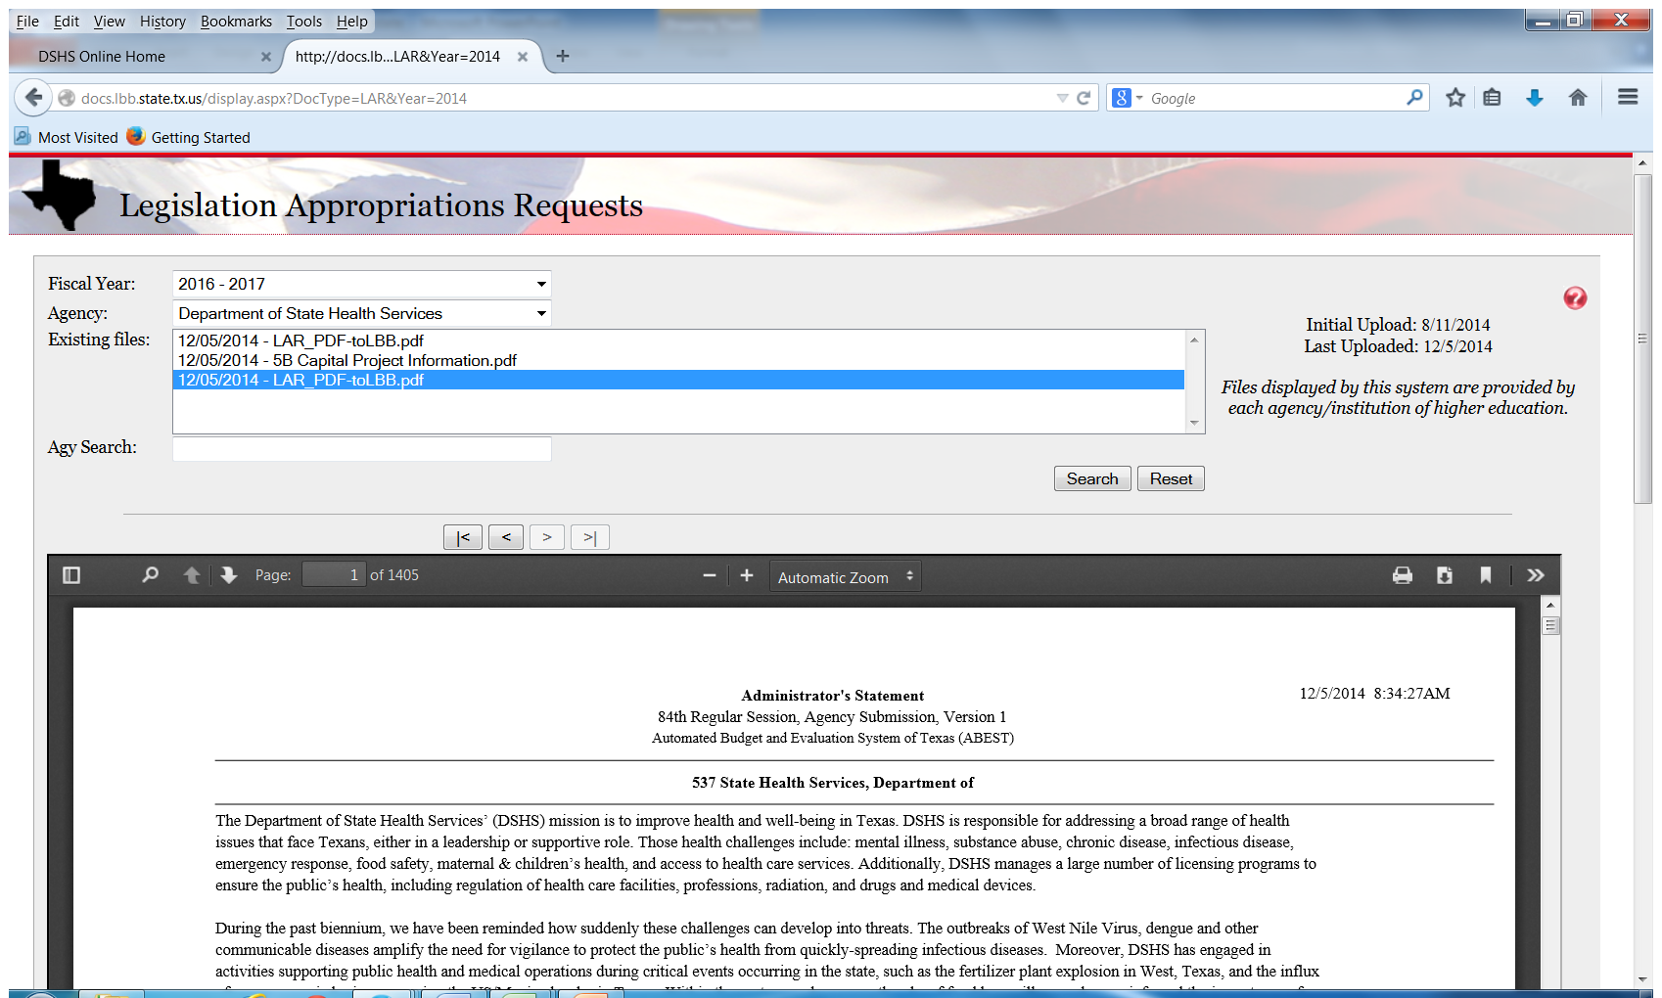

Slide 5
Exceptional Items are Part of the LAR
Exceptional item (EI) is a request for funding in addition to the base budget
Addresses priorities an agency considers of great importance (e.g. Ebola)
Must be supported by data
Support may or may not be sustained at the end of the biennium
Notes:
Legislative Budget Board (LBB) - permanent joint committee of the Texas Legislature that develops budget and policy recommendations for legislative appropriations, completes fiscal analyses for proposed legislation, and conducts evaluations and reviews to improve the efficiency and performance of state and local operations

Slide 6
Strategies to avoid building a Bridge Over Troubled Waters

Slide 7
Agency Foundations for Successful LAR and EI Requests
Long term strategic planning
Systems approach to public health
Effective Surveillance, Data Collection, and Analysis
Accurate description of the problem and possible solutions
Complement EI resources with other funding sources

Slide 9
FY 14 – FY 15 Exceptional Items
Disease Outbreaks and Disaster Response
$1.5 million/year for foodborne epidemiologists positions in sixteen local health departments
Preventing Healthcare Associated Infections
$1 million/year focused on Clostridium difficile infections (CDI)

Slide 10
LHDs with a Foodborne Epi
Austin
Bell County
Brazoria County
Collin County
Dallas County
Denton County
El Paso
Fort Bend County
Galveston County
Harris County
Hidalgo County
Houston
NE Texas
San Antonio
Tarrant County
Williamson County
Cameron County (New)

Slide 11
Mid-year Checks & Balances Expenditures as of 3/1/2015

Slide 12
Surplus Funds
Vacancies – Keep positions filled!
Range for total monthly expenditures $5,500 - $6900

Slide 14
FY 16 – FY 17 Ebola EI
Funding for existing epidemiologist positions sustained AND
Likely will be able to offer additional LHDS a position AND
Transition all LHD epidemiologists contracts to generalist positions effective FY 16 for all selected LHDs
More flexibility for LHDs…idea is to be able to respond to many different emerging ID threats
Allows DSHS EAIDB to focus more on supporting LHDs and DSHS Regional Offices with QA/QI initiatives and program review tools
Contract amount is unchanged
HAI funding for C. difficile projects sustained
Expanding partnerships and implementing improvements to infection control in hospitals throughout Texas

Slide 16
HAI Significant Accomplishments
Partnership with DADS with IPMA contractor
Two CDI/IC trainings for thirteen assisted living centers
Trained living center teams together—administration, medical director, nursing director, environmental
Followed-up with site visits
Eighteen infection control training sessions conducted by TSICP
Over 400 professionals attended statewide

Slide 17
HAI CDI Projects in Transition
Research projects with University of Houston and UT School of Public Health transitioning from research focus to applying evidence based interventions throughout Texas
Texas A & M research group to help with economic analysis
Texas Medical Foundation to help recruit hospitals and collect data

Slide 18
Collaborations and Partnerships
Oversight | Training | Provider Recruitment Program Evaluation Economic Impact | SME Evidence Based Interventions Analysis
DSHS | IPMA | Texas A & M | University of Houston
HAI Advisory Panel | TSICP | UT School of Public Health | UT School of Public Health
 | APIC | Texas Medical Foundation

Slide 19
DADs Assisted Living Centers
Program Assessment and Evaluation
Training
Surveillance
Antibiotic Stewardship
Infection Control
Laboratory
Hospitals
Long term care/Nursing homes
Promoting Best Practices

