Slide 1
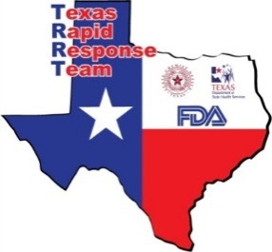
CyclosporiasIS in Texas, 2014 (Part 3)
Venessa Cantu, TX Department of State Health Services
Jane Broussard, Food & Drug Administration
ELC Epi Workshop
April 28, 2015

Slide 2
Overview
Cyclospora in Texas:
2012 & 2013 outbreaks investigations
2014 Epi & Traceback Investigation
2014 Post Response
Preparing for a 2015 Outbreak?

Slide 3
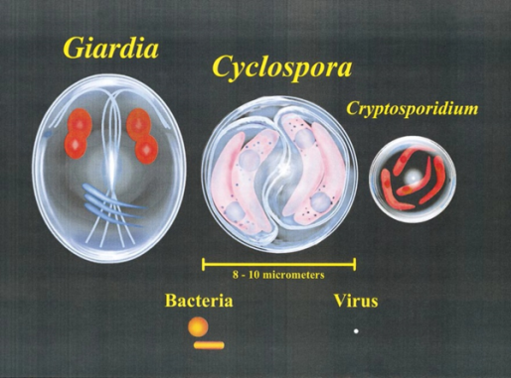
Cyclospora cayetanensis
Transmission
Food and water contaminated with either sporulated oocysts or unsporulated oocysts that have time to sporulate before consumption
Takes more than 1 week for the oocysts to sporulate
Person to person unlikely
Symptoms
Anorexia, nausea, flatulence, fatigue, abdominal cramping, diarrhea, low-grade fever, and weight loss
Notes:
Coccidian parasite
8-10 micrometers
Cyclospora oocysts sporulate in the environment, days to weeks after excretion.
Individuals with Cyclospora infection excrete unsporulated oocysts in their feces…These oocysts require 7-15 days to sporulte under ideal conditions (23 to 27’C) in the environment and presmbaby become infectious to a susceptible host.
Treated with Trimethoprim-sulfamethoxazole (TMP-SMX), or Bactrim*

Slide 4
Laboratory Diagnosis
ID of parasite in stool through microscopy
Concentrated stains
Acid-fast stain
Other methods:
Molecular detection methods---PCR
No current molecular subtyping methods
Detection of Cyclospora in food
Current approved methods limited
Notes:
Diagnosis of cyclosporiasis requires submission of stool specimens for “Ova and Parasite” testing with additional specific orders for Cyclospora identification.
Important thing to note- no current molecular subtyping methods in use ---unknown how much genetic and antigenic diversity is there with C. cayentensis.
no effective testing procedure for Cyclospora on produce- believe has not
FDA/CFSAN has developed a new PCR based method for Cyclospora but it has only been validated within the lab. FDA is in the process of having a multi-lab validation study completed. When the outbreak was ongoing, FDA used both the old (BAM) method and the new PCR based method.

Slide 5
Cyclospora in Texas

Slide 6
Cyclosporiasis in Texas, 2005-2014
*
**
*lab confirmed cases
**2014 provisional data
Notes:
2013– 317 lab confirmed (351 C and P); 2012– 44; 2011– 14; 2010-- 9; 2009--10; 2008-- 6; 2007--2,

Slide 7
2012 Investigation (Part 1)
In 2012, 44 lab confirmed cases of cyclosporiasis were reported in Texas.
9 cases were associated with a restaurant
Strong association with fish tacos but a conclusive vehicle was not identified.
Cilantro, cabbage, poblano pepper, lettuce, and tomato were considered suspect items
Traceback of fresh produce was difficult because a conclusive vehicle was not identified
31 sporadic cases with no travel
52.2% reported cilantro consumption
Other frequently reported items included: blackberries blueberries, raspberries, basil, mesclun lettuce, and other lettuce
Nationally, no increases in cyclosporiasis noted
Notes:
Records collected from restaurant but not reviewed because there were too many suspect items.
Cilantro- 52.2% significant compared to FoodNet Data
Retrospective review of some available records from the 2012 restaurant investigation indicate a possible association with cilantro from Puebla, Mexico

Slide 8
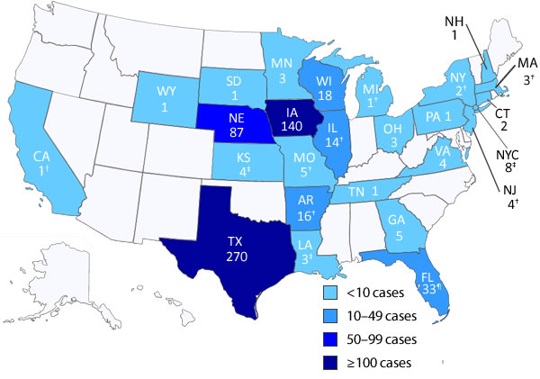
2013 Investigation (Part 2)
Multiple outbreaks of Cyclospora infection in the U.S. in 2013
Restaurant-associated illnesses in Iowa and Nebraska were linked to prepackaged salad mix from Guanajuato, Mexico
Some illnesses among Texas residents were linked to fresh cilantro from Puebla, Mexico

Slide 9
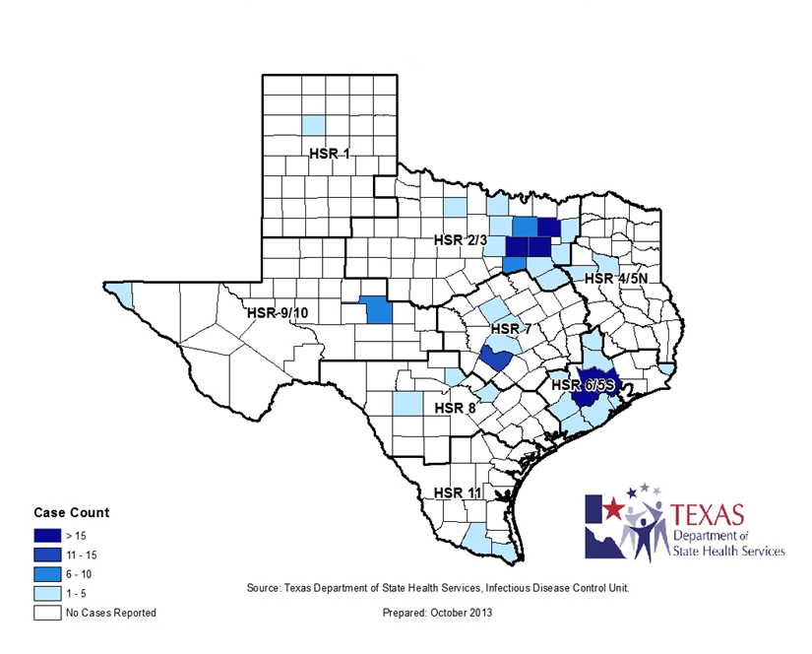
2013 Investigation
317 cases of lab confirmed Cyclospora infections in Texas in 2013
Outbreak associated cases
270 cases met the CDC outbreak case definition
Notes:
Majority of cases in HSR 2/3, followed by 6/5S

Slide 10
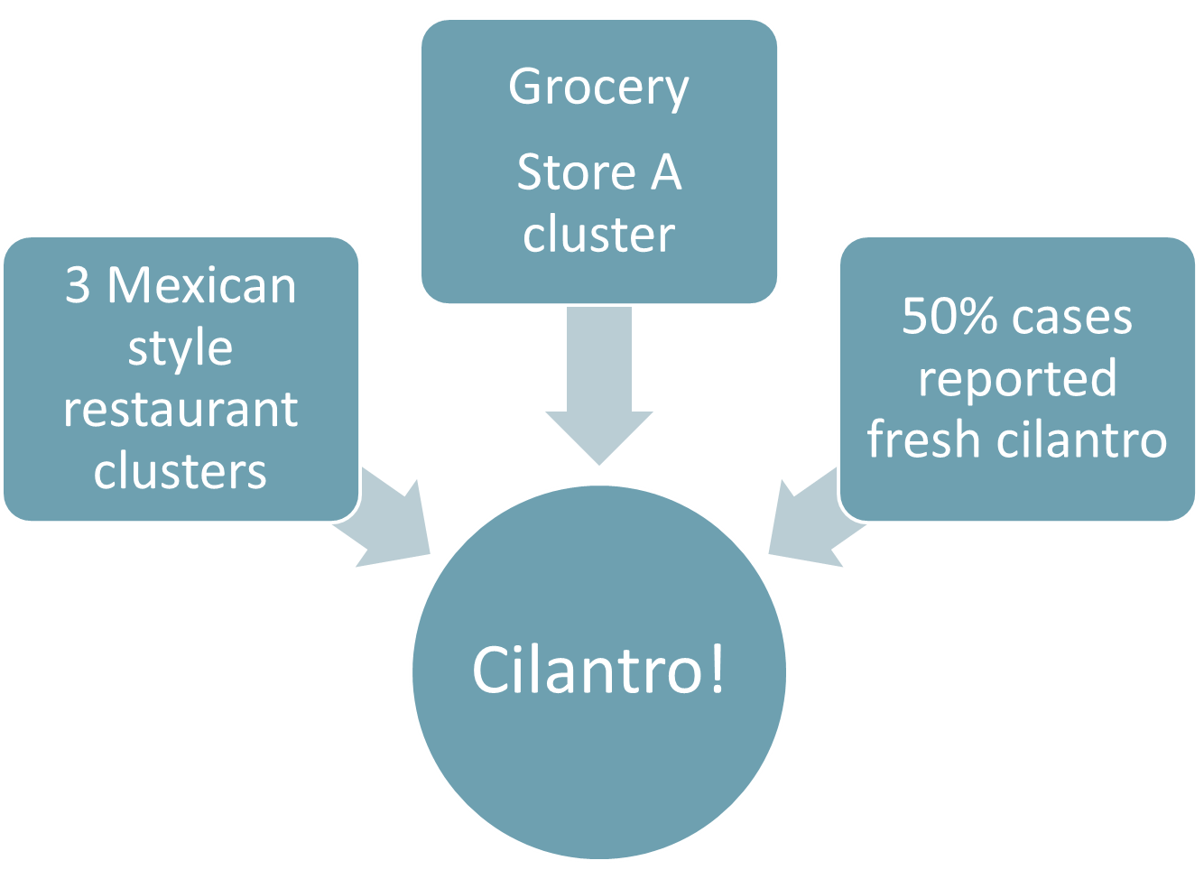
2013 Investigation
Epidemiologic investigation
Notes:
Our final conclusion that some illnesses among Texas residents were linked to fresh cilantro from Puebla, Mexico was due to the epi and traceback investigations of 3 restaurant clusters (1 cluster in Ft Bend County- epi case-control study and ingredient level analysis implicated cilantro) and a grocery store cluster plus a food frequency of over 50% amongst “sporadic” cases (which was significant when compared to the New Mexico Food Net Population Survey) all pointed towards cilantro being a likely source
Prior to the restaurant and grocery store clusters that implicated cilantro and Because of the Midwest investigation earlier in the summer, we did investigate a few other restaurant clusters early focusing on leafy greens that complicated investigation. To this day, still difficult to conclude if any cases or how many cases were exposed to infected leafy greens/salad mix that went to the midwest.

Slide 11
Cyclospora 2013 Regulatory
July 19, 2013 - TRRT was activated
Performed traceback on 8 POS
Team focused on source records for 17 different products
Notes:
Not all 8 POS were complete traceback. We found several distributors in common and noted some trends but we could not make any definitive conclusion on the source of the problem.

Slide 12
Texas Rapid Response Team
A multi-agency, multi-disciplinary group that responds to food and feed emergencies, typically foodborne illness.
Formed from a multiyear cooperative agreement between FDA and state regulatory partners
Notes:
Partners include environmental health, epidemiology, laboratory, public safety and emergency management. All disciplines must be functional in order for the response activities to be efficient and effective.
Core members are: Department of State Health Services, Office of the Texas State Chemist

Slide 13
Texas Rapid Response Team
Deactivation
Phase
Surveillance Phase
Activation
Phase
Alert
Phase
Food/Feed Emergency Cycle
Notes:
There are four phases of the food and feed emergency cycle. All four of these phases must be completed in sequence.
The Surveillance Phase is continual passive observation as member agencies perform day-to-day duties. The team members perform their day-to-day job functions assigned by the applicable agency. Team members may detect changes in the food and/or feed safety system that indicates an increase in foodborne illnesses and/or the beginning of an outbreak. Examples of these systems are - environmental surveillance and monitoring of illnesses by local, state, and federal agencies, PulseNet, media and others. This is usually where epidemiology notices rising number of cases and alerts the environmental group.
The Alert Phase is the time period when a potential incident (called an event) has been identified, but the team has not yet activated. This phase begins when the Activation Coordinating Team (ACT) , meet for the first time to discuss a specific event. During this phase, DSHS Epidemiology conducts weekly calls with Regional and Local health partners to discuss line lists and case interviews to identify foods of interest and potential case clusters.
The Activation Phase begins when the Executive Activation Board activates the team. This mobilizes the TRRT members based on the scope and complexity of the outbreak. Field Teams are deployed to their respective assignments. The team members are assigned to the TRRT and are no longer responsible for their day-to-day activities within their respective agencies until they are demobilized.
Deactivation Phase. The last step in the event cycle is the Deactivation Phase. During this phase, recommendation is made to the Executive Activation Board to deactivate the TRRT Deactivation refers to the return of all team members to their regular duties.
This cycle is continuous.

Slide 14
Cyclospora 2013 Regulatory
Lettuce (Cello)
Tomato
Tomatillo
Cilantro
Spring Mix
Romaine Lettuce
Greens, Micro Mix
Arugula
Acadian Harvest
Yellow Onions
Red Onions
Broccoli Crowns
Cabbage
Kale
Slaw Mix
Spinach
Red Cabbage

Slide 15
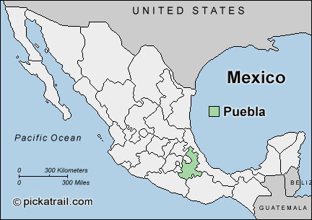
Cyclospora 2013 Regulatory
Public health officials in Iowa and Nebraska performed investigations within their states and concluded that restaurant-associated cases of cyclosporiasis in their states were linked to a salad mix produced by Taylor Farms de Mexico.
Epidemiologic and traceback investigations conducted in Texas by state and local public health and regulatory officials, the FDA, and CDC indicated that some illnesses among Texas residents were linked to fresh cilantro from Puebla, Mexico.
Notes:
This sidetracked us. The Texas Epidemiologists identified cilantro, but because the traceback records in Nebraska and Iowa overwhelmingly showed leafy greens, we ended up looking at 17 products which was almost impossible and really taxed our team.
We clearly had two outbreaks in 2013. The earlier outbreak involved leafy greens and was associated with the Iowa and Nebraska outbreak. In the later outbreak, the epi clearly identified cilantro in the South Texas cases but we continued to try to make it fit the traceback of leafy greens. Our tunnel vision caused us to continue to chase the wrong product and did not allow is to recognize that we had two outbreaks with the same pathogen but with two different vehicles. One with leafy greens and one with cilantro.
One issue we identified in 2013, was our universe was too large. We started our traceback looking at “any leafy green” that included 17 leafy green products.
Another contributing factor to our tunnel vision. We cannot get a PFGE on Cyclospora.

Slide 16
Cyclospora 2014
(Part 3)

Slide 17
2014 Investigation
June 17th
Cyclosporiasis 50 States and Federal Partners Call
Texas reports 8 cases to date in 2014
July 10th (one year anniversary)
11 new cases reported
DSHS regulatory notified
June
July
August

Slide 18
2014 Investigation
July 17th
42 lab confirmed cases
First Statewide Conference Call
Restaurant cluster (POS C) – Dallas County
Restaurant cluster (POS A)-
Kaufman County
July 18th
DSHS Health Advisory issued
July22nd
Restaurant cluster (POS B)- Dallas County
July 10th
June 17th
19 cases
8 cases
June
July
August
Notes:
Health advisory issued encouraging encouraging healthcare providers to test patients for Cyclospora. (if they have diarrheal illness lasting more than a few days or diarrhea accompanied by severe anorexia or fatigue.)

Slide 19
2014 Investigation
July 23rd
DSHS media release
77 lab confirmed cases
Majority of cases in HSR 2/3
2nd statewide conference call
3 restaurant clusters
Ingredient level analysis
Common items: cilantro and possibly onions
POS records collected
July 28th
Texas Rapid Response Team activated
July 17th
42 cases
July 10th
June 17th
19 cases
8 cases
June
July
August
Notes:
DSHS media release announcing increase in cases.
3 restaurant clusters- LHD/RHD – reinterviewing of cases and meal companions, menus obtained, ingredient level analysis= common items being reported by all cases in the clusteres were cilantro and onions.– POS records collected– early on determined that different types of onions were being used.

Slide 20
2014 Investigation
July 30th
116 lab confirmed cases
Restaurant Cluster (POS D)-
Erath County
July 31st
Catered Event (POS E)- Dallas County
July 23rd
77 cases
August 1st
126 lab confirmed cases
July 17th
42 cases
July 10th
June 17th
19 cases
8 cases
Traceback and Record Review
June
July
August
Notes:
Month of August- additional case interviews and follow-up on restaurant clusters.
TRRT working on traceback and record reviews.

Slide 21
Restaurant Clusters
Restaurant A (Kaufman County)
13 cases (4 lab confirmed)
exposure dates ranged 6/12-6/27
Restaurant B (Dallas County)
4 cases (2 lab confirmed)
exposure date 6/21
Restaurant C (Dallas County)
2 cases (2 lab confirmed)
exposure dates- approx. 6/5 & 6/10
Restaurant D (Erath County)
3 cases (2 lab confirmed)
exposure dates 6/16 and 6/21
Restaurant E (Dallas County)
18 cases (2 lab confirmed)
exposure date 7/3
Notes:
Summary info on 5 of the restaurant clusters used in traceback by the TRRT
6th restaurant?- 1 case reported, POS records were collected.

Slide 22
Cyclospora 2014 - Environmental
July 28, 2014 - TRRT was activated
20 assignments were issued
Team focused on ingoing and outbound records from 5/8-7/29
Delegation of Authority ended on September 1, 2014
Notes:
For 2014, Texas Rapid Response Team activated on July 28 and Delegation of Authority expired on Sept 1
The TRRT learned several lessons from the previous year.
One was that we needed to find a better way to document our activities and we started using more ICS forms to do that.
Another was that we needed to narrow the focus on the items of interest.
The third was to listen to the epidemiology more closely.
For 2014 field teams visited 17 firms in Texas
40 team members activated
The time span was 83 days of trace forward and trace back records in addition to questions

Slide 23
Cyclospora 2014 - Environmental
CORE/FDA & TRRT Assignments
Trace back and Trace forward documentation
Bills of Lading
Invoices
Shipping Documents
Request for Information
Notes:
CORE = Coordinated Outbreak Response & Evaluation
We typically associate traceback information with outbreaks because we want to find the source of the problem. However, because we knew how hard it would be to pinpoint the problem, we decided to collect trace forward documentation. This tells us where the product went to and is most often associate with recalls. We wanted to determine if we could see any patterns in the product flow.

Slide 24
Cyclospora 2014-Environmental
Does the firm have the record keeping ability to link shipments?
Are lot numbers available for the shipments?
What is the country of origin of the cilantro used in the above shipments?
Is cilantro manipulated at the facility?
What is the turn-around time for cilantro at the facility?
Are shipments from multiple suppliers comingled?
Notes:
We found that the record keeping was not very good in most firms.
Some firms had a cash and carry policy so we could not track the product flow in these cases.
We also discovered (by accident) some of the distributor practices, like buying old product because someone wanted to get rid of it quickly (50% loss).
Cilantro is a very sensitive product and is easily compromised.

Slide 25
Cyclospora 2014 - Environmental
Additional Information Requested
Water and the use of ice
Washing and cooling of product
Cleaning of Facility
Storage of Product
Product Flow
Personnel
Notes:
Water and the Use of Ice
Is ice produced on-site or is it delivered from outside source?
What is the water source for ice?
Is ice produced, stored and used in sanitary manner?
Does the firm receive cilantro already with ice on top or do they add ice to the cilantro?
If the firm applies ice to keep the cilantro cool, how do they store the cilantro to minimize the ice dripping onto product below it?
Washing and Cooling
Is the product held in cold storage after receiving?
Does the firm use any of the following cooling methods on exposed products: hydro-cooler, forced-air, forced-air chilling? Describe.
If hydro-cooling is used describe how the firm uses it and how often it is cleaned?
What is the source of water that is used in the packinghouse?
Is water used during packing (e.g. washing, cooling)?
Is water that comes into direct contact with cilantro treated?
Storage and Cleaning
Is the product held in cold storage after packing/repacking?
Does the person/team responsible for cleaning the facility use pressurized hoses to clean equipment? Is food still exposed while cleaning is being performed?
Is there pooled water inside the facility?
Product Flow
Please describe in detail and/or construct a flow diagram of product from receipt through distribution. Please include any lot/coding/dating system used to identify and select boxes received/packed/distributed.
Personnel
Do employees wear protective clothing over their uniforms (aprons, smocks, etc.)?
Is clothing, protective gear, or skin observed to come in direct contact with food?
Do employees arrive in and return home in the clothes that they wear during their shift?
Are restrooms located in an area that will minimize contamination?
Are there leaking pipes or pooled water in the restrooms?
Have any employees been ill or shown symptoms of illness during the time period of interest?

Slide 26
Cyclospora 2014 Flow Diagram
Notes:
This was the equivalent of thousands of days of records. All items in blue were domestic. All but one item in white is non-domestic

Slide 27
Cyclospora 2014 - Traceback
17 distributers were identified
22 Suppliers were linked to the traceback records
8 suppliers in California
14 suppliers in Puebla, MX
Epidemiologic and traceback investigations indicated the source of cilantro served at the restaurant clusters during the period of interest was imported from Puebla, Mexico
Notes:
During the response period we were unable to trace back to the farm level. However, FDA contacted the Latin America office and worked with the Mexican authorities to focus on the identified importers.

Slide 28
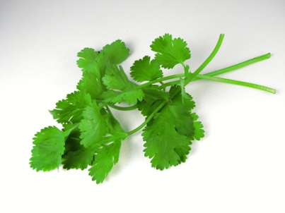
2014 Investigation
August 28th
166 lab confirmed cases
Press and web postings issued by DSHS , FDA, and CDC reporting link to Cilantro from Puebla, Mexico.

Slide 29
2014 Epi Investigation Summary

Slide 30
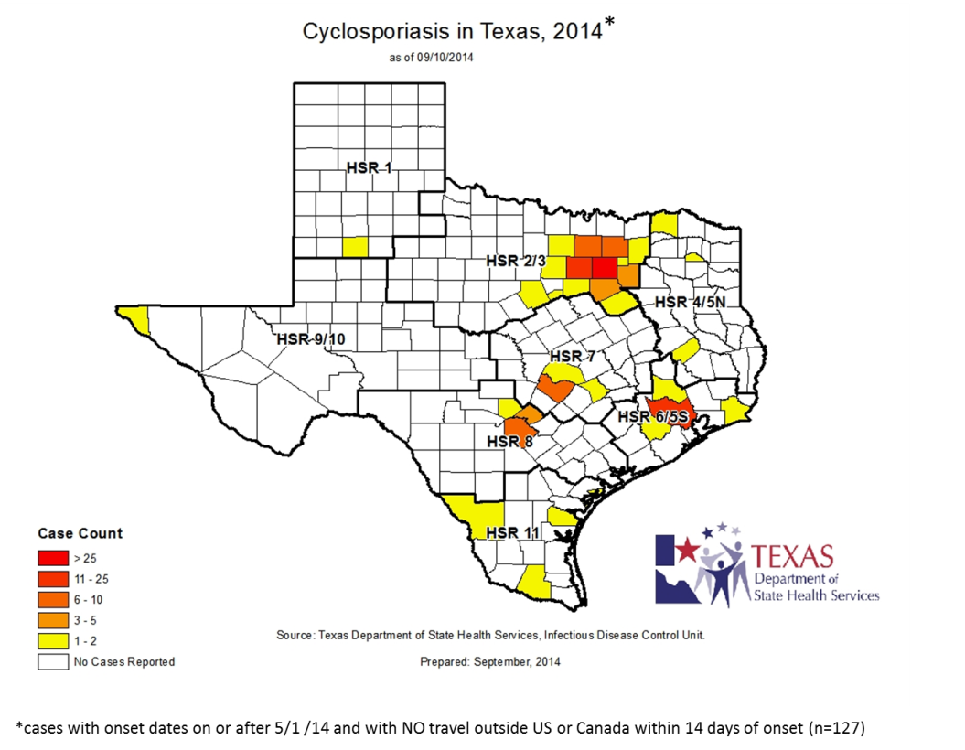
2014 Investigation
In 2014, 175 lab confirmed cases of cyclosporiasis
130 outbreak associated cases
Ages (n=130): range 3-83, median 47 yrs of age
Gender (n=130): Females 57%, Males 43%
Notes:
130 outbreak associated cases
An outbreak associated case was defined as laboratory-confirmed cyclosporiasis in a person with symptom onset during May 1-August 31, 2014, and no known travel outside the United States or Canada in the 14 days prior to symptom onset.
175 lab confirmed (24 probable)-
Region 2/3- almost 60% of cases in HSR 2/3

Slide 31
Outbreak Associated Cyclosporiasis Cases in Texas, by Illness Onset Date, 2014
Notes:
In 2014, 130 outbreak associated cases of cyclosporiasis were reported in Texas, most of which occurred in June and July.
Majority of cases occurred in late June/early July.

Slide 32
Outbreak Associated Cyclosporiasis Cases in Texas, by Illness Onset Date, 2013 and 2014
Notes:
Epi curve comparison of 2013 and 2014 onset dates

Slide 33
Food Frequency Data
56% of cases reported an exposure to cilantro in 2 weeks prior to becoming ill
Notes:
Significant when compared to New Mexico FoodNet Data

Slide 34
FDA Post Response

Slide 35
Cyclospora 2014 Post Response
Investigation of Packing Houses
FDA Mexico City Office in collaboration with SENASICA and COFEPRIS conducted and completed inspections of three suppliers of the cilantro
Inspections were conducted in the fall of 2014
Investigators observed issues with sanitation controls at all three firms.
Notes:
From the importer records, Mexican officials were able to identify some of the suppliers. The inspections were conducted at the packing houses. The inspections were conducted during the September/October time frame and the inspections have been closed. COFEPRIS and SENASICA are working with the firms to ensure compliance with noted observations.

Slide 36
Cyclospora 2014 Post Response
Future Re-Inspection in 2015
Re-inspect packing houses and associated growers
Conduct before June or July 2015 but when the growing season is active
Inspections will focus on the root cause and contributing factors that led to the break in the food safety system.

Slide 37
Cyclospora 2014 Post Response
Potential Areas of Concern
Workers
Animals
Processing
Equipment
Water
Sewage
Environment
Notes:
An Environmental Assessment of Cilantro suppliers in Puebla, MX was not recommended for FY-2014, since the crop season was over.

Slide 38
Challenges and Limitations
Interview and Recall Challenges:
Time from infection to interview
Laboratory Challenges:
No molecular subtyping methods
Development of molecular laboratory subtyping methods for cyclosporiasis could aid in linking cases to each other and to a common source.
Detection of Cyclospora in food
Current approved methods limited

Slide 39
Challenges and Limitations
Food sample analysis for parasite
Product comingling
Language barrier
Record keeping issues
Lack of knowledge of product handling at foreign firms
Notes:
Name of importers and brokers
Records in Spanish

Slide 40
Going Forward
2015
Health Advisory
Routine investigation of cyclosporiasis cases
Cyclospora National Hypothesis Generating Questionnaire (CNHGQ)

Slide 41
Going Forward
FDA will continue to work with industry to discuss strategies on preventing Cyclospora contamination in fresh produce items

Slide 42
Acknowledgements
Texas Department of State Health Services (DSHS)
EAIDB
Laboratory Services Section
Division of Regulatory Services
DSHS Health Service Regions
1, 2/3, 4/5N, 6/5S, 7, 8, 9/10, 11
Centers for Disease Control and Prevention (CDC)
Food and Drug Administration (FDA)
Local Health Departments
Austin-Travis Co Health Department
Beaumont Public Health Dept
City of Garland HD
City of Laredo HD
Collin Co Health Department
Comal Co HD
Corpus Christi-Nueces Co HD
Corsicana - Navarro Public Health District
Dallas Co HD Health Department
Denton Co Health Department
Fort Bend Co Health Department
Galveston Co Health Department
Greenville-Hunt Co Health Department
Harris Co PHES
Hays Co HD
Houston Health and Human Services
Montgomery Co HD
San Angelo-Tom Green Co Health Department
San Patricio Co DOH
Tarrant Co Health Department
Waco-McLennan Co PHD
Williamson Co Health Department

Slide 43
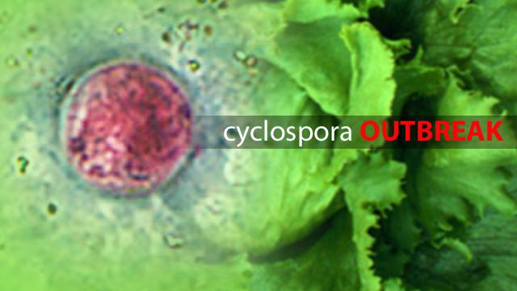
Questions
Venessa Cantu, MPH
Texas DSHS
Foodborne Epi Team Lead
Venessa.Cantu@dshs.state.tx.us
Jane Broussard, CFS CQA
Food & Drug Administration
Emergency Response Coordinator
Jane.Broussard@fda.hhs.gov

