Slide 1

Multi
Drug-Resistant Organisms
Notes:
Reporting
HAI Validation
HAI reporting with a significant focus on any analysis done, AND the results of your validation or reviews that DSHS has done.

Slide 2
Health Care-Associated Infections
United States
722,000 infections/year
75,000 deaths/year
$25-$33B in healthcare costs
Texas
130K-160K infections/year
8K-9K deaths/year
Costs to patient & family, HCW, etc.
Notes:
The US numbers are based off of 2011 data:
- These numbers are down from the 2007 estimates for 1.2 million infections
References:
Magill, S., Edwards, J., Bamberg, W., Beldavs, Z., Dumyati, G., Kainer, M., . . . Fridkin, S. (2014). Multistate point-prevalence survey of health care-associated infections. N Engl J Med, 1198-208.
The Centers for Disease Control and Prevention. (2009, December 29). Template Document for Texas Healthcare-Associated Infections (HAI) Plan. Retrieved from http://www.cdc.gov/HAI/pdfs/stateplans/tx.pdf

Slide 3
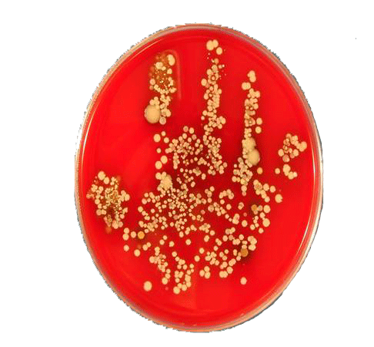
5 Reasons for HAI Reporting
Improve healthcare quality by reducing HAI
Establish standards for comparability of data
Consumer’s right to know
Patient Empowerment
Help to identify facility needs for DSHS support
Notes:
3
In the last few years there has been a strong push for patient empowerment in healthcare.
Most wide-spread, hand hygiene campaigns : Speak up and It’s OK to Ask, which encourage patients to ask their HCWs to clean their hands before providing care.
We are trying to build on the principles of transparency and consumer choice to create incentives and motivate healthcare organizations and providers to provide better, more efficient care.
There have been recent news stories about:
patient suffered some complications following surgery and it emphasized the need for healthcare consumers to have as much information as possible to make informed decisions about their own well being.
Working to establish greater consistency and compatibility of HAI data through developing standardized definitions and measures for HAIs.
Will help DSHS identify educational needs – areas where more education or focused education needs to occur around the state.

Slide 4
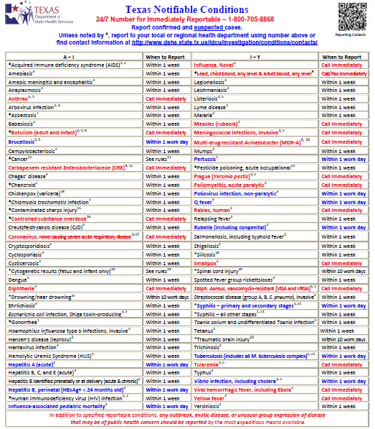
Reporting Requirements
Notes:
Jan 2014 the state of Texas started voluntary reporting of: CRE-E. coli, CRE-Klebsiella species, & MDR-Acinetobacter (MDR-A).
April 20th 2014, reporting became mandatory
All cultured sites to be reported

Slide 5
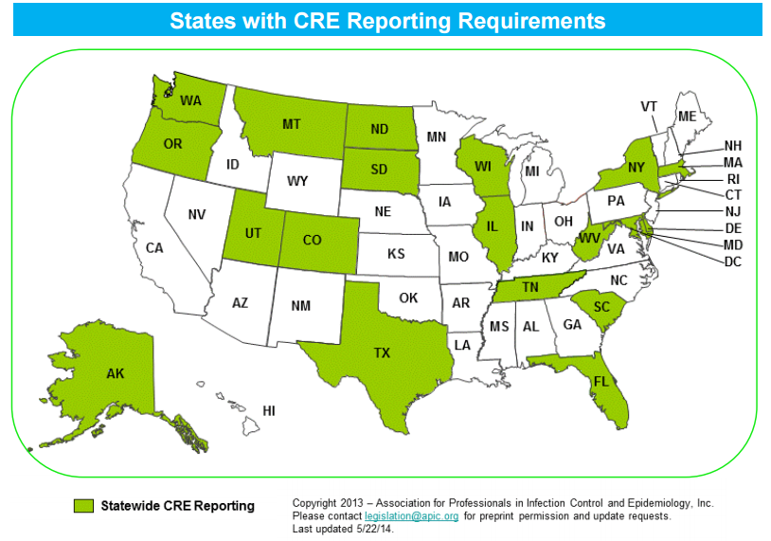
States with CRE Reporting Requirements

Slide 6
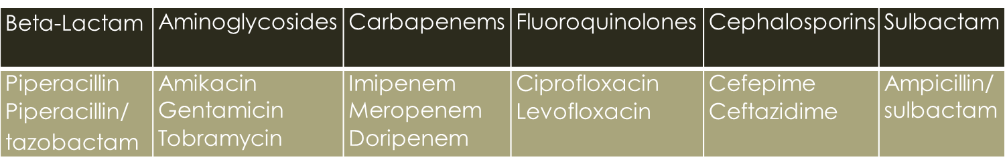
Definitions
CRE
  E.coli or any Klebsiella spp. testing non-susceptible (intermediate or resistant) to imipenem, meropenem or doripenem by standard susceptibility testing methods OR by a positive result for any method FDA-approved for carbapenemase detection from specific specimen sources.
MDR-A
  Nonsusceptible to at least 1 antibiotic in at least 3 antimicrobial classes of the following 6 antimicrobial classes:

Slide 7
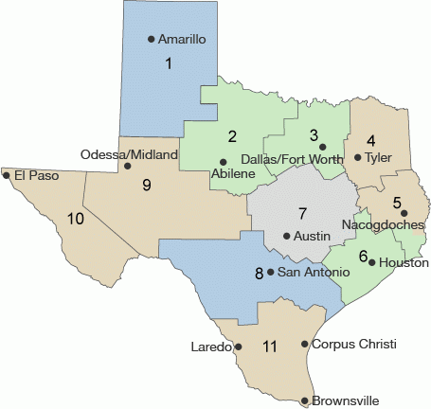
MDRO Reporting – Preliminary 2014
 | CRE | MDR-A | Combo | Total
HSR 1 | 0 | 31 |  | 31
HSR 2/3 | 31 | 186 | 4 | 221
HSR 4/5n | 28 | 48 |  | 76
HSR 6/5s | 293 | 210 | 8 | 511
HSR 7 | 17 | 32 |  | 49
HSR 8 | 35 | 78 | 1 | 114
HSR 9/10 | 0 | 8 |  | 8
HSR 11 | 89 | 248 | 1 | 338
Notes:
This is the total number of isolates reported with prelminary data

Slide 8
HAI/MDRO Epidemiologists
Jessica Ross
1
8
9/10
11
Neil Pascoe
2/3
4/5n
7
Bobbiejean Garcia
6/5s

Slide 9
Help Desk
PAE
Website: www.paetexas.org
Email: paetexas@dshs.state.tx.us
MDRO
Website: idcu.org
Email: mdrotexas@dshs.state.tx.us
HAI
Website: www.haitexas.org
Email: haitexas@dshs.state.tx.us

