Slide 1

Contact Tracing Challenges during the First Domestic Ebola Response
Lauren Weil, MPH, PhD, Epidemiologist
Jessica Smith, MPH, Epidemiologist
DALLAS COUNTY HEALTH AND HUMAN SERVICES
2015 ELC Epidemiology Workshop
April 28, 2015

Slide 2
Acknowledgements
Dallas County Ebola Response Team
CDC Dallas Ebola Investigation Team
Texas Department of State Health Services Central Office and Region 2/3 Ebola Teams
CDC Ebola Epidemiology/Laboratory Task Force
Texas Health Presbyterian Dallas
Tarrant County Public Health Department
Collin County Health Care Services
Denton County Health Department
Liberian Community Association DFW Metroplex
Dallas County Medical Society
Wilshire Baptist Church
Richardson Independent School District
Dallas Independent School District
Dallas County Voluntary Organizations Active in Disaster (VOAD):
  North Texas Food Bank
  The Salvation Army
  Volunteer Center of North Texas
  American Red Cross
  Catholic Charities of Dallas, Inc.
  Jewish Family Service of Greater Dallas
  Society of St. Vincent de Paul, Inc., Diocesan Council of Dallas
  Buddhist Tzu Chi Foundation
  Church of Jesus Christ of Latter-Day Saints
  Texas Baptist Men
CDC Foundation
Dallas Foundation
Vickery Meadow Improvement District
Communities Foundation of Texas
Dwell with Dignity
Vickery Meadow Neighborhood Alliance Food Pantry
Lyda Hill

Slide 3
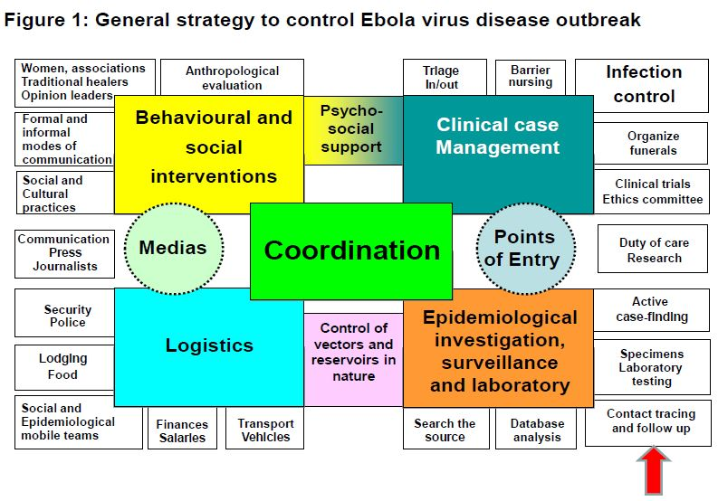
Strategy to Control Ebola Virus Disease Outbreak
WHO. Contact Tracing During an Outbreak of Ebola Virus Disease. September 2014
Notes:
WHO. Contact Tracing During an Outbreak of Ebola Virus Disease. September 2014

Slide 4
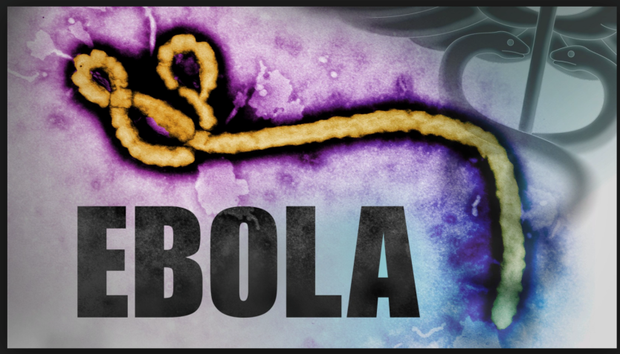
The Investigation Begins
Patient 1 revisits ED and is hospitalized
Patient 3 visits ED
Specimens shipped for testing
Patient 3 diagnosed with Ebola and is transported to Emory
Patient 1 visits ED and is discharged
Patient 2 visits ED and is diagnosed with Ebola
Patient 1 diagnosed with Ebola; CDC EpiAid Team arrives
Patient 1 arrives in Dallas from Liberia
Patient 2 transported to NIH
All 177 contacts complete monitoring
Patient 1 dies
20
25
28
29
30
8
11
14
15
16
7
September
October
November

Slide 5
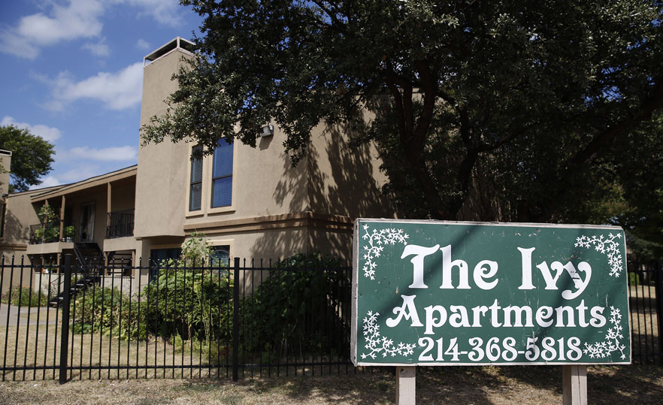
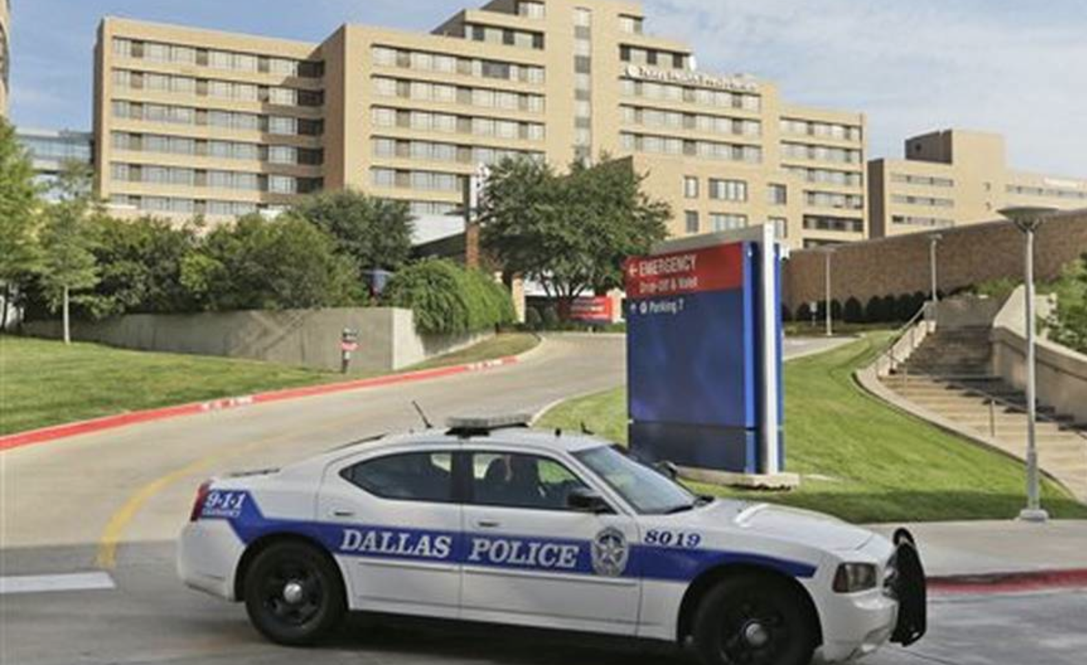
COMMUNITY TEAM
HEALTHCARE TEAM
Patient 1 revisits ED and is hospitalized
Patient 3 visits ED
Specimens shipped for testing
Patient 3 diagnosed with Ebola and is transported to Emory
Patient 1 visits ED and is discharged
Patient 2 visits ED and is diagnosed with Ebola
Patient 1 diagnosed with Ebola; CDC EpiAid Team arrives
Patient 1 arrives in Dallas from Liberia
Patient 2 transported to NIH
All 177 contacts complete monitoring
Patient 1 dies
20
25
28
29
30
8
11
14
15
16
7
September
October
November

Slide 6
Ebola Contact Tracing
OBJECTIVES: Stop Disease Transmission
Identify all possible contacts of the Ebola patient
Interview all possible contacts and assign risk classification
Monitor contacts for 21-day incubation period
Available from: http://www.cdc.gov/vhf/ebola/pdf/contact-tracing.pdf

Slide 7
Identify Contacts
Approach:
Established a procedure with HR and Employee Health
  Managers in departments provided potential lists of contacts
Started a sign-in sheet in the MICU
Began drafting symptom logs, interview forms, and letter to be disseminated to employees
Healthcare contact tracing begins
Patient 1 revisits ED and is hospitalized
Patient 1 visits ED and is discharged
Patient 1 arrives in Dallas from Liberia
20
25
28
29
30
September
October
November

Slide 8
Identify Contacts
Approach:
Established a procedure with HR and Employee Health
  Managers in departments provided potential lists of contacts
Started a sign-in sheet in the MICU
Began drafting symptom logs, interview forms, and letter to be disseminated to employees
Healthcare contact tracing begins
Patient 1 revisits ED and is hospitalized
Patient 1 visits ED and is discharged
Patient 1 diagnosed with Ebola; CDC EpiAid Team arrives
Patient 1 arrives in Dallas from Liberia
20
25
28
29
30
September
October
November

Slide 9
Interview Possible Contacts
Team of 5 epidemiologists
Formalized standard interview form
Interviewed ~100 potential contacts
All interviews took place at the hospital
All healthcare contacts of Patient 1 identified and interviewed
Patient 1 revisits ED and is hospitalized
Specimens shipped for testing
Patient 1 visits ED and is discharged
Patient 1 diagnosed with Ebola; CDC EpiAid Team arrives
Patient 1 arrives in Dallas from Liberia
20
25
28
29
30
3
September
October
November

Slide 10
Assign Risk Exposure Assessment
Team of 7 epidemiologists (2 CDC Team Leads, 2 EIS Officers, 3 DCHHS Epis)
Each interview was discussed and the group agreed/assigned a risk classification
High and Low risk contacts were told in person of their risk classification
Region 2/3 was notified of contacts outside of Dallas County
All jurisdictions began direct active monitoring on 10/4/2014
All 21 healthcare contacts of Patient 1 identified, assigned risk classification, and under direct, active monitoring
Patient 1 revisits ED and is hospitalized
Specimens shipped for testing
Patient 1 visits ED and is discharged
Patient 1 diagnosed with Ebola; CDC EpiAid Team arrives
Patient 1 arrives in Dallas from Liberia
20
25
28
29
30
3
September
October
November

Slide 11
Initial Active Monitoring
High Risk
7
Collin, Denton, Tarrant Counties and DSHS Region 2/3
Active Monitoring - High and Low (1 - in person, 1 - phone check daily)
No Known Exposure were asked to passively monitor
~20 Not a Contact
Low Risk
14
No Known Exposure
~60
Notes:
Not a Contact!!!!

Slide 12
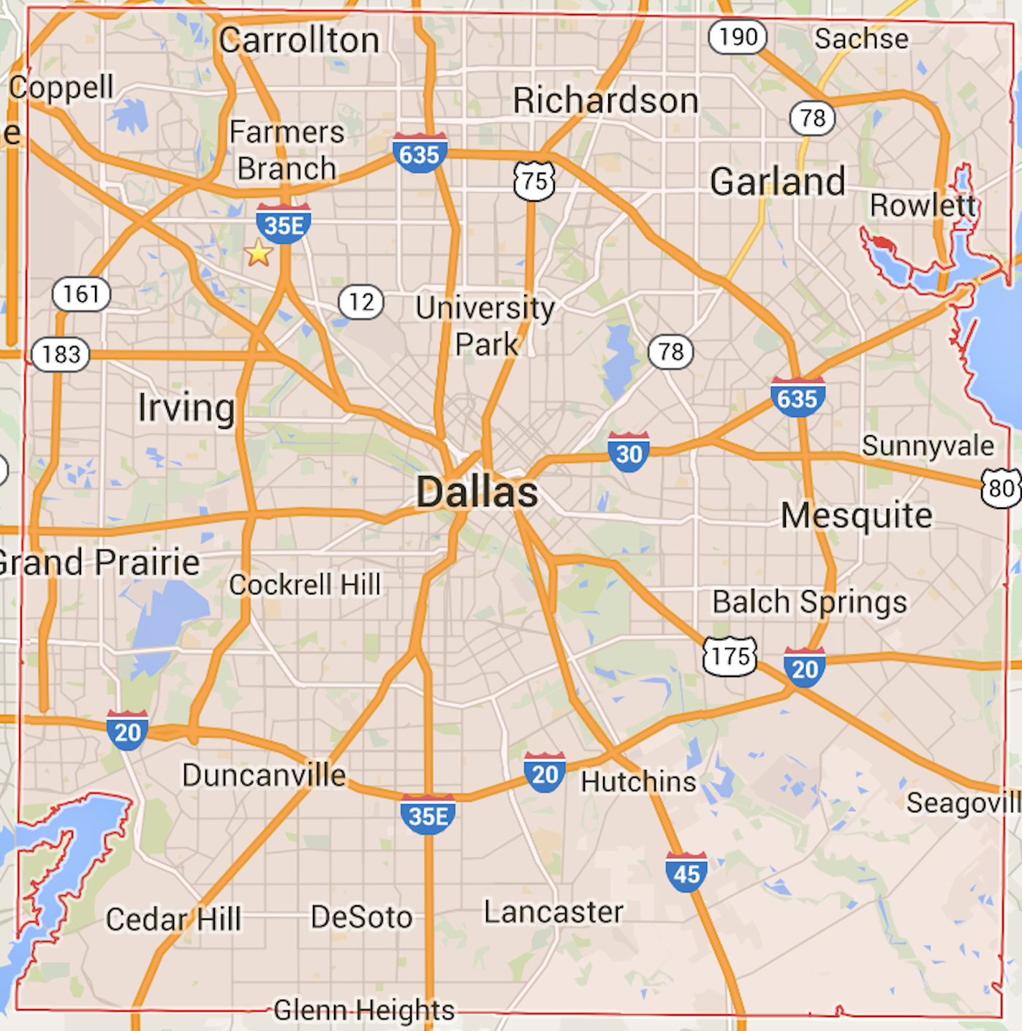
Healthcare Contact Tracing
Total of 11 (Dallas County residents) “high” or “some/low” risk contacts under daily direct active monitoring
Patient 1 revisits ED and is hospitalized
Specimens shipped for testing
Patient 1 visits ED and is discharged
Patient 1 diagnosed with Ebola; CDC EpiAid Team arrives
Patient 1 arrives in Dallas from Liberia
20
25
28
29
30
4
September
October
November

Slide 13
Healthcare Contact Tracing
Patient 1 revisits ED and is hospitalized
Specimens shipped for testing
Patient 1 visits ED and is discharged
Patient 1 diagnosed with Ebola; CDC EpiAid Team arrives
Patient 1 arrives in Dallas from Liberia
Patient 1 dies
20
25
28
29
30
8
September
October
November

Slide 14
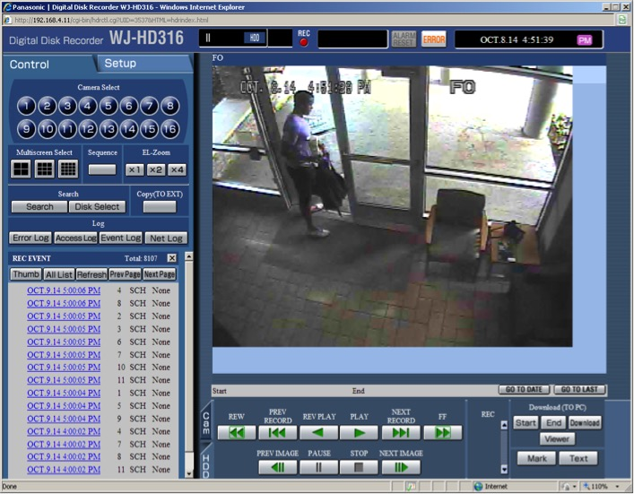
Healthcare Contact Tracing
Patient 1 revisits ED and is hospitalized
Specimens shipped for testing
Patient 1 visits ED and is discharged
Patient 1 diagnosed with Ebola; CDC EpiAid Team arrives
Patient 1 arrives in Dallas from Liberia
Patient 1 dies
20
25
28
29
30
8
September
October
November

Slide 15
Healthcare Contact Tracing
All Epidemiologists report to the hospital (Community and Healthcare Team)
All healthcare workers were re-interviewed (New Exposure Assessments Questions)
High Risk
7
Patient 1 revisits ED and is hospitalized
Low Risk
14
Patient 2 visits ED and is diagnosed with Ebola
Specimens shipped for testing
No Known Exposure
~60
Patient 1 visits ED and is discharged
Patient 1 diagnosed with Ebola; CDC EpiAid Team arrives
Patient 1 arrives in Dallas from Liberia
Patient 1 dies
20
25
28
29
30
8
11
September
October
November
Notes:
No Known Exposure undergoing passive monitoring. New risk assessment forms

Slide 16
Healthcare Contact Tracing
All healthcare worker contacts undergo direct active monitoring
Majority of contacts were monitored at the hospital
Patient 1 revisits ED and is hospitalized
Patient 3 visits ED
Patient 3 diagnosed with Ebola and is transported to Emory
Specimens shipped for testing
Patient 1 visits ED and is discharged
Patient 2 visits ED and is diagnosed with Ebola
Patient 1 diagnosed with Ebola; CDC EpiAid Team arrives
Patient 1 arrives in Dallas from Liberia
Patient 2 transported to NIH
Patient 1 dies
20
25
28
29
30
8
11
14
15
16
September
October
November

Slide 17
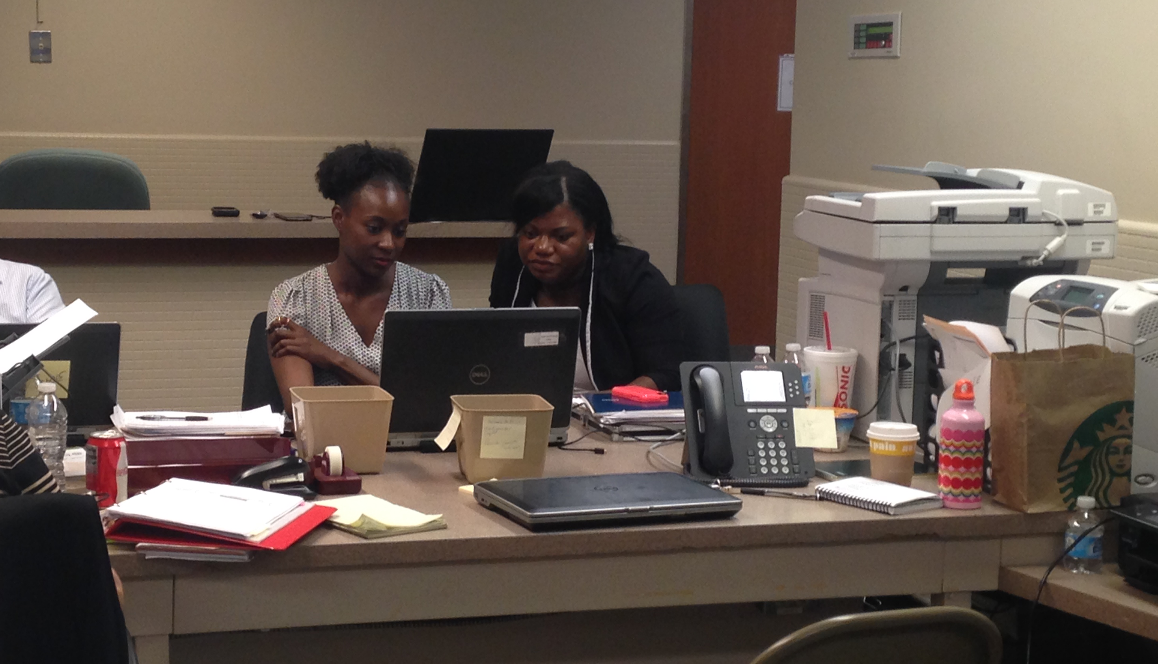
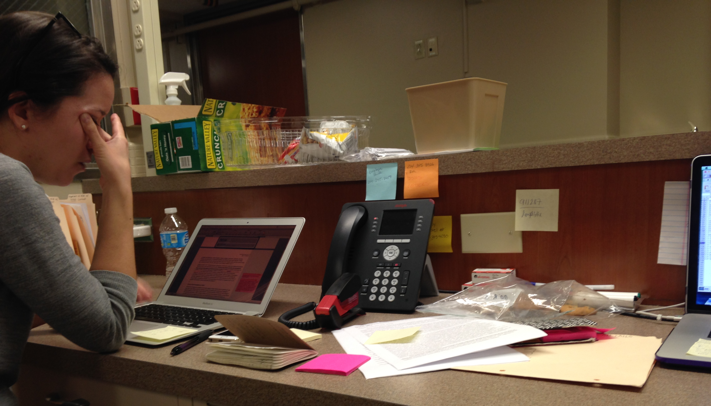
Healthcare Contact Tracing
Healthcare workers’ fears for their health, families, and homes
24/7 on-call emergency number staffed by DCHHS epidemiologists inundated with calls from attention seekers, healthcare professionals, and about travelers returning from Africa
Patient 1 revisits ED and is hospitalized
Patient 3 visits ED
Specimens shipped for testing
Patient 3 diagnosed with Ebola and is transported to Emory
Patient 1 visits ED and is discharged
Patient 2 visits ED and is diagnosed with Ebola
Patient 1 diagnosed with Ebola; CDC EpiAid Team arrives
Patient 1 arrives in Dallas from Liberia
Patient 2 transported to NIH
All 177 contacts complete monitoring
Patient 1 dies
20
25
28
29
30
8
11
14
15
16
7
September
October
November

Slide 18
Community Contact Tracing

Slide 19
Interviewing Possible Contacts
Household contact identification began same day Patient 1 was suspected of having Ebola → did not wait for confirmation of diagnosis
Standardized questionnaires administered via phone
Risk stratification: high, low, or no known exposure
Timeline of activities and community contacts generated for Patient 1
Community contact tracing begins
Patient 1 revisits ED and is hospitalized
Specimens shipped for testing
Patient 1 visits ED and is discharged
Patient 1 arrives in Dallas from Liberia
20
25
28
29
September
October
November
Notes:
On the community side of the response, our contact tracing efforts at Dallas County were underway on September 29, the day the patient’s specimens were sent to Austin and CDC for testing. At that point there was a high enough suspicion that the diagnosis would be confirmed that we wanted to have a good start on identifying who the patient’s contacts were during the time he was symptomatic prior to transport to the hospital. Through interviews with the patient’s family and members of his household, we generated a list of names and contact information of persons with whom he had interacted. As those persons were interviewed in turn, we compared the various accounts of who was where when and doing what to build what we thought was a complete picture of Patient 1’s time spent in Dallas before he was admitted to the hospital.

Slide 20
Interviewing Possible Contacts
Community team:
  4 DCHHS epidemiologists
  4 CDC EpiAid team members
Consultation with CDC EOC re: monitoring
Joint DCHHS/CDC community contact tracing team formed
Patient 1 revisits ED and is hospitalized
Specimens shipped for testing
Patient 1 visits ED and is discharged
Patient 1 diagnosed with Ebola; CDC EpiAid Team arrives
Patient 1 arrives in Dallas from Liberia
20
25
28
1
29
30
September
October
November
Notes:
We continued our phone interviews with potential contacts the day of Patient 1’s diagnosis with Ebola, and checked in with our high and low risk contacts to ask about fever or symptoms. The morning after his diagnosis was confirmed, four members of the CDC Epi Aid team joined our group of four Dallas county epidemiologists at the hospital, which was also our base for community contact tracing. After consulting with the CDC EOC for their guidance, we began direct, active monitoring in which we drove to contacts homes to visually observed their temperatures and ask about symptoms in person followed by an additional check via phone for the remainder of the 21 day incubation period.

Slide 21
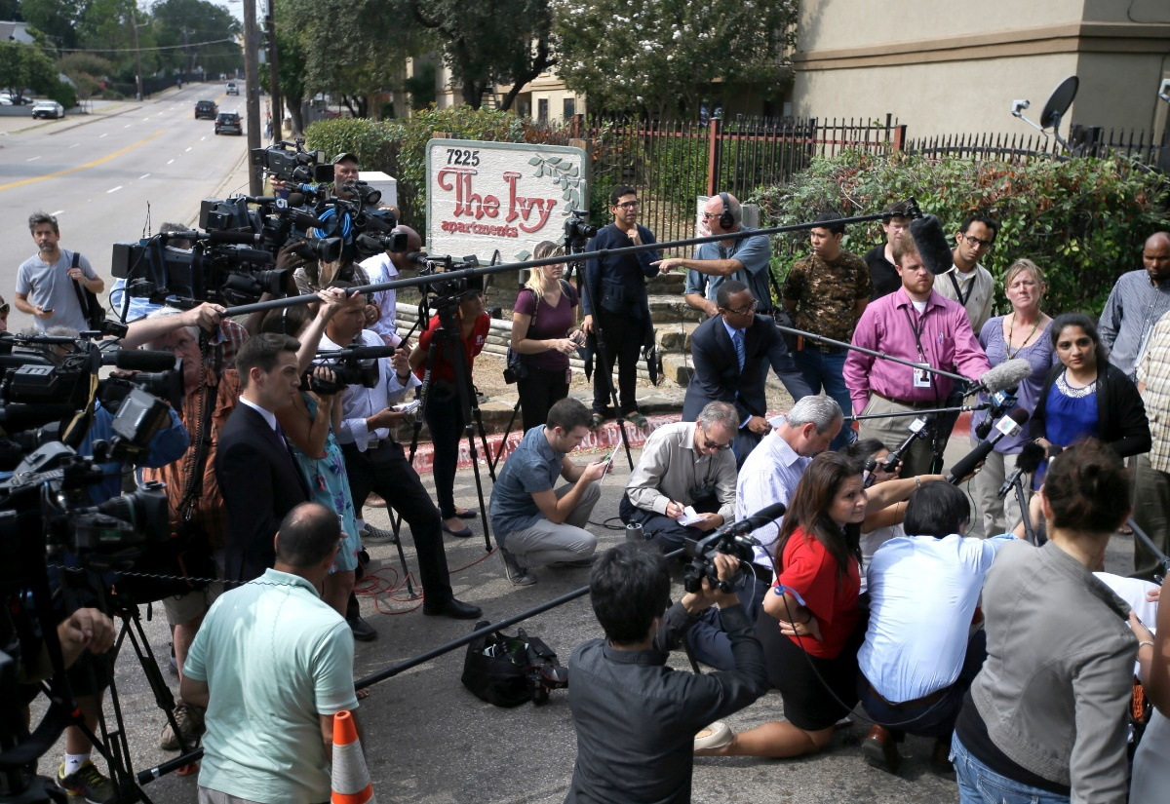
Initiation of Direct, Active Monitoring
Intense media coverage and social stigma begins
Patient 1 revisits ED and is hospitalized
Specimens shipped for testing
Patient 1 visits ED and is discharged
Patient 1 diagnosed with Ebola; CDC EpiAid Team arrives
Patient 1 arrives in Dallas from Liberia
20
25
28
1
29
30
September
October
November
Notes:
So one day after Patient 1’s diagnosis, we were setting out to visit our contacts in person and found that the media had already descended upon their neighborhoods desperate for information. Police were already blocking the entrance to the apartment complex where Patient 1’s fiancé lived, and the media presence and curious bystanders made it difficult for us to discretely visit without revealing which apartment he had been staying at before his admission to the hospital.

Slide 22
Initiation of Direct, Active Monitoring
3 high risk contacts
14 low risk contacts
All high and low risk contacts had the same monitoring protocol
Everything is under control…
All 17 community contacts of Patient 1 identified, assigned risk classification, and placed under direct, active monitoring
Patient 1 revisits ED and is hospitalized
Specimens shipped for testing
Patient 1 visits ED and is discharged
Patient 1 diagnosed with Ebola; CDC EpiAid Team arrives
Patient 1 arrives in Dallas from Liberia
20
25
28
29
30
2
September
October
November
Notes:
2 days after Patient 1’s diagnosis, on October 2nd, all 17 community contacts of Patient 1 were under direct, active monitored by our team: 3 were high risk, 14 were low risk, but all contacts had the same monitoring protocol. Particularly because we thought at the time that we couldn’t be sure if the young children didn’t have high risk exposures, just because an adult didn’t report seeing such an exposure. By Friday the 3rd we were starting to feel like we had a complete list of community contacts because none of the rumors we were hearing checked out, and we were feeling confident we could divide between us the responsibility of who on our team would visit each contact household daily…

Slide 23
Community + Ambulance Contacts of Patient 1
8 school-aged children
3 non-English speakers (Spanish, Armenian, Nepali)
2 persons with complex chronic medical conditions
1 person experiencing homelessness
All 10 ambulance contacts of Patient 1 identified, assigned risk classification, and under direct, active monitoring
Patient 1 revisits ED and is hospitalized
Specimens shipped for testing
Patient 1 visits ED and is discharged
Patient 1 diagnosed with Ebola; CDC EpiAid Team arrives
Patient 1 arrives in Dallas from Liberia
20
25
28
29
30
5
September
October
November
Notes:
However, the night of Friday October 3rd our team learned that we also needed to monitor 10 persons who had been transported in the same ambulance as patient 1 before it was completely cleaned and disinfected. Thanks to Dallas Fire & Rescue and EMS services in Dallas, Emily Hall was able to get the names, phone numbers, and location of ambulance pickup for these 10 persons. Our job was to find them, tell them we were concerned there was a theoretical risk that they had been exposed to Ebola, and make sure they would be compliant with direct, active monitoring.
It didn’t happen as quickly as we would have liked, but by October 5th we had managed to find all 10 ambulance contacts, making a total of 27 community contacts of Patient 1. One contact was homeless and we were lucky that one of our team members, Emily Hall, spotted him while driving at an intersection based on an old mugshot she had tracked down. We had two contacts with chronic medical conditions, one of whom was an ambulance contact that we didn’t track down until October 5th, 2 full days after we had been assigned to find her. When I finally was able to speak with her on the phone and break the news that she had possibly been exposed to the ebola virus during her recent transport in an ambulance, she actually took it pretty well… then I started asking her about symptoms and she reported she routinely experiences nausea, vomiting, diarrhea, headaches, and even frequent brusing. Our team lead David Kuhar was listening to the interview and while we had ourselves on mute he said “she already has every symptom of ebola!”

Slide 24
Addressing Non-Medical Needs of Contacts
Basic necessities (food, diapers, prescription refills)
Exclusion from work/school
Safety concerns (media, stalking, publication of personal information)
All community/ambulance contacts of Patient 1 complete monitoring
Patient 1 revisits ED and is hospitalized
Patient 3 visits ED
Specimens shipped for testing
Patient 3 diagnosed with Ebola and is transported to Emory
Patient 1 visits ED and is discharged
Patient 2 visits ED and is diagnosed with Ebola
All community contacts of Patients 2 and 3 complete monitoring
Patient 1 diagnosed with Ebola; CDC EpiAid Team arrives
Patient 1 arrives in Dallas from Liberia
Patient 2 transported to NIH
All 177 contacts complete monitoring
Patient 1 dies
20
25
28
19
29
30
8
11
14
15
16
4
7
September
October
November
Notes:
Our direct, active monitoring of the 27 community and ambulance contacts of patient 1 ended on October 19. The 3 household contacts of patients 2 and 3 completed monitoring on November 4. During these few weeks, some contacts were excluded from work, or forced to stay home from work when babysitters refused to watch their children for fear of being exposed to Ebola. 5 dallas county contacts were legally quarantined, but community contacts in other households were practically quarantined because of media surrounding their homes or following them in cars. For all of these reasons, many of our contacts had difficulty obtaining their basic necessities such as food and diapers. We had to write numerous letters to employers letting them know our contacts, and people who were not even contacts, were safe to return to work and not a risk to others while aysmptomatic.

Slide 25
Lessons Learned
Contacts’ compliance → build trust and rapport with contacts
Overly-inclusive healthcare contact lists → try to limit to those with potential exposures (and ensure names are legible and cell numbers are provided)
Rapidly finding contact information (and SSNs for Do Not Board list) → Accurint
Managing data and sharing files in the field → encrypted email, secure wireless networks, VPN
Reporting “numbers” → set times for reporting and stick to them
Influx of calls to 24/7 disease reporting line → triage for calls that can be handled by staff or volunteers who are not contact tracers
Notes:
Each contact had their own set of life circumstances and it was important that we try to accommodate them as best we could, both on the community side and the healthcare contact side. One huge benefit to bringing along school assignments or food during our visits was that we felt a bond with our contacts because we heard their concerns firsthand, and we knew in many cases if we didn’t help them, no one would. So many organizations and individuals donated goods to help, but many were afraid to actually make the deliveries. We didn’t want to make contacts feel more stigmatized than they already were
unlike conducting contact tracing in response to other more routine communicable diseases, Ebola is a high consequence disease that had never been encountered before in the United States, so we faced some unique challenges that required us to expand the scope of contact tracing into new areas for us.
As contacts let us know about their financial, social, and basic security concerns, we were fortunately able to find a number of community partners and charitable organizations who were able to contribute resources during the response. However, in many cases, members of the various aid organizations were fearful of interacting with contacts themselves, so the tasks of delivering food and other goods, or picking up school homework assignments fell on our small, over extended team. But, in many ways serving as the face of the response to our contacts gave us the ability to build a strong rapport. We were available 24/7 via our cell phones so that our contacts always knew they could reach us if they felt ill or had other concerns. We tried the best we could to ensure that the same contact tracers visited the same contacts daily. From the contacts’ perspective, they needed to be able to trust that we were going to be there every day to check on them and make sure their questions were answered. And we needed to trust that our contacts were going to feel comfortable disclosing the nature and extent of their interactions with our case patients, and that they would be compliant with monitoring.

Slide 26
Current Activities/Next Steps
Lab meetings
  Specimen transport and protocols
  Laboratory assessment and necessary testing
  PPE
  Environmental cleaning and waste disposal
Infection prevention, hospital emergency management, and EMS meetings
  Patient transport and triage
  PPE
  Clinical care of PUIs

Slide 27
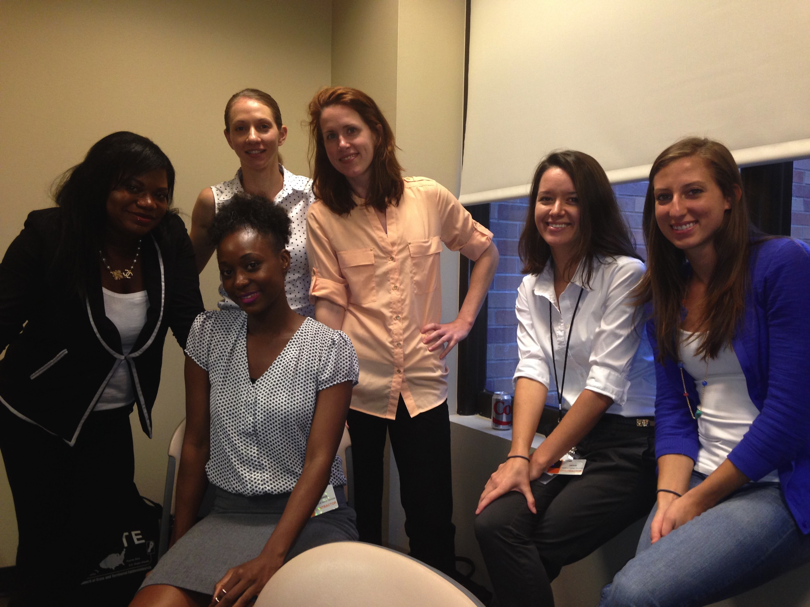
Thank You
Lauren M. Weil
lauren.weil@dallascounty.org
Jessica C. Smith
jessica.smith@dallascounty.org
Dallas County Contact Tracing Team

Slide 28

North Texas Ebola Response Lessons Learned
Heidi Threadgill, Epidemiologist
Community Preparedness Division
DSHS, Health Service Region 2/3

Slide 29
After Action Review (AAR)
After Ebola DSHS Regional staff participated in 3 after action review conferences
  Internal regional DSHS staff
  External partners (Held at NCTCOG)
  Internal statewide DSHS (SMOC)

Slide 30
Lessons Learned
Consistency with risk assessments
Creating or adapting guidance
Safety in the field
Stigma
Coordination between jurisdictions
Communication between staff in field and in office

Slide 31
Lessons Learned
Communication with Preparedness
Epi Aid
  Coordination of information disseminated
  Input
Need for equipment, supplies, data access
Breakdown of ICS

Slide 32
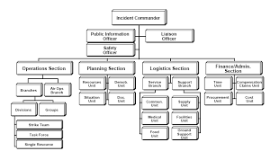
ICS Structure

Slide 33
ICS Structure

Slide 34
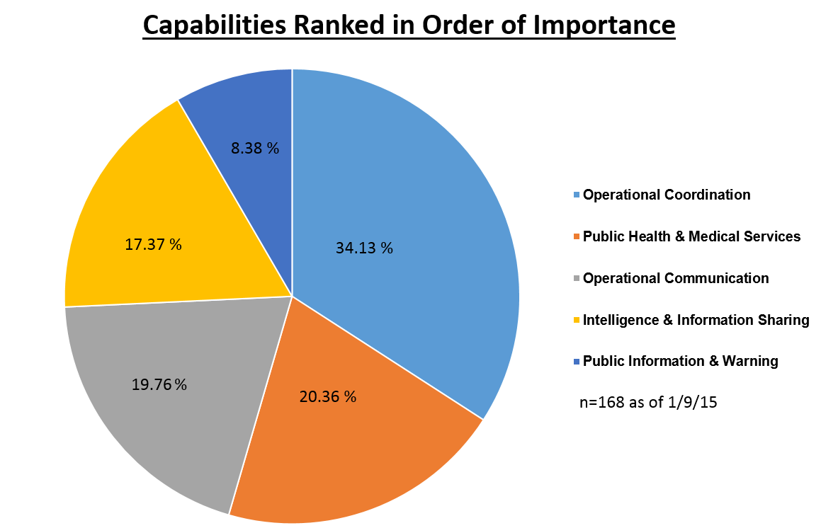
Ebola After Action Reviews

