Slide 1
HAI / MDROs
ELC break out session
Kelly Broussard, MPH
Bobbiejean Garcia, MPH, CIC
Neil Pascoe, RN, BSN, CIC
Jessica Ross, CIC

Slide 2
Objectives
HAI / MDRO Overview
Specific case studies
NBS education and issues
Table Top – case investigation
Q & A

Slide 3
The HAI Problem
United States
722,000 infections/year
75,000 deaths/year
$25-$33B in healthcare costs
Texas
130K-160K infections/year
8K-9K deaths/year
Costs to patient & family, HCW, etc.
Notes:
The US numbers are based off of 2011 data:
- These numbers are down from the 2007 estimates for 1.2 million infections
References:
Magill, S., Edwards, J., Bamberg, W., Beldavs, Z., Dumyati, G., Kainer, M., . . . Fridkin, S. (2014). Multistate point-prevalence survey of health care-associated infections. N Engl J Med, 1198-208.
The Centers for Disease Control and Prevention. (2009, December 29). Template Document for Texas Healthcare-Associated Infections (HAI) Plan. Retrieved from http://www.cdc.gov/HAI/pdfs/stateplans/tx.pdf

Slide 4
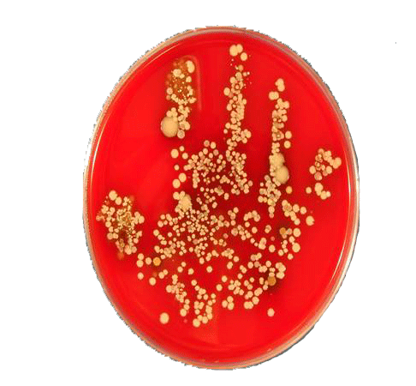
5 Reasons for HAI Reporting
Improve healthcare quality by reducing HAI
Establish standards for comparability of data
Consumer’s right to know
Patient Empowerment
Help to identify facility needs for DSHS support
Notes:
4
In the last few years there has been a strong push for patient empowerment in healthcare.
Most wide-spread, hand hygiene campaigns : Speak up and It’s OK to Ask, which encourage patients to ask their HCWs to clean their hands before providing care.
We are trying to build on the principles of transparency and consumer choice to create incentives and motivate healthcare organizations and providers to provide better, more efficient care.
There have been recent news stories about:
patient suffered some complications following surgery and it emphasized the need for healthcare consumers to have as much information as possible to make informed decisions about their own well being.
Working to establish greater consistency and compatibility of HAI data through developing standardized definitions and measures for HAIs.
Will help DSHS identify educational needs – areas where more education or focused education needs to occur around the state.

Slide 5
2013 Annual Report
Health Care-Associated Infections

Slide 6
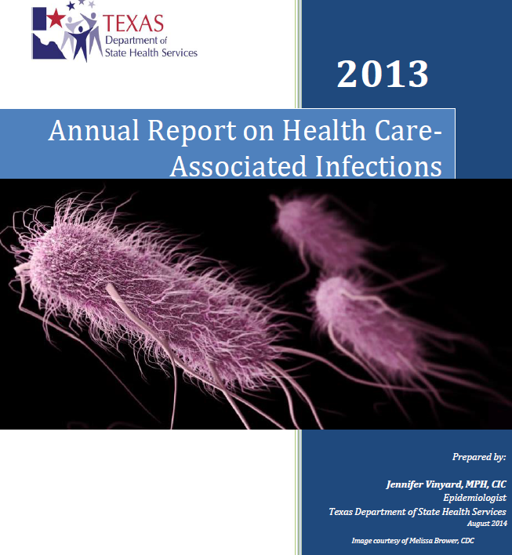
www.haitexas.org
Click “Annual Report”

Slide 7
Who reported?
How did we do?
Facility Type | Number | Percent of Facility Type Reporting HAI
General Hospital | 285 | 75.4
Surgical Hospital | 36 | 9.5
Ambulatory Surgery Center | 24 | 6.3
Critical Access Hospital | 16 | 4.2
Children’s Hospitals | 12 | 3.2
Orthopedic Hospital | 3 | <1%
Oncology Hospitals | 1 | <1%
Women’s Hospital | 1 | <1%
All Facilities | 378 | 100%
Notes:
847 eligible general hospitals and ASCs
Only 413 were required in 2013
The other 434 did not have ICUs nor perform reportable procedures
Of the 413, 378 reported
The remaining 35 that did not report were contacted to find out why and assist in the process

Slide 8
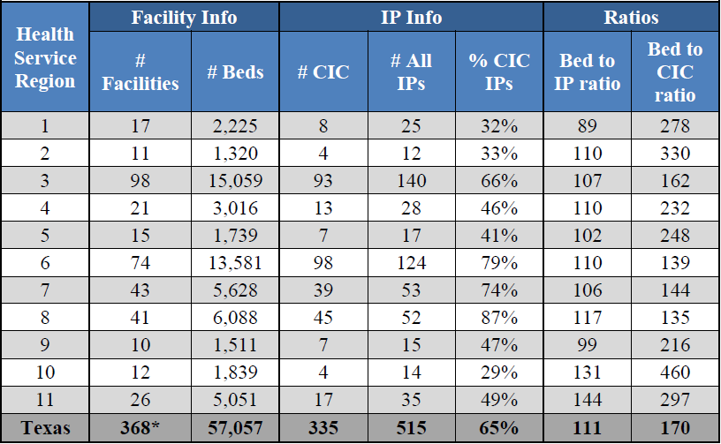
Summary of Texas
Infection Preventionist
Notes:
*10 facilities did not provide bed size or IP information and, therefore, were not included in this analysis.
On average and for each of the HSRs, the CDC recommended 100 beds per 0.8 – 1.0 (FTE) IPs is not met in all regions except region 1.

Slide 9
Future Plans & Ideas for HAIs

Slide 10
Combating HAIs
Initiate CLABSI Validation protocol and perform assessment audits
Expand CLABSI/CAUTI
Notes:
The CDC has a validation protocol that would change our current practice. We have started the steps necessary to meet the requirements to be able to perform this level of validation.
Expand reporting to outside of the ICU’s to include Medical and Surgical wards

Slide 11
Preventable Adverse Events (PAE)
Started public reporting of PAEs January 2015
3 Tier phase-in implementation of different kinds of adverse events
PAE Users enter data into TxHSN
More information
  Website: www.paetexas.org
Questions
  Email: paetexas@dshs.state.tx.us
Notes:
If they haven’t received that information they need to email paetexas@dshs.state.tx.us
Lots of information on www.paetexas.org

Slide 12
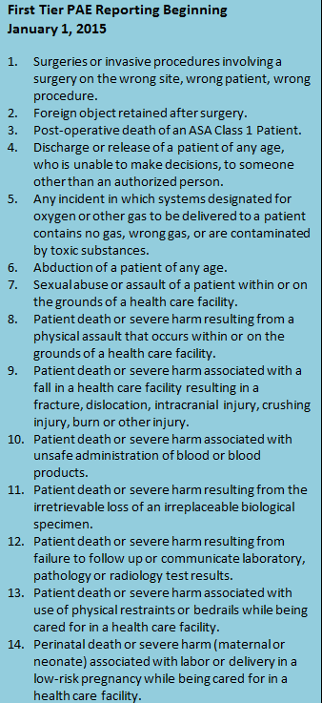
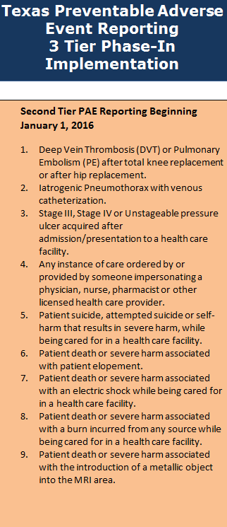
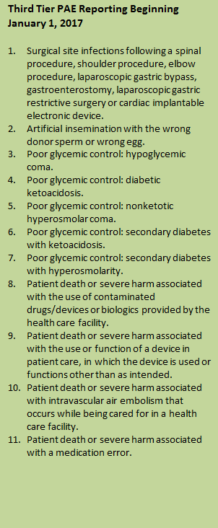

Slide 13
MDRO Reporting

Slide 14
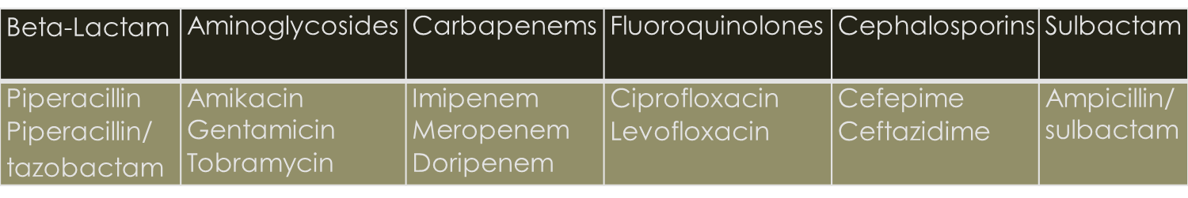
Definitions
CRE
  E.coli or any Klebsiella spp. testing non-susceptible (intermediate or resistant) to imipenem, meropenem or doripenem by standard susceptibility testing methods OR by a positive result for any method FDA-approved for carbapenemase detection from specific specimen sources.
MDR-A
  Nonsusceptible to at least 1 antibiotic in at least 3 antimicrobial classes of the following 6 antimicrobial classes:

Slide 15
Case studies
Bobbiejean Garcia, MPH, CIC

Slide 16

Pan Resistant CRE
Burn Unit
  Private rooms
  Cultures every MWF
International cases
IP <1yr experience
Shared staff of another hospital
Notes:
These are surveillance cultures, at minimum.
Two cases had received international care prior to hospital admission

Slide 17
Pan Resistant CRE
Date | Event
1/26/2015 | Case 1 admitted PR-CRE & MDRA in blood; 1:1
1/29/2015 | Case 2 admitted; Cultures grow no Gram Negs.
2/19/2015 | Case 1 grows PR-CRE again in blood
3/6/2015 | Case 1 grows PR-CRE in Sputum
3/9/2015 | Case 2 wound cultures taken; 1:1
3/11/2015 | Case 2 lab finalized, PR-CRE; IP calls DSHS
3/14/2015 | Case 3 grows PR-CRE in blood
3/20/2015 | New isolation protocol put in place for 3 cases
3/30/2015 | Site Visit by LHD & DSHS
Notes:
These are the dates of the cultures, the finalization dates are a couple days after
LHD was notified of original cases
1/26: patient was 1:1 since admission due to level of care involved
3/9: hospital moved to 1:1 for Case 2 pre-emptively

Slide 18
Pan Resistant CRE
 | Old Isolation Practice | New Temporary Practice
Nursing Ratio | As needed 1:1 | Only 1:1 nursing
Clothing | Standard scrubs | Dedicated hospital scrubs upon each entry; personal scrubs when not in room
PPE | Semi-impermeable gown, gloves | impervious gown, gloves, face masks, hair net
PT/OT | Enter as many times as necessary | Once per day RN responsible thereafter

Slide 19
Pan Resistant CRE
Areas to consider
Disinfectant contact time
EVS Training
Nursing, RT/PT/OT practices
OR
Tub Room
Flight crew
Patient rooms: layout, contents
Notes:
No additional cases after the 3rd.
Contact time was 10 minutes for disinfection -
The rooms were next door to each other
Periodic equipment and rooms were culturing, upon discharge

Slide 20
Pan Resistant CRE
Observation | Recommendation | Facility Feedback
10 Minute Contact Time | Ask manufacture about product with shorter contact time | Manufacture does NOT have comparable product
Manual dilution process | EVS education to ensure understanding – by product company | Will install pre-measured dispenser – date pending
Cracked tub room mats | Replace | One mat replaced – others pending
Notes:
IP stated they used a several disinfectants all w/10 min contact time. When I looked it had 30 sec, 1 min, 5 min kill claim – they will continue to use the Hydrogen Peroxide wipes

Slide 21
Pan Resistant CRE
Additional Items | Facility Feedback
Consider prohibiting EVS staff from wearing artificial nails | To be discussed in May
Change Privacy Curtains on routine basis | Changing curtains every other day – implemented
Increase cleaning frequency of in-use rooms | Cleaning isolation rooms twice daily – implemented
Training to Flight Crew | Course scheduled for June
Testing chemical PH or dilution | EVS manager will do random pH testing to ensure dilution – date pending
Notes:
Will also discuss with the flight crew what products and how they clean (Mexico teams)

Slide 22

Video

Slide 23


Overview of Outbreak Settings and Investigations
Neil Pascoe
Neil Pascoe RN BSN CIC
Emerging and Infectious Disease Branch

Slide 24
Why investigate
Investigation of HA outbreaks helps identify preventable causes of infection and unsafe products and practices
  Prevent additional cases
  Improve detections and reporting of outbreaks, clusters or unusual cases
  Establish investigation protocols and train HD staff
  Identify “unusual” practices
  Improve or establish new standards of intervention or control measures
  Assist in communication between state and local partners (e.g., State Survey Agencies, LHDs, licensing boards)
Notes:
Because it is a core public health function to prevent the spread of communicable disease!

Slide 25
Some Settings Investigated
Hospitals
Long Term Care (NH- others)
Group homes/assisted living centers
Physician offices
Outpatient treatment centers
Dialysis Centers (ESRD)
State schools
Military bases
Prisons/Jails
Law enforcement training center
Tattoo studios
Nail salons
Tanning studio
ASC

Slide 26
Hospital Investigations
MRSA (several)
Group A strep (GAS or S. pyogenes wound infections)
Burkholderia cepacia
Pseudomonas aeruginosa
Acinetobacter baumannii
Mycobacterium mucogenicum (CLABSI)
Sphingomonas
Ralstonia pickettii
NEC, Legionellosis
Device and product –associated
Transplant and tissue associated
Surgical Site Infections (SSI) MDROs et cetera

Slide 27
Product/Device-associated Investigations
Whirlpool
Autoclave
Contaminated dressings (Hydrogel)
Mouthwash (several)
Contact Lens solution (several)
Oxygen Probes
IV flushes (several)
Tanning beds
Arthroscopic shavers
ECMO

Slide 28
Physician Practice
Dermatology practice- (autoclave failure)
Allergy practice (injection safety)
Wound care practice (MDRO)
Wound Care Clinic ( pseudomonas)
* Citations, references, and credits – Myriad Pro, 11pt

Slide 29
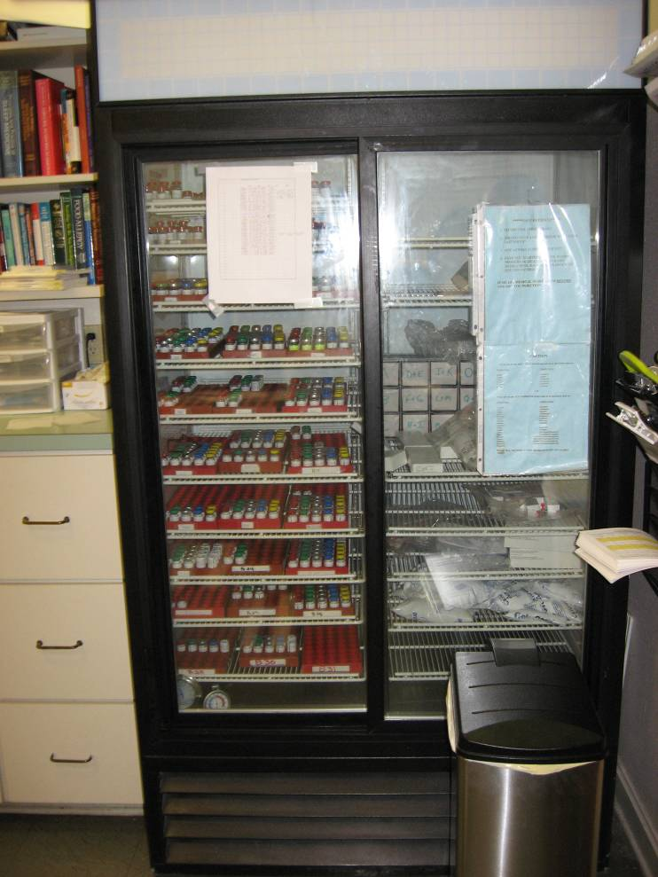
Physician Allergy Practice
Private physician and ID consultant
126 patients
  25 cases 13 confirmed, 12 probable
Use of skin disinfectant benzalkonium chloride (Zephiran)
CDC collaboration – Epi Aid
On site investigation discoveries

Slide 30
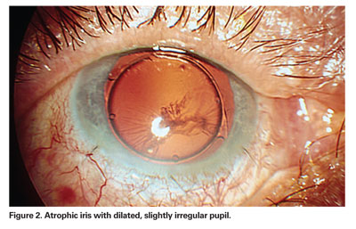
Out Patient Ambulatory Care Setting Practice
Ambulatory Surgical Centers (ASC)
  TASS (Toxic Anterior Segment Syndrome) post-op visual changes due to toxins, inadequate surgical prep, medications and others causes
Streptococcus mitis (unsafe injection practice)

Slide 31
Ambulatory Surgery Center S. Mitis Investigation
Call from a hospital IP
Reported 5 patients with eye infections
All reported recent cataract surgery at one ASC
Eleven total patients 5 lost vision in one eye
Change in staffing led to unsafe injection practice

Slide 32
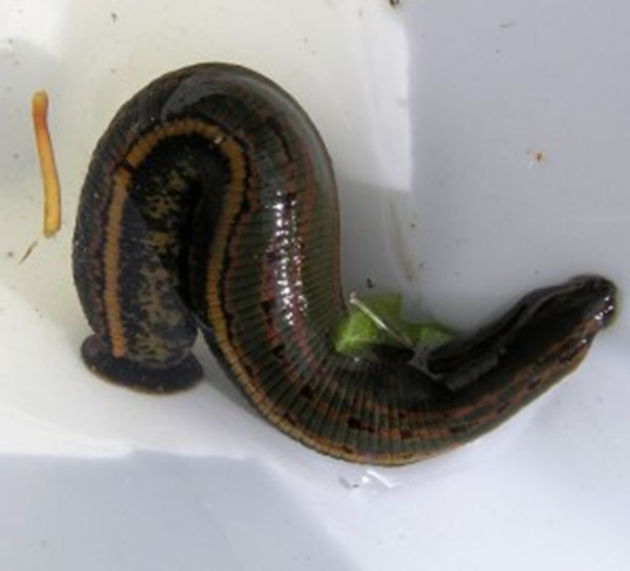
Transmission of Aeromonas hydrophila associated with treatment of medicinal leeches: a Case Report.
Neil Pascoe RN BSN CIC
Nurse Epidemiologist
EAIDB/IDCU

Slide 33
Case Report
50 YOM carpenter
Residential worksite injury January 2013
Complete amputation of the thumb
Transported via EMS
OR same day
2/20/13 reported as HAI- Vibrio vulnificus, MRSA and Aeromonas hydrophila co-infection

Slide 34
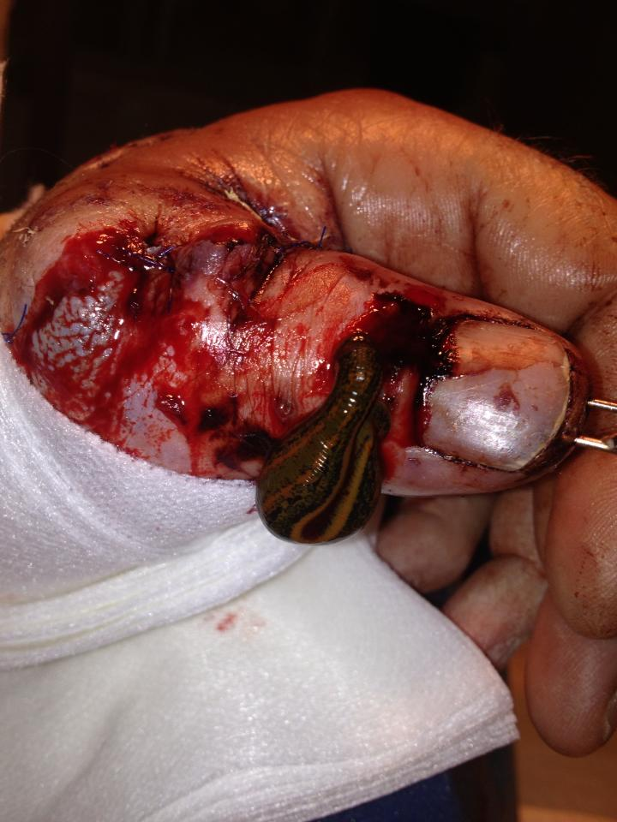

Slide 35
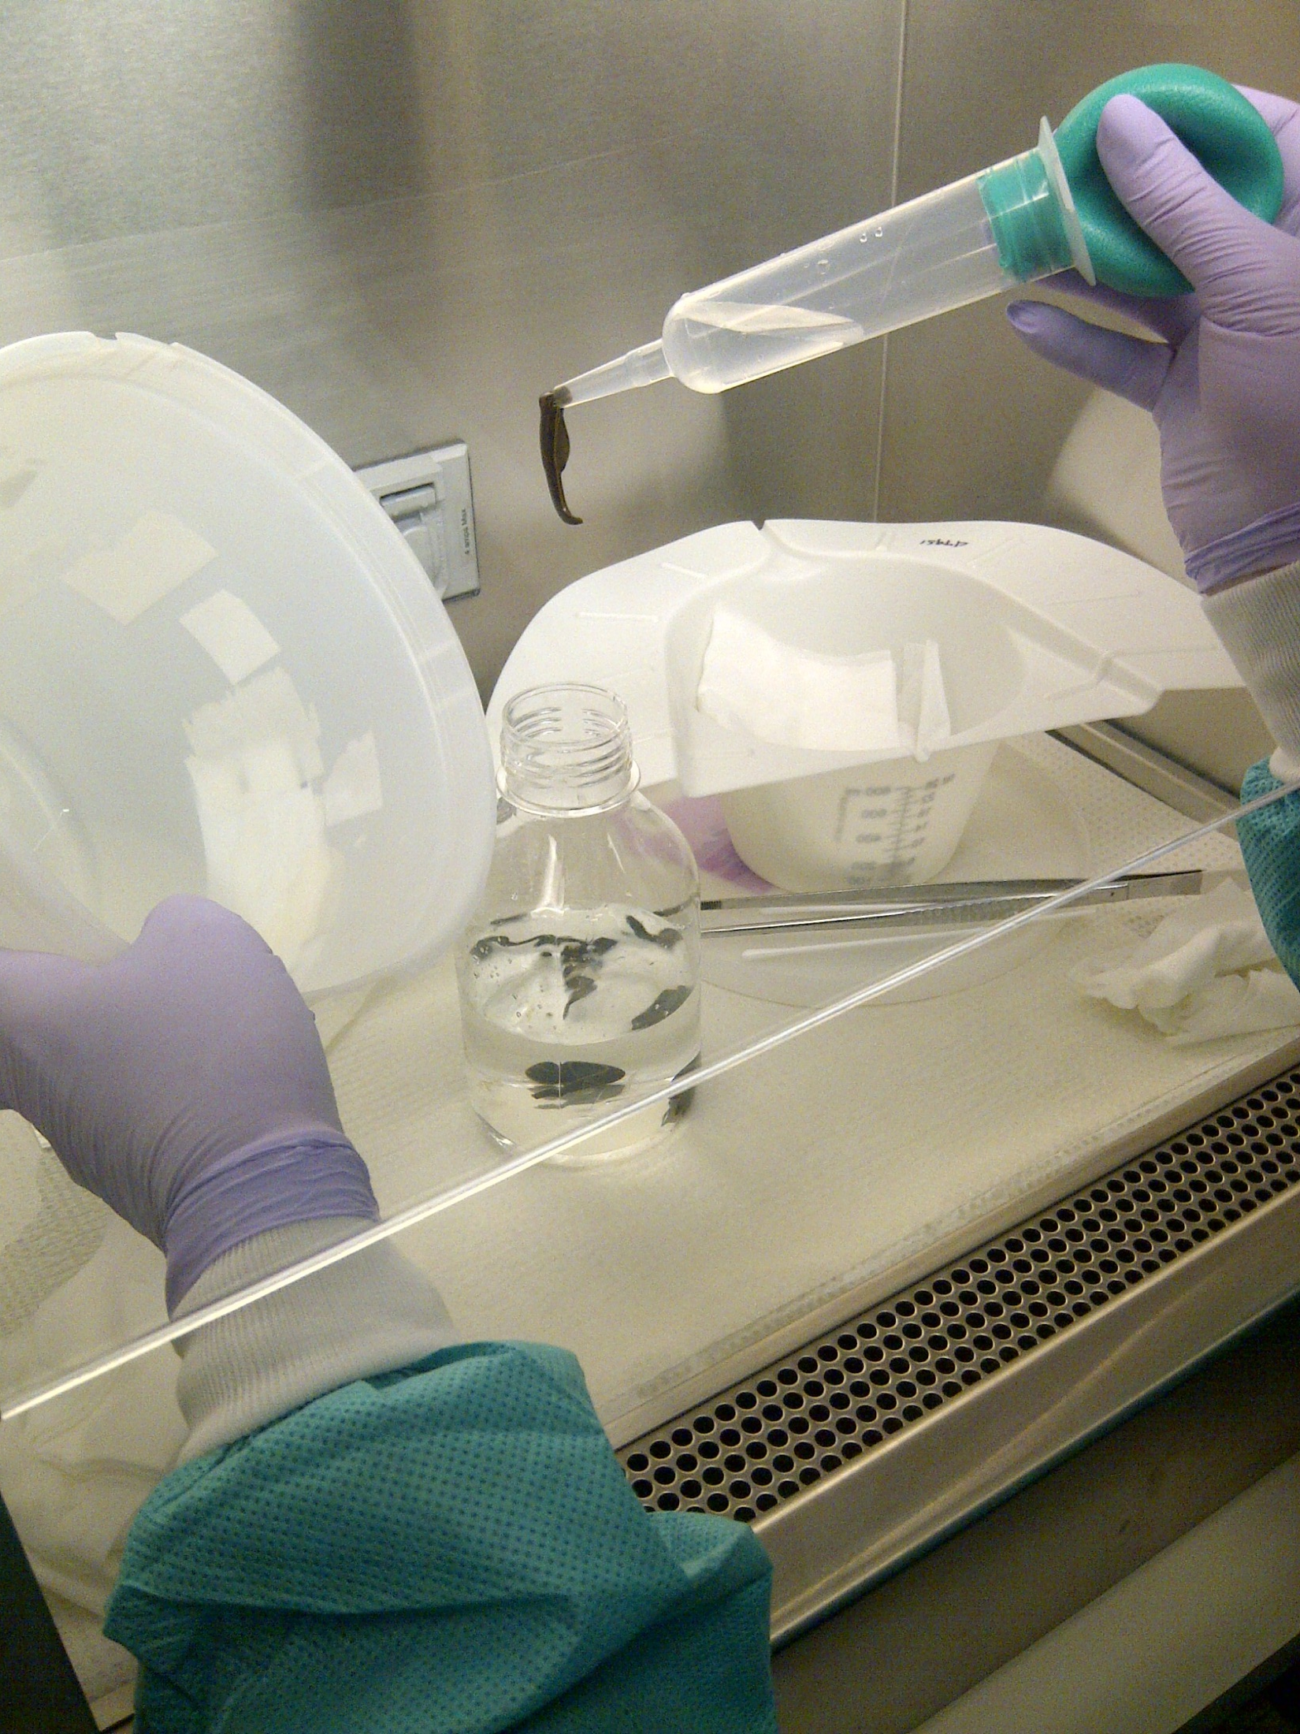

Slide 36
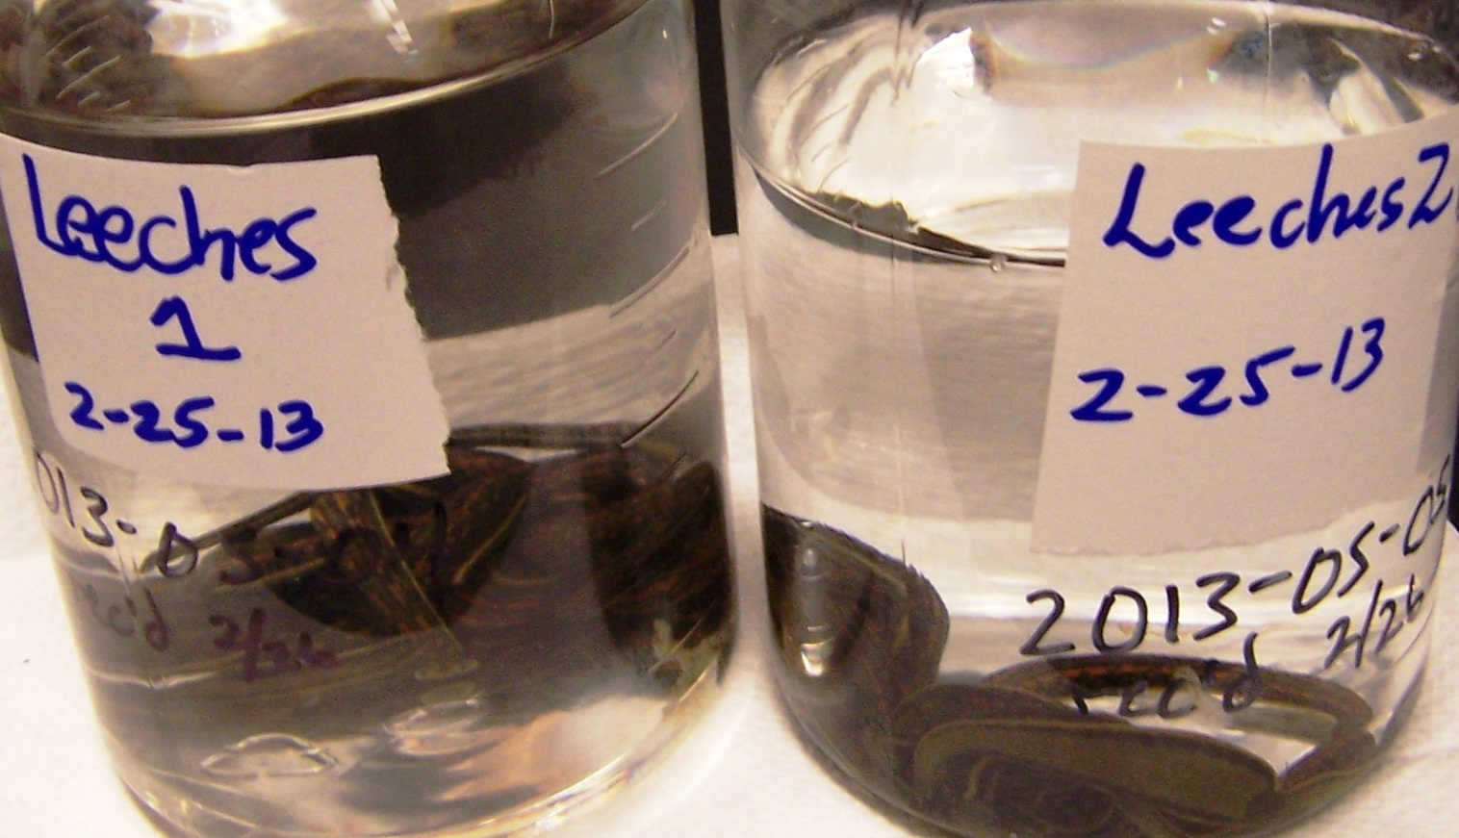

Slide 37
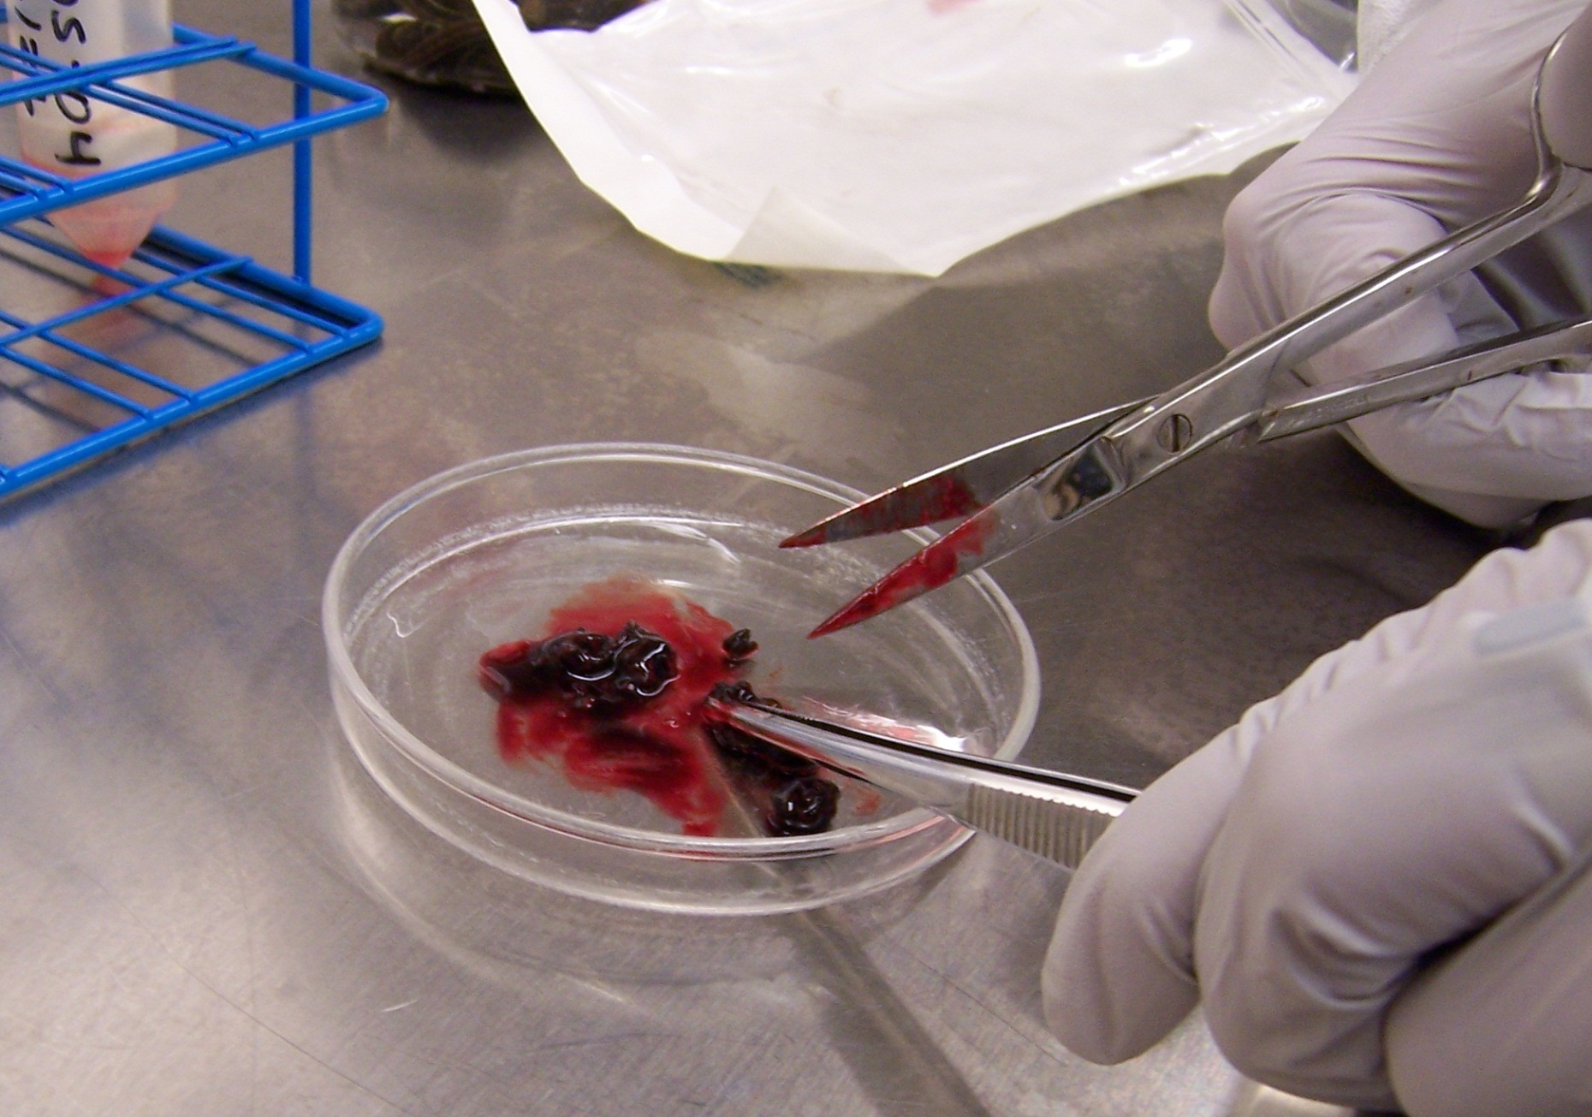

Slide 38
CDC Antimicrobial Susceptibility Testing

Slide 39
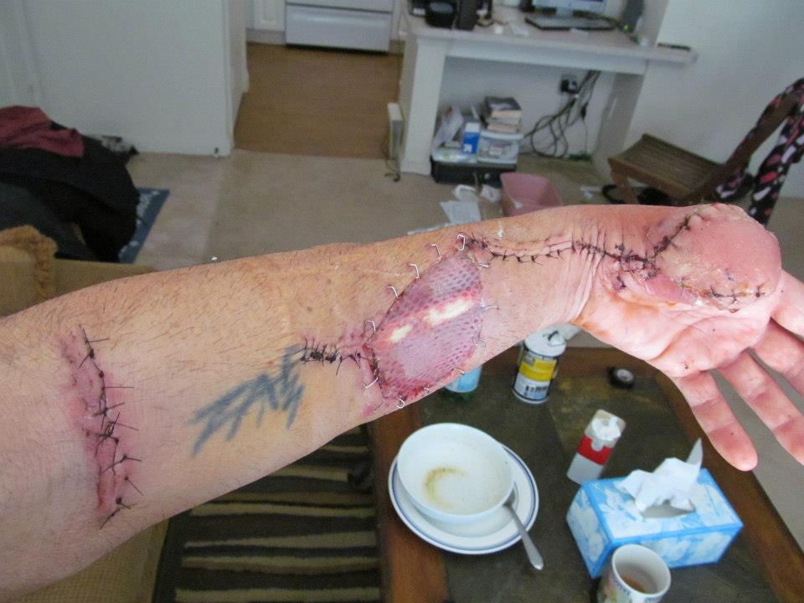

Slide 40


Slide 41
Summary
HAI are many and diverse
Most go unreported
Networking and building IC competencies at all levels is critical
Relationships with IPs in your communities are critical for PH
Attend IPC meetings or develop

Slide 42
Case studies
Jessica Ross, CIC

Slide 43

Break
15 minutes
Be back promptly

Slide 44
NBS data entry
Kelly Broussard, MPH

Slide 45
MDRO Reporting in NBS:
Discussion Points
Big picture/using the Data Entry Guide
Confusion over titles of questions/fields
Limitations of options in drop-down menus
Timeline of healthcare facility stays
Lab report data entry
Associating lab reports with investigations
Program area assignment for lab reports
General questions you have for us
Notes:
Please let me know if you have questions as we go through the slides!

Slide 46
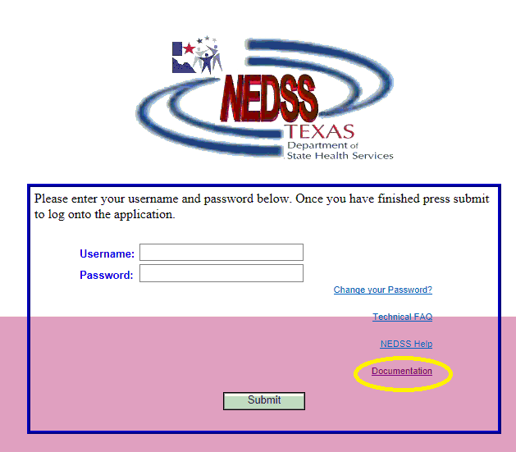
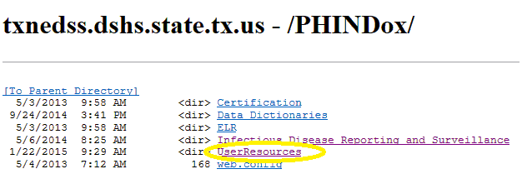

MDROs: Big picture
NBS Investigation + NBS lab report(s)
  As complete as possible, using the…
Data Entry Guide: aka “the DEG”
  Where is it?
Notes:
Overall, a complete report of an MDRO in NBS (aka NEDSS) includes an investigation and at least one lab report. There may be multiple lab reports in certain situations where a patient repeatedly cultures positive for the same MDRO while in the same healthcare facility stay. Having as many of our questions answered as possible is helpful for us to get the right information for possible outbreak investigations, data analysis to reduce MDROs overall in Texas, and on a more immediate scale, to approve the notifications the first time around.
The NBS Data Entry Guide is constantly updated for all of Texas’ reportable conditions, and it is the definitive guide of how to enter investigations and lab reports on NBS, including detailed step-by-step instructions and screenshots of the website itself. The MDRO portion of the DEG will soon be updated to clarify some of the more complex sections, based on the year of feedback from our initial reporting and all of your helpful comments and suggestions. It is worth taking a bit of time to read the MDRO entry portion in its entirety if you are the main MDRO NBS entry/investigator person at your PH department – many of the points of confusion and details we request in our rejection comments will be made much more clearly if you can familiarize yourself with the instructions.
To find the DEG, start on the NBS homepage but do not log in. Go to Documentation at the bottom right corner, leading to a list of folders. Click User Resources, then NBS Data Entry Guide is available in pdf form. Apologies that it is a bit difficult to find.

Slide 47
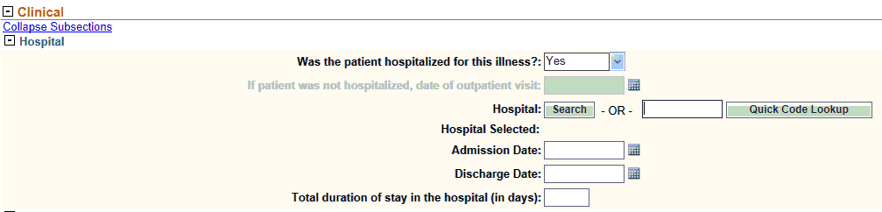
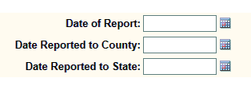

Confusion over titles of questions/fields
Was patient hospitalized for this illness?
Date of Report
Date of Symptom Onset, Diagnosis Date
Notes:
Within the MDRO Investigation (not the lab report), a few of the questions have stood out as being unclear.
We are planning to have the wording of the “Was patient hospitalized for this illness?” changed, as it is asking the wrong question. For MDROs, we need to know if the person was admitted to any kind of healthcare facility – this includes long term acute care, nursing homes, acute care hospitals, etc. – during the time that their laboratory specimen was collected. They do not need to be there due to the MDRO; MDROs do not always cause symptoms or even infection, as a person can be colonized with an organism without being sick from it. The key issue is knowing what healthcare facilities the patient was moving through when they were culture positive for an MDRO, most importantly to implement appropriate control measures and investigate any possible outbreaks. The answer to the question should be “Yes” if they meet the above description, but “No” if they had an outpatient visit to take a laboratory specimen for culture.
Date of Report is meant to be the first day that any public health entity was made aware of the MDRO; usually, this will be the County health department (for MDROs in locations with such health departments). Date Reported to County and to State are dates we mark as required in the DEG, and it’s important to fill these out accurately in order to track how long public health took to fully report an MDRO. Date Reported to State would be the day a Regional office obtained the report, or if entered at a local level, the day the MDRO investigation was submitted on NBS.
Though they can seem vague for the often asymptomatic/long term MDROs, Diagnosis Date and Date of Symptom Onset are important as they are two of the dates used in NBS data cleanup/analysis procedures to categorize cases by MMWR year. Diagnosis Date is when the lab reports were finalized, as that is when the case officially meets the epi case criteria by the laboratory definition of MDRO. Date of Symptom Onset may not be applicable for many MDRO cases; if asymptomatic or not clear from medical record/discussion with IP, leave blank.

Slide 48
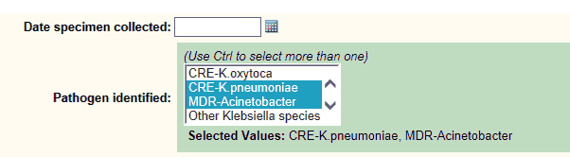
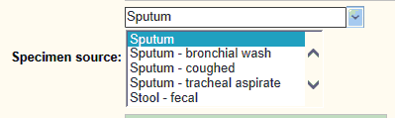
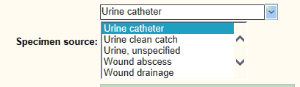
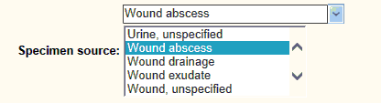
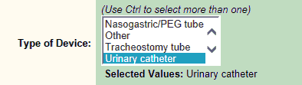
Limitations of options in drop-down menus: Investigation
Multiple pathogens in same specimen
Specimen source options
Indwelling/invasive devices
Notes:
Specimen source options

Slide 49
MDRO Investigation:
Patient healthcare facility “timeline”
Specimen collection date for the associated lab report should be within this time period (if in a healthcare facility) or on the date of outpatient visit (if outpatient)
Notes:
Where was patient at the time they had a specimen collected for MDRO culture? If in ANY healthcare facility, for any reason – does not have to be MDRO related – answer is Yes. If outpatient, answer is No.
Facility they came from: where did they come from IMMEDIATELY before the admit or outpatient date for the main hospital?
Facility they were discharged to: where did they go to IMMEDIATELY after the discharge or outpatient date for the main hospital?

Slide 50
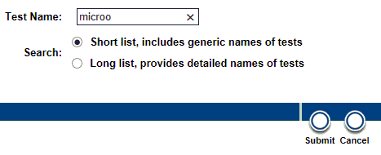

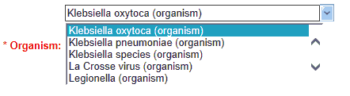
Lab report data entry
Resulted Test
Organism

Slide 51
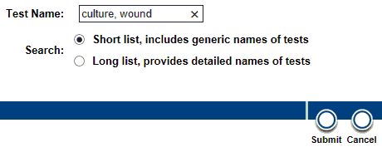
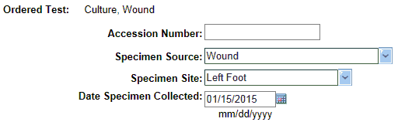
Lab report data entry, continued
Ordered Test (preferred)
Specimen Source (and Site if applicable)
Specimen Collection Date

Slide 52
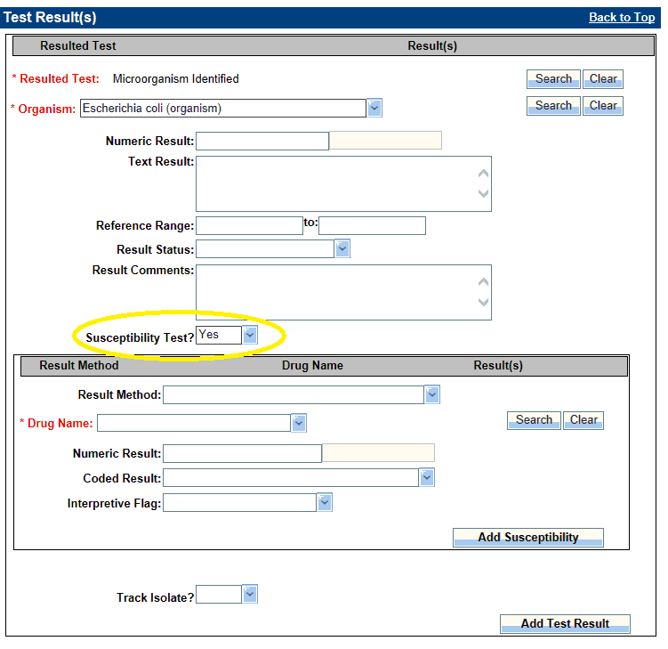
Lab report data entry, continued
Susceptibility Test?
  Yes – box appears
Please enter all susceptibility data, even for antibiotics to which the pathogen was susceptible
  Tracking antibiotic resistance over time

Slide 53
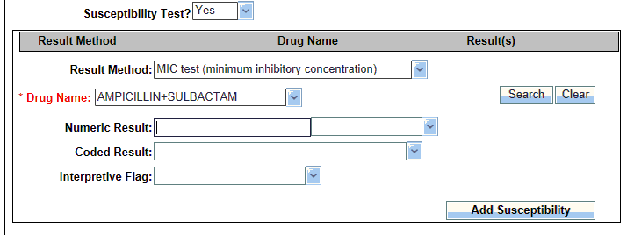
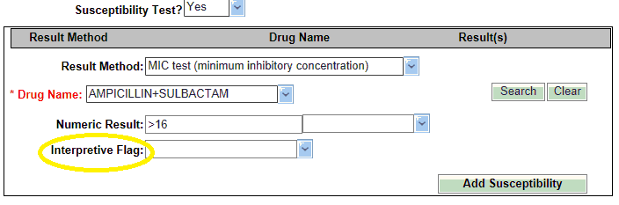
Lab report data entry, continued
Result Method (if available)
Drug Name
→ Ertapenem not available
Numeric Result
Coded Result
→This box disappears after entering a Numeric Result!
Interpretive Flag
Notes:
Numeric Result
Coded Result
Interpretive Flag

Slide 54
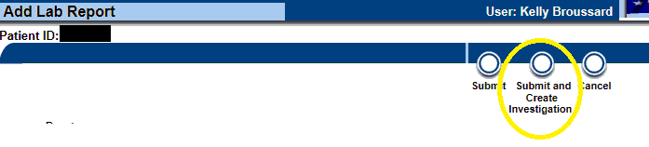
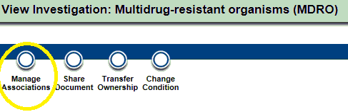
Associating lab reports with investigations
Creating investigation from a lab report does this automatically
If lab report isn’t associated with its investigation, or you need to un-associate unrelated lab reports from an investigation, use Manage Associations button

Slide 55

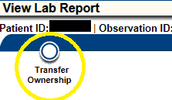
Program Area & Jurisdiction assignment
Program Area: determines disease category, affects who at Central Office can see it
  Always choose Antibiotic Resistance/MDRO
  Rejection because we say there is no lab report? Check the Program Area
Jurisdiction: determines public health entity handling investigation, affects which local/regional public health offices can see it
  Auto-populates based on patient’s home address, may need to change if different health department is entering/handling the MDRO
In the investigation:
In the lab report:
Need to change these in the lab report?
Notes:
Remind them, again, to make the Lab Report entry first so that it’s easier to associate the case

Slide 56
Do you have questions?
For future questions on MDRO NBS data entry:
  mdrotexas@dshs.texas.gov
    Jessica Ross
    Bobbiejean Garcia
    Kelly Broussard
    Neil Pascoe
    One address, to contact them all!
Notes:
This is different than the NEDSS Help Desk.

Slide 57
Table Top – Case Investigation
Notes:
Bigger picture on how a case investigation should go and what to look for/ what questions to ask:
Talk about:
How the IP is involved
Communications : between all stake holders
PH recommendations
What if a drug is not available
Patient admitted into a semi-private room, what to do
What to do when patient is transferred to and from multiple facilities

Slide 58
Table Top reminders…
Assumptions and artificialities may be necessary
During this exercise, the following apply:
  A no-fault learning environment wherein capabilities, plans, systems, and processes will be evaluated
  The scenario is plausible, and events occur as they are presented
Notes:
To complete this exercise in the time allotted and/or account for logistical limitations.
Exercise participants should accept that assumptions and artificialities are inherent in any exercise, and should not allow these considerations to negatively impact their participation.

Slide 59
Exercise Objectives
Discuss role of LHD/ HSR and state central office staff in responding to reports of communicable disease outbreaks and conducting investigations in healthcare facilities (HCF), which includes LTC, outpatient settings, etc.
Review important strategies used to conduct an investigation in a HCF.

Slide 60
Day 1, in the morning
An LHD was notified January 11, 2015 by the infection preventionist (IP) at an acute care hospital about 3 patients who were admitted this week with some kind of joint infections.
The IP had reported the cases to the LHD after learning that all three patients received care at the same outpatient pain clinic the week prior to hospitalization.

Slide 61
Questions to ask…
Does this report meet the definition for a notifiable condition/ disease?
What actions should be taken by the local health department at this point?
Notes:
Q1: yes – unusual group expression of disease
Q2:
would be nice at this point if they contact state HAI/ MDRO team but may not be needed at this point until further medical record review is done.
Do they have any lab results
Instruct the facility to request the lab to save isolates as well original specimens (if possible) Do so for any additional potential cases.
Might want to set up a conference call with HCF team
Might want additional medical records faxed to LHD for review

Slide 62
Day 1, afternoon
Staff from the LHD have a conference call with the hospital IP and review the additional medical records.

Slide 63
Questions to ask…
Are the patients still in house?
What specific things should be reviewed in the medical records?
Are there any common factors?
Notes:
Q1: yes
Q2 : did the patients have surgery or injections of some sort; dates/ times of surgery/ injections; common staff/ physicians in each case; were the patients at the same facility; comorbidities, other epi related information
Q3: yes

Slide 64
Day 2, afternoon
The record review and interviews confirm that all three patients received steroid injections on the same day at the same outpatient clinic.
The LHD suspects the infections are linked and were acquired at the time of the outpatient procedures.
The LHD reports to the state HAI/MDRO team regarding these findings and next steps. Further discussions determine the need to gather additional information about the clinic and to set up a time and date for a site visit.

Slide 65
Questions to ask…
What initial information should you gather about the clinic?
Should any agencies or entities be notified at this stage of the investigation?
What, if any, jurisdiction/ residency issues are there?
Notes:
Q1: Initial information:
What type of facility is it?
Who are they licensed by?
Do they have an IP or team?
Are there common physicians/ staff associated with injections?
Are they aware of any additional cases injected on that same timeframe that we do not know about?
Are they cooperating? What would you do if they do not cooperate?
Q2:
DADs??
DSHS Regulatory
Q3: possible that the hospital and the clinic are in different jurisdictions; also the 3 patients could have different residencies
Other LHD/ HSR

Slide 66
Day 5
A site visit is scheduled at the outpatient clinic.
The LHD Epi and the state HAI/ MDRO Epi and possibly a state licensing auditor, will attend.
Notes:
Also mention a meeting should be held first to discuss what is going on and anyone that the HCF (clinic) wants should be in the meeting; IP, nursing staff, physicians, techs, etc.
What if the clinic attorney is requested to be present?

Slide 67
Questions to ask…
What are the priorities of the site visit?
What preparations does the site visit team need to make in advance of the visit?
What could the site visit team do if the facility is uncooperative and refuses to let the team observe procedures or really conduct a thorough site visit?
Notes:
Q1: Is the facility aware of the 3 current infections and have they started any remediation to the issue
Q2: layout a timeline and case findings
Q3: Inform their local regulatory division; if an auditor is not already on site Not sure I agree with this just yet-NP

Slide 68
Day 5, site visit
The site visit team arrives at the clinic and meets with the clinical manager and others to discuss the purpose of the visit.
The clinic is located in a suburban, middle class neighborhood in a free-standing building. The facility has a waiting room, an office/registration area, four exam rooms with sinks, and two clinician offices and a bathroom.
The clinic sees between 40-60 patients a day and is open 5 days a week from 9:00 – 5:00 PM.

Slide 69
Day 5, site visit
The team learns that the clinic’s physician owns the business license for the clinic, and that it is not affiliated with any other medical facilities.
The physicians and nurses are professionally licensed.
The staff is comprised of a physician, nurse practitioner (clinical manager), one RN, one LVN and three medical technicians.
The physician sees patients one afternoon a week. All staff are full time employees.

Slide 70
Questions to ask…
What additional information is important to know about the clinic and staff?
What documentation would help you learn more about the clinical activities performed by the clinicians?
Would you confirm the medical licensure status of the clinical staff?
Notes:
Q1: what type of training to do they receive, who keeps up with their credentials, training and competencies
Q2: a procedure log
Q3: it would not be inappropriate to do so.

Slide 71
Site visit, finding #1
There are no job descriptions available for review.
The team is told that everyone performs a majority of the clinical activities, including medication preparation and some intramuscular injections.
However, the nurse practitioner and physician perform the medical evaluations and more invasive injection procedures.
Notes:
Do you need job descriptions, what else might suffice?
Everyone=the nurse practitioner, nurses and medical technicians
An invasive injection procedure would be like into the joint or disc space, epidural injections

Slide 72
Questions to ask…
What type of infection control training is needed in this setting? What type of documentation would you look for?
What employee health and infection control policies would you look for in this setting?
Notes:
Q1: injection safety, medication storage
Environmental cleaning and disinfection

Slide 73
Site visit, finding #2
Infection prevention and employee health policies and practices are discussed with the clinical manager. Infection control training is offered by the facility and each employee is offered the Hep B vaccine.
The clinical manager tells you that employees are encouraged to stay home when sick.
There are no written facility-specific employee health policies or procedures.

Slide 74
Update 2 cont…
After the initial meeting with the clinical manager, the team focuses on the areas where the injection procedures are performed, using CDC’s outpatient infection prevention checklist to help direct and focus observations.
Checklist available at:
http://www.cdc.gov/HAI/settings/outpatient/checklist/outpatient-care-checklist.html

Slide 75
Questions to ask…
Based on the information you have learned, what infection prevention practices would you target in your assessment of this setting?
What records or other documentation would you be interested in reviewing?
What specific concerns do you have at this point about the clinic’s infection control practices?
Notes:
Q1: What is the patient preparation for the injections?
Is the injection guided by fluoroscopy?
Where are medications stored for injection- central or for each treatment room.
Ask to have them demonstrate drawing up medication. Specifically ask if new syringe/needle is used for each patient.
Sharps disposal?
Q2: Medical records for each of the cases as well as the patent procedure log for the dates in question to determine order of patients and compare patient order
Were the cases seen in the same treatment rooms.
Q3:

Slide 76
Site visit, finding #3
The facility has a Bloodborne Pathogens Exposure Control plan but no other clinical policies.
  Hand hygiene and PPE supplies are found throughout the facility. You observe staff consistently using PPE and performing hand hygiene when caring for patients.
  No environmental cleaning or sterilization procedures were observed.
  Medications are stored in either a locked cabinet or designated medication refrigerator.
  Injections are prepared in the procedure rooms. The nurses states that both single and multi-dose vials are used.

Slide 77
3 cont…
After reviewing scheduling / procedure logs and patient records, it is determined that the clinic keeps a daily log that includes the patient’s name, appointment time, clinician and purpose of visit.
A nurse or medical technician documents vital signs, medications, and presenting symptoms in the patients’ charts; and the NP or physician documents the diagnosis, treatments and recommendations.
No temperature logs are found on the refrigerator. Open, undated vials of medications are found in the medication refrigerator.

Slide 78
Questions to ask…
What information about the medications used on the three hospitalized cases should you collect?
What information should you gather about the roles of the clinical staff?
What concerns do you have thus far about the office practices?
Notes:
Q1:Name, manufacturer, lot #, expiration date any notations by providers. Take a photo of all products
Q2: staff turnover, anything different about the timeframe under investigation- vacations, LOA??
Q3: how do they perform follow-up or informed if the patients go elsewhere for a problem?

Slide 79
Site visit, finding #4
You learn that the hospitalized patients received knee injections using two different medications, a steroid and an anesthetic agent.
You meet with the registered nurse to discuss injection practices. He tells you the medications used for joint injections come in multi-dose vials, and the patients probably received the medication from the same vial since they were all administered on the same day.
You ask him to show you how the injections are prepared.

Slide 80
Update #4 cont…
The nurses takes you to a small room where the laboratory procedures are performed. He reaches in the refrigerator and removes two vials.
He takes you in an exam room where the medications are prepared and administered.
He begins demonstrating the following procedure.
Notes:
This is where we could do a short demonstration with drawing up a syringe, showing poor practices and then pointing out what was wrong…
Neil – draw up
BG & Jess – make comments

Slide 81
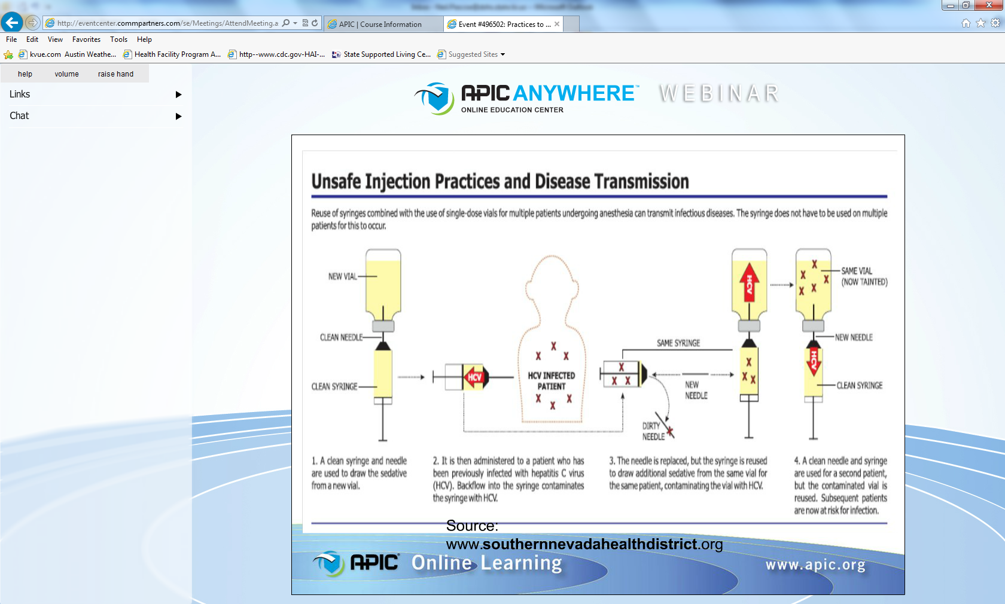

Slide 82
#4 cont… The Injection procedure:
Assembles the medication and alcohol pads on the countertop by the sink.
Opens a sealed package containing a sterile needle and syringe.
Wipes stoppers of both medication vials with an alcohol pad.
Inserts the sterile needle and syringe into the anesthetic vial to draw up a typical dose of medication.
Inserts the same needle and syringe into steroid medication vial and draws up a dose of medication.
The medication syringe is recapped and placed on the countertop until the injection is ready to be administered by the NP or physician.
He explains that the injection site is prepared using alcohol and the medications are injected into the patient using the syringe containing the two medications.
He places both vials back in the medication refrigerator.
Notes:
Do they wipe the tops of a new (unopened) vial (septum). Point here is recognizing the septum is not sterile and must be wiped

Slide 83
Questions to ask…
What concerns do you have about the nurse’s injection practices?
What additional information about the medications should you collect?
Notes:
Q1: Is it ok to reuse a needle? A syringe? Recap and leave medication out on a table? The medication isn’t labeled, how does everyone know the analgesic is already in there?
Q2: when was the vial/s open?, are they not labeled and dated/ initialed, so they track lot #’s on a log form; manufacturers recommendations for expiration dates

Slide 84
Site visit, finding #5
You discover that one of the medication vials is packaged as a multi-dose vial and the other packaged as a single-dose vial. The nurse tells you that the vials are discarded when they expire or when they are empty.
He tells you that all of the nurses and medical technicians prepare medications in the same manner.
You note that the medications in question are manufactured by two well-known commercial pharmaceutical companies.
Notes:
Does this sound reasonable?
How many times have you heard people say “everyone does it this way” only to find 1 or 2 people who are doing it differently.
Is that possible, can well-known companies have issues too?

Slide 85
#5 cont…
The nurse tells you that most of their patients do well after the injections, but sometimes patients continue to have pain or develop infections. He said that he has only seen two injection site infections in the two years he has been there and both occurred within the past month.

Slide 86
Questions to ask…
Should you collect information about these two additional cases?
What is your hypothesis at this point? Why?
Notes:
Q1: see when the other two cases had injections?; did these two cases have a culture collected? ; collect additional epi info and see if the 2 additional cases are related
Ask about comorbidities
Q2: cross-contamination during prep of injectables and possible reason for infections…

Slide 87
Site visit, finding #6
Cultures were not obtained from the two patients who reported infection at the site of their injections. These two patients did receive their injections in the same week as the three hospitalized patients.
The team suspects that all of the infections are related to poor injection practices. They are concerned that other patients may have been exposed.

Slide 88
Question to ask…
How would you go about identifying other potential cases?
Should patient notifications be conducted?
Who should follow-up on the notifications efforts?
Should other entities be involved at this time given the additional information?
Notes:
Q1: getting a list of everyone who had injections from those vials
Q2: who should be notified? Only 5 cases or all patient from the clinic in that time period
Q3: clinic with the help of LHD, possibly state to help out with efforts
Q4: depends on scenario

Slide 89
Site visit, finding #7
The investigation team meets back with the clinical manager, nurses and physician to discuss the findings thus far. The facility is cooperative and willing to take the steps necessary to prevent infections in their patients.
The facility compiles a list of patients for the investigators and agrees to assist in notifying them of a possible exposure.

Slide 90
Questions to ask…
What policy/practice changes would you recommend to the facility?
Does this situation warrant communication with professional licensing board(s) or other entities? If so, who?
How will you facilitate follow-up?

Slide 91
Final thoughts
The role of the LHD/ HSR and state is critical in conducting any type of successful investigation.
Remember that certain challenges exist that should be identified and used to inform outbreak response and related protocols within different types of HCF.
The role of everyone in eliminating HAIs in HCF should be continually evaluated.
Notes:
Local, state and federal partners should be identified prior to the development of an outbreak to facilitate cooperation and collaboration during an investigation.

Slide 92
Questions

