Slide 1

Laboratory Techniques Supporting Infectious
Disease Surveillance and Epidemiology
Personal Protective Equipment Demonstration
Erin Swaney
October 20, 2016

Slide 2
Overview
Definition of PPE
Demonstrations of PPE:
  Biosafety Level (BSL) 2
  BSL2 enhanced
  BSL3
Questions
Notes:
There is never just one way to do something
This demonstration is for a general awareness

Slide 3
Definition of PPE
    Personal Protective Equipment
      Provides a barrier between staff and hazards
      Must be chosen and used appropriately
      Procedures for Donning/Doffing avoid contamination
    Type of PPE chosen by:
      Agent
      Work performed
      Design of lab
Notes:
Hazards could be: chemicals – liquid versus solid, radiation – how strong, flammable – what is flashpoint?, explosive, etc
Staff should know appropriate personal sizes
Staff should be training on donning/doffing PPE
PPE should be checked prior to use for integrity (defects or tears) and replace if needed.
Example of BA on plate versus white powder letter

Slide 4
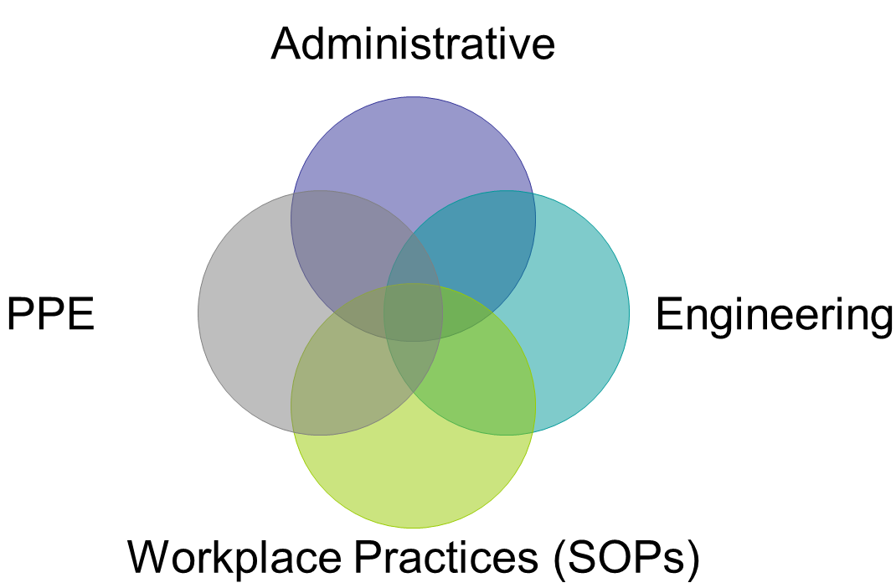
Four Primary Controls
Agent
Notes:
4 controls protect the agent and staff member
Give an example of all 4 types
PPE is proportional to risk and are intertwined with other controls
PPE is the most important control put in place to minimize exposure in the lab
Used PPE is disposed of as regulated medical waste
After removal of PPE, staff wash hands prior to exiting the lab.

Slide 5
BSL2 PPE
Disposable and reusable
Lab coat
Eye protection
Gloves
Notes:
Disposable versus reusable based on work performed. Varying costs add to test price
Does anyone know the difference between a lab coat and a gown? (opening front versus back)
Lab coats can have a wrist cuff or not. Some are water resistant.
Do eyeglasses count as eye protection? (No, they do not have side protection)
Eye protection is required if splashes expected. Splash shields can be added to prescription glasses.
OSHA regulation that non-latex gloves must be provided to those with latex allergies
Glove doffing demo
Remove slowly. Remove one glove at wrist cuff, then use index finger under second glove to remove, or
Take off one glove so it’s inside out, grip with ungloved hand and use it to remove the other glove

Slide 6
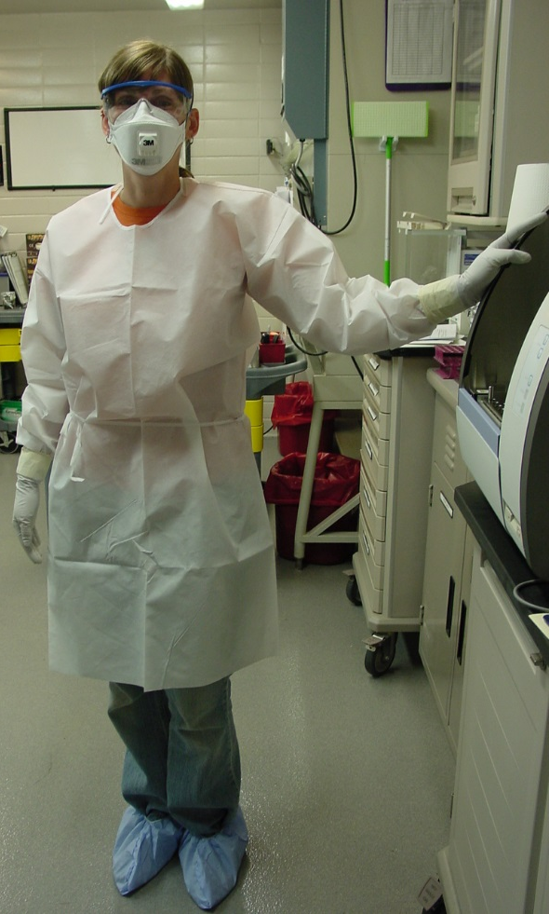
BSL2 Enhanced PPE
Wrap around gown
Double gloves
Respiratory Protection (N95)
Face shield
Disposable sleeves
Notes:
Double gloves can be taped at wrist
Important to leave tab for later removal
Staff with facial hair can’t wear N95 and must wear PAPR
N95s must be fit tested annually
Surgical masks do not provide respiratory protection

Slide 7
Steps for Donning BSL2 Enhanced PPE
Don wrap around gown
Don booties
Don N95 respirator
Don eye protection
Don 1st set of gloves and tape to gown
Don 2nd pair of gloves
Notes:
Demonstration by BT team member

Slide 8
Steps for Doffing BSL2 Enhanced PPE
Doff booties
Doff 2nd pair of gloves
Disinfectant inner gloves and tape
Remove tape
Doff wrap around gown
Enter corridor
Doff eye protection and decon
Doff N95 respirator Doff inner gloves
Wash hands thoroughly
Notes:
Demonstration by BT team member

Slide 9
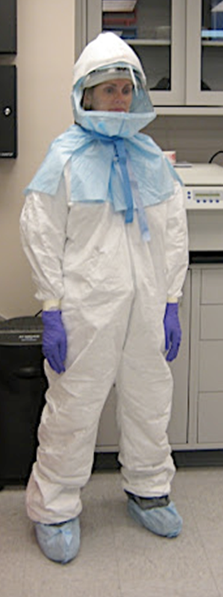
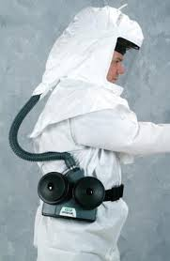
BSL3 PPE
Belt + battery pack
PAPR hood
Tyvek suit
Booties
Double gloves
Notes:
Demonstrating interior style of PAPR, also exterior versions
Differ in decon procedures and cost
PAPR = Powered Air Purifying Respirator
Combination of helmet plus hood
All PPE entering a BSL3 lab must be autoclaved prior to being treated as medical waste

Slide 10
Steps for Donning BSL3 PPE
Remove all jewelry
Remove all clothing (naked)
Don BSL3 scrubs, socks and shoes
Enter PPE anteroom
Check motor / battery of PAPR
Don belt and battery
Tape socks to scrubs
Assemble PAPR
Check Tyvek ® suit for tears
Don Tyvek® suit
Don first pair of gloves
Tape gloves to Tyvek® suit
Don second pair of gloves
Don booties
Don PAPR and tie
Enter corridor
Check gauge and signs
Enter laboratory
Notes:
Demonstration by BT team member

Slide 11
Steps for Doffing BSL3 PPE
Go to doffing area
Remove booties
Remove outer gloves
Spray gloves thoroughly with disinfectant
Remove tape
Enter corridor
Remove Tyvek® suit
Remove hood
Remove tape from around socks
Remove inner gloves
Enter anteroom
Stow PAPR helmet
Recharge battery and stow belt
Wash hands thoroughly
Enter locker room
Remove all clothing
Don clothes and shoes you
brought to lab
Don jewelry
Exit locker room
Notes:
Demonstration by BT team member

