Slide 1
A Case Study of Human Trichinosis in Texas-Region 9/10
Jacqueline Mariscal and Nicole Evert

Slide 2
Trichinellosis Overview
Parasitic disease caused by eating undercooked or raw meat infected with Trichinella larvae
Several different species of Trichinella can cause human disease
  Most common is Trichinella spiralis, which has a global distribution and commonly found in pigs.
Other Trichinella species are less commonly reported as the cause of human disease and may be found in different parts of the world
  Trichinella nativa in Alaska bear meat and walrus meat
Notes:
Parasite; nematode; round worm- Trichinella

Slide 3
Trichinellosis Overview
Incubation 2-8 weeks
Hallmark symptoms include: fever, myalgia, periorbital edema and eosinophilia
Diagnosis
  Demonstration of Trichinella larvae in tissue biopsy
  Detection of Trichinella antibody
Treatment
  Albendazole or Mebendazole
Notes:
1-2 days after Nausea, diarrhea, vomiting, fatigue, fever, and abdominal discomfort are often the first symptoms of trichinellosis.
2-8 weeks after Headaches, fevers, chills, cough, swelling of the face and eyes, aching joints and muscle pains, itchy skin, diarrhea, or constipation may follow the first symptoms
Periorbital edema- “puffy eyes”
Higher than normal number of eosinophils- disease fighting white blood cell; usually account for less than 7% of circulating leukocytes
Anthelmintic- anti worm medication

Slide 4
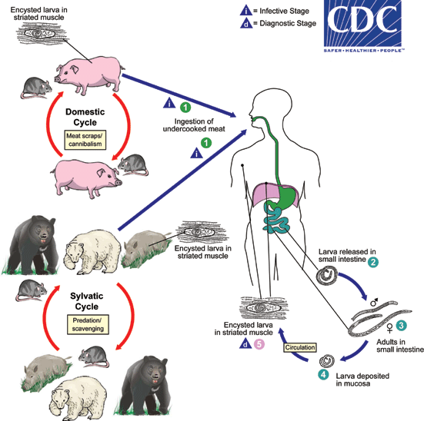
Life Cycle of Trichinellosis
Notes:
In the Arctic, Trichinella is found in carnivores such as bears, wolves, foxes, lynx, coyotes, walruses, and seals
Herbivores also occasionally become infected after accidently ingesting meat
Trichinella infection in humans is divided into intestinal (enteral) phase and a muscular (parental) phase¹
Trichinellosis is acquired by ingesting meat containing cysts (encysted larvae) of Trichinella. After exposure to gastric acid and pepsin, the larvae are released from the cysts and invade the small bowel mucosa where they develop into adult worms (female 2.2 mm in length, males 1.2 mm; life span in the small bowel: 4 weeks). After 1 week, the females release larvae that migrate to the striated muscles where they encyst . Trichinella pseudospiralis, however, does not encyst. Encystment is completed in 4 to 5 weeks and the encysted larvae may remain viable for several years. Ingestion of the encysted larvae perpetuates the cycle. Rats and rodents are primarily responsible for maintaining the endemicity of this infection. Carnivorous/omnivorous animals, such as pigs or bears, feed on infected rodents or meat from other animals. Different animal hosts are implicated in the life cycle of the different species of Trichinella. Humans are accidentally infected when eating improperly processed meat of these carnivorous animals (or eating food contaminated with such meat).

Slide 5
Index Patient
36 yr. old female- Physician from San Angelo, TX
Presented to primary care physician (PCP) on January 29^{th,} 2015 with:
  Fever (103̊ F - Onset 1/24/15)
  Myalgia
  Nausea
  Vomiting
  Headache
  Facial pain and pressure
Diagnosis: Flu
  Treatment: Tamiflu; Levaquin 500 mg
    Shot of Kenalog and Rocephin
Notes:
Findings: mucosal thickening in right maxillary sinus

Slide 6
Index Patient
February 2nd:
  Fevers and other symptoms persisted
  Night sweats
  Headache
  Facial pain and pressure
  Abdominal pain
Lab Analysis
  White blood cell count: 15,000 with 25% eosinophils
February 3rd: Patient relays to PCP that family consumed bear meat obtained from relatives in Alaska
February 4th: Trichinella Antibody by ELISA conducted and detected

Slide 7
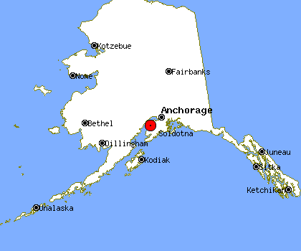
Investigation
Bear meat was obtained from family members hunting in Soldotna, AK.
Froze the meat then cooked it by grilling it for hamburgers on December 18th, 2014
Husband and daughter also consumed the meat

Slide 8
Probable Cases
Both were symptomatic
Husband (36 years old)-
  Date of Onset: 1/15/15
  Fever (101.5), myalgia, periorbital edema, eosinophilia (31%), no GI illness, not as much muscle wasting
  Serologically negative 2/4/15 (ARUP)
Daughter (1 year old)-
  Date of Onset: 1/27/15
  Fever (104.4), eosinophilia (33%), rash (unknown etiology), lethargic, and anorexic x 3 days
  Serologically negative 2/4/15 (ARUP)
Notes:
Daughter received dtap, Hep A, Varicella, and pneumococcal vaccines and 1 year checkup on 1/23/15 no complaints; 27th had the rash

Slide 9
Bear-y Good Time
Family members in Alaska were contacted to obtain bear meat for testing through the CDC
Family provided frozen, grounded bear meat to local Public Health Center, who sent it to Alaska State Public Health Lab (ASPHL) in Anchorage, AK on March 17th, 2015
Meat was examined by CDC and larvae was found
The specimen was tested by PCR using primers that target rRNA gene (ITS1-ITS2 region) of Trichinella spp. The amplified product was sequenced and the DNA sequencing analysis data was similar to the Trichinella nativa ITS1-ITS2 region

Slide 10
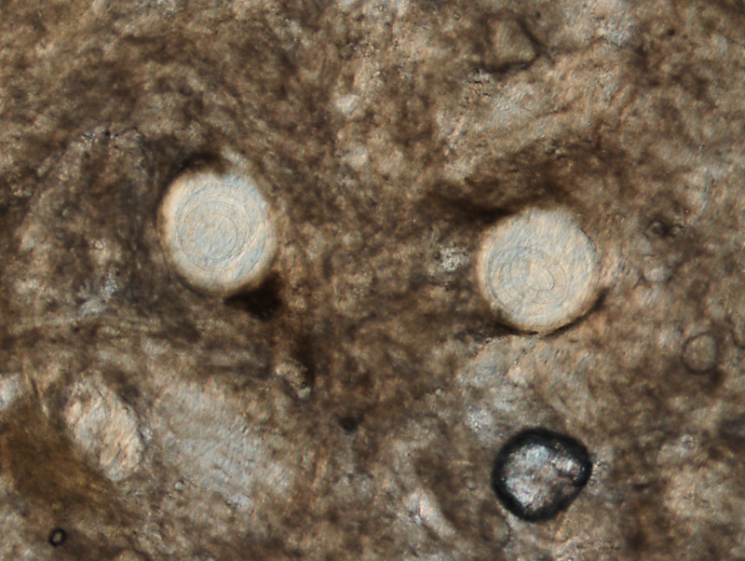
Source: Henry S. Bishop, (CDC/CGH/DPDM)
Notes:
Sliver of meat after it had been sitting in the fridge for a few days (easier to see as the meat starts to break down). Here are three pics - one at 40x showing two larvae in one field; the other two showing those same two larvae at 100x magnification using DIC (Differential Interference Contrast) microscopy.

Slide 11
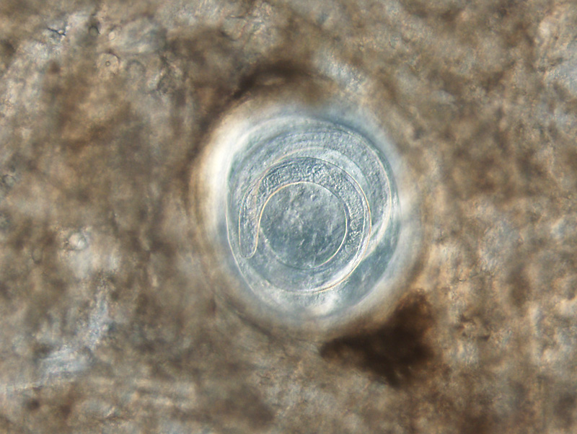
Source: Henry S. Bishop, (CDC/CGH/DPDM)

Slide 12
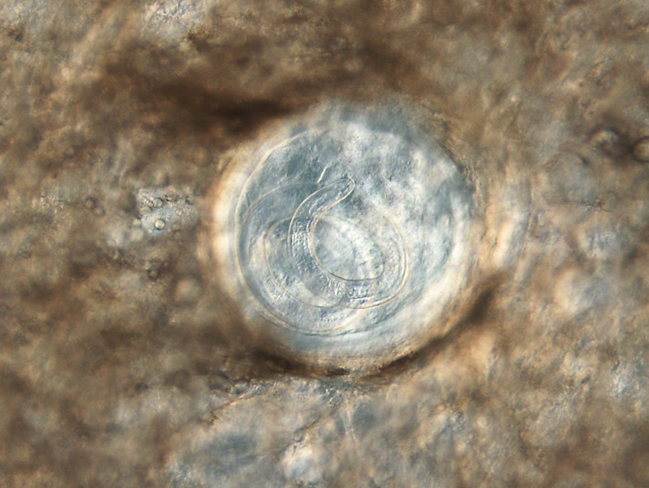
Source: Henry S. Bishop, (CDC/CGH/DPDM)

Slide 13
Trichinellosis: Prevention and Control
Cook meat to safe temperatures.
  160°F (71°C)
Wash your hands with warm water and soap after handling raw meat.
Curing (salting), drying, smoking, or microwaving meat alone does not consistently kill infective worms
  Homemade jerky and sausage were the cause of many cases of Trichinellosis reported to CDC in recent years.

Slide 14
Trichinellosis: Prevention and Control
Freeze pork less than 6 inches thick for 20 days at 5°F (-15°C) to kill any worms.
Freezing wild game meats, unlike freezing pork products, may not effectively kill all worms because some worm species that infect wild game animals are freeze-resistant.
  Trichinella nativa in Alaska bear meat and walrus meat is cold resistant; unlike the T. spiralis larval cysts found in pork, freezing will NOT kill T. nativa larval cysts found in arctic meats¹
Clean meat grinders thoroughly after each use.

Slide 15
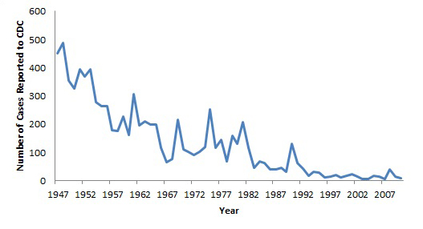
Cases of Trichinellosis in the United States reported to CDC by year, 1947-2007
Source: http://www.cdc.gov/parasites/trichinellosis/epi.html

Slide 16
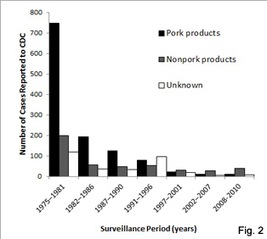
Number of Reported Trichinellosis cases, by source of infection — United States, 1975–2010.
Source: http://www.cdc.gov/parasites/trichinellosis/epi.html

Slide 17
Reported Cases of Trichinellosis in Texas, 2003-2014
2012
Williamson County
  Myalgia
  Trich AB+
  LTFU
Cameron County
  Fever, myalgia, eosinophilia & periorbital edema
  Trich AB+
  Ate pork and hamburger
*preliminary data

Slide 18
Reported Cases of Trichinellosis in Texas, 2003-2014
2012
Harris County
  Eosinophilia
  Trich AB+
  Travel to MX
  Reported eating pork from Mexico

Slide 19
Reported Cases of Trichinellosis in Texas, 2003-2014*
2014*
Travis county
  Fever, chills, cough, myalgia, periorbital pain, eosinophilia and weakness
  Trich AB+
  Ate wild bear skewers while hunting in Alaska
Harris county
  Fever and myalgia
  Ate pork and hamburger
  Trich AB+
*preliminary data

Slide 20
Conclusions
In the United States, Trichinellosis cases are reported to CDC much less commonly now than in the past
  During 2008-2010, 20 cases were reported to CDC each year on average.
The overall number of cases reported has decreased because of:
  Improved pig-raising practices in the pork industry
  Commercial and home freezing of pork
  Public awareness of the danger of eating raw or undercooked meat products.
Since 2003, there have been only 5 cases reported in Texas

Slide 21
Conclusions
Healthcare providers should consider Trichinosis in any patient with the classic constitutional symptoms following gastrointestinal illness and a history of recent wild game consumption.
Testing of sera for Trichinella antibodies can be done through commercial laboratories or CDC
  Muscle biopsies are not commonly performed
Testing of meat for Trichinella larvae can be performed by the CDC
  CDC specimen submission form 50.34:http://www.cdc.gov/laboratory/specimen-submission/form.html

Slide 22
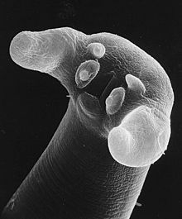
Questions?

