Slide 1
GUIDE TO CASE INVESTIGATION
2016 ELC Epidemiology Workshop
Presenter: Jill Campbell, RN, MPH
Nurse Epidemiologist
TX DSHS HSR7

Slide 2
OBJECTIVES
Why develop case investigation guide?
Case investigation - public health purpose?
Provide template for conducting a case investigation.

Slide 3
Case Investigation Guide - Why
  Training purposes and resource guide
  Consistency across staff/program
  Risk management/ Quality Assurance & Improvement Component:
    Public Health Impact a of Missed Investigation
      High volume of reports
      High consequences
  Accreditation – national level
Develop your guide to case investigation before an incidence occurs
and you are having to put a guide in place due to an investigation error

Slide 4
Case Investigation Purpose
  Protect population health
  Position funding can determine aspect/components of investigation
  Type of agency – state, regional, local

Slide 5
Case Investigation Template
Agency’s Letterhead
Standard Operating Guide, Procedure, Policy
Subject:
Target audience:
Supersedes:
Responsible Position:
Original Date: | Revised/Reviewed Date:
Submitted By/Title:
Manager Approval/Date:
Approved by/Title/Date:
Approved by (signatures)

Slide 6
Tips for Developing a Guide
Assess available staff – select best person(s) for the task
Determine what the guide is to cover
Get something down on paper
Communicate clearly
Set timelines
Don’t re-invent the wheel

Slide 7
Case Investigation Template
Agency’s Letterhead
Standard Operating Guide
Subject: Case Investigation
Target audience: Epidemiology Program Staff
Supersedes: N/A
Responsible Position: Lead Epidemiologist
Original Date: 1/28/2016 | Revised/Reviewed Date: N/A
Submitted By/Title: Lead Epidemiologist
Manager Approval/Date: PHP/EPI Manager
Approved by/Title/Date: Regional Director
Approved by (signatures)

Slide 8
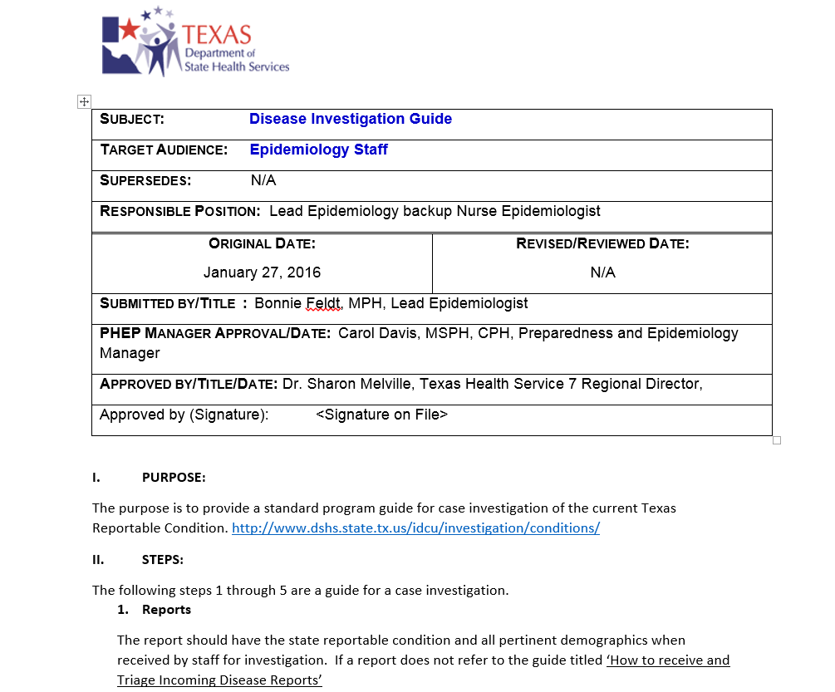
Sample – HSR7

Slide 9
Lets Get Started – Body
I. Purpose:
The purpose is to provide a standard program guide for case investigation of the current Texas Reportable Condition. http://www.dshs.state.tx.us/idcu/investigation/conditions/
Steps:
The following steps A. through E. are a guide for a case investigation.

Slide 10
II. Step – A. Reports
Determine if this section of your guide will address management of all incoming reports or if incoming reports management needs to be a separate guide.
Report is assign to staff. Review and verify the disease report received with a disease you are responsible to investigate.
  Yes – proceed with investigation
  No – route the report to assigned investigator or file appropriately.

Slide 11
II. Step – B. Investigation
Review the report information checking the disease is a Texas Notifiable Condition and lab submitted supports diagnosis and case definition of this disease/infection.
Review disease specific information, DSHS The Emerging and Acute Infectious Disease Guidelines and or CDC website. The state disease specific investigation and surveillance forms are available at: http://www.dshs.state.tx.us/idcu/investigation/
If a specific guide or form is not available; the investigator will review relevant material, including DSHS and CDC guidance and proceed to consult with program lead epidemiologist, supervisor, etc.
The investigator will call provider who ordered the test if appropriate for chart review as indicated and to determine if the case knows test results prior to investigator contacting the case.
Inform program lead(s) or manager of all immediate and bioterrorism conditions investigation when investigation is started.

Slide 12
B. Investigation - continued
Immediate, bioterrorism and one working day reportable conditions will be initiated same day received. Weekly reportable condition will be initiated within XX working days of receipt unless associated with on going outbreak.
Initial contact will be by phone. If necessary to leave a message use the following:
  ‘Hello my name is your name here I am with the Texas State Health Department, I have confidential health information to discuss with you (or if calling a minor the parent or guardian of) person calling name here . I can be reached at my office at (555) 555-5555 between 8 am and 5 pm Monday through Friday. Thank you.’
Reminder: DO NOT leave personal health information on message

Slide 13
B. Investigation - continued
Now that you have initiated the investigation your program will need to determine the following (keep in mind your population’s health):
  Time period to wait for return call, immediate vs. weekly reports
  Number of contact attempts (3 seem to be a common thread)
  Time of day contact is made (recommend varying). Calling after hours?
  Is your program going to use letters and or home visits?
  Time period for over all investigation to be completed – 30 days?
  When is report closed as LOST TO FOLLOW UP?
Keep in mind reason to investigate is to:
  Search for undiagnosed cases/epi-link cases
  Education the person about the disease and prevent further spread
  Determine what public health intervention is necessary
  Assure contacts are identified and have a source of care

Slide 14
B. Investigation - continued
Conducting the investigation interview:
  Be familiar with the investigation form. Ask questions in order unless asking a question could potentially end the interview without getting the critical public health information needed to stop or prevent disease transmission. (exposure, transmission)
  Be respectful and honest
  Give the individual the opportunity to ask questions.
  Close investigation interview thanking the individual for their time and repeat your name and contact information.
Hint: DSHS provides a good training on conducting a foodborne
interview. This technique can be applied in all investigations
http://www.foodborneepitexas.org/

Slide 15
II. Step – C. Documentation
Label the investigation in accordance with your program guideline. Example: case name, date of birth, NBS ID number?
Case identifying information is recorded on all pages that contain case investigation information.
Investigation Forms:
  Electronic: complete the form via computer and print to attach to report along with any pertinent information gathered during the investigation.
  Paper: document in ink, error corrections are made with single line drawn though and initiated. Attach investigation form to the report along with any pertinent information gathered during the investigation.
  Sign forms as indicated

Slide 16
C. Documentation – cont.
Investigation Documentation Order:
  Disease specific case surveillance and investigation form
  Confirmed/pertinent lab reports
  Case investigation pertinent medical information
  Case investigation progress/additional notes
  Miscellaneous documentation pertinent to the case investigation, such as email correspondence, newspaper articles

Slide 17
II. Step – D. NBS Data Entry
The assigned investigator is responsible for case investigation data entry in NEDSS Based System (NBS).
Creation of a case investigation maybe at the beginning of assignment or the end once the investigation is completed. Your program can make this decision.
The data entry will be accordance with the current DSHS document titles ‘Texas NEDSS Base System (NBS) DATA ENTRY GUIDE Emerging and Acute Infectious Disease Branch Zoonosis Control Branch’.
The Texas NEDSS Base System (NBS) DATA ENTRY GUIDE document can be located in the Texas NEDSS login page by clicking on the Documents link ; UserResources: NBSDataEntryGuideSep2015.pdf

Slide 18
II. Step – E. Closing Investigation
All investigation are closed in NBS
  Within XX days of investigation being opened
  By the assigned investigator.
An investigation has been officially closed when:
  The investigation has been ruled out – closed as Not-A-Case
  A NBS notification has been sent for confirmed or probable cases
  The completed investigation form has been faxed to DSHS regional or central office
  The investigation is entered into program database, if choose to have one
A completed and closed investigation is appropriately filed and record retention followed.
  NOTE: In the event an investigator is not going to
  make a XX day deadline it is the investigator responsibility
  to notify the program epi lead in timely manner

Slide 19
IN CLOSING - OBJECTIVES
Why develop case investigation guide?
  Training purposes and resource guide
  Consistency across staff/program
  Risk management/ Quality Assurance & Improvement Component:
    PH Impact of missed investigation
      High volume of reports
      High consequences
  Accreditation – national level
Case investigation - public health purpose:
  Protect population health
  Position funding can determine aspect/components of investigation
  Type of agency – state, regional, local
Provide template for conducting a case investigation

Slide 20
Questions
My Contact Information:
Jill Campbell, RN, MPH
DSHS HSR7 Nurse Epidemiologist
2408 south 37th St., Temple TX76504
254 771-6729 desk
Jill.Campbell@dshs.state.tx.us

