Slide 1
Epidemiology Orientation
Jessica Ross, CIC
HAI Epidemiologist
IDCU/ TDSHS

Slide 2
Objectives
The HAI Epidemiologist
What is CRE/ MDR-A
Transmission
Who is at risk
History of Resistance
Reporting requirements
Case Examples
Laboratory
Control measures/ infection prevention
Additional recommendations/ Supplemental measures

Slide 3
HAI Epidemiologist
Covers a multitude of Infectious Diseases and situations
Bloodborne Pathogens
Meningitis
Influenza
Emergency preparedness
Multidrug-resistant organisms (MDROs)
MRSA, CDIFF
More emerging and urgent threats: CRE, MDR-Acinetobacter (MDR-A)
High consequence diseases
Measles
Ebola or other VHF

Slide 4
HAI Investigation Team
Jessica Ross
HSR 1
Thi Dang
HSR 2/3
Interim, Thi Dang
HSR 4/5 N
Jessica Ross
HSR 9/10
Sandi Henley
HSR 7
Jessica Ross
HSR 8
Bobbiejean Garcia
HSR 6/5 S
Interim, Bobbiejean Garcia
HSR 11
Notes:
Talk about RACs and how there will be some over lap

Slide 5
HAI Investigation Team
Jessica Ross, CIC
Central office
Covers HSR 1, 9/10, and 8
Phone: 512-776-6356, cell: 512-956-1029
Bobbiejean Garcia, MPH, CIC
HSR 6/5 S Regional HAI Epi
Interim for HSR 11, pending job interviews
Phone: 713-767-3404
Thi Dang, MPH, CIC
HSR 2/3 Regional HAI Epi
Interim for HSR 4/5 N, pending job interviews
Phone: 817-264-4585
Sandi Henley, RN, CIC
HSR 7 Regional HAI Epi
Phone: 254-750-9387

Slide 6
What is Enterobacteriaceae?
Large family of gram-negative bacilli
More than 70 species
E. coli, Klebsiella, Enterobacter, Shigella, Salmonella
Normal part of the GI tract
Common cause of infections
Community
Healthcare associated
Notes:
Enterobacteriaceae are a large family of bacteria that are a normal part of a person's digestive system (2). Examples include Escherichia coli and species of the genera Klebsiella, Enterobacter, Serratia, Salmonella and Shigella. Since Enterobacteriaceae live in the gut, they are potentially spread
through fecal-oral and contact (13)
Once intestinal carriage is established, individuals are at risk of infection under the right conditions (13). These organisms can cause serious infections when they spread outside of the digestive system and are a common cause of community-acquired and health care-associated infections (2).
Infections caused by Enterobacteriaceae may include pneumonia, kidney and bladder infections, and bloodstream infections (4).

Slide 7
What is Acinetobacter?
Common in soil & water
A. baumannii – 80% of reported infections
Can cause variety of illnesses
Little risk to the healthy
Notes:
From CDC website

Slide 8
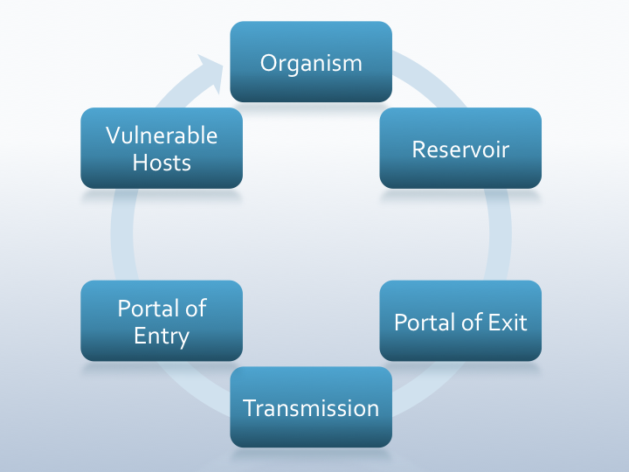
Transmission
Person-to-person
Contact with positive patients
Contact with wounds or stool
Medical devices or equipment
Inanimate objects

Slide 9
Who is at Risk?
CRE & MDR-A infections are more common in patients who have:
Frequent or prolonged hospital stays
Prolonged antibiotic use
Indwelling medical devices
Foley’s
Central lines
Chronic medical conditions
COPD, asthma
History of surgery
Decubitus

Slide 10
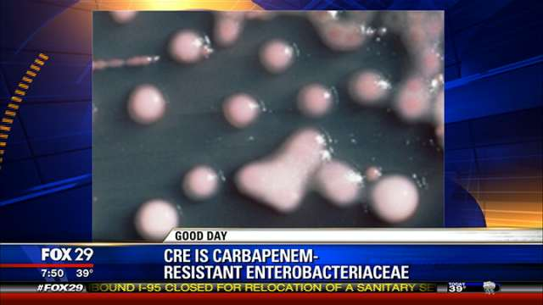
Why are these Important?
Complex resistance
Rapid transmission in health-care settings
Limited treatment options available
High mortality rates
Notes:
CRE is not the first organism we’ve had that has become resistant to antibiotics, so why is it so important? CRE resistance is complex because it can occur in different Enterobacteriacea and is mediated by several mechanisms as discussed previously.
Currently, CRE has developed and spread only within health-care settings, but has the potential to move into the community much like MRSA did. LTACHs have been shown to have a high colonization rate (7).
CRE infections are currently resistant to most all the antibiotics available. New antimicrobial treatment for multidrug-resistant gram-negative bacilli are being developed, however they are in the early stages and will likely not be available in the immediate future (2).
When a patient develops an invasive CRE infection, studies have shown that mortality rates are as high as 40-50%. (6); Carbapenem-resistant Klebsiella pneumoniae (CRKP) is independently associated with an increased mortality rate compared to patients with CSKP (7).

Slide 11
The Development of Resistance
Original treatment with beta-lactam antibiotics such as Penicillin’s
Created the production of β-lactamases (enzymes)
Resistance to penicillin's
Then, production of Extended Spectrum β-lactamases or ESBL’s
Resistance to β-lactams, monobactams & 3rd gen ceph (known as extended spectrum antibiotics).
200 different kinds of ESBL’s (enzymes) which do not effect 2nd gen ceph and carbapenems
ESBL’s are NOT a CRE
Then, production of Carbapenemase
Resistance to Carbapenems (class of beta-lactam antibiotics-last resort): Imipenem, meropenem, doripenem, ertapenem
Identified pan-resistant strains
Notes:
So what is CRE and how do we think it occurred? Enterobacteriaceae infections were originally treated with beta-lactam antibiotics such as penicillin and cephalosporins. Over the past few decades Enterobacteriaceae started to develop resistance to this standard antimicrobial treatment with the production of beta-lactamases.
Beta-lactamases are enzymes that provide bacteria with resistance to certain beta-lactam antibiotics. With time, the bacteria also started to develop extended-spectrum beta-lactamases. We commonly call these ESBLs. ESBLs are enzymes that furthered the bacteria’s resistance to beta-lactam antibiotics by providing additional resistance to monobactams like Aztreonam, and 3rd generation of cephalosporins (5)(9). It’s these 3rd generation of cephalosporin's that are known as ‘extended spectrum’ antibiotics. There are currently over 200 different kind of ESBLs or enzymes identified. ESBLs do not effect 2nd gen cephalosporin's and carbapenems are not effected. An ESBL is not a CRE.
Carbapenems are a class of beta-lactam antibiotics with broad-spectrum activity they were developed as a last-resort treatment for hard to treat infections, such as Enterobacteriaceae that had become resistant to most other beta-lactam antibiotics. This class of antibiotics includes imipenem, meropenem, doripenem, and ertapenem (12). As usage of carbapenems for the treatment of Enterobacteriaceae increased, resistance started to develop. Carbapenem-resistant Enterobacteriaceae (CRE) was uncommon in the United States before 1992, though it had been seen in other parts of the world (8)(11).
Carbapenemase-producing Enterobacteriaceae often carry genes that are resistant to many other antimicrobials, in addition to beta-lactam antibiotics. For this reason, CRE are becoming increasingly multidrug resistance and pandrug-resistant strains have been identified, this means some strains are resistant to all antibiotics (9).

Slide 12
Carbapenemases in the U.S.
Klebsiella pneumoniae carbapenemase (KPC)
Most often found in Klebsiella spp. & E. coli
Metallo-beta-lactamases (MBL)
New Delhi (NDM)
Verona integron-encoded (VIM)
Imipenemase (IMP)
**All of these are enzymes that
make a bacteria be labeled as “CRE”
Klebsiella pneumoniae
Notes:
Now that we know how carbapenemases came to be, here are some of their names.
Klebsiella pneumonia carbapenemase is an enzyme that has spread widely throughout the United States since first being discovered in the United States in 2001. KPC is most often found in Klebsiella spp. and Escherichia coli. Even though the name of the enzyme has a specific bacteria in it, it can appear in any Enterobacteriaceae bacteria. KPC has been found in almost every state according to the CDC - EXCEPT for Maine, Indiana and Alaska
In addition to KPC, new enzymes have emerged in the U.S. since 2009 but are less common within North America. They are called NDM, VIM, and IMP and are usually associated with patients who had exposure to health care in countries where these enzymes are more common (2).
KPC and the MBL carbapenemases are in two different structural classifications. KPC is in the class A carbapenemases and the MBLs are in Class B. The difference in the classes is dependent on their active site of the hydrolytic mechanism, KPC requires serine at the active site and the MBL carbapenemases require zinc (9).

Slide 13
Resistance Mechanisms
So how do these enzymes work?
Mechanisms for Enterobacteriaceae to be a CRE
Active efflux of antibiotic
System pumps out unwanted substances, like antibiotics
Structural mutations with overproduction of β-lactamases
Loss of proteins on the outer membrane and prevents antibiotic entry
Production of carbapenemases
Notes:
So we know how CRE developed and the enzymes that cause a bacteria to be labeled as CRE but exactly do these enzymes work? There are several ways Enterobacteriaceae may develop resistance to carbapenems, unlike other multi-drug resistant organisms, such as MRSA, which are mediated by a single mechanism.
One mechanism of resistance is due to the active expulsion of carbapenem antibiotics out of the cell with the use of bacterial efflux systems. These systems pump out unwanted substances, like antibiotics, from the cell which contribute to bacterial antibiotic resistance.
The two main mechanisms of CRE resistance are 1) structural mutations with beta-lactamase production and 2) production of carbapenemases.
Carbapenem antibiotics are structured to be highly resistant to most beta-lactamases. However, Enterobacteriaceae infections caused by beta-lactamase enzymes (ESBLs or AmpC cephalosprinases) combined with the loss of proteins on the outer membrane of the gram negative bacteria causes a structural change of the cell and prevents antibiotic entry. The combination of an overproduction of beta-lactamases and the structural mutation allow for the resistance to develop (9).
The production of carbapenemases, which are enzymes that inactivate carbapenems, can lead to carbapenem resistance. Carbapenemase-producing Enterobacteriacea can quickly spread from patient to patient and is associated with the increase of CRE in the U.S.
As we stated in the previous slide, CRE often carry more than one type of gene that make them resistant to many types of antibiotics. They are also capable of transferring their beta-lactam and carbapenem resistance to other bacteria within the Enterobacteriaceae family, making additional bacteria resistant to antimicrobial treatments. An example would be a gene spread from Klebsiella pneumoniae to E.coli since these are both Enterobacteriaceae (7).

Slide 14
Defining CRE
CDC – NHSN MDRO Protocol
E.coli or any Klebsiella spp. testing RESISTANT to imipenem, meropenem, doripenem, or Ertapenem by standard susceptibility testing methods
or
by a positive result for any method FDA-approved for carbapenemase detection from specific specimen sources
Notes:
There are varying definitions of what a CRE or Resistant Enterobacteriaceae is. For the purposes of Texas DSHS we are using the NHSN Definition.
The toolkit bases this definition on the 2012 Clinical and Laboratory Standards Institute (CLSI) criteria (4).
Often people will think you can call any gram negative rod “CRE” – you can only call bacteria that fall under the family Enterobacteriaceae’s CRE. This means Acinetobacter and Pseudomonas are NOT considered CRE.

Slide 15
Defining MDR-Acinetobacter
Nonsusceptible to at least 1 antibiotic in at least 3 antimicrobial classes of the following 6 antimicrobial classes:
*note: only the below listed antibiotics can be used to meet this definition
Beta-Lactam | Aminoglycosides | Carbapenems | Fluoroquinolones | Cephalosporins | Sulbactam
Piperacillin Piperacillin/ tazobactam | Amikacin Gentamicin Tobramycin | Imipenem Meropenem Doripenem | Ciprofloxacin Levofloxacin | Cefepime Ceftazidime | Ampicillin/ sulbactam
Notes:
Nonsusceptible means Intermediate or Resistant.

Slide 16
Case Examples

Slide 17
Case 1
NOT Reportable
Why??
Notes:
No MIC was listed just for imipenem – this should raise a red flag, ask your lab “Why did this happen?”
Under the preliminary the machine flagged this isolate for additional testing.
They did a Modified Hodge Test and determined that this was not a CRE. That’s why it says “This isolate does not produce a carbapenamase”
This lab did not need to be reported.
Wait for your lab to be final.

Slide 18
Case 2
What about the Pseudomonas?
Reportable or Not??
Why??
Notes:
ESBL is not a CRE
They can cause a false positive on a modified Hodge test
The imipenem is listed as “S”
Notice the second organism is Pseudomonas – this would not be reported! Pseudomonas is not an Enterobacteriaceae

Slide 19
Case 3
Final report:
Enterobacter cloacae
NOT Reportable
Why??
Notes:
This report says “CRE” but look at the organism, Enterobacter cloacae – only E.coli and Klebsiella spp need to be reported.
This did not have an MIC listed, talk with you lab and ask if this is usual. Or did this happen for a special reason.

Slide 20
Lab Detection for CRE
Clinical and Laboratory Standards Institute (CLSI) breakpoints for determining carbapenem susceptibility
Breakpoints were lowered to improve detection
Modified Hodge Test (MHT)
Tests for carbapenemase
Not necessary with the recommended lowered breakpoints
Other methods
PCR- only for KPC or NDM
Notes:
Another reason why the definition may not be helpful is that while the breakpoints maybe clearly defined with break point number, they are not yet used. As stated, the current CRE definition is based on the 2012 Clinical and Laboratory Standards Institute (CLSI). To improve CRE detection, these breakpoints have been lowered several times in the past 5 years, most recently in 2012. Using the new breakpoints can help identify patients who should be placed in contact isolation, where with the old criteria the patient may not have been isolated. However, the FDA has not yet approved these new breakpoints, so this means manufacturers cannot update their equipment for hospitals to use these breakpoints (7).
The Modified Hodge Test is a test that can be used to detect carbapenemase production in isolates of Enterobacteriaceae. With the recommended lowered breakpoints the MHT is not necessary, however if a lab is not using the current interpretive criteria/breakpoints then the MHT should be done to confirm an isolate as CRE (7). Not all hospitals are able to perform a MHT due to man power.
You might be asking what about other methods to detect CRE. A polymerase chain reaction (PCR) test can only test for specific carbapenemases, like KPC or NDM. This is not something typically done in a clinical lab and it is not necessary to initiate infection control measures – once the lab ID’s resistance to Carbapenem, appropriate measure should be immediately initiated.
Same MIC value has different interpretations (S, I or R)
CLSI breakpoints
“old” CLSI (2009) breakpoints (M100-S19)
“new” CLSI (2012) breakpoints (M100-S22)
FDA breakpoints
Recommendation:
if using old CLSI breakpoints, do MHT
Lab using commercial systems and automated instruments(Microscan, Vitek, etc.) for AST must use FDA-cleared breakpoints, unless they do their own validation studies for CLSI breakpoints.
FDA has not approved all breakpoints for the CLSI M100-S22.

Slide 21
Molecular Subtyping
PFGE (Pulse Field Gel Electrophoresis)
All positive K. pneumoniae isolates delivered to or tested at DSHS central lab are tested by PFGE for molecular subtyping (to build molecular database)
Other isolates may be submitted for PFGE with the approval of an HAI Epidemiologist.

Slide 22
When to Submit
Contact your regional HAI Epidemiologist prior to submission of any isolates
If isolates are sent without Epi approval (especially without antimicrobial susceptibility testing (AST)), lab will contact epi before sample is processed.

Slide 23
How to Submit?
Fill out G2B form
Information on DSHS lab website on how to request submission forms
http://www.dshs.state.tx.us/lab/
Notes:
If request for susceptibility or confirmation for susceptibility test, please check “other” under “Section 4, Bacteriology” and write “susceptibility test for CRE +Organism name (Genus and species)”.
If request for PFGE without susceptibility test (confirmed CRE at the submission site), then check “PFGE for” under “Section 6, Molecular Studies” and write CRE+ Genus and species name (i.e. Klebsiella pneumoniae)
If request to send samples to CDC for resistance mechanisms study without any test at DSHS, please check “other” under “Section 4, Bacteriology” and write “send to CDC”
All Klebsiella spp. positive specimens tested at DSHS will be sent to Molecular Biology Lab for PFGE.

Slide 24
Prevention
Recommendations for:
Acute and long-term acute care facilities
Health departments
Health-care providers
Patients and the public

Slide 25
Core Prevention Measures

Slide 26
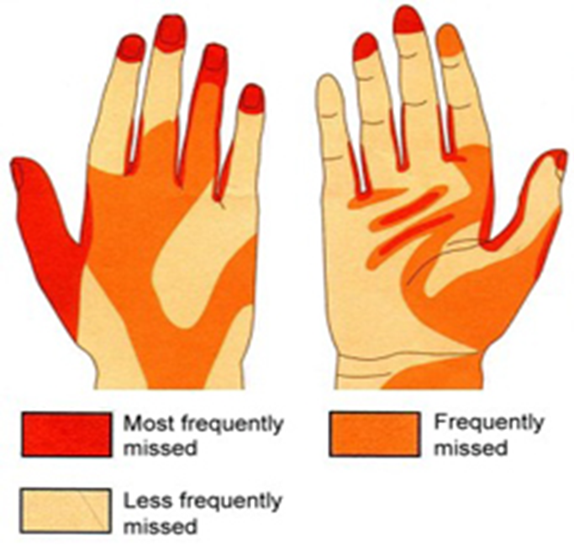
Hand Hygiene Cont…

Slide 27
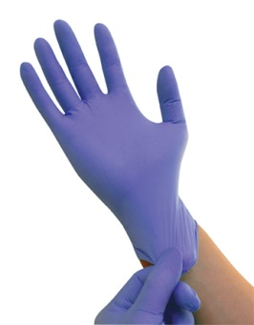
Core Prevention Measures cont…
Contact Precautions
Any patient colonized or infected with CRE should be placed in precautions
PPE (personal protective equipment)
Hand hygiene before gowning and gloving
Gown and gloves before entering patient’s room
Remove gown and gloves before leaving room, then perform hand hygiene
Monitor adherence and provide feedback
Discontinuation of precautions: currently no recommendations

Slide 28
Contact Precautions Cont…
Long term acute care (LTAC)
Use “strict contact precautions” when a patient is:
Incontinent of stool
Not cognitive or behaviorally intact, patient relies a lot on HCP
Ventilator-dependent
Have large draining wounds that cannot be contained
Possible to relax precautions when a patient is:
Continent of stool
Cognitive and behaviorally intact
No draining wounds

Slide 29
Notes:
Ensure your EVS department receives annual training. Do they know what high touch areas are? Provide education to EVS and direct care givers on infection prevention protocols and environmental decontamination. Ensure compliance of routine environmental measures and prioritize room cleaning of patients on contact precautions.

Slide 30
Core Prevention Measures cont…
Patient and staff cohorting
Single-patient rooms if available
If not available, cohort patients with like organisms
Staff cohorting: when possible cohort CRE patients to specific areas and staff
Try keeping CRE patients on specific units
Try using dedicate staff for affected units or limit the number of staff

Slide 31
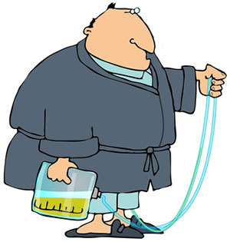
Control Prevention Measures cont..
Limit use of medical devices
Indwelling medical devices increase a patients risk for infection
Processes in place for manipulation of devices when in use
Discontinue devices as soon as possible
Should be monitored on a daily basis

Slide 32
Core Prevention Measures cont…
5. Antimicrobial stewardship
Ensure appropriate use and duration of antibiotics
Stewardship programs can help with:
Antimicrobial resistance
Additional cost
A better system to help with discontinuation of antimicrobials

Slide 33
Core Prevention Measures cont…
CRE screening
Helps to identify patients that might be colonized with CRE who can still spread CRE
Recommended site for screening: stool, rectal, or peri-rectal cultures
Point prevalence survey
You have positive patients and want to look for additional positive patients
Screening of epidemiologically linked patients
A good prevention strategy
Also used for outbreak situations
Notes:
CRE screening should be used for epi-linked patients as a prevention strategy and in CRE outbreaks.
CRE screening might include point prevalence surveys. A point prevalence survey means you’ve identified positive patients and want to look for other CRE positive patients that may exist, either on the same unit or from patients that were associated with a particular patient.
The recommended site for doing this type of surveillance is stool, rectal or peri-rectal cultures, but wound cultures or urine cultures from a urinary catheter have also been used.

Slide 34
Additional Measures
Accurate lab detection and notification of CRE
Retrospective surveillance
Perform surveillance (6-12mos) to find unreported CRE
Intra and inter-facility communication of patients
Notes:
Most of these recommendations come from The CDC CRE Toolkit that was released in 2012. We also have included additional recommendations we have come across through our research. While these are not CDC Core prevention measures, they should be strongly considered by all facilities as basic infection prevention measures.
It is important to ensure that accurate lab detection of CRE is being implemented so that patients infected or colonized with CRE may be immediately placed on isolation precautions. Facilities should educate and increase awareness of CRE importance among laboratory staff. Are your items sent out? How does your reference lab hold up? Does your lab currently report antimicrobial susceptibility panels to your IP? Laboratory staff should immediately notify infection prevention staff of CRE positive results. Create and use your antibiogram
Facilities should consider performing a retrospective lab review over a time period of 6-12 months to determine the number of unidentified CRE positive cases. If unrecognized CRE patients are identified, one round of surveillance cultures in units where cases were detected can be considered if there is concern. This will help facilities monitor progress in CRE prevention, identify possible patterns in affected units, and help prevent further transmission.
There should be prompt communication among laboratory, infection prevention, and healthcare personnel whenever positive CRE specimens are identified. In addition, facilities should communicate CRE status to receiving facilities if patients are being transferred. The CDC has a transfer form if needed
Conduct a hand hygiene survey at your facility –enough sanitizers located in appropriate areas? easier to install than sinks.
Ensure your EVS department receives annual training. Do they know what high touch areas are? Provide education to EVS and direct care givers on infection prevention protocols and environmental decontamination. Ensure compliance of routine environmental measures and prioritize room cleaning of patients on contact precautions. Ensure your Infection Preventionist is up-to-date on their knowledge about CRE and are following current guidelines/recommendations.

Slide 35
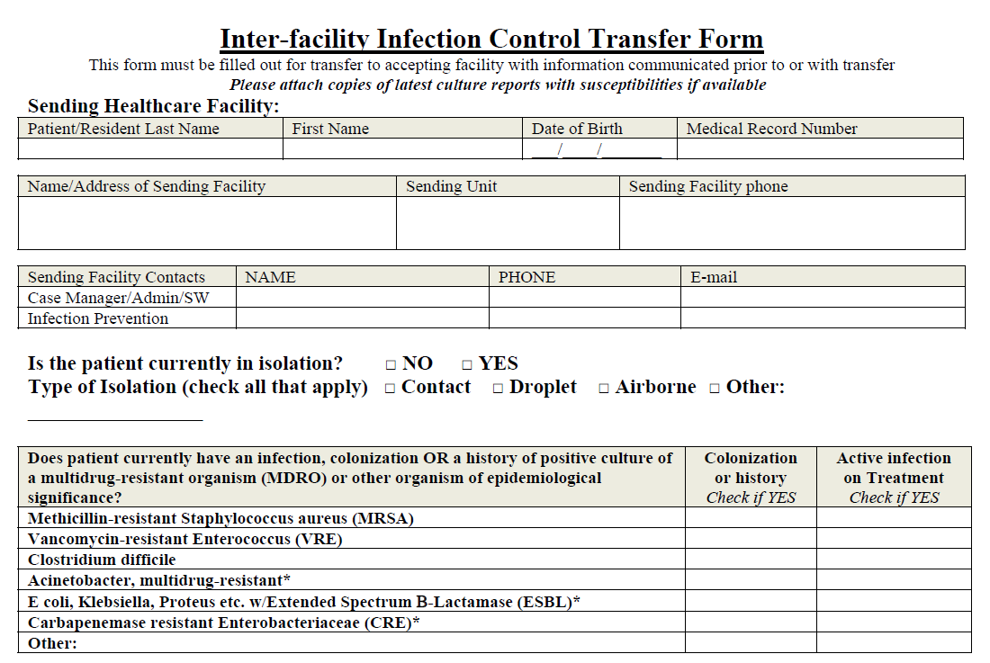
Transfer Form

Slide 36
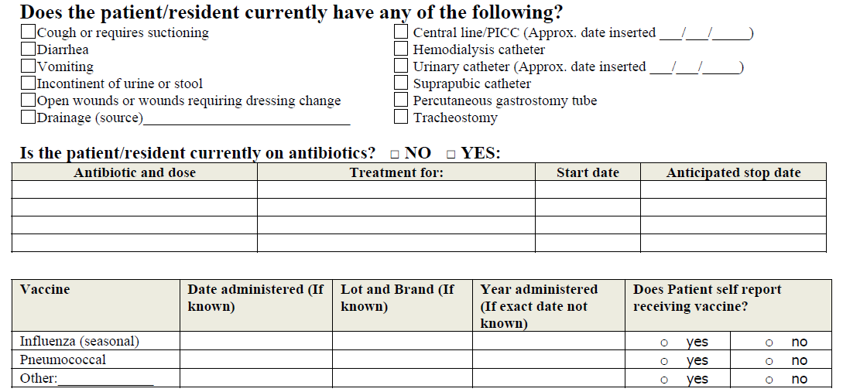

Slide 37
LTAC Specific Recommendations
Resident placement
Low vs. high risk
Modified contact precautions
Occupational and physical therapy
Controlled vs. uncontrolled secretions/excretions
Social activities
Infection risk vs. psychological risk
Admission of CRE+ patients is ok
Notes:
For the prevention and management of CRE in LTACs, the same 6 core measures on the previous slide should be followed, but might be modified due to LTAC setting differences.
Resident placement – if private rooms are not available, CRE positive patients should be cohorted with other CRE positive patients or patients with low risk of acquiring infection such as residents that are:
Not significantly immunocompromised
Are continent of urine and feces
Have no invasive devices (urinary catheters, lines, track, drainage devices)
You do not want to put someone who is neutropenic in a room with someone who is known or at risk of carrying of CRE. In addition, someone who is totally dependent upon medical care or a care giver to daily living would be considered high risk.
Contact precautions – The use of contact precautions may be “relaxed” for patients with low risk of transmission. LTACs should consider risk of transmission and CRE carriage before discontinuing contact precautions. Staff should ensure visitors follow facility policy as well. Will your visitors follow a different practice?
Therapy – CRE positive patients with high risk of transmission should have therapy and treatments performed in the patient’s room if possible. If therapy must be done outside the patient’s room, certain precautions should be taken to reduce the risk of transmission to other patients. If possible:
Use dedicated resident equipment or disposable equipment
Clean all equipment immediately after use
Schedule CRE positive patients for the last sessions of the day
Ensure excretions/secretions are contained and that they are clean – the patient can leave the room and participate in activities
Just like resident place and modified precautions, you need to consider social activities. You should consider the patients level of function both cognitive and physical, and the site of the infection/colonizations.
Lastly, a facility should not deny admission of a patient solely based on the CRE status. With proper precautions, appropriate care can be given to these individuals without transmitting it to other patients

Slide 38
Supplemental Measures
Active surveillance testing
Reactive vs. Proactive approach
It is up to a facility to decide which approach they prefer.
Patients identified as positive on these surveillance cultures should be treated as colonized (i.e., contact precautions, etc.)
2 % Chlorhexidine (CHG) bathing
Different practices may occur when dealing with acute care settings vs. long term care settings
Notes:
Supplemental measures can be implemented when core prevention efforts are not effective in reducing CRE.
We just mentioned screening as a core measure. Active surveillance testing as a supplemental measure is different. Active surveillance testing has been used successfully in other HAI outbreaks when bundled with other interventions. It involves culturing patients who meet a specific criteria, but are not necessarily epidemiologically linked to CRE patients.
Reactive approach: CRE screening in “All patients associated with patient X will be screened” This is a reactive approach. You’re reacting to the issue that has arose. Reactive means the resources are given post-outbreak. The resource cost is dependent upon the size of the outbreak.
Proactive approach: you might culture all patients admitted, from facility X. This would be an example of a proactive approach. You want to catch the patients upon admission before they can spread CRE to your other patients. This means resources are given upfront and will allow early detection and containment.
Chlorhexidine bathing is the process of using 2% diluted liquid chlorhexidine or 2% chlorhexidine wipes to bath patients and is not usually used above the jaw or on wounds. It has been used successfully in reducing MDROs including CRE when bundled with other interventions. In acute-care settings, the bathing will usually be used on all patients regardless of CRE status. In long-term care settings, this intervention might only be used on patients known to be infected or colonized with CRE. Other products may exist on the market, research is pending.

Slide 39
References
Association of Professionals in Infection Control. (March, 2013). CRE: the‘nightmare bacteria’. Retrieved from http://apic.org/For-Consumers/ip-topics/Article?id=cre-the-nightmare-bacteria
Bilavsky, E., Schwaber, M. J., & Carmeli, Y. (2010). How to stem the tide of carbapenemase-producing Enterobacteriaceae? Current Opinion in Infectious Diseases, 23(4), 327-31. doi: 10.1097/QCO.0b013e32833b3571
Centers for Disease Control and Prevention (CDC). (2011). Carbapenem-resistant Klebsiella pneumonia associated with long-term-care facility-West Virginia, 2009-2011. MMWR, Morbidity and Mortality Weekly Report, 60(41), 1418-20.
Centers for Disease Control and Prevention (CDC). (2012). Guidance for control of carbapenem-resistant Enterobacteriaceae, 2012 CRE toolkit.
Centers for Disease Control and Prevention. (March, 2013). Making health care safer. Retrieved from http://www.cdc.gov/vitalsigns/hai/cre/
Centers for Disease Control and Prevention. (2010). Options for evaluating environmental cleaning. Retrieved from http://www.cdc.gov/HAI/toolkits/Appendices-Evaluating-Environ-Cleaning.html#fig1
Centers for Disease Control and Prevention (CDC). (2013). Vital signs: carbapenem-resistant Enterobacteriaceae. MMWR, Morbidity and Mortality Weekly Report, 62(9), 165-70.
Gupta, N., Limbago, B. M., Patel, J. B., & Kallen, A. J. (2011). Carbapenem-resistant Enterobacteriaceae: epidemiology and prevention. Clinical Infectious Disease, 53(1), 60-7. doi: 10.1093/cid/cir202
Halstead, D. C., Sellen, T. J., Adams-Haduch, J. M., Dossenback, D. A., Abid, J., Doi, Y., & Paterson, D. L. (2009). Klebsiella pneumoniae Carbapenemase-producing Enterobacteriaceae, Northeast Florida. Southern Medical Journal, 102(7), 680-7. doi: 10.1097/SMJ.0b013e3181a93f9e
Lokan, L. (2012). Carbapenem-resistant Enterobacteriaceae: an emerging problem in children. Clinical Infectious Disease, 55(6), 852-9. doi: 10.1093/cid/cis543
Marchaim, D., Chopra, T., Pogue, J. M., Perez, F., Hujer, A. M., Rudin, S., Endimiani, A., Navon-Venezia, S., Hothi, J., Slim, J., Blunden, C., Shango, M., Lephart, P. R., Salimnia, H., Reid, D., Moshos, J., Hafeez, W., Bheemreddy, S., Chen, T. Y., Dhar, S., Bonomo, R. A., Kaye, K. S. (2011). Outbreak of colistin-resistant, carbapenem-resistant Klebsiella pneumonia in metropolitan Detroit, Michigan. Antimicrobial Agents and Chemotherapy, 55(2), 593-9. doi: 10.1128/AAC.01020-10
Minnesota Department of Health. (2012). Minnesota Department of Health Recommendations for the Management of Carbapenem-resistant Enterobacteriaceae in Long-Term Care Facilities. Retrieved from http://www.health.state.mn.us/divs/idepc/dtopics/cre/rec.pdf
Perez, F., & Van Duin, D. (2013). Carbapenem-resistant Enterobacteriaceae: a menace to our most vulnerable patients. Cleveland Clinic Journal of Medicine, 80(4), 225-33. doi: 10.3949/ccjm.80a.12182
Schwaber, M. J. & Carmeli, Y. (2008). Carbapenem-resistant Enterobacteriaceae: a potential threat. The Journal of the American Medical Association, 300(24), 2911-3. doi: 10.1001/jama.2008.896
Wu, D., Cai, J., & Liu, J. (2011). Risk factors the acquisition of nosocomial infection with carbapenem-resistant Klebsiella pneumonia. Southern Medical Journal, 104(2), 106-10. doi: 10.1097/SMJ.0b013e318206063d

