Slide 1
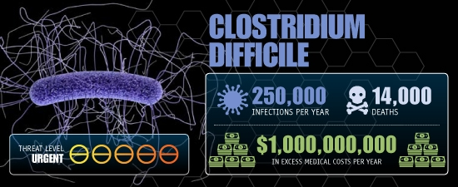
The (Environmental) Impact of Clostridium difficile Infection (CDI)
Kevin W. Garey, PharmD, MS. Professor and Chair
University of Houston College of Pharmacy
New 2011 Data
500,000
29,000
Lessa et al, N Eng J Med 2015: 34.2% of CDI cases were considered community-acquired
Source: CDC Report "Antibiotic Resistance Threats in the United States, 2013”
Lessa CF et al. NEJM 2015;372:825-34.
Notes:
Newer data from Lessa (NEJM 2015): Burden of CDI infections in the US shows almost half a million infections and 29,000 infections yearly. This is using data from 2011 in over 15K cases

Slide 2
Acknowledgements
Many of our recent studies have been funded by a grant from the Department of State Health Services.
Thanks!

Slide 3
A History of C. difficile
1935 - isolated in stool
1996-2003 CDC reports rate of CDI increased from 31 cases per 100,000 persons to 61 cases per 100,000 persons
1978 - C. difficile responsible for antibiotic associated diarrhea
1893 - pseudomembranous colitis first described
2008-11 – England directs significant resources to control CDI (and MRSA)
Current – continued persistence of RT 027 in North America and decrease incidence in Europe
2005 – US continues to report increased CDI
Heinlen L, Ballard JD. Clostridium difficile Infection. The American journal of the medical sciences. 2010;340(3):247-252. doi:10.1097/MAJ.0b013e3181e939d8.
The Clostridium difficile PCR ribotype 027 lineage: a pathogen on the move Valiente, E. et al. Clinical Microbiology and Infection , Volume 20 , Issue 5 , 396 - 404

Slide 4
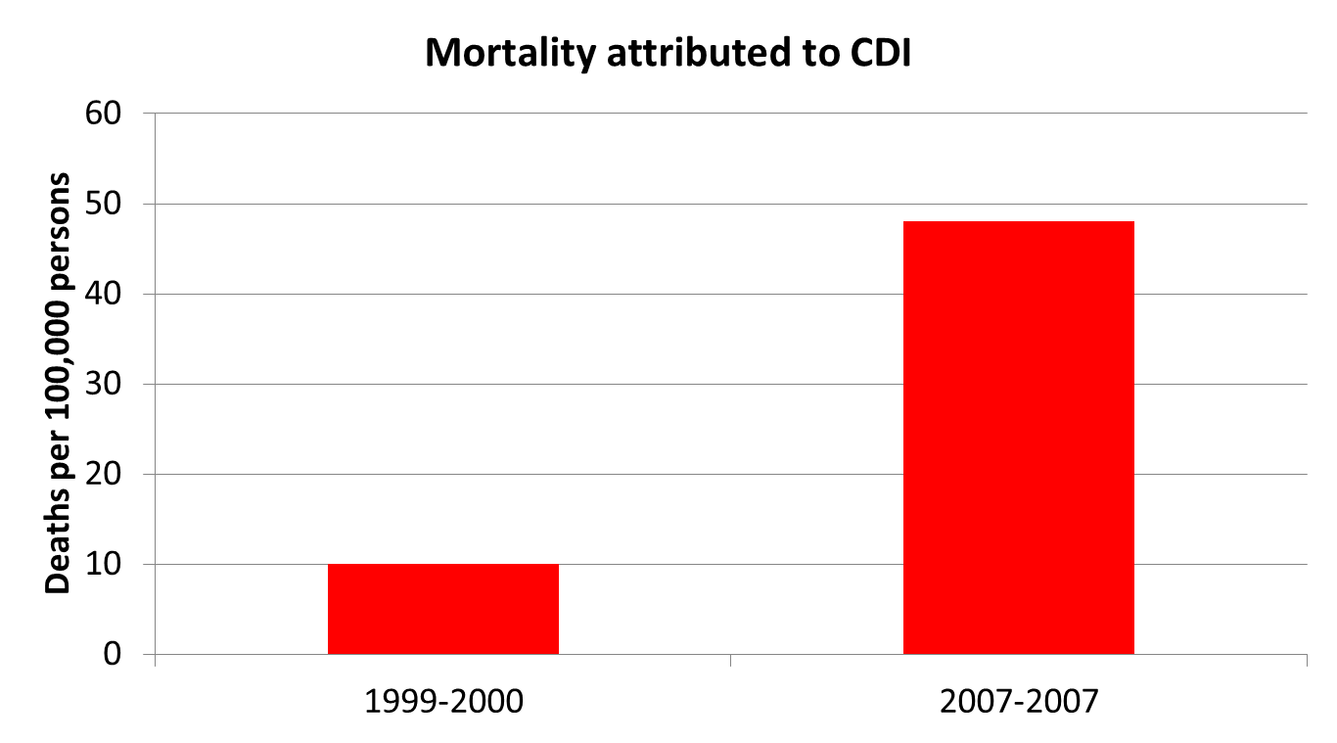
C. difficile is the main contributor to gastroenteritis-associated deaths in the USA
Analysis of National Center for Health Statistics (NCHS) multiple-cause-of-death mortality data for the years 1999–2007, a 5-fold increase in mortality attributed to CDI was noted
Hall et al. CID 2012;55:216-23

Slide 5
How did we get here?
Let’s review a few key concepts on CDI to get everyone up to speed
  Pathogenesis
  Emergence of ‘hypervirulent’ strains

Slide 6
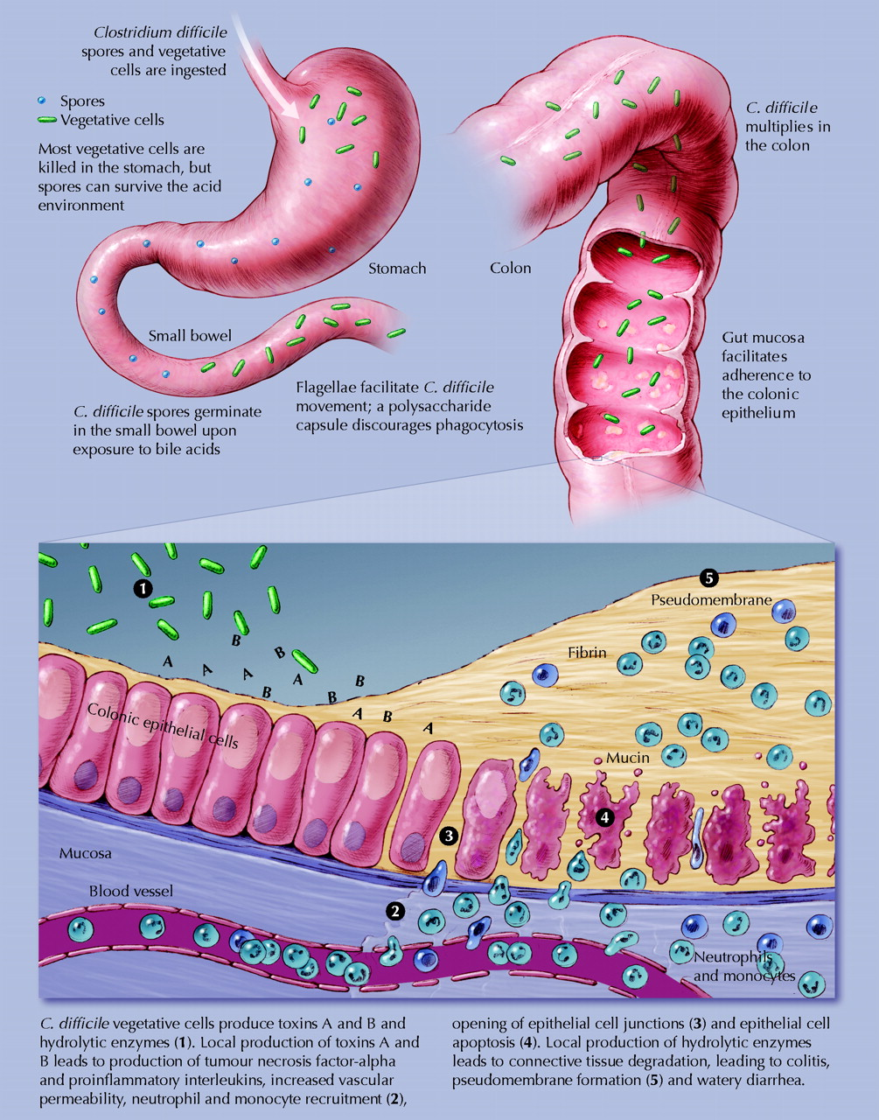
Pathogenesis of Clostridium difficile-associated diarrhea in adults
Poutanen, S. M. et al. CMAJ 2004;171:51-58
Copyright ©2004 CMA Media Inc. or its licensors

Slide 7
Pathogenesis of Clostridium difficile-associated diarrhea in adults
Poutanen, S. M. et al. CMAJ 2004;171:51-58
Copyright ©2004 CMA Media Inc. or its licensors
Notes:
Toxin A: enterotoxin responsible for the expression of diarrhea and colonic inflammation
Toxin B: cytotoxin responsible for actinomorphic changes in tissue culture cells

Slide 8
Hypervirulent C. difficile

Slide 9
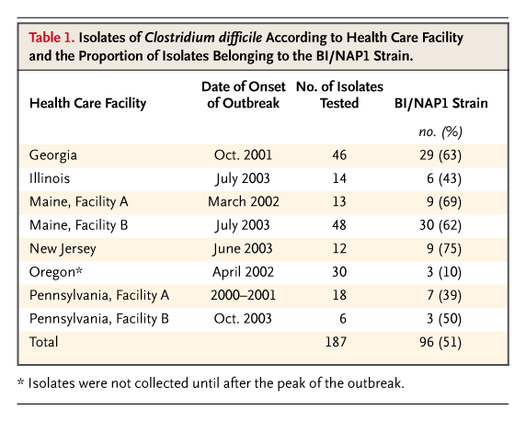
Incidence of hypervirulent strains of
C. difficile, 2005
McDonald et al. N Eng J Med 2005;353:2433-2441

Slide 10
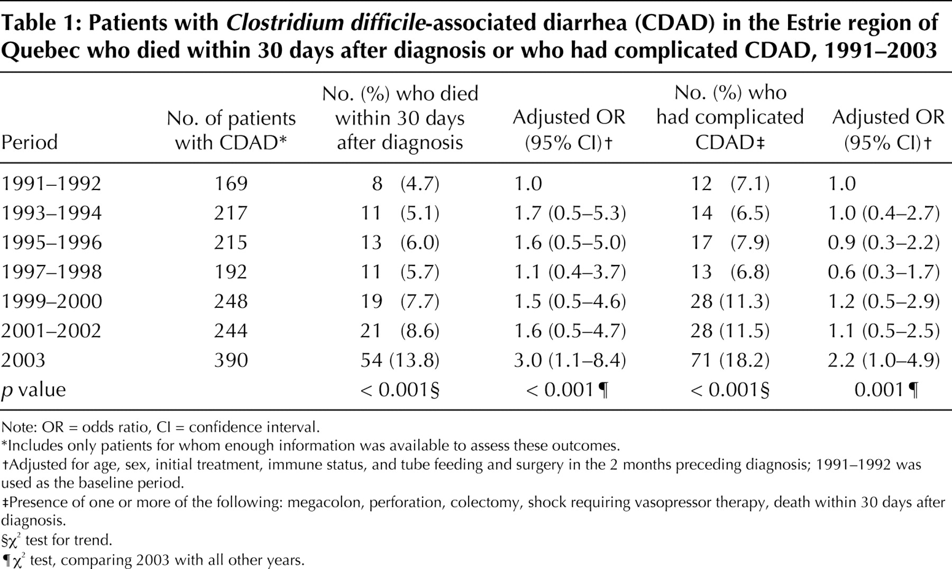
Increasing mortality and complications due to CDAD
Pepin, J. et al. CMAJ 2004;171:466-472
Copyright ©2004 CMA Media Inc. or its licensors

Slide 11
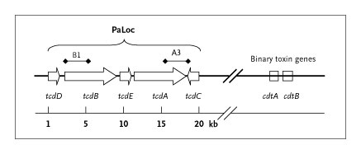
Toxins A and toxin B are produced in the Pathogenicity Locus (PaLoc) of C. difficile
Codes for toxin B
Codes for toxin A
Negative regulator of tcdA and tcdB
tcdC deficient strain = Lots more production of toxins A and B!
McDonald et al. N Eng J Med 2005;353:2433-2441

Slide 12
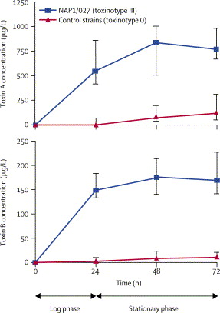
Time course of toxin production by hypervirulent strain compared to control
Warny Lancet 2005;366:1079
Notes:
Median concentration and IQRs are shown. C difficile strains included 25 toxinotype 0 and 15 NAP1/027 strains (toxinotype III) from various locations

Slide 13
The C. difficile Epidemic
RT 027 FQR1 in North America and RT 027 FQR2 responsible for worldwide epidemic¹
1. Trends in Microbiology August 2014, Vol. 22, No. 8
2. The Clostridium difficile PCR ribotype 027 lineage: a pathogen on the move Valiente, E. et al. Clinical Microbiology and Infection , Volume 20 , Issue 5 , 396 - 404

Slide 14
C difficile nomenclature
All these are synonymous terms:
  Toxinotype III: PCR analysis of PaLoc
  PCR ribotype 027: European typing method
  REA Group BI (bee eye): Typing method by Dale Gerding (Hines, IL)
  PFGE: Nap-1: CDC typing method
Work currently being conducted to make ribotyping the preferred typing method in the USA and Europe

Slide 15
Who you calling “hypervirulent”
Michigan: Derivation (n=310/34 severe) and validation (n=433/45 severe) of predictors of severe CDI (ICU admission, colectomy, or death). After accounting for disease presentation severity, ribotype did not predict outcome
Predictorª | Derivation OR (95% CI) | P Value | Validation OR (95% CI) | P Value
Hypervirulent ribotype:
027/078 vs non-027/078 (reference) | 0.82 (.07–10.0) | .874 | 1.34 (.53–3.16) | .516
White blood cell count: Leukocytosis (>12 000 cells/mL) or leukopenia
(<4000 cells/mL) vs normal (reference) | 4.27 (1.14–19.46) | .041 | 2.32 (1.07–5.18) | .035
Low albumin level (g/dL) | 0.25 (.07–.77) | .025 | 0.47 (.25–.87) | .018
Walk et al. CID 2012;doi:10.1093/CID/CIS786

Slide 16
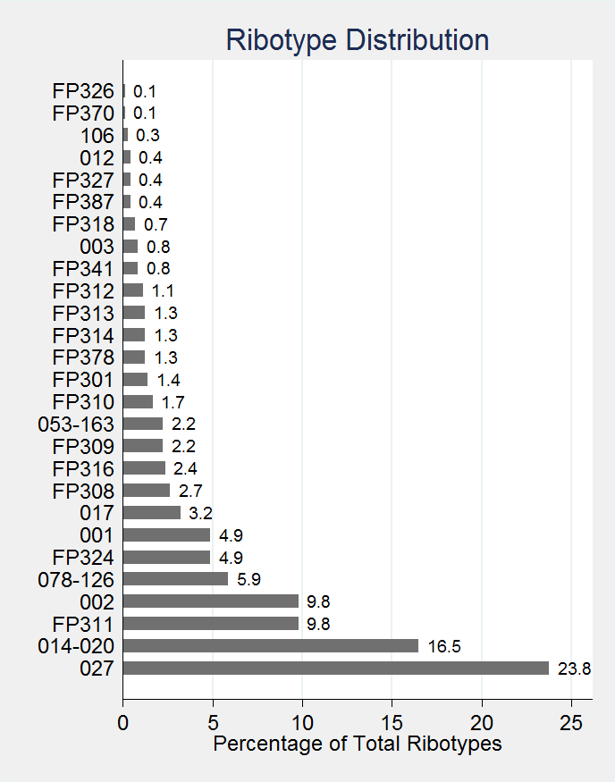
..and there are more ribotypes than just 027
A lot of ribotypes are associated with CDI
Many ribotypes are virulent, including 027
Ribotype | Severe CDI presentation | Severe CDI outcome
027 (n=170) | 54.7% | 18.9%
014-020 (n=118) | 22.9% | 4.2%
FP11 (n=70) | 31.4% | 8.6%
078-126 (n=42) | 21.4% | 9.5%
001 (n=35) | 42.9% | 8.6%
FP24 (n=35) | 37.1% | 22.9%
17 (n=23) | 39.1% | 17.4%
FP8 (n=19) | 36.9% | 10.5%
053-163 (n=16) | 37.5% | 6.25%
FP16 (n=16) | 35.3% | 11.8%
FP9 (n=16) | 25.0% | 18.8%
Aitken et al. ICHE 2015

Slide 17
You are all now expert C diff ribotypers
027 is definitely a virulent ribotype
…..but, there are lots of ribotypes that are equally virulent
Without a doubt, the ribotype 027 strain has put a large focus on the value of strain typing in C. difficile.
Now, let’s use this technology to understand where C. diff may be coming from
  (answer: everywhere)

Slide 18
Standard view of CDI transmission
Symptomatic Patient
with CDI
Patient
Asymptomatic Patient
with CDI
Healthcare workers
Hospital environment
Slide courtesy of Eric Kao

Slide 19
C. difficile is becoming more common in the community setting
CDC: 10 US states identified 984 patients with community-acquired CDI (No previous antibiotics: 36%; No outpatient healthcare exposure: 18%).
Chitnis et al. JAMA Int Med 2013;173:1359-67

Slide 20
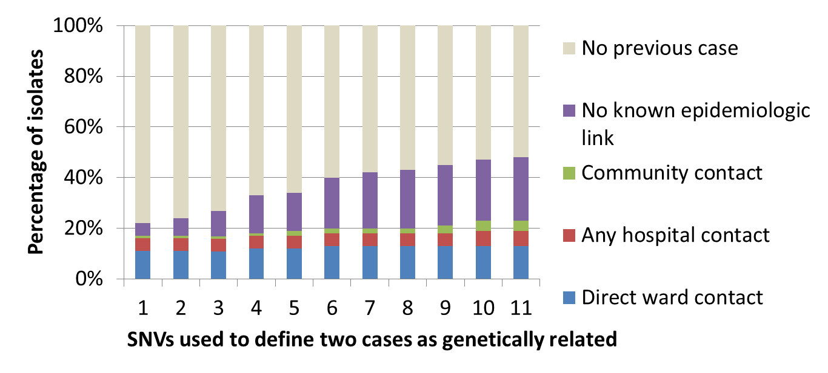
How do patients get infected in the first place?
Where are C diff strains coming from?
Leeds, England: Whole genome sequencing of 1223 cases of CDI. This allows for a highly discriminatory way to see where C diff strains are coming from.
Eyre. N Eng J Med 2013 Sept;369:1195-205

Slide 21

New thoughts on CDI transmission
Symptomatic Patient
with CDI
Patient
Asymptomatic Patient
with CDI
Healthcare workers
Hospital environment
Slide courtesy of Eric Kao

Slide 22

Animals can be colonized with C. difficile
Sweden¹: Ribotype 046 common among neonatal pigs and humans
Germany²: RT 078 and 126 were predominant in piglet populations
Japan³: Ribotype 078 isolates genetically related to European PCR RT 078 strains in humans and pigs
Clin Microbiol Infect 2014;20:02-6
J Clin Microbiol 2013;51:3796-3803
Frontiers in Microbiology 2014;5:513.

Slide 23
New thoughts on CDI transmission
078
Pig in Japan
Pig in Europe
Symptomatic Patient
with CDI
Patient
Asymptomatic Patient
with CDI

Slide 24
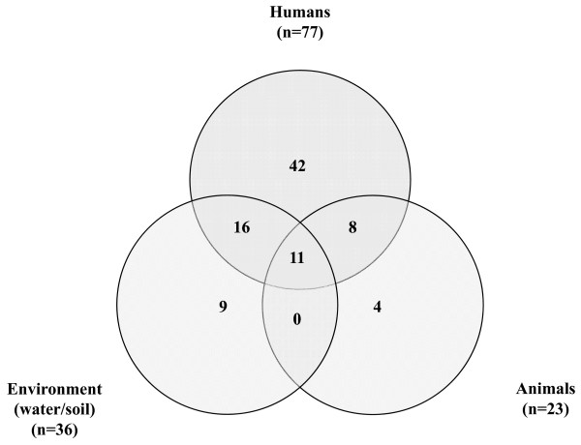
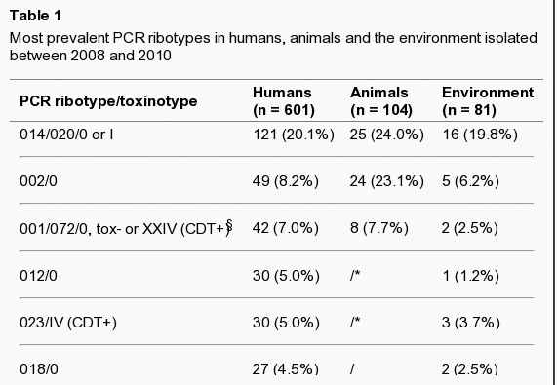
Water and soil can also be a reservoir for C. difficile
Slovenia 2008-2010: 786 isolates, 90 isolates of C. difficile isolated
1. Janezic S, Ocepek M, Zidaric V, Rupnik M. Clostridium difficile genotypes other than ribotype 078 that are prevalent among human, animal and environmental isolates. BMC Microbiology. 2012;12:48. doi:10.1186/1471-2180-12-48.

Slide 25
CDI transmission is getting a lot more complicated!
078
Pig in Japan
Pig in Germany
Symptomatic Patient
with CDI
Patient
Asymptomatic Patient
with CDI
014
Water and soil

Slide 26
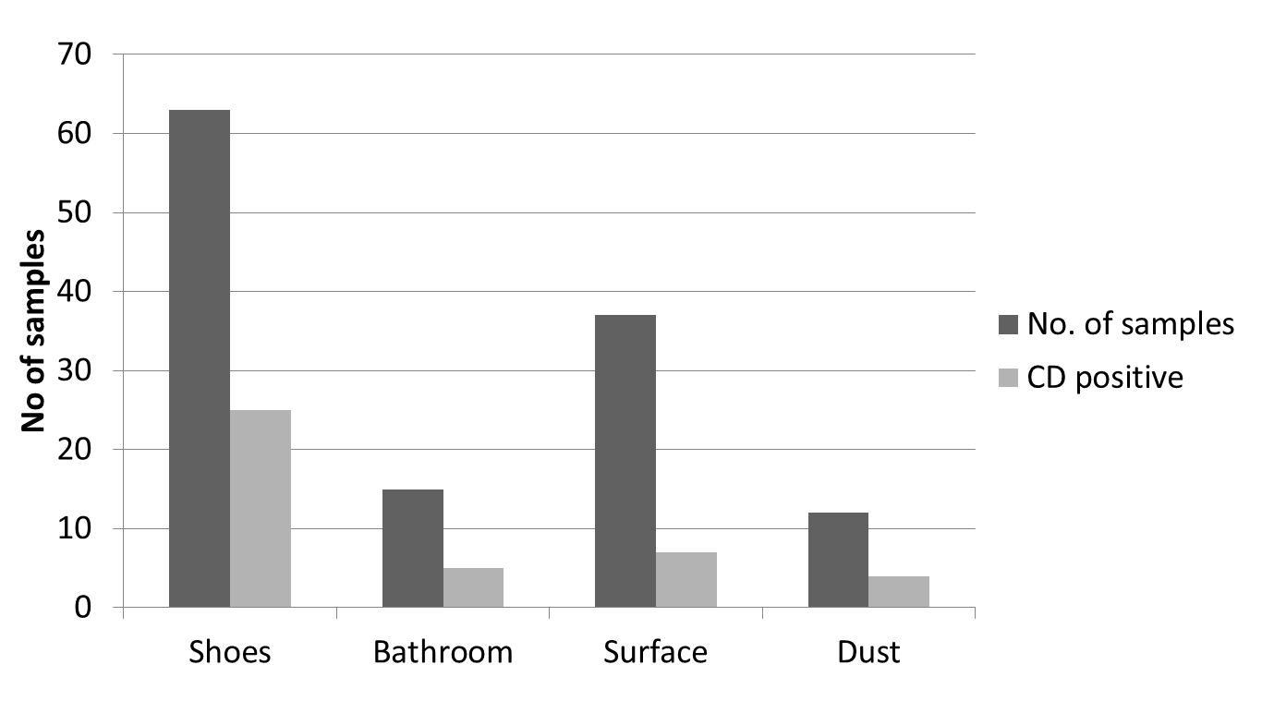
Prevalence of C. difficile (CD) from various environmental samples. Samples collected from 30 households throughout Houston, TX
Alam, Anu, and Garey. Anaerobe 2014

Slide 27
Is C. diff ubiquitous in our environment?
We hypothesized the community environment may contain a large burden of C. difficile contamination.
The objectives of the study was to assess community environmental contamination of toxigenic Clostridium difficile
  Sub-aims
    compare strain relatedness to clinical strains (ribotype)
    assess virulence in a mouse model.

Slide 28
Methods
Environmental contamination
  Assessed C. difficile prevalence in
    Public areas (public parks)
    Chain stores, fast-food restaurants
    Homes (3-5 samples)
      Kitchen and bathroom
      Cleaning supplies
      Shoe soles
  Home: also assessed risk factors for C. diff contamination (type of dwelling, number and ages of home dwellers, pets, recent hospitalization)

Slide 29
Methods cont.
Clinical isolates
  Diarrheal stool from hospitalized patients with positive C. difficile toxin test obtained from two healthcare systems in Houston (7 hospitals)
Microbiology
  Stool and environmental isolates incubated anaerobically for C. difficile (confirmed with PCR)
  C. difficile isolates characterized by fluorescent PCR-ribotyping

Slide 30
Results, number of samples
Isolate source | Number
Environmental
Home | 1173
Chain stores | 230
Fast-food restaurants | 125
Public Area | 540
Clinical isolates | 613

Slide 31
Figure 1. Community environmental contamination of C. difficile
**
**
**p<0.001 compared to either chain stores or fast-food restaurants

Slide 32
Figure 2. Home environmental contamination of C. difficile

Slide 33
Table 1. Risk factors for home contamination with C. difficile
 | C diff positive | C diff negative | P value
Home type
House | 41 (36%) | 71 | >0.3
Apartment | 162 (43%) | 215
Pet in home
Yes | 41 (65%) | 22 | <0.001
No | 144 (38%) | 233
Number of persons in home | 3.6±1.9 | 3.2±1.3 | >0.3
Age of oldest person in home | 42±16 | 44±16 | >0.3
Age of youngest in home | 20±7 | 21±11 | >0.3
Any child in daycare | 10 (5%) | 11 (4%) | >0.3

Slide 34
Frequency of C diff ribotypes (n=401) from environmental strains (25 distinct ribotypes)

Slide 35
Figure 3. Ribotype distribution of clinical vs. environmental C difficile isolates

Slide 36
Environmental strain PH12; ribotype 078 is virulent in a mouse model
Med36 is a clinical strain

Slide 37
Most of the other environmental samples have been conducted in Europe.
How do our results compare to Europe?
Paris, France
Berlin, Germany
Houston, TX

Slide 38
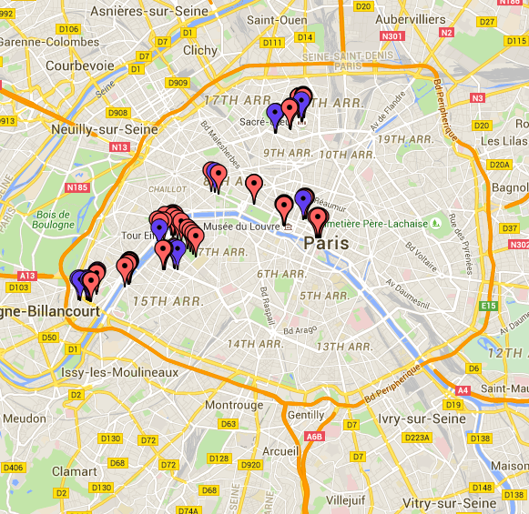
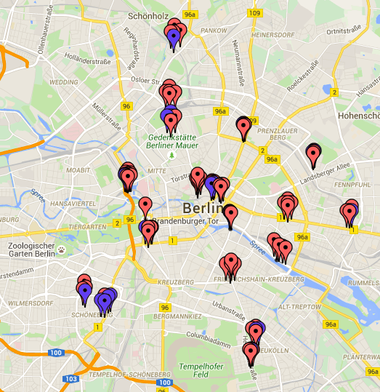
Lucky for me, I had a student do an internship in Paris and Berlin last Summer!
Area swabbed
No C. difficile found
C. difficile isolated

Slide 39
Environmental C. difficile in Berlin and Paris
 | Berlin (n=100) | Paris (n=100)
Overall Prevalence | 22/100 (22%) | 20/100 (20%)
Surface swabbed
Floor | 19/85 (22%) | 14/37 (38%)
Bench | 3/15 (20%) | 4/53 (8%)
Other** |  | 2/10 (20%)
Location
Parks | 6/11 (55%) | 4/42 (10%)
Metro/bus | 14/75 (19%) | 9/18 (50%)
Public areas*** | 2/14 (14%) | 7/40 (18%)
Ribotype
078-126 | 0/22 (0%) | 0/20 (0%)
014-020 | 10/22 (46%) | 1/20 (5%)
27 | 0/22 (0%) | 1/20(5%)
2 | 1/22 (5%) | 1/20(5%)
UM9 | 0/22 (0%) | 2/20 (10%)
UM10 | 1/22 (5%) | 1/20 (5%)
UM11 | 0/22 (0%) | 5/20 (25%)
UM12 | 4/22 (18%) | 3/20 (15%)
UM13 | 3/22 (14%) | 2/20 (10%)
UM16 | 0/22 (0%) | 2/20 (10%)
UM18 | 3/22 (14%) | 0/20 (0%)
UM26 | 0/22 (0%) | 2/26 (8%)
**Other defined as bike handle station release button, board, and side rails, ***excluding parks and metro/bus areas

Slide 40
Environmental C. difficile Prevalence in Berlin and Paris
**defined as bike handle station release button, board, and side rails

Slide 41
Texas vs. Europe
C. difficile environmental prevalence
An Epidemiological Survey of Environmental Clostridium difficile in Berlin and Paris
Overall*: | 21%
Parks: | 32%
Houses: | n/a
General Public: | 16%
Fast Food: | n/a
Chain Stores: | n/a
Community environmental studies on potentially pathogenic Clostridium difficile
Overall: | 219/1040 (21%)
Parks: | 97/235 (41%)
Houses: | 61/175 (35%)
General Public: | 27/200 (14%)
Fast Food: | 10/125 (8%)
Chain Stores: | 21/250 (8%)¹

Slide 42
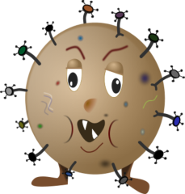
Emerging view of CDI transmission
Host factors that increase vulnerability to CDI might be of more importance than increased exposure to C. difficile
Symptomatic Patient
with CDI
Patient at risk for CDI
Asymptomatic Patient
with CDI
Patient
Healthcare workers
Hospital environment

Slide 43
Next steps
Most of our work to date has been Houston-based
We are currently expanding the environmental and clinical sample collection to the entire state of Texas
  Growth of C. difficile and ribotyping of clinical samples from patients diagnosed with CDI
  Texas-wide environmental sampling from public areas of healthcare and non-healthcare environments
  If anyone is interested in helping with these, please let me know (kgarey@uh.edu)

Slide 44
Conclusion
As long as we live in a world of elderly, hospitalized patients given broad spectrum antibiotics, CDI is here to stay
With a coordinated effort and contemporary epidemiologic techniques, we can likely control and respond to future changes in the pathogenesis of CDI
With a little luck and good science, we may also be able to discover new insights into strategies to prevent and control CDI.

Slide 45
The (Environmental) Impact of Clostridium difficile Infection (CDI)
Kevin W. Garey, PharmD, MS. Professor and Chair
University of Houston College of Pharmacy
New 2011 Data
500,000
29,000
Lessa et al, N Eng J Med 2015: 34.2% of CDI cases were considered community-acquired
Source: CDC Report "Antibiotic Resistance Threats in the United States, 2013”
Lessa CF et al. NEJM 2015;372:825-34.
Notes:
Newer data from Lessa (NEJM 2015): Burden of CDI infections in the US shows almost half a million infections and 29,000 infections yearly. This is using data from 2011 in over 15K cases

