Slide 1
Texas Healthcare Associated Infection (HAI) Reporting and Validation
Jennifer Vinyard, MPH, CIC
HAI Epidemiologist
512.776.3773
Notes:
Introductions

Slide 2

Objectives
The HAI/PAE Background
Introduction to NHSN
Data Reports: SIR Explanation
Data Validation Process
New CLABSI Validation Protocol
Q & A

Slide 3

Healthcare Associated Infections (HAI)
US Statistics
1.7M infections/year
99,000 deaths/year
Consequences to Patient
  Pain and suffering, disability, death
  Loss of income
  Self image
Consequences to Facility
  Loss of revenue ($25-33B/yr in US)
  Preventable incidents not reimbursed
  Increased LOS – bed cannot be occupied by revenue-producing patients
Texas Statistics
130K-160K infections/year
8K-9K deaths/year

Slide 4
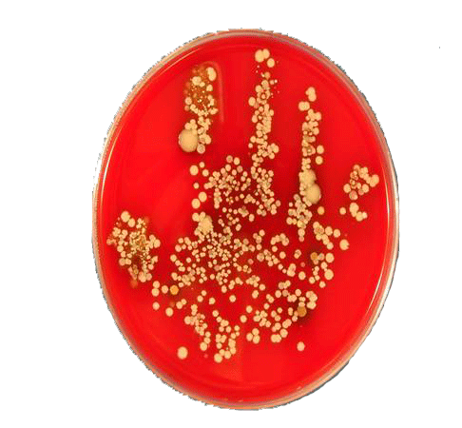
5 Reasons for Reporting
Improve healthcare quality by reducing HAI & PAE
Consumer’s right to know
Establish standards for comparability of data
Help to identify facility needs for DSHS support
Patient Empowerment
Notes:
Movement towards patient empowerment: Speak up and It’s OK to Ask programs. Allowing patients to be involved in their own healthcare.
Striving to build on the principles of transparency and consumer choice to create incentives and motivate healthcare organizations and providers to provide better, more efficient care.
Working to establish greater consistency and compatibility of HAI data through developing standardized definitions and measures for HAIs.
And I’m sure for those facilities that lack Administrative support, I guarantee you, that your administration will be much more concerned about infection prevention measures now that their infection rates will be available for public review.

Slide 5
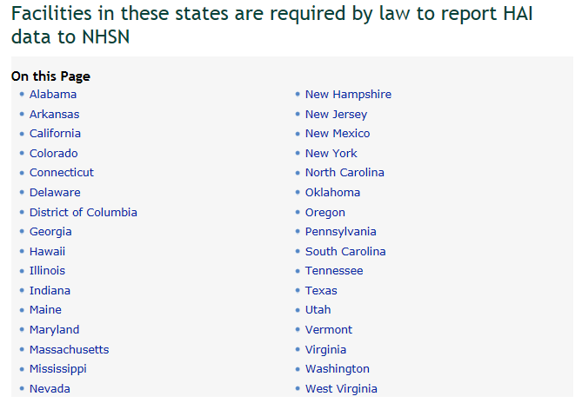
Notes:
5

Slide 6

Legislation Background
79th Legislative Session (2005) passed study bill
  Advisory Panel, White Paper
80th Legislative Session (2007) passed SB 288
  Reporting provisions
81st Legislative Session (2009) passed SB 203: Amended SB 288 (Chapter 98)
  Added two members to AP
  28 PAE
82nd Legislative Session (2011)
  Allows use of NHSN as electronic interface
83rd Legislative Session (2013) HB 3285
  Report HAIs that contributed to patient’s death

Slide 7
Chapter 98 Requirements
Establish 18 member Advisory Panel
Establish Healthcare Associated Infections (HAI) reporting system
Compile and make available to the public a data summary, by health care facility, at least annually
Allow health care facilities to submit concise written comments
Provide education and training
Ensure confidentiality & legal protections
Verify the accuracy and completeness of the data reported
Receiving reports from the public
Enforcement

Slide 8
Reporting Requirements
Who is required to report?
  State-Operated/Maintained hospitals that provide surgical or obstetrical services
  Ambulatory Surgical Centers
    Licensed under Chapter 243
  General Hospitals
    Licensed under Chapter 241
    INCLUDES SOME LTACs and CAHs with ICU/CCU/NICU
  DOES NOT INCLUDE COMPREHENSIVE MEDICAL REHABILITATION HOSPTIAL
Notes:
Who is required to report HAIs in Texas?
That would be:
State operated hospitals that provide surgical or OB services; Ambulatory Surgical Centers, licensed under Chapter 243; and General hospitals licensed under chapter 241.
It is important to note that CAHs and LTACS that are classified as General Hospitals, are required to report if they have ICUs or perform any of the reportable procedures.
I also want to point out that mandatory HAI reporting EXCLUDES comprehensive medical rehab hospitals

Slide 9
DSHS Reporting Requirements
  Central line-associated bloodstream infections (CLABSI) in the following special care settings: adult, pediatric and/or adolescent ICUs & NICUs (Level II/III & Level III Nurseries).
  Catheter associated urinary tract infections (CAUTI) in the following special care settings: adult, pediatric and/or adolescent ICUs.
Surgical site infections (SSI)
  CHILDREN’S HOSPITALS: Cardiac procedures, heart transplants, spinal surgery with instrumentation, and VP shunt procedures
  ALL OTHER GENERAL HOSPITALS & ASCs: Colon surgeries, hip & knee arthroplasties, abdominal & vaginal hysterectomies, vascular procedures, and coronary artery bypass grafts

Slide 10
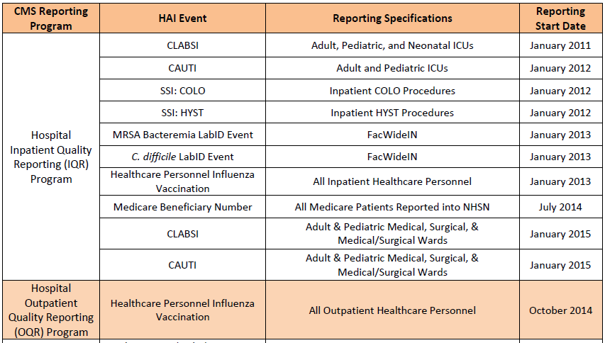
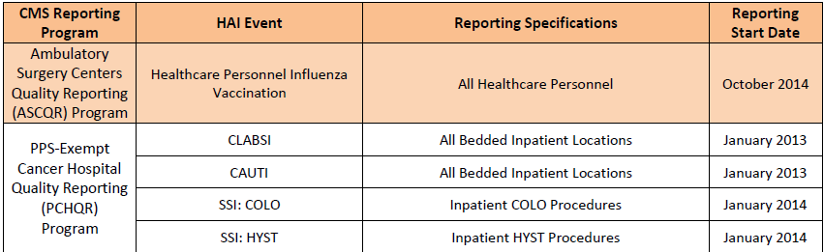
CMS Reporting Requirements
Notes:
10

Slide 11





HAI Reporting Overview
Alerts regarding data & reports
Texas Healthcare
- Safety Network -
View reports & make comments
Notes:
11

Slide 12
What is NHSN?
NHSN is a secure internet based surveillance system that was created and is maintained by the Division of Healthcare Quality Promotion (DHQP) at CDC
Provides a tool for healthcare facilities to collect information about healthcare-associated infections (HAIs) and other adverse patient events using…
  Standardized protocols
  Standard definitions
  Forms
  Analysis with comparative national data
  Outcome and process measures for performance improvement

Slide 13
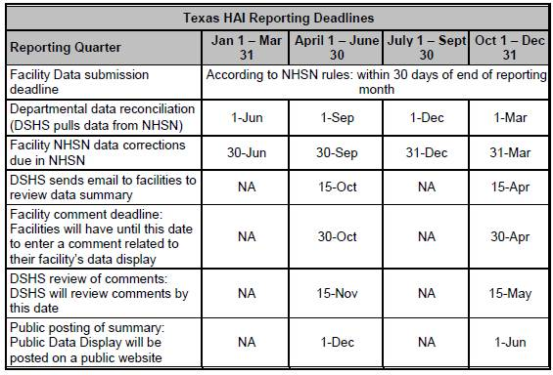
When Do We Report?

Slide 14
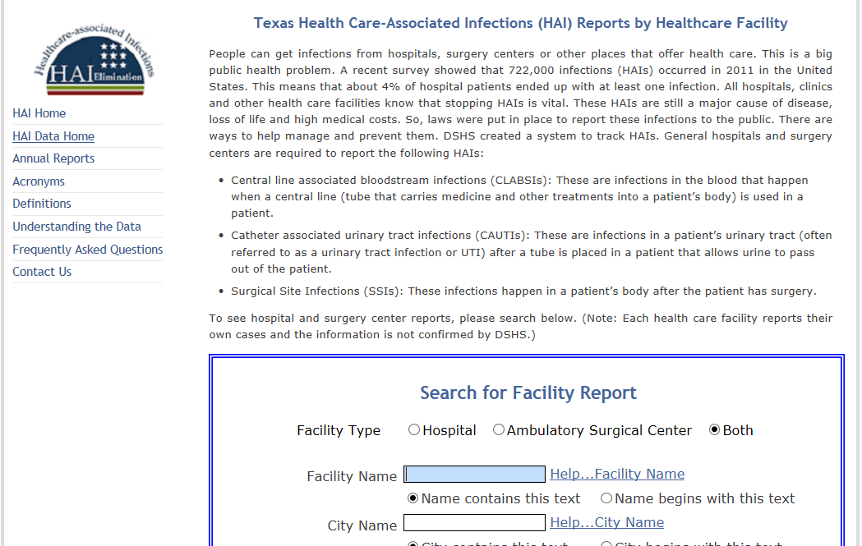
HAI Reports: http://txhsn.dshs.texas.gov/hai/

Slide 15
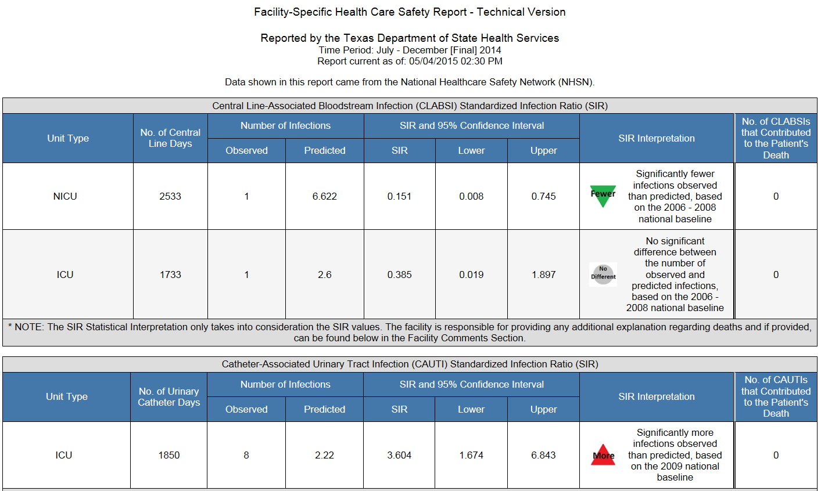
HAI Reports
Notes:
SIR – This is a ratio of the Observed number of infections to the Predicted number of infections.
If the SIR > 1, then the facility has a higher rate of infection than the national benchmark
If the SIR < 1, then the facility has a lower rate of infection than the national benchmark
If the SIR = 1, then the facility has the same rate of infection as the national benchmark
NOTE: If the Predicted number of infections is less than 1, then there is not enough data to calculate a SIR.
Statistical Interpretation/National Comparison: This interpretation takes into account whether the difference between the facility and the national experience is significantly different. If it is not statistically significant, then the facility is considered to have about the same experience as that of the nation.
(green down pointing arrow) Significantly fewer infections observed than predicted, based on the national baseline: this means that the facility has a lower rate of infection than the average health care facility and therefore doing better than the average health care facility in the nation.
(gray circle) No significant difference between the numbers of observed and predicted infections, based on the national baseline: this means that the facility about the same rate of infection than the average health care facility.
(red upward pointing arrow) Significantly more infections observed than predicted, based on the national baseline: this means that the facility has a higher rate of infection than the average health care facility and therefore is doing worse than the average health care facility in the nation.
(white box) The SIR is not calculated when the number of predicted infections is less than 1: Data were reported, but not enough to compare to the national baseline and be able to reliably determine whether they are doing better, worse or the same as the nation.

Slide 16
Data Validation: 2012-2014
Audit data for 6 month period:
  H1 (Jan – June)
  H2 (July – Dec)
Identify facilities based on Standardized Infection Ratio: If Statistically Significantly High
2 Audit Tiers:
  First Time High SIR – no high SIR for same HAI for previous time period)
  Subsequent High SIR – high SIR for same HAI for two reporting periods in a row
Notes:
SIR – This is a ratio of the Observed number of infections to the Predicted number of infections.
If the SIR > 1, then the facility has a higher rate of infection than the national benchmark
If the SIR < 1, then the facility has a lower rate of infection than the national benchmark
If the SIR = 1, then the facility has the same rate of infection as the national benchmark
NOTE: If the Predicted number of infections is less than 1, then there is not enough data to calculate a SIR.

Slide 17
Data Validation

Slide 18
Data Validation: 2012-2014
First Time High SIR (SSI, CLABSI and CAUTI):
  Purpose: To ensure facility is applying the CDC definitions correctly and to verify the number of infections reported to DSHS.
  Site visits for those facilities with significantly high SIRs to verify data reported meet NHSN HAI criteria
  Conducted by Contracted Infection Preventionists (IPs)
  Record Review & IP/Administration staff Interview

Slide 19
Data Validation: 2012-2014
Subsequent High SIR Investigations (SSI, CLABSI & CAUTI):
  Purpose: Once problem has been verified (from first time high SIR audit), DSHS will aid facilities in prevention efforts and provide consultation/support as needed.
  Conducted by CIC certified HAI Epidemiologists
  Phone consultation to review interventions taken and action plans in place at facility to determine if site visit is warranted
  If site visit needed, CIC HAI Epidemiologist will come to facility and may perform environmental rounds, interview floor staff, observe procedures/patient care activities, review policies and patient records.

Slide 20
First Time High SIR
Audit Process
Facility notification (via IP contacts) and list of MRs for review
RHD/LHD Notification
HAI Survey completed by Facility (general data collection questions)
Audit
  Initial Interview – Introductions/Explanation
  MR Review
  Exit Interview
Summary Report Sent to IP and CEO (and RHD/LHD if requested)

Slide 21
First Time High SIR
Audit Results: 2012-2014
97% of events were reported accurately. Those responsible for reporting, mostly Infection Preventionists, had a good grasp of requirements and definitions.
Found that facilities that were audited had very robust IP programs that were good at “finding” and identifying HAIs.

Slide 22
Next Steps:
Identify facilities who may be under-reporting (have no SIR or low SIRs)
Target education and training to these facilities that need it most
Caveat: This type of validation is VERY time and resource intensive.

Slide 23
New Way of Validation
Modeled after the NHSN CLABSI Validation Protocol
CDC recommends targeted validation in order to investigate and correct potential deficiencies in an efficient manner.
NHSN recommends 21 facilities be chosen via targeted selection and 5% of the remaining facilities selected randomly. For Texas, this is approximately 40 facilities.
  During the pilot phase of this protocol:
    8 targeted facilities
    ~4 (1%) facilities randomly selected facilities will be audited.
  After the pilot, this will be re-evaluated to determine time requirements based on available resources.

Slide 24
Facility Selection: Details
6 in the top 33% of facilities with highest number of expected/predicted infections are selected.
  Top 2 facilities with SIRs above the median
  Top 2 with SIRs at or below the median, but above 0
  Top 2 with SIRs = 0
The top 2 facilities without a calculated SIR that have the largest difference between expected and observed infections.
1% of all remaining facilities are randomly selected.

Slide 25
Record Selection
Selected facilities will be required to submit a line list of all positive blood cultures from the given audit period (6 months). Line list should include:
  MRN
  Gender
  DOB
  Admission Date
  NICU/ICU
  Name/Type of ICU (optional)
  Lab Specimen # (optional)
  Specimen Collection Date
  Organism Name

Slide 26
Record Selection
From the line list, DSHS will select:
  Up to 20 records of NHSN reported CLABSIs
  40 records of unreported candidate CLABSI events
    10 from NICU setting (if applicable)
    30-40 from adult/pediatric ICUs

Slide 27
Summary of CLABSI Validation Process
Notify facility and request line list of positive blood cultures
Select medical records for review and notify facility
Select site visit date and send Facility Audit Survey for completion by facility prior to site visit.
Notify CEO/Administrator, DSHS Regulatory and Regional/Local Health Departments about upcoming visit
Review Facility Audit Survey and perform site visit
  Introductions/Entrance Interview
  Chart Review
  Debriefing/Conclusions
Send Validation Summary Report to IPs, CEO/Admin and other staff as needed.

Slide 28
2015 Validation Overview
First Time High SIRs: This will remain the same for SSI and CAUTI
Subsequent High SIRs: This will remain the same for SSI and CAUTI
NEW CLABSI Validation: Only for CLABSI but hope to expand to other HAIs in the future (CAUTI/SSI to begin with 2016 data)
Subsequent High SIR CLABSI: TBD

Slide 29


Current DSHS Validation Team
Candace Campbell, MPH
DSHS Epidemiologist
Candace.Campbell@dshs.state.tx.us
Office Phone: 512.776.6488
Jennifer Vinyard, MPH, CIC
DSHS Epidemiologist
Jennifer.Vinyard@dshs.state.tx.us
Office Phone: 512.776.3773

