Slide 1
Texas Department of State Health Services
Local Health Department Contract Overview
Epidemiology & Laboratory Capacity Workshop
Eric Garza, MPH
Emerging & Acute Infectious Disease Branch
www.dshs.state.tx.us/idcu/

Slide 2
Exceptional Items
83rd Texas Legislative Session
Disease Outbreaks and Disaster Response
Foodborne epidemiologists positions in 17 local health departments
Transitioned into general epidemiologist positions
84th Legislative Session
Ebola
Epidemiologists positions for 28 local health departments

Slide 3
Local Health Departments

Slide 4
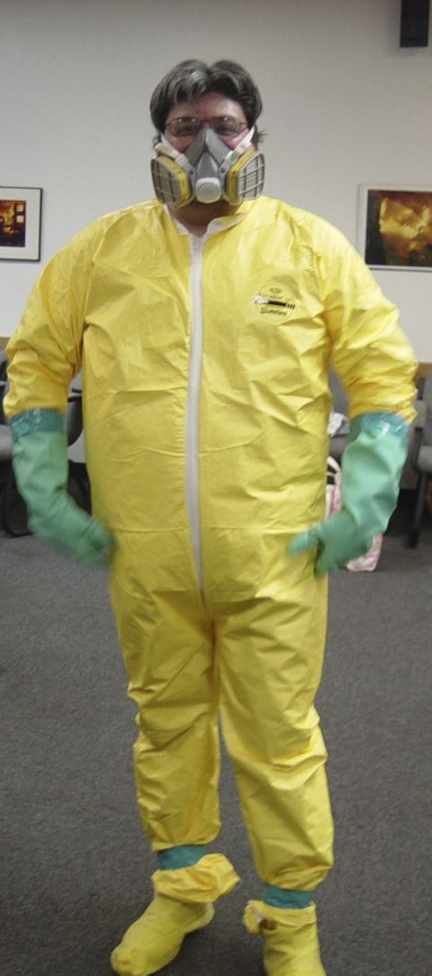
Eric Garza, MPH Epidemiologist, dshs eric.garza@dshs.state.tx.us 512-776-6825
Thank you!

