Slide 1
Using NEDSS for Surveillance
Rules of the road
Utilization of data

Slide 2
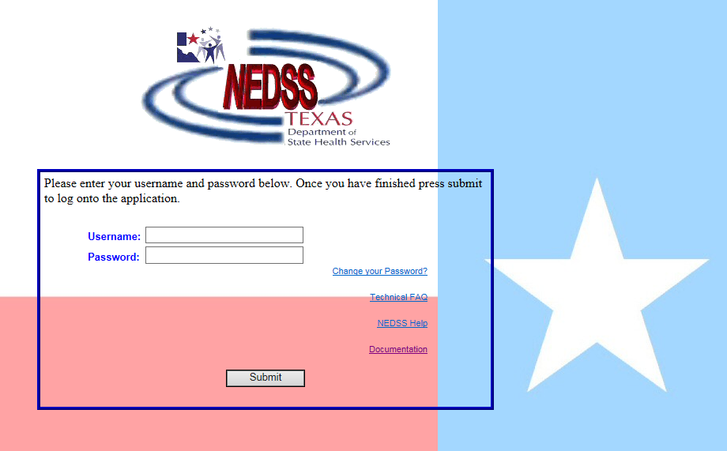
National Electronic Data Surveillance System
NEDSS
NEDSS Based System –
NBS
https://txnedss.dshs.state.tx.us:8009/login/login.asp

Slide 3
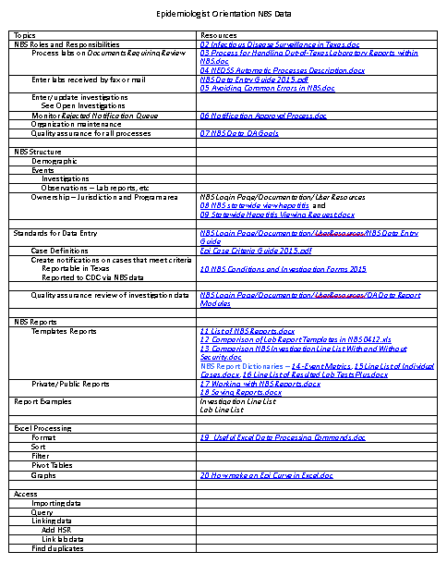
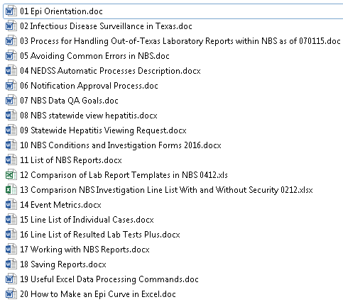
Epidemiologist Orientation - NBS Data (Section 5)

Slide 4
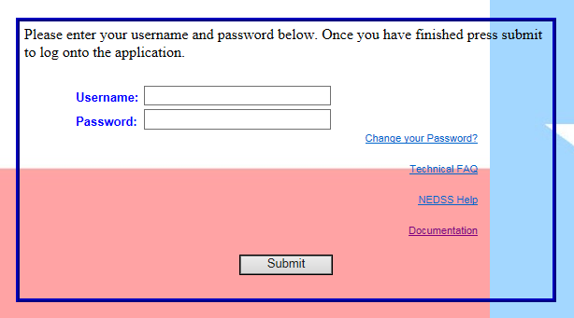
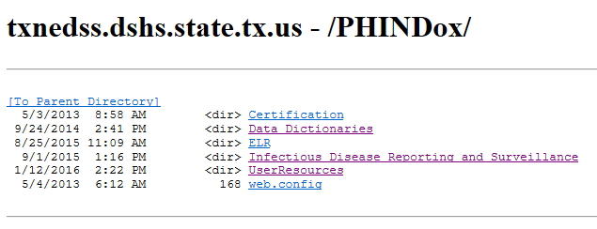
Documentation Link NBS Login Page

Slide 5
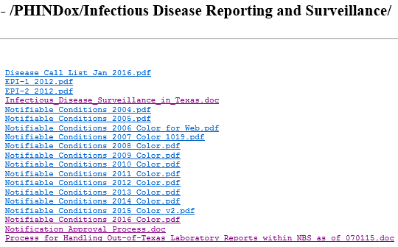
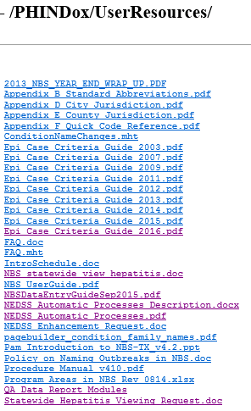
Useful Documents

Slide 6

NEDSS - Shared Data System
Common data
  Real-time views
  Stored data
  Reports
Case review
  Standardization
  Shared official cases
Roles and responsibilities
  Central office
  RHD
  LHD

Slide 7
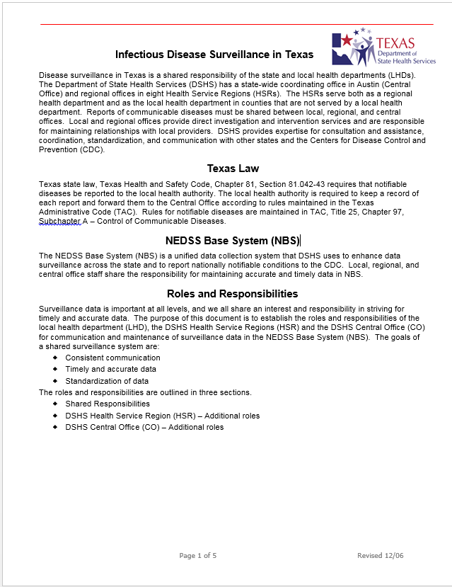
Infectious Disease Surveillance in Texas
Meeting was convened in 2006 to work on processes to utilize NEDSS as a shared data system
  Goals, responsibilities, and processes discussed and methods outlined
  Document published
  See 02 Infectious Disease Surveillance in Texas.doc or copy in txnedss.dshs.state.tx.us - /PHINDox/ Infectious Disease Reporting and Surveillance/
Goals of a shared surveillance system
  Consistent communication
  Timely and accurate data
  Standardization of data
02 Infectious Disease Surveillance in Texas.doc

Slide 8
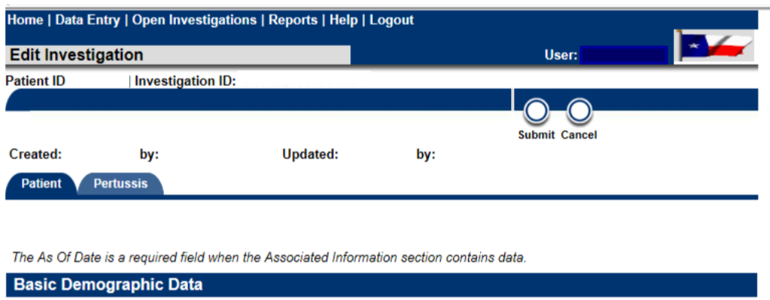
NEDSS Structure
Patient centric
  Patient file shows all investigations, lab reports, and other records
  Demographics kept with “as-of-date” as information is added
Investigations are the focus of epi interest
  Demographics are captured at time of creation
  Updates need to be entered in the Patient tab
  of the investigation
Data entered here
will be in investigation
report

Slide 9

NEDSS Structure
Ownership Silos – Permission Sets
  Jurisdiction
    Only see geographic jurisdictions assigned to you
    Central Office staff have statewide view
    RHDs see RHD and LHDs in their region
    LHDs see just their jurisdiction
    Applies to queues, events (investigations, lab reports, morbidity reports, vaccination history, etc. and report data
  Program Area
    RHDS and LHDs see most or all program areas in EAIDB and Zoonosis
      TB and animal rabies generally seen by different staff
    Central office staff limited by Program Areas relevant to their team
      This allows shorter queues and better focus than seeing all conditions statewide
      Laboratory reports need to be assigned to correct program area for appropriate CO staff to see it

Slide 10
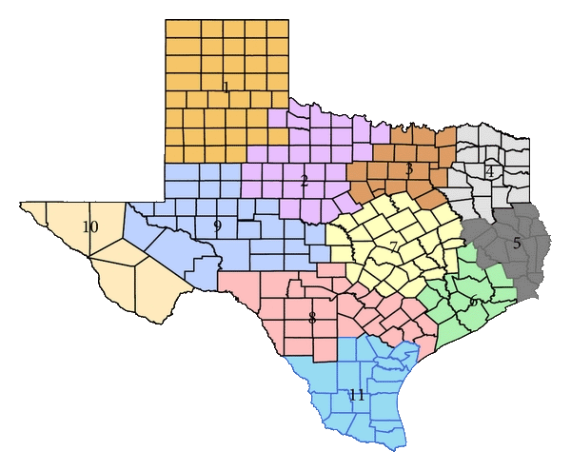
Statewide View
See description and request form in Documentation/UserResources
All jurisdictions have statewide view for MDRO program area
  CRE
  MDR-A
  VISA/VRSA
Available on request for hepatitis program areas
  Acute hepatitis A,D, E
  Hepatitis C
  Immunizations
  See 08 NBS statewide view hepatitis.docx and
  09 Statewide Hepatitis
  Viewing Request.docx
Pros
  See all hepatitis history for patient in NEDSS
  Allows more accurate and efficient classification of chronic cases
  Sort out jurisdiction when reports are in multiple jurisdictions
Cons
  See longer queues
  May need to filter for your jurisdiction when working on other conditions
  Remember to take action on hepatitis cases only in your jurisdiction

Slide 11
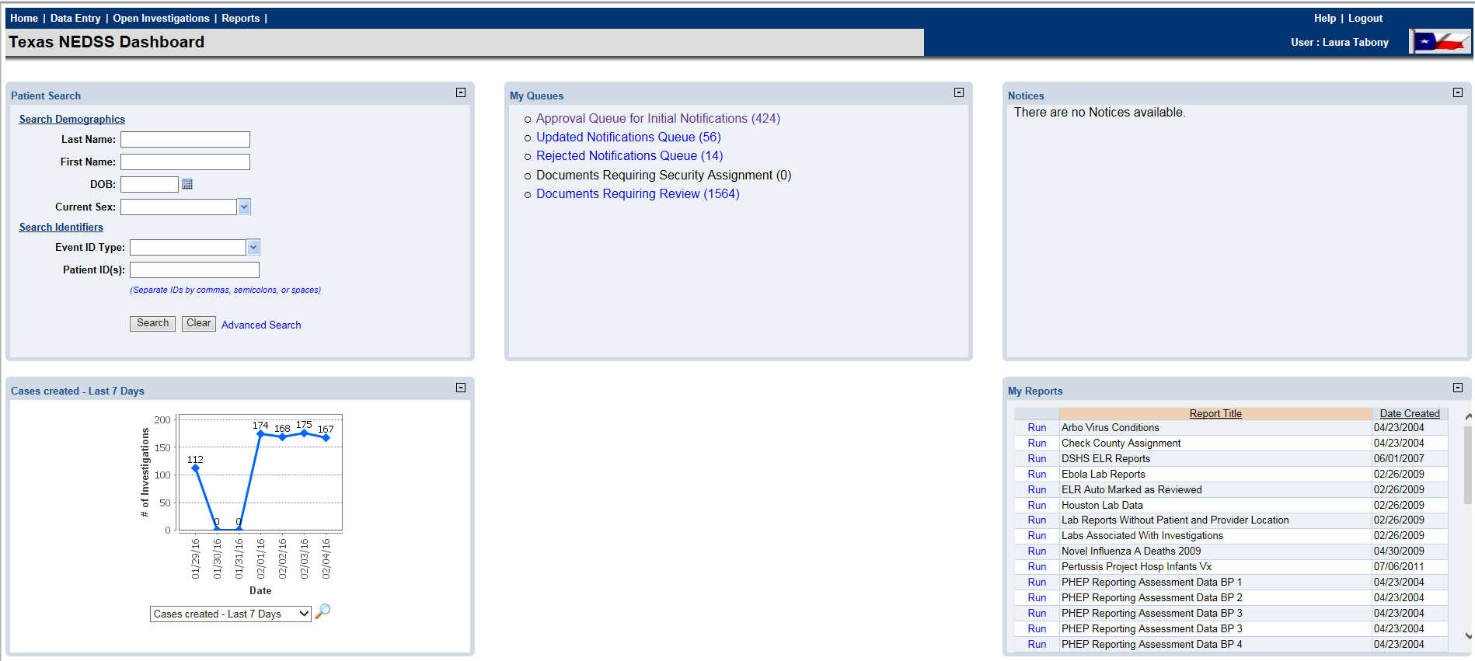
NEDSS – Home Screen
Work the queues
Notice the Notices board
Search for/create patients
Run Saved Reports

Slide 12
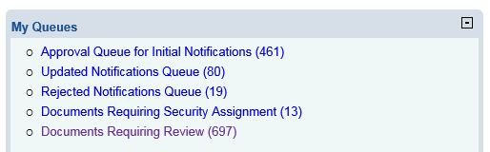

NBS Work Queues
Must have notification approval rights to see notification queues
Everyone sees Documents Requiring Security Assignment but only designated Central Office staff should process records on this queue
Everyone sees Documents Requiring Review and Rejected Notification queues
  See records for jurisdictions and program areas by permission set
    Keep open until complete
The Open Investigations should be used to track investigations until completion
    Create notification* as soon as there is enough information to meet case definition
    Keep open until complete
*See Notifications slide regarding records that require notifications and those that should not

Slide 13
Notifications
NBS Conditions with Suspect Case Status
Requiring Notification, 2016
Condition (s) | Case Status*
Amebiasis | Confirmed and Suspect
Creutzfeldt-Jakob disease | Confirmed, Probable, and Suspect
Dengue | Confirmed, Probable, and Suspect
Malaria | Confirmed and Suspect
Meningococcal infection | Confirmed, Probable, and Suspect
Salmonellosis | Confirmed, Probable, and Suspect
Shigellosis | Confirmed, Probable, and Suspect
Viral Hemorrhagic Fever | Confirmed and Suspect
Create notifications if:
  Reportable in Texas
  Confirmed or Probable meeting case definition (and Suspect for prion diseases)
  Suspect case definitions for some conditions for program tracking purposes. (Not included in case counts)
    See 10 NBS Conditions and Investigation Forms 2016.docx or NEDSS Data Entry Guide at txnedss.dshs.state.tx.us - /PHINDox/UserResources/
  Not a Case status if previous rejected notification
*Create a notification for “Suspect” cases that are listed. If “Suspect” is italicized, it will not be included in official case counts, but it is being tracked for programmatic reasons and should be left as a final status if appropriate. Non-italicized “Suspect” (CJD) indicates an official case count. Do not create notifications for other conditions that have a suspect case definition in the Epi Case Criteria Guide; that is an indicator of a case that should be investigated, not a final status.

Slide 14
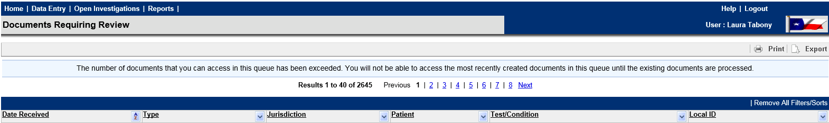
Sweeping the Documents Requiring Review Queue
When the Documents Requiring Review queue exceeds its limit, the most recent lab reports will not be displayed
To control queue size and to keep processing efficient, some lab reports are automatically marked as reviewed or “swept” from the queue
  Lab reports that do not indicate a reportable condition that needs to be investigated
  All hepatitis C ELRs are removed after 48 hours
  All Houston and Harris county ELRs are swept daily (NBS is not their primary system)
  All ELR reports are swept off the queue after 90 days
Resources
  See NEDSS Automatic Processes Description for a full description and instructions on how to pull a report of lab reports that have been “swept” by the system and NEDSS Automatic Processes.pdf which lists the parameters and schedule at txnedss.dshs.state.tx.us - /PHINDox/UserResources/.
  Also in notebook - 04 NEDSS Automatic Processes Description.docx.

Slide 15

LHD/RHD Responsibilities
Enter labs received by fax or mail
  See 04 Avoiding Common Errors in NBS.doc
Review incoming lab reports in Documents Requiring Review queue
  See 03 Process for Handling Out-of-Texas Laboratory Reports within NBS as of 070115.doc
Enter/update/close investigations
  Within 30 days (actually less)
  See txnedss.dshs.state.tx.us - /PHINDox/UserResources/NBS Data Entry Guide
Create notifications on cases that meet reportable criteria
  Only create notifications for conditions reportable in Texas
    Confirmed, Probable, and sometimes Suspect
    Not a Case only to clear a rejected status
  See 07 NBS Conditions and Investigation Forms 2016.docx
Process Rejected Notifications Queue
  Within 10 business days
Quality assurance for all processes
  See 07 NBS Data QA Goals.doc

Slide 16

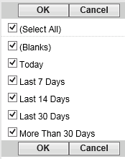
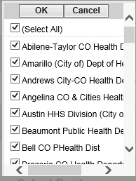

Tips for Monitoring Documents Needing Review Queue
Date Received shows oldest at top
  View ones that are getting too old to meet completion within 30 days and take action
Click on Date Received to sort with newest on top and check for new reports that are urgent or use date filters
Best practice is to process off queue as soon as possible
  Create investigation
  Attach to existing investigation
  Mark as reviewed
If you have statewide view you may want to filter by jurisdiction when not working on hepatitis or MDROs

Slide 17
Central Office Responsibilities
Maintain standards for case criteria and data entry
  Epi Case Criteria Guide
  NBS Data Entry Guide
  Both are in txnedss.dshs.state.tx.us - /PHINDox/UserResources/
Review investigations in Approval Queue for Initial Notifications
    See 05 Notification Approval Process.doc
    Approve or reject with comment on what needs to be remediated
Monitor Documents Requiring Review queue for out of state lab reports
  Forward information to other states
Quality assurance for all processes

Slide 18

Data Quality Assurance
Notification review Central Office
  Case status criteria reflected in data entered
  Condition concordant with lab reported test results
  Basic demographic information completed
  See 06 Notification Approval Process.doc
Monitoring queues for timeliness – LHD/RHD
      Documents Requiring Review - within 2 weeks
      Notification Rejection - within 10 days
      Open investigation queue – review older investigations and complete
Ongoing Data Review – LHD/RHD
    Line list of investigations
      Filter for blank County, Birth Time, Sex, Race/Ethnicity
      Filter for closed confirmed and probable cases without a notification (First Notification Date = blank)

Slide 19
Quality Assurance Goals
Annual Quality Assurance Goals - See 07 NBS Data QA Goals.doc
Annual Quality Assurance Goals
  All of the MMWR Year’s records have been processed off of all of the queues on the NBS home page
  All of the MMWR Year’s cases are entered and are identified as that year MMWR Year and Event Date
  All of the MMWR Year’s records have a final Case Status (“C”, “P”, “N”, or, if defined as a final status, “S”) that meets the case definition for that classification
  All records with Case Status of “C” or “P” have a notification that has been approved and sent to CDC (Texas reportable conditions only)
  Each record has a date of birth (Birth Time) or age (Age Reported) that is reasonable for the condition
  Each record has sex assigned (Current Sex Code = “F”, “M”, or “U” - preferably “F” or “M”)
  As many records as possible have race (Concatenated Race Description) and ethnicity (Ethnic Group)
  Records do not have both unknown race and selected races(s)
  Each record has a County and it is consistent with address and jurisdiction
  Records with died from illness = Yes also have deceased = Yes and a date of death entered on the patient tab of the investigation and patient with deceased = yes have yes, no, or unknown for did the patient die from this illness.
  There are no duplicate cases in the data set of approved confirmed and probable cases
  All investigations of approved confirmed and probable cases are closed (Investigation Status Code is “C”)
  Earliest date suspected is not before onset date. Cases with onset date = earliest date suspected should also be reviewed to assure proper date was selected.
  Other than date of birth, other dates in record should not be in a prior year except for conditions that cross years such as Chagas Disease, CJD, Hansen’s disease, and pediatric influenza mortality.
See NBS Login page - Documentation/UserResources/QA Data Report Modules

Slide 20
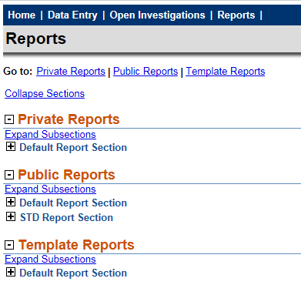
NBS Reports
See 11 List of NBS Reports.docx for description of reports
See txnedss.dshs.state.tx.us - /PHINDox/Data Dictionaries/
All reports start as template reports
Complex reports may be saved to reuse
  Advanced filters
  Field selection and order
  Public or private copies
    Public to share – delete after shared or no longer needed
    See 17 Working with NBS Reports.docx and 18 Saving Reports.docx
Public reports may be altered (filters and/or fields)
  Export data
  Structure will not be altered
  Changes can only be saved by original author
Data tables for the NBS Reports refresh each night. Changes made will not be available in the report data until the following day, even though they are available in the patient view as soon as the record is saved.

Slide 21
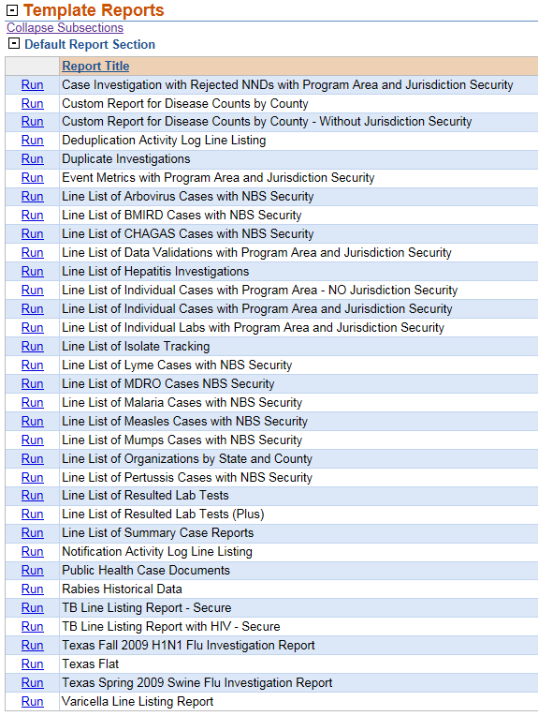

Useful NBS Template Reports
Event Metrics
  Person who created each event with both name and NBS user ID
Line List of Individual Cases with Program Area and Jurisdiction Security
  Limited to jurisdiction you have permission for
  Has basic investigation information including system dates and actions and patient demographics
  Can use Line List of Individual Cases - NO Program Area and Jurisdiction Security to see statewide data
    See 13 Comparison NBS Investigation Line List With and Without Security 0212.xlsx
Line List of Resulted Lab Tests (Plus)
  Most complete lab data
    See 12 Comparison of Lab Report Templates in NBS 0412.xls
  Has field (Investigation Local ID) that can be used to link to investigation data (Investigation ID2) for lab reports that are attached to an investigation
The data dictionaries for these 3 reports are in the notebooks

Slide 22
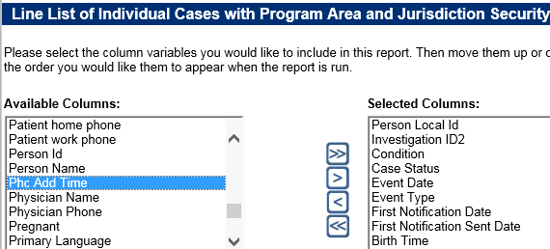
Useful NBS Report Fields – Investigation Line List
Person Local ID (PSN48#######TX01)
  NOT “Person Id” – this is an RDB table ID – not useful to you.
  Use unique numeric string between PSN48 and TX01 to look up patient record from Home page
  In Excel, use find and replace (ctrl H) to find PSN48 and replace with nothing, then find TX01 and replace all to trim entire column down to searchable number.
  PSN number associated with a record may change over time due to patient merges.
Investigation ID 2 (CAS48#######TX01)
  NOT “Investigation ID” – this is an RDB table ID – not useful to you.
  Will not change over time
  Use whole string to look up record by Event ID Type – Investigation ID
  Can be used to link to lab line list data
Condition and Case Status
  Basic fields to assure you have included the correct records for your purpose
  Exclude “Not a Case” in case count and QA data
  Use the correct subset of Confirmed, Probable, and Suspect for your purpose
  Include blank and Unknown Case Status for QA
Event Date and (Event Type)
  Event date is a system generated triaged date
  Event date defaults to one of the following dates , in the order displayed:
    1. Onset Date (O)
    2. Diagnosis Date (D)
    3. Report to County Time (C)
    4. Report to State Date (S)
    5. Phc Add Time (date investigation was created) (P)
  Onset date will be used if available. Data in lab reports is not utilized. Diseases which do not have a diagnosis date field substitute another investigation date in place of diagnosis date in the event date calculation , usually collection date of first positive culture.
First Notification Date
  This is the date the first notification is created. It is a static date unless the notification is rejected. That action resets this field to blank until another notification is created.
  Use this field in reports to assure all completed investigations that are reportable have notifications.
First Notification Sent Date
  This is the date the first notification is approved and sent to CDC.
  Most records should have a First Notification Sent Date within 30 days of first report to public health. Allow tome for notification review and corrections.
Birth Time (DOB)
  There are 2 age dates in the line list but each have limitations. It is recommended for most purposes that age be calculated using the Birth Time and Event Date.
    Age reported is based on age when investigation is created. It is close but may cross age categories.
    Patient Age At Onset is a manually entered date and may be blank or inaccurate.

Slide 23
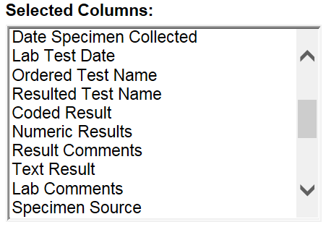
Useful NBS Report Fields – Line List of Resulted Lab Tests Plus
Person Local ID (PSN48#######TX01)
  Use unique numeric string between PSN48 and TX01 to look up patient record from Home page
  In Excel, use find and replace (ctrl H) to find PSN48 and replace with nothing, then find TX01 and replace all to trim entire column down to searchable number.
  PSN number associated with a record may change over time due to patient merges.
Lab Local ID (OBS48#######TX01)
  Will not change over time
  Use whole string to look up record by Event ID Type – Lab ID
Investigation Local ID (CAS48#######TX01)
  Can be used to link to investigation line list data
Date Created
  Often Use as primary filter instead of Event Date range – will not change
  Event date is triaged date - Event date defaults to one of the following items, in the following order 1) Specimen collection date, 2) Lab test date, 3) Date received by public health.
Program Area
  Use for selection or stratification
  Condition Name is >60% blank
Jurisdiction Code
  Use Jurisdiction Code in filter rather than Jurisdiction Name. There is a known unfixed bug that may result in incomplete data using Jurisdiction Name.
  May use Jurisdiction Name as column selected in report
ELR Indicator
  Y – ELR lab report
  N – Manually entered lab report
  blank – Lab report simulated from a morbidity report
Case Review Status
  LOG_DEL – Deleted record
  PROCESSED – Action taken - off Documents Requiring Review queue
  UNPROCESSED –On Documents Requiring Review queue
  blank – Lab report simulated from a morbidity report
Last Changed User Name
  Filter for Last Changed User Name = Elrload, NEDSS and Case Review Status = PROCESSED to find lab reports that were auto marked as reviewed.
Ordered and Resulted Test Names and Result Fields
  Ordered Test Code and Resulted Test Code
    Useful to build filters to select specific test results

Slide 24

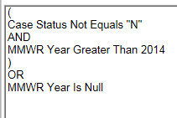
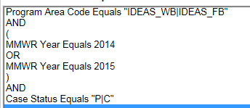
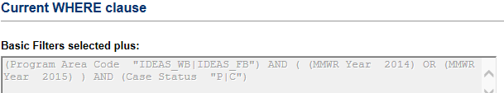

Report Logic
Logic Separators
  Use AND between fields if both must be true
  Use OR between fields when only one must be true
  Use () around multiple statements for one field and to separate OR and AND statements
Use arrows to move statements
  Up Down
  Out - One row or All
  If report returns no data, check your logic
Filters – Must use at least one filter
  Do not have to use basic filter if you use an advanced filter
Logic choices depend on field type
  Categories
  Numeric
Categorical data
  Equals or Not Equals
    Choosing from drop down list – can use Ctrl key to select more than one
    Free text – must be exact- case sensitive
  Is Null or Is Not Null
Numeric data
  Equals or Not Equals
    Type one date or number
  Between
    Type date range - inclusive
  Less Than or Greater Than
    Type one date or number – not inclusive
Insert logic as selected
Example 2
Example 1
SQL View

Slide 25
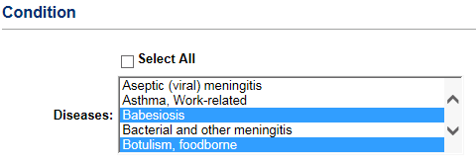
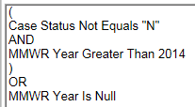

NBS Public Reports
Public and private report template filters and report fields can be altered as needed.
Advantages – Utilize existing complex filters Utilize existing field selection and organization
QA Data Example – current structure
  Basic filter – reportable conditions selected
    Update each year as reportable
    conditions are added and deleted
  Advanced filter – exclude Not a Case and selects based on MMWR Year criteria
  Fields selected and grouped – IDs, condition and status, dates, location, demographics
Edit for other usage as needed
  Include only confirmed, probable cases, and suspect cases
  Edit MMWR Year
  Add, remove, or rearrange selected columns
Export date
You can’t save changes to a public report unless you are the author.

Slide 26
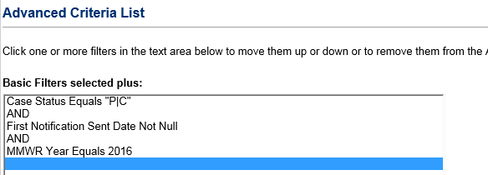
Case Count Data
NBS has cases that have been ruled out, are in the process of being investigated and approved, and completed cases.
For case counts select the appropriate filters
  Case Status – Confirmed or Probable
  Use First Notification Sent Date not null for cases that have been finalized and approved
  Time frame – by MMWR Year
Use report filters or filter in Excel
Provisional data levels
  Include cases without final status that have not been ruled out
  Include cases with final status with notification created (First Notification Date not null)
  Include cases with final status with notification created (First Notification Sent Date not null)

Slide 27

Preparing NEDSS Report Data in Excel
Open CSV file and save as Excel
Format data
  Expand fields
    Click in upper left-hand corner to select all data and double click a column divider
  Format dates
    Select first column with date, right click, format cells, select top date format
    Select other date columns and use F4 (repeat last action key) to format others
  Resize columns that are too wide for screen
    Select column, right click, resize column from 255 to 25. Use F4 (repeat) for additional columns
  Trim Person Local ID to unique digits
    Use Find and Replace (Ctrl H)
    Find “PSN48” and replace with nothing
    Find “TX01” and replace with nothing
    This will allow easy copying to look up patient in NBS
  Save as Excel file
View data
  Filter
  Pivot tables

Slide 28

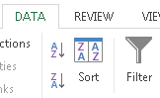

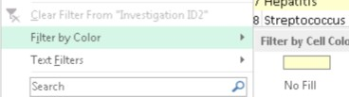
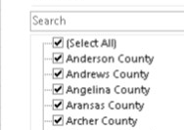
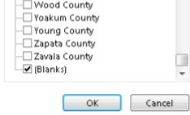
Filtering NEDSS Report Data in Excel
Filter data
  Select all data by clicking in upper
  left hand corner
  In the menu bar, click on Data and Filter
Filter to select data of interest
  Blank County
Quick QA using filters
  Filter for each of the following one at a time and highlight the rows
    County blank
    Birth Time blank
    Case Status blank or “U”
    First Notification Date blank
  Filter for the highlighted color
  Remediate the records

Slide 29
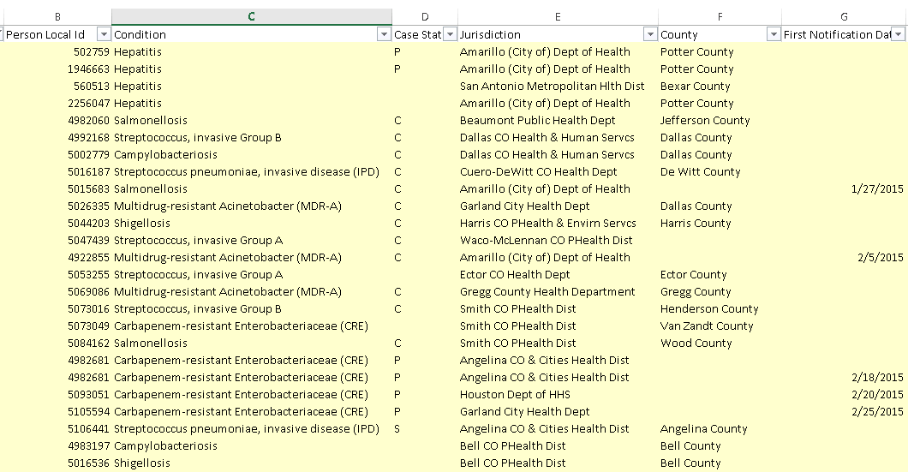
Filtering Results

Slide 30
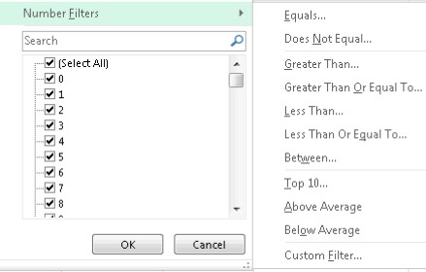
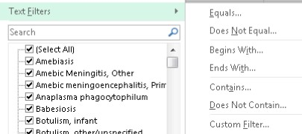
Filtering NEDSS Report Data in Excel
Filtering options – text
  Selection
  Search
  Text content
Filtering options – numeric
  Selection
  Numeric range

Slide 31
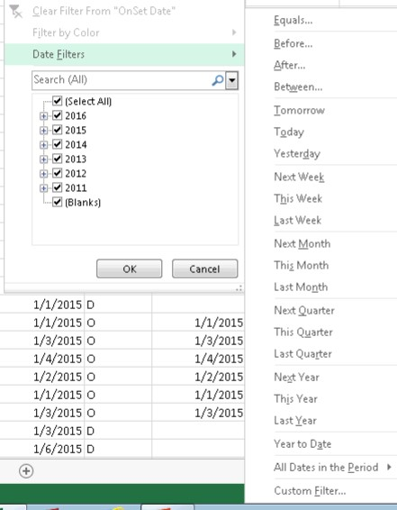
Filtering NEDSS Report Data in Excel
Filtering options – date
  Selection
  Search
  Date ranges

Slide 32
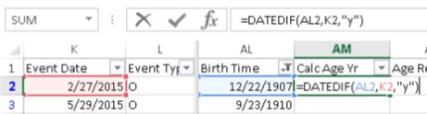
Data Enhancement - Age
Calculate age using Event Date and Birth
Calculate Age in years using DATEDIF formula
  Sort by Birth Time (DOB)
  If DOB = 1/1/1901 assume it is a fictitious date and delete it (year increases by 1 each year) then resort
  Filter for Birth Time not blank
  Create a new column, Calc Age Yrs
  Format the cells in the column as numbers with no decimals
  Use the DATEDIF function to calculate the age in years at event date
  Copy the formula down the Calc Age Yrs column through the rows that have a Birth Date value
  Filter for Birth Time is blank
  Fill in with age from other age field if available
  Type Unknown if no age data is available
=DATEDIF(cell,cell,”y”)
  In DATEDIF formula earlier date goes first
  =DATEDIF(Birth Time cell,Event Date cell,”y”) for age in years
  Use “y” for age in years, “m” for age in months, and “d” for age in days
Event date = Onset date if known and will not be blank
Most accurate age
  Age Reported is the patient’s age when the investigation is entered in NEDSS
  Patient Age At Onset is a manually entered field and is very incomplete and subject to error

Slide 33
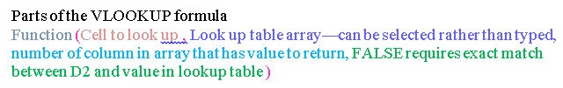
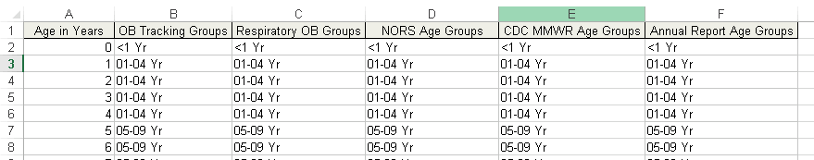
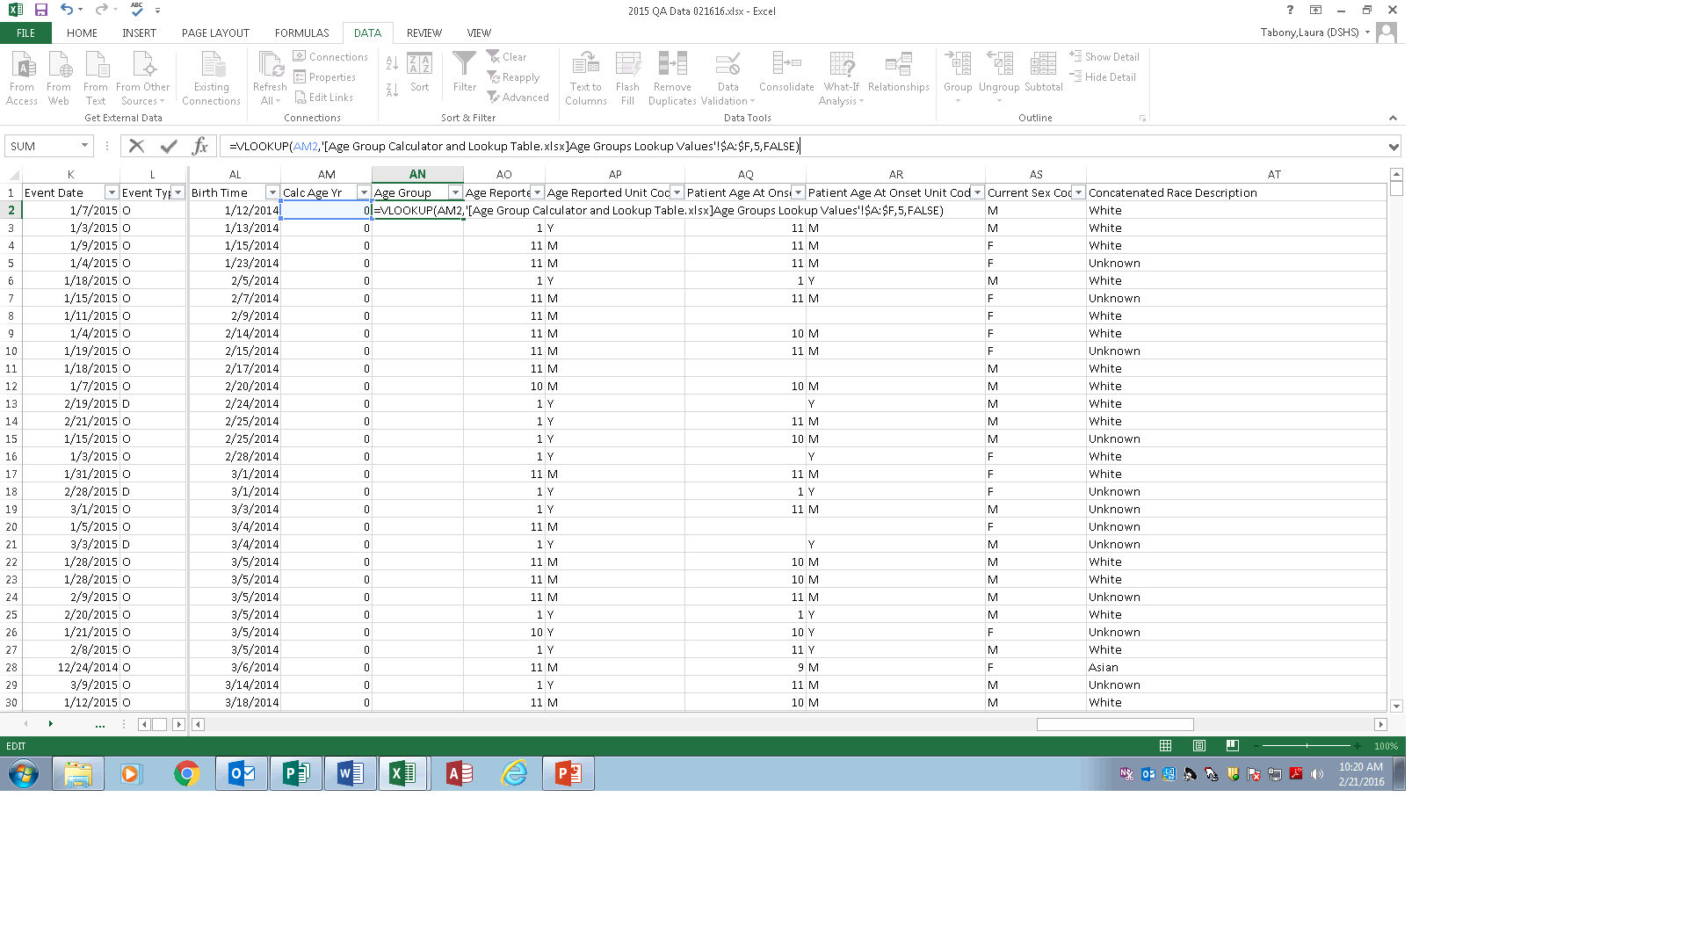
NEDSS Report Excel Data Enhancement – Age Group
Copy Calc Age Yrs column and Paste Special as values in same column
Sort by Calc Age Yrs
Create a new column, Age Group
Use VLOOKUP to fill in age group
  Format the cells in the column as text
  Use Excel file with ages and desired age groups as look up table
  Use the VLOOKUP function to fill in the age group based on Calc Age Yrs
  Copy the formula down the Age Group column
  Filter Age Group and assure there are no blanks
Parts of the VLOOKUP formula

Slide 34
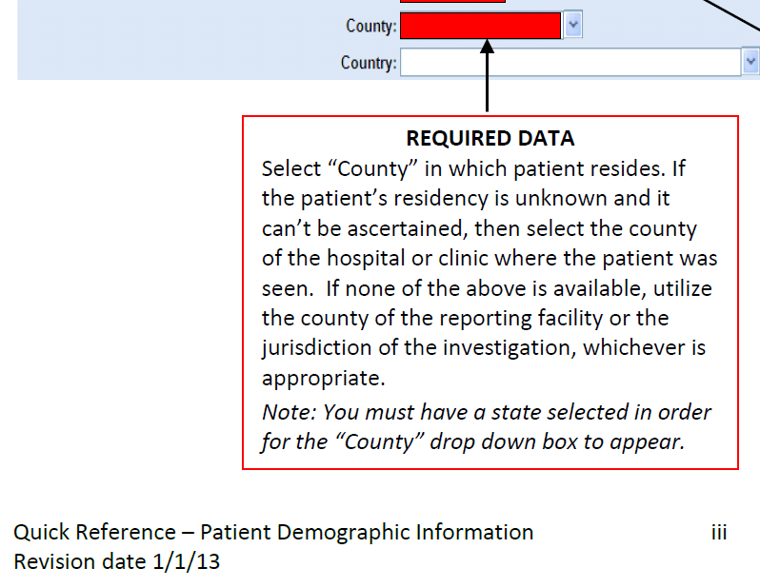
Data Enhancement - HSR
Sort by Jurisdiction
  Filter for Out of State then enter Out of State for HSR and HSR Group
Sort by County and select County not blank and Jurisdiction not out of state
  Use VLOOKUP table to assign HSR and HSR group by county
Select County is blank
  Use VLOOKUP table to assign HSR and HSR group by jurisdiction
Remediate missing counties in NEDSS on patient tab of investigation
  Patient county
  If patient address unknown use county of ordering provider or ordering facility
  If provider unknown use county of reporting facility or investigating jurisdiction as appropriate
  Do not assign city or zip if patient address is unknown
See DEG quick reference guide for investigations

Slide 35
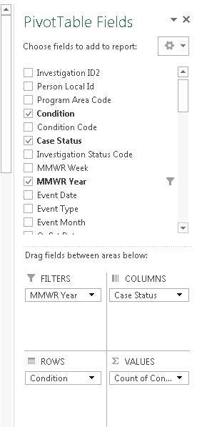
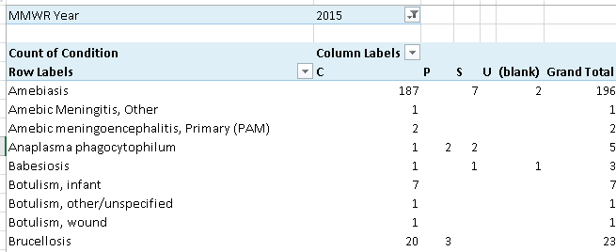
Excel Pivot Table
Use a field for values that does not have blanks – usually a required or system generated field
Use page filters or row and column filters as needed
Rename labels

Slide 36
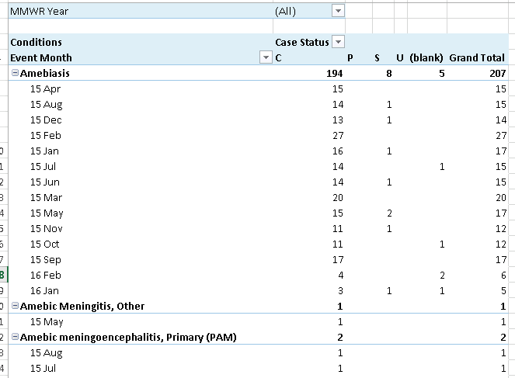

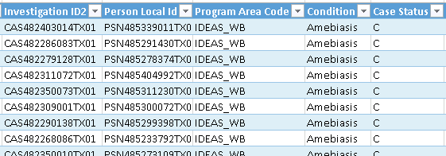
Excel Pivot Table – Stacked Rows
Stack rows
Generate line list for any
subset by right clicking on cell

Slide 37
Excel Pivot Table - Percentage
Percentage or row, column, or total
  Value – condition x 2
  Select cell in 2nd column for pertussis, rt click, show values as, % of column total
  Rename columns Count and Percent; format % to 1 decimal
 | Pertussis |  | Varicella (Chickenpox)
Age Group | Count | Percent | Count | Percent
<1 Yr | 285 | 19.9% | 185 | 12.7%
01-04 Yr | 278 | 19.4% | 342 | 23.4%
05-09 Yr | 208 | 14.5% | 415 | 28.4%
10-14 Yr | 203 | 14.2% | 193 | 13.2%
15-19 Yr | 97 | 6.8% | 80 | 5.5%
20-24 Yr | 19 | 1.3% | 51 | 3.5%
25-29 Yr | 35 | 2.4% | 35 | 2.4%
30-34 Yr | 42 | 2.9% | 34 | 2.3%
35-39 Yr | 48 | 3.4% | 42 | 2.9%
40-44 Yr | 37 | 2.6% | 33 | 2.3%
45-49 Yr | 39 | 2.7% | 18 | 1.2%
50-54 Yr | 35 | 2.4% | 5 | 0.3%
55-59 Yr | 25 | 1.7% | 10 | 0.7%
60-64 Yr | 21 | 1.5% | 3 | 0.2%
65+ Yr | 58 | 4.1% | 14 | 1.0%
Grand Total | 1430 | 100.0% | 1460 | 100.0%

Slide 38
Excel Pivot Table - Charts
Graph food and water borne conditions by event month
  Use program area filter
  Use jurisdiction filter to look at each jurisdiction
  Pivot table: Filters – Program Area and Jurisdiction, Row- Event Month, Column and Value – Condition
  Show creating line graph from pivot table; switch row and column (rt click, select data, switch)
  Hide all field buttons on chart
  Add title and axis titles (Design, Add Chart Element)

Slide 39

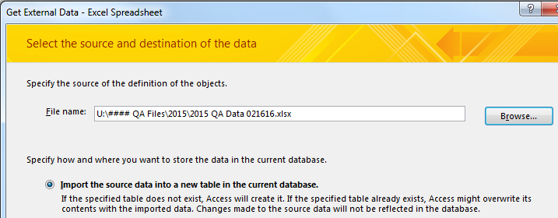





Using NEDSS Report Data in Access
Import into Access
  Open/Create Access database
  External Data tab
  Excel
  Browse
    Select file
    OK
Prepare data for import
  Run report data -> CSV file exported
  Expand fields
    Click in upper left-hand corner to select all data and double click a column divider
  Format dates
    Select first column with date, right click, format cells, select top data format
    Select other date columns and use F4 (repeat last action key) to format
  Delete extension on Zip Code
    Use Find and Replace (Crtrl H),
    find “-****” and replace with nothing
  Save as Excel file

Slide 40
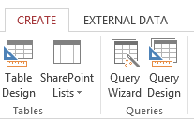
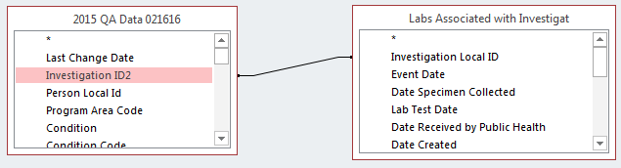
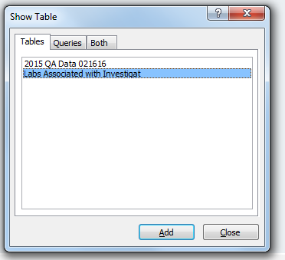
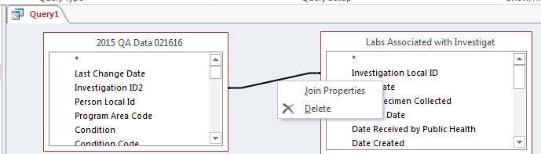
Access Query – Join Lab and Investigation Data
Create in Query Design
Add tables by double clicking on each
Click on Investigation ID2 in investigation data and drag to Investigation Local ID in lab data
Then click on line to get join properties

Slide 41

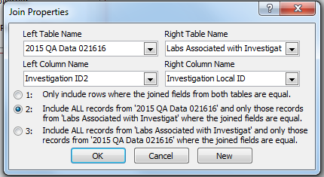
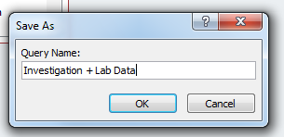
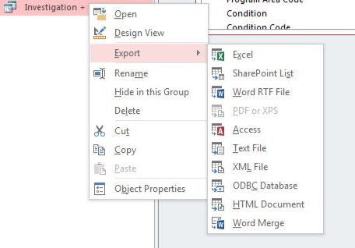

Access Query – Join Lab and Investigation Data – continued
Select all investigation
and matching lab records
OK
Select fields by pulling down to Field row.
Use * to select all fields
Select datasheet view to check
Save file
Right click on query and select Export and Excel

Slide 42





Access Query – Find Duplicate Query
Select fields to match on (e.g., Person Local ID and Condition)
Select fields to include. Use >> to select all.
Compare duplicates
  Consider whether different species of organism or separated by enough time to be separate cases
  If duplicates – close 1 as Not a Case and conserve best information in surviving record (earliest date reported, completeness of data, etc.)
Create in Query Wizard
Select Find Query Wizard
Select table with data to be checked

Slide 43





Email Packet – Electronic resources
Email request to laura.tabony@dshs.state.tx.us

