Slide 1
Neglected Tropical Diseases
Keeley Morris
Greg Leos
Inger Vilcins

Slide 2
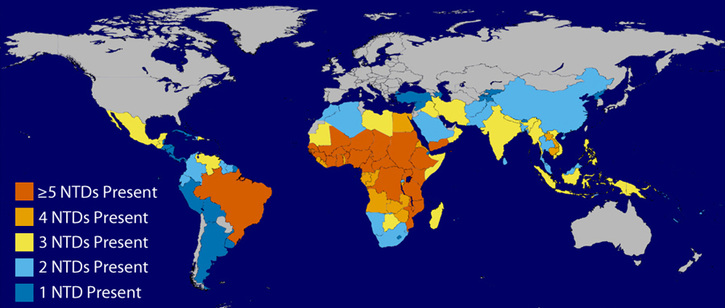
What is a Neglected Tropical Disease?
Affect of one billion people globally
Referred to as “neglected” diseases because they are largely eradicated in developed countries and affect only the world’s poorest populations
In the United States there is concern that these disease may be present but relatively undetected/unreported, leading to considerable knowledge gaps for how these disease may affect people living in the US
Notes:
When we say “neglected tropical diseases” we a referring to a group of diseases that impact over a six of the worlds populations. These diseases lead to significant morbidity and mortality among the poorest of the poor. They thrive in areas with poor sanitation where access to clean water is lacking. 100% of low-income countries are impacted by 5 or more neglected tropical diseases.

Slide 3
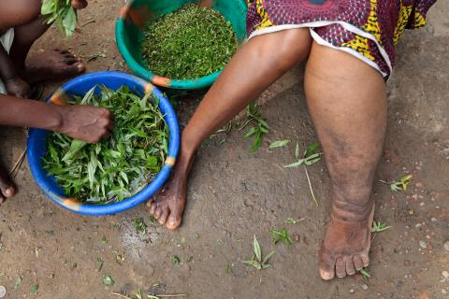
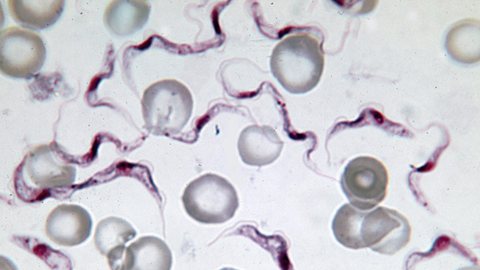
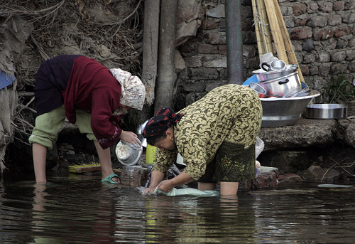
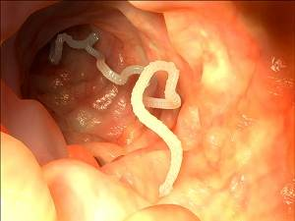
Neglected Tropical Diseases (NTDs)
Buruli ulcer | Leprosy (Hansen’s disease)
Chagas disease | Lymphatic filariasis*
Cysticercosis | Onchocerciasis*
Dracunculiasis (Guinea Worm Disease)* | Rabies
Echinococcosis | Schistosomiasis*
Human African Trypanosomiasis (African Sleeping Sickness) | Soil-transmitted Helminths (ascariasis, hookworm, and trichuriasis)*
Fascioliasis | Trachoma*
Leishmaniasis | Yaws
Notes:
Here is a list of what the WHO considers to be a neglected tropical disease. The diseases with an asterisk beside the name are treatable via mass drug administration. Mass drug administration for these diseases is considered extremely safe. These drugs are capable of treating several diseases at once and cost only 10-50 cents per person per year.

Slide 4
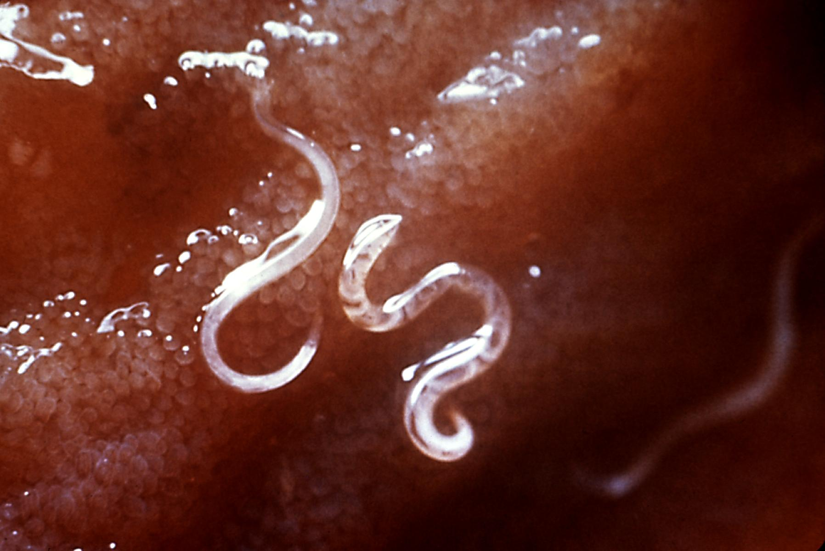
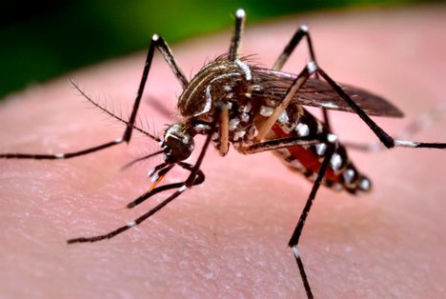
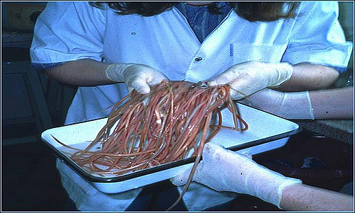
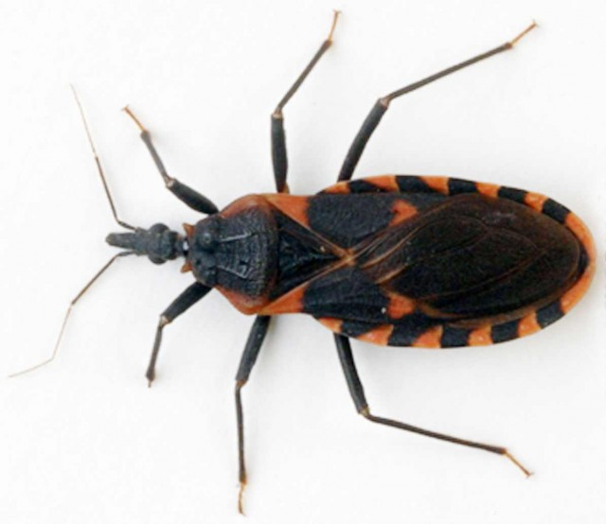
Neglected Tropical Diseases in Texas
Ascariasis*
Cysticercosis
Chagas disease
Dengue/Severe dengue
Echinococcosis*
Fascioliasis*
Hookworm (ancylostomiasis)*
Leishmaniasis
Leprosy (Hansen’s disease)
Paragonimiasis*
Rabies
Taeniasis
Trichuriasis*
*Newly reportable in 2016
Notes:
Although these diseases are rare in developed countries there has been growing concern that they may persist amongst our nations poor. In the U.S. areas of extreme poverty that lack access to clean water and proper sanitation are at increased risk for endemic transmission of these diseases. In Texas, favorable climate as well as the presence of disease vectors are also cause for concern.

Slide 5
Newly Reportable NTDs
HCID Team
Ascariasis
Hookworm (ancylostomiasis)
Trichuriasis
Main Contact: Keeley Morris
Foodborne Team
Fascioliasis
Paragonimiasis
Main Contact: Greg Leos
Zoonosis
Echinococcosis
Main Contact: Inger Vilcins
For HCID and Foodborne Teams fax to EAIDB at 512-776-7616
For Zoonosis Control Branch fax to 512-776-7454

Slide 6
HCID Team NTDs – Soil Transmitted Helminths
Keeley Morris, MPH

Slide 7
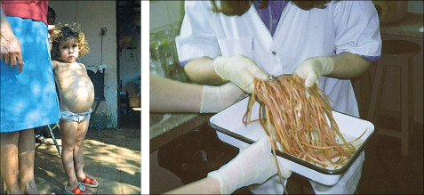
Ascariasis
Causative agent:
Ascaris lumbricoides
Prevalence:
Over 1 billion people infected worldwide (most prevalent of all intestinal nematodes).

Slide 8
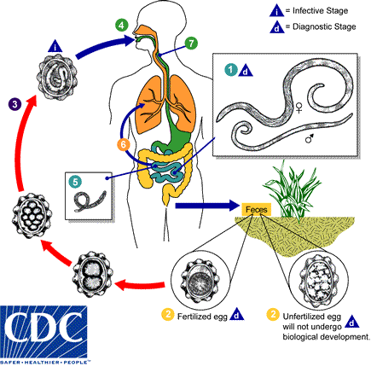
Life Cycle
Soil
Mouth
Intestines/bloodstream
Lungs
Throat
Intestines (with possible migration)
Time period from ingestion of eggs to mature egg laying adults is approx. 8 weeks. Adult worms can live in the intestines for up to 2 years.
Infected individuals have an output of up to 200,000 eggs a day.
Notes:
Fertilized infective Ascaris spp. eggs from contaminated soil are ingested.
Migrate into the bloodstream and eventually the lungs.
Larvae mature in the lungs and then ascend the bronchial tree and are swallowed.
Once in the small intestine the larvae develop into a mature adult worm.
Adult worms live in the lumen of the small intestine. A female may produce approximately 200,000 eggs per day, which are passed with the feces . Unfertilized eggs may be ingested but are not infective. Fertile eggs embryonate and become infective after 18 days to several weeks , depending on the environmental conditions (optimum: moist, warm, shaded soil). After infective eggs are swallowed , the larvae hatch , invade the intestinal mucosa, and are carried via the portal, then systemic circulation to the lungs . The larvae mature further in the lungs (10 to 14 days), penetrate the alveolar walls, ascend the bronchial tree to the throat, and are swallowed . Upon reaching the small intestine, they develop into adult worms . Between 2 and 3 months are required from ingestion of the infective eggs to oviposition by the adult female. Adult worms can live 1 to 2 years.

Slide 9
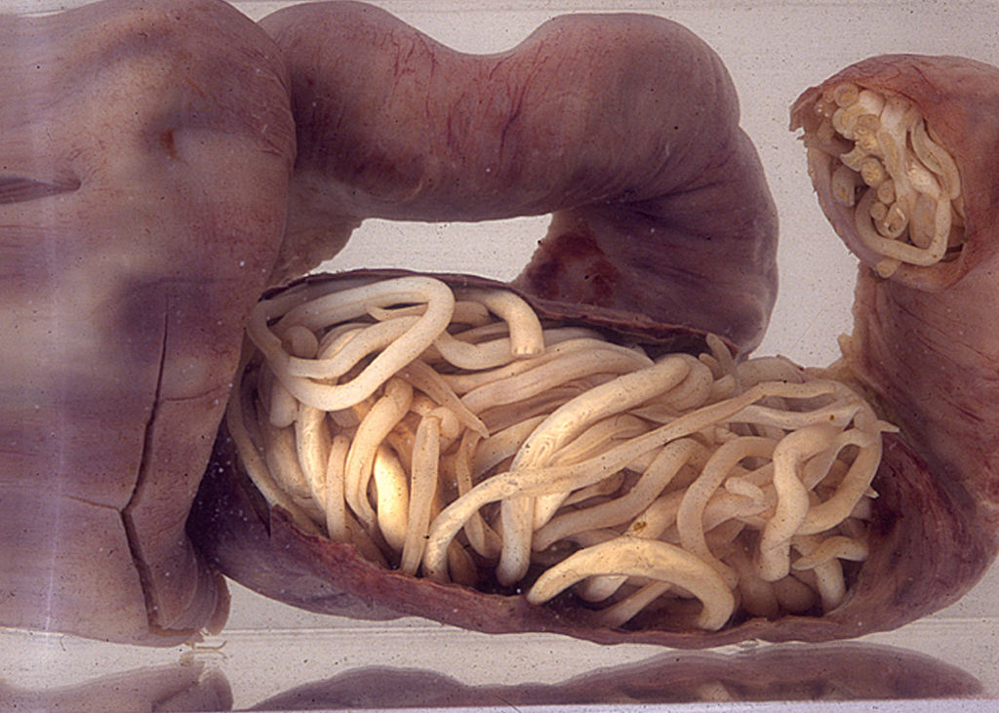
Transmission:
Fecal-oral transmission from contaminated soil
Can occur from ingesting food or water exposed to contaminated soil
Not transmitted directly from person to person
Incubation Period:
Eggs must live in the soil for at least 18 days before becoming infective
Once a person is infected respiratory symptoms may develop as in as little as 2 weeks during larval migration
Symptoms:
85% of cases are asymptomatic
Fever during migratory phase
Intestinal obstruction due to a bolus of worms
Inflammation of internal organs including pancreatitis and appendicitis

Slide 10
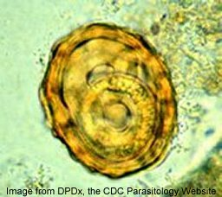
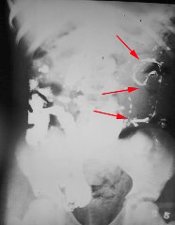
Laboratory Criteria
Microscopic identification of Ascaris eggs in feces OR
Microscopic identification of ascrid larvae in sputum or gastric washings OR
Identification of adult worms passed from the anus, mouth or nose
Case Classifications
Confirmed: A case that is laboratory confirmed
Probable: A clinically compatible case with evidence of infection such as
An ultrasound showing worms in the pancreas or liver or
CT scans or MRI showing worms present in the ducts of the liver or pancreas
Treatment
Anthelminthic such as albendazole and mebendazole, are the drugs of choice for treatment of Ascaris infections
Infections are generally treated for 1-3 days

Slide 11
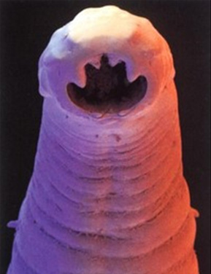
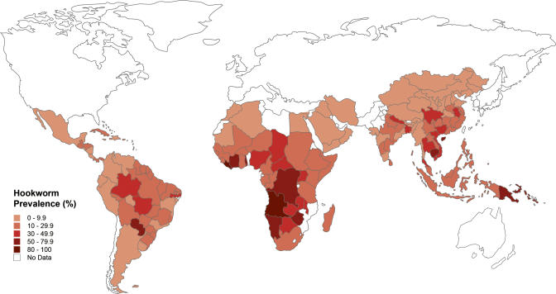
Hookworm (Ancylostomiasis)
Causative agent:
Ancylostoma duodenale and Necator americanus
Prevalence:
750 million people infected worldwide (most commonly with Ancylostoma duodenale).

Slide 12
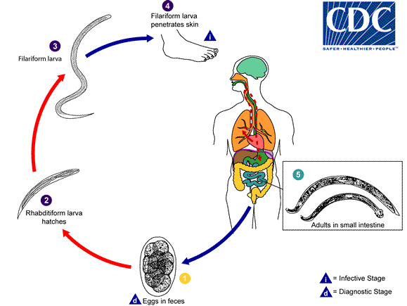
Life Cycle
Soil
Skin
Bloodstream
Lungs
Intestines (attach to intestinal wall for lifespan)
Egg production by an adult worm begins about 5-7 weeks after exposure.
Adult worms can live in the intestines for several years.
Infected individuals have an output of up to 30,000 eggs a day.
Notes:
Fertilized infective hookworm eggs penetrate the skin upon contact (typically through the feet)
Migrate into the bloodstream and eventually the lungs.
Larvae mature in the lungs and then ascend the bronchial tree and are swallowed.
Once in the small intestine the larvae develop into a mature adult worm and attach to the intestinal wall.
Eggs are passed in the stool , and under favorable conditions (moisture, warmth, shade), larvae hatch in 1 to 2 days. The released rhabditiform larvae grow in the feces and/or the soil , and after 5 to 10 days (and two molts) they become filariform (third-stage) larvae that are infective . These infective larvae can survive 3 to 4 weeks in favorable environmental conditions. On contact with the human host, the larvae penetrate the skin and are carried through the blood vessels to the heart and then to the lungs. They penetrate into the pulmonary alveoli, ascend the bronchial tree to the pharynx, and are swallowed . The larvae reach the small intestine, where they reside and mature into adults. Adult worms live in the lumen of the small intestine, where they attach to the intestinal wall with resultant blood loss by the host . Most adult worms are eliminated in 1 to 2 years, but the longevity may reach several years.
Some A. duodenale larvae, following penetration of the host skin, can become dormant (in the intestine or muscle). In addition, infection by A. duodenale may probably also occur by the oral and transmammary route. N. americanus, however, requires a transpulmonary migration phase.
While most worms live roughly 1-2 years. Adult worms over 15 years old have been recovered. In addition, ancylostoma duodenale species can live dormant in muscular tissue for many years.

Slide 13
Transmission
Primarily percutaneous by direct exposure to contaminated soil
Oral and transmammary transmission has also been recorded
No human to human transmission occurs with the rare exception of transmission from an infected mother to her fetus via breast milk
Incubation Period
Eggs need at least one week in soil to mature to infective larvae
5-9 weeks from skin penetration to mature adult worms
Symptoms may develop within the first day or two of infection or may take several months if larvae enter dormant phase
Symptoms
Maculopapular rash (at infection site)
Burning of the skin initial exposure
Pneumonitis (during larval migration through lungs)
Diarrhea
Abdominal pain
Severe anemia
Growth and cognitive impairment in children

Slide 14
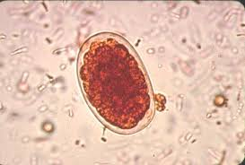
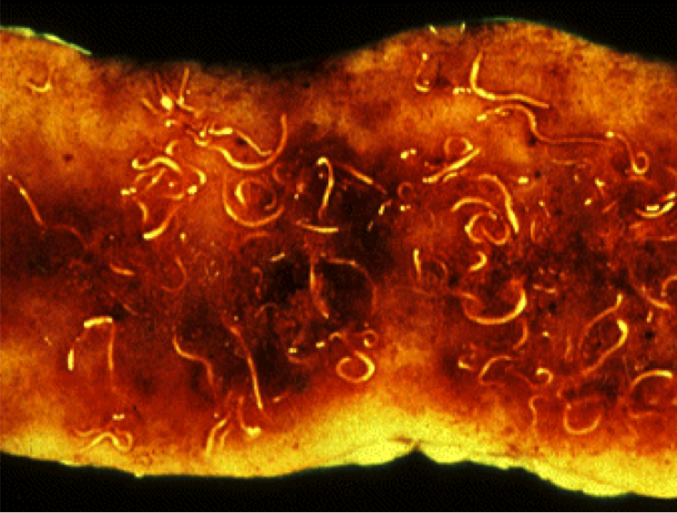
Lab Criteria
Microscopic identification of Ancylostoma or Necator eggs in feces OR
Microscopic identification of Ancylostoma or Necator species of larvae cultured from the feces OR
Identification of adult worms expelled after treatment
Case Classifications
Confirmed: A case that is laboratory confirmed
Treatment
Anthelminthic such as albendazole and mebendazole, are the drugs of choice for treatment of Ascaris infections
Infections are generally treated for 1-3 days
Iron supplementation in individuals with anemia

Slide 15
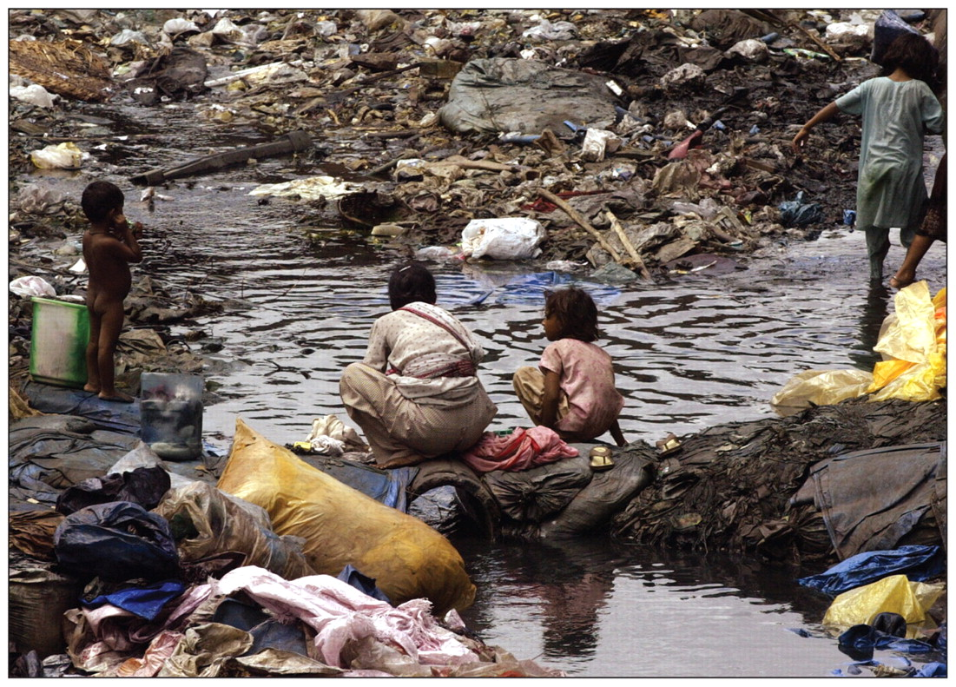
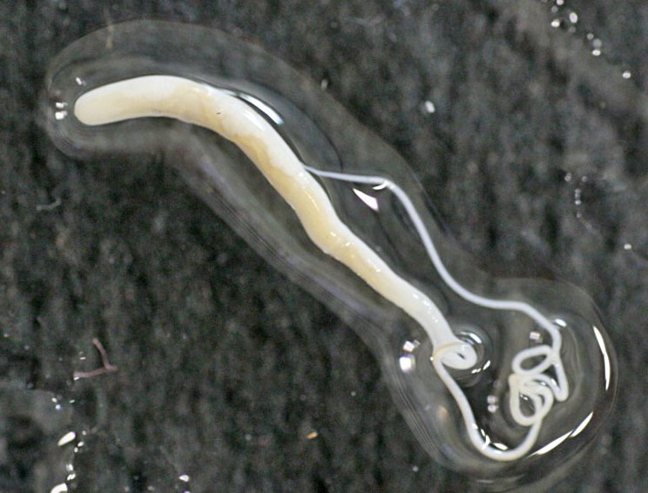
Trichuriasis (whipworm)
Causative Agent:
Trichuris trichiura
Prevalence:
800 million people infected worldwide.

Slide 16
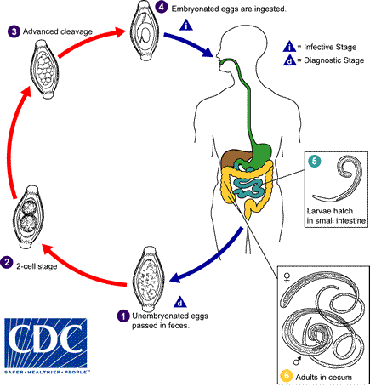
Life Cycle
Soil
Mouth
Intestines (attach to intestinal wall for lifespan)
Time period from ingestion of eggs to mature egg laying adults is approx. 8 weeks.
Adult worms can live in the intestines for up to 1 year.
Infected individuals have an output of up to 20,000 eggs a day.
Notes:
Fertilized infective T. trichuria eggs from contaminated soil are ingested.
Once in the small intestine the eggs hatch and develop into a mature adult worm.
The unembryonated eggs are passed with the stool . In the soil, the eggs develop into a 2-cell stage , an advanced cleavage stage , and then they embryonate ; eggs become infective in 15 to 30 days. After ingestion (soil-contaminated hands or food), the eggs hatch in the small intestine, and release larvae that mature and establish themselves as adults in the colon . The adult worms (approximately 4 cm in length) live in the cecum and ascending colon. The adult worms are fixed in that location, with the anterior portions threaded into the mucosa. The females begin to oviposit 60 to 70 days after infection. Female worms in the cecum shed between 3,000 and 20,000 eggs per day. The life span of the adults is about 1 year.

Slide 17
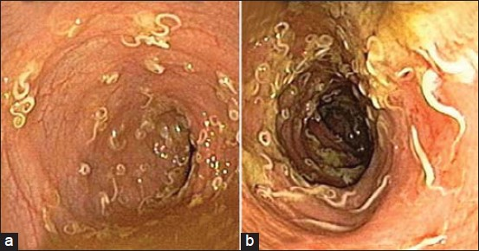
Transmission:
Fecal-oral transmission from contaminated soil.
Can occur from ingesting food or water exposed to contaminated soil
No human to human transmission occurs
Incubation Period:
Eggs must live in the soil for 15-30 days before becoming infective
Once ingested it takes 2-3 days for larvae to develop into adults
Females begin ova positing approx. 60-70 days after infection
Symptoms:
Light infestations are generally asymptomatic
Abdominal pain
Diarrhea
Rectal prolapse
Anemia leading to growth retardation and cognitive impairment

Slide 18
Lab Criteria
Microscopic identification of Trichuria eggs or worms in feces OR
Observation during sigmoidoscopy, proctoscopy, or colonoscopy of Trichuria worms characterized by a threadlike form with an attenuated, whip-like end OR
Identification of worms on prolapsed rectal mucosa
Case Classification
Confirmed: A case that is laboratory confirmed
Treatment
Anthelminthic such as albendazole and mebendazole, are the drugs of choice for treatment of Ascaris infections
Infections are generally treated for 1-3 days
Iron supplementation in individuals with anemia

Slide 19
Foodborne Team NTDs
Greg Leos, MPH, CPH

Slide 20
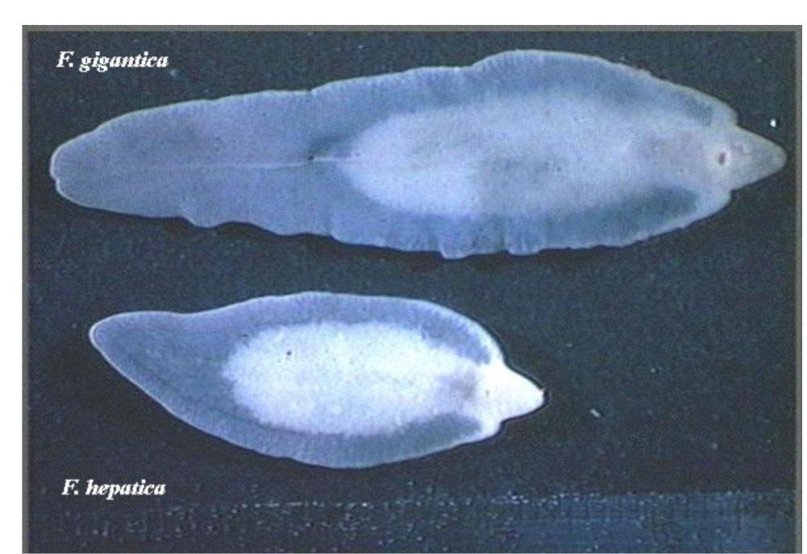
Fascioliasis
Infectious Agent: Fasciola species
Fasciola hepatica
aka ‘sheep liver fluke’, ‘common liver fluke’
Fasciola gigantica (less common)
aka “Giant liver fluke”
Geographical distribution:
Fascioliasis occurs worldwide.
Human infections with F. hepatica are found in areas where sheep and cattle are raised, and where humans consume raw watercress, including Europe, the Middle East, and Asia.
Infections with F. gigantica have been reported, more rarely, in Asia, Africa, and Hawaii.

Slide 21
Fascioliasis
FASCIOLA LIFE CYCLE

Slide 22
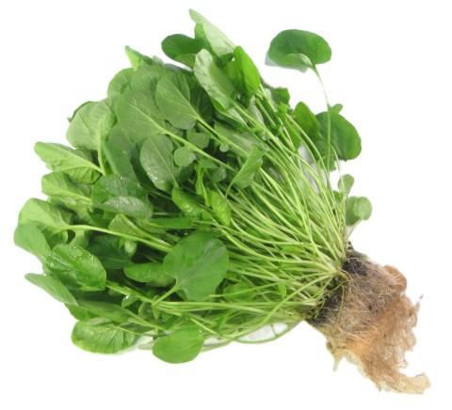
Fascioliasis
Transmission:
primarily through consumption of uncooked aquatic plants (such as watercress)
ingesting contaminated water
not transmitted directly from person to person
Incubation Period:
Acute phase of infection: symptoms, if any, can start 4-7 days after the exposure and can last several weeks or months
Chronic phase of infection: symptoms, if any, can start months to years after the exposure
:

Slide 23
Fascioliasis
Clinical Illness:
Acute phase
caused by the migration of the immature fluke through the hepatic parenchyma
nausea, vomiting, pain, chills and fever and marked eosinophilia are commonly observed
Chronic phase
caused by the adult fluke within the bile ducts
symptoms are more discrete and reflect intermittent biliary obstruction and inflammation
inflammation of the liver, gallbladder, and pancreas can also occur

Slide 24
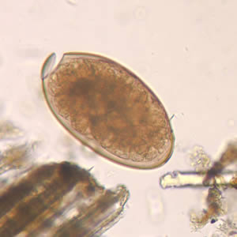
Fascioliasis
Laboratory Diagnosis:
Microscopic exam- identification of Fasciola eggs in stool (sometimes in duodenal contents or bile)
Detection of Fasciola coproantigens
Detection of Fasciola antibodies
Treatment:
Triclabendazole is the drug of choice for
treatment of fascioliasis.

Slide 25
Paragonimiasis
Infectious agent: Paragonimus species
aka "the lung fluke“
most common is Paragonimus westermani
aka “the oriental lung fluke”
Geographical distribution:
Paragonimus spp. are distributed throughout the Americas, Africa and southeast Asia
Paragonimus westermani is distributed in southeast Asia and Japan
Paragonimus kellicotti is endemic to North America

Slide 26
Paragonimiasis: Life Cycle

Slide 27
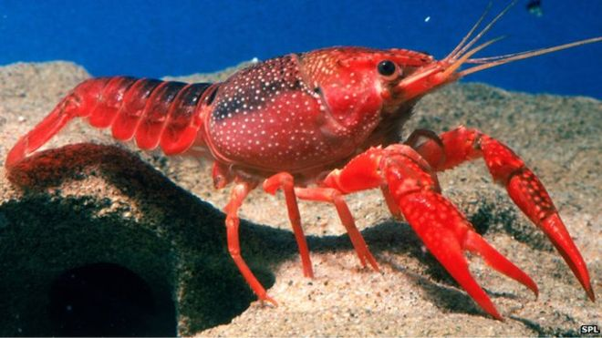
Paragonimiasis
Transmission:
Primarily through consumption of raw, salted, pickled, or partially cooked freshwater crabs or crayfish (crawfish) containing infected larvae (metacercariae)
not transmitted directly from person to person
Incubation Period:
Variable; approximately 7-12 weeks after ingestion of the infectious larvae
:

Slide 28
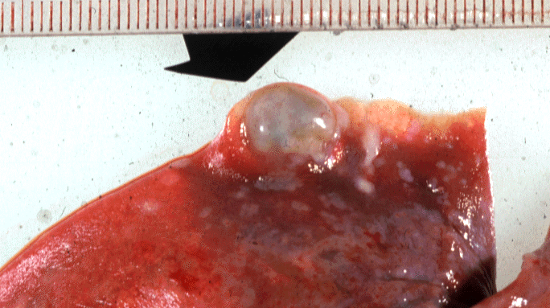
Paragonimiasis
Clinical Illness
Acute phase
diarrhea, abdominal pain, fever, cough, urticaria, hepatosplenomegaly, pulmonary abnormalities, and eosinophilia
Chronic phase,
pulmonary manifestations include dry cough, rusty-colored or blood-tinged sputum on exertion, and pleuritic chest pain
extrapulmonary disease is not uncommon, with flukes found in such sites as the CNS, subcutaneous tissues, intestinal wall, peritoneal cavity, liver, lymph nodes and genitourinary tract

Slide 29
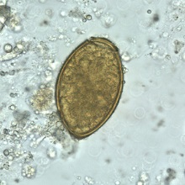
Paragonimiasis
Laboratory diagnosis:
Microscopic exam- identification of Paragonimus eggs in stool or sputum
Detection of Paragonimus antibodies
Treatment:
Praziquantel is the drug of choice for treatment of paragonimiasis

Slide 30
Zoonosis Control Branch NTDs Inger Vilcins MIPH, PHD

Slide 31
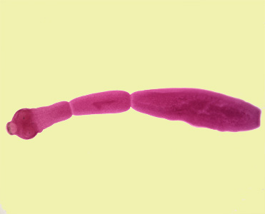
Echinococcosis

Slide 32
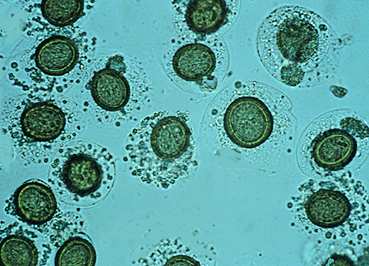
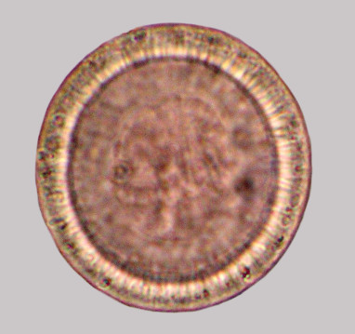
Echinococcosis
Parasitic infection caused by the larval stage of species of the tapeworm Echinococcus
Four species exist in North America
Hosts involved in the life-cycle and disease manifestation in humans vary according to tapeworm species
Transmission to humans involves the ingestion of eggs
Water
Food
Soil
Feces
Contaminated coats of dogs and cats

Slide 33
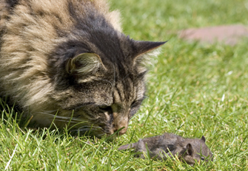
Echinococcosis - Lifecycle
Dead-end/accidental intermediate hosts become infected by ingesting tapeworm eggs –
Hosts - humans, sheep, cattle, horses, camels, goats, pigs and small rodents
Eggs hatch into larvae, migrate out of GIT and develop into cysts and tumors in various organs
Predators are the definitive hosts –
Hosts - canids and felids
Ingest cysts within intermediate hosts, the tapeworm completes its lifecycle in the GIT and eggs are shed into the environment through their feces

Slide 34
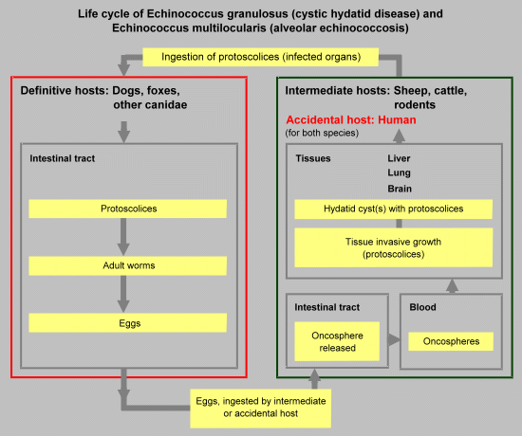

Slide 35
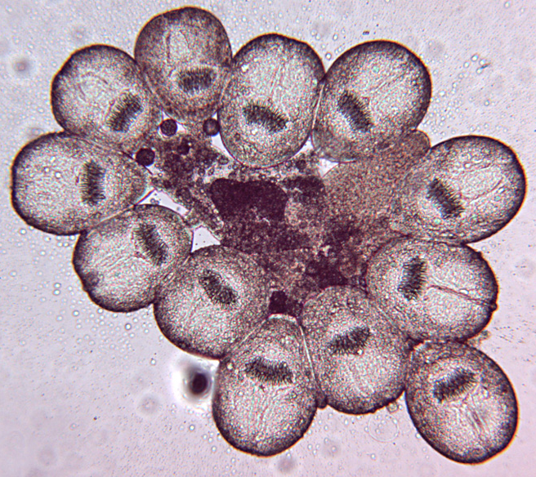
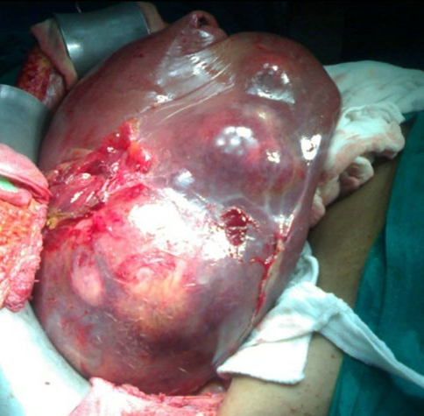
Echinococcus granulosus
Cystic Echinococcosis - CE
Hosts – Sheep, goats, swine, cattle, horses, camels, dogs and other canids
Dogs – become infected from ingesting the encysted organs of butchered meat
Human infection –
Eggs hatch releasing oncospheres - penetrate the intestinal wall
Oncospheres reach organs and produce hydatid cysts -grow over several years filling with daughter cysts
Organs mainly involved - brain, spleen, kidneys, bone, heart, eyes and nervous system
Symptoms are associated with cyst growth and location, severe outcomes associated with rupture

Slide 36
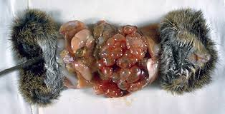
Echinococcus multilocularis
Alveolar Echinococcosis - AE
Hosts – Small rodents, and canids such as foxes, coyotes and dogs
Human infection –
Development of tumors – larvae remain in the proliferative stage and invade and destroy the surrounding tissues
Organs mainly involved – liver and rarely the brain
Symptoms - localized pain, weight loss and malaise, liver failure and death occurring if left untreated

Slide 37
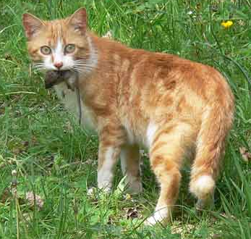
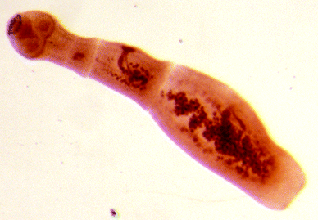
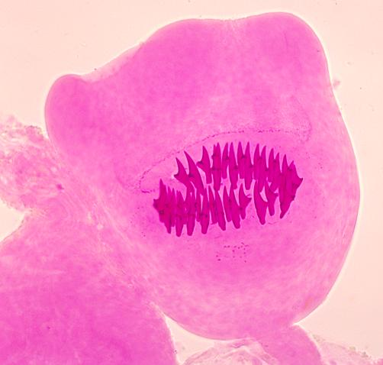
Echinococcus vogeli and oligarthrus
Polycystic, Neotropical or Unicystic Echinococcosis
E. oligarthrus
Hosts – Rodents and wild and domestic felids
Human infection (similar to CE) –
Development of invasive cysts in the muscle, subcutaneous tissue and organs such as the heart and lungs

Slide 38
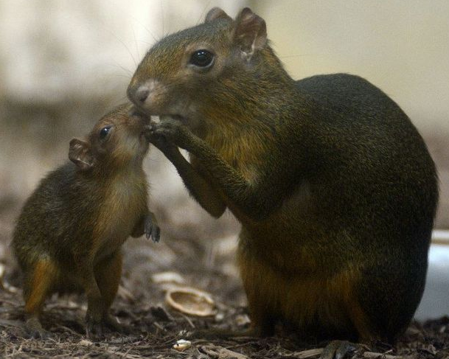
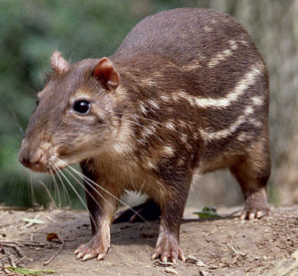
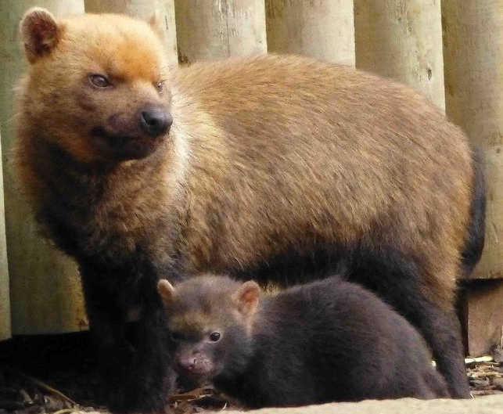
Echinococcosis vogeli and oligarthrus
Polycystic, Neotropical or Unicystic Echinococcosis
E. vogeli
Distribution - South and Central America
Hosts – Rodents (Pacas, agoutis and spiny rats) and canids (bush dogs and domestic dogs)
Human infection (similar to AE) –
Development of invasive tumors in organs – mainly liver and lungs (rarely other organs)
Symptoms - localized pain, weight loss and malaise, liver failure and death occurring if left untreated

Slide 39
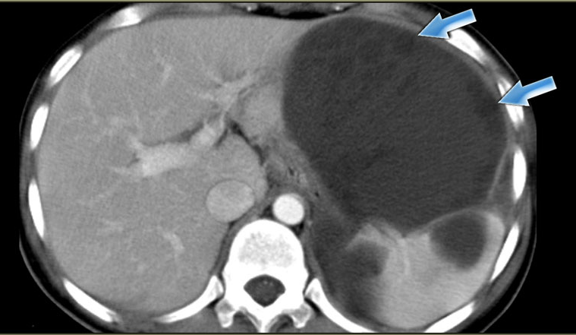
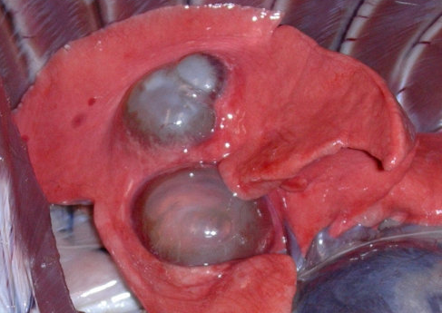
Echinococcosis – Laboratory diagnosis
Confirmed: presence of echinococcus in tissue
Laboratory detection of cysts or tumors using imaging techniques -
Computed Tomography (CT)
Magnetic Resonance Imaging (MRI)
Ultrasonography (US)
Standard Radiology (X-Ray)
Collection and examination of materials collected by biopsy or puncture during surgery -
Hydatid cyst fluid
DNA detection by PCR of protoscoleces
Histological detection of protoscoleces, hooks or cell wall materials for characteristic structures

Slide 40
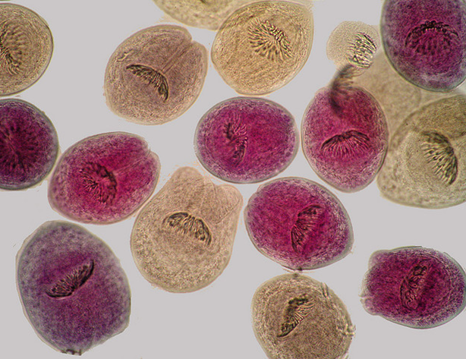
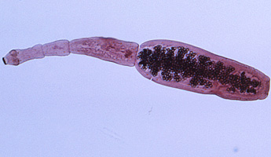
Echinococcosis – Laboratory diagnosis
Blood tests (ELISA, IFAT, immunoblot) – are useful in assisting with the diagnosis of an infection
Highly unreliable alone –
False positives - infection with other helminthic infections, cancers and chronic immune disorders
False negatives - common in patients with intact cysts or tumors, and are dependent on location
Cysts or tumors located in the liver or bone are most likely to illicit a positive response versus all other locations

Slide 41
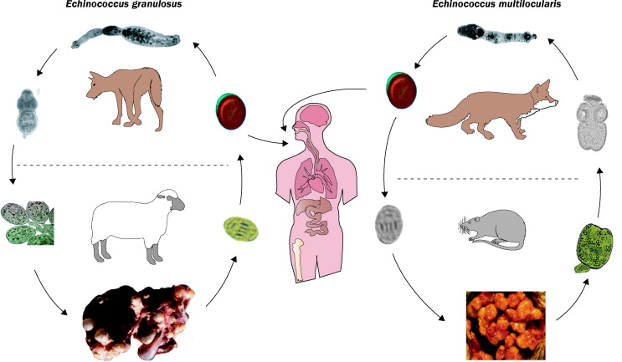

Slide 42
Questions?

