Slide 1
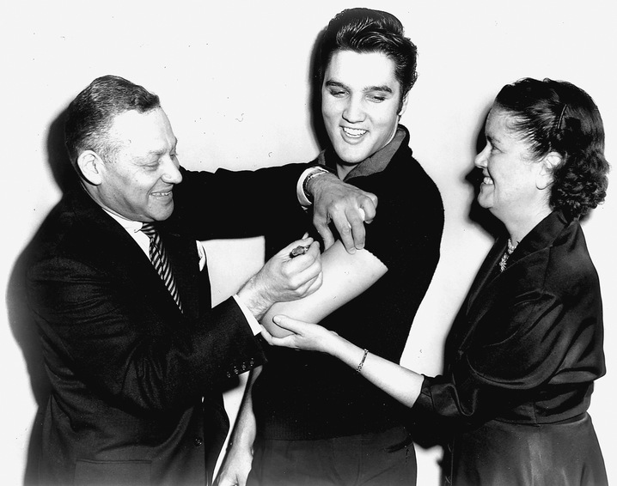
Vaccine Preventable Disease Surveillance and Investigation

Slide 2
VPD Team
Rachel Wiseman, team lead
  Measles, rubella, tetanus, polio, diphtheria
Brandy Tidwell
  Varicella, pertussis, Haemophilus, mumps
Kayla Boykins
  Hepatitis A and B, sometimes C, pertussis
Vacant
  Measures your VPD performance (Imm contract)
Notes:
There are 4 of us on the VPD team. I’m the lead and I generally handle the rarer conditions. Brandy and Kayla are the starting points for varicella, pertussis, haemophilus, mumps, and hepatitis (which sometimes includes C). They manage the NBS queues for these conditions and will be able to help answer many of your questions. If they can’t, they’ll refer you to me. We have a 4th position, previously held by Eric, but is currently vacant. When that position is filled, the job duties may change, but that position will be in charge of monitoring the VPD portion of the Immunization contract.

Slide 3



Kayla
Brandy

Slide 4
Vaccine Preventable Diseases
Diphtheria
Haemophilus influenzae
Hepatitis A
Hepatitis B, Acute
  Perinatal Hepatitis B
Measles
Mumps
Pertussis
Polio
Rubella and CRS
Tetanus
Varicella
Meningococcal Disease
Pneumococcal Disease
Influenza
Rotavirus
HPV
Shingles
Notes:
The conditions in black are the VPDs that are reportable that my team handles. The ones in blue are VPDs that Lesley’s team handles. The red ones are not reportable. If you have questions about them, Lesley gets flu, I can take the rest of them, at least to get you started.

Slide 5
Comparison of Highest and Current Morbidity, VPDs, Texas
Disease | Highest Case Count | 2014 | Percent Decrease
Hepatitis A | 4,892 (1973) | 123 | 97.5%
Hepatitis B, Acute | 1,960 (1998) | 122* | 93.8%
Hib | 843 (1988) | 12 | 98.6%
Measles | 88,000 (1958) | 10 | 99.9%
Meningococcal | 356 (1951) | 22* | 93.8%
Mumps | 32,939 (1950) | 15 | 99.9%
Pertussis | 21,588 (1947) | 2,576 | 88.1%
Pneumococcal | 1,952 (2009) | 1,562 | 20.0%
Polio | 2,778 (1950) | 0* | 100%
Rubella | 8,408 (1970) | 0* | 100%
Tetanus | 55 (1954) | 4 | 92.7%
Varicella | 26,888 (1997) | 1,647* | 93.9%
Notes:
Great strides have been made in reducing all the vaccine preventable diseases and record lows or ties for lows were achieved in 2014 for many of these diseases.

Slide 6
VPD Investigation: How to
Read the Investigation Guidelines!
Read the Case Criteria!
Always assess vaccination history of patient
  Immtrac
  Patient
  Patient’s mom
  Patient’s employer
  Patient’s PCP
  Patient’s school
Notes:
These are just some basic instructions or common themes to all or most VPD investigations. First, read the guidelines (you’ll get a hard copy on Thursday and they’re online). Read the case criteria. If you don’t understand some part of it, just ask us. We always want a patient’s vaccination history. There are lots of places to try to get it. For daycare and school aged children, you should always be able to find a record.

Slide 7
More How to
Lab testing is your friend
Assess (and enter) all risk factors
Follow hospitalized patients to discharge
Communication toolkits are available
Inform EAIDB immediately of:
  Deceased patients -MMRV specimens
  Measles suspects coming to DSHS lab
  Unusual VPDs -Media interest
Notes:
Lab testing is pretty critical to VPD investigations, especially the rarer conditions. Hospitalized patients should be followed until discharge. Several of these VPDs can be fatal. We have had patients die of pertussis and tetanus and no one knew because no one followed up. There are toolkits available for measles, mumps, pertussis and hepatitis A. I’ll talk more about those later. If any of the following happen, please let the VPD team know immediately.

Slide 8

Use the Guidelines!
Case definitions
Laboratory instructions
Awesome flow charts
Basic disease/epi info
Win EAIDB’s undying approval
Investigation hints, tips, suggestions, requirements
http://www.dshs.state.tx.us/IDCU/health/infection_control/Investigation-Guidance/

Slide 9
Use the Case Criteria Guide!
VPD case definitions are very specific
  Require detailed clinical information
  Require specific laboratory testing
Many VPDs do not have a probable case definition; one has no confirmed case status
Learning the case definitions will help your investigations and improve your time using NBS

Slide 10
VPD Communication Toolkits
Includes resources and educational info
  Vaccine information
  Fact sheet
Includes modifiable versions of
  Health alerts
  Press releases
  Notification letters
Can be used at any time by LHD, HSR or others
Measles includes additional resources such as scripts for assessing PEP need and detailed lab testing information

Slide 11
Toolkit Links
Pertussis
http://www.dshs.state.tx.us/idcu/disease/pertussis/links/
Hepatitis A
http://www.dshs.state.tx.us/idcu/disease/hepatitis/hepatitis_a/links/
Measles
http://www.dshs.state.tx.us/idcu/disease/measles/links/
Mumps
http://www.dshs.state.tx.us/IDCU/disease/mumps/Mumps-Resources.doc

Slide 12



Slide 13
Prioritizing Intensity of Measles Response
High Concern | Lower Concern
Travel to endemic area or contact with measles case (Not Mexico) | No exposure history
Unvaccinated | Vaccinated
Clinically compatible | Not clinically compatible (e.g. low fever, short rash duration, no “Cs”)
IgM+ result from a commercial lab | Physician has an alternate diagnosis (e.g. scarlet fever)
All measles reports are urgent and should be investigated immediately.
Those with higher concern may need to have control measures implemented (e.g. PEP, quarantine) before lab results are available.
Lower concern suspects can sometimes be ruled out without testing, if desired.
Contact EIADB for help determining response efforts.

Slide 14
Following up on Rubella IgM+
Most of the rubella IgM+ labs you will see for will be prenatal immunity testing
  Contact the provider, if mom to be is asymptomatic, you’re done.
  If symptomatic, more investigation and possible preparation for a CRS investigation may be needed.
Positive labs for men, children, or non-pregnant women need more investigation

Slide 15
Measles/Rubella Notes
Lab testing process identical, just check the correct test on lab forms
PCR is preferred testing
Measles Communication Toolkit available for measles investigations
Rubella diagnoses are highly unlikely
  Only 2 cases in Texas in last 10 years
  <20 cases annually in US
  IgM prone to be falsely positive

Slide 16
Investigation Activities
Isolate patient (if in infectious period)
Notify EAIDB at time of report
Collect specimens for DSHS lab
  PCR swabs and serum samples (maybe urine)
Find out everywhere patient has been during infectious period
  Medical visits -School or work
  Friends/family -Travel of any kind
  Any public events or outings (e.g. daycare, groceries, church, concerts, baseball game)

Slide 17
Investigation Activities, 2
Notify all potential exposure sites
  If patient traveled, inform EAIDB
  Assess vaccination history of all contacts
  If in PEP window, prophylax everyone that is unvaccinated
  Consider a press release if patient visited public places (e.g. concert, shopping) while infectious
  Issue health alert
Find out where patient was exposed

Slide 18
Measles Confirmed Case Status
Must have all of the following:
  Generalized rash lasting at least 3 days
  Temperature of at least 101 F
  Cough, coryza or conjunctivitis
And one of the following:
  Positive measles PCR (not available outside DSHS)
  Positive for measles IgM (DSHS-preferred)
  4-fold rise in titers in acute and convalescent samples (unlikely to get)
  Epi-linked to a lab-confirmed case

Slide 19
Rubella Confirmed Case Status
Must have all of the following:
  Generalized maculopapular rash
  Temperature of at least 99F
  Arthralgia, lymphadenopathy or conjunctivitis
And one of the following:
  Positive for rubella IgM antibody
  Rubella virus identified (PCR or culture)
  4-fold rise in titers in acute and convalescent samples
  Epi-linked to a lab-confirmed case

Slide 20

My girls. (And, yes, I am way too young to have teenagers)

Slide 21
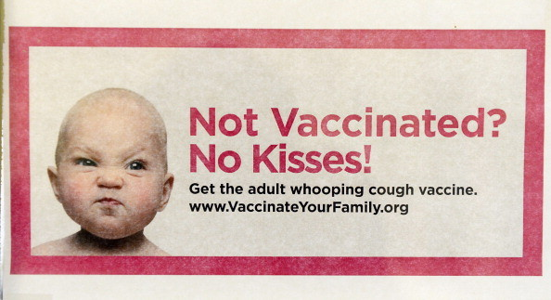

Slide 22
What starts a pertussis investigation?
All positive PCRs
All reports from school nurses, day cares, providers, etc
All coughing contacts of cases
All culture tests, positive or negative
All DFA results
All serology (do your best)

Slide 23
Investigation Considerations
Focus on high-risk contacts for prophylaxis
  Infants
  Pregnant women
  Immunocompromised
  People who have contact with above
  Household
Other exposed people should still be notified
  Travel, school, camp, church, family, etc
Identify any coughing contacts—evaluate and treat (if appropriate)

Slide 24
Investigation Considerations, 2
Ask all of the questions on the case track
  Then enter all of the answers into NBS
Even if you do everything correctly, an outbreak may still continue to spread. Sorry.
Hospitalized infants need to be followed until discharge and d/c date entered into NBS
There is a form that should be completed for pertussis deaths
  Inform EAIDB of any pertussis deaths immediately, even if patient does not meet case definition

Slide 25
Pertussis PEP
Free antibiotics for pertussis contacts are available from DSHS
  Available to all HSRs and only LHDs that do not already purchase antibiotics for pertussis
  Pertussis contacts must meet specific epi and financial criteria
  Regions and certain locals can get antibiotics
    Must sign up through DSHS pharmacy ITEAMS
    Must have training in place
    Must have SDOs in place
  Contact regional DON or Immunization office for more information

Slide 26
Pertussis Case Definitions
Clinical case definition
  Must have at least 14 days of cough
  AND either
    Whoop OR
    Post-tussive vomiting OR
    Paroxysmal coughing
    OR apnea (INFANT cases only)
Laboratory case definition
  PCR+ OR
  culture+

Slide 27
Pertussis Case Status,
Cases OVER 12 months old
Confirmed
  meets clinical and lab case definition
  OR meets clinical case definition and is epi-linked to PCR+ case
  OR has cough and a positive CULTURE
Probable
  meets clinical case definition and is not epi-linked or laboratory confirmed

Slide 28
Pertussis Case Status,
Cases UNDER 1 year old
Confirmed
  meets clinical (can have apnea) and lab case definition
  OR meets clinical case definition (can have apnea) and is epi-linked to PCR+ case
  OR has cough of any length and positive culture
Probable
  meets clinical case definition (can have apnea) and is not epi-linked or laboratory confirmed
  OR cough of any length, 2nd symptom, and is either PCR+ or epi-linked to PCR+ case

Slide 29

“And it was so typically brilliant of you to have invited an epidemiologist.”

Slide 30
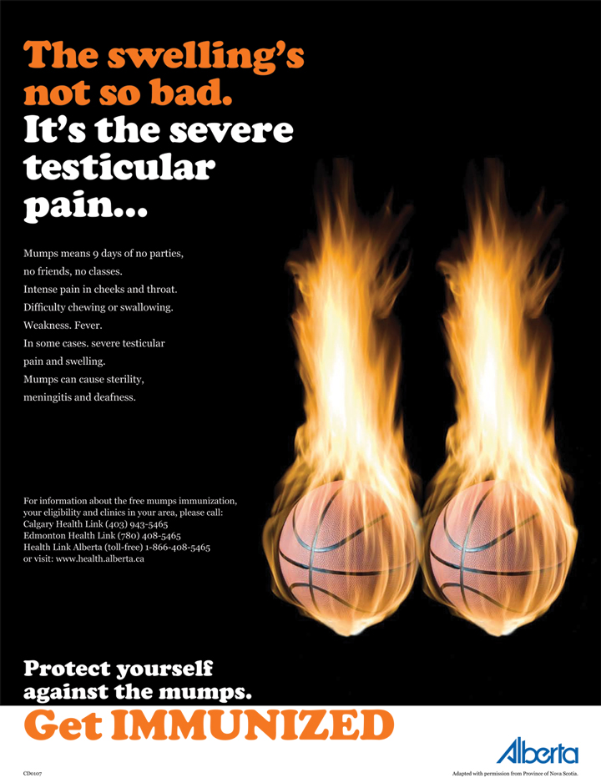

Slide 31
Investigation Considerations
IgM can be falsely negative in vaccinated individuals
IgM can be falsely positive in anyone
Obtain a buccal swab for PCR
Is patient isolated (if infectious)?
Did patient expose unvaccinated individuals?
  No PEP for mumps. Monitor for symptoms
Is there a congregate setting exposure?

Slide 32
3rd Dose of MMR?
For outbreaks in highly vaccinated populations:
  A 3rd dose of MMR can be given to exposed people
  Outbreak should be ongoing
  Outbreak should be in high-risk setting (e.g. dorm, jail, HCF)
  Contact EAIDB if 3rd dose is being considered

Slide 33
Mumps Case Status
Confirmed: Culture/PCR+ AND has 2+ days of parotitis or has orchitis, oophoritis, meningitis, encephalitis, hearing loss, mastitis or pancreatitis
Probable: 2+ days of parotitis (or has oophoritis or orchitis) AND IgM+ or epi-linked to another confirmed or probable case or to a community with an outbreak of mumps

Slide 34
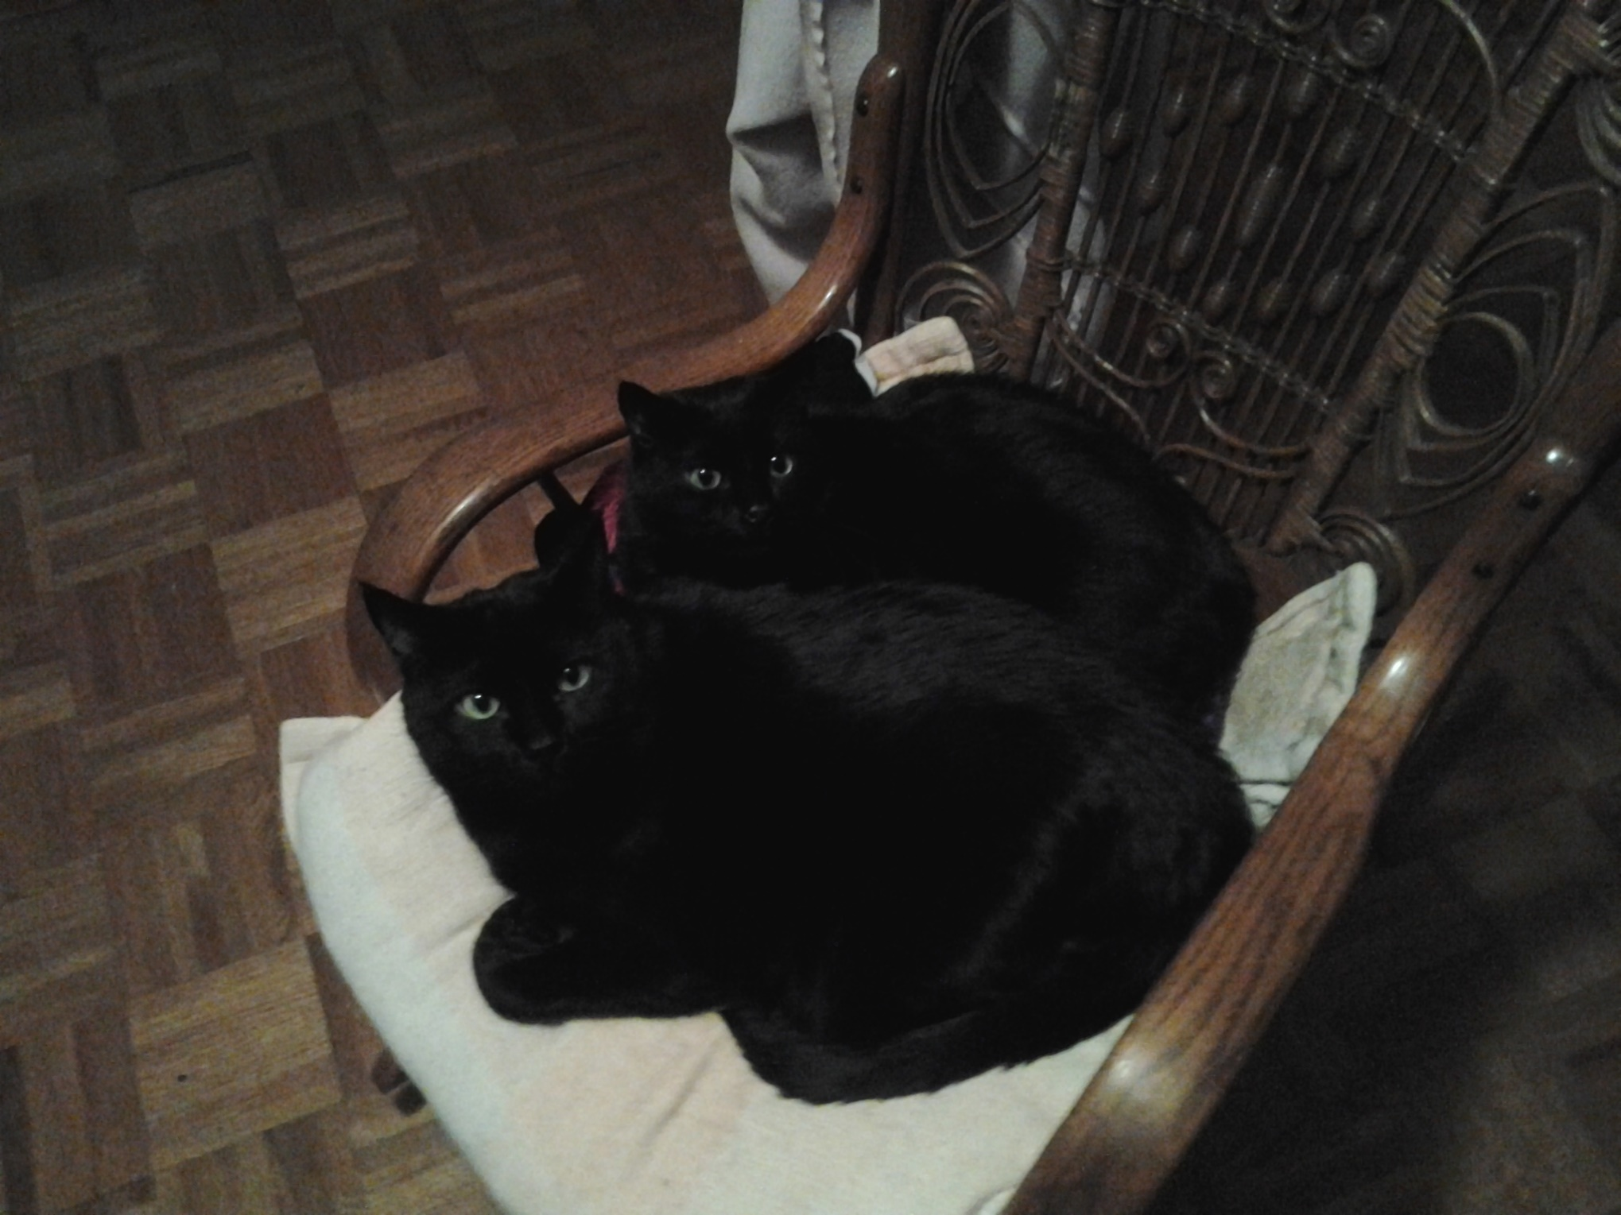
My evil minions

Slide 35


Slide 36
Diagnostic Considerations
Parental diagnosis of chickenpox is acceptable
Laboratory confirmation:
  Rise in IgG acute/convalescent samples
  PCR+
  Culture
IgM is NOT confirmatory
A single IgG is NOT confirmatory

Slide 37
Following up Lab Results
Specific lab results should be investigated in a limited fashion:
  All labs for patients under 20 years old
  All labs, except IgG, for patients 20-50 yo
  NO labs for patients over 50
Contact provider or patient and assess:
  Reason for testing/diagnosis
    Shingles v immunity v chickenpox
  Vaccination status, symptoms (# lesions)
Labs for immunity or shingles testing should not be made into varicella cases in NBS!

Slide 38
Varicella Reporting/Investigation
Varicella has its own reporting form and no case track
  Enter all information from report into NBS
  If reporter does not provide vaccination status, please find it and enter into NBS
Varicella does not typically need investigation EXCEPT for outbreaks, hospitalizations, and deaths

Slide 39
Investigation Considerations
Is there a congregate setting exposure site?
Are contacts immune?
Are any contacts pregnant or immunocompromised?
Try to obtain specimens
  Can be submitted to DSHS or CDC
  Private providers can submit directly to CDC
  Follow CDC directions for specimen collection regardless of where you are sending

Slide 40
Varicella Case Status
Clinical case definition: Acute onset of diffuse maculopapulovesicular rash. In vaccinated people, rash may be mild with few or no vesicles
Confirmed: Clinically compatible AND lab confirmation or epi-linked
Probable: Clinically compatible without lab confirmation or epi-linkage
***Two probable cases that are linked should both be made confirmed cases.***

Slide 41
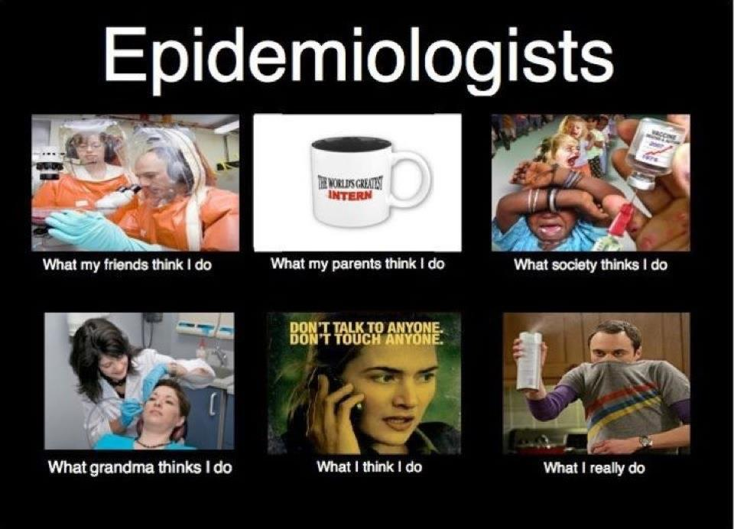

Slide 42
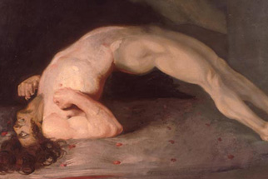
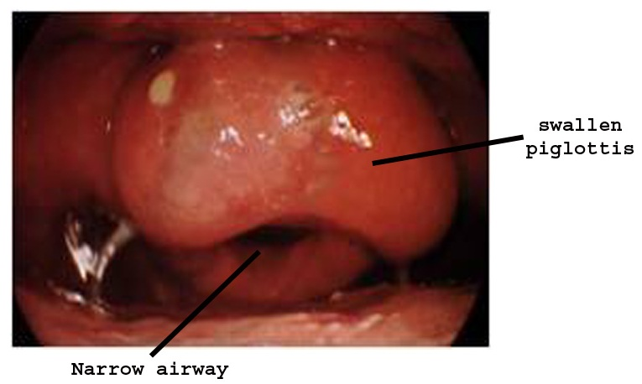

Slide 43
Investigation Considerations
Tetanus
  Obtain medical record
  Long-term follow up (until recovery/death)
Haemophilus influenza (used to be HIB only)
  Will the lab submit an isolate to DSHS lab for serotyping?
    This is required for patients under 5
  Only HIB cases need PEP, and then only in certain instances
  Long-term follow up (until recovery/death)

Slide 44
Tetanus Case Status
Probable only
No laboratory confirmation required
Clinical definition: acute onset of hypertonia and/or painful muscular contractions and generalized muscle spasms

Slide 45
H. Flu Case Status
Confirmed:
Invasive disease (e.g. meningitis, bacteremia/septicemia, cellulitis, etc)
Isolation of H. flu PCR+ for from a sterile site (e.g. blood, CSF, joint fluid, etc)
Probable:
Invasive disease
H. flu type b antigen identified in CSF ONLY (urine is not acceptable)

Slide 46
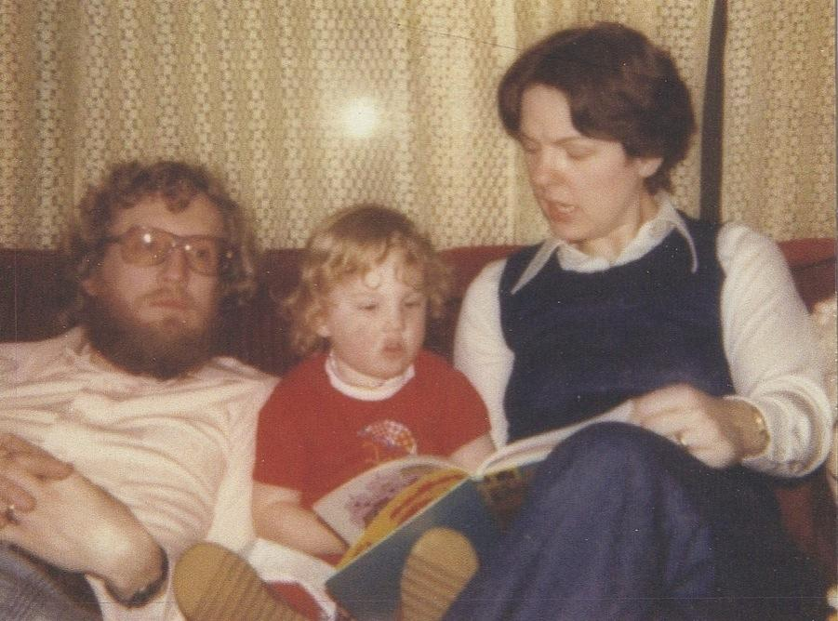
I was totally adorable, right?

Slide 47
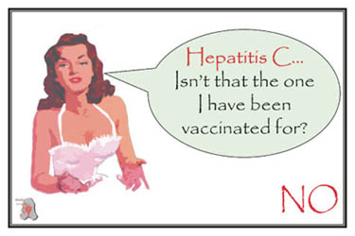

Slide 48
Investigation Considerations
Hepatitis B
  Is patient pregnant? Notify perinatal program
  Is this a health care exposure?
    Is education on infection control warranted?
    Is regulatory involvement warranted?
    Is this an outbreak related to a HCF?
  Are there contacts to vaccinate or prophylax?
  Is this a vaccine failure?
  Have all risk factors been assessed and entered into NBS?

Slide 49
Investigation Considerations
Hepatitis A
  Is patient a food handler?
  Is this a common source food outbreak?
    Regulatory? Environmental inspection?
  Are there contacts to vaccinate or prophylax?
  Is this a vaccine failure?
  Have all risk factors been assessed and entered into NBS?

Slide 50
Common Hepatitis Mistakes
There is no probable case status (only Zuul)
Not entering risk factors
Perinatal hep B ONLY applies to infants between 1 and 24 months old
  Their mothers are either acute cases or chronic cases of hepatitis B
Chronic cases do not need to be entered into NBS (unless your jurisdiction chooses to) and should NOT be sent for notification.

Slide 51
Hepatitis B, Acute
Case Status
Confirmed only
  Acute onset of symptoms OR jaundice OR elevated liver tests (>100)
  AND surface antigen or IgM positive
Other considerations
  Not known to be a chronic case
  Documented laboratory conversion (HBsAg negative to positive) within past 6 mos can be a case without any symptoms/jaundice/elevated LFTs

Slide 52
Hepatitis A
Case Status
Confirmed only
Acute onset of symptoms OR jaundice OR elevated liver tests (>100)
AND IgM+ for antibody to hep A
  or epi-linked to lab confirmed case

Slide 53


Slide 54


Slide 55
Did you know…
That all your epi, surveillance, and nursing staff should have documented immunity to measles, mumps, rubella, and varicella?
And that being born before 1957 doesn’t count?
And that if you do not have documentation and you are exposed, you can be quarantined?
FUN FACTS!

Slide 56
Housekeeping
Outbreaks for all VPDs is 3 cases. Three.
Case tracks are available for all VPDs except diphtheria, polio, varicella and CRS.
  Submit all confirmed/probable case tracks to EAIDB (or your region, who will forward them)
  For varicella, we don’t need a form (unless deceased)
  For other diseases with no form, use the CDC form and/or submit hospital records, notes and lab results
For VPD deaths, submit hospital records and lab results to EAIDB

Slide 57
Immunizations Quarterly Report
Most LHDs have a contract with the state for Immunizations.
VPD investigations are part of that contract.
We measure your performance.
  Goal: 90% of VPD investigations completed within 30 days of report to public health
  Completed means notification done in NBS
Every quarter, we provide LHDs with how long their VPD investigations take.
If below 90%, LHD must justify and correct.

Slide 58
Prioritizing Investigations
Rare VPDs
  Measles, rubella, diphtheria, polio
VPDs that have critical specimen collection times
  Measles, mumps, rubella
Diseases that have PEP time frames
  Measles, hep A and B, varicella
Severe VPDs
  Infant pertussis, diphtheria, pregnant women exposed

Slide 59
Disease Investigation
Interview patient and/or provider to obtain:
  Demographic info:
    Name, DOB, race/ethnicity, home address, phone#
  Clinical info:
    onset of illness, symptoms, laboratory testing & results, treatment
  Vaccination history
  Close contacts
  Exposure setting
  Travel history

Slide 60
Disease Investigation, 2
Collect specimens for testing
Obtain digital photos (for rash-illnesses)
Implement appropriate control measures
Inform potentially exposed
  Phone calls
  Letter
  Health alert
  Media
  Via DSHS Austin

Slide 61
PEP Information
DSHS Austin has IG for measles, hep A
Immunizations (DSHS or LHD) probably has MMR, varicella, hep A, hep B, DTaP and Tdap
  Funds for adult/outbreak vaccine are often in flux
For DSHS Immunizations to release IG or vaccine for PEP, permission must be obtained from EAIDB

Slide 62
Obtaining IG
Assess epidemiologic need
Obtain weight and age for those needing IG
Identify where IG should be shipped to and who will receive it
Provide case history and all of the above info to EAIDB
If received before 1 PM, IG can be released that day for overnight delivery
  Weekend restrictions may apply
  If after 1 PM, we will try to get it out

Slide 63
Obtaining Vaccine
Assess epidemiologic need
Identify where vaccine should be shipped to and who will receive it
Provide case history and shipping info to EAIDB
If ordered before 1 PM, vaccine can be released that day for overnight delivery
  Weekend restrictions may apply
  Regional/local vaccine stock can be used
  Only uninsured children can receive VFC
  Never (ever) give VFC vaccine to adults. Seriously. No.

Slide 64
Isolation/Quarantine
Work/school exclusions
  4 days: measles (from rash onset)
  5 days: mumps, pertussis (with treatment)
  7 days: rubella (from rash onset), hep A (if food handler, possibly day care)
  Until vesicles become dry or 24 hours have passed with no new lesions: varicella
Quarantining exposed unvaccinated can be considered but is not usually recommended except for measles and healthcare exposures

Slide 65
Miscellaneous
Assume people with no vaccination documentation are unvaccinated
Home visits may be necessary
  Specimen collection
  Vaccine delivery
  To reach patient or contacts
Obtain medical records for all VPD-related deaths

Slide 66
More Miscellaneous
IgG results do not need to be investigated EXCEPT for pertussis, and varicella in patients <20 yo
EAIDB searches Medicaid records for unreported varicella and tetanus cases. These are entered into NBS by EAIDB and the information then forwarded to the jurisdiction
EAIDB searches vital statistics for unreported VPD deaths. We will ask you to investigate these and tell us what you find.

Slide 67

Kodi
Still too young
Luna, on her
18th bday

Slide 68
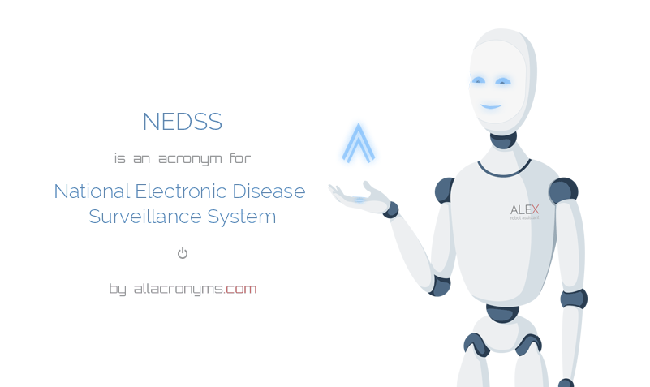
NBS Considerations

Slide 69
Miscellaneous
Do not submit notifications for “not a case” investigations.
All VPDs should be sent for notification in NBS within 30 days of initial report
  This is measured for each LHD/HSR on the quarterly report for the Immunization grant
  This is an Immunizations grant deliverable
The CDC provides Texas and LHDs money for VPD investigations.
  All information requested is based on CDC expectations that are tied to funding!

Slide 70
NBS Queues
Documents Requiring Review Queue should be checked daily
  Once it is on this queue, the clock is ticking for turn around time for Immunizations Quarterly report
Rejected Notifications Queue should be checked at least weekly
  The more information you include, the less likely it is to be rejected
  Read the case definitions
  If you don’t fix rejected investigations, they will count against you on the Immunizations Quarterly report

Slide 71
Common NBS Mistakes
Illness duration often needed to meet case definition
  Pertussis: enter # of days of cough, must be at least 14 days
  Mumps: enter # of days of parotitis, must be at least 2 days
  Measles: enter # of days of rash, must be at least 3 days
Temperature needed for measles, rubella to meet case definition

Slide 72


Slide 73
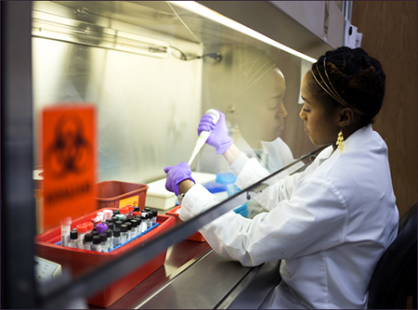
Laboratory

Slide 74
Why Collect Specimens?
Helps to make or confirm diagnosis
DSHS lab has better tests
  Commercial IgM more prone to false positives
  DSHS turn around usually same day
  PCR not widely available for MMR, not available at all commercially for measles
CDC can do even better tests
  Confirm outbreaks/transmission
  Identify importation sources

Slide 75
Collecting Specimens
Serum, nasopharyngeal specimens, throat swabs, buccal swabs, dried vesicles, other?
  Can be collected by LHD/HSR staff
  Can be collected by private provider
Need DSHS lab submission form
  A form for EACH specimen
Follow instructions exactly
  Ask if you’re confused

Slide 76
Sending Specimens
INFORM EAIDB ABOUT SPECIMENS
  MMRV, diphtheria, polio, smallpox
Obtain tracking # from FedEx/Lone Star
Ship to the physical address (not PO box)
Follow the directions exactly
  Read the guidelines -Call the lab/EAIDB
Ship overnight
Specimens should not arrive on weekends/holidays

Slide 77


