Slide 1
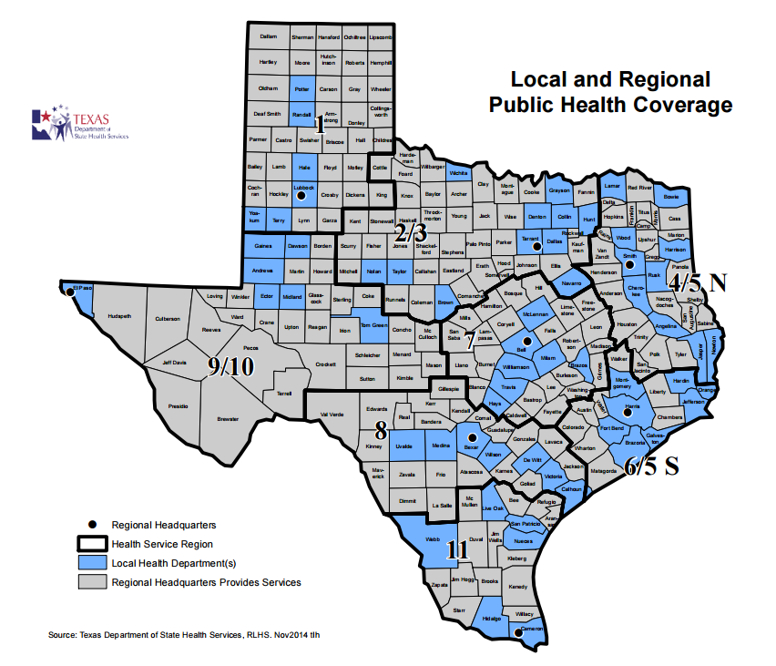

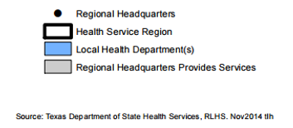
Local Epidemiology Capacity in Texas:
A Proposed Evaluation
Jennifer Horney, PhD, MPH
Associate Professor
Texas A&M School of Public Health
Kahler Stone, MPH
Graduate Research Assistant
Texas A&M School of Public Health

Slide 2
Overview
Background
Research Model and Methods
Proposed Research Questions
Open Discussion and Feedback

Slide 3
Background
  Increases in number of local epidemiologists in Texas since 2013
  83rd Texas Legislative Session (SUR)
    Foodborne epidemiologists in local health departments
    Now generalists
    17 in LHDs
  84th Texas Legislative Session (SUREB)
    High consequence infectious disease epidemiologists in local health departments
    28 in LHDs

Slide 4


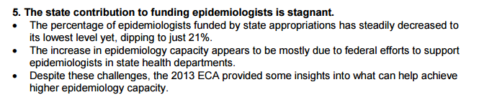
Notes:
Ask Eric if the money for the contract epis comes from the feds or the state…is there a plan for the states to pick up the tab in the future? Would be consistent with CSTE findings if the case

Slide 5
Background - Nationally
Epidemiology workforce has been slowly growing nationwide
  (CSTE 2013. 2013 National Assessment of Epidemiology Capacity)
Epidemiology workforce is diverse in training and experience
  (O’Keefe, et al. 2013. Frontiers in Public Health)
Still rely on outside positions or agencies for epidemiologic surge capacity during infectious disease emergencies
  (Enanoria, et al. 2014. Public Health Reports)
Notes:
Funded from the state – these are State of Texas dollars and are not being reimbursed or funded from the federal government for these positions
Positions were created to increase capacity by specifically adding epidemiologists to LHDs, not fund existing staff
Texas is not following the national trend of cutting appropriations to epidemiologic capacity like the rest of the country

Slide 6

Background - Texas
Home rule state with high variance in LHD size – leaving epis with a range of roles and responsibilities in Texas
Texas stands out – contract epis are funded from the state, not a federal stream
Contract epi positions have minimum requirements for hiring

Slide 7
Background
Limited research on LHD adaptation and epi specific response
  A number of studies look at overall LHD or system performance metrics, but not an emphasis on burden
  Majority of prior research on LHD as a single unit, not internal programs or functional groups
  Limited research on epidemiologic capacity exists from local health department perspective
Notes:
Looking at accreditation and inputs, outputs, and performance indicators in general.
Studies have looked at the LHD as one unit and not done much research within the functional areas or programs within the LHD
Limited research on epidemiology as a function and how that unit handles a response or performs in a LHD

Slide 8
Research Model and Methods
CDC-funded Preparedness and Emergency Response Research Centers
Conduct research to evaluate the structure, capabilities, and performance of public health systems for preparedness and emergency response
Focused on state and local health department systems, functions, and burdens of emergency response
  Accreditation and public health emergency response, surveillance systems, preparedness workforce infrastructure

Slide 9
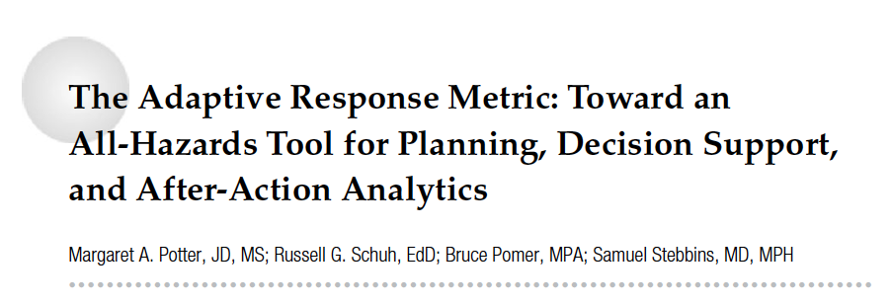
Adaptive Response Metric (ARM):
A metric and framework developed by Potter et al.
Aims to look at the internal adaptations to public health emergency responses
  Allows for LHD complexities and uniqueness in response
Notes:
Both articles are describing the ARM metrics, the first is a validation and the other is an example.

Slide 10
ARM: Uses stage-state approach
Stage 1
Normal duties are unaffected by the addition of duties to address the emergency.
Stage 2
Normal duties of function are altered for key staff - overtime is required or some duties are postponed.
Stage 3
Normal duties of function altered or suspended – the workforce is expanded: extra staff and volunteers are enlisted.
Stage 4
Stage 5
All of function staff are involved in response to the emergency and maintenance of critical activities.
Normal functions cease or merge with emergency response efforts.
Notes:
We incorporate a stage-state approach to categorizing observational and quantitative data as a way to identify common sequences or patterns of response while preserving the individual organization variation in the ways stages are negotiated or experienced.
Nonprofit organizations have used similar approaches in assessing function and patterns within an organization

Slide 11
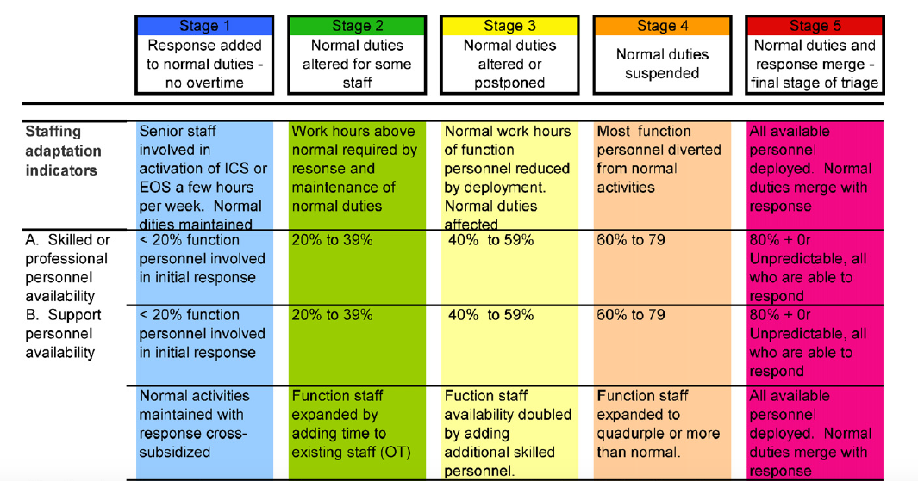
ARM: Skilled and personnel availability through stages

Slide 12
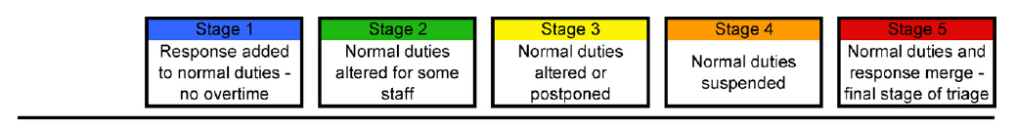
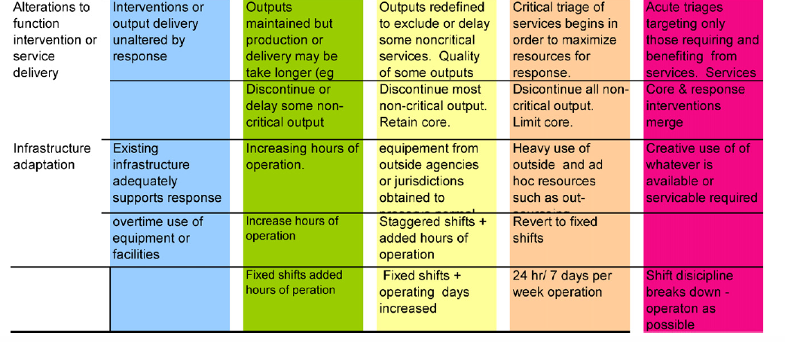
ARM: Function or service delivery and infrastructure through stages

Slide 13
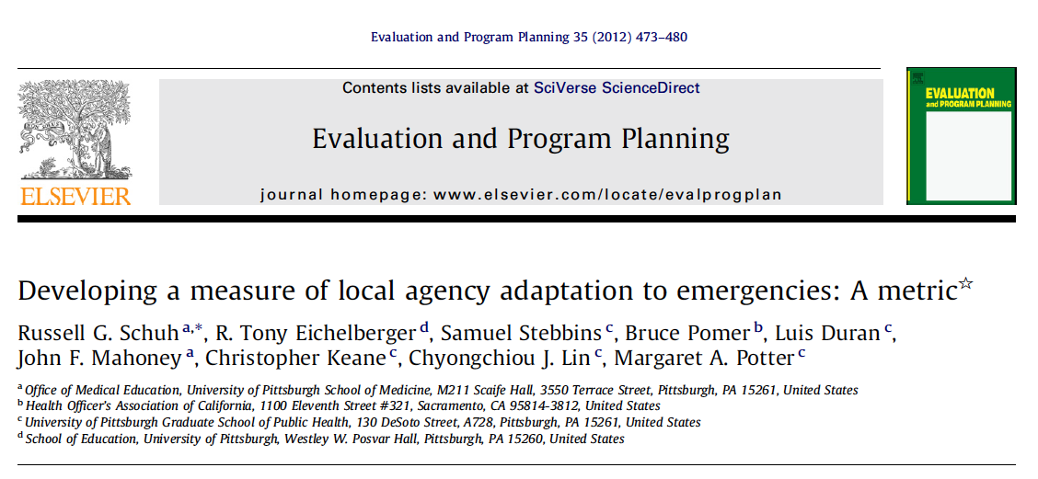
Application of the ARM model to the 2009 H1N1 pandemic
  4 LHDs in California were studied using ARM
  Each unit within the LHD was evaluated using the 5 stages
  Interviews with unit leadership to determine stages and timeframes
    Raw burden score (stage # X number of days/wks)
    Weighted burden score (raw score X subunit % of budget)
Notes:
The term burden is used because it was frequently used by LHD personnel during the validation of this metric

Slide 14
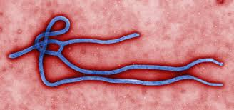
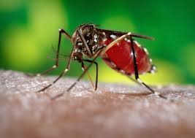
Research Models and Methods
ARM can be adapted to specific functions and provide a framework for a proposed study of epidemiology capacity in Texas
  LHD / State surveillance information prior to first round of contract epis
  Ebola as target event after first round of contract epis
  Zika as target event after second round of contract epis

Slide 15

Proposed Research Questions
Describe the overall system capacity
Quantify the burden of emergency response on epidemiology capacity
  Understand the epidemiology function within the LHD and how it interacts with other functions under stress
  Understand maintenance of day-to-day public health operations in the midst of emergency responses.
Notes:
Need to wrap up and lay out some discussion points to get feedback from contracted epis in the room

Slide 16
Proposed Data Types and Sources
Adaptive Response Metric (ARM) data
  Qualitative interviews with contract epis and leadership staff
Additional metrics
  NBS
  Regular monitoring reports
  Disease reporting
    Investigation completeness, outbreaks reported/investigated

Slide 17
Discussion and Feedback
Notes:
Need to wrap up and lay out some discussion points to get feedback from contracted epis in the room

Slide 18
Questions?
Jennifer A. Horney, PhD, MPH, CPH
Associate Professor
Department of Epidemiology & Biostatistics
School of Public Health | Texas A&M University
214 SPH Administration Building | MS 1266
College Station, Texas 77843-1266
phone 979-436-9391 | horney@sph.tamhsc.edu
Notes:
Need to wrap up and lay out some discussion points to get feedback from contracted epis in the room

