Slide 1
Zika in Texas
Epidemiology & Laboratory Capacity Conference
October 3, 2017
Austin, Texas
Kelly Broussard, MPH
Epidemiologist, Zoonosis Control Branch
Texas Department of State Health Services

Slide 2

Objectives
Summarize the epidemiology of Zika
Review recent Texas and United States Zika case counts
Describe current laboratory testing options and testing eligibility in Texas
Source: http://i2.cdn.turner.com/cnnnext/dam/assets/160202092019-07-zika-forest-large-169.jpg
www.cdc.gov

Slide 3
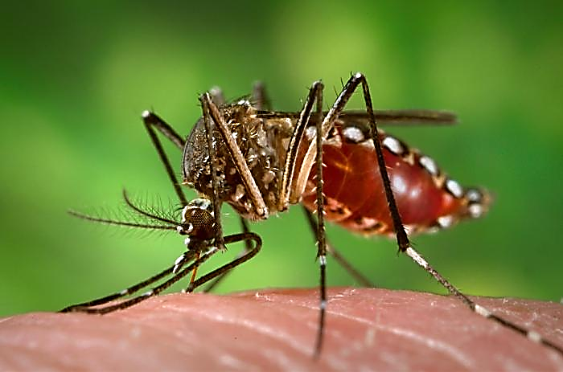
Zika Virus
Mild symptoms: fever, maculopapular rash, joint pain, conjunctivitis
  Most Zika infections are asymptomatic (estimated 80%)
Transmission primarily vectorborne in areas where Aedes aegypti and Ae. albopictus mosquitoes are abundant
  Sexual transmission from men or women, regardless of symptoms
  Congenital transmission to growing fetus during pregnancy
Image Source: https://phil.cdc.gov/phil/details.asp

Slide 4
Zika Virus
Severe outcomes of Zika infection during pregnancy (microcephaly, intracranial calcifications, limb contractures, etc.)
  Texas data, Jan 2016-July 2017: Among 219 completed pregnancies enrolled in US Zika Pregnancy Registry, 8% had Zika-associated birth defects
Related to and can cross-react with:
  West Nile virus and St. Louis Encephalitis virus, which can be acquired throughout Texas during mosquito season
  Dengue virus, clinically similar to Zika and shares distribution & vector
Hall NB, Broussard K, Evert N, Canfield M. Notes from the Field: Zika Virus-Associated Neonatal Birth Defects Surveillance — Texas, January 2016–July 2017. MMWR Morb Mortal Wkly Rep 2017;66:835–836.

Slide 5
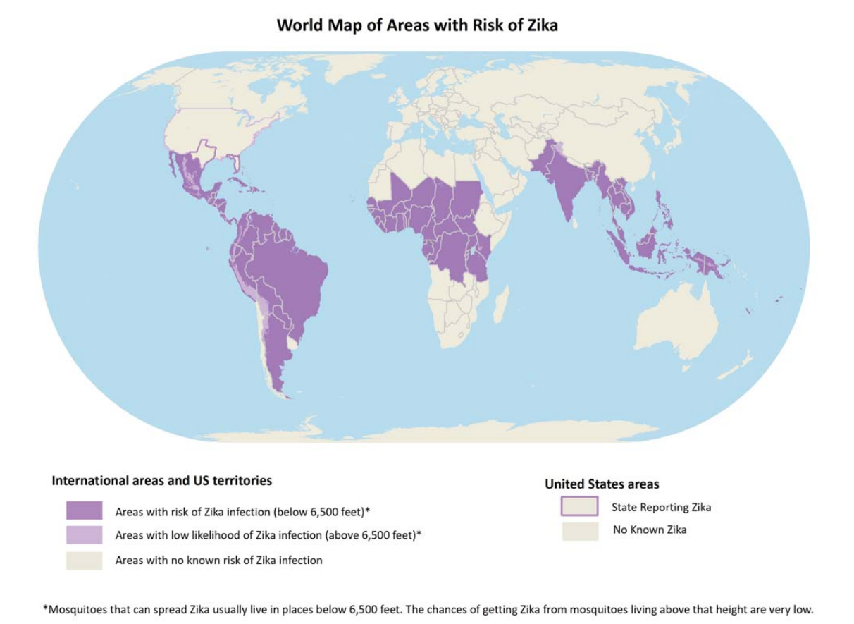
Areas with Risk of Zika Transmission

Slide 6
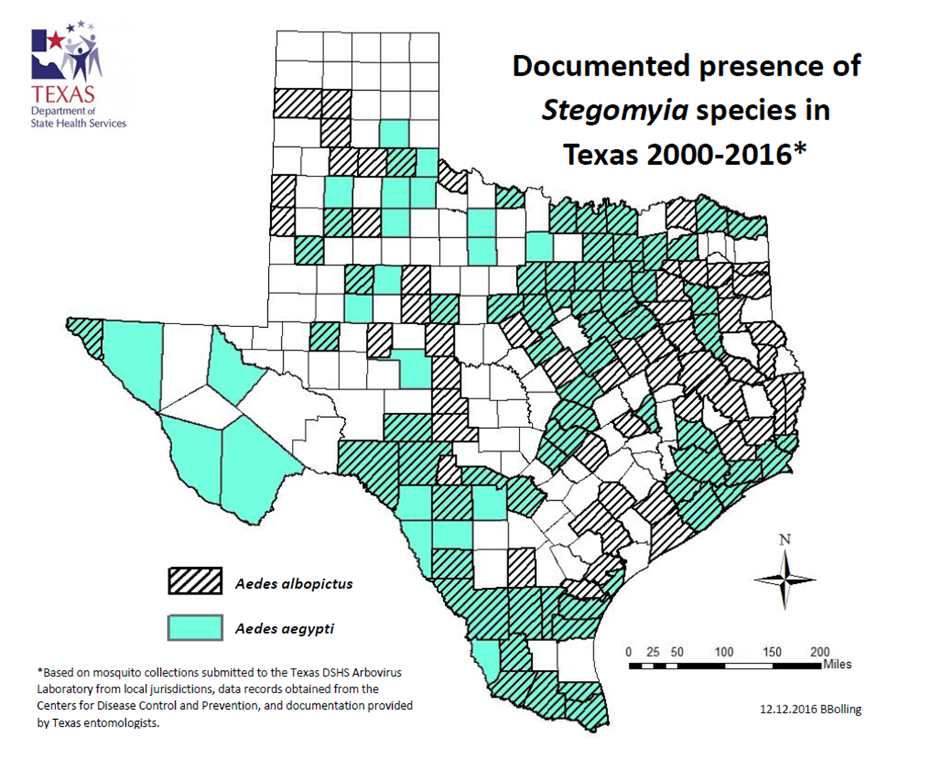

Slide 7
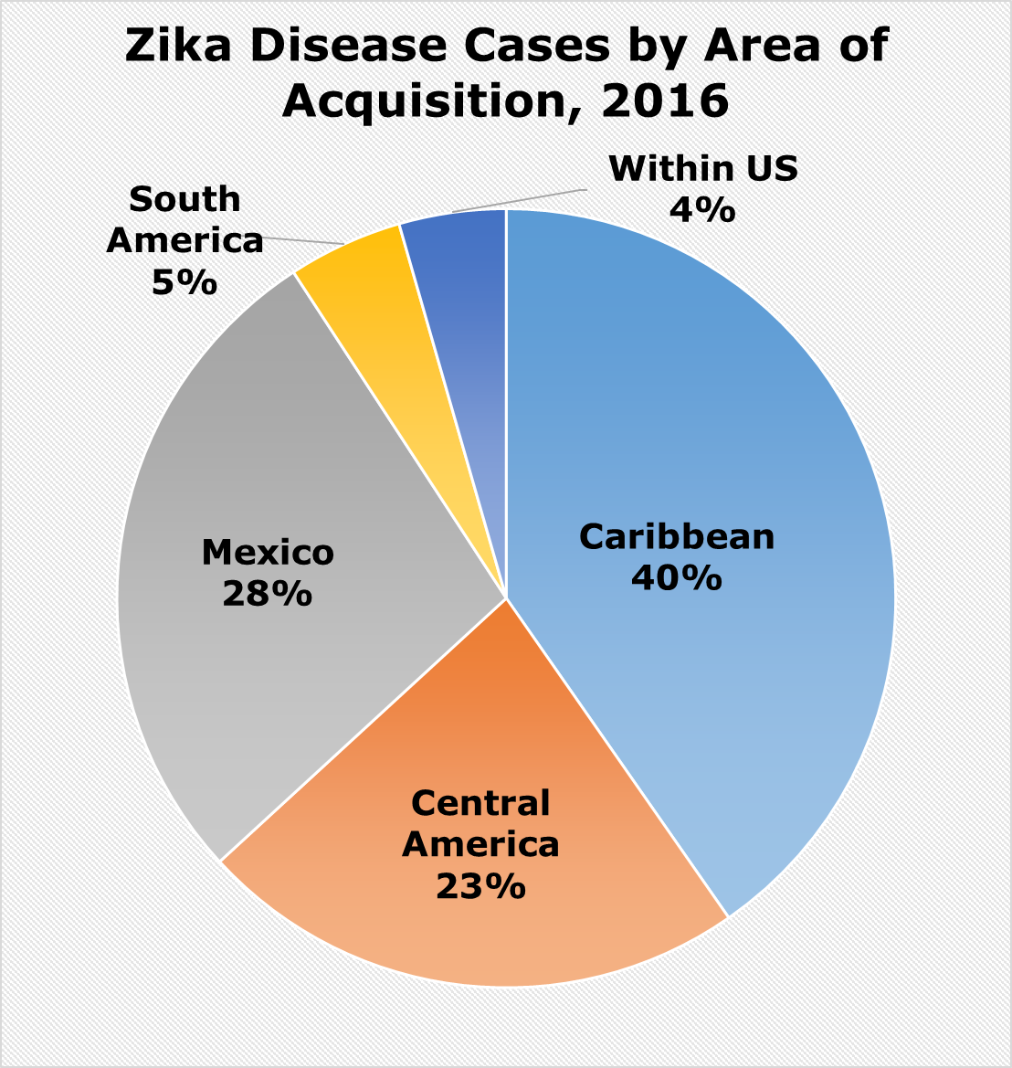
Zika Disease Cases in Texas, 2016
Includes:
3 congenital disease cases
6 Texas mosquito-borne cases
2 sexually acquired cases

Slide 8
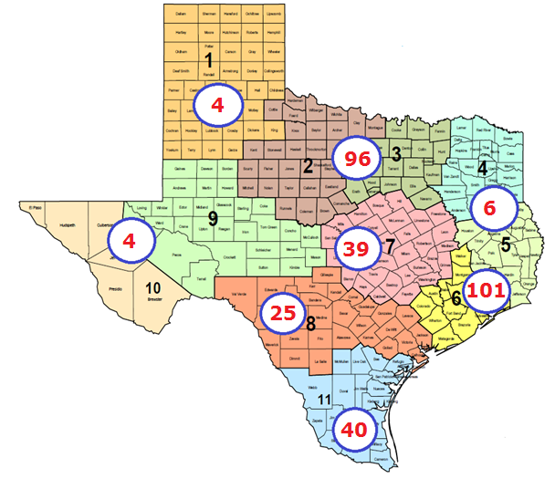
Zika Disease Cases by Health Service Region, 2016
N = 315

Slide 9
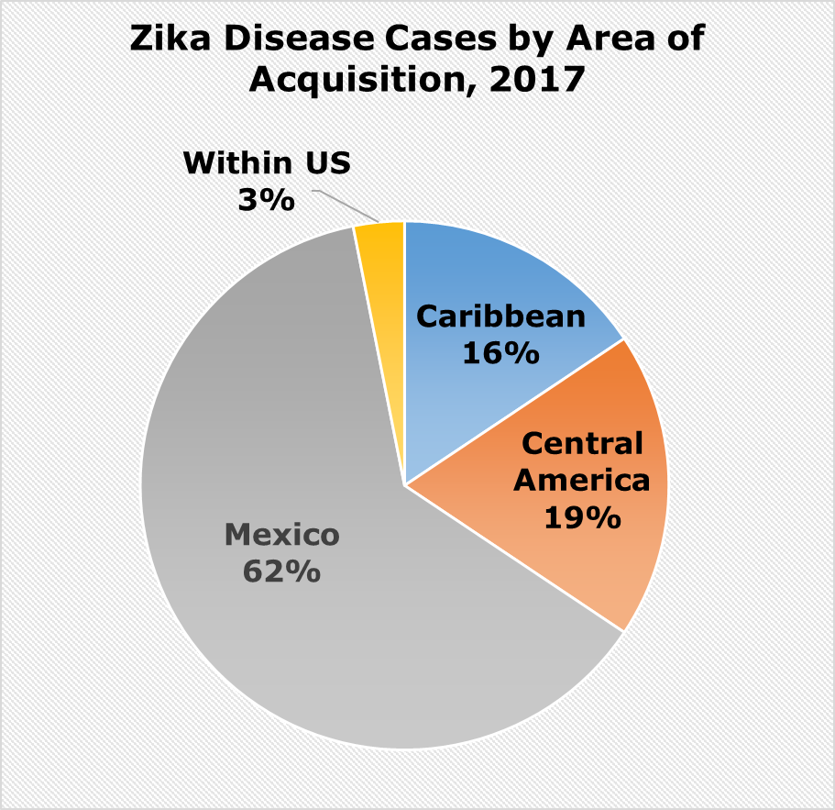
Zika Disease Cases in Texas, 2017
Zika Disease Cases in Texas by Residence County, 2017*
County | Total
Bexar | 2
Brazoria | 1
Brazos | 1
Cameron† | 10
Collin | 1
Dallas | 2
Denton | 1
Harris | 7
Lubbock | 1
Smith | 2
Travis | 1
Webb | 1
Upshur | 1
Total | 31
*as of close of business 9/22/17
† Includes one case transmitted by mosquitoes in Texas (Cameron).

Slide 10
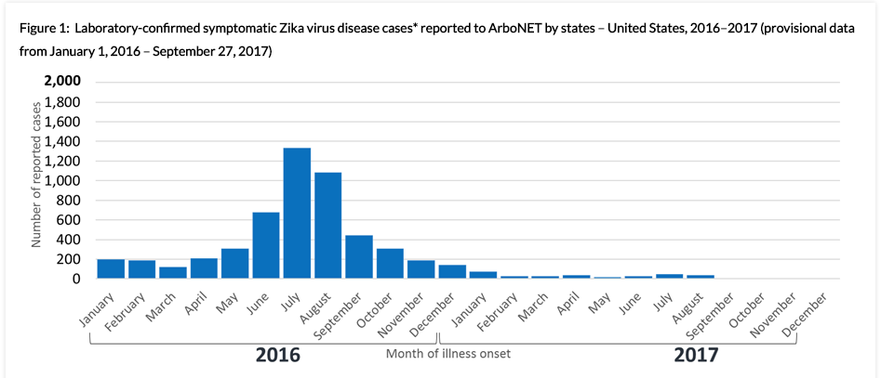
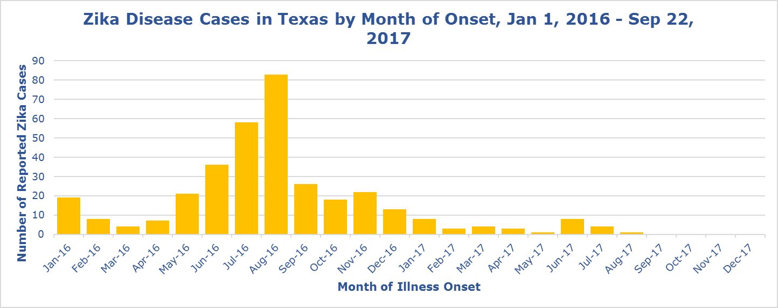
Zika Disease Cases by Onset, 2016-2017: US and Texas
US data source: https://www.cdc.gov/zika/reporting/case-counts.html

Slide 11
United States Zika Pregnancy Registry
Surveillance of birth outcomes for mother/infant pairs who seek medical care in the US and who have laboratory evidence of possible Zika virus infection
  Differs from Zika disease case definition for Texas (lab criteria more flexible, symptoms not required, Texas residency not required)
    As of 9/22/17, 420 individuals enrolled in Texas for the USZPR
      Zoonosis Control Branch finalizes total number of enrolled mother/infant pairs via NEDSS lab data, case reporting, etc.
  Birth Defects Epidemiology & Surveillance Branch conducts rapid ascertainment of birth defects consistent with Congenital Zika Syndrome in Texas infants
    May follow-up on infants born to mothers in USZPR
Local Health Department participation differs based on resources
  Some jurisdictions within Texas have received funding or have a CDC fellow onsite

Slide 12
Changing Knowledge, Changing Guidance
Oct 2016:
-DSHS expands testing criteria to include symptomatic pregnant women in RGV counties with no known Zika exposure
Apr 2016:
-CDC concludes Zika is a proven cause of microcephaly and other birth defects
Dec 2016:
-CDC Health Alert recommends testing for pregnant women living in or traveling to Brownsville
Aug 2017:
-DSHS expands testing criteria to more S Texas residents and recommends PCR and IgM
-Brownsville cautionary area designation removed
Jan 2016:
-S. American outbreak underway
-Testing recommended for symptomatic travelers only
Feb 2016:
-Sexual transmission identified
-Testing recommended for asymptomatic pregnant women with exposure (IgM only)
Aug 2016:
-Local mosquito-borne transmission in Miami, Florida identified
Apr 2017:
-DSHS expands testing criteria to all pregnant women in RGV, regardless of symptoms
Jul 2016:
-Female to male sexual transmission identified
-PCR testing recommended for asymptomatic pregnant women (exposures < 2 weeks)
Nov 2016:
-CDC recommends more PCR testing, updates testing guidance
-Local mosquito-borne transmission in Brownsville, Texas identified

Slide 13
Zika Testing Options
Test Type | Availability | Specimen Types | Caveats
IgM antibody detection | Widespread - commercial and public health labs | Serum, CSF | False positives and cross-reactivity common, unclear duration of IgM
Plaque Reduction Neutralization Test (PRNT) | Limited – public health labs only (certain states, CDC) | Serum, CSF | Time consuming, cannot distinguish timing of infection
PCR | Widespread - commercial and public health labs | Serum, urine, CSF, whole blood, amniotic fluid | Limited window of detection, false positives possible
Tissue pathology | Very limited – CDC only (requires pre-approval) | Placenta, umbilical cord, products of conception, fetal losses | Very time consuming, cannot distinguish between maternal and fetal infection

Slide 14
Zika Testing Eligibility
Symptomatic individuals
  Travel or sexual exposure – 1+ symptoms
  Residence in select RGV counties* – rash and fever, conjunctivitis, or arthralgia
  No known exposure – 3 or more Zika symptoms
Asymptomatic pregnant women
  Travel or sexual exposure
  Residence in select RGV counties*
Infant with maternal exposure
  Mom is Zika positive or
  Zika-associated birth defects detected
*Cameron, Hidalgo, Kinney, Maverick, Starr, Val Verde, Webb, Willacy, or Zapata

Slide 15
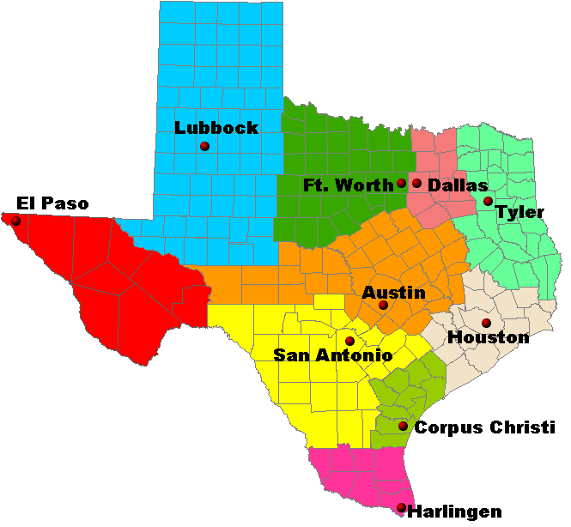
Laboratory Response Network

Slide 16

Further Resources
Web resources for continuous updates
  CDC: http://www.cdc.gov/zika/index.html
  PAHO: http://www.paho.org/hq/
  DSHS: http://www.texaszika.org/
Thank you!
  Nicole Evert, ZCB epidemiologist
  Regional Zoonosis Control program staff
  Local health department epidemiologists

Slide 17
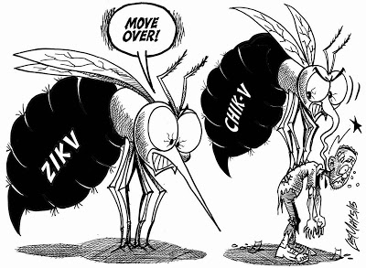
To be continued…
Cameron County Department of Health and Human Services
  Isabel Huerta &
  Dino Chavez

