Slide 1
Emerging Healthcare Associated Pathogens in Texas
What are our facilities doing to prevent the spread?
October 4, 2017

Slide 2
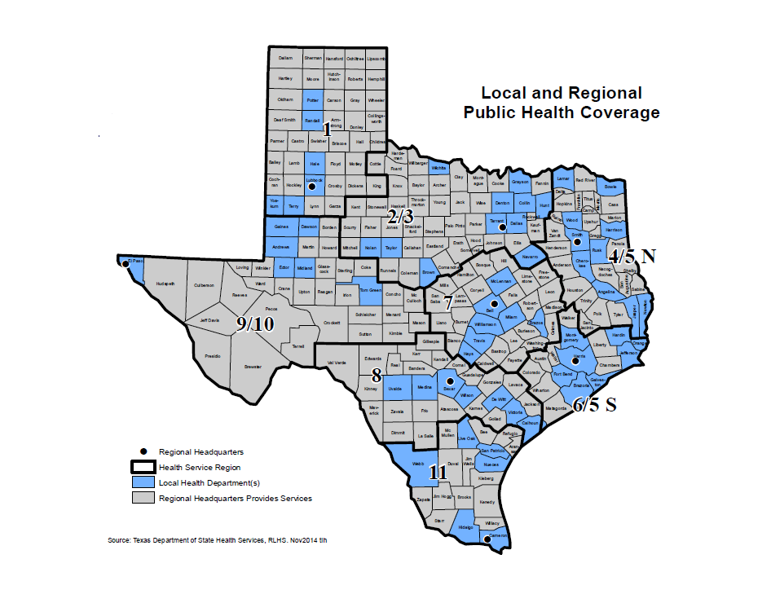


Gillian Blackwell, PHR 1
Gillian.Blackwell@dshs.texas.gov
806-783-6418
Sandi Arnold,
PHR 9/10 (interim) & 7
Sandi.Arnold@dshs.texas.gov
254-771-6788 (M&T)
254-750-9387 (W-F)
Thi Dang, PHR 2/3
Thi.Dang@dshs.texas.gov
817-264-4500
Annie Nutt, PHR 4/5N
Anna.Nutt@dshs.texas.gov
903-533-5317
Gretchen Rodriguez, PHR 8
Gretchen.Rodriguez@dshs.texas.gov
210-949-2025
Bobbiejean Garcia, PHR 6/5S
Bobbiejean.Garcia@dshs.texas.gov
713-767-3404
Melba Zambrano, PHR 11
Melba.Zambrano@dshs.texas.gov
955-444-3208
Notes:
Before HAI Support came directly from Central Office

Slide 3
Identification of Emerging Resistance
Notes:
I would like to start our presentation off with a discussion about emerging resistance.

Slide 4
Emerging Pathogens of Concern
Multi-Drug Resistant Organisms:
  Currently reportable:
    VISA/VRSA, CRE, MDR-A
  Bacteria with mobile resistance genes
  Candida auris
  Clostridium difficile
Notes:
The emerging pathogens of concern for healthcare acquired infections include currently reportable: VISA/VRSA, CRE and MDR-A, bacteria with mobile resistance genes, C.auris and C.difficile. The focus for the first part of this presentation will be these bacteria with mobile resistance genes.

Slide 5
Mobile Resistance Genes
  1. Carbapenemase-Producing (CP) genes:
    Examples: KPC and NDM
  2. Genes conferring resistance to Colistin:
    Examples: mcr-1, mcr-2, mcr-3
Notes:
There are 2 types of mobile resistance genes our lab is currently capable of testing for, those include 1. carbapenemase producing genes such as KPC and NDM, which are genes that as the name implies, confer resistance to the carbapenem antibiotics. And secondly, genes conferring resistance to the antibiotic colistin, such as mcr-1.

Slide 6
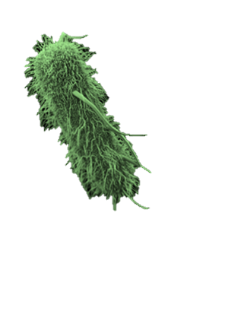
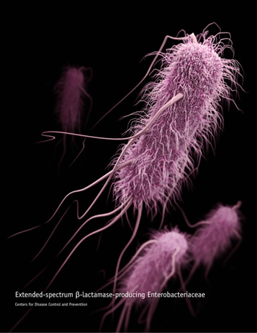


What’s the big deal?
Super Bug!
E.Coli with mcr-1
CRE E.coli
Notes:
CDC/James Archer for photo
Transmission of these resistance genes into bacteria that are already highly resistant is the biggest concern. For example, if an E.coli expressing the mcr-1 gene (colistin resistance) shares genetic information with a CRE E.coli, this could result in a super bug that is resistant to all known treatment options. These superbugs have high mortality rates due to limited treatment options. There has been research recently that shows synergistic effects of 3 antibiotics used together for treatment.

Slide 7
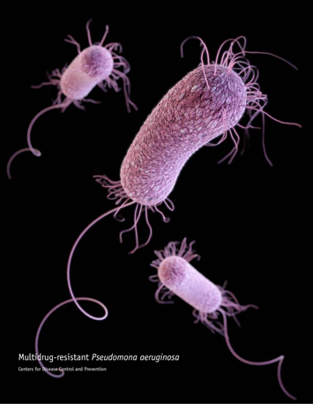
Isolate Submission - ARLN
Voluntary
Texas only tests for Carbapenem resistance in:
  Enterobacteriaceae:
    Escherichia coli
    Klebsiella pneumoniae
    Klebsiella oxytoca
    Enterobacter species
  Acinetobacter baumanii
  Pseudomonas aeruginosa
Current capabilities for resistance mechanisms: KPC, NDM, IMP, VIM, OXA-48, mcr-1
    Validation in progress for mcr-2
Notes:
Picture of PA: CDC/James Archer
Our Antibiotic Resistance Lab Network kicked off in June of this year. The ARLN is able to test the following bacteria species for carbapenemase production as well as PCR testing for a panel of resistance mechanism genes listed below. When an isolate is received at the lab, Antibiotic Susceptibility Testing (AST) is performed first to confirm the original susceptibility panel from the sending facility, then carbapenemase testing and PCR testing occur.

Slide 8



Result Notification
Isolate sent for testing
Report within 1 working day of results
Report within 1 working day of results
Public Health
Provide assistance; Initiate investigation
Notes:
Isolates are sent to the state lab in Austin, results are communicated to the sending facility and the health department, then public health is able to reach out to the facility to provide further investigation support if a Tier 1, 2 or 3 organism is identified. Although not pictured here, if the lab identifies a potential novel resistance mechanism, they will forward the isolate on to the CDC for confirmation.

Slide 9
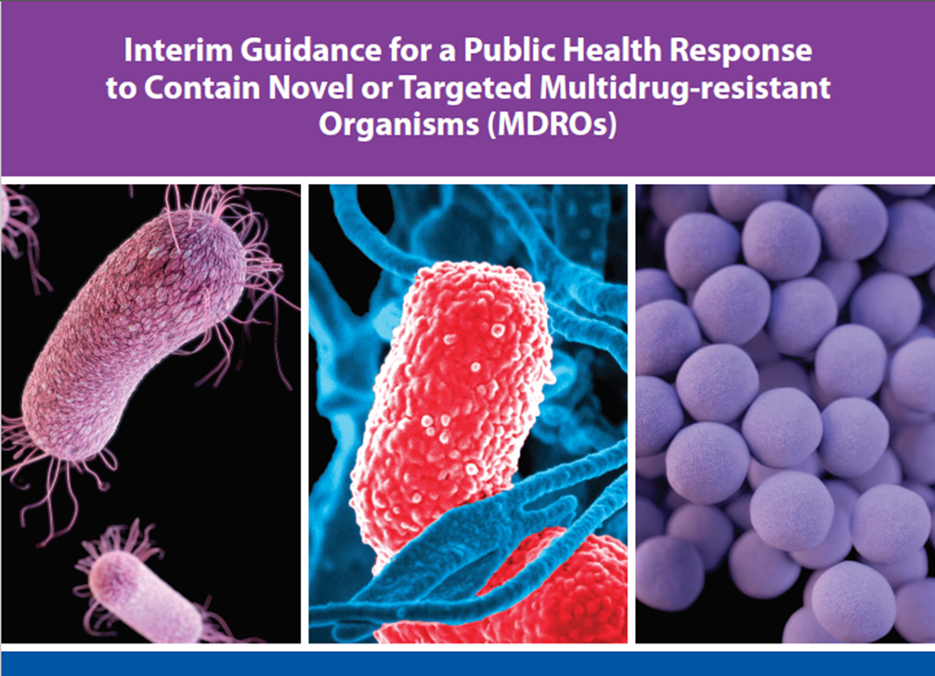
Public Health Response
Notes:
https://www.cdc.gov/hai/outbreaks/docs/Health-Response-Contain-MDRO.pdf
We look to the CDC’s Interim Guidance for a Public Health Response to Contain Novel or Targeted Multidrug-Resistant Organisms (MDROs) for our public health response.

Slide 10
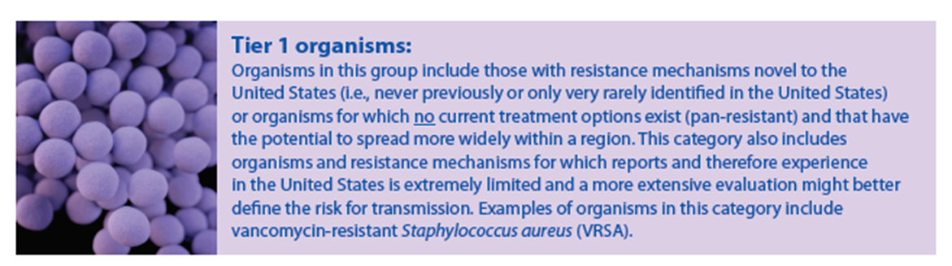
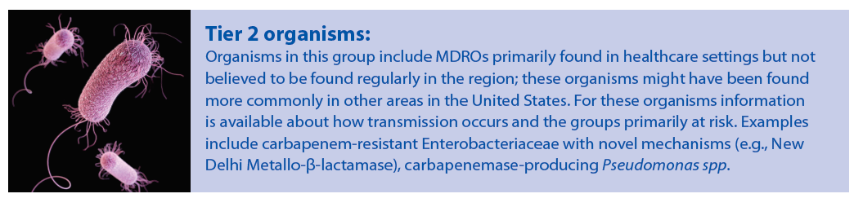
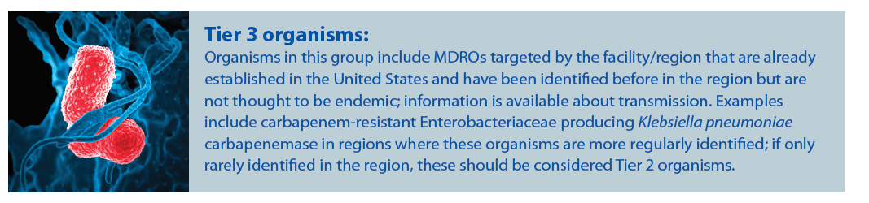
Tiers of Response
Notes:
The guidance document breaks the organisms down into 3 Tiers. The first tier is reserved for rare or pan-resistant organisms, and requires the biggest response. For example, mcr-1 or a novel resistance mechanism would both fall in Tier 1 and require extensive investigation and response which Thi will cover in our next section of the presentation. The second tier is for organisms primarily found in healthcare settings but not believed to be found regularly in the region. Examples include the resistance gene OXA-48, as well as carbapenemase-producing Pseudomonas species. The third tier includes organisms that are already established in the region, for example, KPC in Texas.

Slide 11
Public Health Notification and Response

Slide 12
Initial Notification
Once one of the alert triggers is met, an email is sent by the ARLN to notify:
CDC
State HAI Coordinator
Regional HAI Epidemiologist
Notes:
Once one of the alert triggers is met, the ARLN immediately notifies:
CDC
the State HAI Coordinator
Regional HAI Epidemiologist
so that appropriate infection control measures may be implemented.

Slide 13
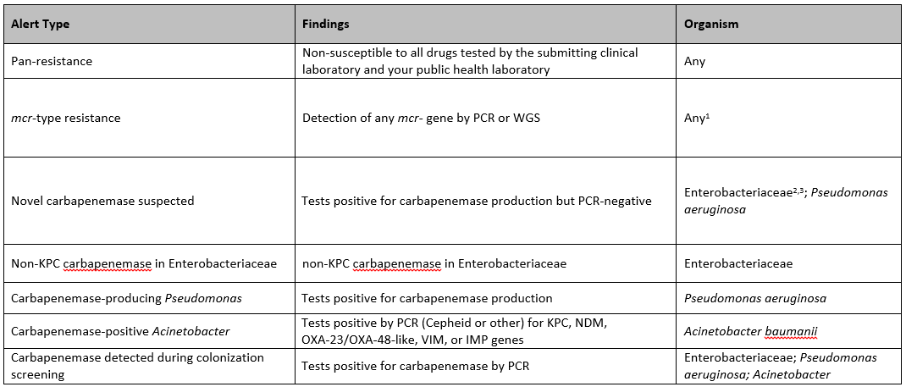
Triggers for Notification
Notes:
This table summarizes the AR findings that should trigger these email alerts.

Slide 14
Notification Process
HAI Epidemiologist obtains a copy of the lab report from Citrix
HAI Epidemiologist notifies the Epidemiology Team Lead in the Region
HAI Epidemiologist notifies the Chief Epidemiologist of the appropriate local health department where the facility is located. This is the facility where the specimen was collected.

Slide 15
Facility Notification
Health Department Epidemiologist notifies facility, ensures appropriate precautions are in place, and obtains patient history
Notes:
Once one of the alert triggers is met, the ARLN immediately notifies:
CDC
the State HAI Coordinator
Regional HAI Epidemiologist
so that appropriate infection control measures may be implemented.

Slide 16
What information does the epidemiologist need?
Medical history
Travel history
Healthcare history (outpatient and inpatient)
Roommates in healthcare facilities
Infection control interventions implemented to date

Slide 17
Infection Control & Prevention Measures
Contact Precautions
Retrospective Data
On-Site Observations
Colonization Study
Prospective Surveillance Study
Environmental Sampling
Source: CDC Interim Guidance for a Health Response to Contain Novel or Targeted Multidrug-resistant Organisms
Notes:
Contact Precautions is recommended with extra efforts for education recommended for such things as hand hygiene, proper PPE selection, proper donning/doffing of PPE, disposable supplies, etc. Staff need to be educated on the organism and resistance mechanism so they fully understand the importance of their compliance. Proper environmental disinfection is of utmost importance and needs to be included for all staff who would enter the patient’s environment.
A look at retrospective data for the facility is recommended to help establish a baseline. This information can be obtained from the lab and pharmacy. Obtaining an antibiogram for the facility would be helpful. Antibiogram for each TX public health region is available online.
Observe staff practices to identify gaps in infection control. Places to visit include areas that the patient has been or has received services (i.e., Dialysis).
Colonization study may be recommended depending on the history of the patient.
i) Identification of high risk contacts
ii) Screening for “presence of mechanism” via Rectal swabs
iii) If contacts are positive, start new round of testing
iv) Steps of this process will be covered by Tarrant
Through prospective surveillance, facilities may be requested to submit isolates to the ARLN for a certain time period following the initial infection to monitor the presence of the resistance mechanism at the facility.
Sending isolates to ARLN for 3 months
Ensure that DSHS Lab/ARLN has capacity to accept the isolates
Environmental sampling is also something that may be recommended depending on the situation.

Slide 18
Public Health Response:
Texas’ First mcr-1 Case

Slide 19
Notification of mcr-1
State HAI Coordinator notified the HAI Epidemiologist
LHDs contacted
Regional office was contacted
CDC contacted to provide assistance
Notes:
This was our first Tier 1 notification from the ARLN. Since this event, we have used what we learned and made improvements to our notification process.
I first want to share how this isolate came to be tested.. The original isolate was an (ESBL+) E.coli that was tested at a large reference lab, and found to have colistin resistance. Due to the colisitin resistance, the reference lab thought it would be neat to see if this organism was carrying a special gene, so they sent it in to the ARLN for testing. Unfortunately, the HAI Epi was not aware of the isolate being sent, therefore was not looking out for a result. This, and the fact that the original result was about 1 month old, made it much harder to track down the patient when we received the mcr-1 result.
The day of the positive lab result for mcr-1, the lab contacted the State HAI Coordinator, who called me immediately with the result since I was covering for Thi (2/3). From there, the regional office was notified and CDC was contacted to provide assistance. The LHDs that were involved were then contacted by the regional office.

Slide 20
Notes about mcr-1
Until June 2017, mcr-1 has not been identified in Texas or in a Texas resident
Few cases have been seen in the U.S.
Collaboration with CDC is necessary

Slide 21
Case Patient
49 y/o male
McLennan County resident
5/21/17 Urine culture +
ESBL E. coli
6/15/17 Isolate sent from reference lab to ARLN due to colistin resistance
ARLN PCR testing revealed presence of mcr-1 resistance mechanism

Slide 22
Dallas County Health & Human Services

Slide 23
Dallas County
Point Prevalence Study
Dallas County epidemiologists worked with the LTAC to obtain rectal swabs
11 patients were swabbed
Swabs were sent to CDC
All isolates were negative for mcr-1

Slide 24
Dallas Co. Retrospective & Prospective Surveillance
Epidemiologists collaborated with the Infection Preventionist to identify additional cases
No additional cases identified
The reference lab for the LTAC was asked to submit isolates to DSHS Lab for 3 months for prospective surveillance. The lab chose not to participate.

Slide 25


MCR-1 Case Study
By: Tijera Bell, MPH, CIC
TARRANT COUNTY PUBLIC HEALTH
Accountability.
Quality.
Innovation.
Updated: September 2017
A healthier community through leadership in health strategy.

Slide 26
Initial Report
TARRANT COUNTY PUBLIC HEALTH
DSHS Region 2/3 HAI notified Tarrant County Public (TCPH) of the patient’s lab results and current healthcare facility (HCF)
TCPH notified HCF and the patient was placed on contact isolation immediately
Multidisciplinary team of TCPH epis, DSHS HAI epi, and HCF staff established to develop a strategy for infection control measures

Slide 27
Phases of the study
TARRANT COUNTY PUBLIC HEALTH
Test of Cure
Point Prevalence Study
Prospective Surveillance

Slide 28
Findings
TARRANT COUNTY PUBLIC HEALTH
Test of Cure
  Unable to complete
Point Prevalence Study
  All specimens were negative for MCR-1 gene
Prospective Surveillance
  <5 ESBLs during the surveillance period, all were present on admission

Slide 29
Best Practices Identified
TARRANT COUNTY PUBLIC HEALTH
Establish positive rapport with the HCF immediately
Ensure non-medical staff understands isolation signs (social workers, therapy staff, etc.)
“Secret Shopper” hand hygiene audits

Slide 30







Main Address:
1101 S. Main Street
Fort Worth, TX 76104
TARRANT COUNTY PUBLIC HEALTH
Accountability.
Quality.
Innovation.
Social Media:
Phone:
817-321-4700
Website:
health.tarrantcounty.com
A healthier community through leadership in health strategy.

Slide 31
Brazos County Health Department
Yao Akpalu, MB.ChB, MPH, CPH

Slide 32
Waco – McLennan County Public Health District
Vaidehi Shah, BDS, MPH
Epidemiologist
vaidehis@wacotx.gov

Slide 33
Regional Health Department Roles
Participated and provided input in meetings and conference calls
Provided information resources
Assisted with arrangements for specimen submission

Slide 34
Takeaways
Non-traditional epidemiology investigation steps
Extensive collaborative effort between various entities
Conducting point prevalence study for emerging HAIs
Understand what comprises a prospective surveillance study for emerging HAI pathogens.
Notes:
These investigations do not include the traditional epidemiology investigation steps.
Extensive collaborative effort
Roles of HAI Epidemiologist, Regional Epidemiologist, and Local Health Department epidemiologist
Lab for facility as well as ARLN
Understand steps for conducting point prevalence study for emerging HAIs.
Understand what comprises prospective surveillance study for emerging HAI pathogens.

Slide 35
References
Centers for Disease Control and Prevention (2017). Antibiotic Resistance Lab Network. Retrieved from: https://www.cdc.gov/drugresistance/solutions-initiative/ar-lab-networks.html.
CDC (2017). CDC Antibiotic/Antimicrobial Resistance. Retrieved from: https://www.cdc.gov/drugresistance/index.html.
CDC (2017). CDC Interim Guidance for a Health Response to Contain Novel or Targeted Multidrug-resistant Organisms. Retrieved from: https://www.cdc.gov/hai/outbreaks/mdro/index.html
Texas Department of State Health Services (2017). Texas Notifiable Conditions. Retrieved from: https://www.dshs.texas.gov/idcu/investigation/conditions/.

Slide 36

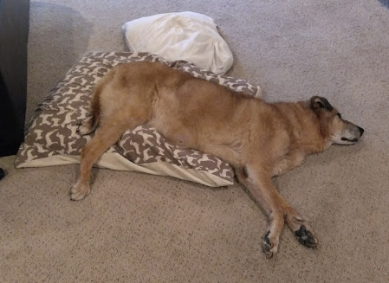
Carbapenemase Producing Pseudomonas aeruginosa
Notes:
Let sleeping dogs lie!

Slide 37
CRPA
  “new” IP
  Special population: burn patients
  High turn-over at facility
  Previous P. aeruginosa outbreak
  December 2016-January 2017
Notes:
IP started October 2016, I reached out to them in June ____ to do a check-in and see how things were going
IP states they are investigating a P.aeruginosa outbreak but was having trouble submitting isolates.

Slide 38
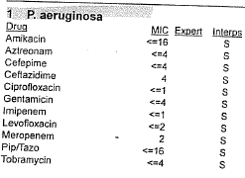
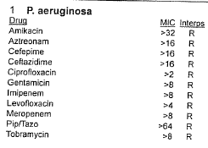
CRPA
Admit Date | 1st CRPA Date | Source | Isolate Date - DSHS | Residence
4/23/2017 | 4/24/2017 | Sputum | 6/7/2017 | Guatemala
5/14/2017 | 5/31/2017 | Sputum | 6/17/2017 | USA (Texas)
5/11/2017 | 5/22/2017 | Wound | 6/7/2017 | Mexico
5/4/2017 | 5/15/2017 | Wnd & Bld | 6/11/2017 | Mexico
Wound – 5/20/2017
Sputum – 6/17/2017
Notes:
Even though the hospital was having trouble, they had saved the isolates for shipping.
So we get the isolates submitted to the lab at the end of June (6/28 to be exact), they are from various body sources and all are occurring with just a couple of weeks from admission.
And it isn’t just a pseudomonas cluster, it turns out it is a pan-resistant pseudomonas
YAY

Slide 39
CRPA – PFGE
Pattern 310
Pattern 311
Notes:
PFGE results are finalized July 3rd
Both patterns, 310 and 311 had been previously identified before at the facility, during the last outbreak.
So did that last outbreak really end?
We had these isolates submitted as part of ARLN not just for PFGE so this means the DSHS lab automatically did mechanism testing

Slide 40
CRPA – Mechanism Testing
Pattern 310
unknown
Pattern 311
IMP gene
Notes:
As part of ARLN, once specimens are sent to DSHS lab, they are then sent to CDC.
CDC received the results and then finalized their ARLN results.
Results showed 3 isolates with matching PFGE pattern (pattern 310) and only sensitive to Colistin;
With an unknown carbapenemase mechanism of resistance (i.e. it was negative via PCR for the most common mechanisms detectable by DSHS ARLN laboratory: IMP, VIM, KPC, NDM and OXA).
The 4th isolate was of a different PFGE pattern (pattern 311) but positive for IMP mechanism of resistance. This is the first identification of IMP in Texas and remains rare in the US.

Slide 41
CRPA – Which Tier?
Notes:
So you remember the 3 Tiers
And might be thinking, ok this is Tier 2. because it has list “Pseudomonas”
But this is a pan-resistant pseudomonas so it jumps to Tier 1.

Slide 42
CRPA – Site Visit
LHD, LHA, DSHS
Findings
  Reusing single-patient device
  60 HH observations (70% compliance)
  Inappropriate sink usage
  Cracked liners in tub room
Point prevalence study following Monday
Notes:
CDC lab contacted the state on July 10th, once the severity of the situation is realized (which took a couple of days) and schedules were coordinated, we plan a site visit for Friday of the following week.
The final letter to the facility was about 4 pages of findings and recommendations
HH: unprofessional behavior/eye rolling
Sinks: storing items on and immediately by, 2 sinks for body fluids, hh and cleaning
The facility agreed to do a PPS for the other 12 patients on the unit. They did ask “what if we don’t want to do it?”…. ‘well, then we have to get the LHA involved because this is a public health concern’

Slide 43
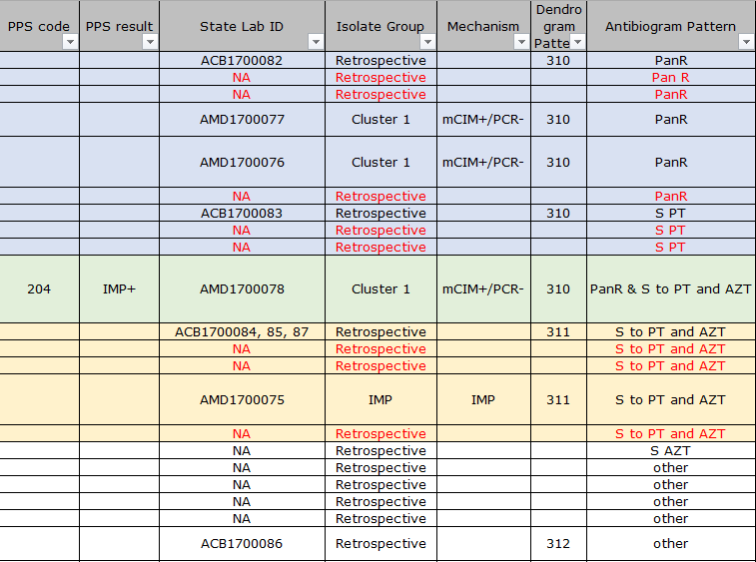
CRPA
Notes:
The point prevalence did not reveal any “new” patients with CRPA but it did show that one of the previous CRPA patients now had the IMP gene
NOT GOOD
This means that an unknown mechanism and IMP gene are now potentially together.
The CDC looked at the lab information we had sent and came up with this really helpful table.
Blue, Green, Orange, Tan

Slide 44
CRPA
Continued communications with the hospital
Learning as we go
Is it over yet?
Notes:
The LHDs and DSHS are integral, we teach and we learn
The IP has implemented changes, they experienced a fire, but still manage to keep CRPA down… and then we have one more case about a week and a half after our visit.
1) July 30 2017 Trach Aspirate, pan resistant
2) Aug 1 2017 Thigh biopsy, sensitive, only resistant to Imipenem

Slide 45
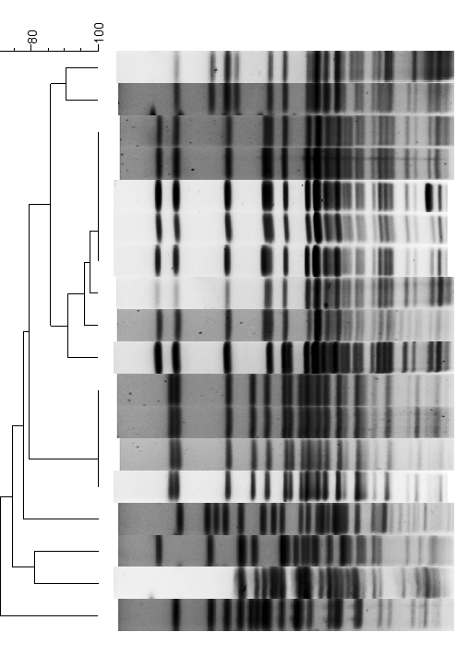
CRPA
Notes:
The newest isolates (2 from same patient) were not part of the previously identified outbreak.
They were tested by DSHS and showed to be positive for a Carbapenemase producer but it was unknown which mechanism
The isolates were just sent to the CDC last week of September so those results should be available this week.
The LHA thought CRPA had spread to another hospital so we had to test that isolate as well, it did not match any of these previously ID’d cases.

Slide 46
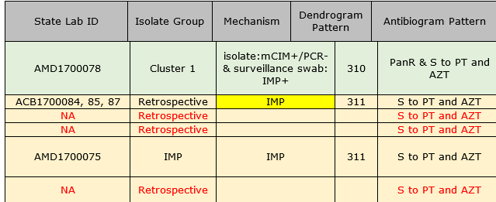
CRPA – Where are we now?
Continued submission of HA-CRPA
Beginning CA-CRPA
Notes:
After the last case was ID’d they experienced a fire and then about 2-3 weeks later we had Hurricane Harvey. But no new cases!
Given the population that the facility serves we are considering, as of last week, to start submission of any CRPA. Both HAI and upon admission
The facility does not want to participate in DSHS ARLN so we are working out a way to do this.
Mechanism testing and WGS takes a long time. As CDC has said, it’s not even looking for a needle in a hay stack. It’s looking for something that you don’t know what it looks like in a stack of other things you don’t know. This is new, in the resubmission and testing of old isolates, they found the IMP gene from the 2016 outbreak. So…did it really go away?

Slide 47
Infection Control Assessment and Response (ICAR) Visits
Notes:
Hello my name is Gretchen Rodriguez, HAI Epidemiologist for Region 8 and I will be presenting along with Melba Zambrano, HAI Epidemiologist for Region 11 about the Infection Control Assessment and Response (ICAR) Visits that our team has conducted throughout the state.

Slide 48
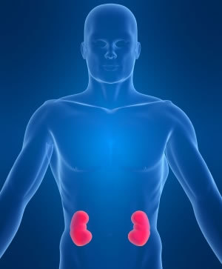
Objectives
Explain what are ICAR visits
Understand Texas’ facility selection criteria
Discuss lessons learned from the conducted visits
  Strengths
  Weaknesses
  Challenges
Notes:
The objectives of this part of the presentation is to explain what are the ICAR visits, understand Texas’s facility selection criteria and discuss what we have learned from these visits, including strengths and challenges identified.

Slide 49
ICAR Overview
Tool was developed by the CDC under the Epidemiology and Laboratory Capacity (ELC) Grant.
Began with Ebola preparedness; expanded to all facility types.
  Reporting summary data began March 2016, ends March 2018.
Primary goals: Assist health departments in assessing infection prevention practices and guide quality improvement activities.
Notes:
The whole ICAR concept was developed by the CDC under the ELC Grant. It first began with Ebola Preparedness and expanded then to all facility types. The data collected during our visits is shared with the CDC on a quarterly basis. The data reported includes the demographic information of the facilities and all findings and gaps identified, but it does not include facilities’ identifiers. The primary goal of the tool was to assist health departments in assessing the infection prevention practices in healthcare facilities and to guide quality improvement activities.

Slide 50
Overview of Tool
Facility Demographics
Infection Control Program & Infrastructure
Direct Observation of Facility Practices
Infection Control Guidelines and Other Resources
Notes:
The ICAR tool has four Sections:
Section 1 relates to facility demographics.
Section 2 request information regarding the infection control program and infrastructure.
Section 3 is connected to direct observations.
Section 4 has infection control guidelines and other resources that can be shared with the facility prior to/or after visit.

Slide 51
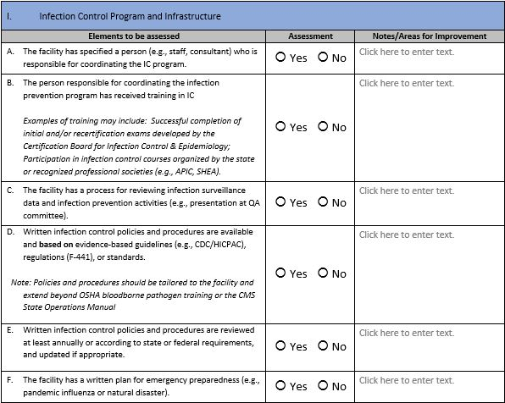
ICAR Tool
Notes:
This is how the ICAR tool looks like. The tool for Acute Care Facilities have over 100 questions and the one for LTC has around 70. So they are very long. Although the questions ask for yes or no answers, we go deeper than that. We want to know the specific processes, how they do it, and in some occasions ask to see copies of their policies and/or supporting documentation.

Slide 52
Facility Selection Criteria
CDC allows each participating state to choose its own criteria for selecting facilities.
    Texas chose to present visits as voluntary, collaborative and consultative.
  Outreach can be based on:
      Healthcare Associated Infection (HAI) rates
      Outbreaks/complaints
      Non-accredited facilities (such as outpatient)
      Upcoming accreditation survey
      CMS changes (LTCF)
Notes:
How do we select facilities to go and do the visits? The CDC allows each participating state to choose its own criteria for selecting facilities. Texas chose to present visits as voluntary, collaborative and consultative. Emails were sent out to all types of healthcare facilities throughout the state to bring awareness to the project. Each region also recruited in their own way, some additional examples include phone calls to facilities to discuss infection prevention consult visits, customized flyer emailed out region-wide, and presenting the project at professional organization meetings such as APIC.

Slide 53
Agenda for the Visit
Before visit
During visit
Visits anticipated to last half a day (at minimum)
After visit
Allot time at end of visit to summarize findings and
formulate plan for gap
mitigation
If performing direct observations, may take longer
Provide completed ICAR tool to facility
Share tool in advance of the visit
Give facility time to review and answer the questions
Ask the facility if there are any specific areas/issues they would like covered during the assessment
Notes:
The logistics behind a visit starts before we go into the facility. We share the tool in advance with the IP to make sure they get familiarized with the type of questions we will ask. Once we are at the facility, apart from completing the tool, we also do a facility tour and walk around the facility to assess environmental factors that may have an impact in infection control. After the visit is completed we send the facility the completed ICAR tool along with resources to help mitigate identified gaps.

Slide 54
Supplements
Areas the ICAR tool does not include:
  Beauty salons
  Pool
  Therapy gyms
  Kitchen
  Staff observations
  Laundry
  Med rooms
  Miscellaneous (e.g., fountains, pet therapy, disinfectants)
Notes:
We noticed that the ICAR tool does not include all areas of the facilities. Some of the areas that are not included are: beauty salons, pools, therapy gyms, kitchen etc. Because they are not included, we make sure to go visit these areas during out facility tool to identify additional areas that may need improvement. There are no checklists for these areas, but we use our experience and knowledge of standards to assess.

Slide 55
Completed ICAR Visits
Region | Assessments
HSR 1 | 0
HSR 2/3 | 17
HSR 4/5 N | 28
HSR 6/5 S | 19
HSR 7 | 22
HSR 8 | 6
HSR 9/10 | 5
HSR 11 | 67
Total | 163
March 2016- July 2017
Notes:
From March 2016- July 2017 the HAI Epidemiology Team conducted 163 visits. 92 visits to long term care facilities, 43 visits to acute care facilities, 23 visits to dialysis clinics and 4 to outpatient clinics. Since we only did 4 outpatient visits, we are not including the results of these visits in our presentation today but we will be talking about the results in the Acute Care, Long Term Care and Dialysis Clinics.

Slide 56
Acute Care Facilities
43 visits conducted
Notes:
We are going to start with the results of Acute Care Facilities. These results are from the 43 visits that we conducted across the state.

Slide 57
Demographic
 | Mean | Min | Max
Number of licensed beds | 123.97 | 10 | 557
FTE IP | 1.03 | 0.03 | 5
Notes:
The facilities that we visited had a number of licensed beds ranging from 10 to 557. These facilities had an average of 1 FT IP. Only 23% of the IPs were CIC certified and 70% have gotten at least some type of training in Infection Control. That means that 30% of the IC programs are being run by people without infection control training.

Slide 58
Infection
Control Program
Notes:
As I mentioned before, the first section of the tool is meant to assess the overall infection control program. In this set of questions we want to make sure that the facilities provide support for infection control , that their IP is trained, that the facilities do annual risk assessments to evaluate program and prioritize potential risks of infection, that the facility has written policies and procedures based on evidence-based guidelines and that education is provided to patients, families and staff members. Overall 91% of our facilities had good policies and procedures but as mentioned before only 70% of the IPs are actually trained in infection control. So that is a gap.

Slide 59
Hand Hygiene
Notes:
Hand hygiene is the single most important measure to prevent the risk of infection. During our assessment of hand hygiene practices, we saw that 93% of the facilities had supplies necessary for adherence to hand hygiene easily accessible in patient care areas but although most facilities provided education to the staff about hand hygiene, the facilities did not have a competency-based training program of hand hygiene. What we mean by competency-based and what we want to see is that the facilities provide training to all personnel upon hire and annually thereafter and that the personnel has to demonstrate competency after each training. This demonstration can be done by doing direct observations, having a checklist, doing a post-test, etc.

Slide 60
Catheter Associated Urinary Tract Infections (CAUTI)
Notes:
If a patient has an invasive device their risk of getting a HAI increases. That is why one of the HAIs that is primarily monitored is Catheter Associated Urinary Tract Infections or CAUTIs. Facilities licensed as general hospitals, that have an ICU are required to report this infection to the state of Texas. 94% of the facilities we visited monitored CAUTI data but only 44% of the facilities had a competency-based training program for maintenance of the catheter.

Slide 61
Central Line Associated Bloodstream Infection (CLABSI)
Notes:
Central Line Associated Bloodstream Infections or CLABSIs is another infection that is required to be reported to the state of Texas if the facility is licensed as a general hospital and has an ICU. 77% of the facilities collected and monitored CLABSI data but only 35% did routine audits for the maintenance of the lines. In the infection control world, audits of maintenance is generally called Bundle Rounds and what we want to see is that the facility is doing rounds to make sure that all the ements of the “bundle” are being met, suck as: cleaning the hub before accessing it, dressings are being changed as appropriate, etc. We want the facility to have a formal process of auditing these practices, documenting the results and providing feedback to the staff.

Slide 62
Surgical Site Infections (SSI)
Notes:
Another very important element of infection control is making sure that the surgeries are performed in a safe manner. As with CAUTIs and CLABSIs, the majority of the facilities had a good process for monitoring SSI data but they were not performing routine audits to ensure that their staff was following their policies and/or evidenced-based guidelines that help prevent infections.

Slide 63
Device Reprocessing
All elements below 75%
Notes:
An element that is related to SSIs, is making sure that semi-critical and critical equipment and instruments are processed and cleaned appropriately after being used. Semi-critical instruments are those that touch mucous membranes, like endoscopes, and they have to go through a high-level disinfection process. Critical equipment, those that are in contact with sterile sites, (like blood) have to go through a sterilization process. Overall, all of the elements that we assessed related to these processes were below 75%. That includes making sure staff had competency-based training and were doing routine audits to ensure compliance with policies and evidence-based practices.

Slide 64
Environmental Cleaning
Rest of elements below 75%
Notes:
Related to environmental cleaning, we saw that the majority of the facilities had a good policies and process for identifying clean equipment from dirty equipment, but facilities did not have a competency-based training program, did not have clear defined responsibilities for cleaning tasks and were not doing routine audits to ensure compliance with policies.

Slide 65
Auditing/ Feedback
All elements below 75%
Notes:
In this slide we want to emphasis the overall lack of a formal auditing process that our acute care facilities have. All elements that were assessed had less than 75% yes responses for this questions.

Slide 66
Competency Training
All elements below 75%
Notes:
The same with competency-based trainings for all elements of an infection control program. As you can see, all these elements are below 75% as well.

Slide 67
Surveillance
Notes:
Good news is regarding surveillance. It is not shown here but 95% of the facilities were compliant with notifiable conditions and had updated contact information of their local health department. Apart from that, we determined that facilities had a good process for detecting early new acquired infections during hospital stay and were also good at communicating infectious status within their own facility. Facilities were lacking in having a good process for detecting infectious status at the point of entry.

Slide 68
ABX Stewardship
Notes:
Antibiotics have transformed the practice of medicine and we all know that prompt initiation of antibiotics to treat infections has been proven to reduce morbidity and save lives. However, 20-50% of all antibiotics prescribed in U.S. acute care hospitals are either unnecessary or inappropriate. Patients who are unnecessarily exposed to antibiotics are placed at risk for serious adverse events with no clinical benefit. The misuse of antibiotics has also contributed to the growing problem of antibiotic resistance. Improving the use of antibiotics is an important patient safety and public health issue. Evidence shows that having an Antibiotic Stewardship Programs can both optimize the treatment of infections and reduce adverse events associated with antibiotic use.
From our assessment we found that 88% of our facilities have access to drug expertise but only 37% of our facilities have an antibiotic stewardship program that meets the 7 CDC Core Elements. These are: Leadership Commitment, Accountability, Drug Expertise, Action, Tracking, Reporting and Educating.

Slide 69
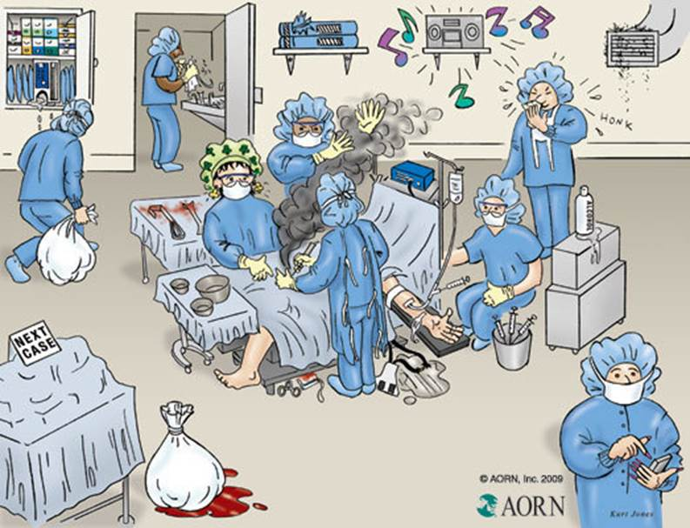
Notes:
What is wrong with this picture?

Slide 70
Top 3 Gaps
Audits
Competency Training
Antibiotic Stewardship

Slide 71
Top 3 Strengths
Infection Control Program & Infrastructure
Surveillance
Environmental Cleaning

Slide 72
Long-Term Care Facilities
92 visits conducted
Notes:
Good afternoon, as previously mentioned- My name is Melba Zambrano. I am going to review LTCF and Dialysis ICARs. We conducted 92 LTCF visits in Texas. We won’t review all domains in the ICAR but instead concentrate on the most important elements.

Slide 73
IC Program & Infrastructure Overview
Notes:
In the IC Program and Infrastructure Domain , you can see 91% of LTCF have a process in place for reviewing IP activities. The data show that only 15.2% of facilities have an individual with infection control training in charge of the IC program. This is a gap we try to address through partnerships with DADS, CIC training, and HAI epi as a resource.

Slide 74
Antibiotic Stewardship
All elements below 75%
Notes:
The new CMS standards for LTCF include Antibiotic Stewardship as part of the infection control survey. Regulations become effective on f Nov. 28, 2017 LTCF under the TAG 441. As you may note by the data collected only 10% of LTCF had written policies on antibiotic prescribing.

Slide 75
Auditing and Documentation
All elements below 75%
Notes:
Auditing and documentation is a method of closing the loop and ensuring patient care activities are practiced correctly. Audits fell below the 75% line in hand hygiene, PPE, Injection safety, and environmental cleaning. This means the EVS can be using hot water rather than indicated disinfectants or staff may not be using PPE when dealing with a contact isolation patient.

Slide 76
State Disease Reporting
All elements below 75%
Notes:
CMS Regulation F520 Quality Assurance and performance Assurance is combined with F441 infection control when discussing audits and performance improvements. One area where LTCF can benefit from adjusting their programs is in disease reporting. Only 57% of facilities had a reportable disease list or knew where to find one. 52% did not have a plan for outbreak response, and only 73% knew their point of contact at the local a nd state level.

Slide 77
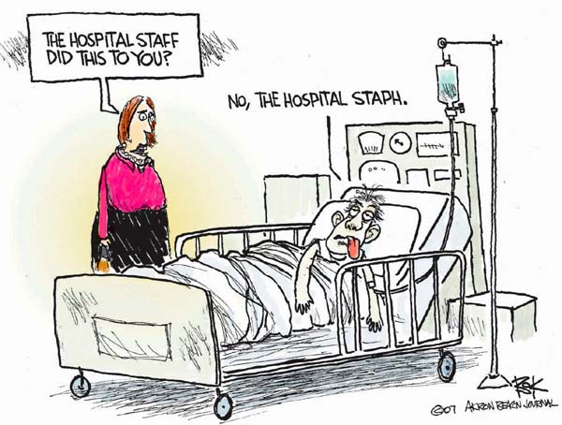
Notes:
No wonder why you may hear this in healthcare. The hospital staff did this to you-----then the little pun- No the hospital Staph

Slide 78
Top 3 Gaps
Antibiotic Stewardship
Infection Control training
Audits
Notes:
To recap the largest gaps in LTCF were antibiotic stewardship, The IP infrastructure as many lacked training, and audits , which are necessary for project improvement.

Slide 79
Top 3 Strengths
Respiratory/ Cough Etiquette
Healthcare Personnel & Resident Safety
Injection Safety & Point of Care Testing
Notes:
LTCF did have some strengths in respiratory/ cough etiquette. I was happy they offered their influenza vaccine and place signs like clockwork. The healthcare personnel and resident safety, and point of care testing. Many facilities had a process in place for disinfecting the glucometer post use.

Slide 80
Dialysis Clinics
23 visits conducted
Notes:
We conducted 23 Dialysis visits in Texas. Show of hands how many of you have been in a dialysis center. A few good.
There are various types of dialysis services such as nocturnal, pediatric, and home hemodialysis. We limited the ICARs to adult centers and inpatient/ outpatient settings.
The tool was constructed for outpatient centers, but we had request from hospitals to assist in their dialysis units.

Slide 81
Center Type & Census
Staffing: 38.5 contracted, Center 38.5% & 23.1% hospital
Notes:
The census in these settings ranged from less than 25 clients in the rural areas to over 100 in other centers. The patient census affected spacing of stations- we will discuss this later.
Infection Preventionist were challenged with keeping constant attention on the dialysis centers and juggling their other job duties.
This was complicated further with a large bulk of the work staff being contract.

Slide 82
Infection Control Training
Figure 5: There was an even split between CIC-trained IPs and other training, which consisted of either corporate training in infection control or work experience from a previous infection control position.
Notes:
“What training does the person in charge of IC at the facility have?”
Only 38.5% were certified in infection control.
This answer was not based on the quality person or regional director prior training. It specifically asked the IP at the facility.
It was found that at time, no one was in charge of infection control (ex. no training).

Slide 83
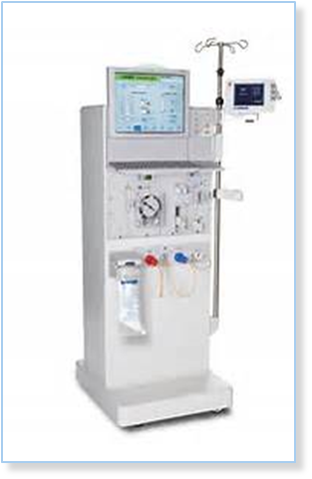
Infection Control Training, Competency, & Audits
Facility routinely conduct audits of staff IC practice?
Facility provides feedback on adherence to staff.
All elements below 75%
Notes:
The CDC has developed standardized audit tools for Dialysis, yet our data shows they are seldom used…
Feedback is important in closing the loop of communication. Some means of feedback which can be utilized and were recommended include: mandatory meetings, communication boards, or immediate feedback.

Slide 84
Surveillance & Disease Reporting
Notes:
Have any of you read field notes were an outbreak occurred due to break in communication? Maybe the hospital did not tell the nursing home the patient was a contact isolation patient- for fear that the patient would not be accepted. Well it also happens in dialysis centers. Only 69.2% of centers had a system to communicating transfers.
Dialysis centers have a higher risk of Hepatitis transmission. OSHA mandates that vaccination be available for employees within 10 days of assignment (CDC, 2013).
The testing criteria for HCV-Negative Patients is:.
Monthly ALT testing. This facilitate timely detection of new infections. If the is no ALT elevations then testing for anti-HCV every 6 months is sufficient to monitor the occurrence of new HCV infections.
If unexplained ALT elevations then repeat anti-HCV testing. If unexplained ALT elevations persist then test for HCV RNA (CDC, 2001)
The recommendation for Hepatitis C testing is for outpatient centers- yet in certain areas, patients have no funding and utilized the hospitals as their center- at times receiving dialysis only weekly.
Some of these hospital- mainly the non-profits did discuss the HCV testing with their medical directors-and obtained status of HCV results from the center for those who regularly visited a center.

Slide 85
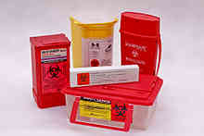
Environmental Cleaning
Notes:
The data showed facilities have a policy/ procedure for routinely emptying and cleaning reusable waste containers.
These are leak-proof containers used for disposal of used dialyzers and tubing. Though the facilities lacked the cleaning process.
Forty percent of facilities also lacked policies and procedures for routinely cleaning and disinfecting dialysis clamps.
Facilities did not consider the eye splash risk, the timing of soaking the clamps were not defined in some facilities, areas were the clamps air-dried was not kept and appeared to be used for weeks without cleaning. Also noted no boundary between clean and dirty areas.

Slide 86
Injection Safety
Notes:
Ninety-two percent of facilities surveyed were utilizing a safety feature on their needles. Out of those with no separately physically separate room, only 69.2% have room available in the facility for storage and preparation of injection medications. In total only 53.8% have a procedure for cleaning surfaces where injectable medications prepared.
In most centers each station had their own sharp container, but some centers had no sharp containers in the patient area.
The staff housed the sharp container in a soiled room and walked across entire center with the sharp in their hand.
This poor practice was done to save cost.

Slide 87
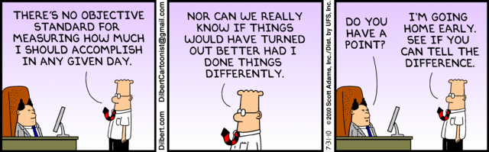
Best & Poorest Performing
Notes:
What I am trying to say hear is – Don’t be a Dilbert- In everything we do- have purpose- A collaboration between public health & healthcare make a difference.

Slide 88
Top 3 Gaps
Competency Training & Auditing
Surveillance & Reporting
Respiratory Etiquette
Notes:
Dialysis Centers shared competency training, auditing, surveillance, & reporting gaps with the other HCF types.
Additionally the respiratory hygiene domain was not met. Respiratory hygiene practices can be met by creating or purchasing a respiratory hygiene station with gel, tissues, cough etiquette sign and mask. In the clinical area, is there ability to separate symptomatic patients at a minimal of 6 feet from another station. This may be difficult if the facility has overlapping stations. Hence, 53.8% did have this ability to separate the recommended distance. In some facilities, they placed mask on those patients with respiratory illness.

Slide 89
Top 3 Strengths
Healthcare Personnel Safety
Personal Protective Equipment (PPE)- Training & Supplies
Environmental Cleaning
Notes:
The top 3 strengths of dialysis Centers included HCP safety, PPE Training & Supplies, & Environmental Cleaning.
For HCP Safety the focuses of the ICAR was related to post exposure, Tuberculosis & work exclusions.
THE CMS tool wanted to ensure post exposure standardized practices in compliance with OSHA recommendations and HR laws were being upheld.
It is important to verify staff members are receiving follow-up visits, post exposure testing, & offered prophylaxis in a timely manner.
A surveyor visiting a HCF will verify logging of injuries, root cause analysis of injury, and implementation of preventive measures.
HCP safety also includes baseline tuberculosis screening with a two step skin test, unless the facility is utilizing quantiferon or t-spot.
Work exclusion policy should encourage reporting illness without fear of being penalized.
Dialysis Centers did well in providing PPE training on hire and annually, as well as insuring adequate supplies were available. With the Ebola incident in Texas, it may have skewed the percentage of PPE training. The centers were conducting the trainings on hire, but this was a new practice of annually verifying competency. The facilities did not have a policy/protocol for staff to routinely change/launder gowns…practices varied from end of shift to end of day to Q 3 days.

Slide 90
Conclusion & Next Steps
ABX Stewardship expert
CIC & future training
DADS partnership
TAP
  CAUTI
  CLABSI
Notes:
We are welcoming our new member to the group- He will serve as our antibiotic stewardship expert. The have offered CIC training and will look at other methods to continue training IP in Texas. We have partnered with DADS in LTCF, and targeted projects such as Tap which concentrate on CLABSI, CAUTI and SSI.

Slide 91
Conclusion
Visits allowed us to:
Better understand the most common IC challenges and strengths in the state.
Provide facilities with resources to help mitigate identified gaps.
Improve communication and increase collaboration between the facilities and the health departments.
Notes:
Visits allowed us to:
Better understand the most common IC challenges and strengths in the state.
Provide facilities with resources to help mitigate identified gaps.
Improve communication and increase collaboration between the facilities and the health departments.

Slide 92
Future Efforts
ARLN continues to test for emerging pathogens.
HAI Team continues to assess healthcare facilities for their readiness to respond.
Public Health has a vital role to play in leading these investigations while we continue to build a picture of resistance for our state through the ARLN and stop transmission of highly resistant organisms.
Notes:
We have shared emerging resistance threats, we have shared specific examples of what we have already seen in Texas, and we have shared the results of our infection prevention onsite assessments looking at our readiness to respond. The ARLN continues to test for these emerging pathogens, while the HAI Team continues to assess healthcare facilities for their readiness to respond. Public Health, everyone in the room, has a vital role to play in leading these investigations while we continue to build a picture of resistance for our state through the ARLN and stop transmission of highly resistant organisms.

Slide 93
Questions?

Slide 94
Thank you

Slide 95
Questions from attendees at the ELC Conference
Question: How are they identifying mcr-1 in ESBL? Is it that all samples tested are carb resistant? Or is sample submission based on the facilities wishes?
Answer: ESBL is usually seen in E.coli. If resistant to any carbapenems (antibiotics) then the HAI Epidemiologists will ask for isolates to be submitted the DSHS lab (WHICH LAB) for mechanism of resistance testing. In some cases physicians will also ask for these test. Mcr-1 is a type of mechanism of resistance. Facilities in Texas have been asked to participate in ARLN lab submissions but it is not mandated.

Slide 96
Questions from attendees at the ELC Conference
Question: When will CDC/CMS require LTCF’s (NH’s) to report CRE’s and develop comprehensive antimicrobial stewardship programs?
Answer: CRE is a reportable condition, it has been reportable condition for some time and can be found in the notifiable condition list. Flag 441 is the newest CMS regulations, DADS regulatory will be using to survey LTCF facilities. The antibiotic Stewardship portion is effective on 11/28/2017.

