Slide 1
Specimen Submission Requirements Update and Lab Discussion
Charles “Chip” Cohlmia
Vaccine Preventable Diseases Epidemiologist
Emerging and Acute Infectious Disease Branch
Texas Department of State Health Services
10/4/2017

Slide 2
Overview
Lab procedures
Specimen submission
  Specimen submission forms
  Investigation guidelines
  Required isolates
Available testing at DSHS Austin
Data entry
HL7 pilot project

Slide 3

DSHS Lab - Austin
Laboratory facility located on-site at DSHS Central Office
Conducts required and optional specimen testing for Texas public health
Works with CDC and Central Office

Slide 4
Health Department Recommendations
Role of the health department
  Prepared to collect or assist with the collection of specimens
  Maintain a stock of supplies to use while any additional supplies are needed
    DSHS EAIDB can coordinate shipments of collection kits
      Influenza/Influenza-like illness
      Pertussis (PCR)
      Fecal specimens for bacterial culture
      Fecal specimens for intestinal parasites
      Mumps/Measles/Rubella

Slide 5
Laboratory Resources
Appendix C: DSHS Laboratory Resources
  Basic Health Department Recommendations
  Getting a Lab Submitter ID and Specimen Submission Forms
  How to order Specimen Collection Supplies
  Basic Steps to Ship Specimens
  Preferred Specimen Summary Table

Slide 6
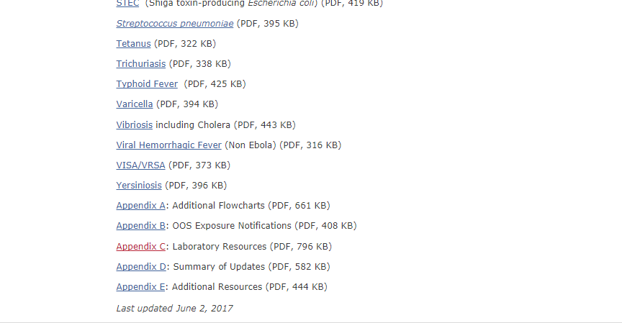
Laboratory Resources
http://www.dshs.texas.gov/IDCU/investigation/Investigation-Guidance.doc

Slide 7
Submission Notifications
Notify EAIDB when specimens for these diseases are being shipped
  Acute Flaccid Myelitis (AFM)
  Botulism
  Coronavirus (MERS)
  Diphtheria
  Ebola
  Gastroenteritis outbreaks
  Influenza, novel/variant
  Measles
  Mumps
  Polio
  Rubella
  Varicella
  VISA/VRSA
  Other rare pathogens

Slide 8
Specimen Submission
Specimen Submission Forms
  G-2A
    Serology/Immunology
  G-2B
    Bacteriology, Molecular Studies, and Parasitology
  G-2V
    Virology

Slide 9
Specimen Submission
Lab hours
  Monday-Friday
  8:00am – 5:00pm
Specimen receiving hours
  Monday-Friday
  8:00am – 5:00pm

Slide 10
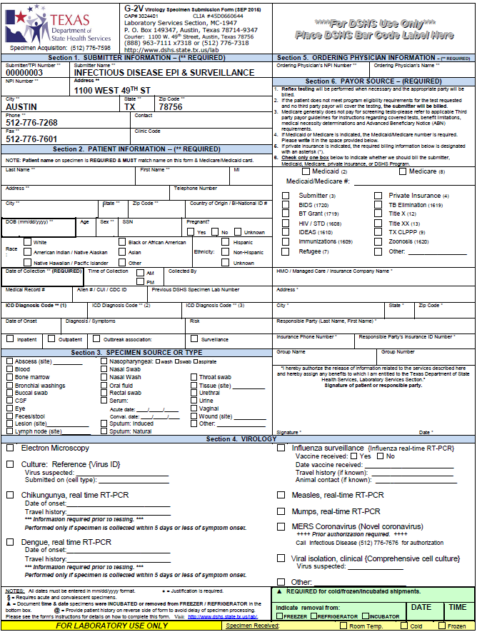
Specimen Submission

Slide 11
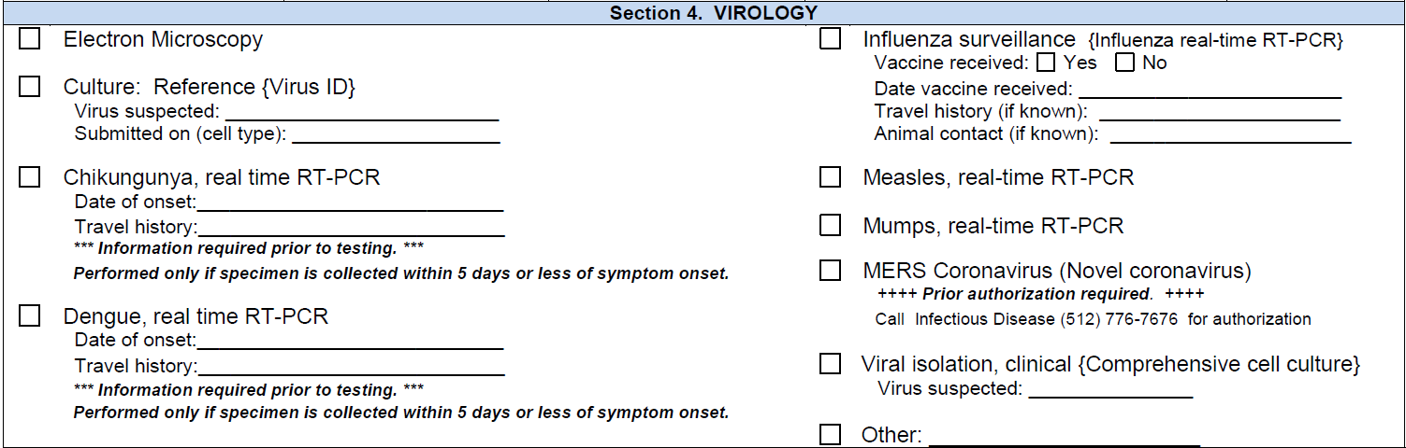
Specimen Submission

Slide 12
Specimen Submission
Specimen receiving
  Specimen source
    Buccal swab? Serum specimen?
  Specimen collection materials
    Viral transport medium?
  Specimen storage/shipping
    Cold? Frozen? Ambient? Sent overnight?
  Causes for rejection

Slide 13
Steps to Ship Specimens
Review specimen submission guidance
  Correct transport media
  Specimens are labeled correctly
  Submission form for each specimen submitted
  Shipped cold? Ambient? Frozen?
  Triple contained
  Shipped according to International Air Transport Association standards
  Shipped overnight

Slide 14
Required Isolates and Where to Send Them
Some isolates required to test at DSHS – Austin Laboratory
  Texas Administrative Code
    Title 25, Part 1, Chapter 97, Subchapter A, Rule §97.3
      Diseases requiring submission of isolates
    Title 25, Part 1, Chapter 97, Subchapter A, Rule §97.3
      Where to submit an isolate

Slide 15
Required Isolates
Anthrax (Bacillus anthracis)
Botulism (Clostridium botulinum)
Brucellosis (Brucella species)
Diphtheria (Corynebacteria diphtheria)
Haemophilus influenzae, invasive, in children under five years old (Haemophilus influenzae from normally sterile sites)
Listeriosis (Listeria monocytogenes)
Meningococcal infection, invasive (Neisseria meningitidis from normally sterile sites or purpuric lesions)
Plague (Yersinia pestis)
Salmonellosis, including typhoid fever
Shiga toxin-producing Escherichia coli infection (E.coli O157:H7, isolates or specimens from cases where Shiga toxin activity is demonstrated)
Staphylococcus aureus with a vancomycin MIC > 2 µg/mL
Streptococcus pneumoniae, invasive, in children under five years old (Streptococcus pneumoniae from normally sterile sites)
Tuberculosis (Mycobacterium tuberculosis complex)
Tularemia (Francisella tularensis)
Vibriosis (Vibrio species)

Slide 16
Where to Submit?
Title 25, Part 1, Chapter 97, Subchapter A, Rule §97.3
  (C) All diseases requiring submission of cultures in §97.3(a)(4) of this title (relating to What Condition to Report and What Isolates to Report or Submit) shall be submitted to the Department of State Health Services, Laboratory Services Section, 1100 West 49th Street, Austin, Texas 78756-3199 or other public health laboratory as designated by the Department of State Health Services.

Slide 17
Special Circumstances
Non-required isolates
  Invasive Haemophilus influenzae or Streptococcus pneumoniae in an individual over the age of 5
Isolate submission through a non-designated lab
  Isolate submission still required through the guidelines in the TAC

Slide 18
The DSHS Lab Menu
DSHS – Austin lab provides testing for infectious conditions
  List of tests available on the laboratory website
    https://www.dshs.texas.gov/lab/default.shtm
  Please note the preferred test for each condition
    Pros and cons to each laboratory test
    Questions? Ask an epi!

Slide 19
Typing
Genotyping
  Identifies genetic markers and can provide additional information
  Genotyping done through DSHS Lab – Austin and CDC reference laboratories
    CDC Laboratory - Atlanta
    Minnesota Reference Laboratory

Slide 20
Reporting and Data Entry
DSHS results
  Labware/LIMS
  Finalized lab report
    Demographic fields
    Lab result
  Lab result distribution
CDC/Minnesota results
  Genotyping results

Slide 21
How Data are Used
Lab reports
  Communicate with CDC
  Communicate with public health partners
  Track outbreaks
    In-state
    Multi-state
Genotyping results

Slide 22
Pilot Project
HL7 Messaging
  HL7 stands for “Health Level 7”
    A set of international standards for transfer of clinical and administrative data between software applications used by various healthcare providers
  Coded message to allow for the creation of an electronic laboratory record (ELR)
    ELRs received by the local and regional health departments are generated from HL7 messages

Slide 23
Pilot Project
CDC pilot project
  Texas and Arizona
  Usage of HL7 messaging with reference laboratories
    Convert systems to allow for usage of HL7 messages instead of paper labs
      Reduces delay in reporting of lab result
      Reduces data entry error
      Creates HL7 message highway between the CDC and Texas

Slide 24
Pilot Project
Timeline?
  Still in the works
    Currently setting up HL7 messaging and testing
Paper labs
  CDC will continue to send paper labs as well as HL7 messaging for the duration of the pilot project
  DSHS Central Office will continue to send paper labs to public health jurisdictions
Currently for VPDs ONLY

Slide 25
Thank you
Charles “Chip” Cohlmia
Vaccine Preventable Diseases Epidemiologist
Emerging and Acute Infectious Disease Branch
Texas Department of State Health Services
Charles.Cohlmia@dshs.Texas.gov

