Slide 1
Mumps, Mumps, and more Mumps
Charles Cohlmia – Emerging and Acute Infectious Disease Branch
Heidi Honza – Health Service Region 2/3
Daphne Lynch – Collin County Health Department
10/3/2017

Slide 2
Overview
State of Mumps in Texas
Outbreaks
HSR 2/3 Outbreak – Johnson County
Cheerleading Competition Outbreak – Collin County
State Resources and CDC Collaboration

Slide 3
Epidemiology of Mumps
Transmission
Respiratory droplets or direct contact with nasopharyngeal secretions
Symptoms
Fever
Headache
Myalgia (muscle pain)
Fatigue
Loss of appetite
Unilateral or bilateral parotitis

Slide 4
Epidemiology of Mumps
Incubation period
Average of 16-18 days (Range: 12-25 days)
Communicability
From 3 days before symptom onset until 5 days after symptom onset
Vaccine
2 doses of the MMR vaccine recommended
88% effective at preventing infection

Slide 5
Mumps in Texas
Recent surge in mumps cases
312 cases in 2008-2015
Median of 20 cases per year
191 cases in 2016
150 cases with onset between 11/1 and 12/31
400 cases in 2017*
Most mumps cases in one year since 1990
* Data provisional as of 9/27/2017

Slide 6
Like Father, Like Son

Slide 7
Mumps in Texas*
550 cases reported with onset of illness on or after 11/1/2016
Cases have been identified in 39 counties
Age range is from 10 months – 80 years old
Median age: 20 years old
236 (43%) are 18 years of age or younger
* Data provisional as of 9/27/2017

Slide 8
Mumps in Texas*
550 cases reported with onset of illness on or after 11/1/2016
Of the 550 cases, 476 (87%) had a known vaccination status
Of the 476 case-patients, 398 (84%) report being vaccinated
* Data provisional as of 9/27/2017

Slide 9
Vaccination Status by Age Group, Texas, 2016-2017*
Vaccinated? | ≤ 18 years of age N / (Column %) | > 18 years of age N / (Column %)
Yes | 218 / (92.4) | 180 / (57.3)
No | 13 / (5.5) | 65 / (20.7)
Unknown | 5 / (2.1) | 69 / (22.0)
* Data provisional as of 9/27/2017

Slide 10
Vaccination Status by Age Group, Texas, 2016-2017*
Vaccinated? | ≤ 18 years of age N / (Column %) | > 18 years of age N / (Column %)
Yes | 218 / (94.4) | 180 / (73.5)
No | 13 / (5.6) | 65 / (26.5)
* Data provisional as of 9/27/2017

Slide 11
Mumps in Texas*
550 cases of mumps since 11/1/2016
362 (64%) are outbreak related
Divided among 15 outbreaks
Largest outbreak: Johnson County – 191 cases
Smallest outbreak: Amarillo, Texas – 2 cases
188 cases denoted as not being associated with an outbreak
* Data provisional as of 9/27/2017

Slide 12
Number of Mumps Cases with Onset of Illness on or after 11/1/16 by Onset Week and Outbreak, Texas, 2016-2017*
* Case counts as of 9/27/2017

Slide 13
Mumps Outbreak in Johnson County, Texas, November 2016-March 2017
Diana Cervantes*, Heidi Honza*, Thi Dang⁺, David Retana*, Steven Pulvino*, Loan VanAuker*, Kelly LaMendoza*, Laura Lockwood⁺, Charles Cohlmia⁺
*Texas Department of State Health Services, PHR 2/3
⁺Texas Department of State Health Services

Slide 14
Mumps Outbreak: Detection

Slide 15
Outbreak in Johnson County?
Call received-local IP
3 cases of parotitis, possible mumps
Possibly same school district?
Saturday 11/19/2016:
Initial Cases Reported

Slide 16
Outbreak in Johnson County?
Case #1
10 year old female, Hispanic
Earache, sore throat, swelling by ear and jaw
Fully vaccinated, IgM pending
Case #2:
14 year old male, White, non-Hispanic
Left-sided swelling after football
Fully vaccinated, IgM pending
Monday 11/21/2016: Review of Cases
Saturday 11/19/2016: Initial Cases Reported

Slide 17
Outbreak in Johnson County?
Case #3:
17 year old male, Hawaiian/Pacific Islander
Left-sided swelling, pain eating, fever
Vaccination-Marshall Islands
Transferred to another hospital: non-mumps DX
Interview pending
** No travel/Ill contacts
**ONSETS for all within 2-3 days
** Different Schools
Monday 11/21/2016: Review of Cases
Saturday 11/19/2016: Initial Cases Reported

Slide 18
Outbreak in Johnson County!!
Case #4 and #5
8 year-old males
Parotitis/Mumps exposure
Hispanic and “Multi-racial”
Same elementary school
IgM pending
No travel
Monday 11/21/2016: Review of Cases
Tuesday 11/22/2016: Two More Cases Reported
Saturday 11/19/2016: Initial Cases Reported

Slide 19
Outbreak in Johnson County!!
Weeklong School Closure
Mumps PCR
Testing awareness
State Lab- holiday/Zika delay
4/5 cases were provided awareness
Saturday 11/19/2016: Initial Cases Reported
Monday 11/21/2016: Review of Cases
Tuesday 11/22/2016: Two More Cases Reported
Wednesday 11/23/2016: Thanksgiving Holiday Begins

Slide 20
Outbreak in Johnson County!!
School reports more cases
Marshallese population
Case #3-AR travel
Four of six case confirmed
Prevention and control!!!
Saturday 11/19/2016: Initial Cases Reported
Monday 11/21/2016: Review of Cases
Tuesday 11/22/2016: Two More Cases Reported
Tuesday 11/30/2016: Mumps Confirmed
Wednesday 11/23/2016: Thanksgiving Holiday Begins

Slide 21
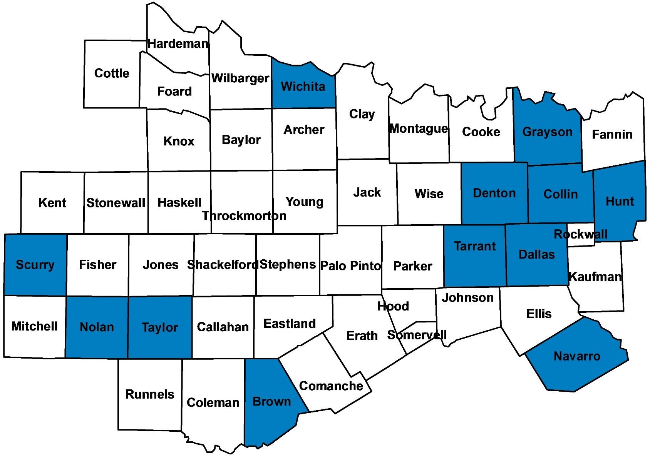
Johnson County: Overview

Slide 22
Mumps Outbreak: Data Summary

Slide 23
Mumps: Trends
Texas/Regional Mumps
YEAR | TEXAS | HSR 2/3
2015 | 20 | 6
2014 | 15 | 6
2013 | 13 | 1
2012 | 15 | 5
2011 | 68 | 9

Slide 24
Johnson Co. Outbreak
Counts as of 6/05/2017
Case Count |  | %
Confirmed | 117 | 61%
Probable | 74 | 39%
TOTAL | 191 | 100%
Genotype G

Slide 25
Johnson Co. Outbreak
Vaccine Status of Cases
MMR Vaccine Doses |  | %
0 Doses | 12 | 6%
1 Dose | 8 | 4%
2 Doses | 114 | 60%
3 Doses | 0 | 0%
Unknown | 57 | 30%
TOTAL | 191 | 100%
No serious complications!

Slide 26
Johnson Co. Outbreak
Age Distribution

Slide 27
Johnson Co. Outbreak
Race/Ethnicity Distribution

Slide 28
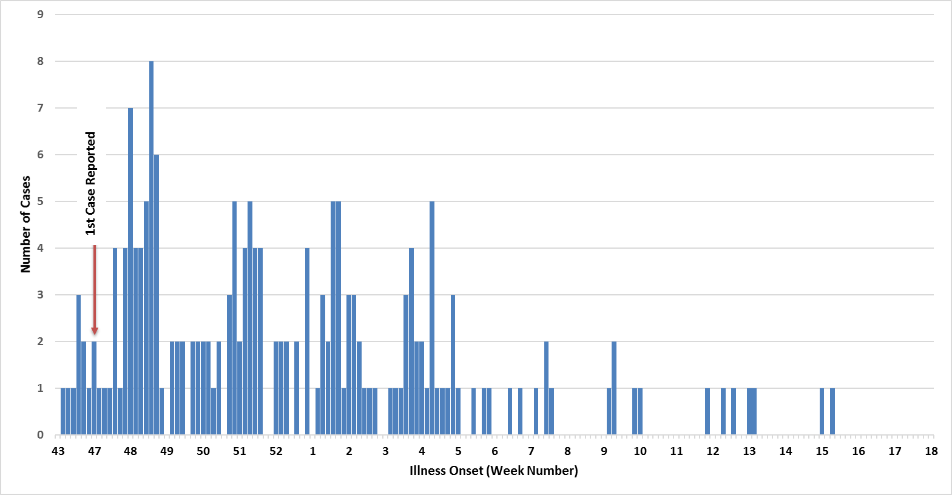
Johnson Co. Outbreak: Epidemic Curve
1
2
3
4
5
6
7
8

Slide 29
Mumps Outbreak: Control and Prevention

Slide 30
Response: Internal Structure
Staff Meeting
2X/day-weekly
Regional Epis/imms/administration/PH nurses/LHA/preparedness/VPD Epis
Action Items
Case review/status/settings/jurisdictions
Field Work/Testing
Database/Line list
Communications
Other “non-mumps” cases

Slide 31
Response: Stakeholder Outreach
In-Person Meetings
EOC/media
Regional LHD Calls
Weekly-monthly
Mumps Outbreak Summary
Daily-weekly

Slide 32
Response: Community Outreach
AR insight/Input- IMPORTANT!
Community/Church
Awareness/immunizations
Liaisons/Missionaries
Worksites
Awareness/immunizations
Exclusions
Field work
Flexible!
PH nurses testing/immunizations
Advisories/website

Slide 33
Response: School Districts
Schools
Awareness Letters
Affected districts/surrounding districts- sports
Immunizations review
Exclusion
Immunizations clinics
Daily-Weekly communication
Case reporting
Case status

Slide 34
Response: Healthcare Providers
Healthcare Provider Exposure
Outreach/Recommendations
Furlough
Awareness/Advisories
Reporting
Testing
Regulatory Agency Notification

Slide 35
Mumps Outbreak: Lessons Learned

Slide 36
Lessons Learned
Community Insider- MUST!!
HAI Epidemiologist- Indispensable
Schools- Extended Exclusion Plans
Vaccine Objectors Documents
Reporting- 1 day vs. 1 week
Vaccine Works!!

Slide 37
Thank you
Heidi Threadgill Honza
Heidi.Threadgill@dshs.texas.gov

Slide 38
Collin County Response to a Mumps Outbreak
Daphne Lynch, MPH

Slide 39
Reported Mumps Case #1
On December 06, 2016, Collin County Health Care Services (CCHCS) received a call from an urgent care facility reporting a suspected case of mumps.
Parotitis onset December 05, 2016
Confirmed by PCR at DSHS Lab

Slide 40
Reported Mumps Case #2
On December 07, 2016, CCHCS received another call from a private physician’s office suspecting mumps.
Parotitis onset November 29, 2016
Confirmed by PCR at DSHS Lab

Slide 41
Public Health Investigation
Public health investigation aimed to identify potential sources of infection and individuals possibly exposed during the period of communicability for the two cases.
It was found that cheerleading was a commonality between the two cases of mumps.
Two separate cheer facilities.
The first reported case had visited the facility where the second case regularly attends.
Both cases reported attending a cheer event at UTA on 11/06/2017.

Slide 42
Mumps Cases #3
On December 13, 2016 Denton County Health Department identified a symptomatic contact to Mumps Case #2 and determined it to be a probable case of mumps.
Total cases now at 3 = Outbreak

Slide 43
Public Health Investigation
Investigation found that cases reported attending cheerleading events while contagious.
Communication between Health Service Region 2/3 counties identified another case of mumps from Tarrant County that reported attending a cheerleading event.
There were 5 local cheer competitions held occurring on 11/6/2016, 11/19/2016, two on 12/03/2016 and 12/10/2016.
Attendance at these events included cheerleading groups from all over Texas and neighboring states.
Notes:
This information prompted a further look into local cheer events and their organizing agencies.

Slide 44
Outbreak Summary
A total of 12 cases were associated with the outbreak.
Cases were identified in Collin County, Denton County, Grayson County, and Tarrant County.
Onsets ranged from 11/21/2016 – 12/28/2016.
Due to the number of participants at each event and the involvement of many state athletic groups an alert was issued through Epi-X.

Slide 45
Epi Curve
Notes:
Onsets ranged from 11/21/2016 – 12/28/2016.

Slide 46
Public Health Findings
Of the 12 case-patients identified:
Eleven (91.7%) reported attending cheer event #1 on 11/6/2016.
Five (41.7% ) reported attending cheer event #2 on 11/19/2016
One (8.3%) case reported attending cheer event #3 on 12/3/2016
Five (41.7%) reported attending cheer event #4 on 12/3/2016
The majority of cases had already recovered by event #5.
One case reported attending cheer event #5 on while contagious

Slide 47
Epi Curve
Cheer Event # 1 – 91.7% of cases in attendance
If exposure occurred on 11/6/2017 – probable onset from 11/18/2016 – 12/1/2016
Notes:
Onsets ranged from 11/21/2016 – 12/28/2016.

Slide 48
Public Health Findings
83.3% were female and 16.7% were male
Majority of cases were ages 18-49
50% of cases did not have immunization records
All in the 18-49 age group
Only one dose of the MMR vaccine was routinely recommended for children 1 year and older starting in 1977 ⁽¹⁾.
It was not until 1989 that a two dose recommendation was implemented ⁽¹⁾.
Age | Count | Percent
< 1 Years | 0 | 0.0%
1-4 Years | 0 | 0.0%
5-13 Years | 1 | 8.3%
14- 17 Years | 1 | 8.3%
18-49 Years | 9 | 75.0%
>50 Years | 1 | 8.3%
Total | 12 | 100%
MMR | Count | Percent
Both | 5 | 41.7%
One | 1 | 8.3%
Unk/None | 6 | 50.0%
Total | 12 | 100%
Notes:
Most likely the individuals with unk vaccine status were under-vaccinated. Two doses of MMR vaccine has about 88% effectiveness, one dose about 78% effectiveness

Slide 49
Public Health Findings
Of the 12 case-patients identified:
Seven (58.3%) were parents of competitors
Three (25%) were competitors
Two (16.7%) were staff at cheerleading competitions or practice facilities
Over half of the cases (58%) were associated with one cheerleading practice facility.

Slide 50
Conclusions
Early multi-jurisdictional cooperation lead to prompt case identification and health alert distribution.
The organization of cheerleading competitions:
Competitors vs. spectators
The lack of knowledge surrounding immunity status suggests public health should promote the knowing of one’s immunity status.

Slide 51
Refereneces
1. The Centers for Disease Control and Prevention. (2015). Epidemiology and Prevention of Vaccine-Preventable Disease (13th ed.). Atlanta, GA: US Department of Health and Human Services.

Slide 52
Central Office
Specimen Testing
Case Review
Guidance Documents
Communication
Reporting
Vaccine

Slide 53
Central Office VPD Staff
Allison Sierocki – Epi II
Kelsey Sanders – Epi I
Raymond Dinnan – PHPS III
Laura Lockwood – Epi I
Left DSHS in April, 2017

Slide 54
Specimen Testing
DSHS Lab in Austin
Buccal swabs – PCR testing
Positive specimens may be genotyped at CDC or CDC reference laboratories
Genotype G
Reporting results

Slide 55
Case Review / Investigation Guidance
DSHS VPD staff coordinates with local and regional offices to ensure completeness of investigation
Used for press releases, internal communications, and CDC reporting
Investigation Guidelines
Data Entry Guidelines
Epi Case Criteria

Slide 56
Communication and Reporting
Dissemination of information
Texas Health Departments
Lab reports, outbreaks, etc.
CDC
Other states

Slide 57
Vaccine
Vaccine provided through cooperation with the Immunizations Branch
MMR vaccination clinics and vaccination campaigns
Clinics conducted throughout the mumps outbreaks

Slide 58
Acknowledgements
DSHS EAIDB Central Office
HSR 2/3
Collin County
DSHS Laboratory – Austin
Immunizations Branch
CDC

Slide 59
Thank you
Charles “Chip” Cohlmia
Vaccine Preventable Diseases Epidemiologist
Emerging and Acute Infectious Disease Branch
Texas Department of State Health Services
Charles.Cohlmia@dshs.Texas.gov

