Slide 1
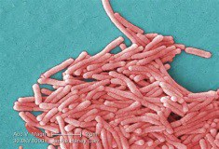
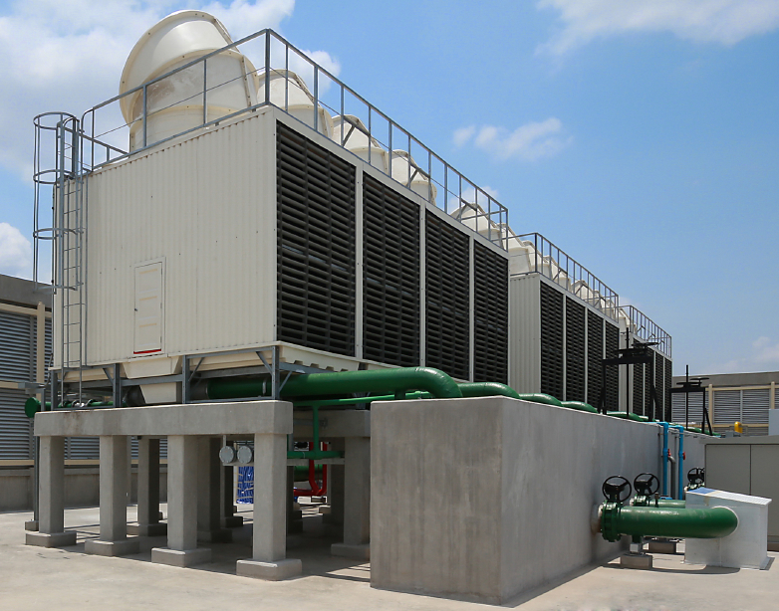
Legionellosis: Overview, Texas Trends and a Large Healthcare Facility Outbreak in HSR 6/5S
Johnathan Ledbetter, MPH
IRID Team Leader
&
Hailey Rucas, MPH
State Flu Surveillance Coordinator

Slide 2
Topics
Legionellosis Overview
Texas Legionellosis Data Trends
Large Healthcare Facility Outbreak in HSR 6/5S: A DSHS-Austin Perspective

Slide 3
Legionellosis Overview

Slide 4
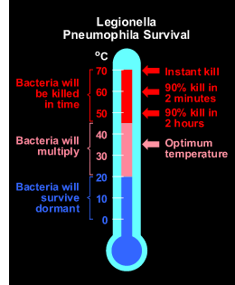
Legionella Ecology
Legionella bacteria live in water (primarily) and soil, can live inside protozoa
Favorable conditions:
  Stagnant water (dead legs in plumbing)
  Warmer water (prefers: 77°F-108°F)
  Presence of organic matter
  Absence of residual disinfectant

Slide 5
Infection and Prevention
Transmission/infection:
  Legionella can be a problem in manmade water systems
  Need amplification, aerosolization (or aspiration), and infection of susceptible host
  Occasionally acquired from compost or potting soil exposure (L. longbeachae)
  No person-to-person transmission (limited?)
Prevention:
  Surveillance and outbreak investigation
    Identify and control sources
  Maintain equipment
  Legionella prevention plans
  Maintain hot (≥140°F) and cold (≤ 68°F) water temperatures
  Avoid high-risk behaviors (e.g., smoking)
  Wear PPE if occupational exposures

Slide 6
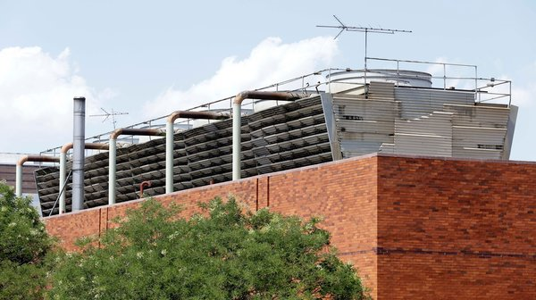
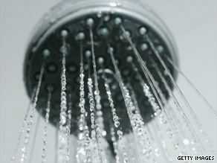
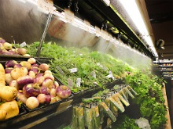
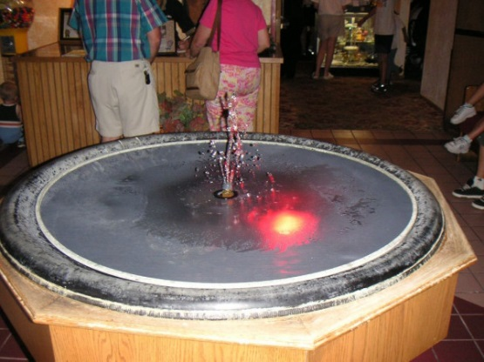
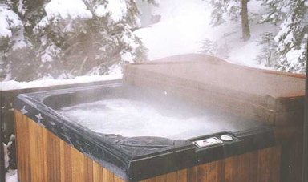
Sources of Aerosolized Legionella
Cooling towers
Evaporative coolers (swamp coolers)
Misters (produce, recreational)
Decorative fountains
Spa pools, thermal pools, springs
Humidifiers
Respiratory therapy equipment
Domestic plumbing (hot and cold water)
Etc.

Slide 7
Legionellosis Disease
Both of these legionellosis conditions are reportable:
  Legionnaires’ disease
    Incubation period: 2-10 days
    Cough, pneumonia, chest pain, fever, chills, myalgia, fatigue, N/V/D, abdominal pain, AMS;
    5%-30% of cases die
      Higher in nosocomial cases
  Pontiac fever
    Incubation period: 5-72 hours
    flu-like (milder), some with GI symptoms, no pneumonia, no deaths
    Hospitalization rarely required
    Does not result in death
      Complete recovery usually occurs within a week without antibiotics

Slide 8
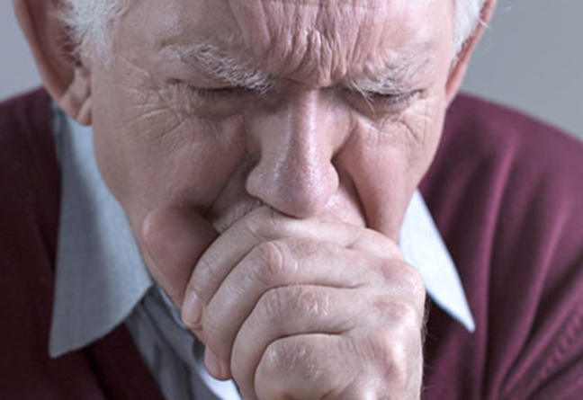
Legionellosis Risk Groups
Increased risk of infection:
  Recent travel with an overnight stay outside of the home, including stay in a healthcare facility
  Exposure to hot tubs
  Recent repairs or maintenance work on domestic plumbing
  Renal or hepatic failure, diabetes, chronic lung disease
  Systemic malignancy
  Immune system disorders
  Smoking (current or former)
  Age ≥50 years

Slide 9
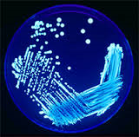
Clinical Laboratory Testing
Legionella pneumophila serogroup 1 (Lp1) estimated to cause 85% of human cases
Lab confirmation (case criteria) requires one of these:
  Culture positive for ANY Legionella species
    Primary method of detecting non-Lp1 cases
    Important for outbreaks (link clinical & environmental samples)
  Legionella urinary antigen test positive
    Detects Lp1*
    Most common test type
  Seroconversion by a fourfold or greater rise in specific serum antibody to Lp1
Ask clinical labs not to discard Legionella isolates

Slide 10
Legionellosis Case Definition/Classification
p. 164
EAIDB Investigation Guidelines
Clinical Case Definition
  Associated with two clinically and epidemiologically distinct illnesses: Legionnaires’ disease and Pontiac Fever
Laboratory Confirmation
  A clinically compatible case that meets at least one of the confirmatory laboratory criteria:
    Isolation (culture) of any Legionella organism from respiratory secretions, lung tissue, pleural fluid or other normally sterile fluid
    Detection of Legionella pneumophila serogroup 1 antigen in urinary using validated reagents
    Demonstration of seroconversion by a fourfold or greater rise in specific serum antibody titer between paired acute and convalescent phase serum specimens to Legionella pneumophila serogroup 1 using validated reagents
Note: DFA and PCR tests for Legionella are not considered confirmatory for determining the case classification of Legionellosis cases.
Case Classifications
  Confirmed: A clinically compatible case that meets at least one of the confirmatory laboratory criteria
  Probable: No probable case definition for Legionellosis

Slide 11
Definitions
p. 164
EAIDB Investigation Guidelines
Definitely associated: spent the whole incubation period at the facility
Possibly associated: spent part of the incubation period at the facility
Outbreaks
  One definitely healthcare-associated case OR two or more possibly healthcare-associated cases within 1 year associated with the same healthcare facility
  Two or more cases associated with the same facility (e.g., hotel, gym, etc.) or other common location (e.g., amusement park) within 1 year

Slide 12
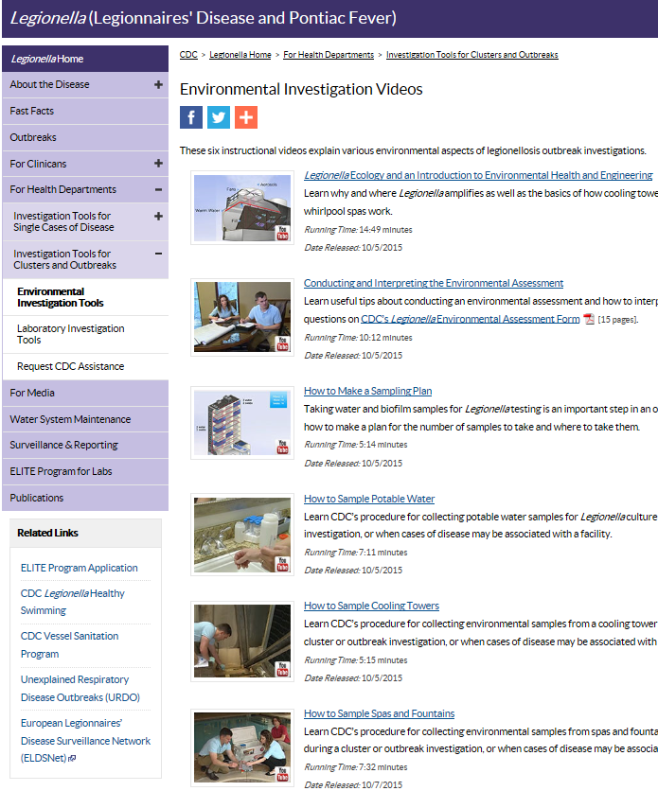
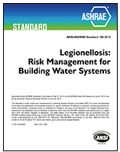
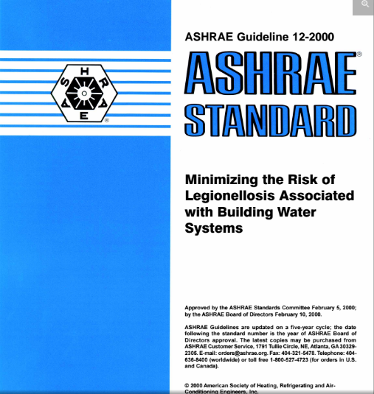
Resources
Legionellosis
  Legionellosis investigation toolkits: http://www.cdc.gov/legionella/health-depts/index.html
  CDC environmental investigation videos: http://www.cdc.gov/legionella/videos.html
  ASHRAE Guideline 12-2000: Minimizing the Risk of Legionellosis Associated with Building Water Systems
  ANSI/ASHRAE Standard 188-2015 Legionellosis: Risk Management for Building Water Systems

Slide 13
Texas Legionellosis Data Analysis

Slide 14
Trend of Legionellosis in Texas from 2004–2017*
* As of Sept. 12, 2017
Notes:
Total Number of Cases: 2049
Avg: 147 cases per year (range 29-292)

Slide 15
Data Analysis for Reported Texas Legionellosis Cases, 2004–2017*
Over 54% of cases are ≥ 60 years of age
~59% of the cases are male
 | Sex
Age Category | Female | Male | Unknown | Total
≤9 | 1 | 1 |  | 2
10--19 | 2 | 4 |  | 6
20-29 | 18 | 33 |  | 51
30-39 | 42 | 75 | 2 | 119
40-49 | 100 | 184 | 1 | 285
50-59 | 192 | 283 |  | 475
60-69 | 195 | 327 |  | 522
70-79 | 167 | 191 |  | 358
≥80 | 121 | 108 |  | 229
Unknown | 1 | 1 |  | 2
Total | 839 | 1207 | 3 | 2049
* As of Sept. 12, 2017

Slide 16
Data Analysis for Reported Texas Legionellosis Cases, 2004–2017*
* As of Sept. 12, 2017

Slide 17
Data Analysis for Reported Texas Legionellosis Cases, 2004–2017*
* As of Sept. 12, 2017

Slide 18
Data Analysis for Reported Texas Legionellosis Cases, 2004–2017*
* As of Sept. 12, 2017

Slide 19
Legionellosis-Associated Reported Deaths in Texas, 2004–2017*
Number of deaths: 199
  Average/year: ~15 deaths (~10.0%)
* As of Sept. 12, 2017

Slide 20
Reported Legionellosis Outbreaks in Texas, 2014–2017*
Number of Outbreaks: 69
  Average/year: ~17 (range: 10-21)
*As of Sept 27, 2017

Slide 21
Reported Legionellosis Outbreaks in Texas, 2014–2017*
*As of Sept 27, 2017

Slide 22
Large Healthcare Facility Outbreak in HSR 6/5S: A DSHS-Austin Perspective

Slide 23
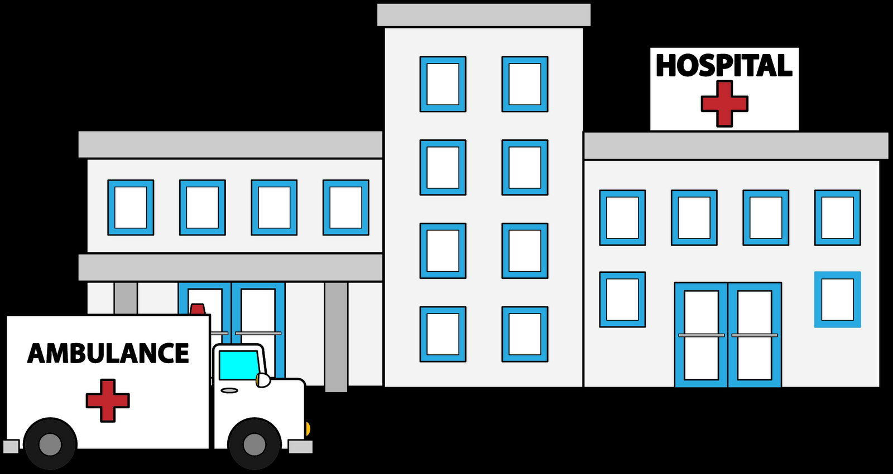
Case Counts
9 cases
  4 non-Texas residents
  5 Texas residents
  2 In-patient visits
  7 Out-patient visits
  6 L. pneumophila serogroup 1
  3 other L. species
In addition to 2016, there were clusters reported in 2014 and 2012

Slide 24
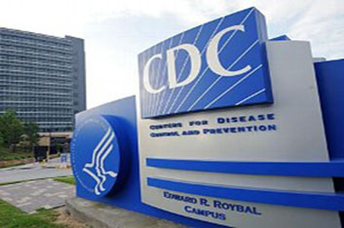
Environmental Sampling and Assessment
CDC developed an itinerary and sampling plan prior to the visit in April 2017
Team Makeup:
  CDC staff members
  Hospital representative
  DSHS and/or Local Health Dept. staff
3 teams
Tested water parameters and collected samples for testing

Slide 25
General Itinerary- April 2017
Timeframe |  | Activity
Tuesday | AM | Introductory meeting Facility walkthrough (may be best opportunity to finalize sampling plan — i.e., which teams will go where and when)
 | PM | 3 teams begin sampling of water systems by building (mains, hot water systems, surge tanks, decorative water features)
Wednesday | AM | Begin Cooling Tower (CT) visits (CDC Environmental Staff as primary team lead) 5 different buildings Continue water system sampling
 | PM | Continue CT visits as needed Continue water system sampling
Thursday | AM | Finish any unfinished sampling Cooling tower call?
 | PM | Wrap-up meeting to discuss observations and findings

Slide 26
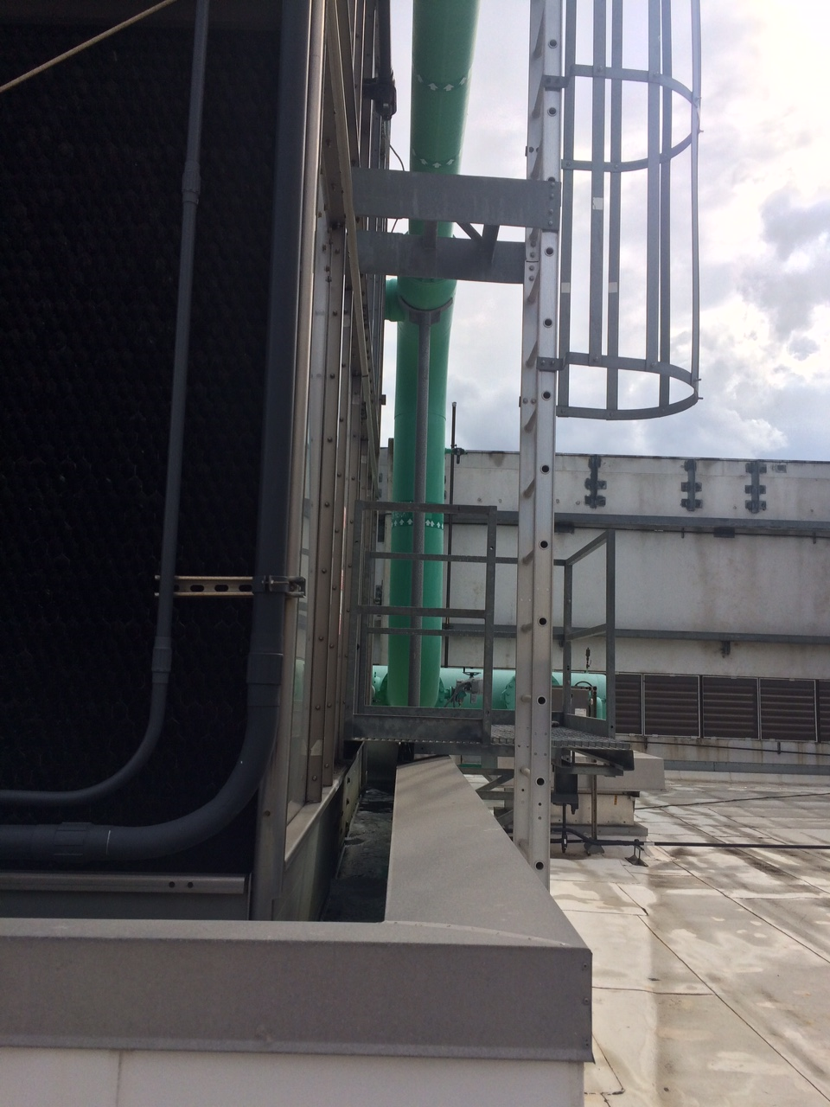
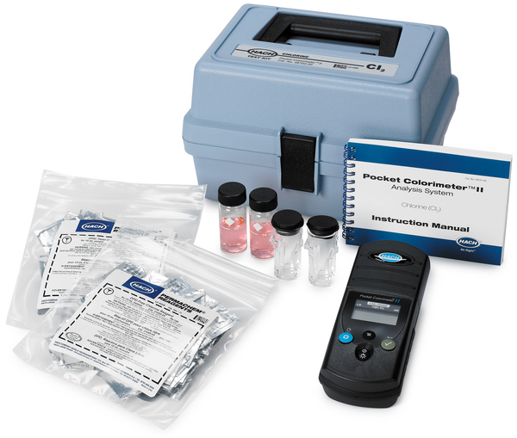
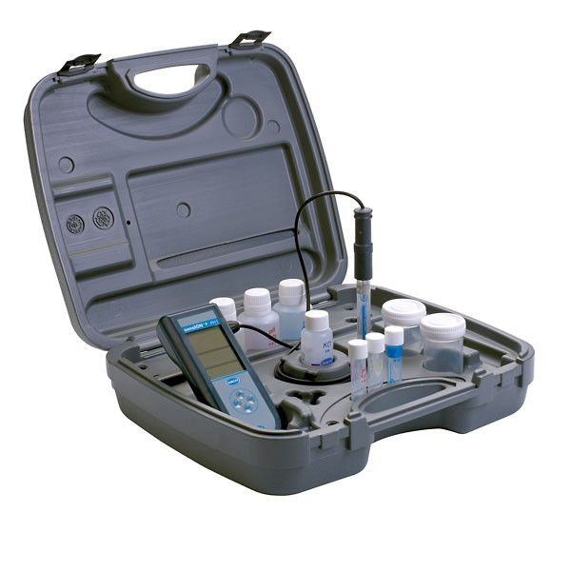
Environmental Assessment and Sampling
Water parameter testing tools
Disinfectant colorimeter
pH Meter and Thermometer

Slide 27
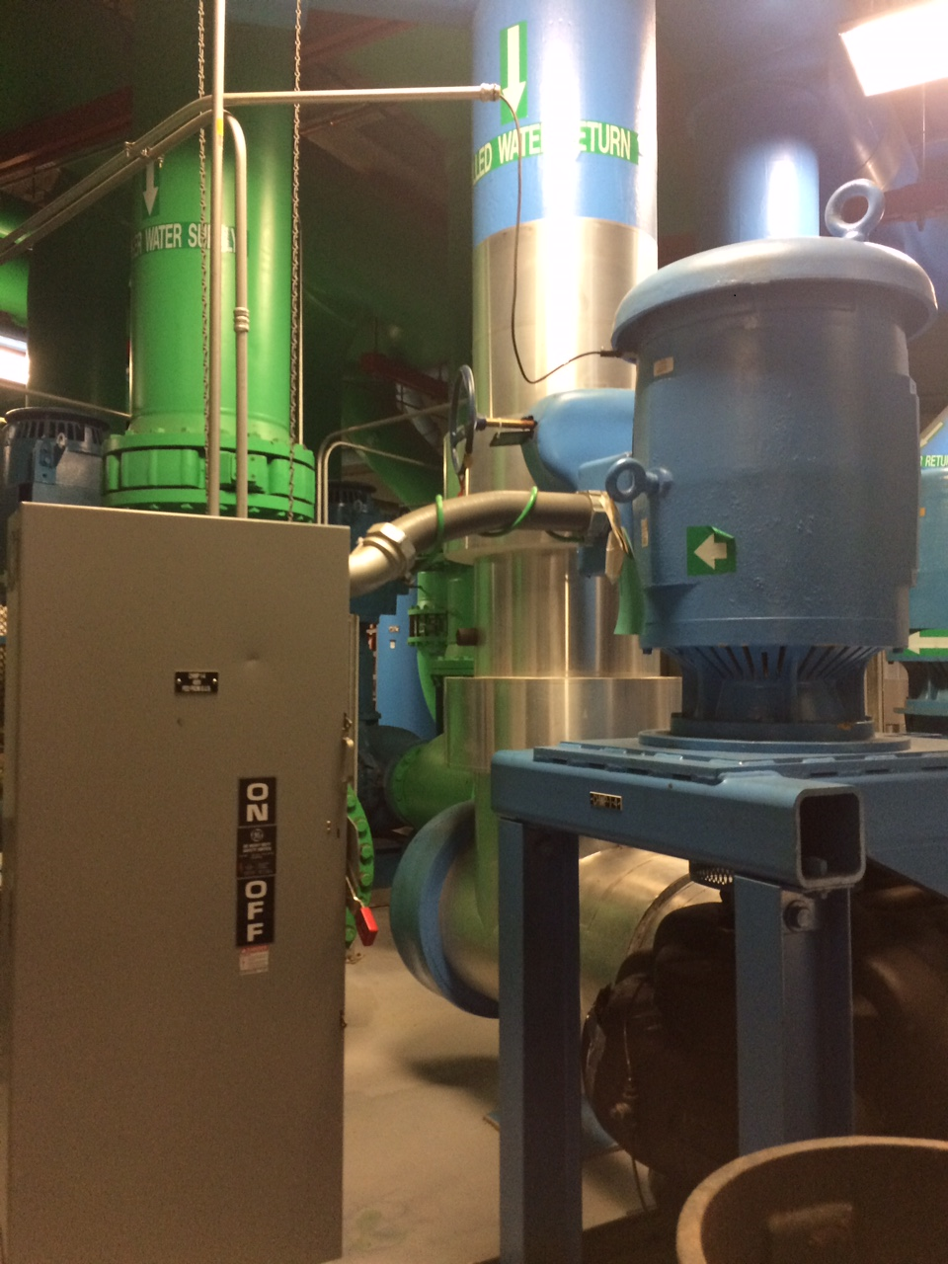
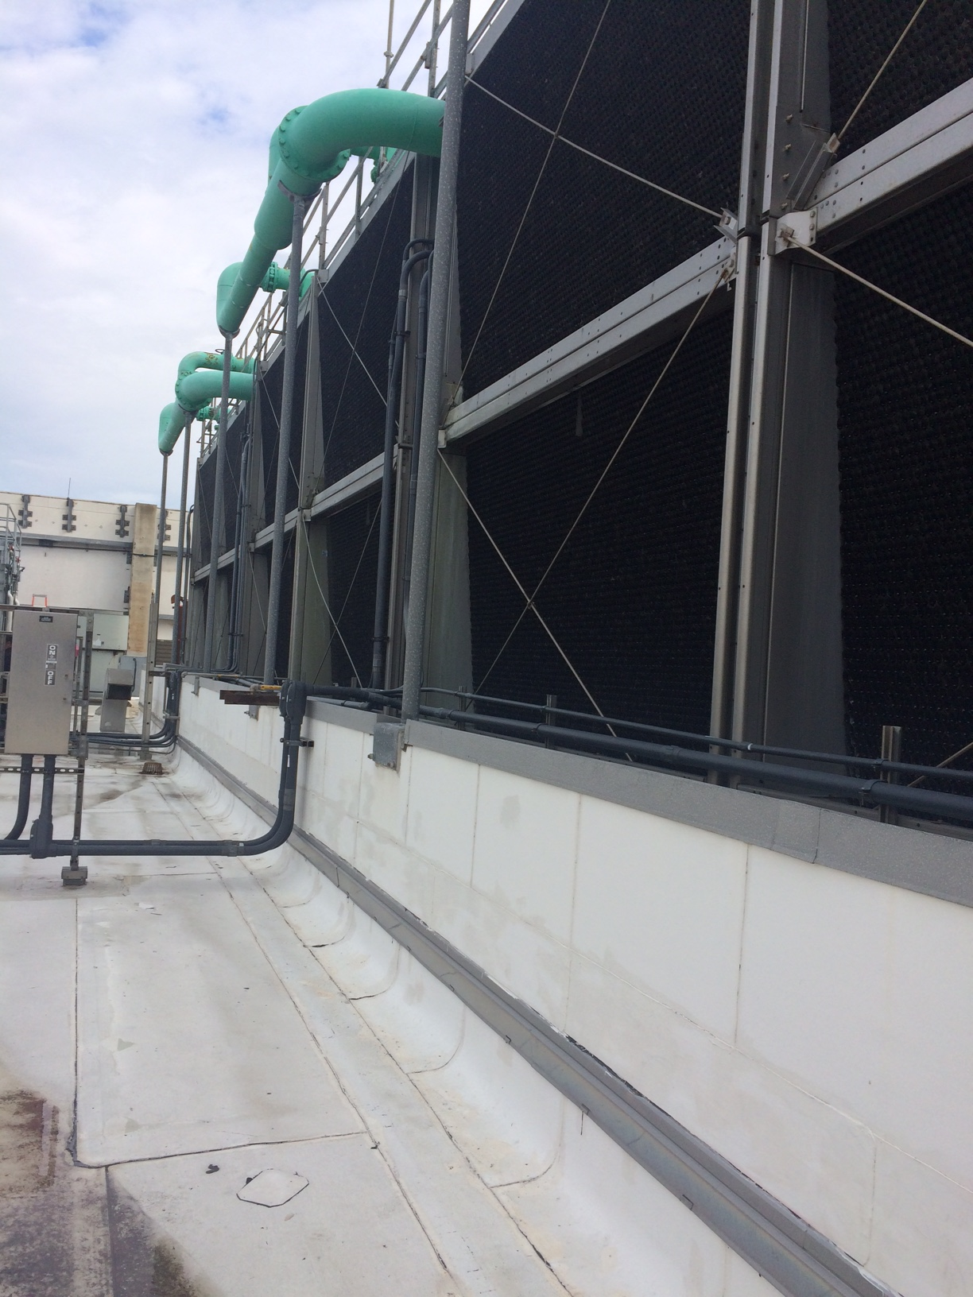
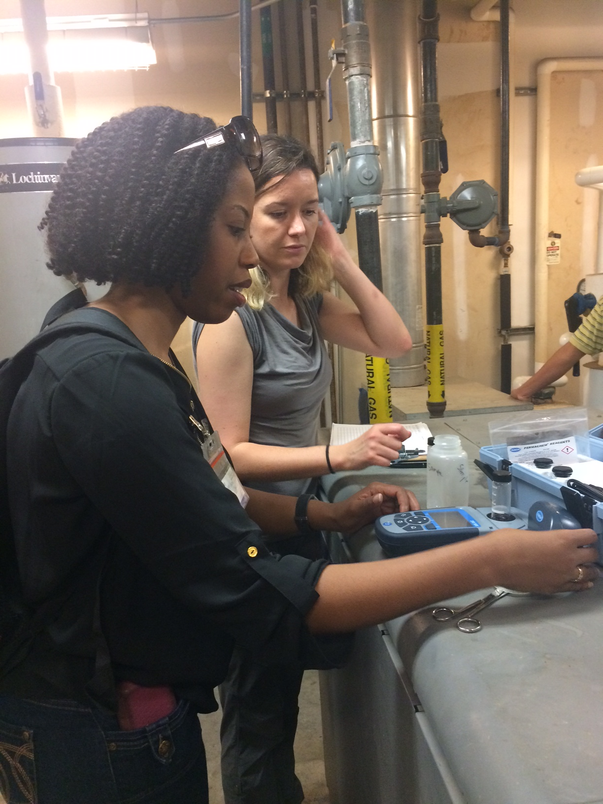
Environmental Assessment and Sampling

Slide 28
Takeaways from the Experience
Wear comfortable clothes and shoes
  Going to be bending down, standing, and walking around
  Dealing with water
  Mechanical rooms
Try to get a map of the facility beforehand
  Map case exposures (e.g. room numbers, water fountains, etc.), if known
Testing water parameters is easy with appropriate equipment
  Make a plan before going to the facility, if possible
  Test a proximal, medial, and distal site (at least) for each water loop
Make sure someone that is knowledgeable about the facilities’ water system (e.g. engineer, plumber, etc.) is present during the environmental assessment
  Coordinate with the person beforehand
If a cooling tower is present, verify that person responsible for maintenance will be in attendance

Slide 29
Questions???

