Slide 1

New Innovations in Antimicrobial Stewardship
Dr. Melissa LeBrun

Slide 2




The Urgent Challenge of AMR in the U.S.
Alarming AMR Burden
Concerning Trends During COVID-19
Priority Pathogens Pose Grave Threat
National Action Plan Aims High
Over 2.8 million antimicrobial-resistant infections and 35,000 deaths annually in the U.S., costing over $4.6 billion
Hospital-onset AMR infections increased by 20% during the pandemic, with nearly 40% of infections acquired in healthcare settings
CDC identified 7 key AMR pathogens, including C. auris, MRSA, and CRE, with cases surging since 2019
The U.S. National Action Plan takes a One Health approach, focusing on rapid diagnostics, antibiotic R&D, and enhanced surveillance
The escalating AMR crisis in the U.S. requires a comprehensive, technology-driven response to preserve antimicrobial effectiveness and protect public health.

Slide 3
National Action Plan and CDC Initiatives
National Action Plan
  The National Action Plan takes a One Health approach, aiming to strengthen healthcare, public health, veterinary medicine, agriculture, food safety and research and manufacturing
Key Objectives
  Advancing rapid diagnostic tests, accelerating antibiotic R&D, improving international collaboration, and enhancing surveillance systems

Slide 4
Innovative Antimicrobial Stewardship Strategies
Digital Monitoring Systems
Technology-Supported Integrated Programs
Real-time tracking and reporting systems enable continuous monitoring of prescribing behaviors and resistance patterns. Digital monitoring emphasizes bottom-up implementation models that understand user practices and design systems to add value to everyday work.
User-centered design approaches like the CeHRes Roadmap guide antimicrobial stewardship toolkit development. Multidisciplinary programs combine infection prevention, antibiotic stewardship, and diagnostic stewardship.
Artificial Intelligence and Machine Learning Integration
Digital Health Technology Integration
Electronic health record interventions can optimize antimicrobial stewardship across the continuum of care, from diagnosis to discontinuation of therapy. Workflow integration and antimicrobial stewardship impact are key considerations.
AI-powered clinical decision support provides individualized, real-time recommendations on optimal antimicrobial treatment. Predictive analytics can facilitate infection prevention efforts and resistance pattern analysis.

Slide 5
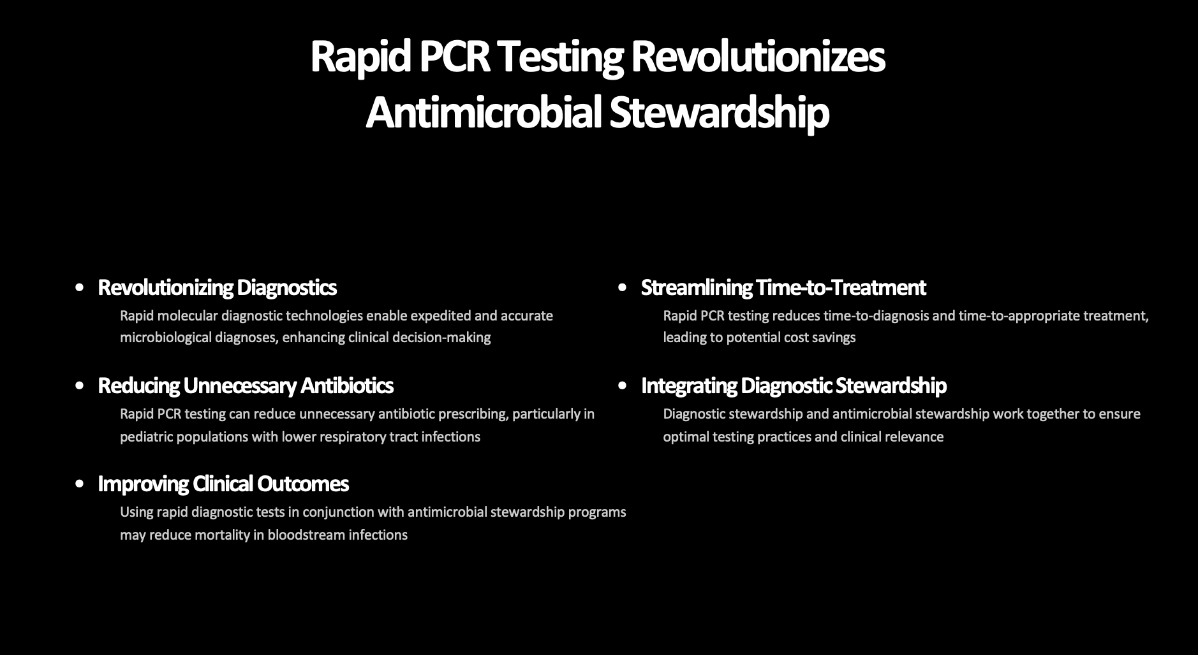

Slide 6

The Role of Rapid PCR Testing in Antimicrobial Stewardship
Rapid PCR testing has the potential to play a powerful part in improving the delivery of higher quality care, reducing diagnostic errors, and optimizing patient outcomes in urgent care settings. The technology's turnaround time accelerates time-critical clinical decisions and allows for early, targeted intervention that improves patient outcomes.

Slide 7
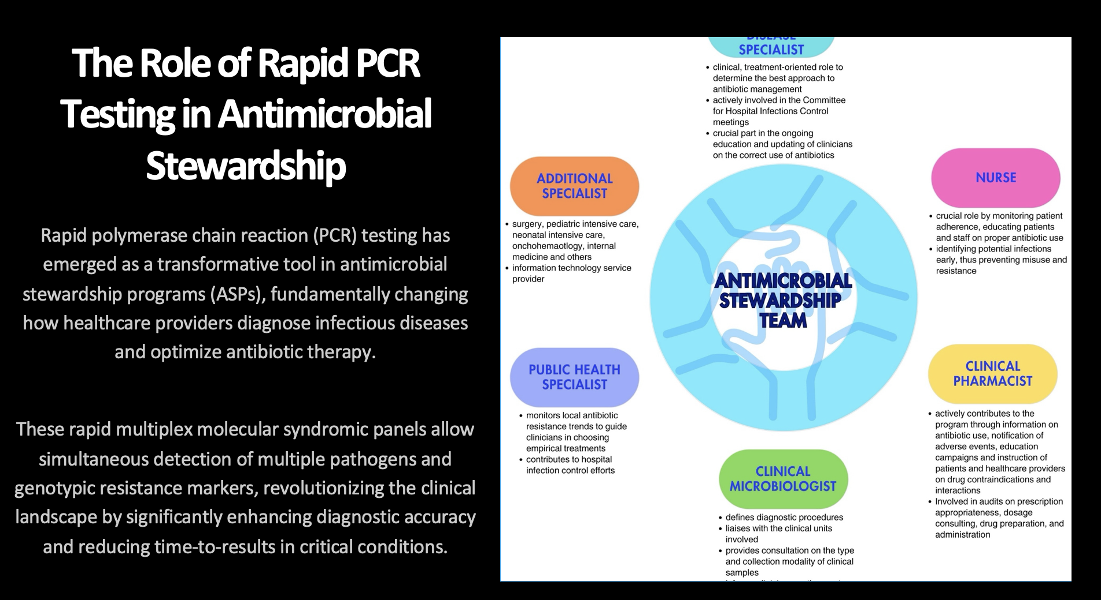

Slide 8
Rapid PCR-Healthtrack Rx
Targeted patient selection: Syndromic multiplex PCR testing should focus on patients with worsening symptoms, recent antibiotic exposure, comorbidities, risk factors for polymicrobial infections, or severe clinical presentation to maximize diagnostic utility.
Antibiotic stewardship: Early pathogen identification through multiplex testing can inform appropriate treatment decisions and reduce unnecessary or inappropriate antibiotic prescribing in community-acquired pneumonia cases.
Clinical symptom alignment: Testing panels should be matched to the patient's presenting clinical symptoms to increase the likelihood that detected organisms are truly pathogenic rather than incidental findings.
Overtreatment prevention: Appropriate use requires limiting testing to patients with clear infectious signs and symptoms, thereby avoiding overdiagnosis and subsequent overtreatment of non-pathogenic organisms.

Slide 9
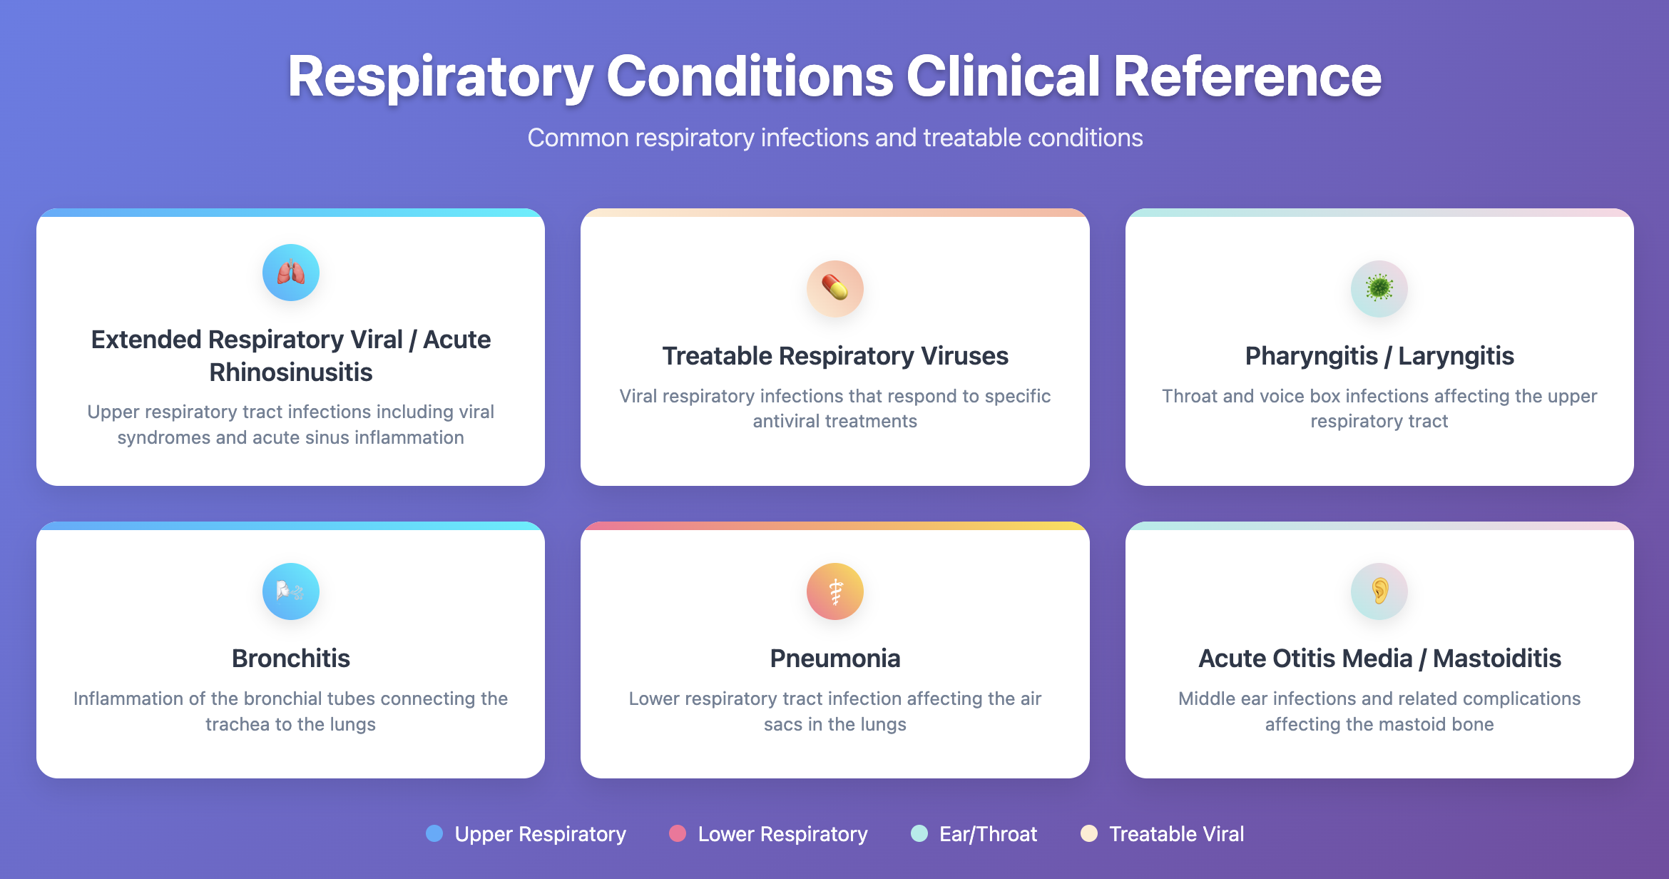

Slide 10
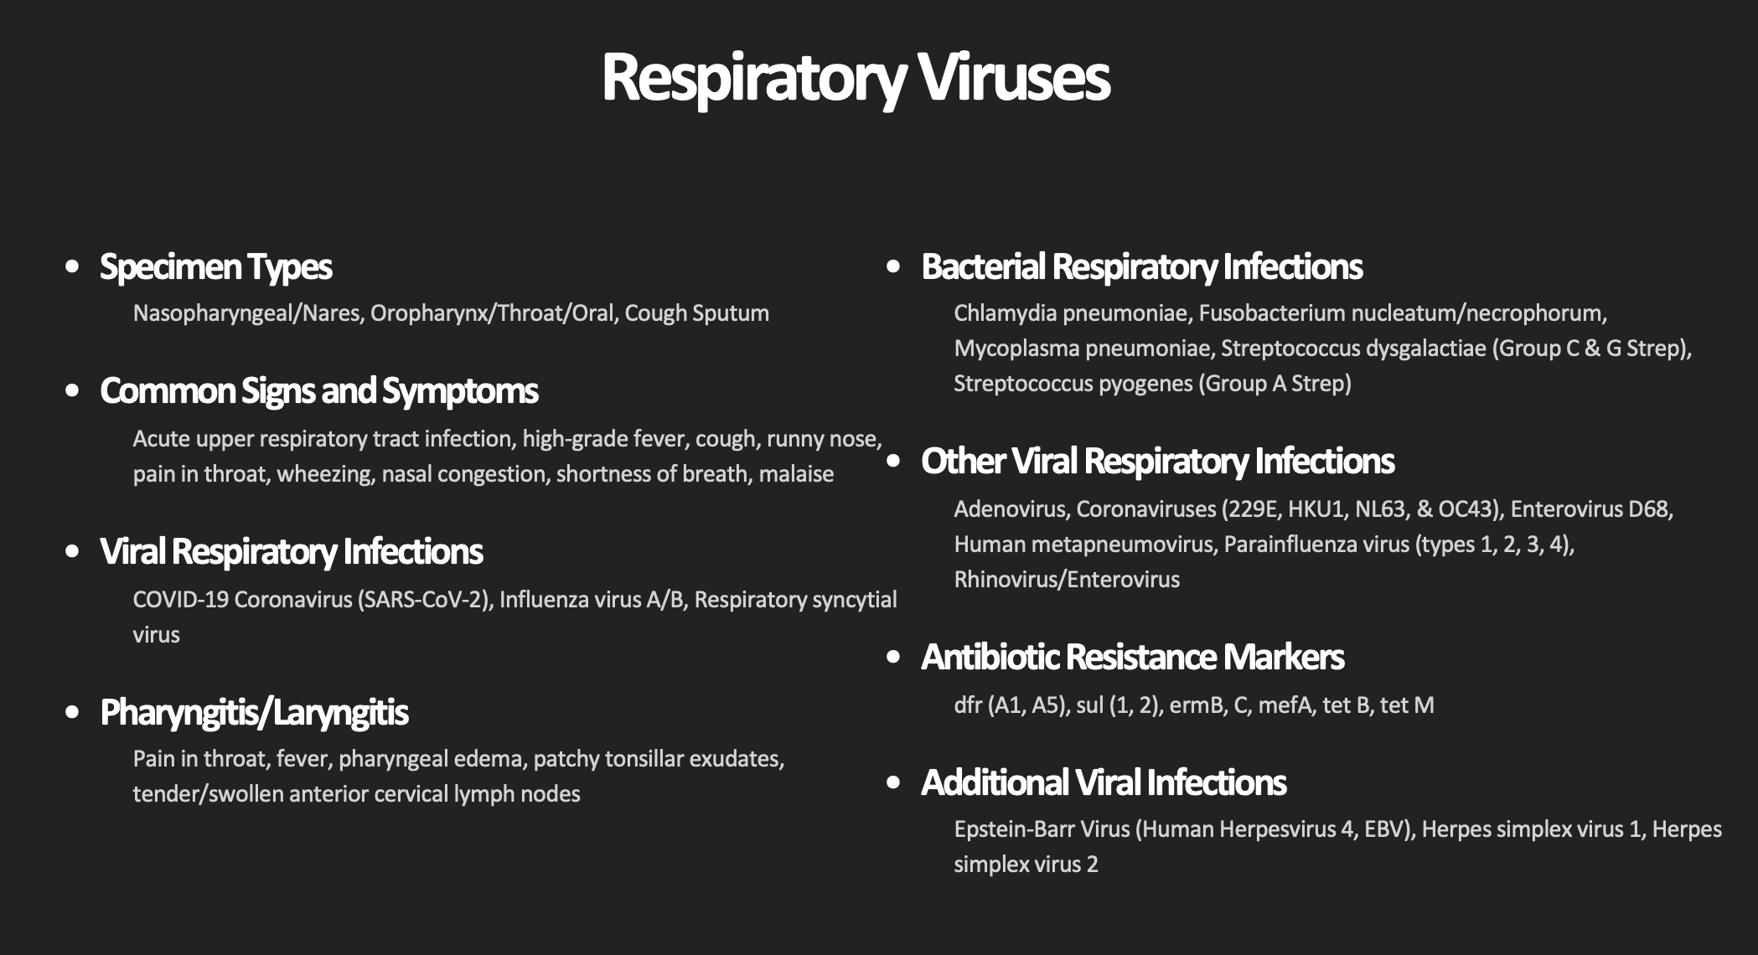

Slide 11
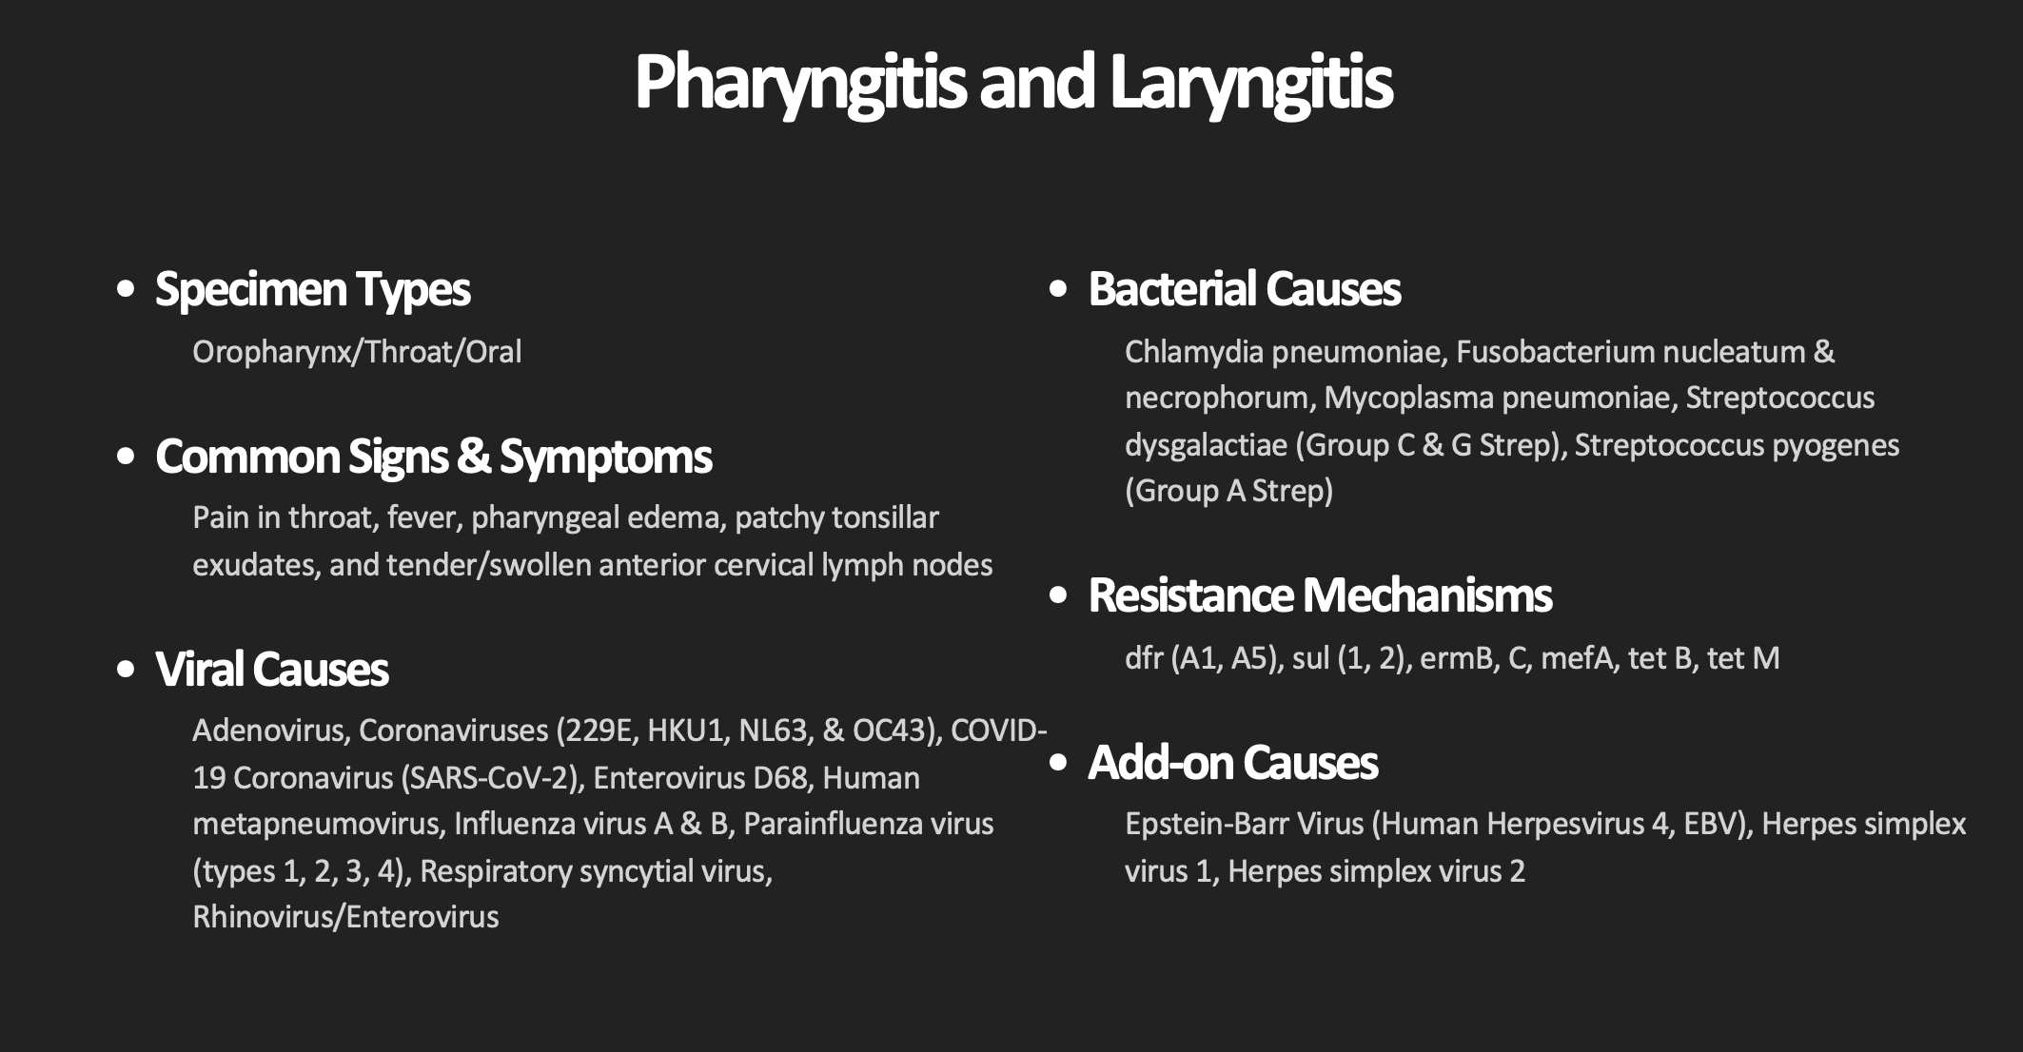

Slide 12
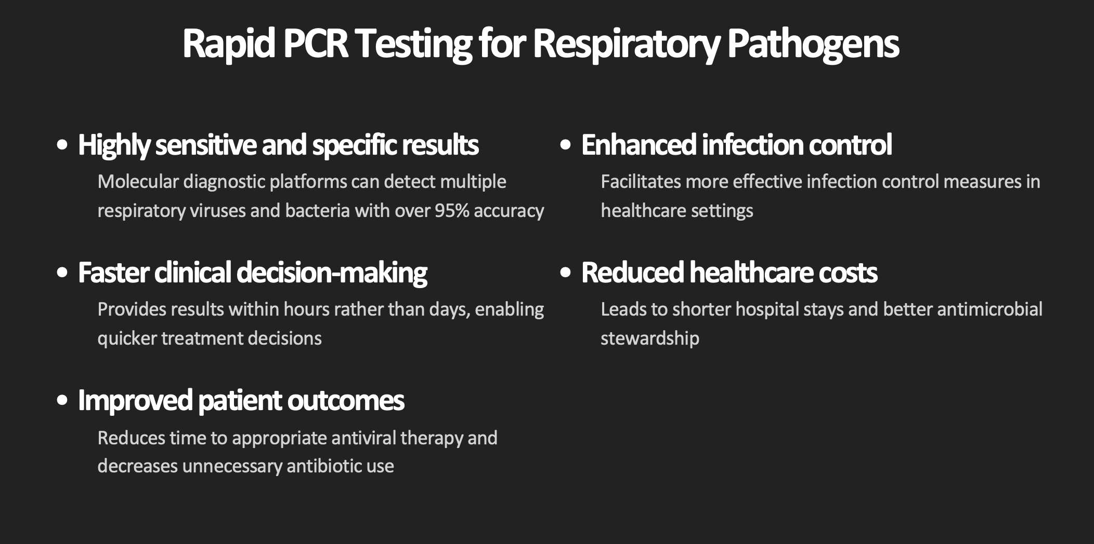

Slide 13
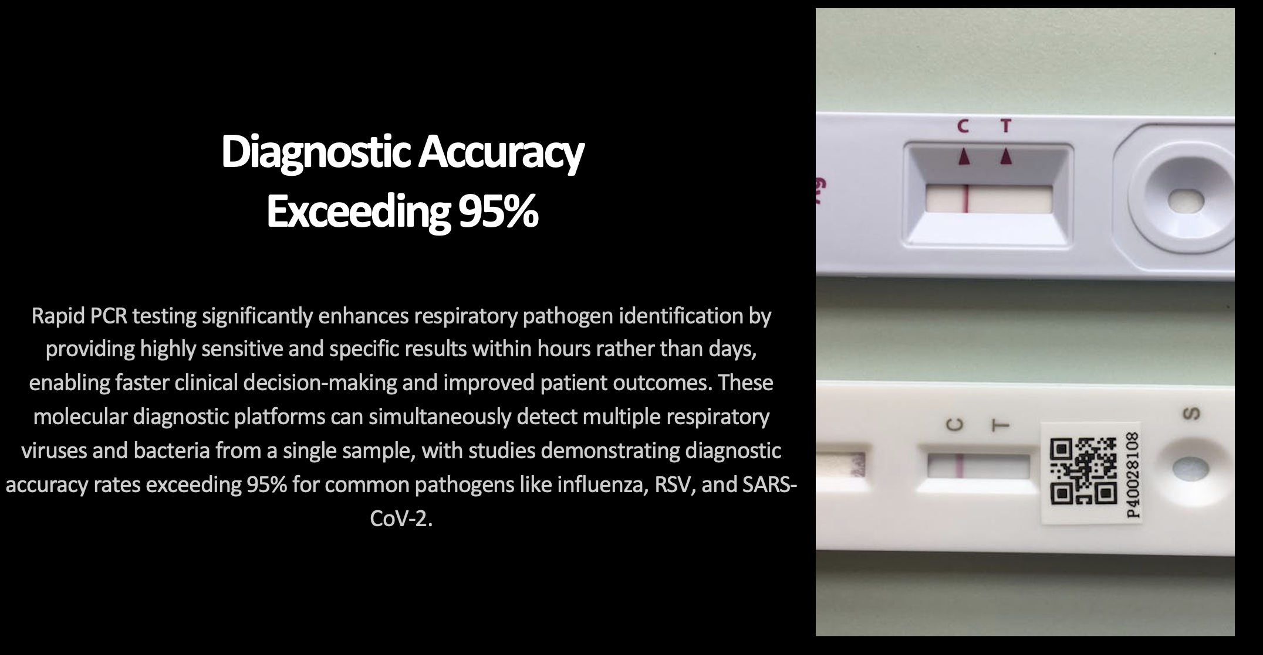

Slide 14
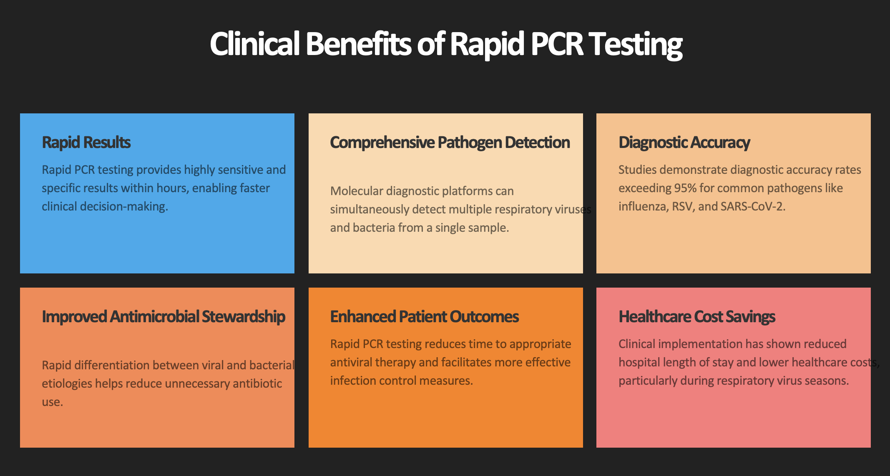

Slide 15
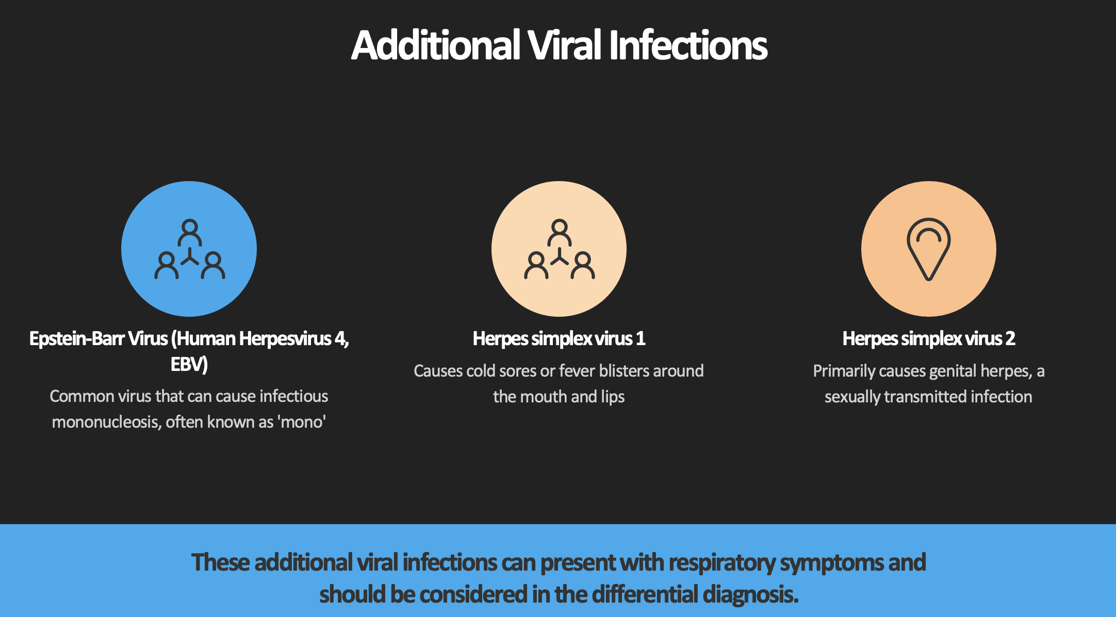

Slide 16

Genitourinary Pathology

Slide 17


Slide 18


Slide 19
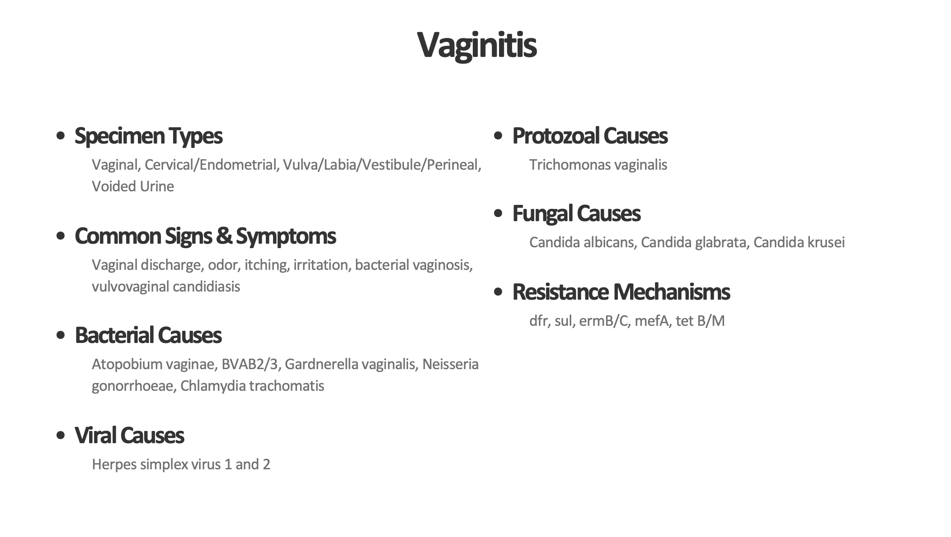

Slide 20
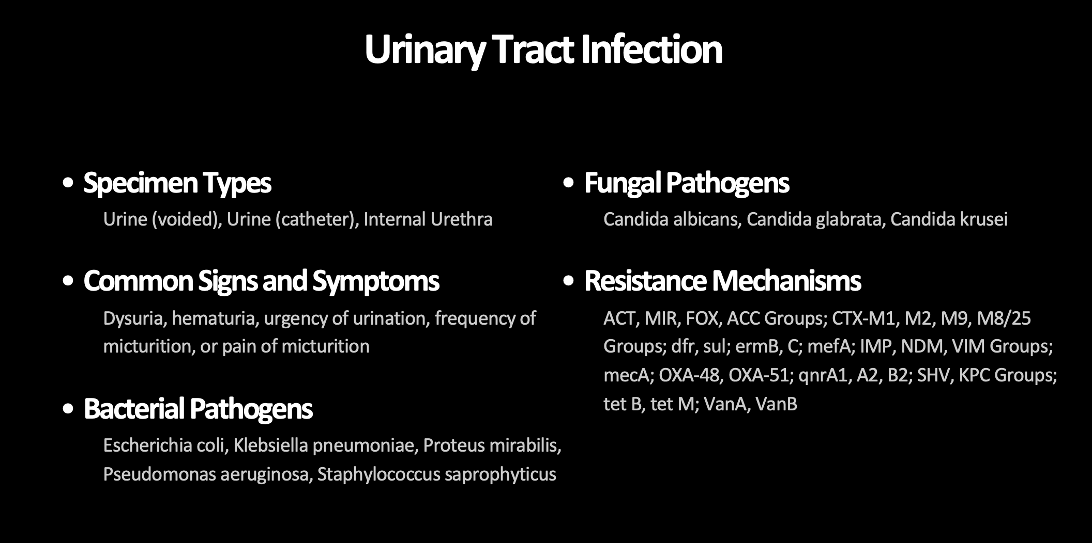

Slide 21
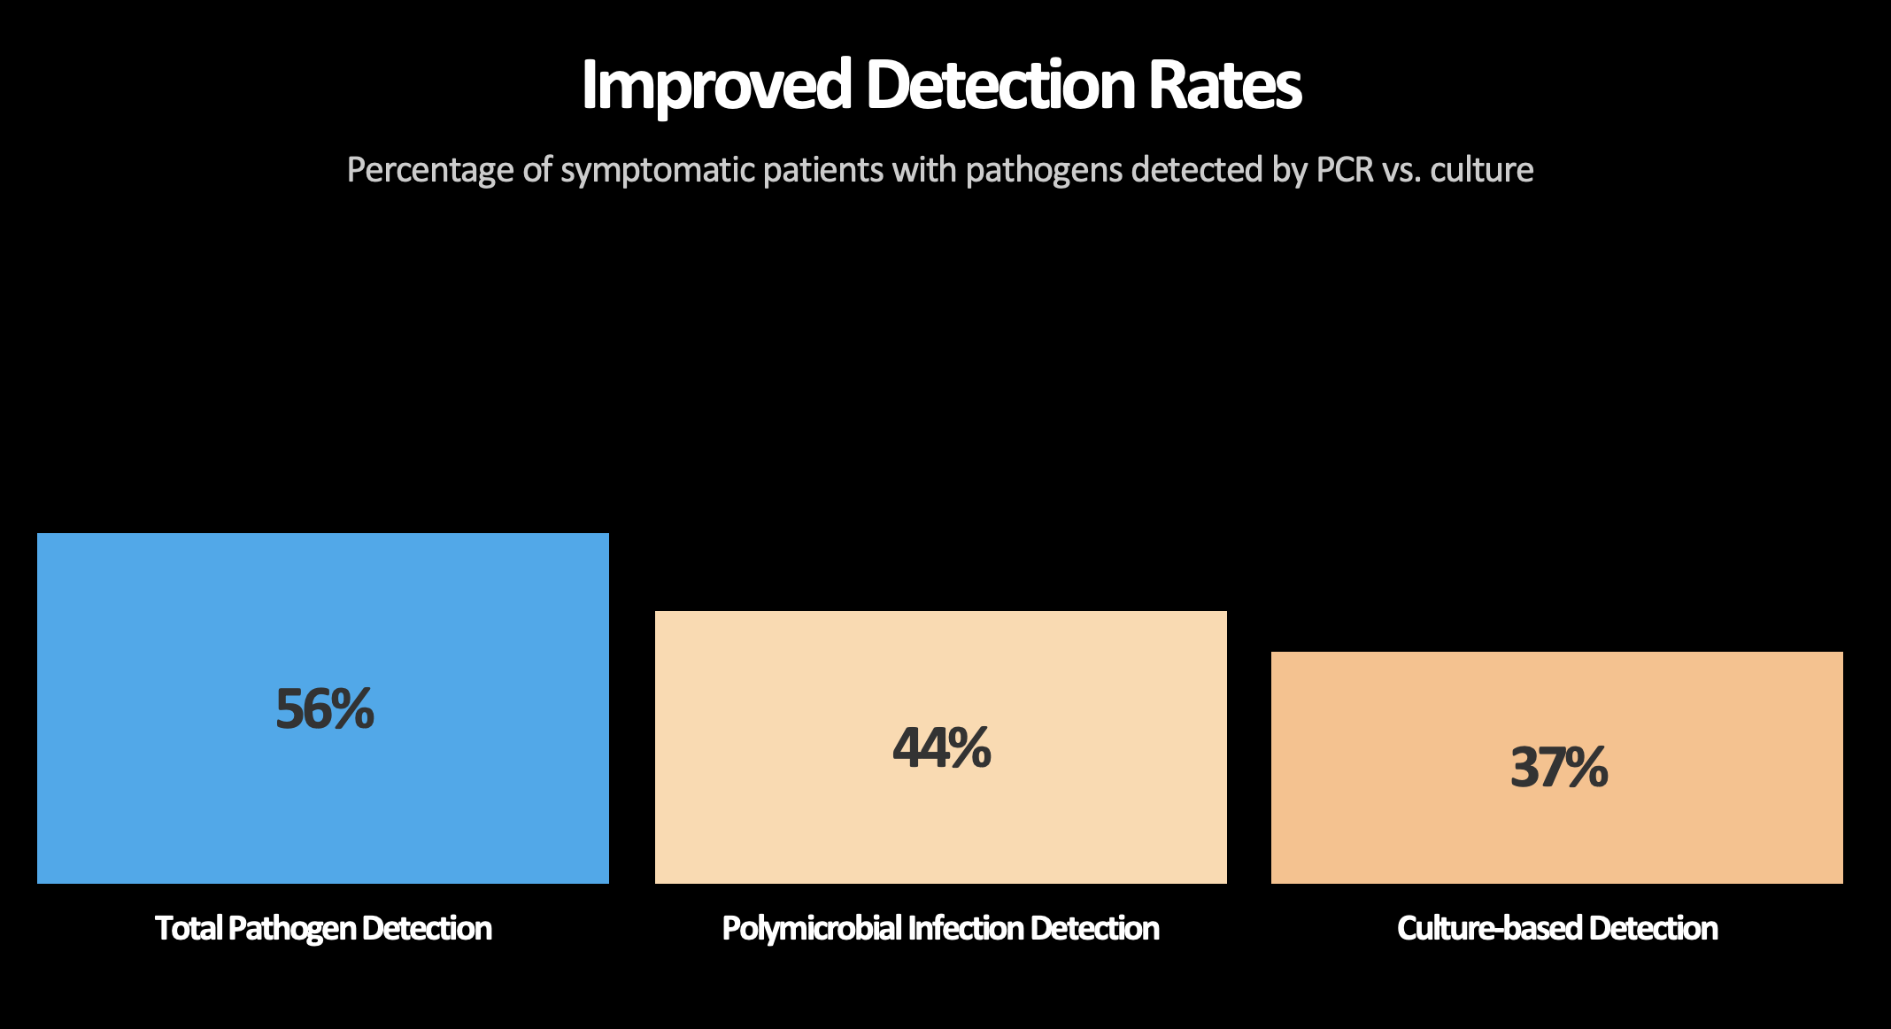

Slide 22
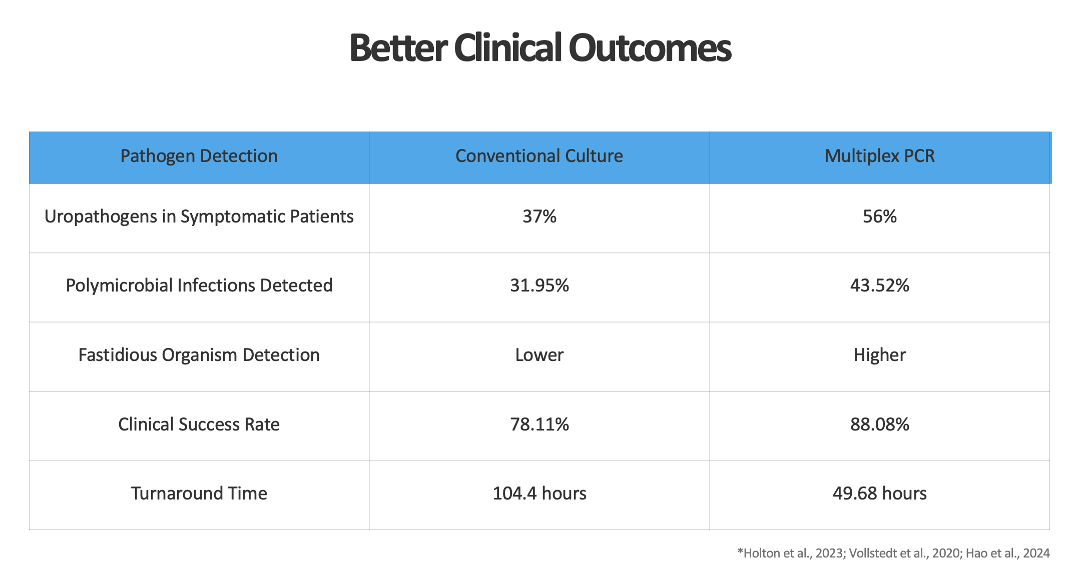

Slide 23
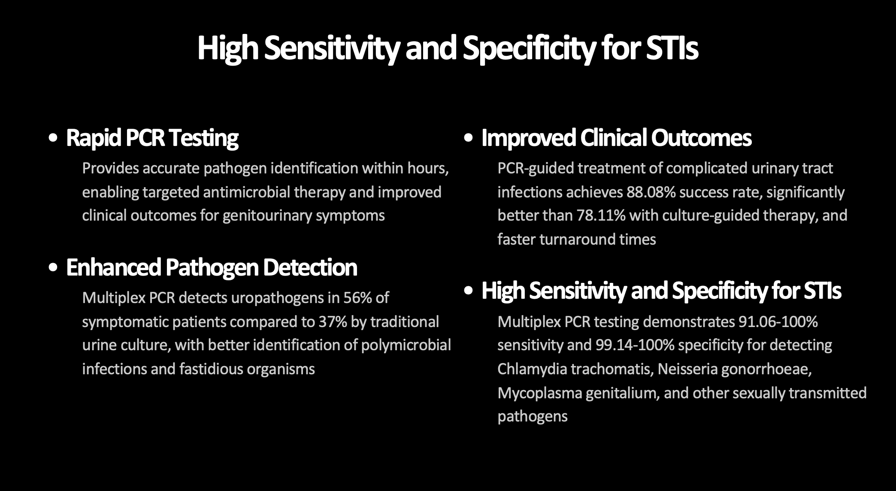

Slide 24
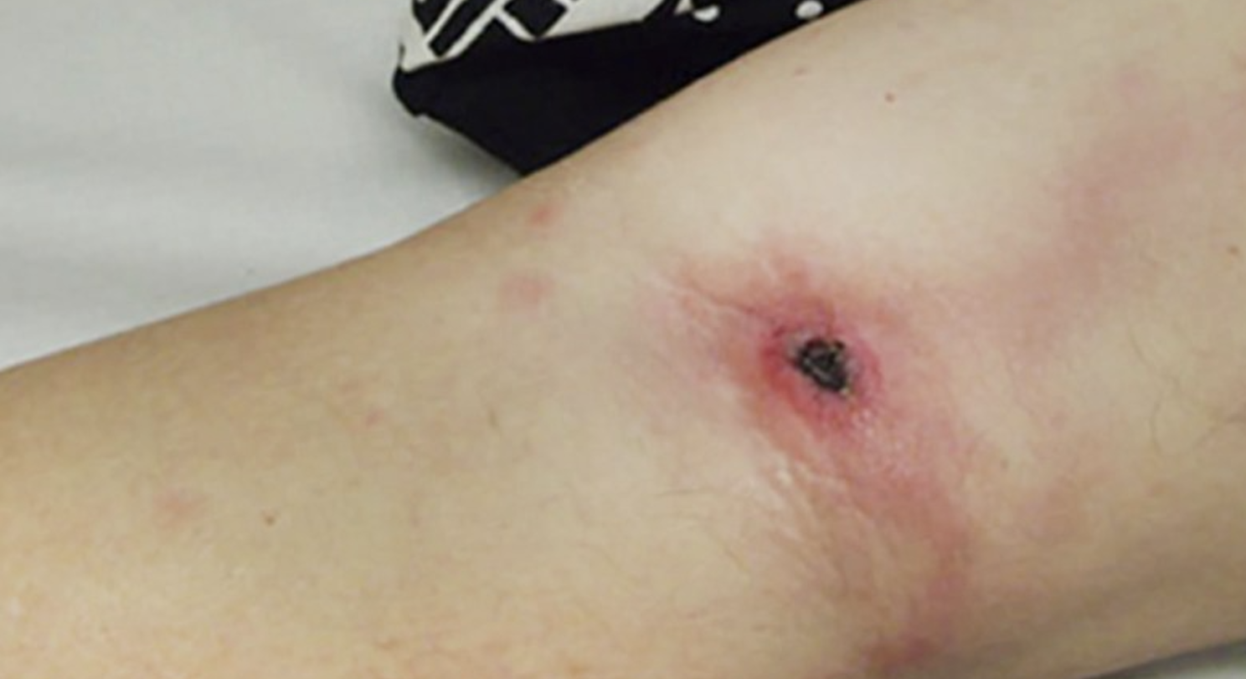

Slide 25
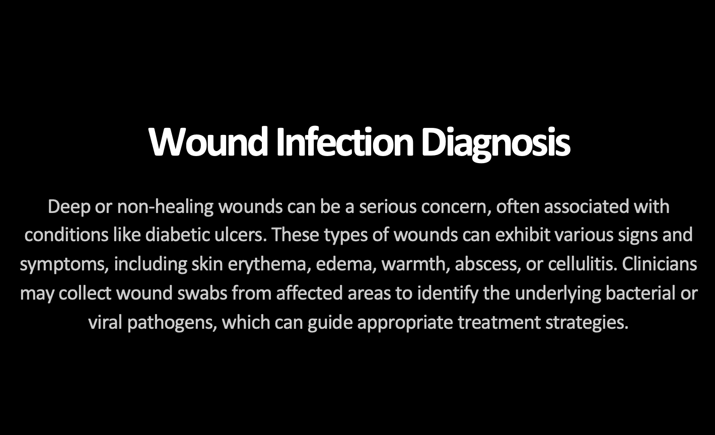

Slide 26
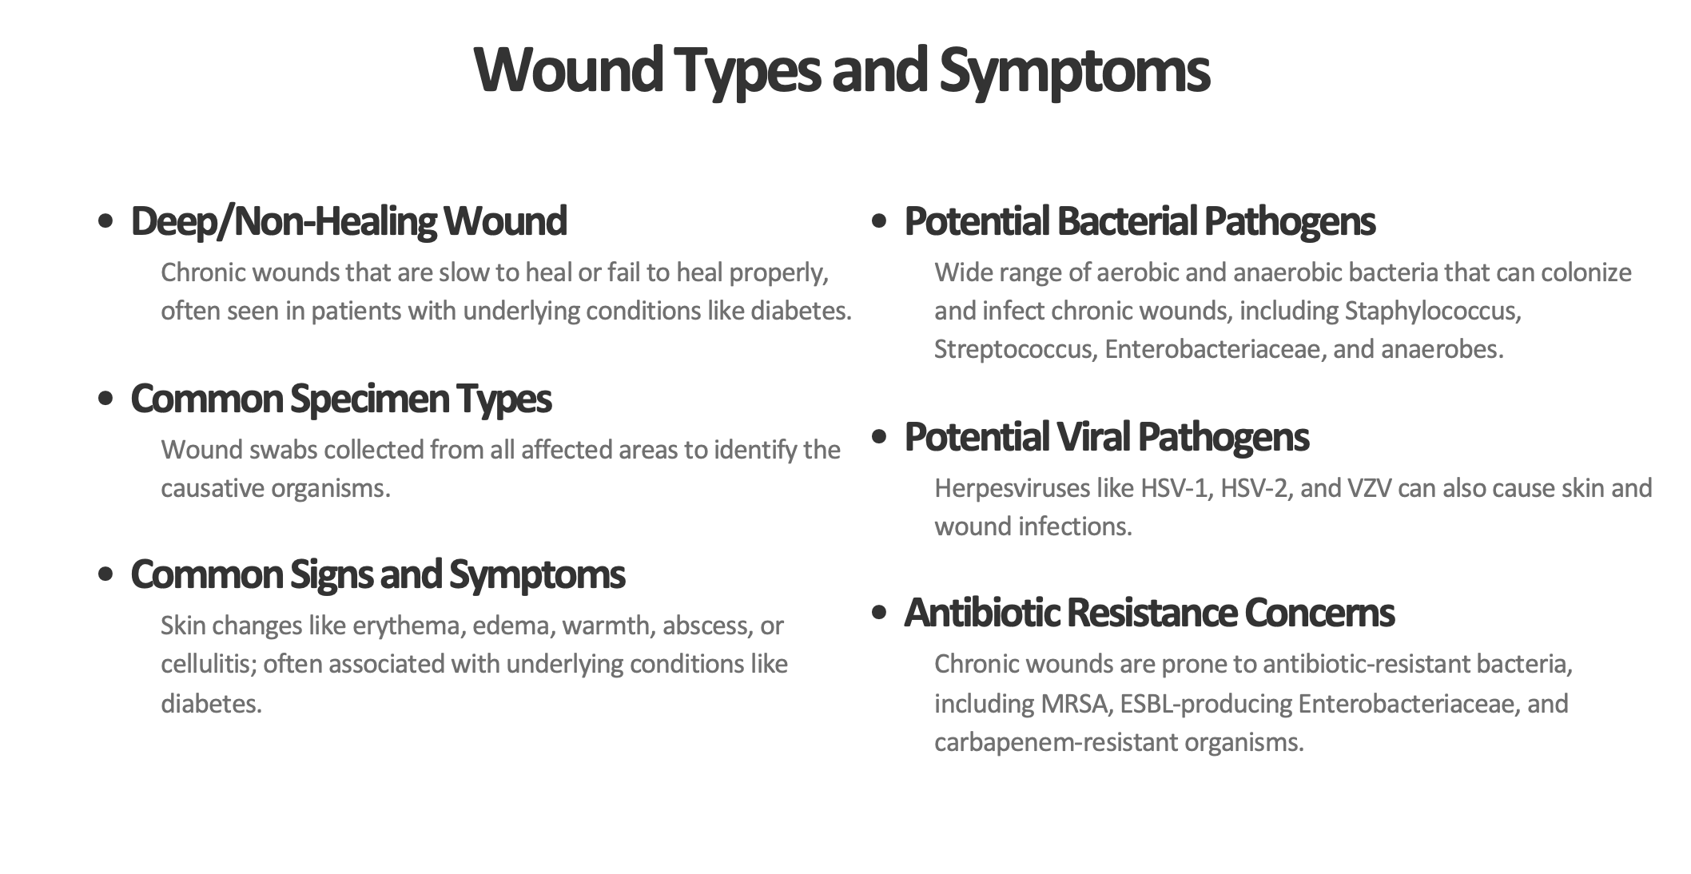

Slide 27
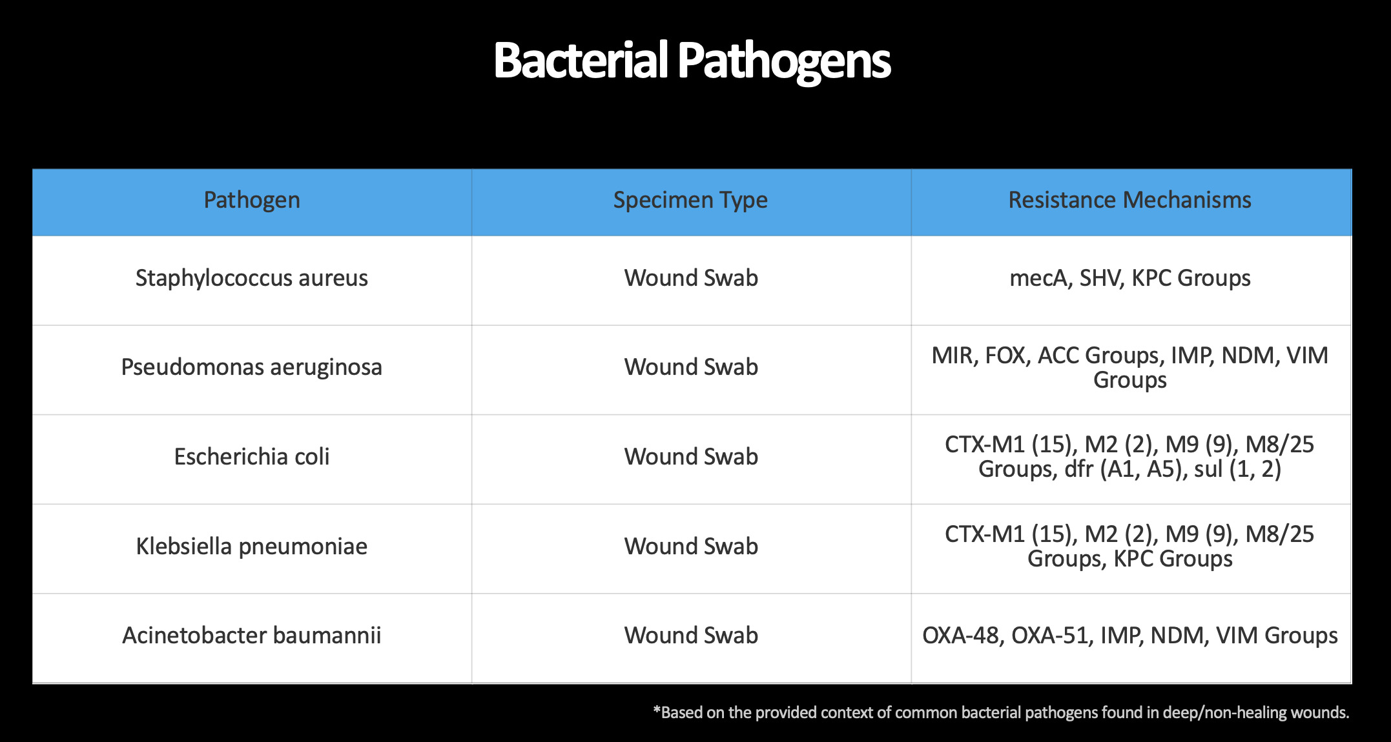

Slide 28
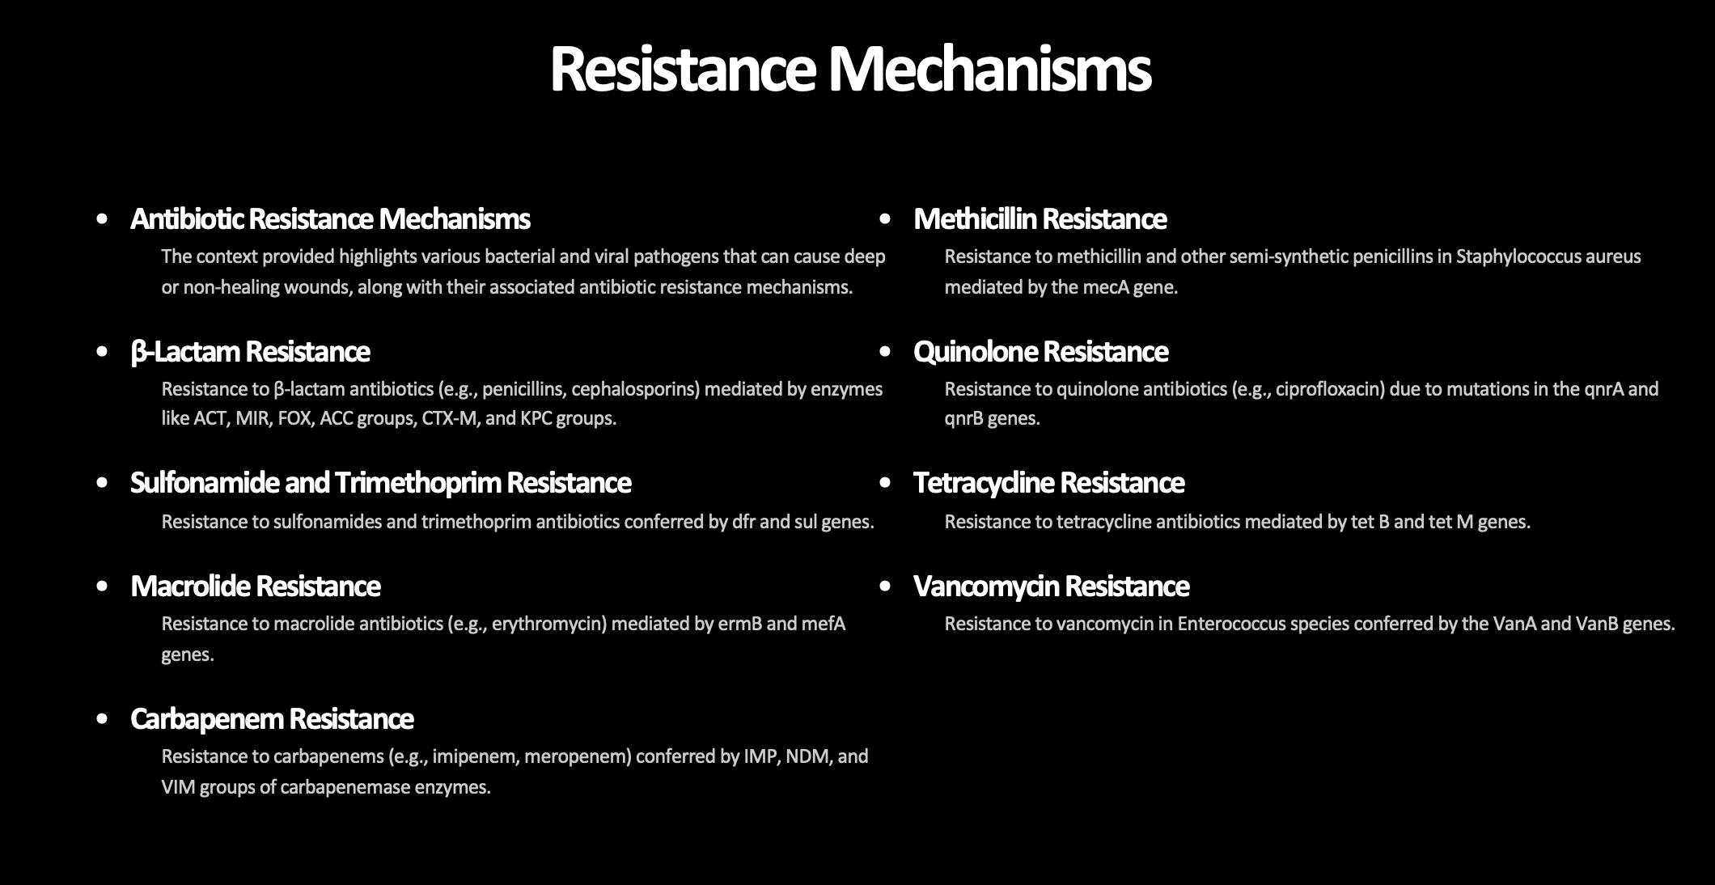

Slide 29
Q & A

Slide 30
REFERENCES
Beganovic, M., McCreary, E. K., Mahoney, M. V., Dionne, B., Green, D. A., & Timbrook, T. T. (2019).Interplay between rapid diagnostic tests and antimicrobial stewardship programs among patients with bloodstream and other severe infections. Journal of Applied Laboratory Medicine, 3(4), 601-616.
HealthTrackRx. (n.d.). Test today, results tomorrow: Fast, accurate diagnostic testing. https://www.healthtrackrx.com/
Jinks, T., Subramaniam, S., Bassetti, M., Cotta, M. O., De Waele, J. J., Horcajada, J. P., ... & Roberts, J.A. (2024). Opportunities to enhance diagnostic testing and antimicrobial stewardship: A qualitative multinational survey of healthcare professionals. Infectious Diseases and Therapy, 13, 1621-1637.
Ku, T. S. N., Al Mohajer, M., Newton, J. A., Wilson, M. H., Monsees, E., Hayden, M. K., ... & Vaughn, V.M. (2023). Improving antimicrobial use through better diagnosis: The relationship between diagnostic stewardship and antimicrobial stewardship. Infection Control & Hospital Epidemiology, 44(12), 1901-1908.
Mahony, J., Chong, S., Merante, F., Yaghoubian, S., Sinha, T., Lisle, C., & Janeczko, R. (2017).Implementation of rapid molecular infectious disease diagnostics: The role of diagnostic and antimicrobial stewardship. Journal of Clinical Microbiology, 55(6), 1783-1791.

Slide 31
REFERENCES
Moore, L. S. P., Villegas, M. V., Wenzler, E., Rawson, T. M., Oladele, R. O., Doi, Y., ... & Huttner, A.(2023). Rapid diagnostic test value and implementation in antimicrobial stewardship across low-to-middle and high-income countries: A mixed-methods review. Infectious Diseases and Therapy, 12(6),1445-1463.
Peri, A. M., Chatfield, M. D., Ling, W., Furuya-Kanamori, L., Harris, P. N., & Paterson, D. L. (2024). Rapid diagnostic tests and antimicrobial stewardship programs for the management of bloodstream infection: What is their relative contribution to improving clinical outcomes? A systematic review and network meta-analysis. Clinical Infectious Diseases, 79(2), 502-515.
Walker, A. M., Timbrook, T. T., Dyer, A., Johnson, S. W., Knutsen, L., & Sharma, S. (2024). Breaking boundaries in pneumonia diagnostics: Transitioning from tradition to molecular frontiers with multiplex PCR. Diagnostics, 14(7), 752.
Walls, T., Stark, E., Pattemore, P., & Jennings, L. (2024). Rapid PCR testing reduces antibiotic prescribing in children presenting to hospital with lower respiratory tract infections due to influenza. Influenza and Other Respiratory Viruses, 18(3), e13265.
Zacharioudakis, I. M., Zervou, F. N., Peirano, G., Kreiswirth, B. N., & Aguero-Rosenfeld, M. E. (2025).The role of rapid multiplex molecular syndromic panels in the clinical management of infections in critically ill patients: An experts opinion document. Critical Care, 29, 34.

