Slide 1
Healthcare-Associated Infections (HAI)-Lights From The Field
Karen Nunez, MS, MPH, CIC, Angel Guevara, MS, MPH, CIC, Kourtney Lopez, MPH, CIC, Kelly Broussard, MPH, Kylie Reckinger, MPH
Texas Department of State Health Services
Healthcare Safety Unit and Zoonosis Control Branch
Tarrant County Public Health
2025 Healthcare Safety Conference
July 23, 2025
Notes:
Good morning! My name is Karen Nunez, HAI Epi from Public Health Region 11, and our presentation is titled 'Healthcare-Associated Infections from the Field,' also known as 'Highlights from the Field.' This presentation will highlight field-based epidemiologic investigations conducted by the Texas Department of State Health Services and Tarrant County Public Health and strategies in infection prevention within healthcare settings.

Slide 2
Presentation Outline
Overview of Healthcare Safety Unit and healthcare-associated infection (HAI) epidemiologists
Hepatitis B exposure in an acute care hospital dialysis unit
Methicillin-resistant Staphylococcus aureus (MRSA) in a neonatal intensive care unit (NICU) Investigation
West Nile Virus-infected organ donor and infected recipients' investigation
Surveillance of localized transmission of Candida auris in an acute care setting
Notes:
We’ll begin with an overview of the Healthcare Safety Unit and the role of healthcare-associated infection epidemiologists. Then, we’ll examine specific investigations, including a Hepatitis B exposure in a dialysis unit, MRSA in a neonatal intensive care unit, an investigation involving West Nile Virus transmission through organ donation, and conclude with surveillance efforts for localized transmission of Candida auris in an acute care setting.
Each topic emphasizes the importance of epidemiological investigations and surveillance to protect patient safety.

Slide 3
1. Overview of Healthcare Safety Unit and HAI Epidemiologists
Notes:
Overview of Healthcare Safety Unit and HAI Epidemiologists

Slide 4
Healthcare Safety Unit
Vision
Helping to achieve safe, quality healthcare that improves the well-being of everyone in Texas
Mission
Promoting safe and quality healthcare through awareness, education, transparency, monitoring, and response
Available at: https://www.dshs.texas.gov/healthcare-safety-unit, accessed 05/20/25.
Notes:
The Healthcare Safety Unit’s vision is to help achieve safe, quality healthcare that improves the well-being of everyone in Texas. Our mission is to promote safe and quality healthcare through awareness, education, transparency, monitoring, and response.
For more information, I encourage everyone to visit our website shown below to learn more about HAIs, multidrug-resistant organisms, antimicrobial stewardship, preventable adverse events, and other resources such as antibiograms, annual reports, and our Texas Antimicrobial Resistance Laboratory Network Response Plan.

Slide 5
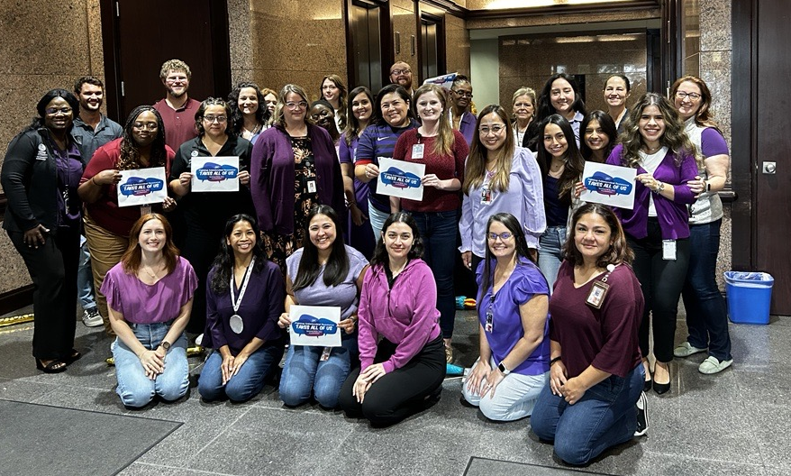
Healthcare Safety Unit Teams
Investigations
  Healthcare-Associated Infections Team
  Antimicrobial Resistance Team
Data and Training
  Data Validation Team
  Texas Healthcare Safety Network Team
  Antimicrobial Stewardship Team
  Training Team
Williams, Rae. (2024) Photograph of the DSHS HSU at an annual meeting at the Texas Department of State Health Services. [Photo] Austin, Texas.
Notes:
Here, we highlight the various specialized teams that work collaboratively within the healthcare safety unit, each one focused on critical aspects of healthcare safety and quality.
Under investigations we have the Healthcare-Associated Infections Team and Antimicrobial Resistance Team, under Data and Training, we have the Data Validation Team, the Texas Healthcare Safety Network Team, Antimicrobial Stewardship Team and Training Team.
Shown here is a picture of all the teams at one of our annual meetings.

Slide 6
Healthcare-Associated Infections
Healthcare-associated infections (HAIs) are infection patients get while or soon after receiving health care
On any given day, about one in 31 hospital patients has at least one HAI
Available at: https://www.cdc.gov/healthcare-associated-infections/about/index.html, accessed 07/03/25.
Notes:
Now, Healthcare-Associated Infections are infections patients get while or soon after receiving healthcare.
Some of the causes of HAIs are poor hand hygiene, inadequate cleaning, disinfection, and sterilization, improper use of medical devices, and inadequate infection control practices.
Examples of HAIs
Central line-associated bloodstream infections (CLABSI)
Catheter-associated urinary tract infection (CAUTI)
Surgical site infections (SSI)
On any given day, about 1 in 31 hospital patients has at least one HAI

Slide 7
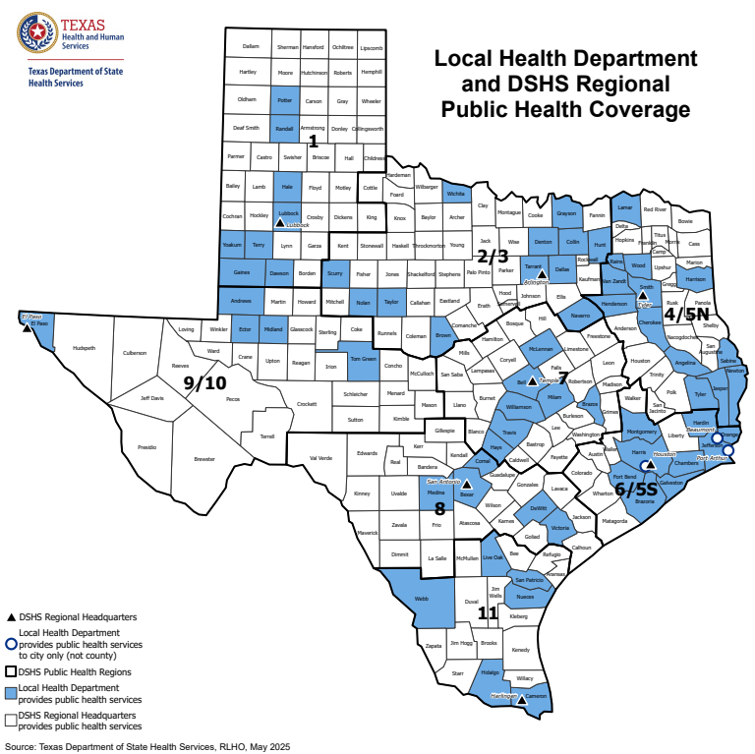
Texas Public Health Regions
Texas is divided into 8 different public health regions (PHRs)
1-2 HAI epidemiologists assigned to each PHR
Available at: Texas Local and DSHS Regional Public Health Coverage Map | DSHS, accessed 07/03/25.
Notes:
Texas has 8 Public Health Regions, each with 1 or 2 HAI Epidemiologists from DSHS providing on-site infection control expertise. This allows us to address infection control challenges much more effectively within each region while also building, maintaining, and strengthening relationships with our local stakeholders. The blue-colored counties are counties with a local health department, and all non-colored counties fall under the jurisdiction of DSHS.

Slide 8
HAI Epidemiologists Role
Offer infection prevention and control (IPC) expertise
Conduct infection control assessments (ICARs)
Respond to investigations and outbreaks in healthcare facilities
Assist local health departments and other DSHS programs
Provide education, training and mentoring
Notes:
What is the role of an HAI Epidemiologist?
1st Box: one of the primary roles of HAI Epis is to be a healthcare infection prevention and control experts and a resource for regional and local stakeholders such as public health departments, infection preventionists, healthcare facilities, and the general population. We also collaborate with Infection Control professional groups like local APIC Chapters, the End Stage Renal Disease Network, HHSC Regulatory, HHSC Quality Monitoring Program, the Texas Medical Foundation, Texas correctional facilities, and Academic Centers.
2nd Box: Another role of an HAI Epi is to provide education, training, and mentorship on HAIs and MDROs to local health departments and healthcare settings to sustain infection control expertise and ensure best practices, recommendations, and policies are followed appropriately in the field.
3rd Box: Another role of an HAI Epi is to conduct standardized non-regulatory proactive or response-driven infection control assessments, known as ICARs, provided onsite or remote for healthcare facilities, often in collaboration with local health department staff, to identify, evaluate, and provide healthcare facility-specific infection control recommendations.
4th Box: From these ICARs, epis can promptly respond to investigations and manage outbreaks in healthcare settings, to prevent the further spread of infectious diseases among visitors, other patients, and staff, and decrease patient morbidity and mortality.
5th Box: Lastly, HAI Epis often partners with other programs such as epidemiology, zoonosis control, vaccine-preventable diseases, tuberculosis, border health, and the HIV/STD program, when needed, to assist with infection control questions.

Slide 9
HAI Investigations
Antimicrobial resistant organisms
Bloodborne pathogens
Medical products
Organ transplants
Notes:
HAI Investigations can range in scope from responding to novel or emerging antimicrobial-resistant organisms to bloodborne pathogen exposures and to investigating potentially compromised medical products such as Botox, bone allografts, epidural anesthesia, and organ transplants.
To learn more about some of these investigations and how we collaborate, I will now pass it over to Angel Guevara, who will discuss a Hepatitis B exposure in an acute care hospital dialysis unit.

Slide 10
2. Hepatitis B Exposure in an Acute Care Hospital Dialysis Unit
Notes:
Hello, my name is Angel Guevara. HAI Epi from Public Health Region 11.
As Karen mentioned, I will be discussing a hepatitis B exposure in an acute care hospital’s dialysis unit.

Slide 11
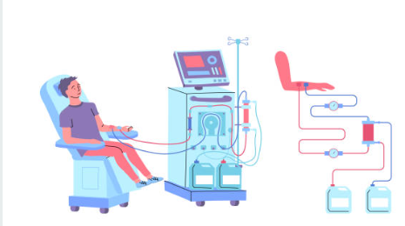
HAIs in Dialysis Settings
Patients on hemodialysis face a significantly elevated risk of infection​
516,837 patients on hemodialysis in the United States
Important to implement consistent and evidence-based infection prevention strategies in these facilities​
Available at: https://www.istockphoto.com/vector/cartoon-character-boy-and-hemodialysis-renal-scheme-concept-vector-gm1978047332-558854696?searchscope=image%2Cfilm, accessed 07/03/25.
Notes:
Patients on hemodialysis face a significantly elevated risk of infection, due to the frequent need for vascular access, which creates a direct pathway for bacteria and other pathogens to enter the bloodstream. Additionally, many of these patients are immunocompromised, either due to their underlying kidney disease or other chronic conditions. They're also in healthcare settings multiple times per week, increasing the chance of exposure.
Given this, it is important to implement consistent and evidence-based infection prevention strategies across dialysis facilities.

Slide 12
Hepatitis B Overview
Vaccine-preventable liver infection caused by the Hepatitis B virus (HBV)
Transmitted through activities that involve percutaneous or mucosal contact with infectious blood or body fluids
Two stages: acute and chronic
Long incubation period
Available at: https://www.dshs.texas.gov/vaccine-preventable-diseases/vaccine-preventable-disease-conditions/hepatitis-b and https://www.cdc.gov/hepatitis-b/about/index.html, accessed on 07/03/25.
Notes:
Hepatitis B is transmitted through activities that involve percutaneous (i.e., puncture through the skin) or mucosal contact with infectious blood or body fluids. When present, signs and symptoms can include fever, fatigue, loss of appetite, nausea, vomiting, abdominal pain, dark urine, clay-colored bowel movements, joint pain, and jaundice. There are two stages of hepatitis B: acute and chronic. Incubation is 45-180 days with an average of 60-90 days

Slide 13
Hepatitis B Clinical Testing
CDC recommends the use of the triple panel test, which includes testing for:
  HBsAg
  Anti-HBs
  Total antibody to hepatitis B core antigen (total anti-HBc)
Anti-HBs ≥ 10 mIU/mL are generally considered protective against hepatitis B
Available at: https://www.cdc.gov/hepatitis-b/hcp/diagnosis-testing/index.html, accessed on 07/03/25.
Notes:
Different serologic markers or combinations of markers are used to identify different phases of HBV infection. Hepatitis B surface antigen, hepatitis b surface antibody, and hepatitis B core antibody, they determine whether a patient has acute or chronic HBV infection, is immune to HBV as a result of prior infection or vaccination, or is susceptible to infection.
Antigen: A foreign substance in the body, such as the hepatitis B virus.
Antibody: A protein that your immune system makes in response to a foreign substance.
Antibodies can be produced in response to a vaccine or to a natural infection. Antibodies usually protect you against future infections.
A healthcare provider will review test results and provide a diagnosis.

Slide 14
Hepatitis B Infection Control Recommendations for Dialysis clinics
Standard Precautions
Immunization
Serological surveillance
HBV - dedicated isolation room
Environmental cleaning and disinfection
Notes:
Box 1: Standard Precautions should be used to prevent exposure of healthcare professionals to blood or body fluids of hepatitis b surface antigen-positive patients. This includes hand hygiene, gloves, gown, mask, and face shield. Possible exposure to blood or other potentially infectious bodily fluids is high during dialysis treatment; therefore, strict adherence to Standard Precautions is necessary.
Box 2: Routine vaccinations are recommended for healthcare professionals before starting employment. This includes HBV Vaccine Series and HBIG postexposure prophylaxis.
Box 3 All vaccine recipients should have their anti-HBs levels re-tested annually, and a booster dose should be administered if their hepatitis b surface antibody levels fall below 10 milli-international units per milliliter.
Box 4: HBV patients are to receive dialysis in a dedicated isolation room, on a dedicated machine using dedicated equipment and supplies.
Box 5: Follow the Manufacturer's Instructions for Use along with CDC recommended use of 1:100 bleach solution, EPA-approved disinfectant with tuberculocidal claim or against HBV and HIV.

Slide 15
Patient Timeline
09/24/24 – Admission date
  66-year-old male with history of end-stage renal disease, coronary artery disease (CAD), and chronic HBV, presents to the emergency department with chest pain
  Patient is admitted to the hospital for dialysis
09/24/24 - 09/27/24 – Dialysis treatment
  Received in-house dialysis but not in an HBV-dedicated isolation room
09/27/24 – HBV result discrepancy discovered
  Hospital staff realized they had misread the patient’s HBV positive result and listed it as negative on a paper chart
Notes:
So, let’s take a look at the timeline of events that led to a public health notification and investigation.
On September 24, 2024 a 66-year-old male patient with a history of end-stage renal disease, coronary artery disease, and chronic hepatitis B virus infection presents to the emergency department with chest pains and is subsequently admitted to the hospital.
Now, most people on hemodialysis receive treatment three times a week. From September 24 – 27, this chronic hepatitis B patient received in-house dialysis treatments, but not in an HBV-dedicated isolation room.
It wasn’t until September 27 that hospital staff found a discrepancy in the patient’s HBV results. Hospital staff realized they had misread the patient’s HBV positive result on the computer and listed it as negative on a paper chart.

Slide 16
Facility Actions
Identify exposed patients
Determine HBV status of exposed patients
Notify exposed patients
Notify outpatient dialysis clinics where exposed patients were receiving care
Notified public health
Notes:
In response to the discrepancy, the hospital began to take a series of actions, including identifying all the patients who used the same dialysis machines after our index patient.
Next, the facility determined the HBV status of each of the exposed patients. Initial testing showed 4 patients with hepatitis b surface antibody levels of more than 10 mIU/mL, so those 4 had immunity. However, 3 patients had less than 10 mIU/mL.
Then, all patients were notified of their possible HBV exposure, regardless of the initial test results, and all those patients’ outpatient dialysis clinics.
Hidalgo County Health and Human Services and PHR 11 were notified shortly after the hospital identified the discrepancy. Since this investigation involved Hepatitis B and a healthcare setting, the region’s vaccine-preventable disease surveillance coordinator, the emerging and acute infectious disease unit vaccine-preventable disease group, and HAI Epis were looped in for recommendations.

Slide 17
Public Health Actions
Reviewed line list of exposed patients
Provided testing and vaccination recommendations
Conducted infection control assessment to identify infection control gaps
Notes:
To prevent further transmission, public health actions included reviewing a line list of exposed patients, recommending a comprehensive postexposure testing schedule to be decided by patients’ providers, recommending that patients receive one dose of hepatitis B vaccine since they were already beyond the window to receive hepatitis B immunoglobulin, and recommending an infection control assessment.

Slide 18
Infection Control Assessment
On 10/08/24, HAI epidemiologists and local health department epidemiologist conducted an onsite infection control assessment
Gaps observed included:
  Hand hygiene
  Personal protective equipment (PPE)
  Environmental cleaning and disinfection
Recommendations were provided on how to mitigate identified gaps
Notes:
On October 8, HAI Epis and the local health department conducted an onsite infection control assessment. During the assessment, several gaps were observed.
Hand Hygiene
Empty and hidden alcohol-based hand sanitizer (ABHS) behind a signage stand
Missed hand hygiene (HH) opportunities upon entry to the dialysis unit, even when the empty and hidden ABHS was refilled and made accessible.
Missed HH opportunities after doffing gloves and donning new gloves
HH performed while holding onto items
Personal Protective Equipment
Using workstations with gloved hands
Improper use and storage of isolation gowns
Isolation gowns not properly disposed of in trash bin
Face shields were not being used while connecting/disconnecting patients
Patients with assigned “Sitters” not wearing any PPE
Environmental Cleaning and Disinfection
We were told by hospital staff that terminal cleaning was performed on Sept. 27th; however, curtains were observed to have an older August date, noting the last time they were changed
Biohazard bins placed underneath curtains
An open glove box and other small equipment were found within the splash zone of a dirty sink
Opportunities for cross-contamination when moving patients into Bay 3 when Bay 2 was in use

Slide 19
Next steps
Facility develop an action plan to address identified gaps
Healthcare facility and public health collaborated to ensure appropriate follow-up was done for exposed patients
Public health monitored the exposed patients for 6 months
The facility met all its action plan success goals by the end of January 2025
Notes:
Box 1: After the assessment, the facility began to develop an action plan with evidence of compliance based on our ICAR observations and recommendations report.
Box 2: The hospital infection preventionist provided regular, detailed updates on an Excel spreadsheet to public health on what they were doing to correct gaps in infection control.
Box 3: Public health monitored all exposed patients for 6 months to determine if any of them would later test positive. Thankfully, none of the exposed patients had a positive result during their 6-month incubation period.
Box 4: The facility met all its action plan success goals by the end of January 2025. With the incubation period having ended, no positive patients, and the facility having implemented changes with supported staff compliance to prevent another exposure, we concluded the investigation.

Slide 20
Acknowledgements
Hidalgo County Health and Human Services
  Amy Gonzales, MPH, Epidemiologist
  Hector J. Perez, MPH, Epidemiologist
  Jackeline Gonzalez, BS, Epidemiologist
DSHS Public Health Region 11
  Norma Mendiola, VPD Coordinator
  Karen Nunez, MS, MPH, CIC, HAI Epidemiologist
DSHS Emerging and Acute Infectious Disease Unit – Vaccine Preventable Disease Group
  Whitney Tillman, MPH, Manager
  Binoj Peter, MPH, Epidemiologist
  Elise Huebner, MS, MPH, CIC, Epidemiologist
Notes:
I want to acknowledge Hidalgo County Health and Human Services Epidemiologists, Amy Gonzalez, Hector Perez and Jackeline Gonzales, DSHS PHR 11 staff Norma Mendiola and Karen Nunez, and DSHS EAIDU staff Whitney Tillman, Binoj Peter, and Elise Huebner for their roles in this investigation.

Slide 21
3. Methicillin-Resistant Staphylococcus aureus (MRSA) in a Neonatal Intensive Care Unit
Notes:
I will now pass it over to Kourtney Lopez to discuss our next HAI-light from the field, Methicillin-Resistant Staphylococcus aureus in a Neonatal Intensive Care Unit.

Slide 22
Methicillin-Resistant Staphylococcus aureus (MRSA) Overview
Invasive S. aureus infections are high in neonates
Neonates can become colonized with MRSA while in the neonatal intensive care units (NICUs)
MRSA is the most reported HAI in NICUs
Available at: NICU S. aureus Prevention and Control Recommendations, accessed on 07/03/25.
Notes:
I want to provide an overview on methicillin-resistant Staphylococcos aureus infections in the neonatal intensive care unit setting. Staphylococcus aurus is the most commonly reported healthcare-associated infection or HAI in United States NICUs. Invasive S. aureus infections are high among neonates given they are most often preterm and low birthweight. Neonates can become colonized with methicillian-resistant Staphylococcus aureus, or MRSA, while in the NICU. Since the discovery of MRSA, it has migrated to not be associated exclusively with healthcare stays. We know that there’s community spread of MRSA and many hospital systems monitor those rates in their community. MRSA in the NICU is a difficult pathogen to navigate because the longer in the healthcare setting, the higher chance of developing such an infection. Unlike typical acute care settings where patients leave after short duration of stay, neonates can be in the facility for weeks or sometimes even months.

Slide 23
MRSA Screening Recommendations
Perform active surveillance testing for MRSA colonization in NICUs when:
  There is an increase incidence of S.aureus
  There is evidence of ongoing health-care associated transmission
  In an outbreak setting
Test at regular intervals to promptly identify newly colonized patients
Available at: Summary of Recommendations | Infection Control | CDC, accessed on 07/03/25.
Notes:
Per CDC, the implementation of active surveillance testing for MRSA colonization is recommended when there is evidence of ongoing healthcare-associated transmission. This recommendation can lead to the prompt implementation of infection control strategies that will result in a reduction of person-to-person transmission and decreased incidence of MRSA colonization and infection in neonates.

Slide 24
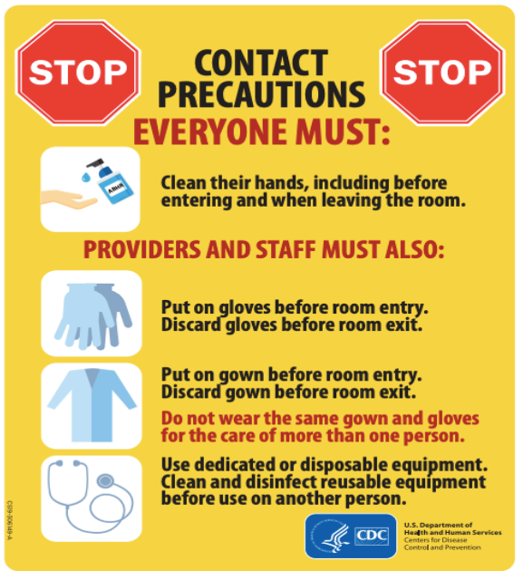
MRSA Infection
Control
Recommendations
Contact precautions
Hand hygiene
Patient isolation and cohorting
Education and training
Dedicated equipment
Staff cohorting
Available atTransmission-Based Precautions | Infection Control | CDC, accessed 05/26/25.
Available at: NICU S. aureus Prevention and Control Recommendations, accessed on 07/03/25.
Notes:
CDC recommends the use of Contact Precautions in inpatient acute care settings for patients colonized or infected with MRSA. In 2022, the US acute care hospitals (ACHs) observed a 16% decrease in hospital-onset MRSA bacteremia. Interventions like contact precautions and hand hygiene have contributed to the decrease. In addition to contact precautions, strong adherence to hand hygiene, patient isolation and cohorting based on MDRO status, staff cohorting to MRSA patients, the use of dedicated equipment and increased education and annual training can also lead to reduced transmission and incidence of MRSA in the NICU, as well as other settings.

Slide 25
Initial Report
On 12/10/24, HAI epidemiologists were alerted to an increase of MRSA infections in the NICU of an acute care hospital
The hospital requested molecular testing to identify sequence and relatedness of patient isolates
Notes:
In Texas, MRSA is not a reportable condition; however, unusual presentation or clusters of nonreportable organisms are required to be reported to public health for follow-up. The acute care hospital reported and increased number of MRSA in their NICU and we coordinated for isolates to be sent to DSHS for whole genome sequencing to determine the genetic relatedness of the patient isolates. The facility suspected that they were having a cluster in their NICU. We worked closely with the local health department and acute care hospital to characterize this cluster of cases. We discussed meeting for a remote ICAR to discuss their previous internal infection control auditing results, with a later onsite ICAR to be completed with the facility.

Slide 26
Facility Audits
Facility shared previous auditing data of hand hygiene among some healthcare workers in the NICU
83.58% compliance out of 134 observations
Notes:
During the remote infection control assessment, the facility shared results of internal infection prevention auditing that showed that over 134 observations for the month of November, 83.58% adherence to hand hygiene was observed on the NICU. The facility further broke down their data based on position. Within those 134 observations, 80.21% hand hygiene compliance was observed by RNs and LVNs, 75% hand hygiene compliance was observed among technicians, such as EEG technicians, EKG and cardiology technicians and respiratory technicians. 89.47% hand hygiene compliance was observed among respiratory therapists. We also received 3 more months of auditing data and reviewed the facility trends to prepare for our upcoming onsite infection control assessment.

Slide 27
Infection Control Assessment
On 01/30/25, HAI epidemiologists and local health department epidemiologist conducted an onsite infection control assessment
Gaps observed included:
  Low hand hygiene and personal protective equipment (PPE) compliance
  Inconsistent environmental cleaning and processing of equipment
Notes:
We were able to go onsite to the facility within a few weeks of our remote infection control assessment. During our onsite ICAR, we walked the facility with the infection preventionists and were able to make many observations on the floor. During our PPE and hand hygiene observations, we observed student nurses doing clinical rotations and traveling healthcare providers that were under contract and not typically assigned to the facility, such as travel nurses not adhering to proper hand hygiene procedures or PPE donning and doffing. We also observed compliance gaps to contact precautions among consulting physicians from other departments that had to come onto the floor. This was also a topic of discussion while speaking with nurses that were stationed near the entry points to the NICU. Inconsistent environmental cleaning standards, such as lack of hand hygiene or gloving when reprocessing instruments in the NICU were observed. We observed reprocessing of IV poles and lines and noticed inconsistent hand hygiene and glove usage during the process.

Slide 28
Action Plan Tool Example
Type of observation | Strengths | Opportunities for improvement
PPE Observations | Signage for donning and doffing observed throughout facility PPE easily accessible | 0% PPE compliance observed Re-educate all clinical staff on PPE requirements Reiterate expectations for PPE removal upon exiting the patient’s room
Notes:
Upon conclusion of the ICAR, we met with the local health department and the facility leadership to develop an action plan tool to summarize our observations, the strengths we saw and the areas for improvement. Here is an example of the summary action plan tool we provided to the facility to quantify the gaps that were observed during the visit. We observed 0% compliance with PPE across 8 observations. What that number means is that during the whole day, we kept an eye out for people using PPE on the floor. We observed 8 instances of PPE usage that did not adhere to proper donning/doffing, such as reusing the same gown from one room to another, reusing gloves from one room to another, and in one instance, gloves being removed, no hand hygiene being conducted, and moving to another room to begin care for another patient. We observed student nurses with improperly tied gowns bending over infants during care, causing the gown to drape downward onto the bed, and in one instance, their badges touching the infant. We also observed dedicated equipment for rooms on contact precautions being removed and reused in different parts of the NICU, such as a rolling stool to a nursing desk. The strengths we saw was that there was signage posted throughout the facility, especially on door signs for transmission-based precautions that showed diagrams for donning and doffing PPE. We also observed that PPE was abundantly available in the hallways on the doors for easy staff access. Given our observations on the floor, we recommended re-education of all clinical staff on PPE requirements for donning and doffing, especially with emphasis on appropriate wearing of gowns. We recommended staff be educated on dedicated items remain in those rooms. We also discussed that a possible partnership with the nursing schools in the area to collaborate on infection control for the NICU before clinical rotations or a targeted orientation program for those nursing students for the NICU setting would help to educate new professionals on the importance of infection control adherence in the NICU.
Not included in this chart but provided to the facility was the hand hygiene observations. We observed 20% compliance over 5 observations. Some of the strengths we observed was a nurse mentor coaching another clinical staff member on conducting hand hygiene upon room exit. We also observed this same mentor providing just-in-time education for some of the PPE noncompliance we mentioned previously. We did recommend that all staff be re-educated, including consulting physicians and staff from other floors, on hand hygiene expectations, especially when exiting a patient room and before entering a patient’s room. We recommended a sign be posted at the entryway that physicians used in the back of the NICU, such as a stop sign, with a reminder to use ABHS when entering be placed and to ensure that ABHS was readily accessible at that entrance since many of the consultants, such as pulmonologists, cardiologists, etc used this door.

Slide 29
Recommendations Provided
Increase education for providers, student nurses and traveling nurses
Partner with nursing school on infection control education
Add hand hygiene signage to all entry points
Re-educate of terminal clean and equipment cleans
Notes:
This slide provides a summary of the key recommendations we provided to the facility. In addition to what was discussed previously, we recommended increasing education on expectations for infection control on the NICU floor for visiting providers, such as travel nurses, and student nurses. We recommended increasing education among all providers, not just NICU staff exclusively, because there is overlap depending on the clinical situation of these infants, which would also included auditing of compliance. We recommended expanding this education to include any medical students that did rotations at their facility. We recommended increased auditing of terminal cleaning and daily cleaning of rooms.

Slide 30
Facility actions
Implemented additional infection control training for all healthcare workers
Increased auditing of hand hygiene and PPE compliance
Continued active surveillance testing for MRSA colonizations
Increased auditing of environmental cleaning
Notes:
After our infection control assessment, we met with the facility approximately one month later to discuss any changes that had been made and provide support where we could if needed. During that meeting between the local health department, the acute care hospital, and our HAI-epidemiologists, the facility reported that they had begun a training initiative for all healthcare workers on infection control. They had increased auditing of hand hygiene and PPE compliance and were working on a collaboration with the nursing programs in their area for new students. They have continued active surveillance testing for MRSA colonizations and reported a decrease in new colonizations. They had also began auditing environmental cleaning at a higher frequency and were working on education to the environmental services staff. In conclusion, this joint effort between our team, the local health department, and the acute care hospital served as an opportunity to bring awareness of MRSA in the NICU, to work collaboratively and help the facility identify additional gaps during the course of care that could be improved, and strengthen partnerships between public health and our healthcare facilities.

Slide 31
Acknowledgements
Acute care hospital staff
Galveston County Health District
  Sharon Stonum, Epidemiologist
  Donya Guyton, Epidemiologist
  Belinda Hernandez, EPI Data Intake
Texas Department of State Health Services
  Kajal Amin, HAI Epidemiologist
  Paola Gonzalez, HAI Epidemiologist
Notes:
I want to sincerely thank our partners that worked with us during this investigation, especially our acute care hospital partners who may be either here today or watching virtually. We sincerely thank you for your continued partnership with public health to strengthen infection control practices and reduce the occurrence of healthcare associated infections. I also want to thank the local health department for working tirelessly to be a resource for healthcare facilities in their area and for working with us to address this facility’s concerns. I also want to thank our other HAI epidemiologists that assisted with the onsite visit.

Slide 32
Contact Us!
AntibioticStewardship@dshs.texas.gov
HAIOutbreak@dshs.texas.gov
HAITexas@dshs.texas.gov
ICAR@dshs.texas.gov
MDROTexas@dshs.texas.gov
PAETexas@dshs.texas.gov
Sharps.Injury@dshs.texas.gov
Notes:
If there are any questions or concerns, we have many inboxes to to reach out to. I will now transition our presentation over to Kelly Broussard at the Zoonosis Control Branch.
AntibioticStewardship@dshs.texas.gov
For questions related to the Antimicrobial Stewardship Team at DSHS.
HAIOutbreak@dshs.texas.gov
For questions related to healthcare-associated infection (HAI) outbreaks and investigations.
HAITexas@dshs.texas.gov
For questions related to state mandated healthcare-associated infections (HAI) reporting for general hospitals, assistance with Texas Healthcare Safety Network (TxHSN) troubleshooting or guidance, assistance with certain National Healthcare Safety Network (NHSN) questions, or to contact the Healthcare Safety Unit’s training team.
ICAR@dshs.texas.gov
For questions related to infection prevention and control guidance, assistance with management of healthcare outbreaks, requests for infection control assessments (ICARs) in healthcare facilities, or to contact DSHS Healthcare-Associated Infections Epidemiologists.
MDROTexas@dshs.texas.gov
For questions related to multidrug resistant organisms (MDRO) that are reportable in Texas, alerts for non-reportable antimicrobial resistant organisms, or assistance with requests for the antimicrobial resistant laboratory network (AR Lab Network).
PAETexas@dshs.texas.gov
For questions related to reporting preventable adverse events (PAEs) for general hospitals and ambulatory surgical centers or assistance with the Texas Healthcare Safety Network (TxHSN).
Sharps.Injury@dshs.texas.gov
For questions or guidance related to reporting needlestick or other sharp instrument injuries.

Slide 33
Two Fatal Kidney Transplant-Associated West Nile Virus Infections, 2024
Kelly Broussard, MPH
Zoonosis Control Branch
Disease Surveillance and Epidemiology Section
Office of the Chief State Epidemiologist, Department of State Health Services
DSHS Healthcare Safety Conference, July 22, 2025

Slide 34
Objectives
Blood and Organ Supply Screening and Safety
West Nile Virus Background
Organ Transmission Investigation Process
Organ Transmission WNV Investigation in 2024
Investigative Conclusions

Slide 35
Blood and Organ Supply Screening and Safety

Slide 36
Transplant/Transfusion Safety Measures
Donor assessment/questionnaire to identify risk factors and medical history
  Blood donor deferral lists
Infectious disease screening
  Blood products screened for West Nile Virus (WNV) and more, usually by nucleic acid amplification testing (NAAT). Products quarantined until screening is negative
  Organs and tissues not required to be screened for WNV but many organ procurement organizations (OPOs) opt to perform it
Organ and tissue recipients are followed post-transplant for development of disease, are notified if they may have been exposed to a pathogen
Blood banks and OPOs should report positive results to public health and regulatory agencies - Notification pathways vary based on type of scenario
Notes:
Transplants and transfusions in the US utilize a variety of measures to screen and review donations for pathogens and malignancies.
Donor assessments and questionnaires identify risk factors and relevant medical history, which for blood donor screening, places some on temporary or permanent deferral lists.
Blood products are screened usually by nucleic acid testing for pathogens including West Nile virus; they are not used until shown to be free of these pathogens. However, not all organs and tissue donors are screened for WNV, though many organ procurement organizations do choose to do so.
Organ and tissue recipients are followed post-transplant for the development of disease and are notified if exposed to a pathogen.
Blood banks and OPOs should report any positive test results or suspected cases to public health and regulatory agencies.

Slide 37
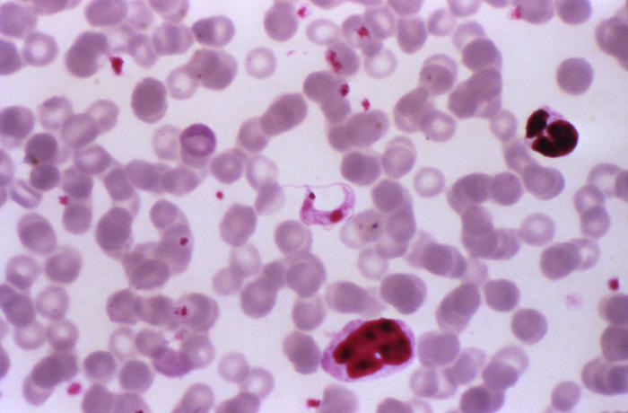
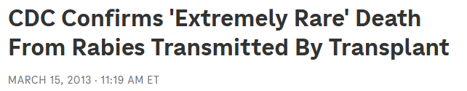
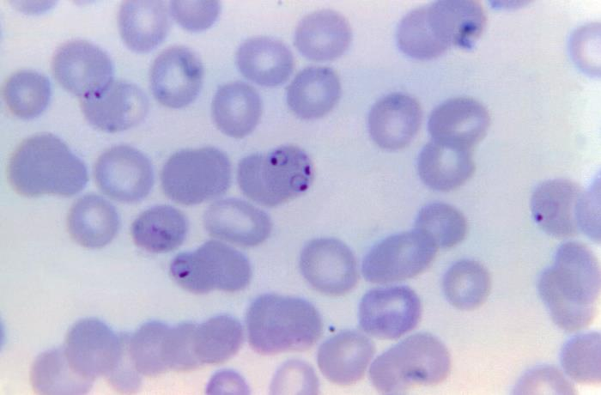
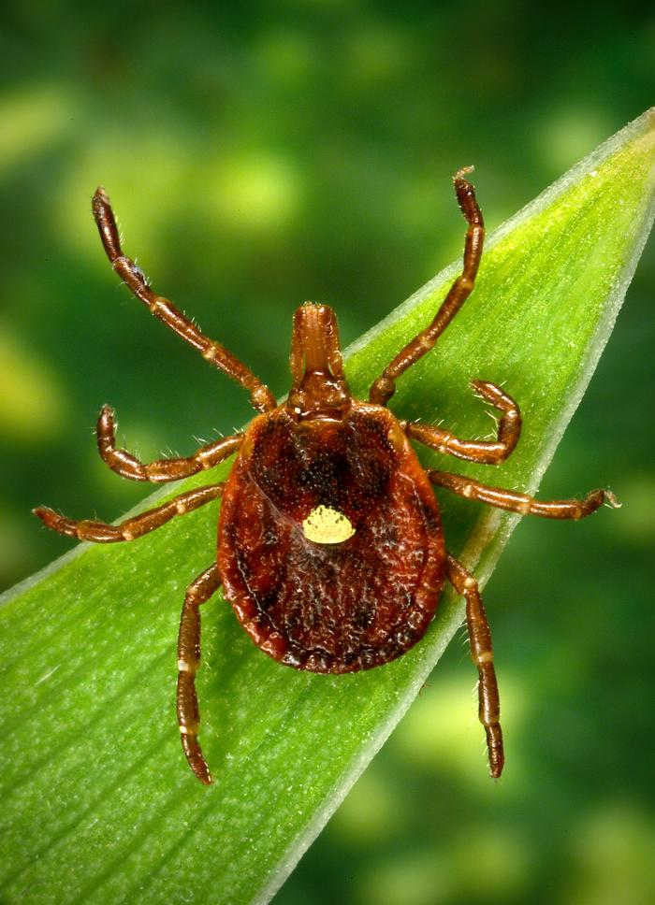
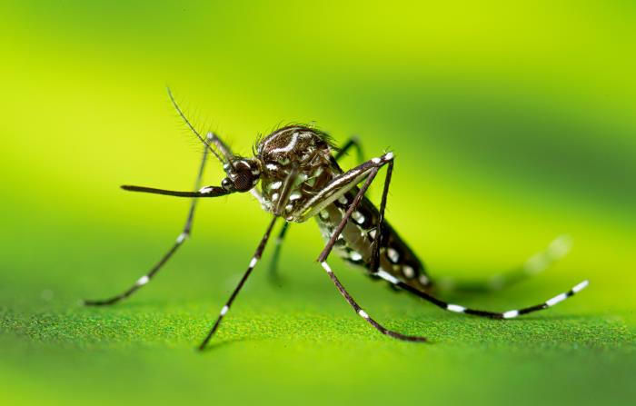
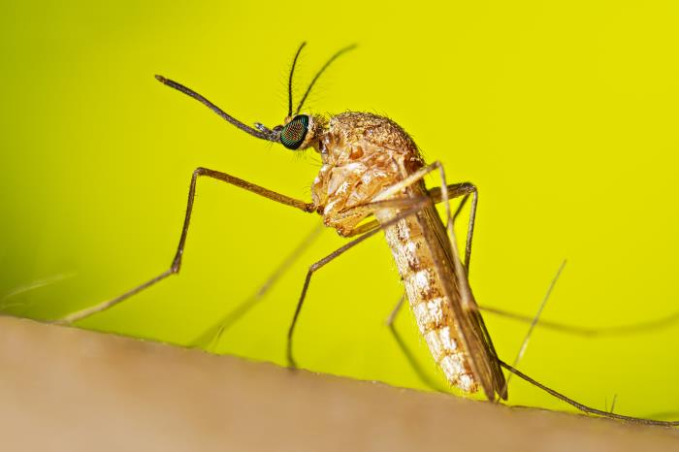
Zoonotic Transplant/Transfusion Risks
P. falciparum
Image source: https://www.npr.org/sections/thetwo-way/2013/03/15/174399689/cdc-confirms-extremely-rare-death-from-rabies-transmitted-by-transplant
T. cruzi
Aedes aegypti
Parasites: Babesia spp., Malaria (Plasmodium spp.), Leishmania spp., Chagas disease (Trypanosoma cruzi)
Viruses: Zika, dengue, chikungunya, and West Nile viruses
Bacteria: Anaplasma and Ehrlichia spp., Brucella spp.
Culex quinquefasciatus
Amblyomma americanum
Vector and pathogen photo credit: https://phil.cdc.gov/default.aspx
Notes:
There are many zoonotic diseases that pose a potential risk to blood, organ, and tissue recipients. Here you see examples of these pathogens and their vectors, including rabies, Chagas disease, malaria, babesia, leishmania, Zika, dengue, chikungunya, Anaplasma, Ehrlichia, brucella, and last but not least…West Nile!
https://phil.cdc.gov/default.aspx

Slide 38
West Nile Virus Background

Slide 39
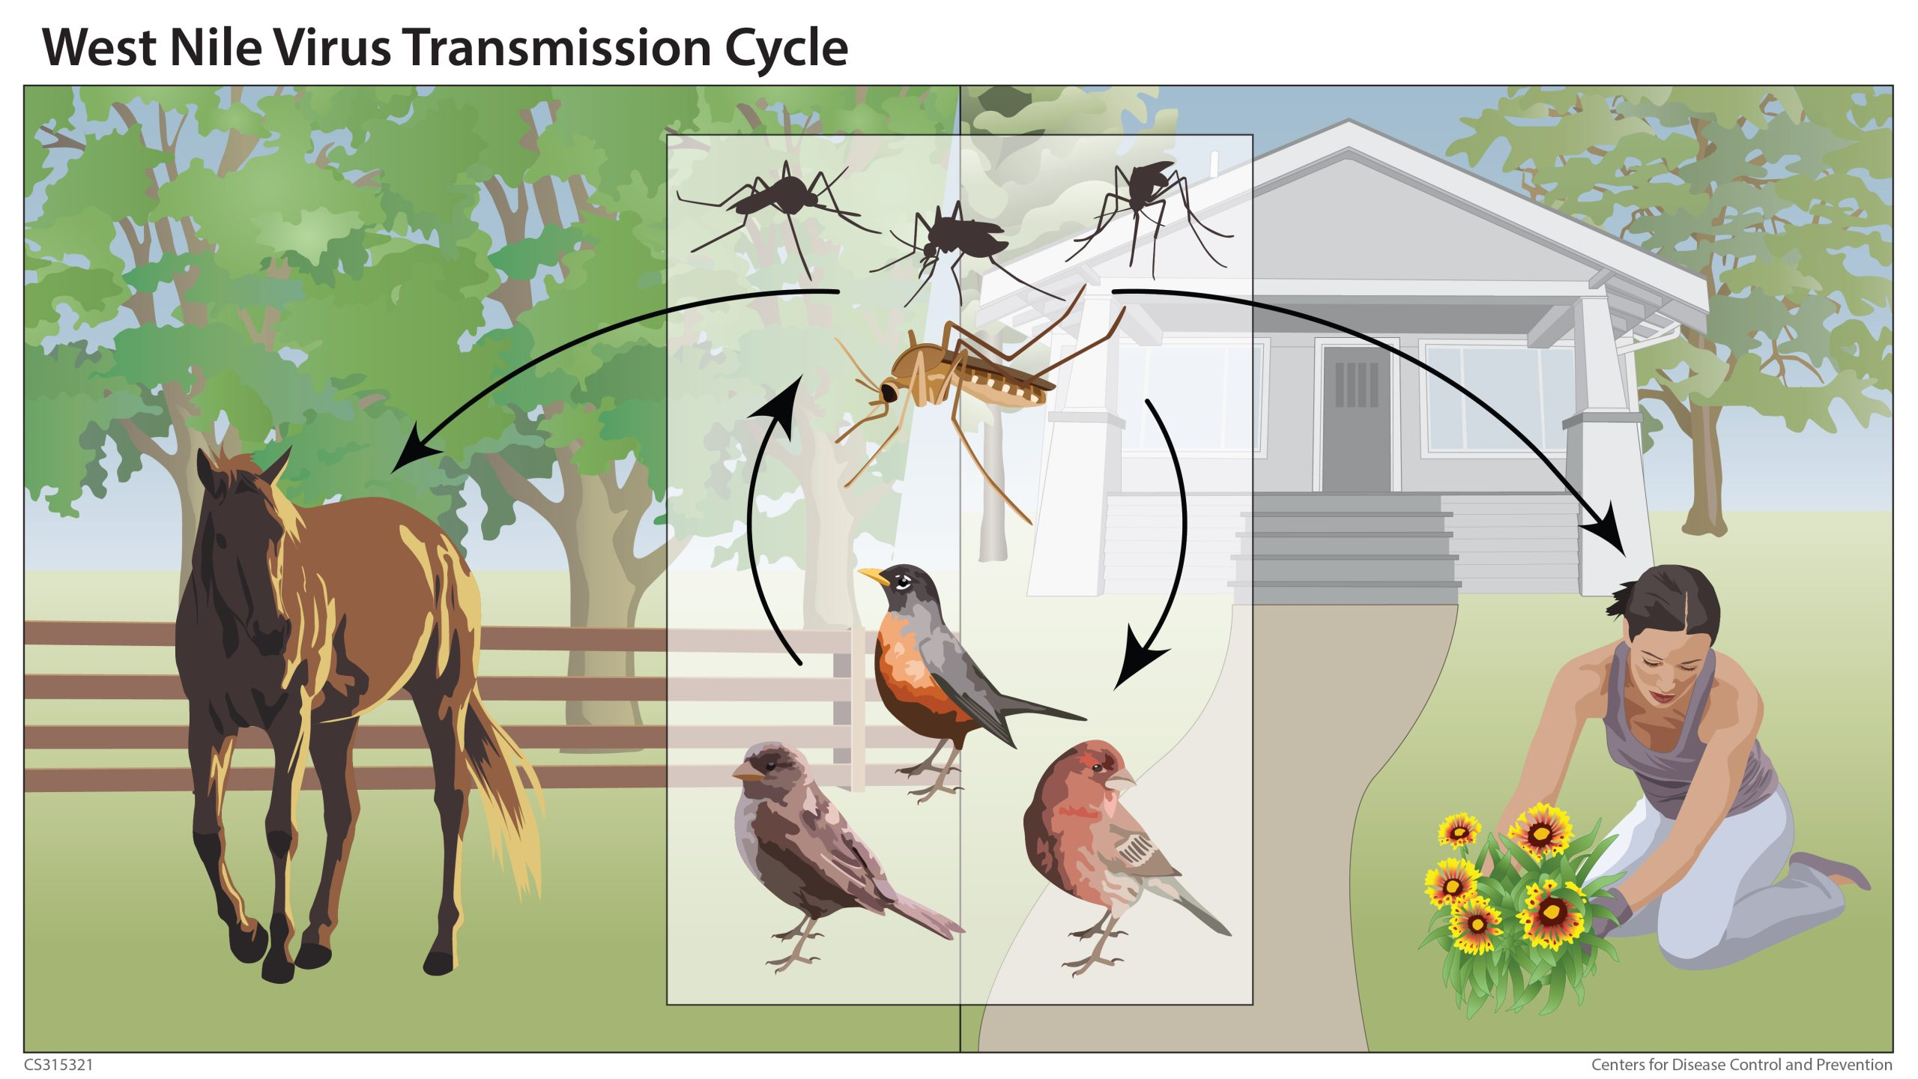
About WNV
First reported in Texas in 2002 after North American emergence in 1999 in New York
Spreads to humans through Culex species mosquito bites
1 in 150 infected develop West Nile neuroinvasive disease (WNND); 1 in 20 infected develop West Nile fever (WNF)
Immunocompromised and elderly at highest risk for severe disease
Incubation period: 2-14 days, longer in immunocompromised
Image source and reference: https://www.cdc.gov/west-nile-virus/about/index.html
Notes:
Incubation period, transmission methods, examples of past wnv organ investigations https://www.cdc.gov/west-nile-virus/about/index.html

Slide 40
Annual WNND and WNF Cases and Case Fatality Ratio (CFR) in Texas, 2015-2024*
2024 Detailed Data:
456 total cases, 363 (80%) WNND
56 WNV-caused deaths
100 WNV+ blood donors

Slide 41
Organ Transmission Investigation Process

Slide 42
Public Health Investigation Process
DSHS Zoonosis Control Branch (ZCB) Central
Positive donor result
Positive recipient result
DSHS Zoonosis Control Region(s), DSHS Healthcare Associated Infections (HAI) Central/Region
Coordinate assigned staff
Regional preference for HAI and ZCB roles – flexible!
Local Health Dept.
Contact recipients/donors
Investigation with facilities
Communicate with blood/tissue banks, OPOs
Recommend additional testing
Investigation with facilities
May serve as LHD
Report any cases meeting Epi Case Criteria
Coordinate with CDC, other states
Repeat and perform additional testing at public health laboratories to confirm recipient/donor infection & assess infection in other recipients
Identify all potentially affected recipients and determine health status
Assess risk of natural exposure and blood product and organ exposure
Notes:
KB section

Slide 43
Assessing Risk of Transmission
Organ Transmission
Minimal mosquito exposure
Genetic analysis connecting donor to recipient(s) or among recipients
Natural Transmission
Weak lab or clinical evidence in donor
Only one of multiple recipients affected
Significant mosquito exposure
A variety of test methods relevant for interpreting donor and recipient infection:
Nucleic Acid Amplification Tests (NAATs, includes PCR):
  Highly sensitive and specific
  Blood screening assays are typically many fold more sensitive than commercially available diagnostic assays (can be prone to false positives)
IgM and IgG, total antibody assays
  Not always reflective of current infection
Antigen detection assays
Notes:
KB slide

Slide 44
Organ Transmission WNV Investigation in 2024

Slide 45
Public Health Investigation
Left Kidney Recipient (LKR) clinical course
Jul 19
Left and right kidneys and liver transplanted into recipients
Aug 23
RKR CSF collected WNV PCR+ at commercial and CDC lab; serum collected WNV IgM+ at commercial lab
Oct 9
ZCB received WNV PCR-, WNV IgM+ and WNV PRNT+ results on donor, confirming infection (but not systemic viremia)
Right Kidney Recipient (RKR) clinical course
Public health action
Jun 29
Donor presented for medical care with neurological symptoms
Aug 30
Liver recipient serum WNV PCR- and IgM-
Aug 11
Right kidney recipient (RKR) onset of symptoms (encephalitis)
Oct 11
LKR serum WNV IgM- and WNV PRNT+ at CDC
Aug 29
DSHS PHR 6/5S ZC notified DSHS ZCB of RKR illness, test results, and history of transplantation
Jul 18
Donor expired from illness; WNV NAAT negative in serum via OPO pre-donation screening
Notes:
Should I include public health action steps like requesting specimens? Should be obvious after I explain general procedure

Slide 46
Public Health Investigation
Apr 1 2025
Commercial lab provided DSHS and CDC with raw sequence data from LKR 12/15/24 CSF
Dec 9
LKR onset of symptoms (encephalitis) – almost 5 months post-transplant
Dec 18
RKR expired from illness
Dec 27
LKR expired from illness
Dec 2
Liver recipient serum WNV PCR-
Dec 15
LKR serum WNV IgM+ CSF positive for WNV by metagenomic sequencing at commercial lab
Dec 18
Rabies in LKR ruled out by CDC testing/ consultation
Mar 2025
Additional analysis of 10/11/24 (pre-onset) LKR serum revealed low-level viremia
Dec 13
ZCB notified of LKR illness through provider request for rabies consultation with CDC

Slide 47
Investigative Conclusions

Slide 48
Genetic Analysis and Conclusions
Recipient | Testing lab | Specimen type | Collection date | Total reads | Length of assembled reads (% of genome) | Similarity to LKR 12/15/24 CSF sequence
Right Kidney Recipient | CDC | CSF | 8/23/24 | 4900 | 9115 nucleotides (88.3%) | 98.8%
Left Kidney Recipient | CDC | Serum | 10/11/24* | 257 | 687 nucleotides (8.8%) | 100%
 | CDC | Serum | 12/14/24 | 2 | 150 nucleotides (1.3%) | 0% (no overlap, small read)
 | Commercial | CSF | 12/15/24 | 102 | 2860 nucleotides (25.4%)** | N/A
*In March 2025, CDC did re-analyzed this 10/11/24 serum specimen and detected a new result of a low-level viremia in the LKR two months prior to symptom onset!
**This commercial lab was cooperative with our request to share the raw sequence data from their Next Generation Sequencing (NGS) result of WNV in the LKR; the original specimen was not available for CDC testing.
Notes:
The two kidney recipients each had specimens at CDC (Left kidney had two), and one recipient was also tested at Mayo Labs with a next-gen sequencing result of WNV in CSF. In March, CDC did additional PCR and sequencing work and detected a new result of a low-level viremia in the left kidney recipient’s serum from 10/11/24*.
CDC lab staff were able to generate partial genomes for each recipient, and the WNV strains detected in both were highly related as they differ from most similar strain available in BLAST (a public repository of sequenced genomes) at consistent nucleotides.
There were 5 nucleotide positions that distinguish the two recipients’ partial WNV sequences from each other, with one of these changes resulting in an amino acid change in NS5 (an antigen portion of the virus). This suggests that these WNV strains come from a common origin and the few changes are a result of replication in the individual patients. However, this interpretation is limited by the small amount of sequence data from the L kidney serum sample.
Because the 10/11/24 serum was slightly viremic for WNV, the L kidney recipient asymptomatically harbored a subclinical infection detected almost 3 months after transplant, and subsequently became symptomatic 5 months after transplant. This is unusual based on the existing limited published data on similar cases, but there are many factors at play with regard to the immunosuppression of this patient (as organ recipients are strongly immunosuppressed).
In addition, Mayo Labs was cooperative with our request to share the sequence data file** they have for the specimen they tested, so that CDC could analyze their own sequence data in that context.
The table below demonstrates the comparison of the Mayo data on the Left kidney recipient’s CSF to the other left kidney specimen and the right kidney recipient specimen. These data demonstrate strong relatedness among the different sequenced specimens and reinforces the conclusion that the best explanation for the two organ recipients’ exposure to WNV is from the transplanted kidneys, not natural infection.
What this all means is that we have a clear infection source and transmission mode identified for the two WNV cases in the organ recipients. The two recipients’ cases have been approved in NEDSS for 2024, and we have updated the transmission modes to reflect this new conclusion.
Also, the other person who received an organ (liver) from the same donor has continued to test negative and remain healthy. The limited number of similar cases like this in the literature make it difficult to say definitively why, but it is worth noting that this is not the first verified organ-derived WNV case we have investigated that is specific to donated kidneys. I’m sure additional research will shed more light on this one day.

Slide 49
Investigative Conclusions
Both kidney recipients and donor had confirmed WNND; the donor passed NAAT-only screening for WNV. Both the donor and recipients had potential natural exposure to mosquitoes. The liver recipient remained uninfected and well.
Left kidney recipient harbored subclinical low-level WN viremia at least 2 months prior to onset; onset was 5 months post-transplant, the longest documented incubation period for a kidney-derived WNV transmission event.
The WNV strains in each kidney recipient were highly related based on genetic analysis and comparison to public WNV genomic data. The small changes between the strains are better explained by replication of the virus in each patient than by two separate natural infection events.

Slide 50
Conclusions
Investigation Conclusion
Strong lab and epidemiological evidence of transplantation transmission from donor to two recipients, despite pre-donation NAT screening
Limitations
Difficulty in obtaining sufficient molecular data to generate conclusions
Difficulty obtaining autopsy specimens for analysis
Time spent ruling out an unlikely etiology of rabies
WNND not a differential despite neurological illness in WNV season in endemic region
Notes:
We concluded that this was transplantation transmission of WNV despite the use of donor NAT screening. Limitations included difficulty obtaining kidney biopsies and a lack of donor CSF collection to provide more detailed diagnostics.
WNV was not considered a differential diagnosis by the donor’s medical team despite his neurological illness and the strong endemicity of WNV in Texas.
The donor’s serum viremia was also below the limit of detection for the screening NAT used by the OPO. Therefore, we suggest that both WNV IgM and NAT are used to screen organ donors with unexplained neurological illness during WNV season.
We recommend maintaining investigation guidance documents and tools to streamline your response in similar cases.
Continued research into the risk of organ transmission of WNV is ongoing and necessary.

Slide 51
Future Recommendations
Considerations
Evaluate by IgM and NAAT for WNV for unexplained neurological illness during WNV season (medical teams and OPOs)
Public health depts. should maintain investigation guidance and tools (line list templates, checklists) to streamline investigations with CDC, OPOs, and blood banks
Continued research into risk of organ transmission of WNV (organ sequestration, screening assay limitations, etc.)
Notes:
We concluded that this was transplantation transmission of WNV despite the use of donor NAT screening. Limitations included difficulty obtaining kidney biopsies and a lack of donor CSF collection to provide more detailed diagnostics.
WNV was not considered a differential diagnosis by the donor’s medical team despite his neurological illness and the strong endemicity of WNV in Texas.
The donor’s serum viremia was also below the limit of detection for the screening NAT used by the OPO. Therefore, we suggest that both WNV IgM and NAT are used to screen organ donors with unexplained neurological illness during WNV season.
We recommend maintaining investigation guidance documents and tools to streamline your response in similar cases.
Continued research into the risk of organ transmission of WNV is ongoing and necessary.

Slide 52
Resources
https://www.dshs.texas.gov/mosquito-borne-diseases/dshs-arbovirus-weekly-activity-reports
https://unos.org/transplant/improving-organ-procurement-and-oversight/
https://www.cdc.gov/west-nile-virus/causes/organ-transplantation.html
https://www.cdc.gov/west-nile-virus/hcp/clinical-signs/possible-persistence.html
http://www.donorsmatter.pitt.edu/unit-1/federal-regulations
https://wwwnc.cdc.gov/eid/article/28/2/21-1697_article
DSHS ZCB and HAI team joint SOP and tools for organ and blood/tissue-based investigations; check with your Regional ZC team for these documents!

Slide 53
Thank You!
Acknowledgements:
DSHS Region 6/5
DSHS Region 4/5N
DSHS Region 2/3
Brazoria County Health Dept
Harris County Public Health
CDC Arbovirus and Blood and Tissue Teams
DSHS ZCB Colleagues
Kelly.broussard@dshs.texas.gov
Notes:
I would like to thank all the fellow epidemiologists and investigators in Texas and at CDC who worked on this unique and challenging case. Thank you for your time!

Slide 54
Uncovering Candida auris:
A Targeted Surveillance Effort in an Acute Care Hospital
Kylie Reckinger, MPH
High Consequence Infectious Disease
July 2025

Slide 55

Discuss outbreak and public health interventions with Candida auris in a Tarrant County acute care hospital (ACH)
Address public health priorities and implement proactive strategies
Understand the purpose of a point prevalence survey (PPS)

Slide 56
Definitions
Healthcare Acquired Infection* (HAI): An infection that occurs on or after the 3rd calendar day of an admission to an inpatient facility where admission occurs the 1st calendar day
Colonization: A patient that has C. auris on their skin and other body sites without experiencing symptoms. This test uses an E-swab and is a composite, bilateral axilla and groin swab.
Infected (clinical): A patient that has C. auris isolated from inside the body (blood, wound, urine, etc.) and is symptomatic
Contact: Any person(s) that was on the same unit, floor, or care area as the index patient. Patients that receive care from the same healthcare personnel or are exposed to common mobile medical equipment as the index patient
Point Prevalence Survey (PPS): A research method that measures the proportion of individuals in a population who have a disease in a particular point in time
ACH- Acute Care Hospital
*NHSN definition

Slide 57

Candida auris Overview
Candida auris (C. auris) is a multidrug resistant yeast that can cause life-threatening infections
Highly transmissible in healthcare settings
Transmitted via contact with patients who are colonized or infected with C. auris or contact with surfaces like bed rails, doorknobs, IV poles, etc.
Patients diagnosed with C. auris need to be placed in contact isolation
  Gown and gloves
Colonization diagnosis is for life
  Clinical infections can resolve
  Retesting is not recommended
Clean with EPA list P
  List K (C. difficile) as a back up
Identification of C. auris | Candida auris (C. auris) | CDC

Slide 58

PPS Cadence
Screening every 2 weeks until 2 screenings are completed with no positives
If no positives, screen again in 4 weeks
If no positives again, final screen is 4 weeks later
If there are positives at any point, screening starts over

Slide 59
Timeline of Events
Dec 2023
Index patient has a positive blood culture for C. auris
Jan 2024
Feb 2024
TCPH notifies ACH that a contact has screened positive at another facility
May 2024
TCPH is notified and contact tracing begins
TCPH conducts an ICAR with PHR 2/3
June 2024
Oct 2024
Jan 2025
ACH implements EPA List P products for entire network
Admission screening tool goes live
Screening is postponed due to lab bandwidth and operational challenges
3 units selected for screening (64, 26, 36)
Screening resumes with new selection criteria (9 units, 50 total patients)
Aug 2024
ACH and TCPH meet to discuss setbacks and challenges; rounded with IP’s
Feb 2025
6 units test out!
Another unit tests out
April 2025
Another unit tests out
June 2025
Testing resumes and all 26 beds on last unit are screened
PPS officially begins with DSHS lab
ACH and TCPH meet to discuss new screening and targeted strategies
May 2025
Screenings are postponed
Sept 2024
July 2024
ACH presents additional logistical difficulties

Slide 60

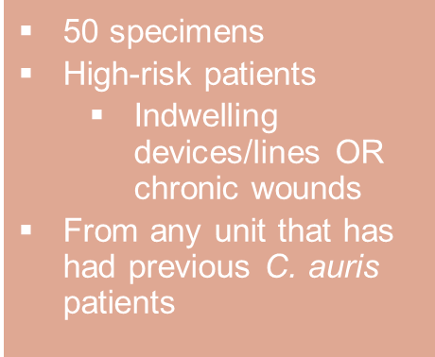
Timeline of Events
Dec 2023
Index patient has a positive blood culture for C. auris
Jan 2024
Feb 2024
TCPH notifies ACH that a contact has screened positive at another facility
May 2024
TCPH is notified and contact tracing begins
TCPH conducts an ICAR with PHR 2/3
June 2024
Oct 2024
Jan 2025
ACH implements EPA List P products for entire network
Admission screening tool goes live
Screening is postponed due to lab bandwidth and operational challenges
3 units selected for screening (64, 26, 36)
Screening resumes with new selection criteria (9 units, 50 total patients)
Aug 2024
ACH and TCPH meet to discuss setbacks and challenges; rounded with IP’s
Feb 2025
6 units test out!
Another unit tests out
April 2025
Another unit tests out
June 2025
Testing resumes and all 26 beds on last unit are screened
PPS officially begins with DSHS lab
ACH and TCPH meet to discuss new screening and targeted strategies
May 2025
Screenings are postponed
Sept 2024
ACH presents additional logistical difficulties
  CDC Data & Risk Factors
  Breathing tubes
  Feeding tubes
  Catheters
  TCPH Data
  >90% of cases had an indwelling device/wound (within 6 months) & Immunocompromised
+

Slide 61
PPS Patient Results
February 2024 - June 2025
Total Patients Screened
1,046 patients
Gender
7 female
34 patients
27 male
Average Age
Average Admission Length
35.8 days
58 years old
Positive Cases

Slide 62
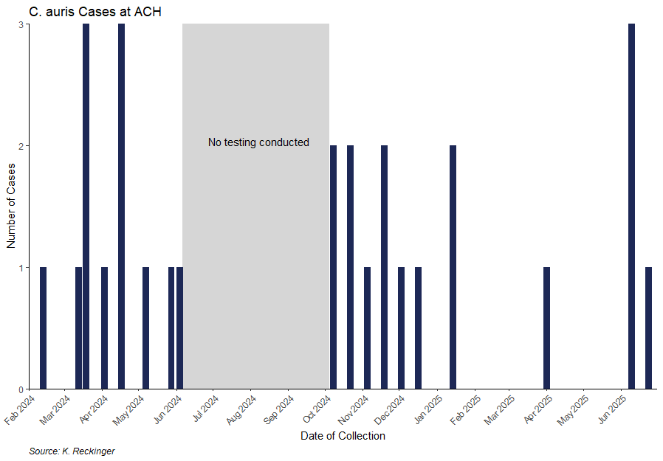
PPS Patient Results

Slide 63
PPS Challenges
Staff turnover
Transient patient population in ACH
Lab bandwidth
Screening fatigue
Staff noncompliance/ inconsistent EVS practices

Slide 64
Applied Solutions
Facility Actions
Implemented a customized admission screening tool
Prioritized high-risk patients and expanded screening to target key units
Increased frequency of rounding
Shared screening results with internal leadership
Public Health Support
Held bi-monthly meetings with IP team
Collaborated with PHR 2/3 for timely lab results and reporting
Ensured communication of positive cases between facilities
Proactively provided facilities in outbreak

Slide 65
Key Takeaways
Maintain flexibility
Embrace open communication and transparency
Foster multidisciplinary collaboration
Continue proactive approach

Slide 66
Acknowledgements
ACH IP’s and Lab
DSHS PHR 2/3
DSHS Lab
TCPH Collaborators

Slide 67
References
About C. auris | Candida auris (C. auris) | CDC
EPA’s Registered Antimicrobial Products Effective Against Candida auris [List P] | US EPA
Identifying HAIs for NHSN Surveillance
Screening Recommendations for Healthcare Facilities | Candida auris (C. auris) | CDC
Identification of C. auris | Candida auris (C. auris) | CDC

Slide 69
Thank you!
Healthcare-Associated Infections (HAI)-Lights From The Field
Karen Nunez, MS, MPH, CIC, Angel Guevara, MS, MPH, CIC, Kourtney Lopez, MPH, CIC, Kelly Broussard, MPH, Kylie Reckinger, MPH

