Slide 1
Respiratory Syncytial Virus and life saving interventions
Rama Thyagarajan, MD, MPH, FIDSA, CIC
Associate Professor, Dell Medical School
Department of Internal Medicine
July 23, 2025

Slide 2
Objectives
Attendees should be able to
Describe epidemiology and clinical symptoms of Respiratory syncytial virus (RSV) related illness in different populations
Understand the role of monoclonal antibodies and vaccines in reducing serious illness, hospitalizations and death due to RSV
Promote targeted RSV prevention efforts in high-risk groups both in health care and community settings

Slide 3
Disclosures and Conflicts of interest
None

Slide 4
Describe epidemiology and clinical symptoms of RSV related illness in different populations

Slide 5
Epidemiology
Annual global estimates of RSV illness
-33.1 million cases of lower respiratory tract infections ( LRTI) in < 5 yr olds
-3 million hospitalizations ( < 5 yr olds)
-RSV is second leading cause of death in infants ( between 1-12 months), 99% in low- and middle-income countries
Colosia A, et al . Systematic literature review of the signs and symptoms of respiratory syncytial virus. Influenza Other Respir Viruses. 2023
Fujiogi M, et al. Trends in bronchiolitis hospitalizations in the United States: 2000-2016. Pediatrics 2019
Dalziel SR, et al. Bronchiolitis. Lancet 2022;400:392-406.
Shi T,,et al. Global, regional, and national disease burden estimates of acute lower respiratory infections due to respiratory syncytial virus in young children in 2015: a systematic review and modelling study. Lancet 2017
Mazur NI, P, et al . Respiratory syncytial virus prevention within reach: the vaccine and monoclonal antibody landscape. Lancet Infect Dis. 2023 Jan;

Slide 6
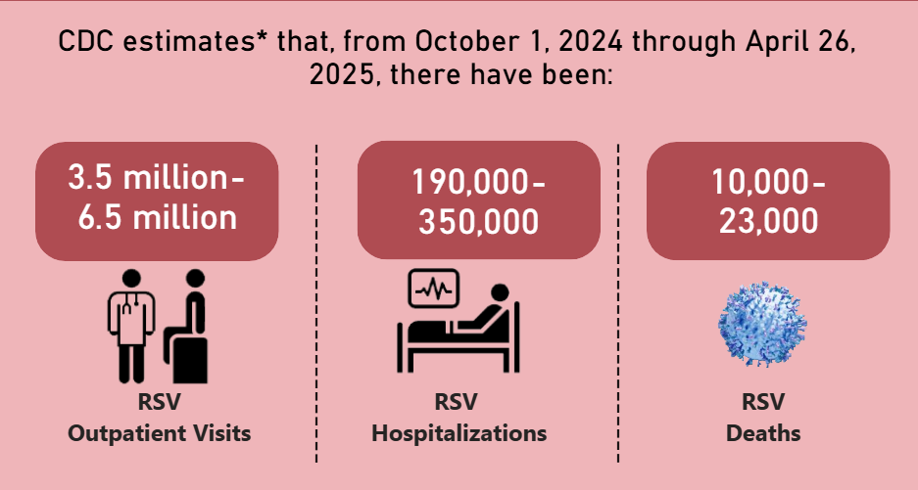
Epidemiology of RSV in US
https://www.cdc.gov/rsv/php/surveillance/burden-estimates.html

Slide 7
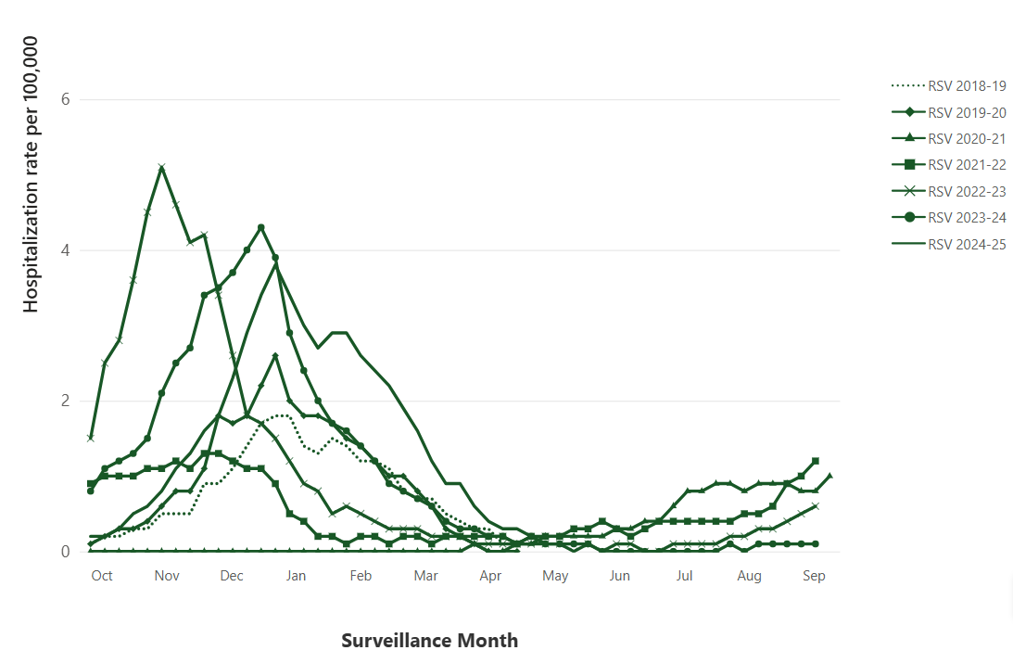
Seasonal variation
https://www.cdc.gov/resp-net/dashboard/

Slide 8
RSV Epidemiology in children (US)
Approximately 58,000–80,000 RSV-associated hospitalizations; 100–300 RSV-associated deaths occur annually among U.S. children aged <5 years
RSV is a common cause of LRTI in U.S. infants, leading cause of hospitalization among U.S. infants ( < 6 months of age) with 2% to 3% of ALL young infants hospitalized for RSV disease
An estimated 79% of children aged <2 years hospitalized with RSV had no underlying medical conditions
Fleming-Dutra KE, et al . Use of the Pfizer Respiratory Syncytial Virus Vaccine During Pregnancy for the Prevention of Respiratory Syncytial Virus–Associated Lower Respiratory Tract Disease in Infants: Recommendations of the Advisory Committee on Immunization Practices — United States, 2023. MMWR Morb Mortal Wkly Rep

Slide 9
Clinical symptoms in infants
Nasal stuffiness, runny nose, cough, fever, difficulty breathing and difficulty feeding
In severe cases infants may present with severe breathing difficulty, blue discoloration of lips and extremities and may stop breathing completely
Colosia A, et al. Systematic literature review of the signs and symptoms of respiratory syncytial virus. Influenza Other Respir Viruses. 2023 Feb; Oppenlander KE, et al. Respiratory Syncytial Virus Bronchiolitis: Rapid Evidence Review. Am Fam Physician. 2023 Jul

Slide 10
Clinical symptoms in children
Cough, nasal stuffiness, fever, wheezing and difficulty breathing are common symptoms
Bronchiolitis is the most common presentation when kids have increased work of breathing, poor oral intake, wheezing on exam
Children older than 5 yrs have milder symptoms with runny nose, sore throat, cough without fevers but can get wheezing in kids with asthma or other health conditions
Colosia A, et al. Systematic literature review of the signs and symptoms of respiratory syncytial virus. Influenza Other Respir Viruses. 2023 Feb: Oppenlander KE, et al. Respiratory Syncytial Virus Bronchiolitis: Rapid Evidence Review. Am Fam Physician. 2023 Jul

Slide 11
RSV Epidemiology in adults (US)
3-7% of community living adults > 60 yrs of age experience RSV infection annually
About 136,000 hospitalizations among adults 65 and older occur annually
Wildenbeest JG, et al. Respiratory syncytial virus infections in adults: a narrative review. Lancet Respir Med. 2024; Havers FP et al. Burden of Respiratory Syncytial Virus–Associated Hospitalizations in US Adults, October 2016 to September 2023. JAMA Netw Open. 2024

Slide 12
Clinical symptoms – Adults
Cough, runny nose, sore throat, fever, fatigue
In adults > 60 years and those with comorbidities
  Symptoms may progress to lower respiratory tract involvement, pneumonia, mechanical ventilation
  RSV like other viral infections exacerbate underlying cardiopulmonary disease
Symptoms last for 3-7 days but usually longer for infants, older adults and immunocompromised individuals
Coultas JA et al. Respiratory syncytial virus (RSV): a scourge from infancy to old age. Thorax. 2019 Oct: Nam HH, et al . Respiratory syncytial virus infection in adults. BMJ. 2019 Sep.

Slide 13
RSV in immunocompromised
Individuals are immunocompromised
- Cancers, organ/bone marrow transplants
- Medications that suppress the immune system like prednisone, biologics
- Immune conditions like Lupus
Typically presents with cough, difficulty breathing, sputum production and fever rapidly progress to pneumonia ( 44%) and respiratory failure ( 28%).
They shed the virus longer , have more complications ( ICU stay, mechanical ventilation and death)
Average length of stay ( 9-15 days)
Loubet P, et al. Clinical characteristics and outcome of respiratory syncytial virus infection among adults hospitalized with influenza-like illness in France. Clin Microbiol Infect. 2017; Celante H, et al. Prono-RSV study group of the clinical data warehouse of Greater Paris University Hospitals. Prognosis of hospitalised adult patients with respiratory syncytial virus infection: a multicentre retrospective cohort study. Clin Microbiol Infect. 2023; Wildenbeest JG, et al. Respiratory syncytial virus infections in adults: a narrative review. Lancet Respir Med. 2024

Slide 14
Understand the role of monoclonal antibodies and vaccines in reducing serious illness and death due to RSV

Slide 15
Palivizumab
Monoclonal antibody that needs five monthly injections
Indicated for preterm ( < 35 weeks), infants with congenital heart disease or lung disease
Impact RVS trial - RSV related hospitalization decreased by 55% ( 10.6% in placebo group and 4.8% in Palivizumab group)
CHD trial reduced hospitalization by 45% ( 9.7% in placebo and 5.3% in Palivizumab group)
NIH Daily Med on Palivizumab

Slide 16
Nirsevimab
Injectable Monoclonal antibody (long acting) with passive protection for
5 months ( Beyfortis)
Preformed antibodies that bind to F protein site and prevents RSV from multiplying in the body
FDA approval in July 2023 based on 3 clinical trials showing 70% reduction in RSV lower respiratory tract infection
Anaphylaxis/rash reported
Used between October to March ( RSV season)
Potential risk of preterm birth and hypertension in pregnancy ( being monitored)
Assad Z, et al. Nirsevimab and Hospitalization for RSV Bronchiolitis. N Engl J Med. 2024 Jul; FDA approval of Monoclonal antibodies for RSV prevention

Slide 17
Nirsevimab indications
1. Infants aged <8 months born ( injection within one week of birth) during or entering their first RSV season
  - whose mother did not receive RSVpreF vaccine
  - whose mother’s receipt of RSVpreF vaccine is unknown,
  - or who were born <14 days after maternal vaccination.
  2. Infants and children aged 8–19 months who are at increased risk for severe RSV disease and are entering their second RSV season are recommended to receive Nirsevimab regardless of maternal RSVpreF vaccination
Age in months | Dosage of intramuscular Nirsevimab
< 8 | 50 mg ( weight < 11 lbs., 100 mg if weight > 11 lbs.)
8-19 | 200 mg as 2 injections , different sites

Slide 18
Nirsevimab and RSV hospitalization
Nirsevimab was given free of charge to all infants born after Feb 2023 (French study 2023-24 RSV season)
Prospective, multicenter, matched case–control study ( Oct 15-Dec 10, 2023)
Analysis of Nirsevimab effectiveness therapy against hospitalization for RSV-associated bronchiolitis in infants younger than 12 months of age.
Matching infants ( <12 months) with RSV in hospital with matched controls who were admitted for non-RSV related illness ( 2:1 match)
1035 infants ( 690 case ( 3.1-month median age) and 345 controls ( 3.4 months median age)
Assad Z, et al . Nirsevimab and Hospitalization for RSV Bronchiolitis. N Engl J Med. 2024 Jul

Slide 19
Nirsevimab and RSV hospitalization
60 cases (8.7%) and 97 ( 28.1%) control had received Nirsevimab
The estimated effectiveness of Nirsevimab therapy
Hospitalization for RSV-associated bronchiolitis - 83.0%
RSV-associated bronchiolitis resulting in critical care - 69.6%
RSV-associated bronchiolitis resulting in ventilatory support- 67.2%
Assad Z, et al . Nirsevimab and Hospitalization for RSV Bronchiolitis. N Engl J Med. 2024 Jul

Slide 20
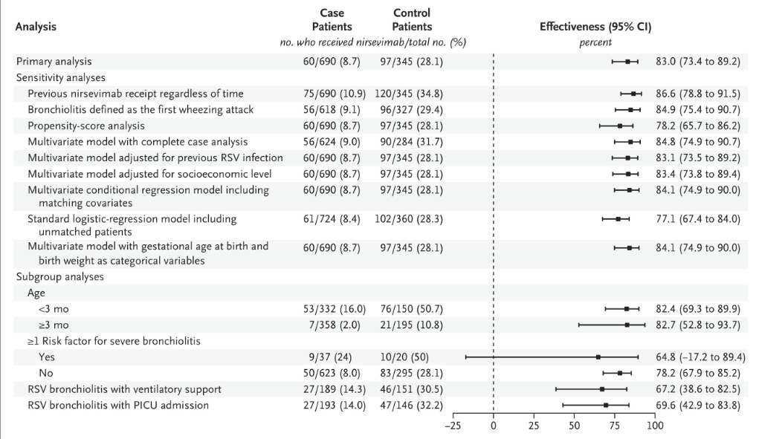
Assad Z, et al Nirsevimab and Hospitalization for RSV Bronchiolitis. N Engl J Med. 2024 Jul

Slide 21
Palivizumab vs Nirsevimab
Nirsevimab ( Beyfortis) for all infants is more cost effective in comparison to Palivizumab (Synagis) for high-risk infants
Broader eligibility
More convenient dosing ( 1 vs 5 injections)
Higher and more sustained neutralizing antibody levels
Comparable efficacy and safety.
NIH Daily Med on Palivizumab; Bini C, Marcellusi A, et al . Cost-Effectiveness Analysis of Nirsevimab for the Prevention of Respiratory Syncytial Virus among Italian Infants. Clin Drug Investig. 2025 Jul

Slide 22
Clesrovimab
Long-acting monoclonal antibody lasting for 5 months
FDA approval June 9, 2025, based on Merck data
Not approved by ACIP yet
Reduced incidence of RSV-associated medically attended LRTI by 60.5% (95% CI: 44.2, 72.0, p<0.001) (incidence rates: Clesrovimab, 0.026; placebo, 0.065).
Reduced RSV-associated hospitalizations through 5 months 84.3% (95% CI: 66.7, 92.6, p<0.001) (incidence rates: Clesrovimab, 0.004; placebo, 0.024)
Comparable to Pazulizumab
https://www.merck.com/news/u-s-fda-approves-mercks-enflonsia-clesrovimab-cfor-for-prevention-of-respiratory-syncytial-virus-rsv-lower-respiratory-tract-disease-in-infants-born-during-or-entering-their-fir/

Slide 23
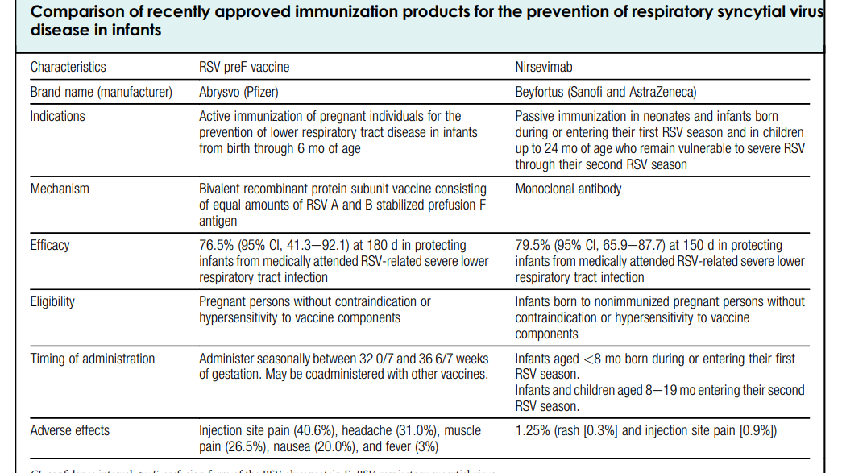
Society for Maternal-Fetal Medicine. Joseph NT, et al. Society for Maternal-Fetal Medicine Statement: Clinical considerations for the prevention of respiratory syncytial virus disease in infants. Am J Obstet Gynecol. 2024

Slide 24
Maternal vaccine
September 2023, ACIP and CDC recommended RSVpreF vaccine ( Abrysvo)
Indications
- Pregnant persons 32–36 weeks’ gestation (September–January in most of the continental United States) to prevent RSV-associated lower respiratory tract infection (LRTI) in infants.
- Either maternal RSVpreF vaccination during pregnancy or Nirsevimab administration to the infant is recommended to prevent RSV-associated LRTI in infants, but both are not needed for most infants.
Fleming-Dutra KE, et al . Use of the Pfizer Respiratory Syncytial Virus Vaccine During Pregnancy for the Prevention of Respiratory Syncytial Virus-Associated Lower Respiratory Tract Disease in Infants: Recommendations of the Advisory Committee on Immunization Practices - United States, 2023. MMWR Morb Mortal Wkly Rep. 2023

Slide 25
Maternal vaccine
Bivalent recombinant protein subunit vaccine , single IM dose , 32-36 weeks of gestation ( during RSV season)
Maternal antibodies, provide passive immunity to babies for 6 months of life, protection may fade after 3 months
Fleming-Dutra KE, et al . Use of the Pfizer Respiratory Syncytial Virus Vaccine During Pregnancy for the Prevention of Respiratory Syncytial Virus-Associated Lower Respiratory Tract Disease in Infants: Recommendations of the Advisory Committee on Immunization Practices - United States, 2023. MMWR Morb Mortal Wkly Rep. 2023

Slide 26
Adult non pregnant RSV vaccination
Single dose of intramuscular vaccine
All adults >75
Adults 60-75 ( comorbidities)
Arexvy (GSK),Abrysvo (Pfizer), and mResvia (Moderna) are three approved vaccines.
mResvia is a mRNA vaccine and other protein subunit vaccines
Side effects mostly mild, similar rates as in placebo
FDA/CDC are monitoring potential increased risk of Guillain Barre syndrome ( a neurologic condition with muscle weakness ). Estimates of 10 excess cases for 1 million senior vaccinations.
Rarity of GBS and significant risk of RSV related complications in age > 74 must be balanced
https://www.cdc.gov/vaccine-safety/vaccines/rsv.html

Slide 27
Safety
RSV vaccines are safe, can be co-administered with other vaccines
Report adverse events to Vaccine Adverse Event Reporting System (VAERS). Report any clinically significant adverse event even if causation uncertain at https://vaers.hhs.gov/index.html or by telephone at 1-800-822-7967.
Public and caregivers are encouraged to report to CDC’s V Safe program
Nirsevimab safety
Adverse reactions to nirsevimab may be reported to MedWatch online (https://www.fda.gov/medwatch), by fax, by mail, or by contacting FDA at 1-800-FDA-1088.
CDC Vaccine safety system resources link https://www.cdc.gov/vaccine-safety-systems/resources/index.html
https://www.cdc.gov/mmwr/volumes/72/wr/mm7241e1.htm?s_cid=mm7241e1_w

Slide 28
Promote targeted RSV prevention efforts in high-risk groups both in health care and community settings

Slide 29
Promote targeted preventive therapy in high-risk groups both in health care and public health settings
Goal is to maximize protection during highest vulnerability to infants tailored to timing of birth and local RSV season
Public Health
Health care provider
Community Organizations

Slide 30
Role of public health - Education
1. Healthcare Provider education
  -Availability and efficacy
  -Recommendations and position statements of professional societies like Maternal-Fetal medicine, American Association of Pediatrics guidelines, CDC etc.,
  2. Education of pregnant persons and infant caregivers- timing, availability, benefits and safety of vaccine
  3. Public health campaigns to prioritize high risk populations and facilitate provider training

Slide 31
Role of public health – Policy implementation
Ensure guidelines from professional societies ( American Association of Pediatrics and Society of Maternal Fetal Medicine) are integrated into clinical practice
Advocate for inclusion of these preventive measures into routine prenatal and pediatric care.
Integrating RSV prevention into prenatal and Peds workflow- prompts in EHR standardize vaccine availability in OB clinic
Facilitate Nirsevimab in high risk/underserved areas before hospital discharge

Slide 32
Role of public health – Remove barriers to access
Provider hesitancy and lack of familiarity is a major barrier to access. Coordinating with health care providers to ensure high risk populations ( preterm infants and those with health conditions) receive appropriate prophylaxis
Access to vaccine and Nirsevimab in high-risk infants
Address logistical challenges to administration
Facilitate reporting of adverse events to vaccine and monoclonal antibodies

Slide 33
Role of public health – Remove barriers to access
Ensure product availability
Monitor insurance coverage
Communication tools to address parenteral/caregiver concerns about adverse effects, long term safety for infants, uncertainly about side effects, choice of vaccine vs monoclonal antibody, perception that immunization is too new
Target strategies to address high risk groups- non-English speaking, low health literacy, black and Hispanic etc.,

Slide 34
Role of public health –Monitoring impact
  Play a key role in monitoring the impact of the preventive strategies
  - CDC RSV associated hospitalization network ( RSV-NET)
  - New Vaccine Surveillance Network (NVSN)
  Communicate the impact to providers and target population

Slide 35
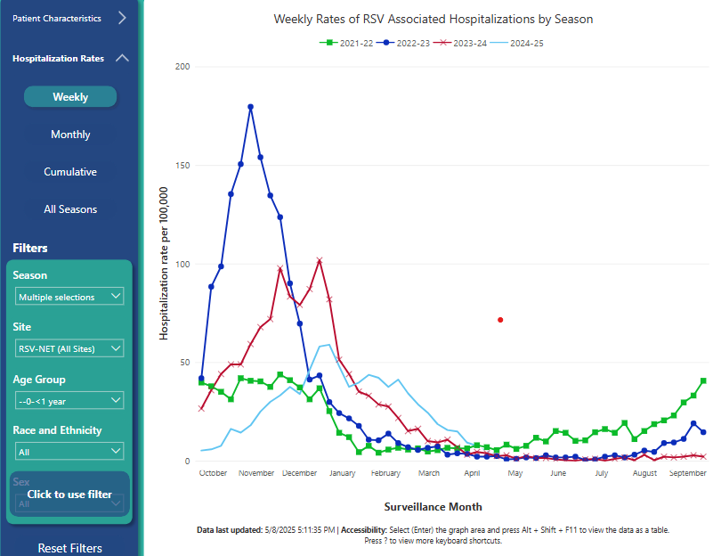
Patton ME, et al. Interim Evaluation of Respiratory Syncytial Virus Hospitalization Rates Among Infants and Young Children After Introduction of Respiratory Syncytial Virus Prevention Products — United States, October 2024–February 2025. MMWR Morb Mortal Wkly Rep 2025;

Slide 36
References
Patton ME, Moline HL, Whitaker M, et al. Interim Evaluation of Respiratory Syncytial Virus Hospitalization Rates Among Infants and Young Children After Introduction of Respiratory Syncytial Virus Prevention Products — United States, October 2024–February 2025. MMWR Morb Mortal Wkly Rep 2025;
Fleming-Dutra KE,. Use of the Pfizer Respiratory Syncytial Virus Vaccine During Pregnancy for the Prevention of Respiratory Syncytial Virus-Associated Lower Respiratory Tract Disease in Infants: Recommendations of the Advisory Committee on Immunization Practices - United States, 2023. MMWR Morb Mortal Wkly Rep. 2023 Oct 13;
Jones JM, Use of Nirsevimab for the Prevention of Respiratory Syncytial Virus Disease Among Infants and Young Children: Recommendations of the Advisory Committee on Immunization Practices - United States, 2023. MMWR Morb Mortal Wkly Rep. 2023 Aug 25

Slide 37
References
Society for Maternal-Fetal Medicine. Electronic address: pubs@smfm.org; Joseph NT, Kuller JA, Louis JM, Hughes BL. Society for Maternal-Fetal Medicine Statement: Clinical considerations for the prevention of respiratory syncytial virus disease in infants. Am J Obstet Gynecol. 2024 Feb;230(2):
Razzaghi H, Garacci E, Kahn KE, Lindley MC, Jones JM, Stokley S, Calhoun K, Black CL. Maternal Respiratory Syncytial Virus Vaccination and Receipt of Respiratory Syncytial Virus Antibody (Nirsevimab) by Infants Aged <8 Months - United States, April 2024. MMWR Morb Mortal Wkly Rep. 2024 Sep 26.

Slide 38
Questions?

