Slide 1
Trauma-Informed Practice and Self-Care
Holly Fullmer, MS, CDCORP, CTCM
Behavioral Health Services
Texas Health and Human Services
July 23, 2025

Slide 2
Objectives
Define trauma and its impact on our bodies, brains and how it can show up in behaviors.
Discuss co-regulation and how it can help when connecting with and supporting people.

Slide 3

Self-Care Alert
Step out and take a break.
Talk to someone you trust.
Do something relaxing.

Slide 4
Stress Response Cycle
Sympathetic Nervous System vs. Parasympathetic Nervous System
Stress Response:
Prepares you for fight, flight or freeze. Responses include:
Heart rate increases
Breath is fast and shallow
Pupils dilate
Digestion is inhibited
Increased blood to muscles
Relaxation Response:
Calms you down and prepares you to rest. Responses include:
Heart rate slows
Breath is full and slow
Pupils shrink
Digestion is active
Hormones rush in, lifting mood

Slide 5
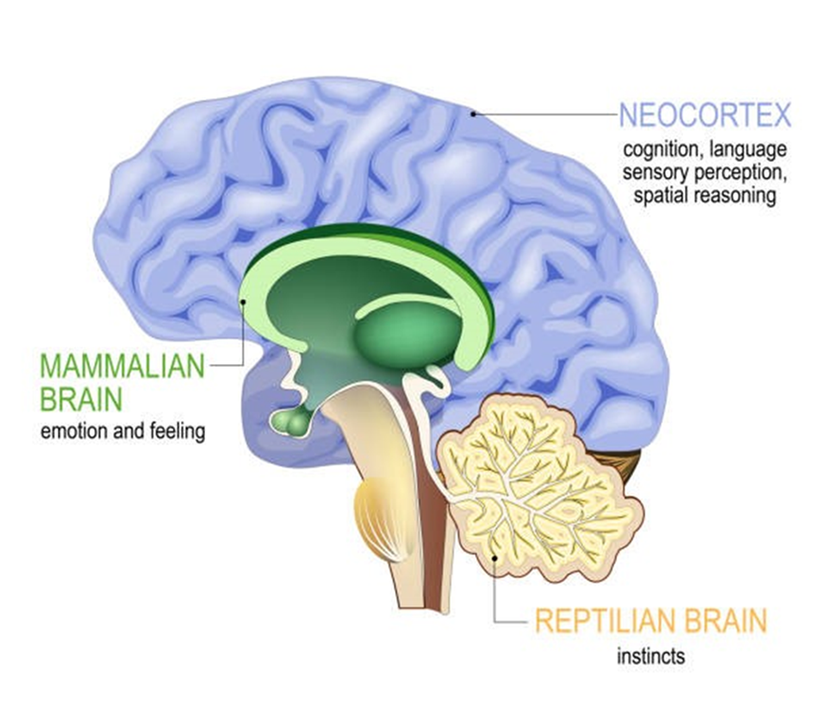
Brain Development

Slide 6
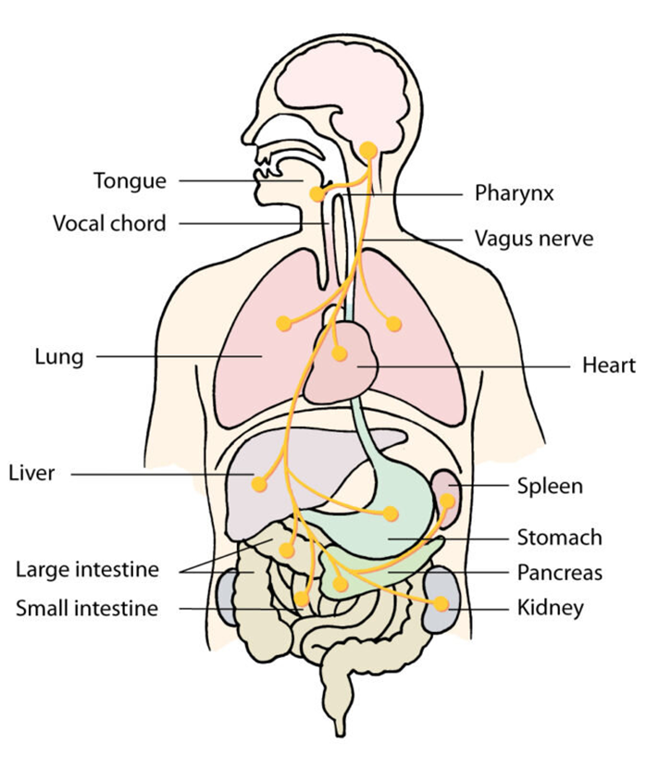
Vagus Nerve

Slide 7
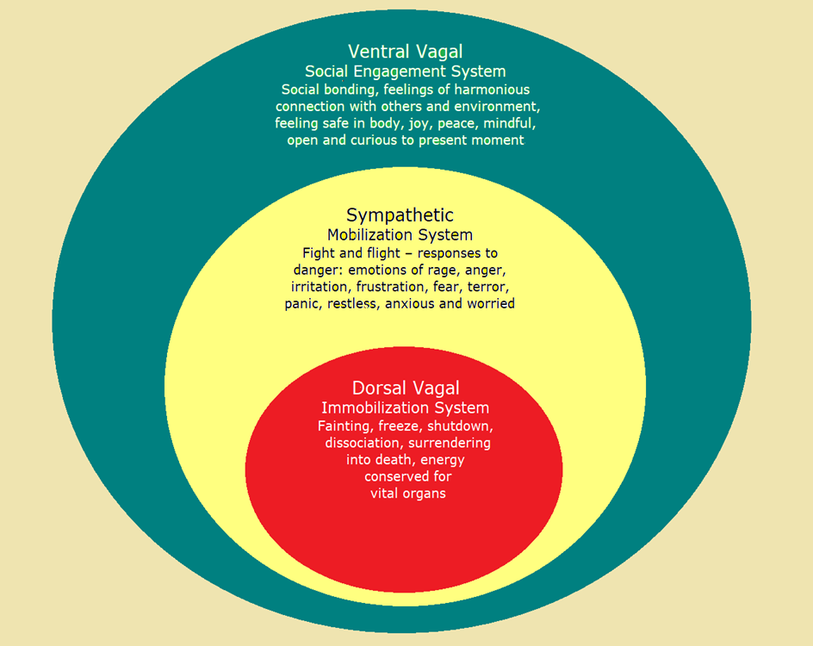
Polyvagal Theory

Slide 8

Trauma Impact
Shock trauma
Chronic stress
Complex trauma
Adverse environments
Neglect

Slide 9
Trauma Responses
Flight
  Workaholic
  Over-thinker
  Anxiety, panic, obsessive- compulsive disorder (OCD)
  Difficulty sitting still
  Perfectionist
Fight
  Anger outburst
  Controlling
  “The bully”
  Narcissistic
  Explosive behavior
Freeze
  Difficulty making decisions
  Stuck
  Dissociation
  Isolating
  Numb
Fawn
  People pleaser
  Lack of identity
  No boundaries
  Overwhelmed
  Codependent

Slide 10
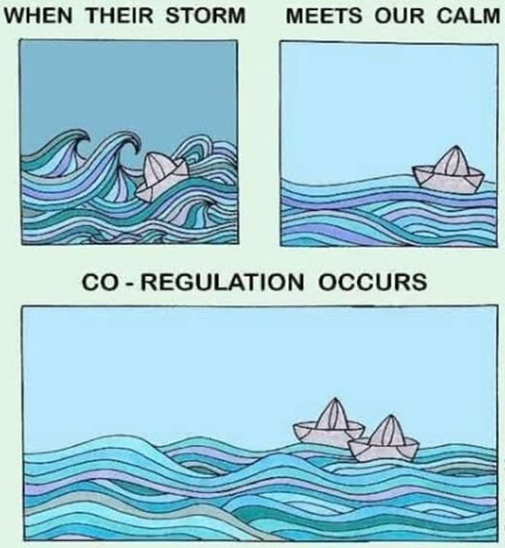
Co-Regulation

Slide 11
Trauma-Informed Care
SAMHSA Definition
A program, organization, or system that is trauma-informed realizes the widespread impact of trauma and understands potential paths for recovery; recognizes the signs and symptoms of trauma in clients, families, staff, and others involved with the system; and responds by fully integrating knowledge about trauma into policies, procedures, and practices, and seeks to actively resist re-traumatization.

Slide 12
Principles of Trauma-Informed Care
Safety
Trustworthiness and Transparency
Peer Support
Collaboration
Empowerment
Humility and Responsiveness

Slide 13

Example
Shifting our language, our presence, our listening, and expanding our empathy and capacity for compassion can generate results, outcomes and return on investment.

Slide 14
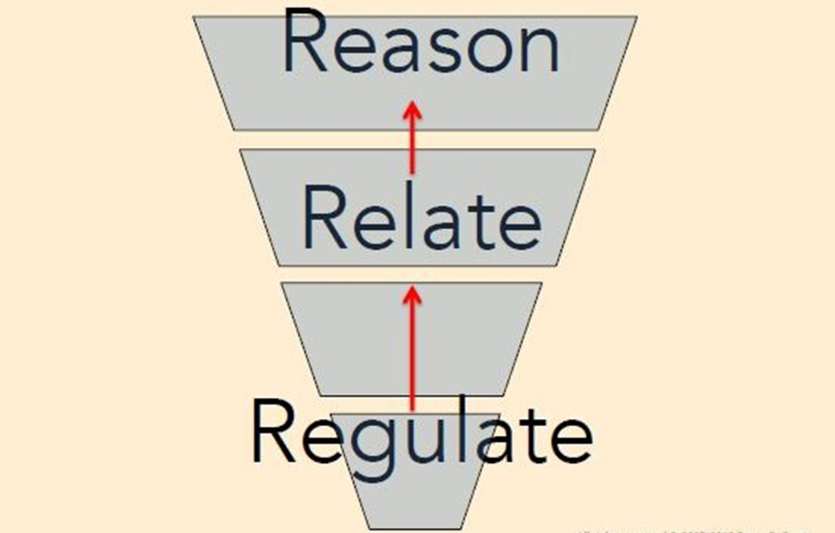
Sequence of Engagement

Slide 15

Resource
samhsa.gov/mental-health/trauma-violence/trauma-informed-approaches-programs

Slide 16
Thank you!
Holly.Fullmer@hhs.texas.gov

